Slide 2
EAM at ESS
Asset and Maintenance Management Function
PRESENTED BY ola nanzell

Slide 3
Engineering Management Group 2023-09-25
83060
Engineering Management
Magnus Täcklind
Consultants: 3
83062
Asset & Maintenance Management
Ola Nanzell
83063
PLM & CAD Management
vacant
83061
Technical Content Management
Joakim Meyer
83061
Systems Engineering
Magnus Täcklind
Employees: 2
Consultants: 6
Employees: 3
Consultants: 2,5
Employees: 2
Consultants: 8
Employees: 1 + 1 vacant
Staff total: 33
Employees: 11 + 2 vacancies
Consultants: 20
Own budget or on Technical office: 14
Distributed budget : 6

Slide 4
Asset and Maintenance Management Function
Part of Engineering Management Group
To provide:
Central asset management, including ownership of the end-to-end process for assets.
A global work order procedure for work coordination, authorization of work, integrated with ESH&S framework.
Information System Ownership and Application Management for the EAM platform.
Maintenance management, framework and strategies to the wide organisation through the ESS Maintenance Handbook and subordinate ESSMS documents.
To ensure:
Available and efficient cross-functional procedures, rules, guidelines to ensure that the EAM system is configured and populated.
That initiatives and projects are governed and approved via TIM steering committee.
That installation, maintenance, operations and assets information are structured to be searchable and available.
Available and efficient cross-functional procedures, rules, guidelines to support overall maintenance activities.
An efficient maintenance program through the maintenance handbook.

Slide 5
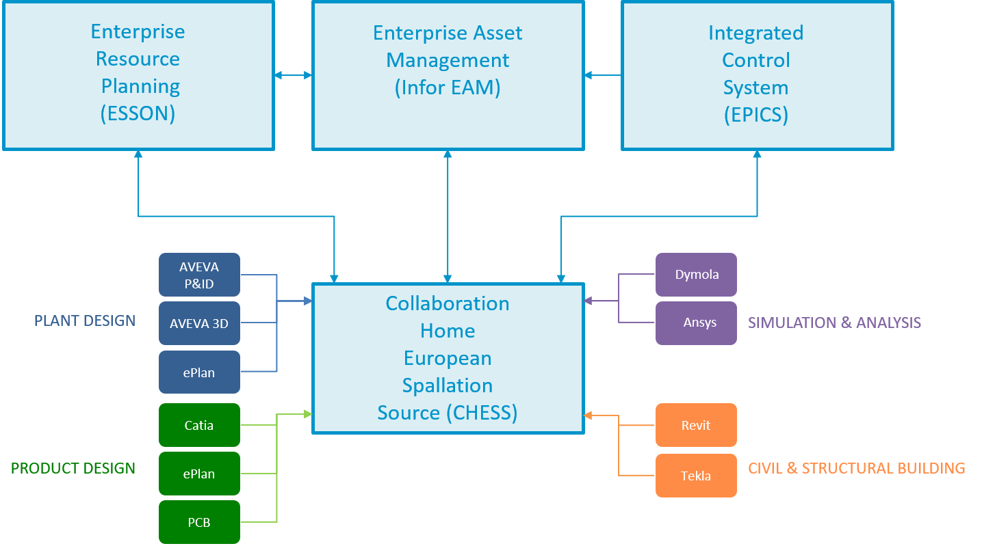
Technical Information Management at ESS
Technical Information Management (TIM) addresses the needs of organizing, finding, tracking, sharing, monitoring and reusing technical project information and communications throughout the full lifecycle of ESS
TIM
Program- and Project Management through TIM Projects as decided upon by the TIM Steering committee.

Slide 6
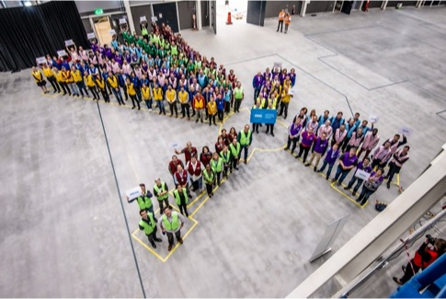
EAM Pre-study and deployment
2017-2018
Performed in 2017 when ESS realised that Jira and excel was probably not tools fit for purpose to maintain a large scale facility.
The first buildings was handed over from Skanska to ESS and we needed to start maintaining them
Took one year and engaged the majority of the company
Focus on
Information modelling of the ESS structures
Work planning and execution
Preventive maintenance
Inventory management
Roles, access and configuration
Deployment was done during 2018 focusing on migrating the installation work orders from jira

Slide 7
Strategy
Level the strength of the tool
Consolidate and migrate
Do not customize
Integrate, do not copy data
Hand in hand with ESSMS
System and process grows hand in hand

Slide 8
EAM Offering at ESS
EAM Light & Other Services
Core Offering
2018
Mobile application (vendor)
2019
2020
Work Orders
2021
Asset Management
Services
2022
2023
Cognos Reporting
Warehouse
Training
PM Schedules

Slide 9
EAM Offering at ESS
EAM Light & Other Services
Core Offering
2018
EAM Light
RadWork Permits
Requisitioning
2019
Non conformities
2020
2021
2022
2023
Electrical LoTo
KPI

Slide 10
EAM Offering at ESS
EAM Light & Other Services
Document Integration
Core Offering
2018
2019
2020
2021
Warehouse
2022
2023
Track Radiated Equipment
RP Survey

Slide 11
EAM Offering at ESS
EAM Light & Other Services
Core Offering
2018
Energization
2019
2020
TREE
2021
2022
2023
Sample Management

Slide 12
EAM Offering at ESS
EAM Light & Other Services
BMS
Core Offering
2018
2019
2020
2021
2022
2023
Equipment tree

Slide 13
EAM Offering at ESS
EAM Light & Other Services
Core Offering
2018
Rapid Request
2019
2020
Store Kiosk
2021
Open CAD
2022
2023
Component Administration
Labels

Slide 14
EAM Offering at ESS
EAM Light & Other Services
BMS
Document Integration
Core Offering
EAM Light
Mobile application (vendor)
RadWork Permits
Requisitioning
Energization
Rapid Request
TREE
Work Orders
Non conformities
Store Kiosk
Warehouse
Services
Asset Management
Open CAD
Cognos Reporting
Warehouse
Electrical LoTo
Training
Track Radiated Equipment
PM Schedules
RP Survey
Component Administration
Equipment tree
KPI
Sample Management
Labels

Slide 15
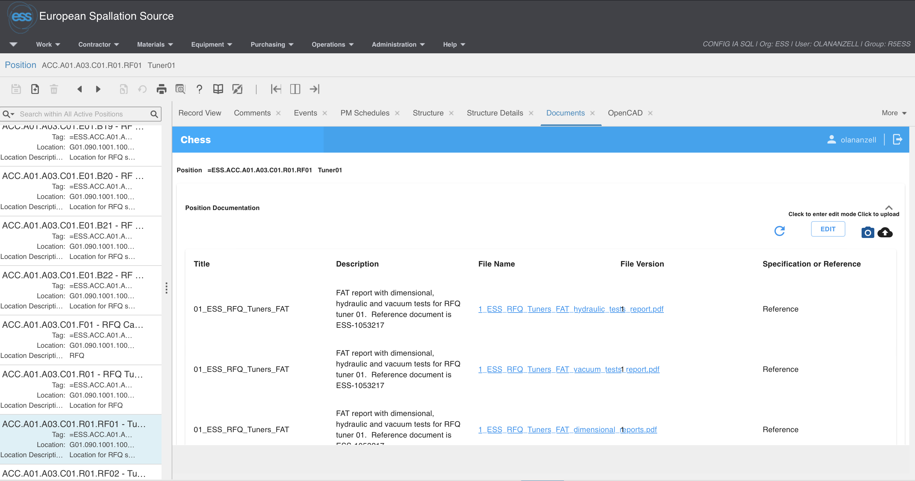
Document Integration
EAM Light & Other Services
BMS
Document Integration
Core Offering
EAM Light
Mobile application (vendor)
RadWork Permits
Requisitioning
Energization
Rapid Request
TREE
Work Orders
Non conformities
Store Kiosk
Warehouse
Services
Asset Management
Open CAD
Cognos Reporting
Warehouse
Electrical LoTo
Training
Track Radiated Equipment
PM Schedules
RP Survey
Component Administration
Dependency tree
KPI
Sample Management
Labels

Slide 16
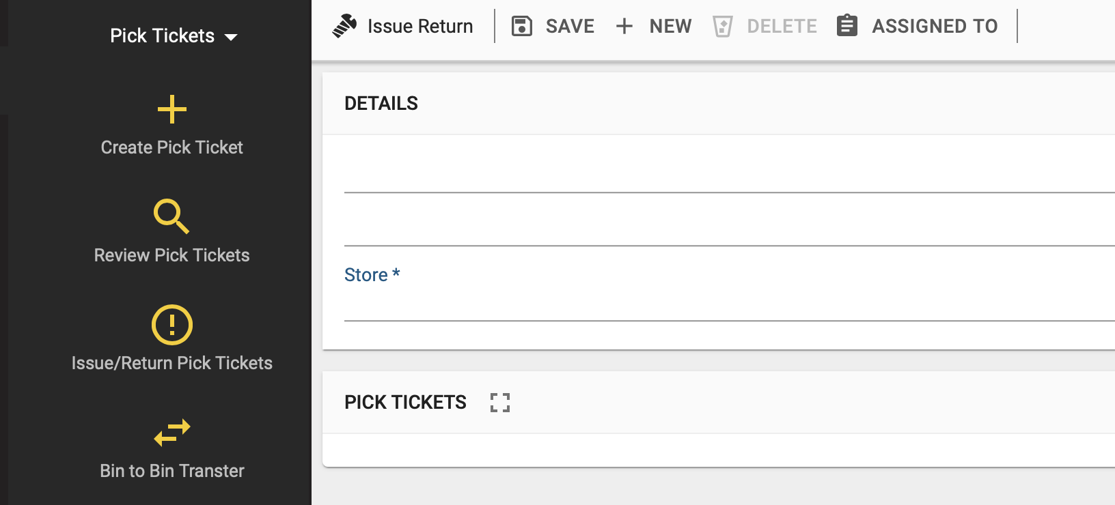
Document Integration
EAM Light & Other Services
BMS
Document Integration
Core Offering
EAM Light
Mobile application (vendor)
RadWork Permits
Requisitioning
Energization
Rapid Request
TREE
Work Orders
Non conformities
Store Kiosk
Warehouse
Services
Asset Management
Open CAD
Cognos Reporting
Warehouse
Electrical LoTo
Training
Track Radiated Equipment
PM Schedules
RP Survey
Component Administration
Equipment tree
KPI
Sample Management
Labels

Slide 17
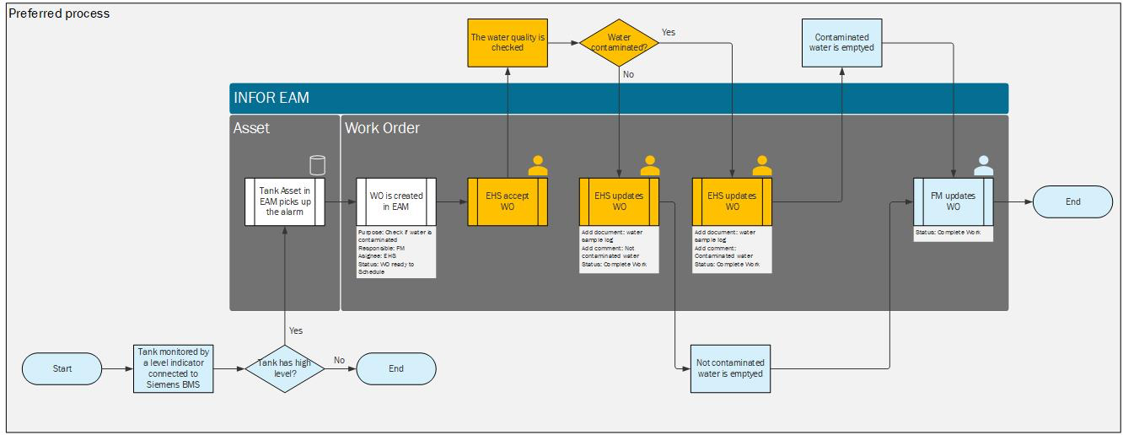
Document Integration
EAM Light & Other Services
BMS
Document Integration
Core Offering
EAM Light
Mobile application (vendor)
RadWork Permits
Requisitioning
Energization
Rapid Request
TREE
Work Orders
Non conformities
Store Kiosk
Warehouse
Services
Asset Management
Open CAD
Cognos Reporting
Warehouse
Electrical LoTo
Training
Track Radiated Equipment
PM Schedules
RP Survey
Component Administration
Equipment tree
KPI
Sample Management
Labels

Slide 18
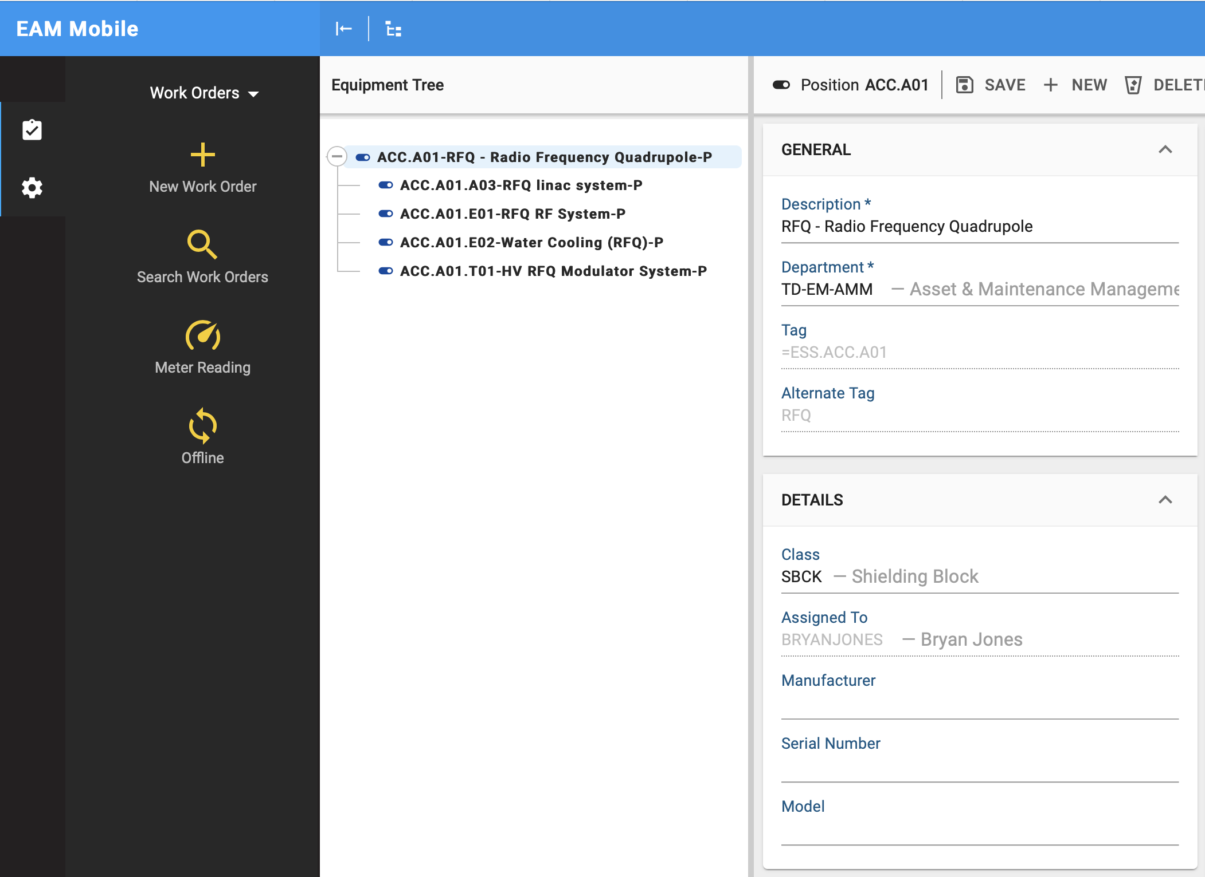
Document Integration
EAM Light & Other Services
BMS
Document Integration
Core Offering
EAM Light
Mobile application (vendor)
RadWork Permits
Requisitioning
Energization
Rapid Request
TREE
Work Orders
Non conformities
Store Kiosk
Warehouse
Services
Asset Management
Open CAD
Cognos Reporting
Warehouse
Electrical LoTo
Training
Track Radiated Equipment
PM Schedules
RP Survey
Component Administration
Equipment tree
KPI
Sample Management
Labels

Slide 19
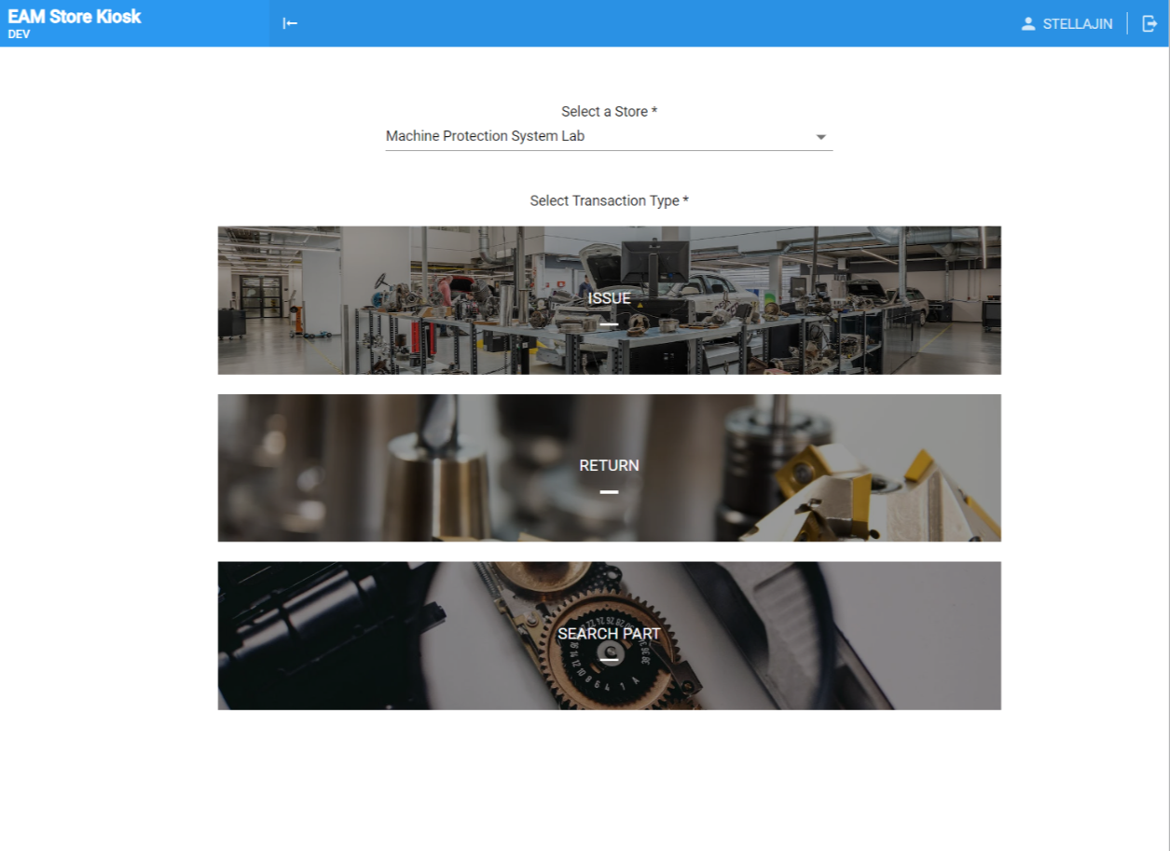
EAM Offering at ESS
EAM Light & Other Services
BMS
Document Integration
Core Offering
EAM Light
Mobile application (vendor)
RadWork Permits
Requisitioning
Energization
Rapid Request
TREE
Work Orders
Non conformities
Store Kiosk
Warehouse
Services
Asset Management
Open CAD
Cognos Reporting
Warehouse
Electrical LoTo
Training
Track Radiated Equipment
PM Schedules
RP Survey
Component Administration
Equipment tree
KPI
Sample Management
Labels

Slide 20
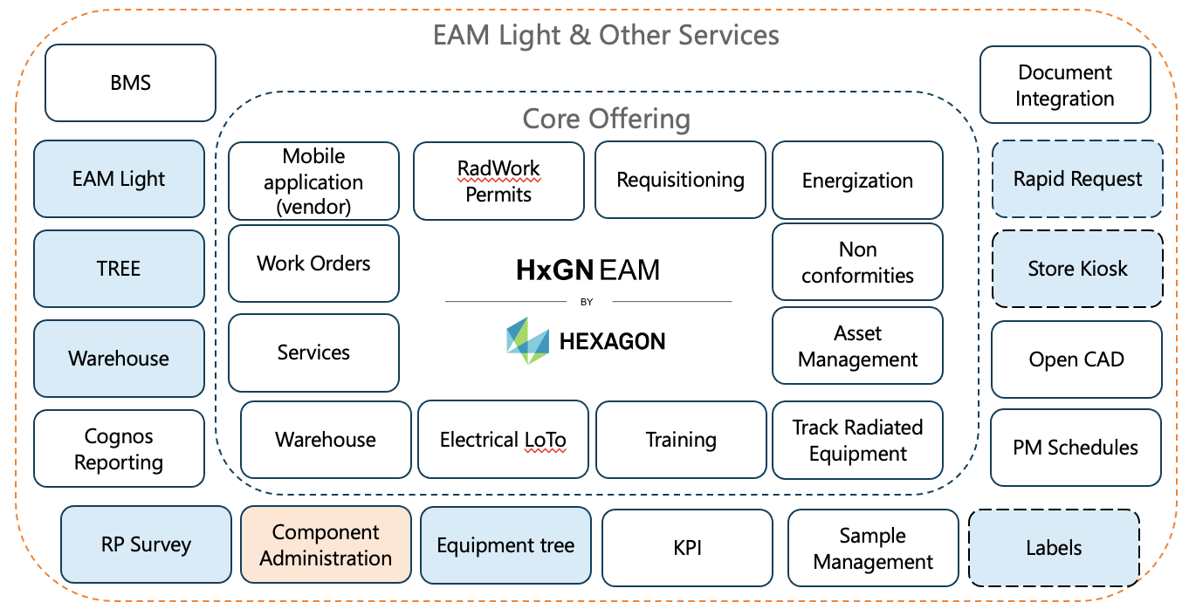
Requests
Graphical Workflow
Mobile Permits
QC Inspections
Procurement support
GIS
Chemical database
HotWorks Permit
Working at Heights
Meter Readings
ATEX Permit
RFID Support
Depreciation
Mechanical LoTo
Request for Connection
Receiving Inspection
2D and 3D suppport
QC of goods
Confined Space Permit

Slide 21
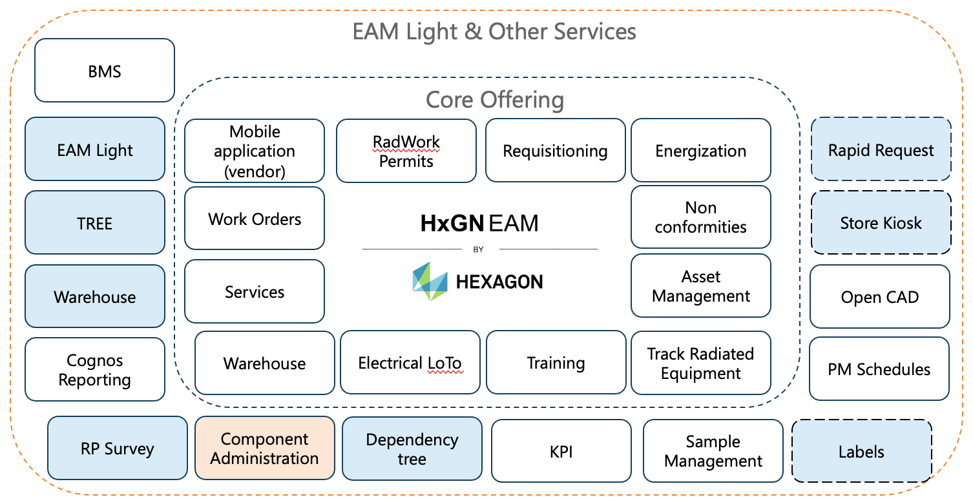
Requests for implementation
Procurement support
QC of goods
Mobile Permits
Constant tweaking and improving
HotWorks Permit
Confined Space Permit
QC Inspections
Meter Readings
GIS
RFID Support
Chemical database
Mechanical LoTo
Working at Heights
Request for Connection
ATEX Permit
Receiving Inspection
Depreciation
2 FTE EAM Light & Integrations
3 FTE EAM System Engineers
2 FTE Component Administrators
Support, training and Maintenance
2D and 3D suppport
Graphical Workflow

Slide 22
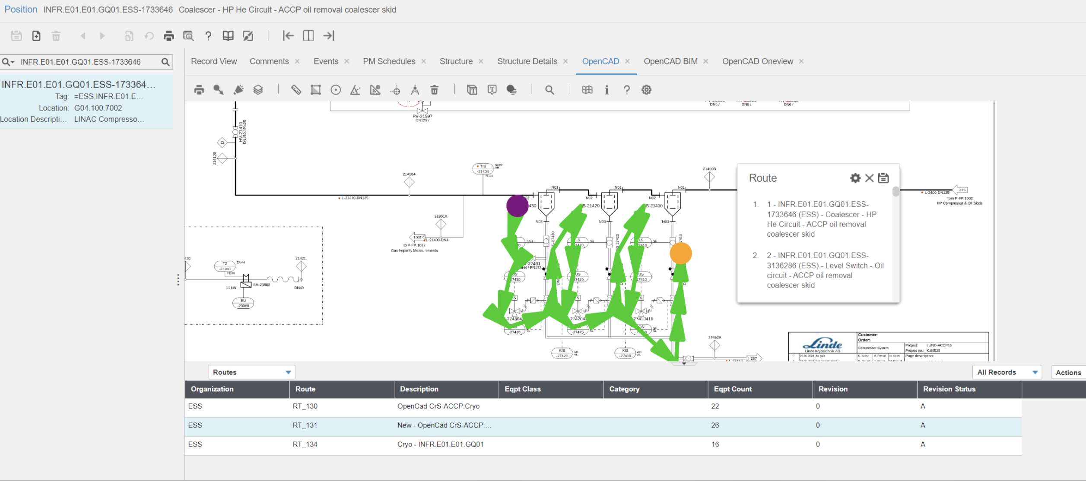
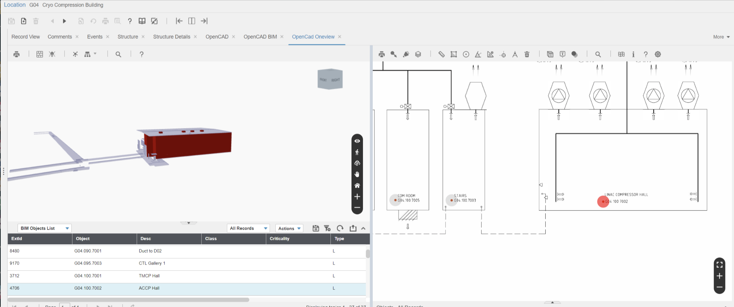
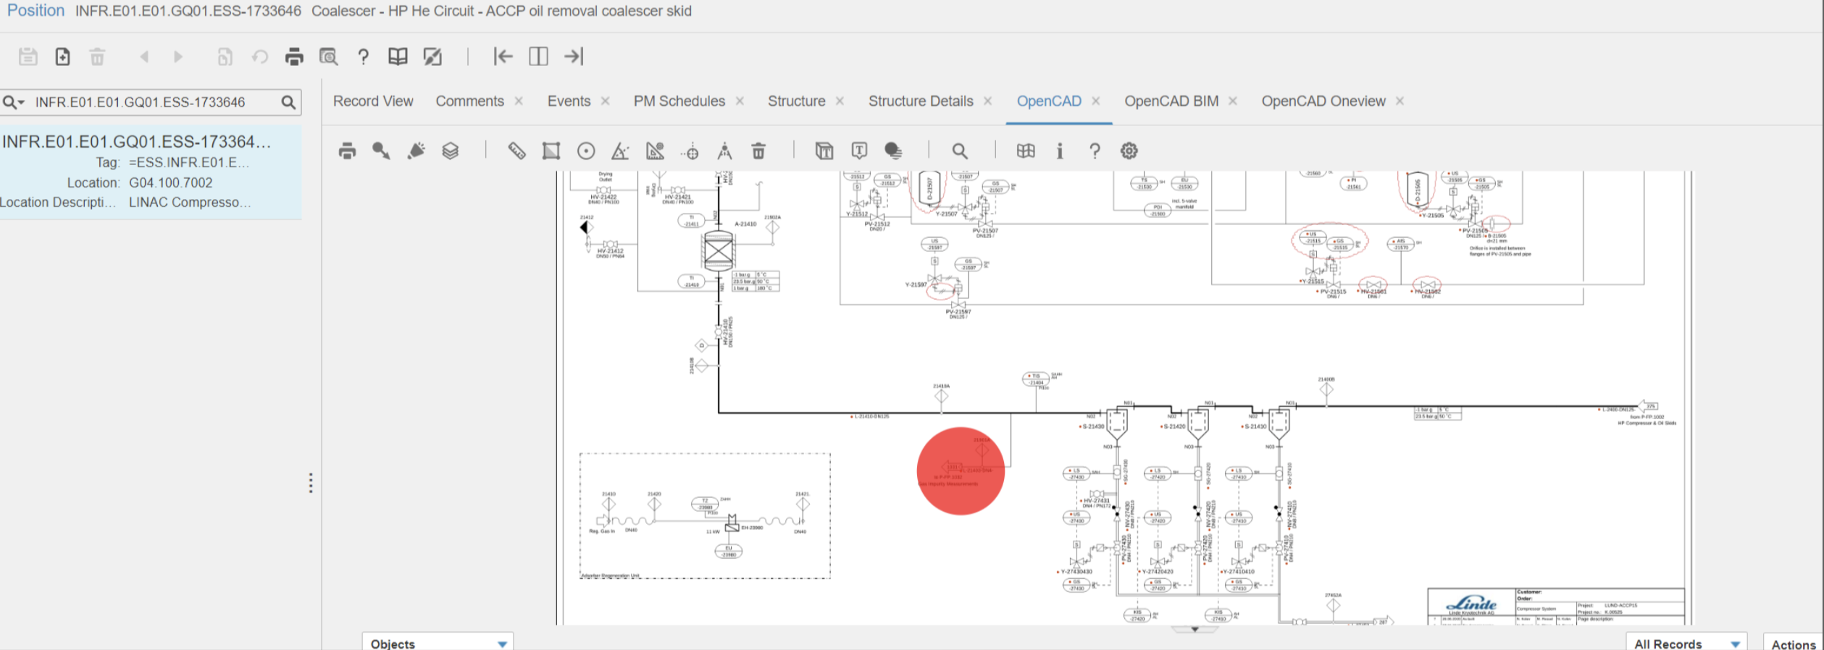
Levering 2D and 3D
ESS Digital Twin

Slide 23
Lessons learned
Try not to do everything at once
Build a team that understand the business, science labs are different
Get commitment from management
You end up driving a lot of things!
Difficult to cater to so many use cases, installation, commissioning and maintenance
Greenfield, good and bad
Everything can be discussed and challenged
Processes can be developed alongside tools
Not to customize was the right thing
If you need to get the data in, providing it as central service was the right thing

Slide 24
Finish presentation

