Slide 2
Asset & Maintenance Management Worksop 27-29/9-2023
ESS Logistics
JÖRGEN LARSSON – Senior logistics officer

Slide 3
Agenda
1 Background
2 History
3 Today
4 Future

Slide 4
Background

Slide 5
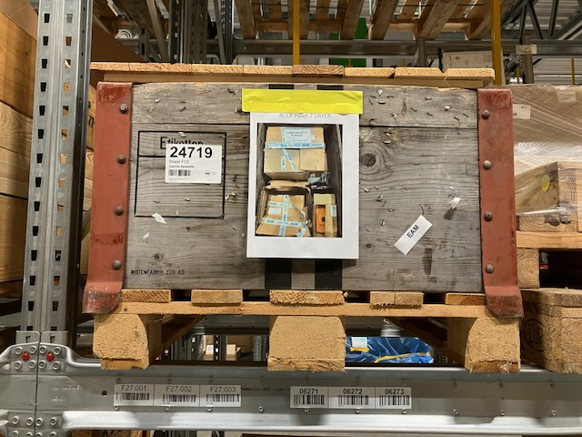
Background
Jörgen – coming from?
The ”short term solution”
Implemented 2016 - Access database developed to have physical
control of inbound parcels and pallets in multiple storage areas
The Service
Receiver emailed packing list and unique identification number
Receiver makes a goods receipt in Unit4 (P2P)
SITE transport ordered for pallets in JIRA
Parcels delivered to dedicated drop-off points on SITE / Parcel Service Point in B01
Photo taken as PoD when delivering pallets

Slide 6
History

Slide 7
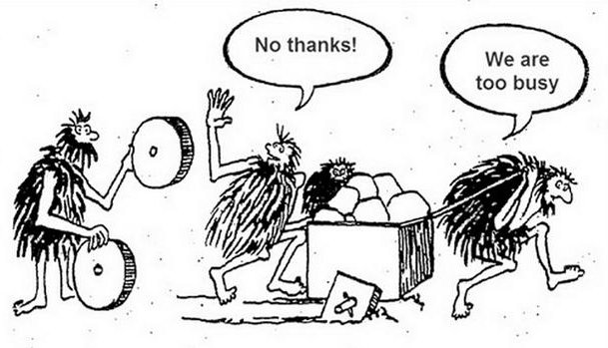
History
Reinventing the wheel – world champions
The way forward to the long-term solution
UNIT4 as the solution
Evaluated and dismissed
Access database solution still used
Learn from other RIs

Slide 8
Today

Slide 9
Today
The lifetime of a Part - From Birth to Disposal
Replenishment of standard components
Automated based on minimum levels defined by the organisation
Consignment stock – the way forward?
INBOUND - Birth
Non-Po receipt
Consignment stock - gases
Outbound & Returns
Pick-ticket – in use
Returns process defined but not implemented
STAKEHOLDERS
Users
Suppliers
Procurement
Finance
EAM Team
Disposal
On sale (RI Marketplace or Auctions)
Scrapped
Donation

Slide 10
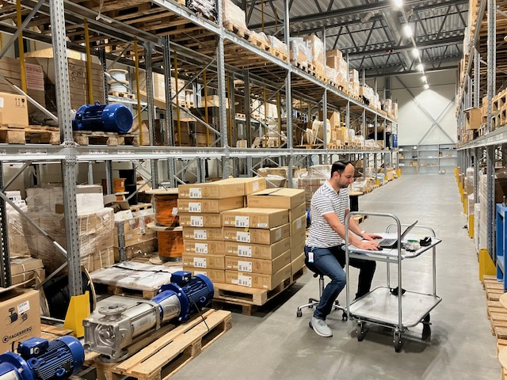
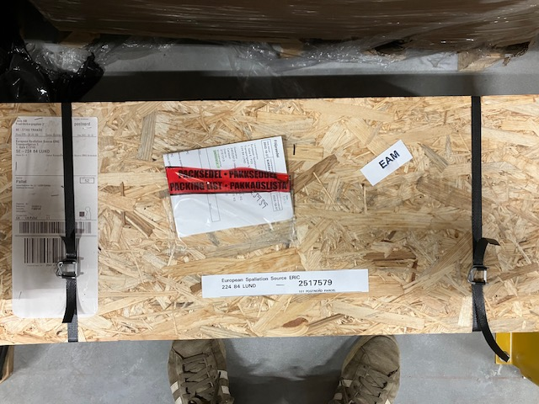
Today
Back-, Front- & Storage filling of Master Data
The long night's journey towards dawn
EAM the chosen tool!
Involvement in development and process development!
Major task in entering Master Data.
Access database still used
The challenges
Acceptance from organization
Integration Unit4 and EAM

Slide 11
Future

Slide 12
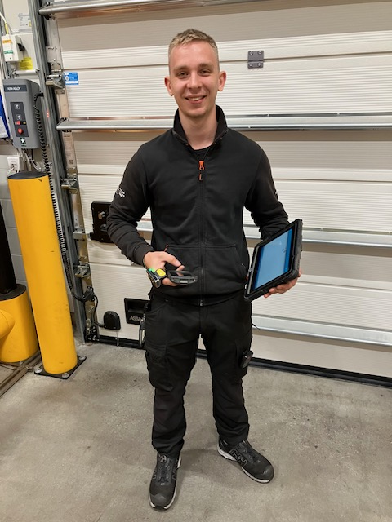
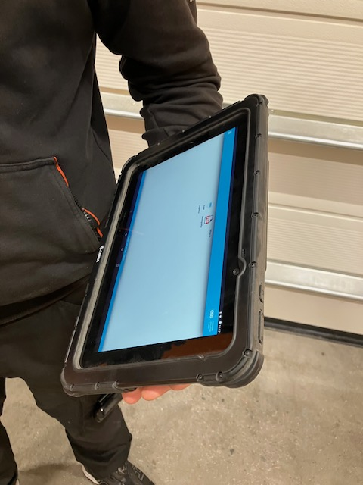
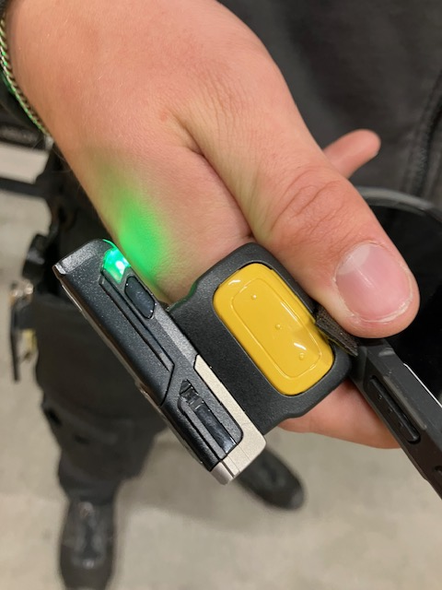
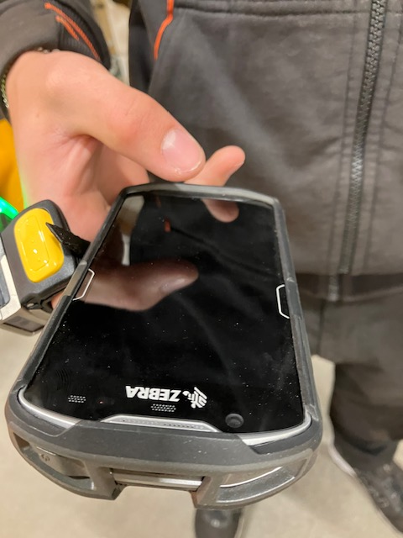
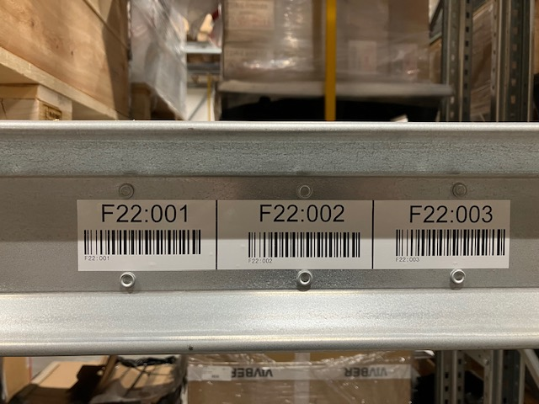
Future
Ready, willing and able!
Tablet
Finger scanner
Handscanner
Warehouse ready

Slide 13
Who Are we?
RI Logistica stands for: Research Institutes Logistics
It started as an Idea in 2019 under the EU funded BrightnESS2 project
A first virtual conference took place in May 2021 with 250 international participants
RI.Logistica covers all aspects of logistics for all RI stakeholders
Our goal is to simplify logistics and all connected processes
RI.Logistica is a non-profit organization since Autumn 2022

Slide 14
Manifest
Purpose
Saving tax-payers money
Increasing efficiency
Creating standards
Vision
Research Infrastructures in Europe want to create a European Association for logistics services and networking
Goals
Establishing a joint face towards authorities and suppliers:
Attacking the challenges through all RI life cycle phases
Creating joint and consignment stock for spare parts and consumables
Creating standardised, harmonised, digitalised forms used by RIs that users only need to fill in one time per shipment
Simplified HS Code for Samples

Slide 15
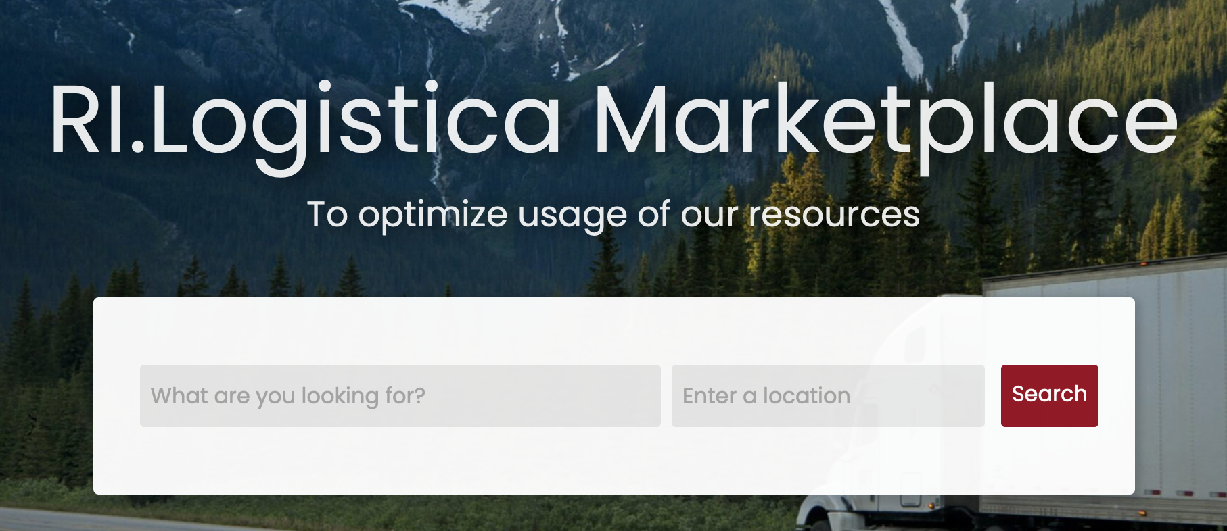
The Marketplace and 2nd life-shelf warehouse
Online shop for surplus stock components and equipment
Instead of scrapping the goods, or occupying desperately needed space in the warehouse, make good use of the items
A solid contribution to sustainability
Time saving as no big procurement process involved
Easy delivery arrangements possible

Slide 16
The ILO Ukraine Initiative
Help to rebuild the scientific infrastructure in Ukraine by donations
Initaitive ongoing
2022-10 PERRIA ask RI Logistica for a logistics solution
2022-11 “Green corridor” set up for deliveries into Ukraine
2022-11 Solution set with Lund, Sweden as HUB for donations
2022-12 Information through ILOs
2023-05 First donation received
2023-05 Elettra commits to donate version 1
2023-06 Meeting with Mats Persson, Minister of Education
2023-09 Meeting with DG Research & Innovation in Brussels

Slide 17
…..already members
……new possible members we are in contact with in regard to membership

Slide 18
Cooperation in place
Cooperation in progress

Slide 19
Questions

