Slide 1
ESS Structures and configuration management - ESS
PRESENTED BY Joakim Meyer

Slide 2
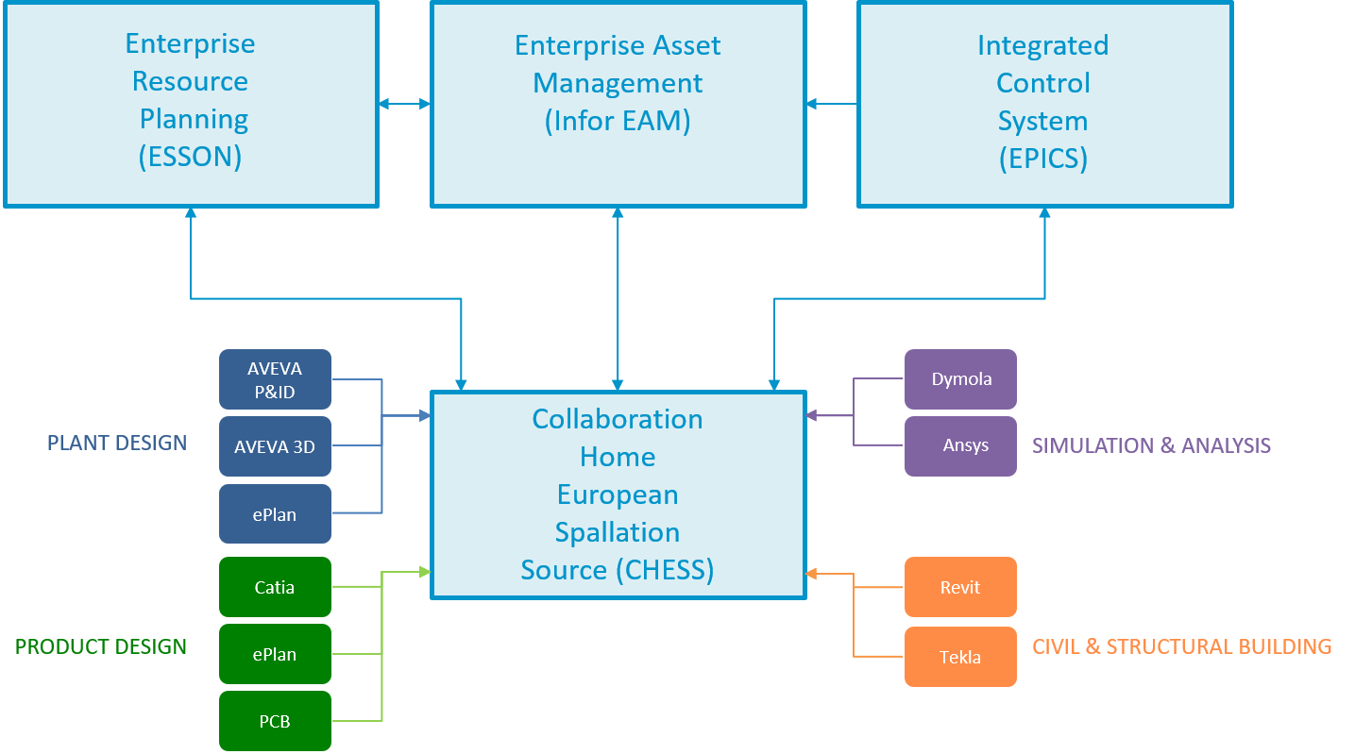
ESS Structures and configuration management
What is the purpose of Technical Content Management at ESS?
Technical Content Management addresses the needs of organizing, finding, tracking, sharing, monitoring and reusing technical project information and communications throughout the full lifecycle of ESS

Slide 3
ESS Structures and configuration management
Technical Content Management who we are and what we do.
Lead by Joakim Meyer as Functional Leader
Technical Content Management is responsible in supporting of structuring information in ESS breakdown structures and its related tagging and labelling. Also gives support and training to all projects and their partners in Technical Content Management.
We are today 3 central resources supporting that work. 2 resources are supporting specific work packages and 3 technical writers

Slide 4
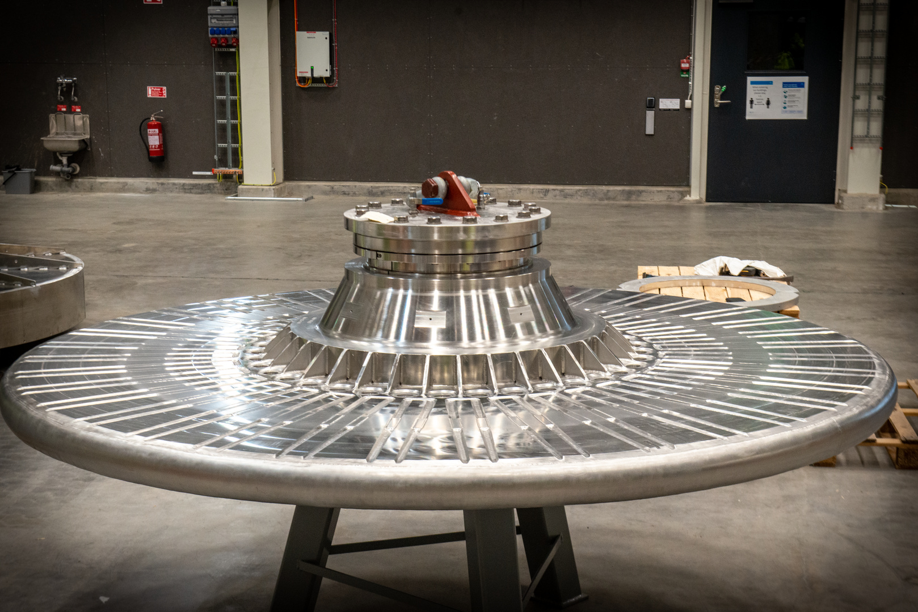
ESS Structures and configuration management
ESS Breakdown Structures - How do we manage information?
ESS Breakdown structures are created and mastered in CHESS and EAM.
CHESS is our implementation of Dassault Systèmes 3dexperience Platform.
We use CHESS for both Plant and Product lifecycle management and document management.
These “structures” are used to share and relate information between our systems.
The ESS-breakdown structures are using:
ISO 81346-1 main principal for structuring information
ISO 15926-4 life-cycle data of the information.

Slide 5
ESS Structures and configuration management
What do we use Facility Breakdown Structure (FBS) for.
Concerns itself with enough information to design, build, install and operate the full plant in a safe and reliable manner.
What systems do we need
What components do they consist of
How should the components in a system be configured and calibrated for optimal system performance
It is a functional breakdown of the facility and uses ISO 81346-1 as it’s main principle.
Assigns unique TAGS to systems and components for common usage at ESS and is the connection to other tags such as cable name, ESS-name and alternate tags

Slide 6
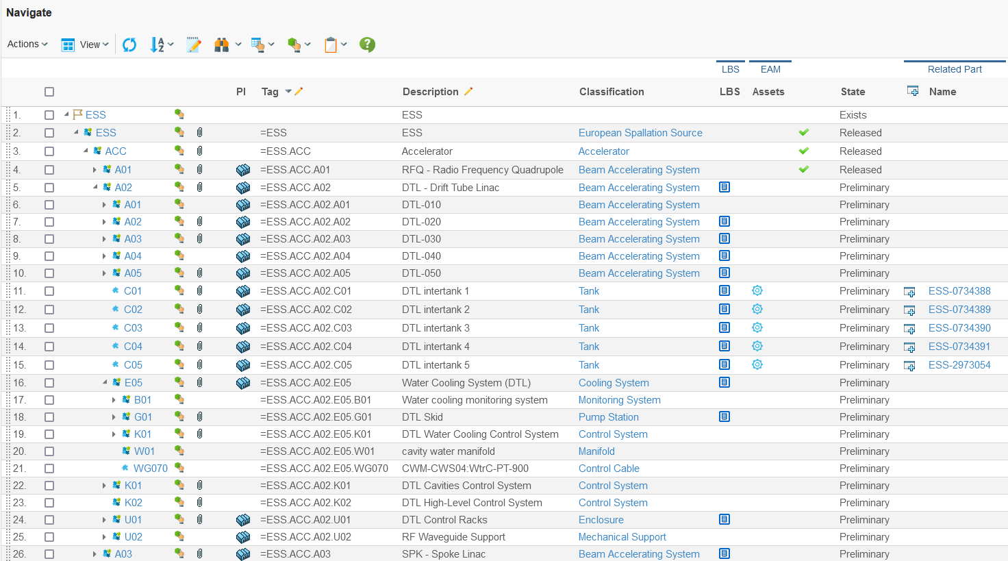
ESS Structures and configuration management
FBS - Single entry point to all information
Tag description
Reference Data class
Status
Structural information
Access to all tag documents
Full tag
Entry point to the tags installed asset
Access to detailed tag information
Parts that can be used for realization of the tag
Access to runtime 3D master model, the EPL
Entry point to the tags location

Slide 7
ESS Structures and configuration management
Location Breakdown Structures (LBS) shows where on site system assets are installed.
In the LBS the physical boundaries of the site are managed.
Is currently divided into two breakdowns:
+ESS
Buildings
Levels
Rooms
++ESS (landscape outside of buildings)
It is a physical location breakdown of the facility and uses ISO 81346-1.
Assets and FBS nodes shall be connected to their location in the LBS

Slide 8
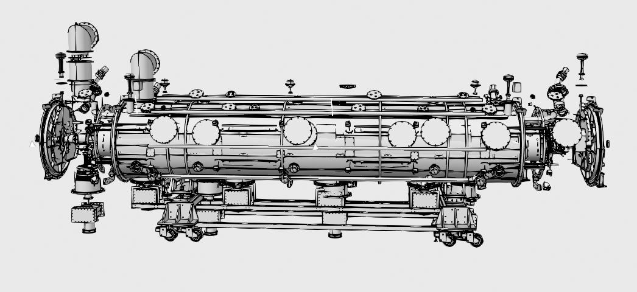
ESS Structures and configuration management
What are we planning to use in the facility is reflected in Parts and EBOM
Product design with consolidated Engineering Bill Of Material (EBOM) consisting of Parts
Parts are used by:
Design
Procurement
Warehouse management
Maintenance and operations

Slide 9
ESS Structures and configuration management
When do we need to register Assets?
Is connected to a unique serial number
Is installed with an FBS Tag
Assets are registered based on
Value
Operation & Maintenance perspective
Safety function
Is used by:
Operation & maintenance
Warehouse management
Finance

Slide 10
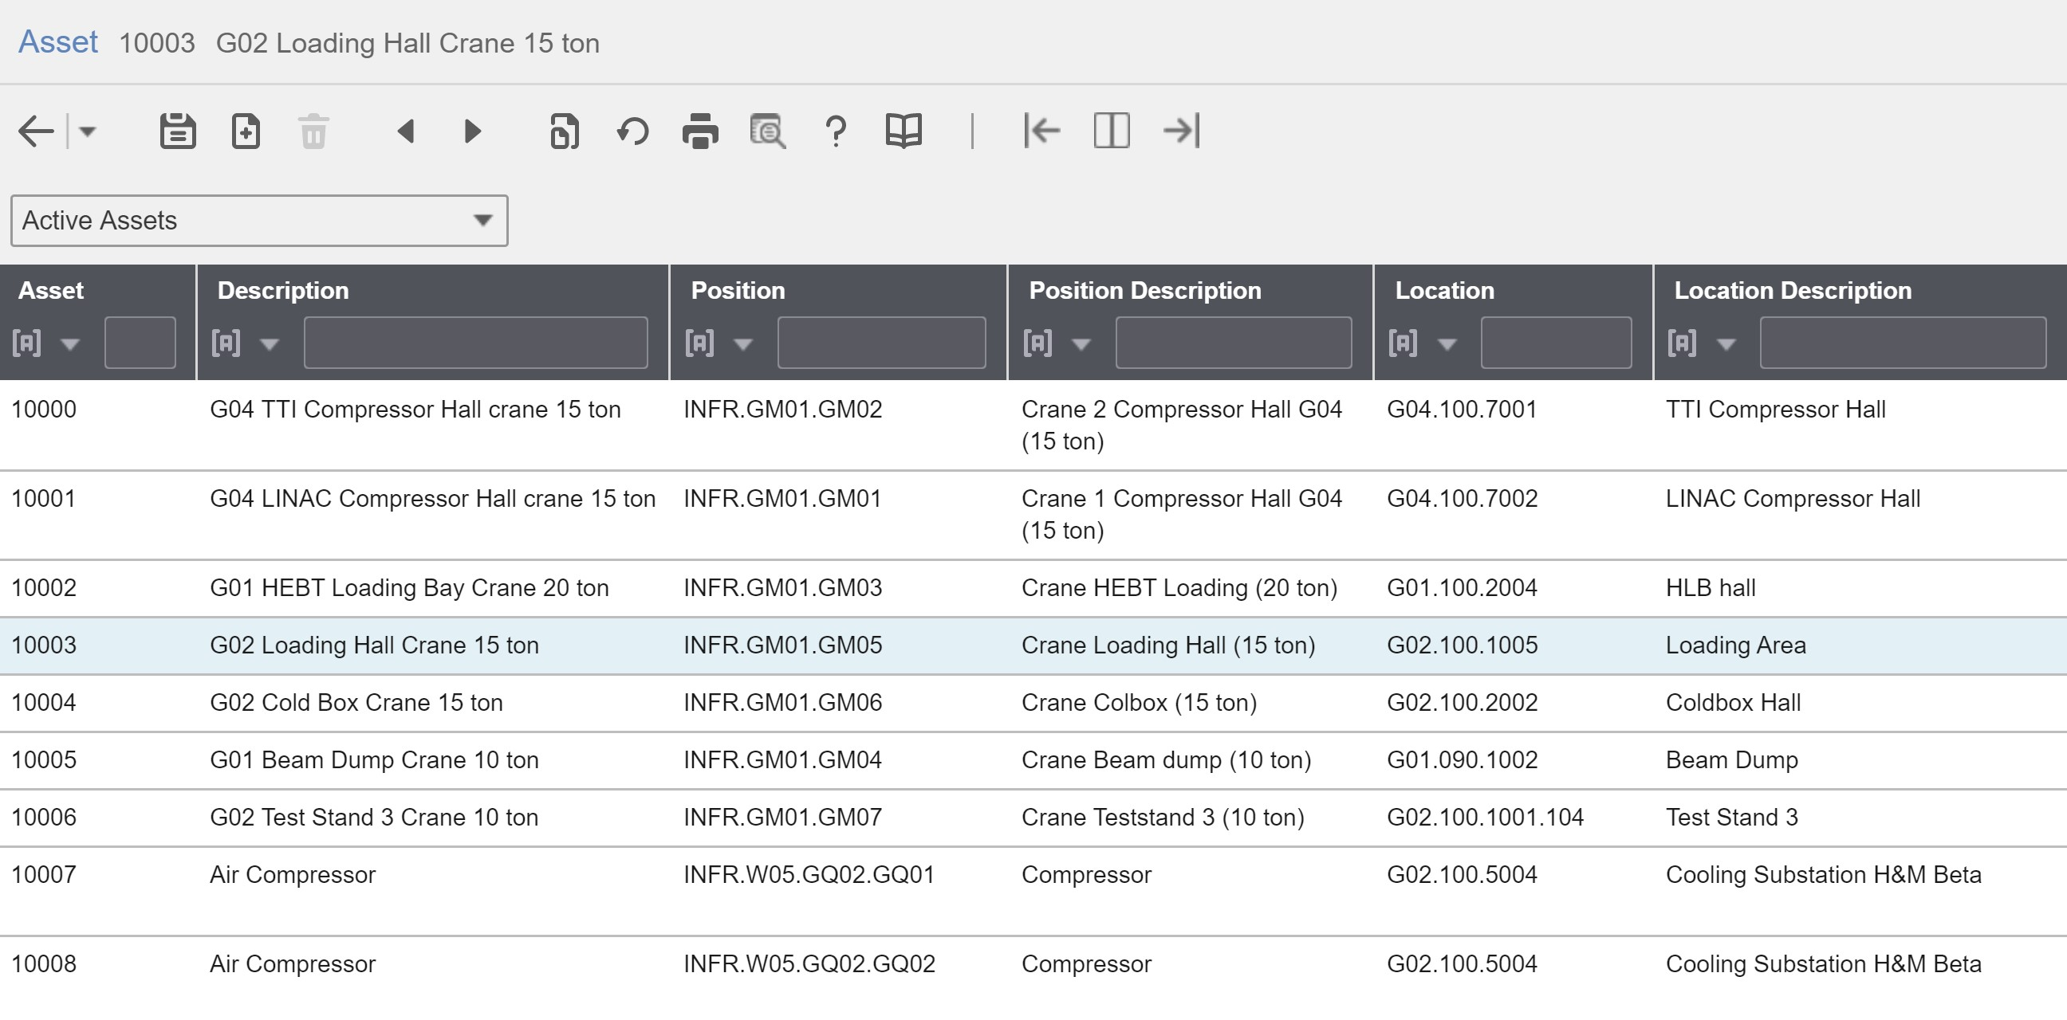
ESS Structures and configuration management
Asset information in EAM

Slide 11
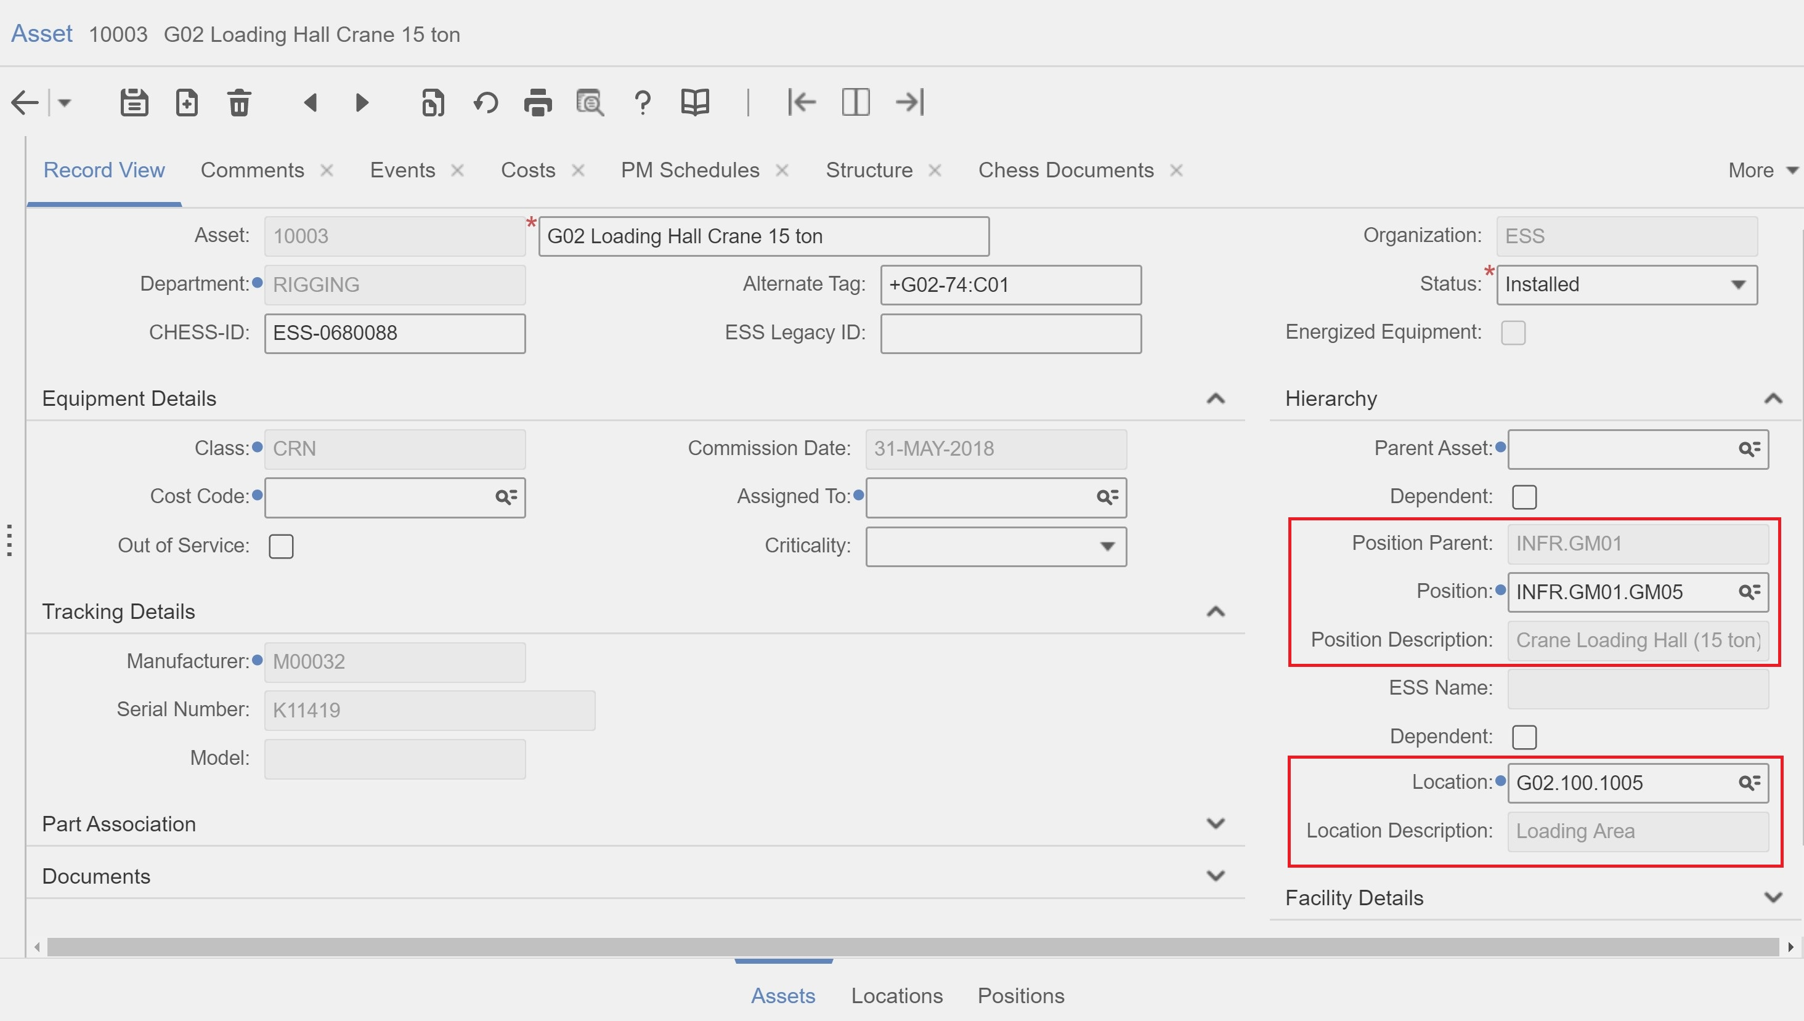
ESS Structures and configuration management
Assets in EAM

Slide 12
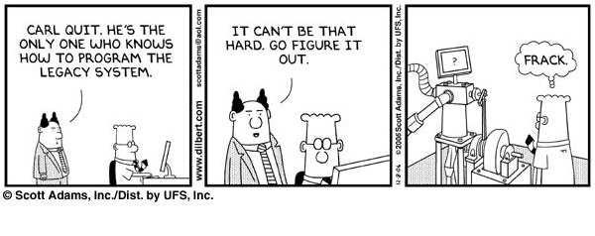
ESS Structures and configuration management
Information is required in view of operations, maintenance and future upgrades
ESS Breakdown Structures form the backbone for Facility documentation.
Location Breakdown Structure (LBS): contains mainly architectural information.
Facility Breakdown Structure (FBS): contains Facility documentation.
The Part/EBOM structures accommodate detailed design data or standard component information.
Assets provides information for all installed assets in order to support on-site activities.
Information structures/Data | Location Breakdown Structure (LBS) | Facility Breakdown Structure (FBS) | Product structure (Part/EBOM) | Assets
Unique identifier | LBS TAG | FBS TAG | Part Number | Asset ID
Type of Data | Requirements System descriptions, Analysis, Building Systems Design Data mainly drawings and models. | Requirements System descriptions, Analysis, Test and Validation plans, Operating instructions, Plant Design documentation | Product Design Information Manuals Operating Instructions etc. | Material Certificates, Calibration data, Travelers etc.

Slide 13
ESS Structures and configuration management
How ESS-breakdown structure relates to each other
CHESS
FBS
ICS
ESS
LBS
ACC (Accelerator)
ESS-Name (EPICS)
MBL
ESS
Cryomodule 1
MBL-010Crm:EMR-Crm-001
+ESS.G
Cryomodule 2
MBL-020Crm:EMR-Crm-001
+ESS.G01
+ESS.G01.090
+ESS.G01.090.1001
+ESS.G01.090.1001.100
+ESS.G01.090.1001.102
IS
Installed
M-ECCTD
Cavities
M-ECCTD 003
RF Couplers
Cryostat
EAM
Part or E-BOM

Slide 14
ESS Structures and configuration management
When is the information generated and updated
Detailed Design
Procurement
Construction
Commissioning
Operation
Maintenance
De-commissioning
Facility Breakdown Structure (FBS) creation after PDR
FBS detailing and LBS connection during detailed design
Bill of materials (parts) and FBS
As-built, Spare part lists
Assets, updated as built
Work order, asset management, warehouse management
Work order, asset management, warehouse management
FBS and Assets
Preliminary Design

Slide 15
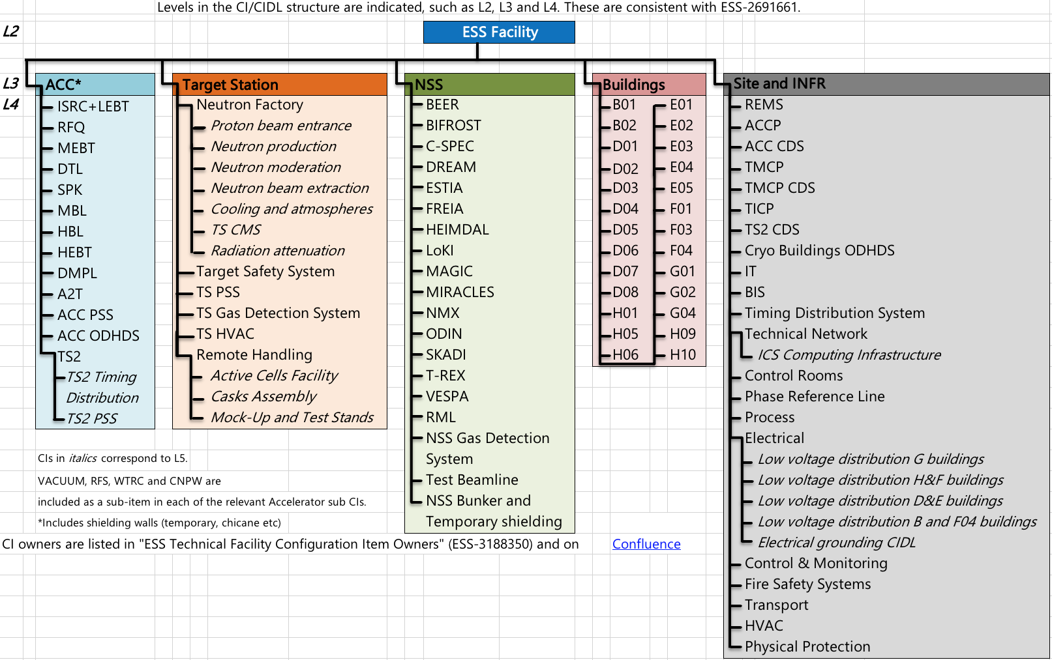
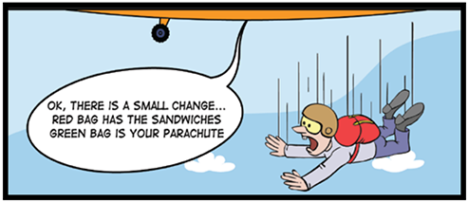
ESS Structures and configuration management
Configuration Management (CM) does so by striving to ensure:
that the configuration of all software and hardware (buildings, systems etc) is known at all times.
any changes to these are known and agreed.
All Facility systems are organized in a CM specific breakdown structure based on the FBS/LBS.
This CM breakdown structure with its content is controlled by Baselines and Configuration Change Management

Slide 16
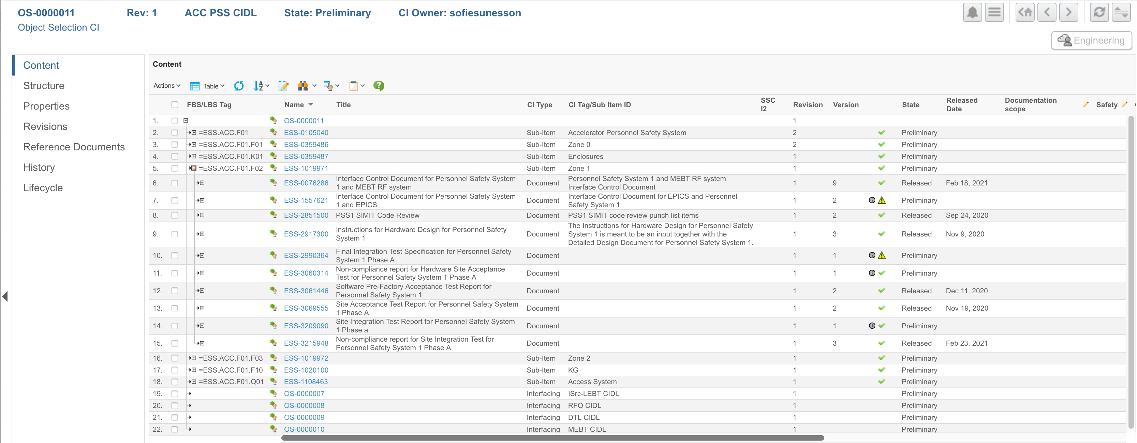
ESS Structures and configuration management
CIDLs describe the CIs internal configuration breakdown
A CIDL describes a CI in its CI context
Internal structure of systems/devices (Sub-Items)
External context with interfacing CI(s), hierarchical CIs in the same CI branch e.g. parent CI
Relation between CI structure and FBS/LBS
The Facility Breakdown Structure (FBS) and Location Breakdown Structure (LBS) are defined in CHESS, the ESS plant/product lifecycle database
Example of a CHESS CIDL
The CIDL contains references to its systems, interfaces, its information and its status

Slide 17
Finish presentation

