Slide 2
Engineering at ESS
One of the cornerstones for successful asset management
PRESENTED BY Karen jónsdóttir

Slide 3
Agenda
1 Engineering and Asset Alignment – Key to success
2 Historical Retrospect
3 Overview of Design & Engineering
4 Mechanical Engineering
5 Electrical and I&C Engineering
6 Plant & Process Engineering
7 Conclusion and Future

Slide 4
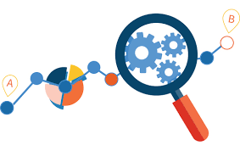
Engineering and Asset Alignment
A key to success
Asset Management
It is ideal to build up your asset management with engineering data
This is not always possible
Being a greenfield, ESS has benefited of good advice from other facilities and industries.
The challenge lies in getting the whole community to buy-in engineering ways of working.
If this can be done from the start it paves the way for asset management, saves time in the long run for both maintenance and planning and will have an effect on budget and time line.
Engineering Data

Slide 5
Historical Retrospect at ESS
Challenges will always be there
ESS has had the same challenges as any facility – documentation is not popular!
Two camps with different perspectives:
The boring squares vs. the flexible inventors
The professionals vs. the unstructured
Many wanted to chose their own tools and work in their own way.
Key to success: Strong willed and tireless team with the support of other facilities and experienced advisors made it so we have minimum of designing tools, a solid configuration view and vision of operations practical challenges.
We are not there yet but we still have a chance to get close to our goal, if we continue.
2011
2012
2013
2014
2015
2016
2017
2018
2019
2020
2021
2022
2023

Slide 6
Overview of Engineering
Mechanical, Electrical and Plant&Process + Facility Engineering
Design & Engineering organization was started 2014 by Magnus Täcklind. The ESS project had been running for 2-3 years with some tangible mechanical design ongoing → uphill from start
Catia V6 was on board early and was quickly followed by EPlan and in 2015 Aveva suite.
Today our 3 main design tools are:
Catia V6 for mechanical design and our EPL
EPlan for electrical design
Aveva for process and piping design as well as electrical routing.
Possibility to transfer native files to most of them.
We work integrated with our PLM setup, CHESS, and consider try to implement items for our Asset Management system, Infor.
Discipline specific framework that is linked to ESS overall engineering framework.
We are currently ~110 in-house staff members total. Some shadow resources do exists, estimated to additional ~15%.
Benefit for our staff is combined framework and support core team within their disciplines.
Set up model:
Staffed deployed and dedicated to a work package
Performing engineering/design work for limited activities (concept/design/manufacturing/installation/testing)
Full project execution on behalf of a work package.

Slide 7
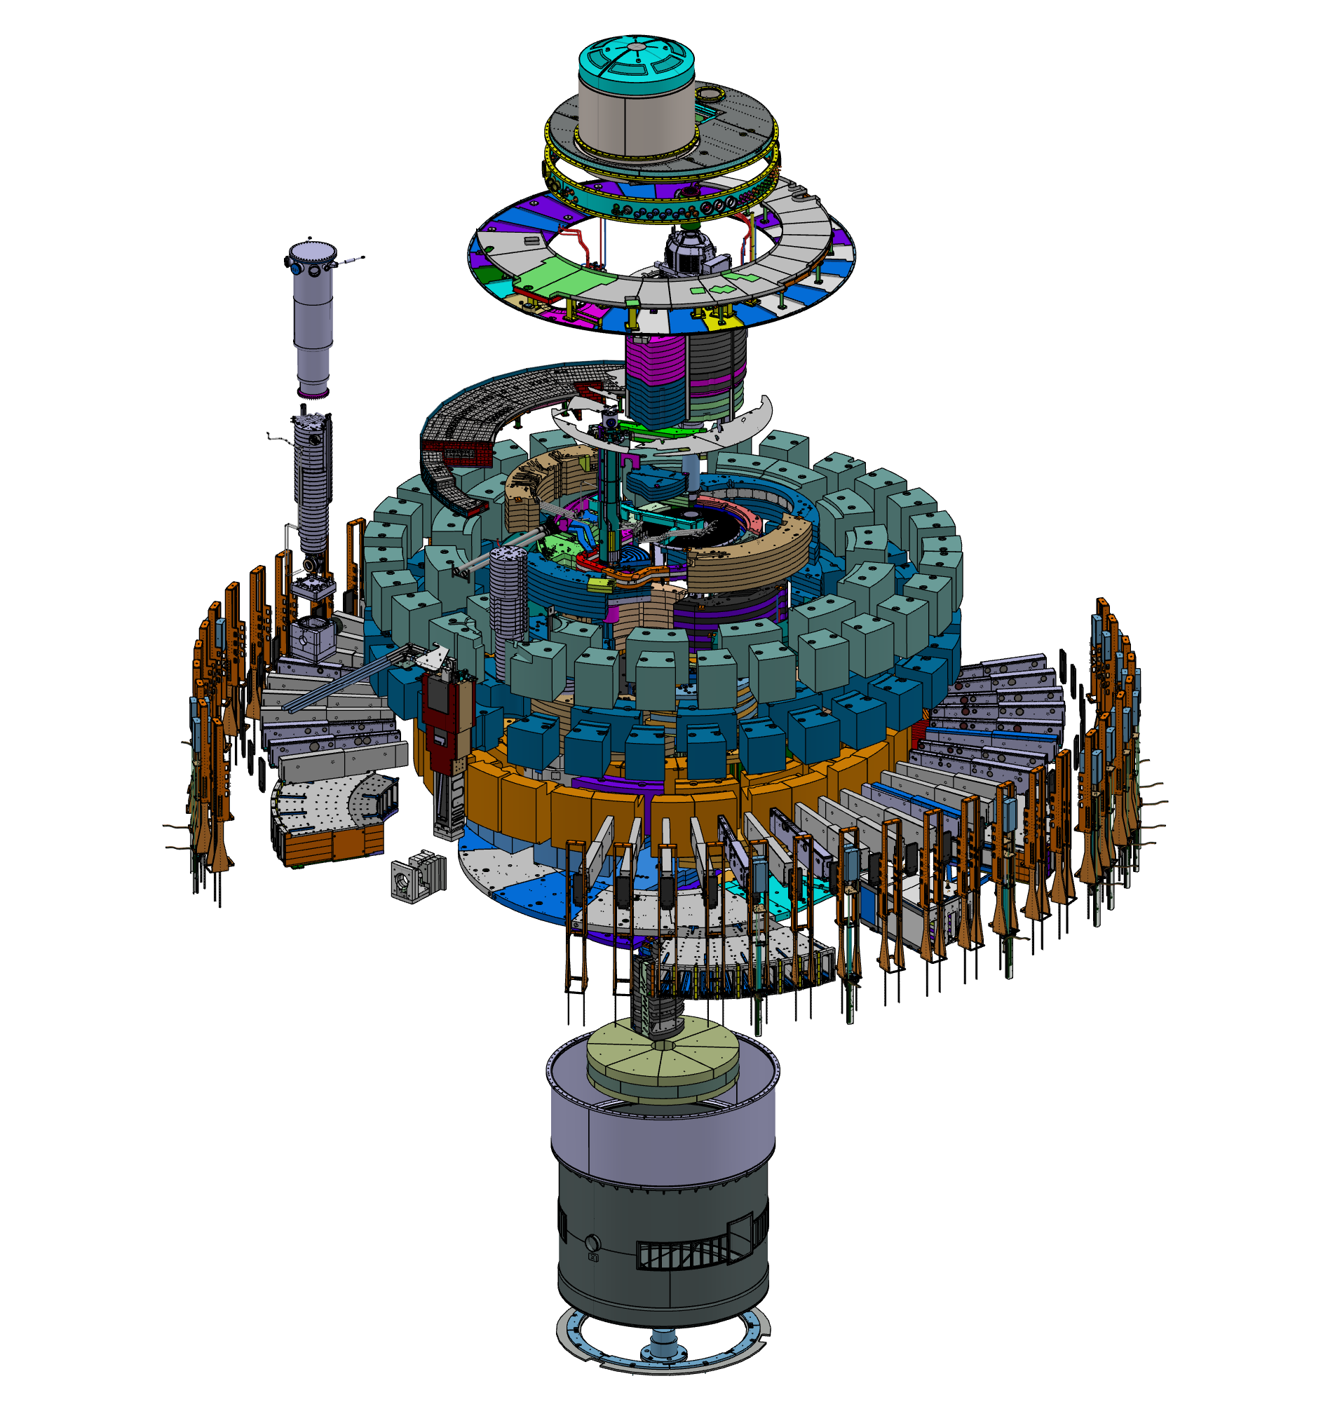
Mechanical Engineering
Set up and progress
All mech design is made in CATIA V6.
Challenge: New when released → Customizations.
Opportunity: Same supplier as CHESS → engineering data integration ready solutions.
Selling points:
Graded approach – only do what must be done.
Possibility to transfer other CAD tools native files to CATIA.
Properly implemented:
Functional structures, release flows, framework
Templates for documentation
Title blocks on 2D drawings aligned and including design standards selection.
Implementation of ISO GPS for 2D drawings improved manufacturing communication and deliverables.
Close collaboration with:
Spatial integration team
Technical Content Management
Quality

Slide 8
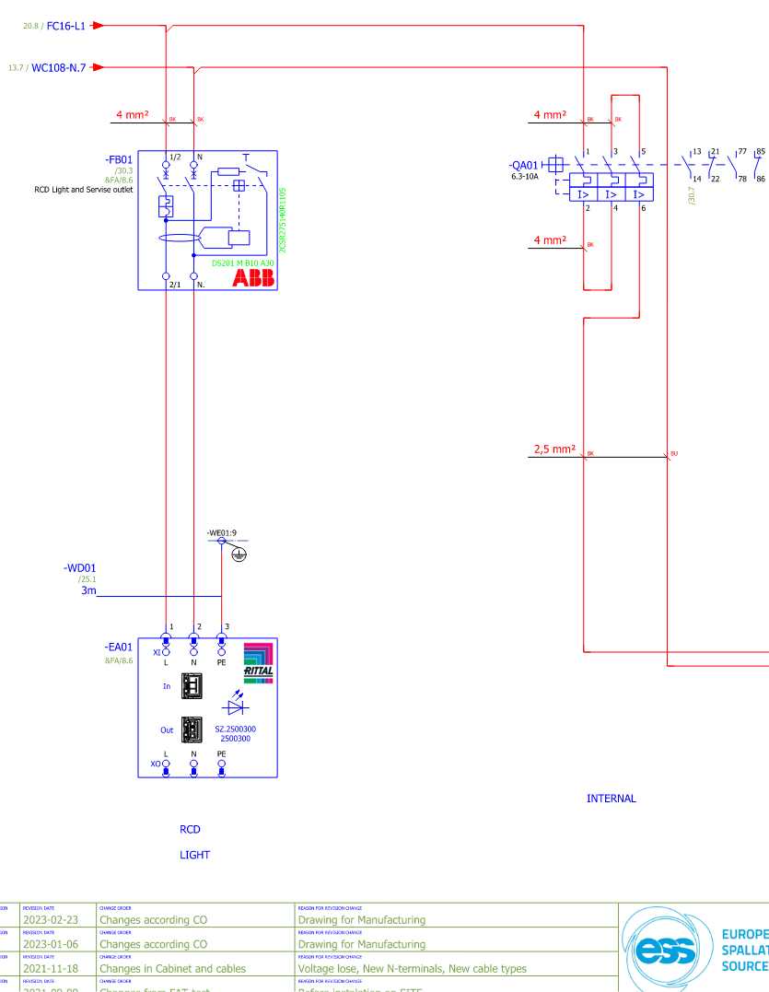
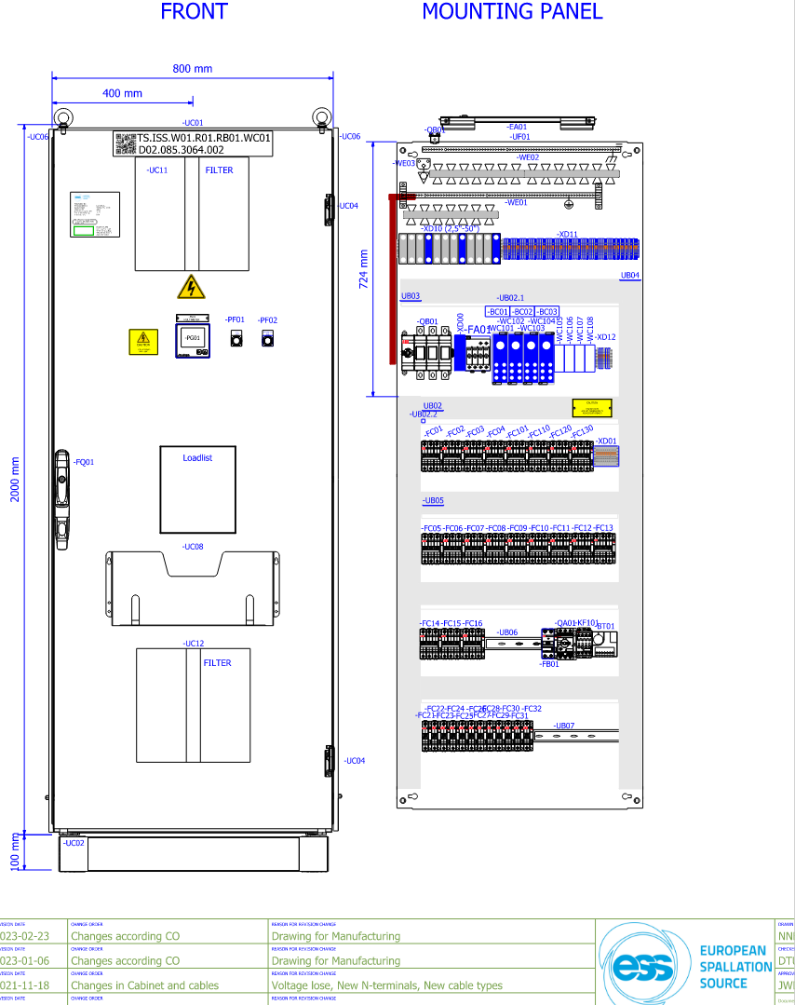
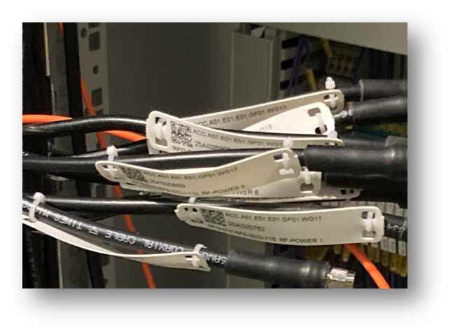
Electrical and I&C Engineering
Set up and progress
Key to success:
Clear view of how to transfer data from partners to tools.
Clear view of how to support with legislative compliance.
Close connection to PLM and EAM platforms as early as possible .
Clear view of who owns the data and where does it go.
All design is made in Eplan.
Partners can get the following support:
ESS offers support for review
Drafting support/transfer of design data
Framework and legislation advice
Elvis is used for calculations of cables
Aveva E3D is used for cable routing
Internal database for each cable with naming and engineering data. Currently with +43k Cables identified
Challenges: Swedish legislative standards
Opportunities: Tagging used from CHESS, design documentation transferred to CHESS and EAM.

Slide 9
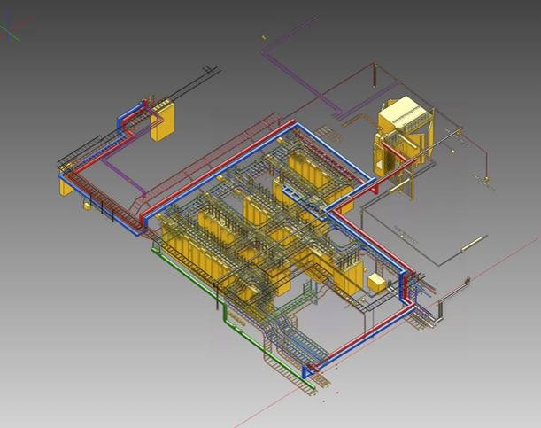
Plant and Process Engineering
Set up and progress
All process and piping design in AVEVA.
Challenges:
Piping design tools vary
P&ID done often in non-piping tools.
Opportunity:
Time savings by connecting process and piping due to automated generation of many documentations
Close collaboration with:
Technical Content Management
Spatial Integration
Quality
Key to success:
Clear view of how to transfer data from partners to tools.
Clear view of how to support with legislative compliance.
Close connection to PLM and EAM platforms as early as possible .
Offer support to team to transfer data when not able to comply to tools usage

Slide 10
Conclusion & Future
In order to be successful with asset management, you should have engineering data as one of the corner stones, well aligned with the facility structure and nomenclature as well as the asset mgmt. system. This will save time, not only in operation, but during manufacturing, installation, testing and commissioning and reducing amount of re-works.
Next steps for Design & Engineering:
- Continue to adjust and improve our way of working.
- Get a handle on the as-built process for mechanical systems.
- Make maintenance data available in EAM system in order to better plan for maintenance.

Slide 11
Finish presentation

