Slide 2
CERN’s Asset & Maintenance Management Application Portfolio
Goran Perinic, CERN

Slide 3
What is CERN?
CERN is the world’s largest research centre for particle physics.
Our mission is to provide scientists with tools to study the building blocks of matter and the origins of the universe.
How: By building and operating huge particle accelerators.
23 Member States
>10k People On-site
>80 Collaborating Countries
1.6 bn USD Annual Budget

Slide 4
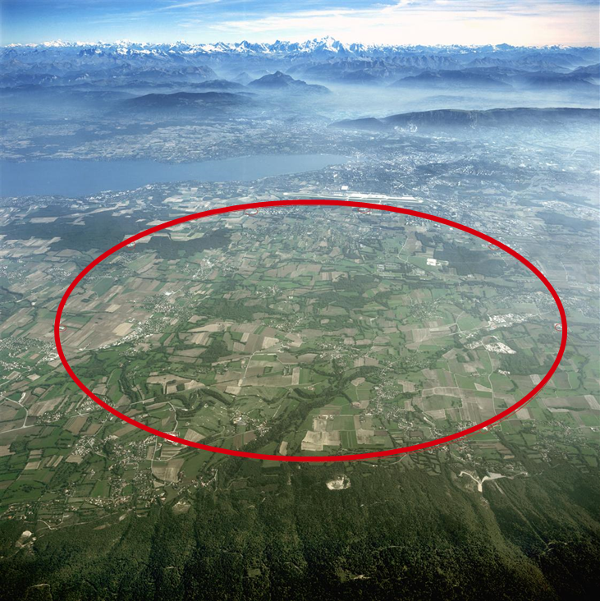
The LHC
The Large Hadron Collider:
Located outside Geneva, Switzerland.
100 million components
27 km circular tunnel
100 m below ground
Speed of particles:
99.999999% of speed of light
11,000 revolutions / second
Cost: ~8 BCHF

Slide 5
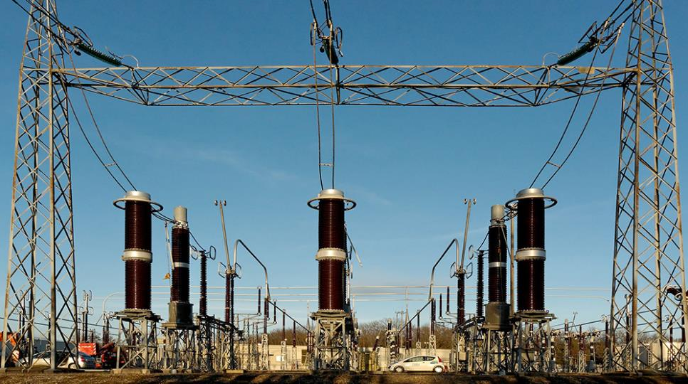
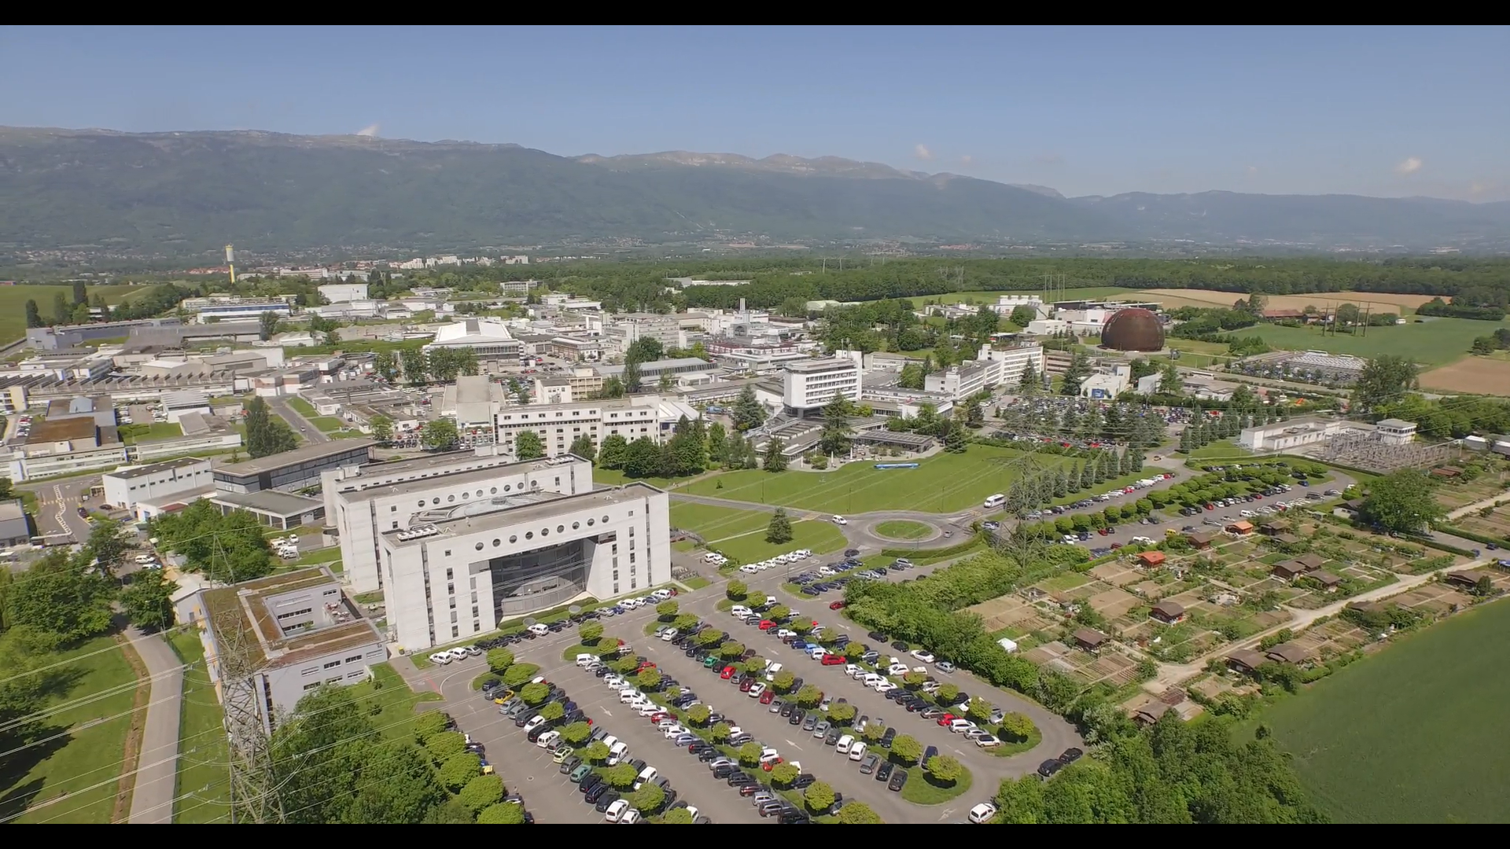
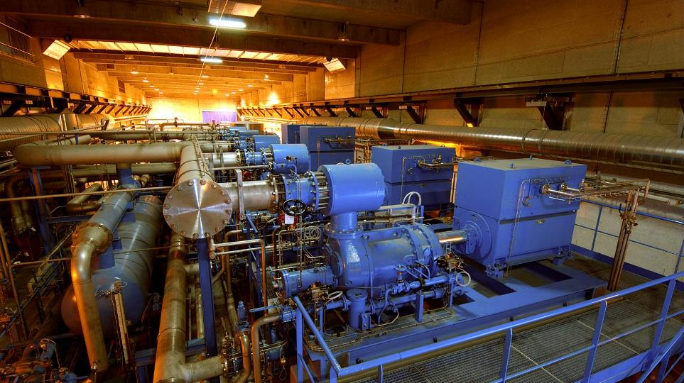
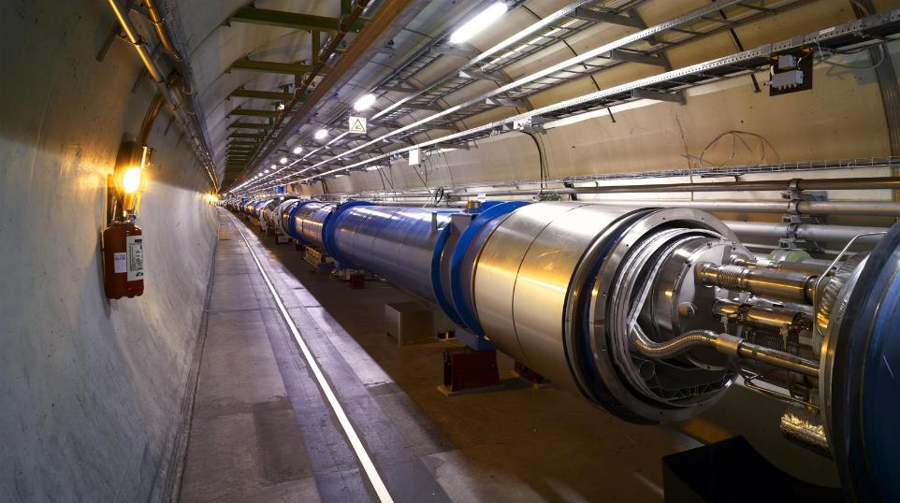
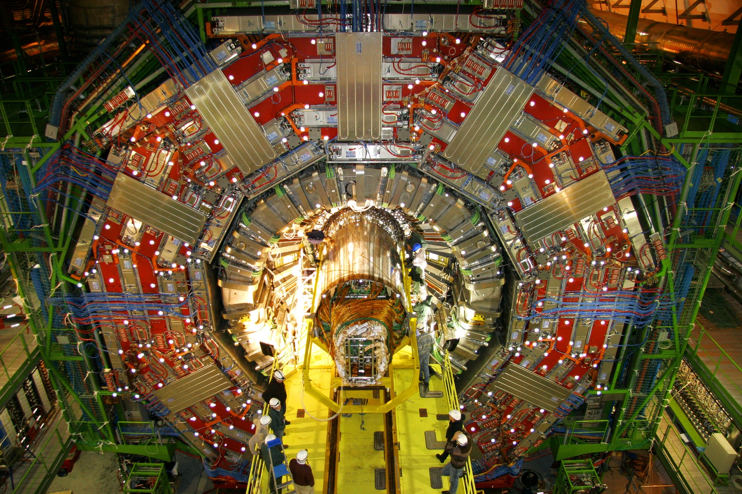

Slide 6
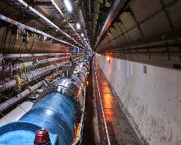
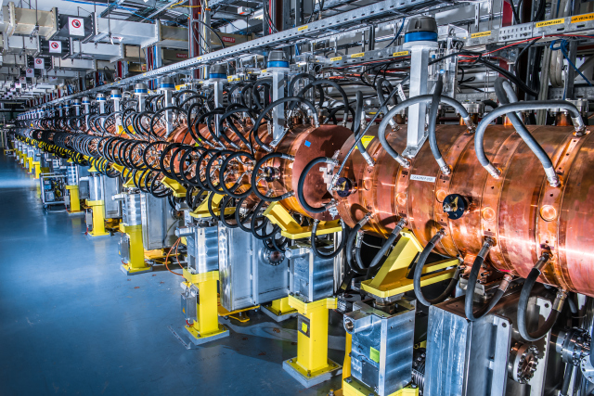
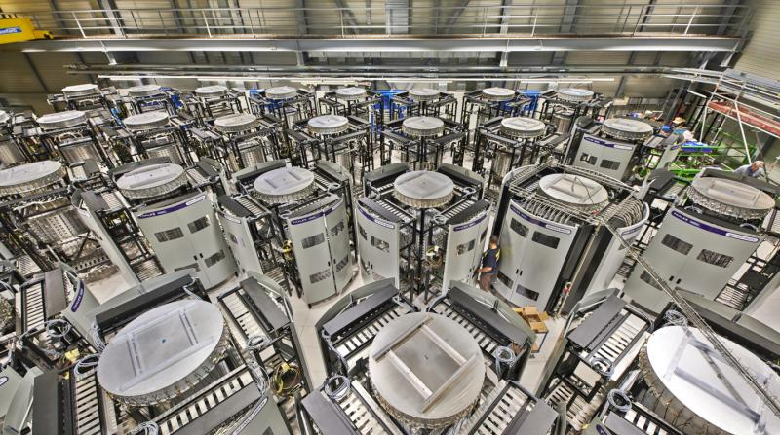
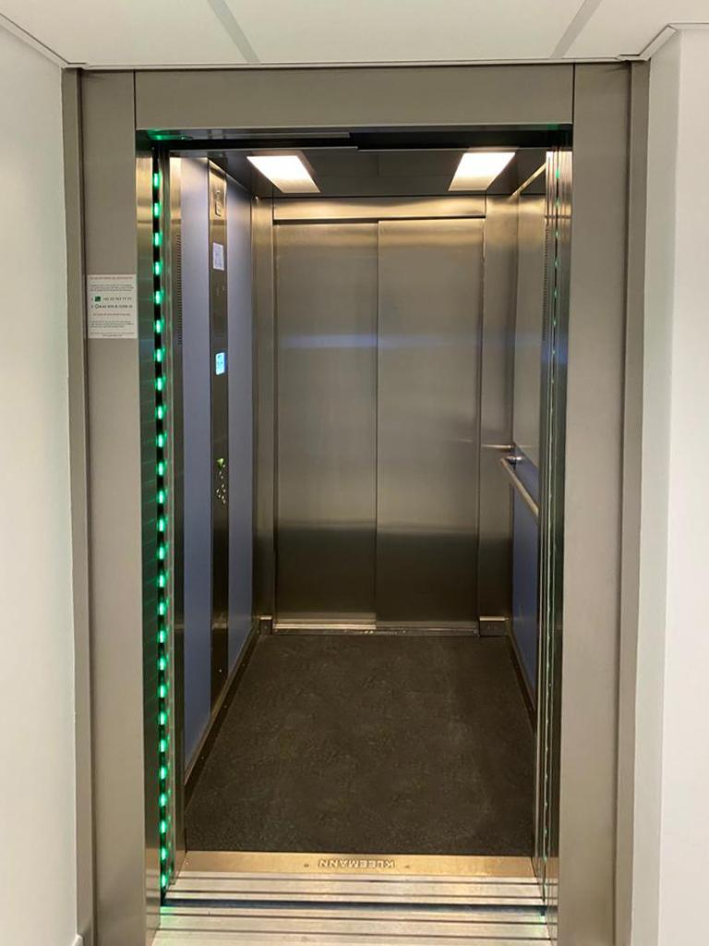
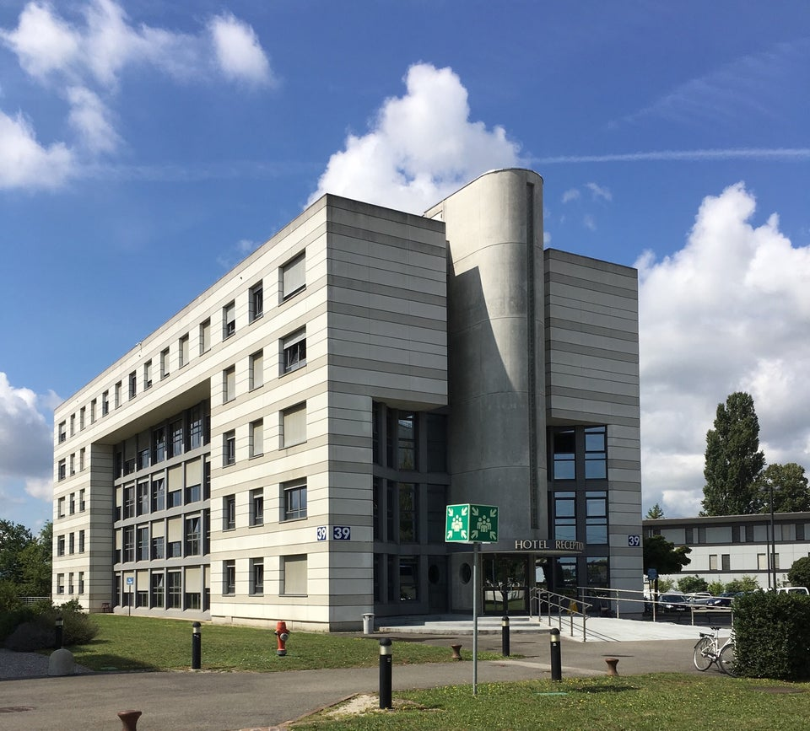
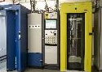
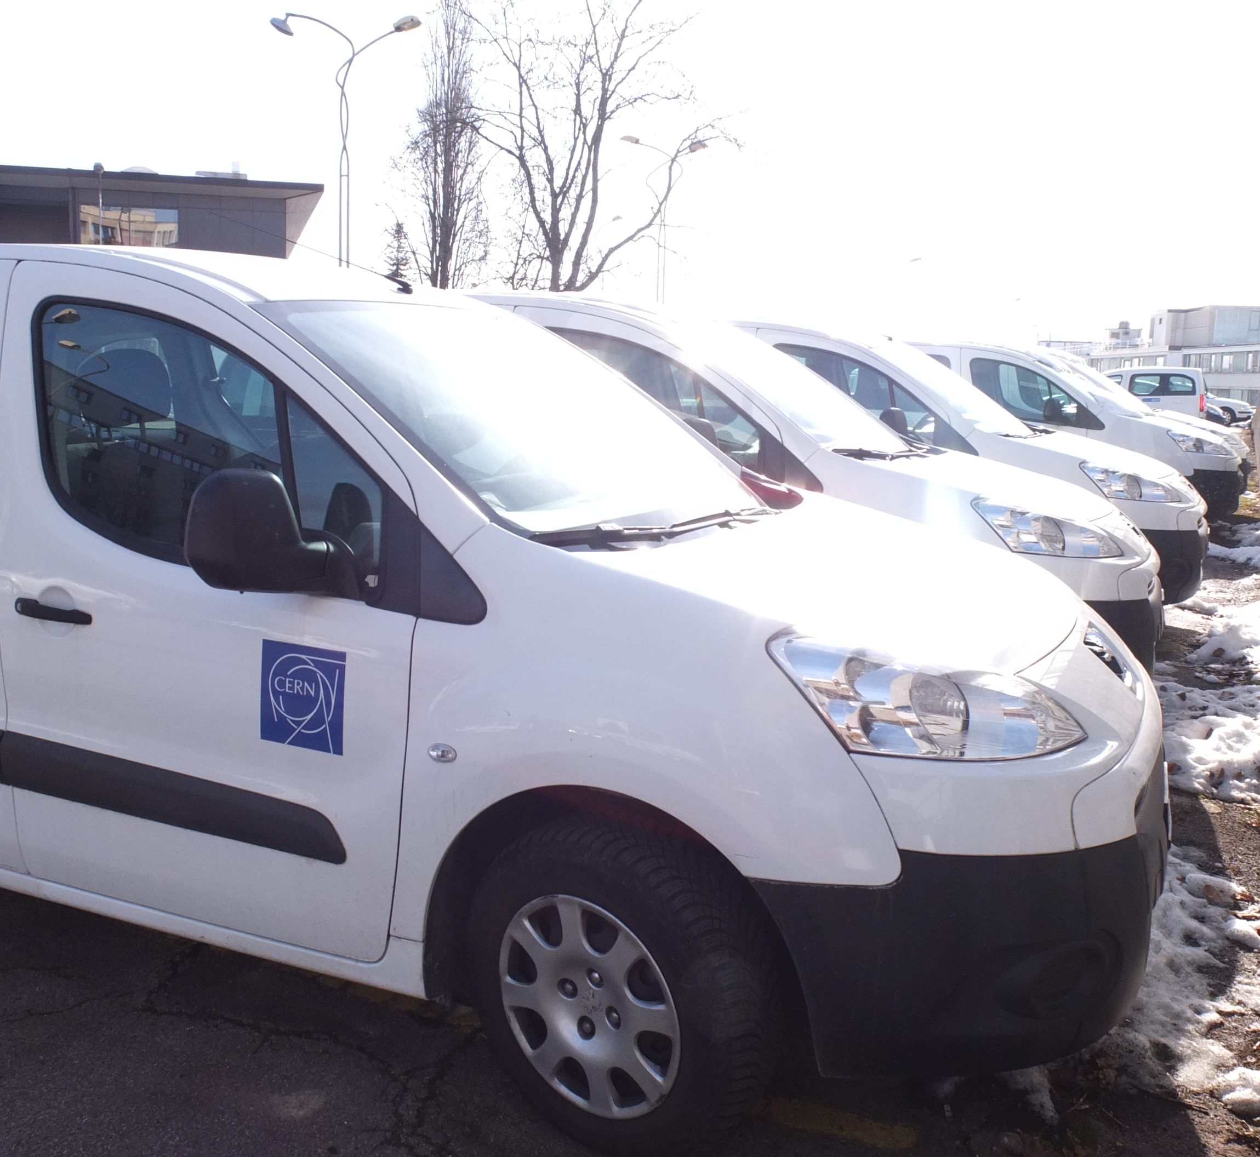
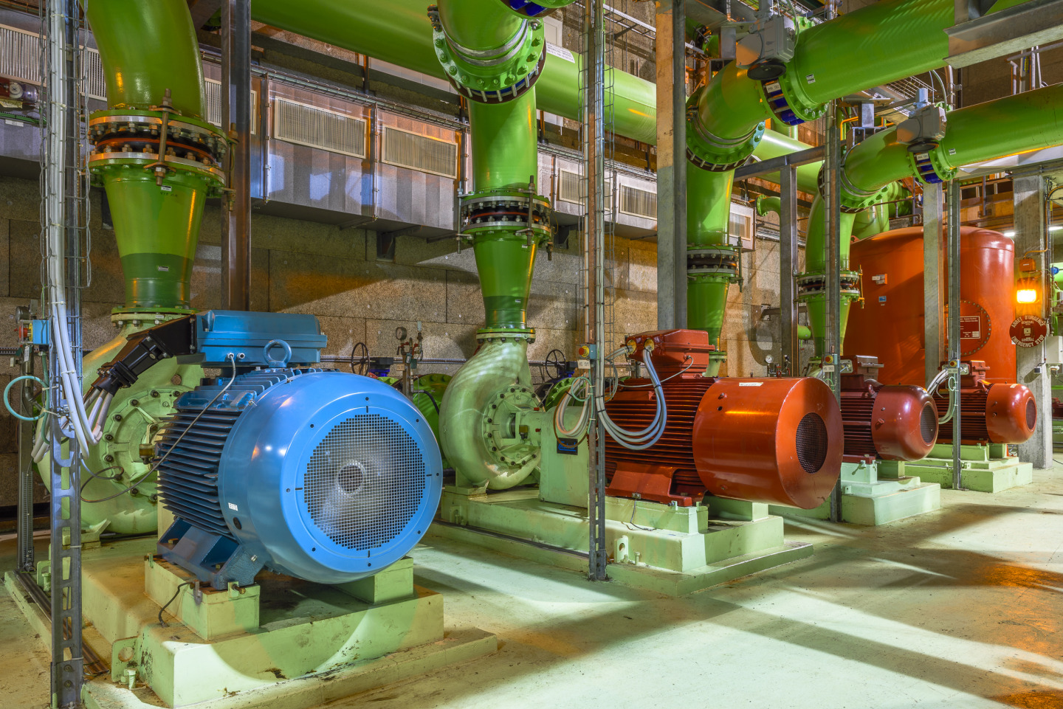
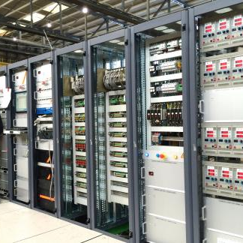
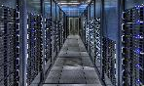
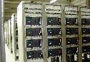
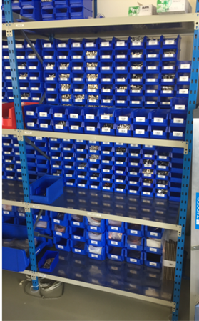
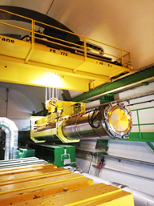
Asset Management at CERN

Slide 7
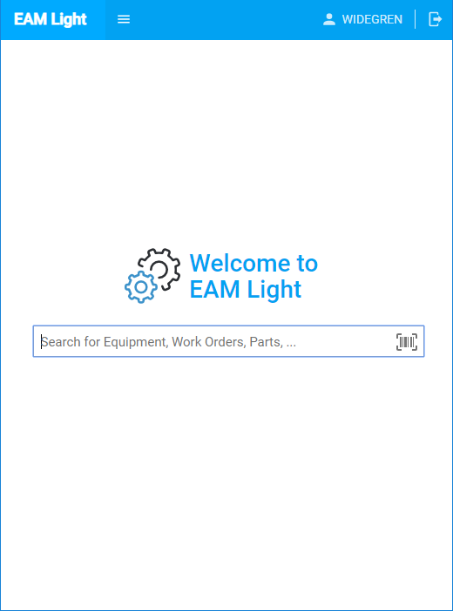
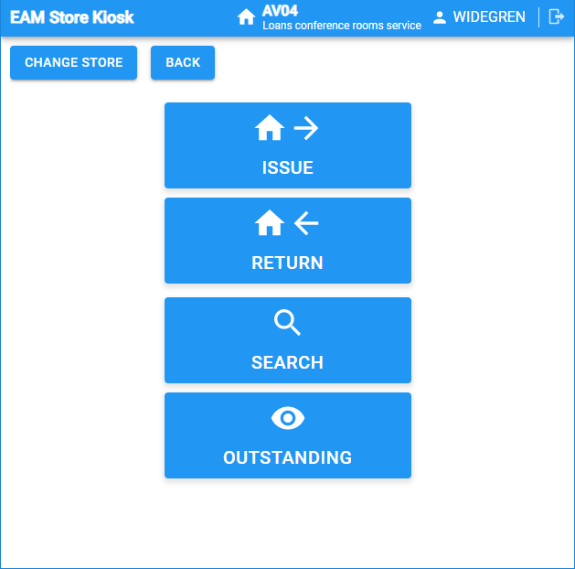
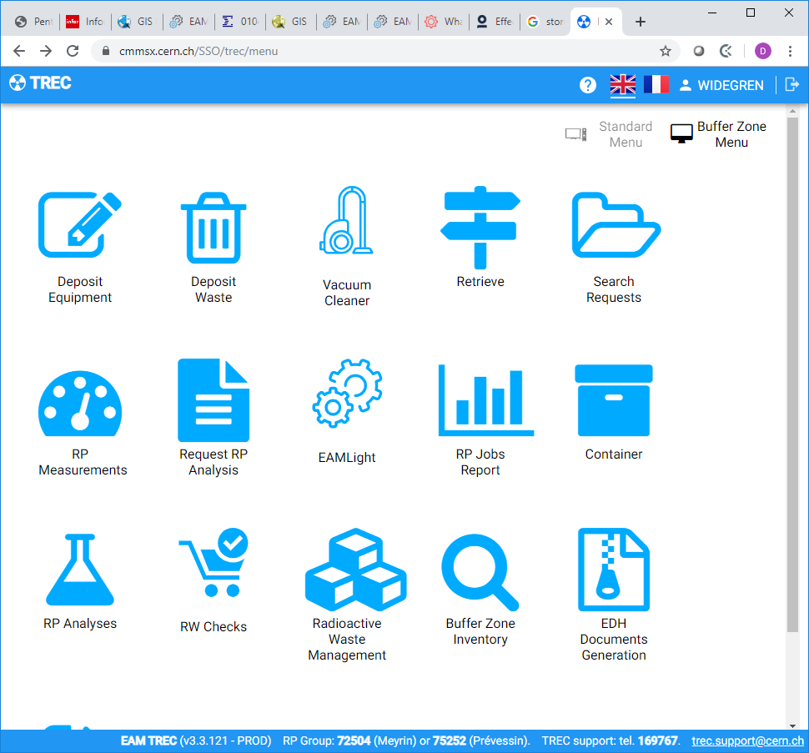
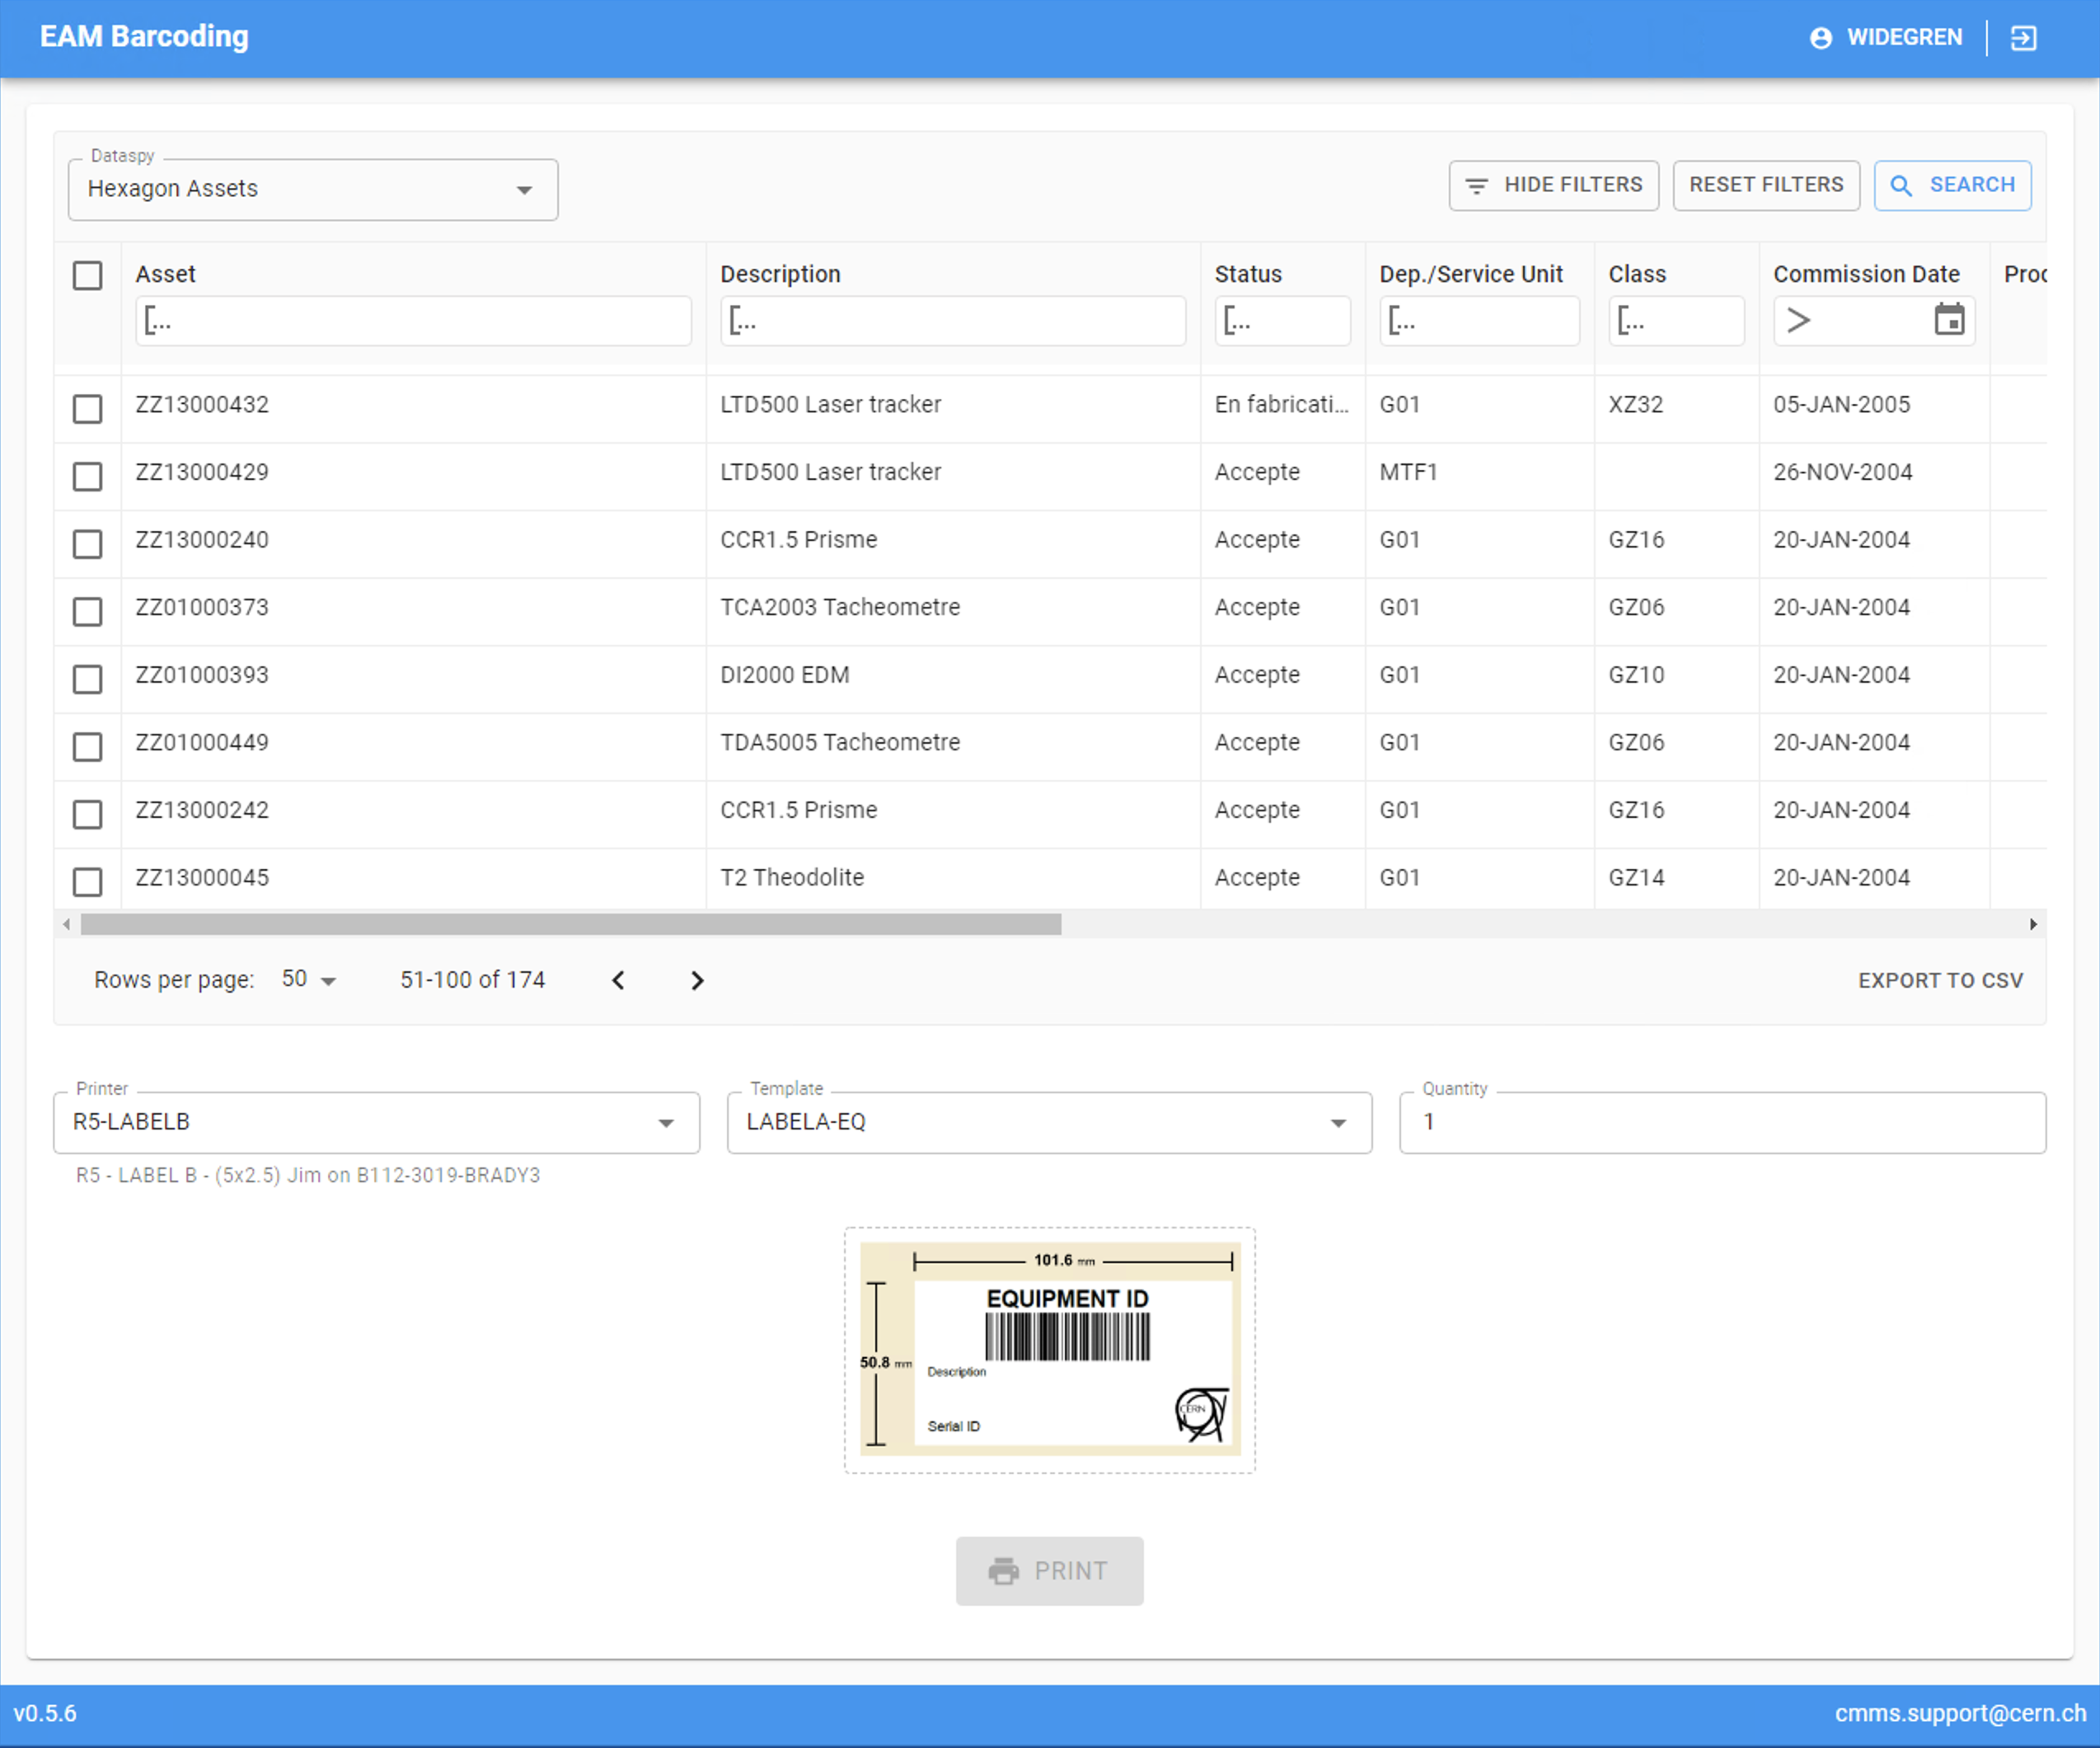
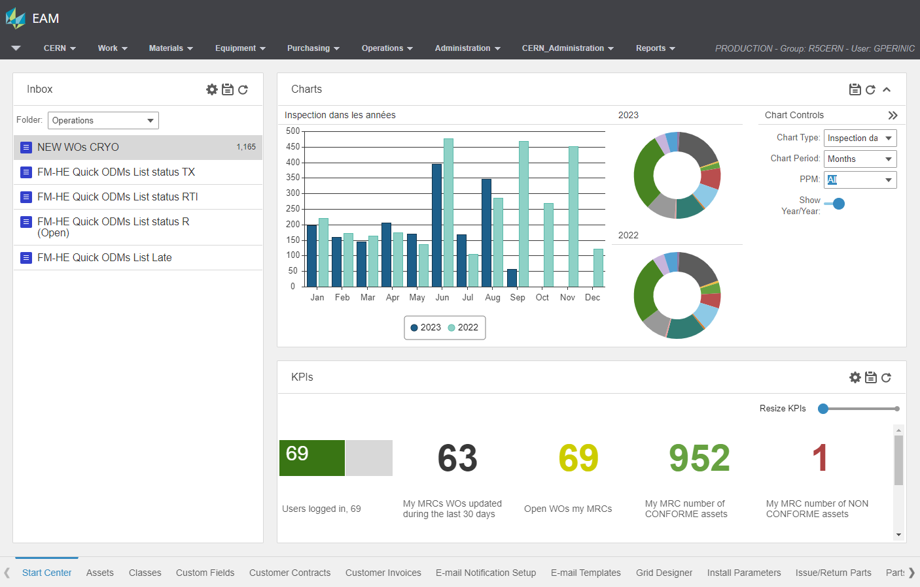
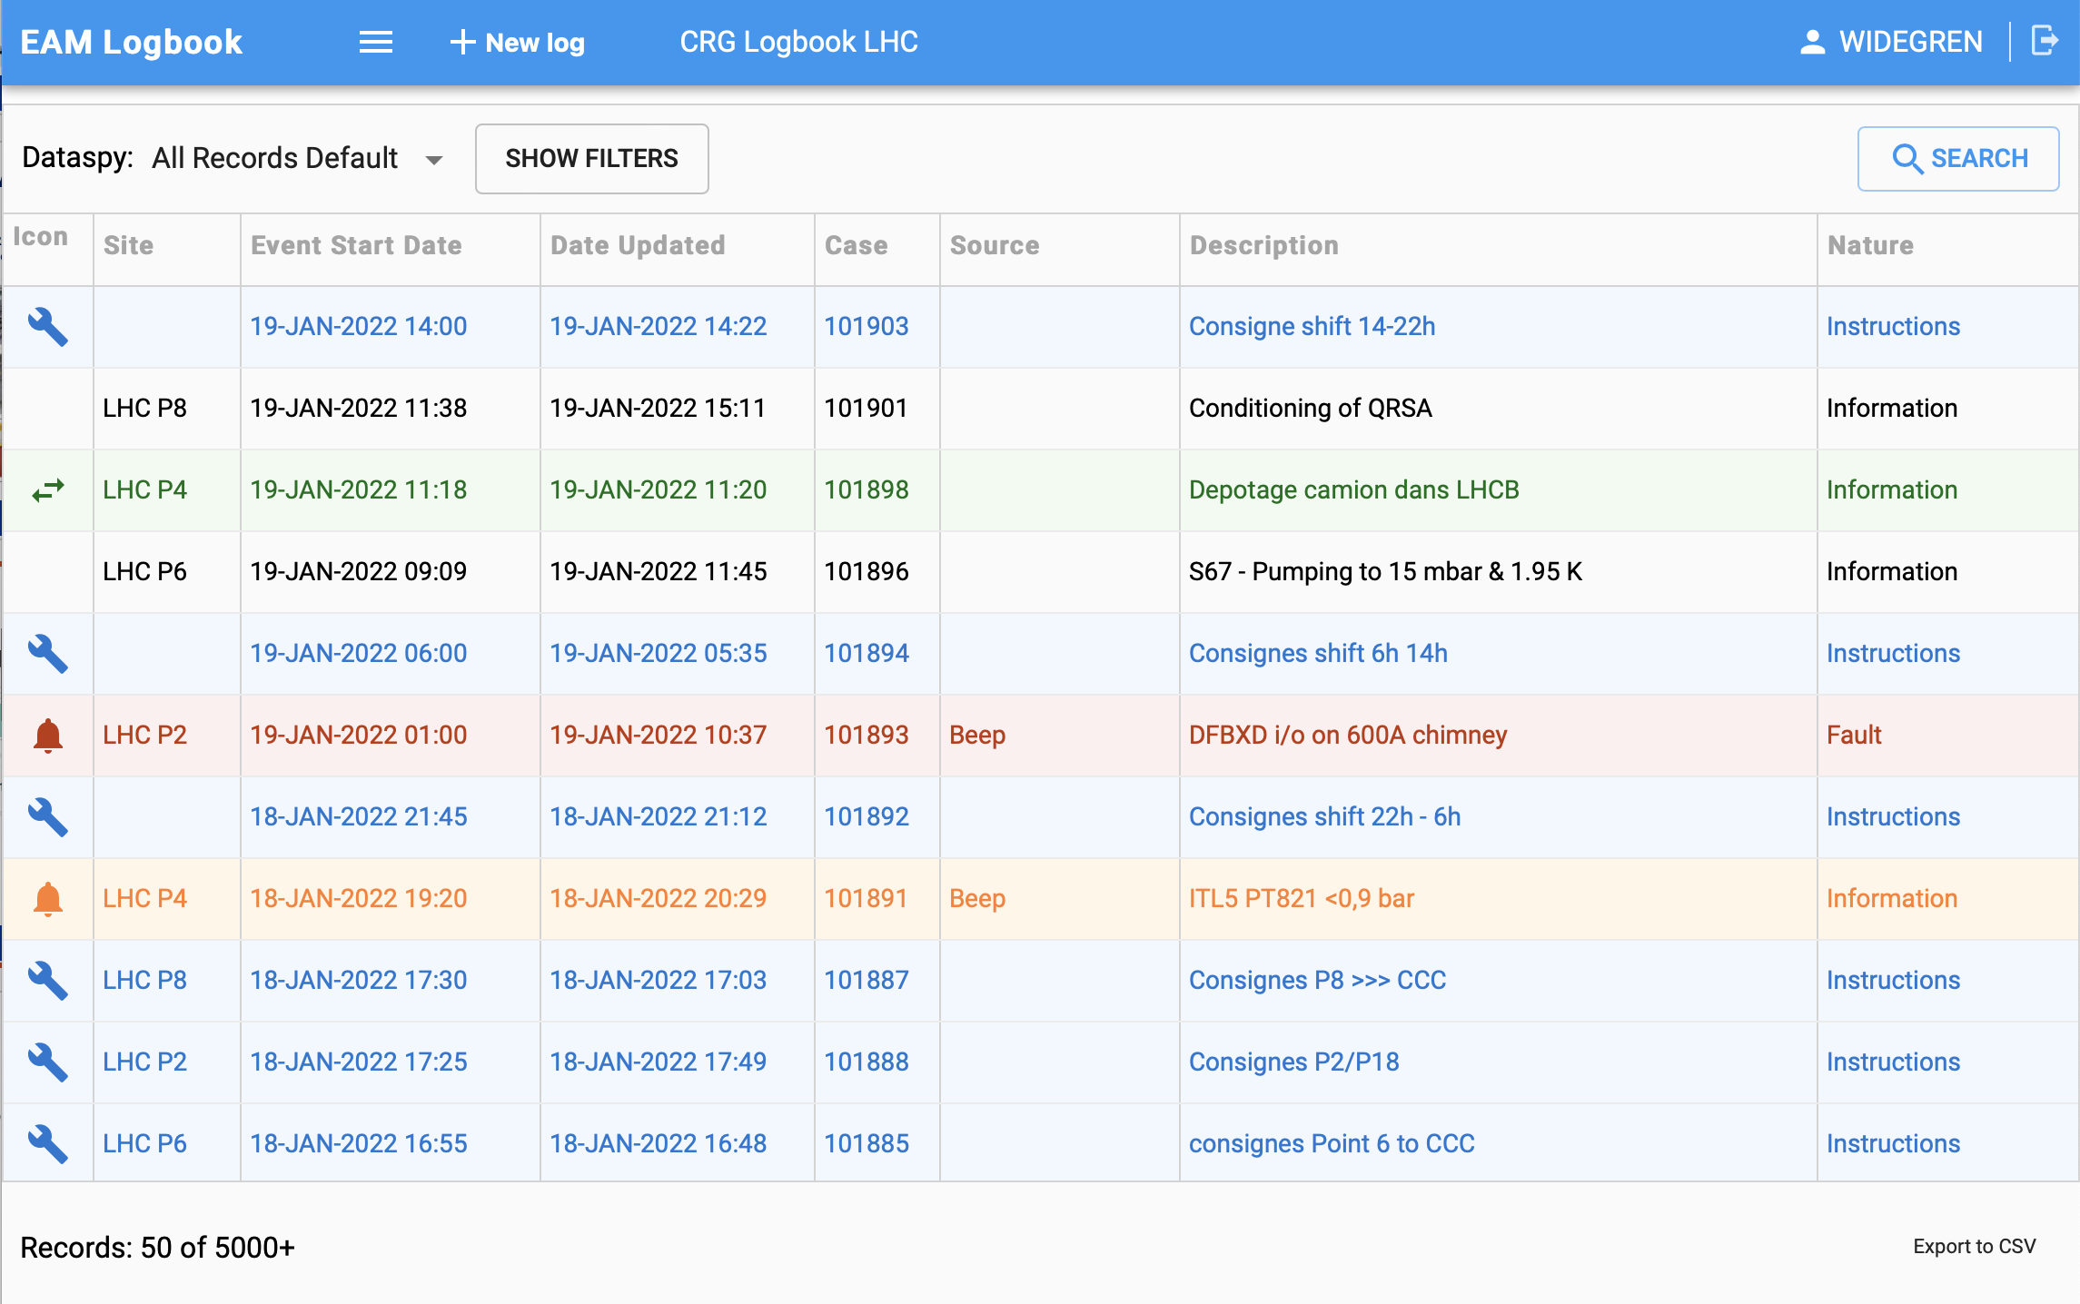
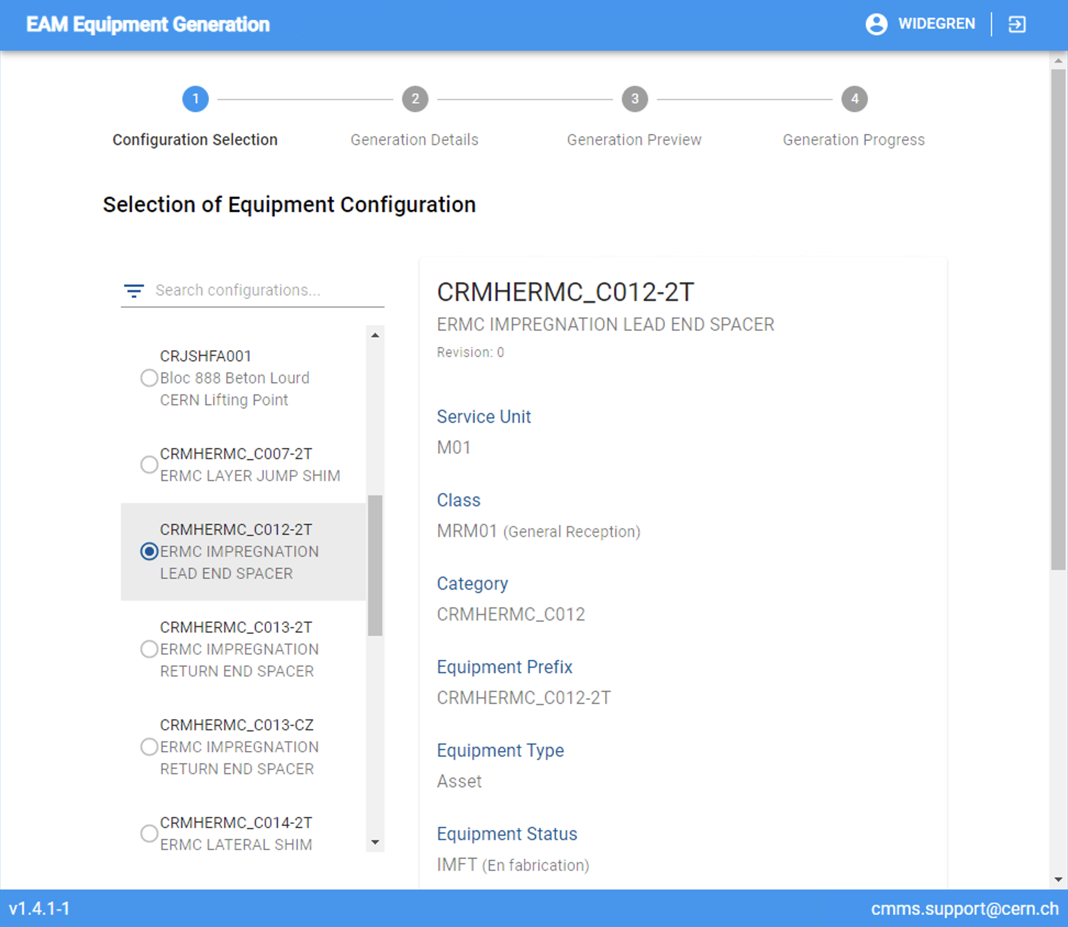
EAM at CERN in 2023
EAM Light Mobile/Simplified Interface
EAM Store Kiosk Store Management
TREC Radioactive Traceability
EAM Barcoding Barcode Printing
Hexagon EAM Enterprise Asset Management
EAM Logbook Issue Management
EAM Eqp. Generator Equipment Creation
Track It Activity Coordination

Slide 8
Our Core Data Model
Safety inspec-tion
Trans-port
Failure/ repair
Storage
Instal-lation
Mainte-nance
Functional Position
Asset
Quality assur-ance
step
Location
RP clear-ance

Slide 9
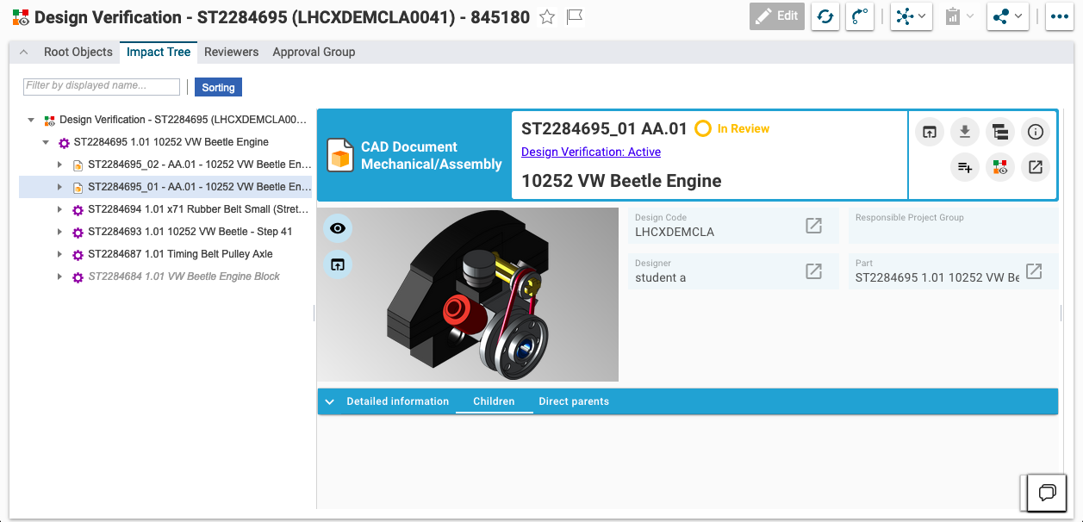
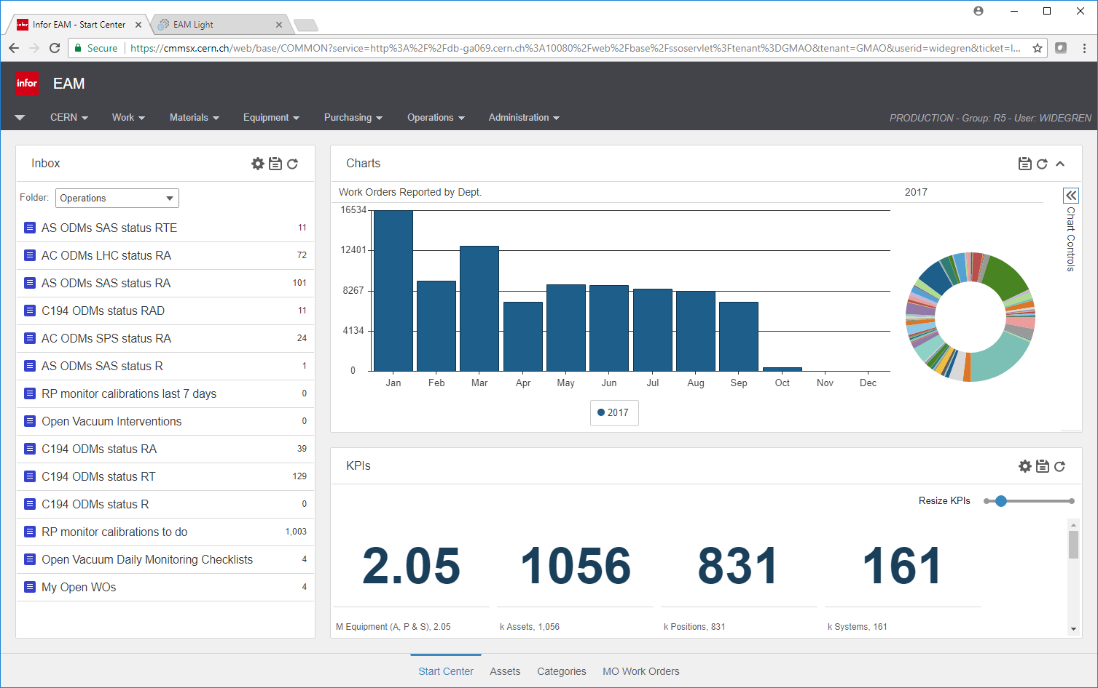
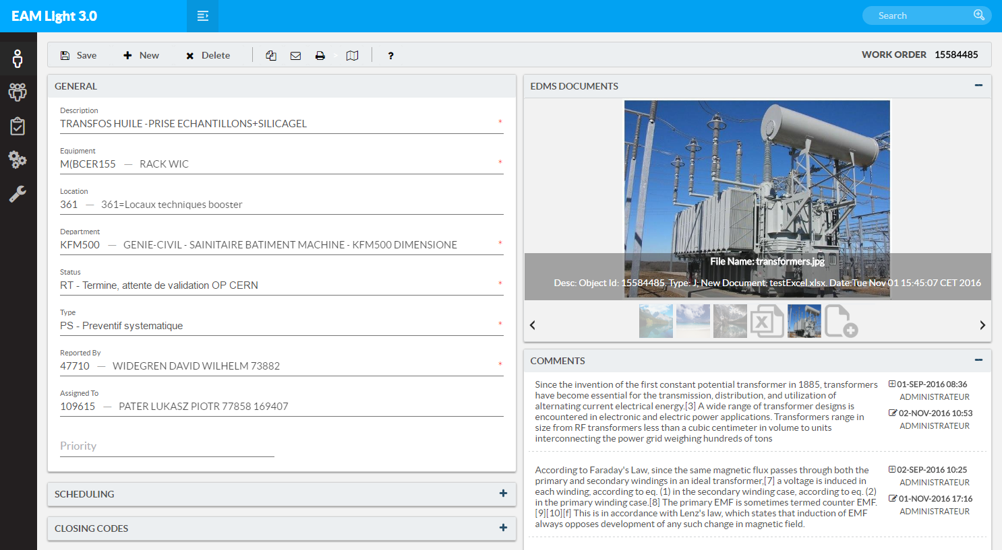
Our Application Landscape Architecture
DESIGN & CONFIG. MANAGEMENT
MANUFACTURING & INSTALLATION
OPERATION & MAINTENANCE
DISPOSAL & WASTE MANAGEMENT
PLM Product Lifecycle Management
MTF Manufacturing & Test Folder
HxGN EAM Enterprise Asset Management
TREC Radioactive Traceability
PLM
EAM
FINANCIAL DEPRECIATION Plant, Property & Equipment
WEB SERVICES HUB System Integrations via Standard APIs
REPORTING & ANALYTICS Business Intelligence & Data Warehousing
DIGITAL TWINS Engineering Digital Twins with 3D Visualization
ERP(s) Other apps.
SCADA Control Systems
IoT Data
Sensor logs
Databases Specialist data
Geolocations GIS & Metrology data
Supplier APIs Data exchange
And more.. 30+ Integrations

Slide 10
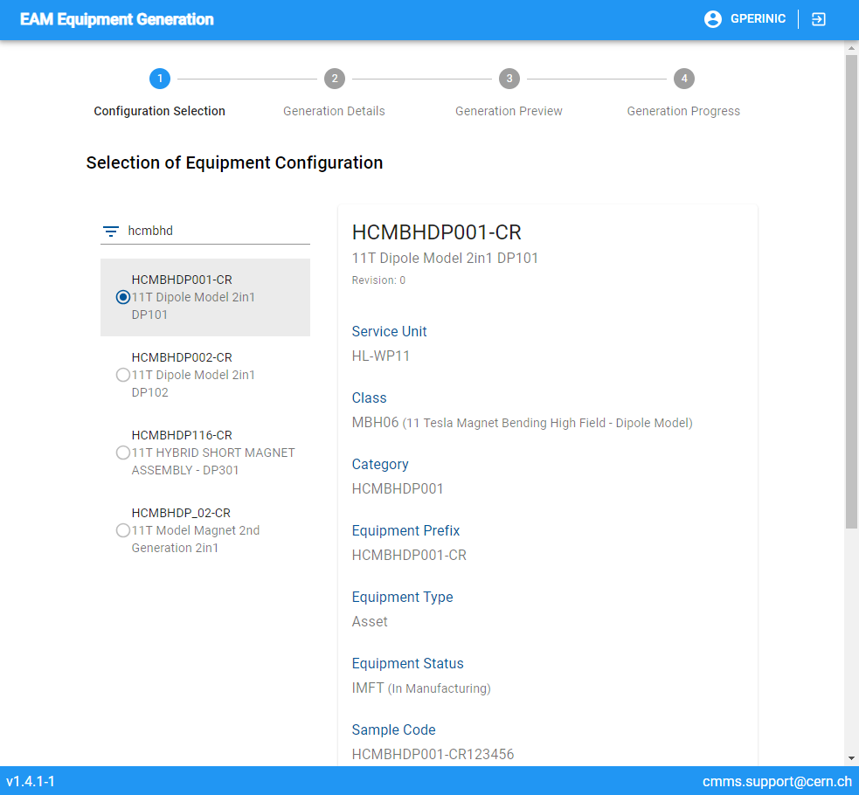
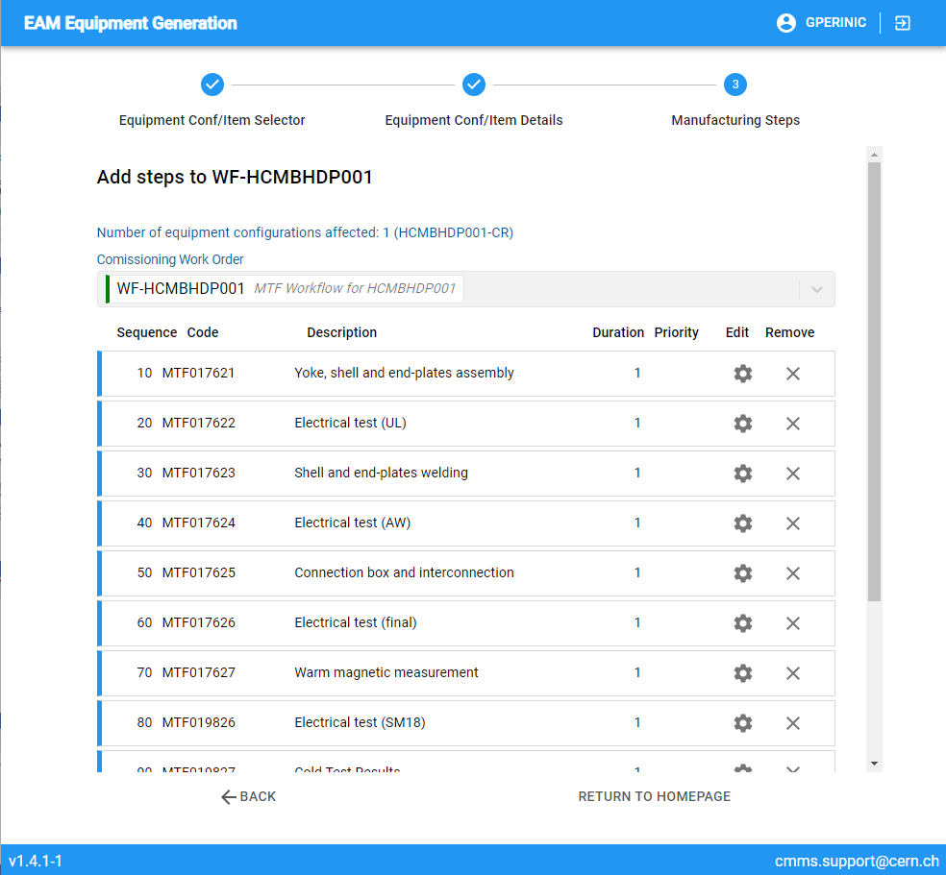
Equipment and Workflow Generator
Template based creation of
Equipment records and, as required, associated
Quality assurance steps
Used for series of identical or very similar components (that shall be traced individually)

Slide 11
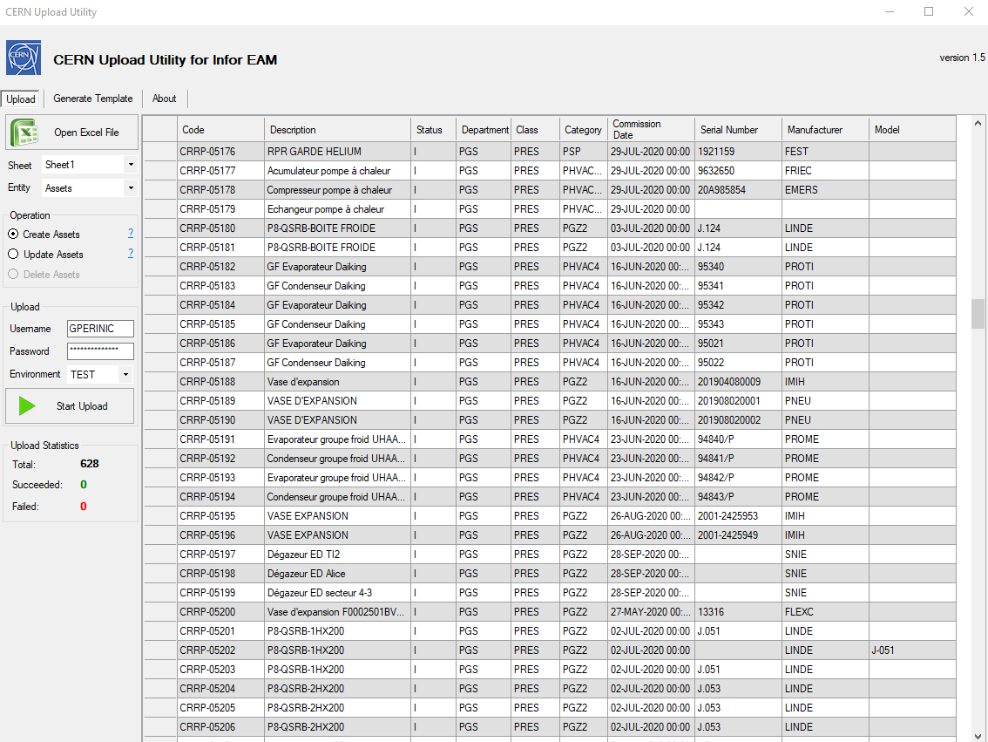
Upload Utility
Excel based creation of
equipment records (assets, functional positions, systems)
equipment structures
work orders
activities
tasks
standard WOs
checklists
comments
PM schedules
routes
campaigns
parts
store records
bins
price lists
part associations
substitute parts
material lists
part stock
part transactions
equipment dependencies
…

Slide 12
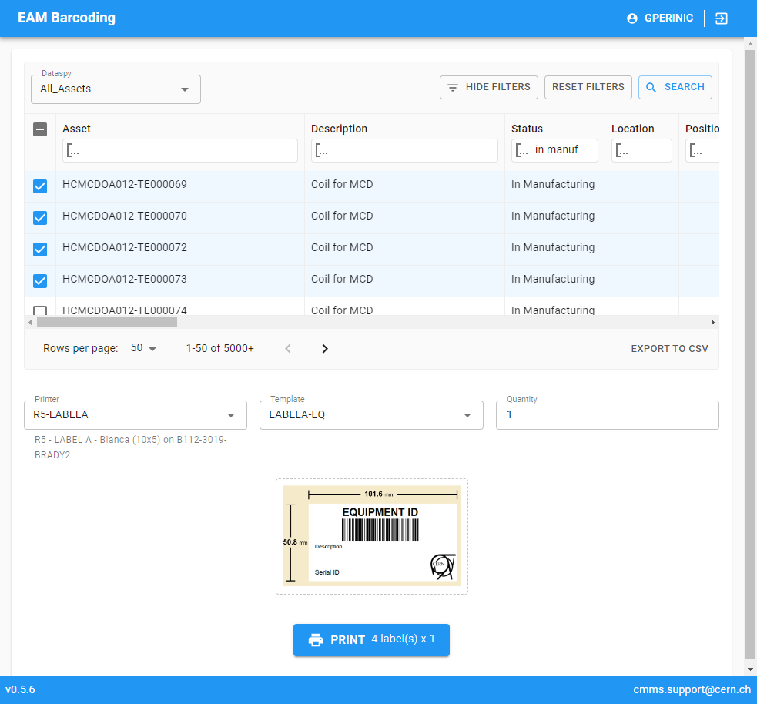
Barcode Printing
Web-based module for barcode printing from
Store Kiosk
EAM Light
Standalone web interface

Slide 13
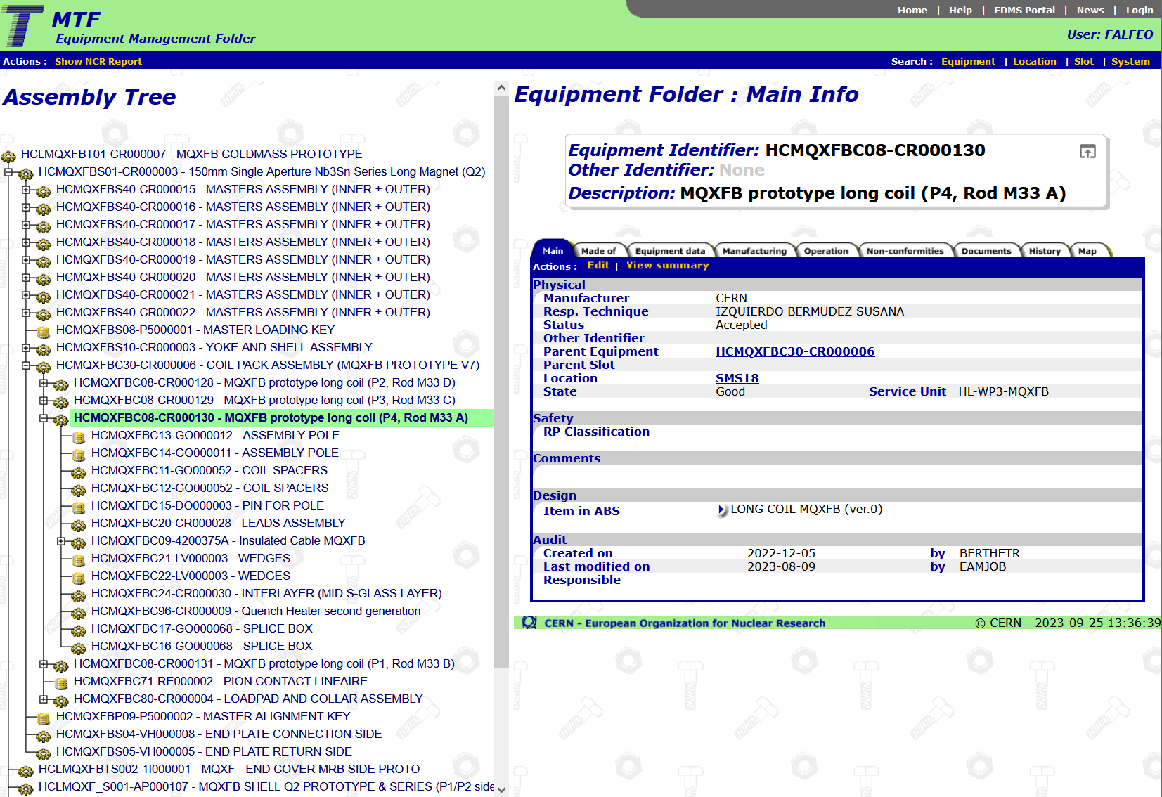
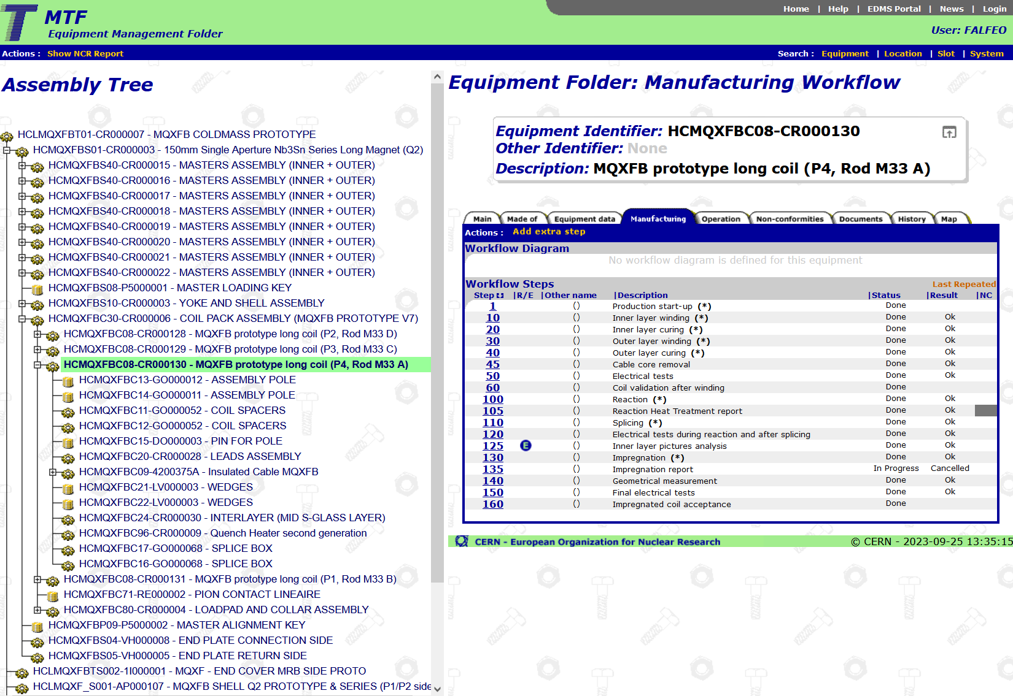
MTF
Manufacturing follow-up
Application put into place for the construction of the LHC.
Most functionalities now available in other applications, but nevertheless still in use in the accelerator domain

Slide 14
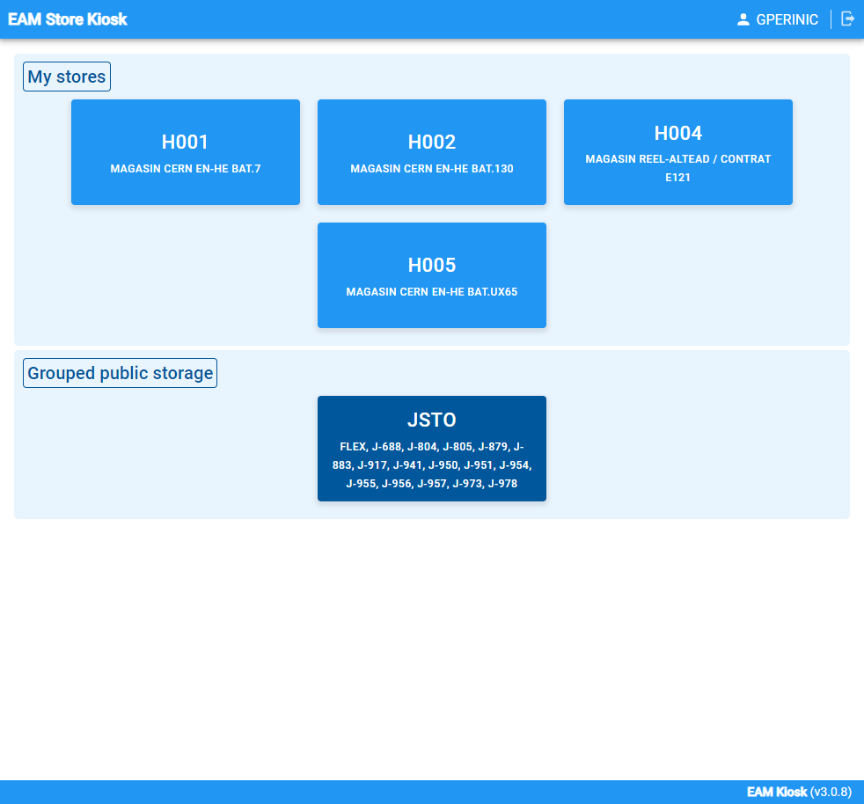
EAM Store Kiosk
Store management application for
Self service stores
Supervised stores
Central stores
There will be a detailed presentation by Peter Jurcso tomorrow morning.

Slide 15
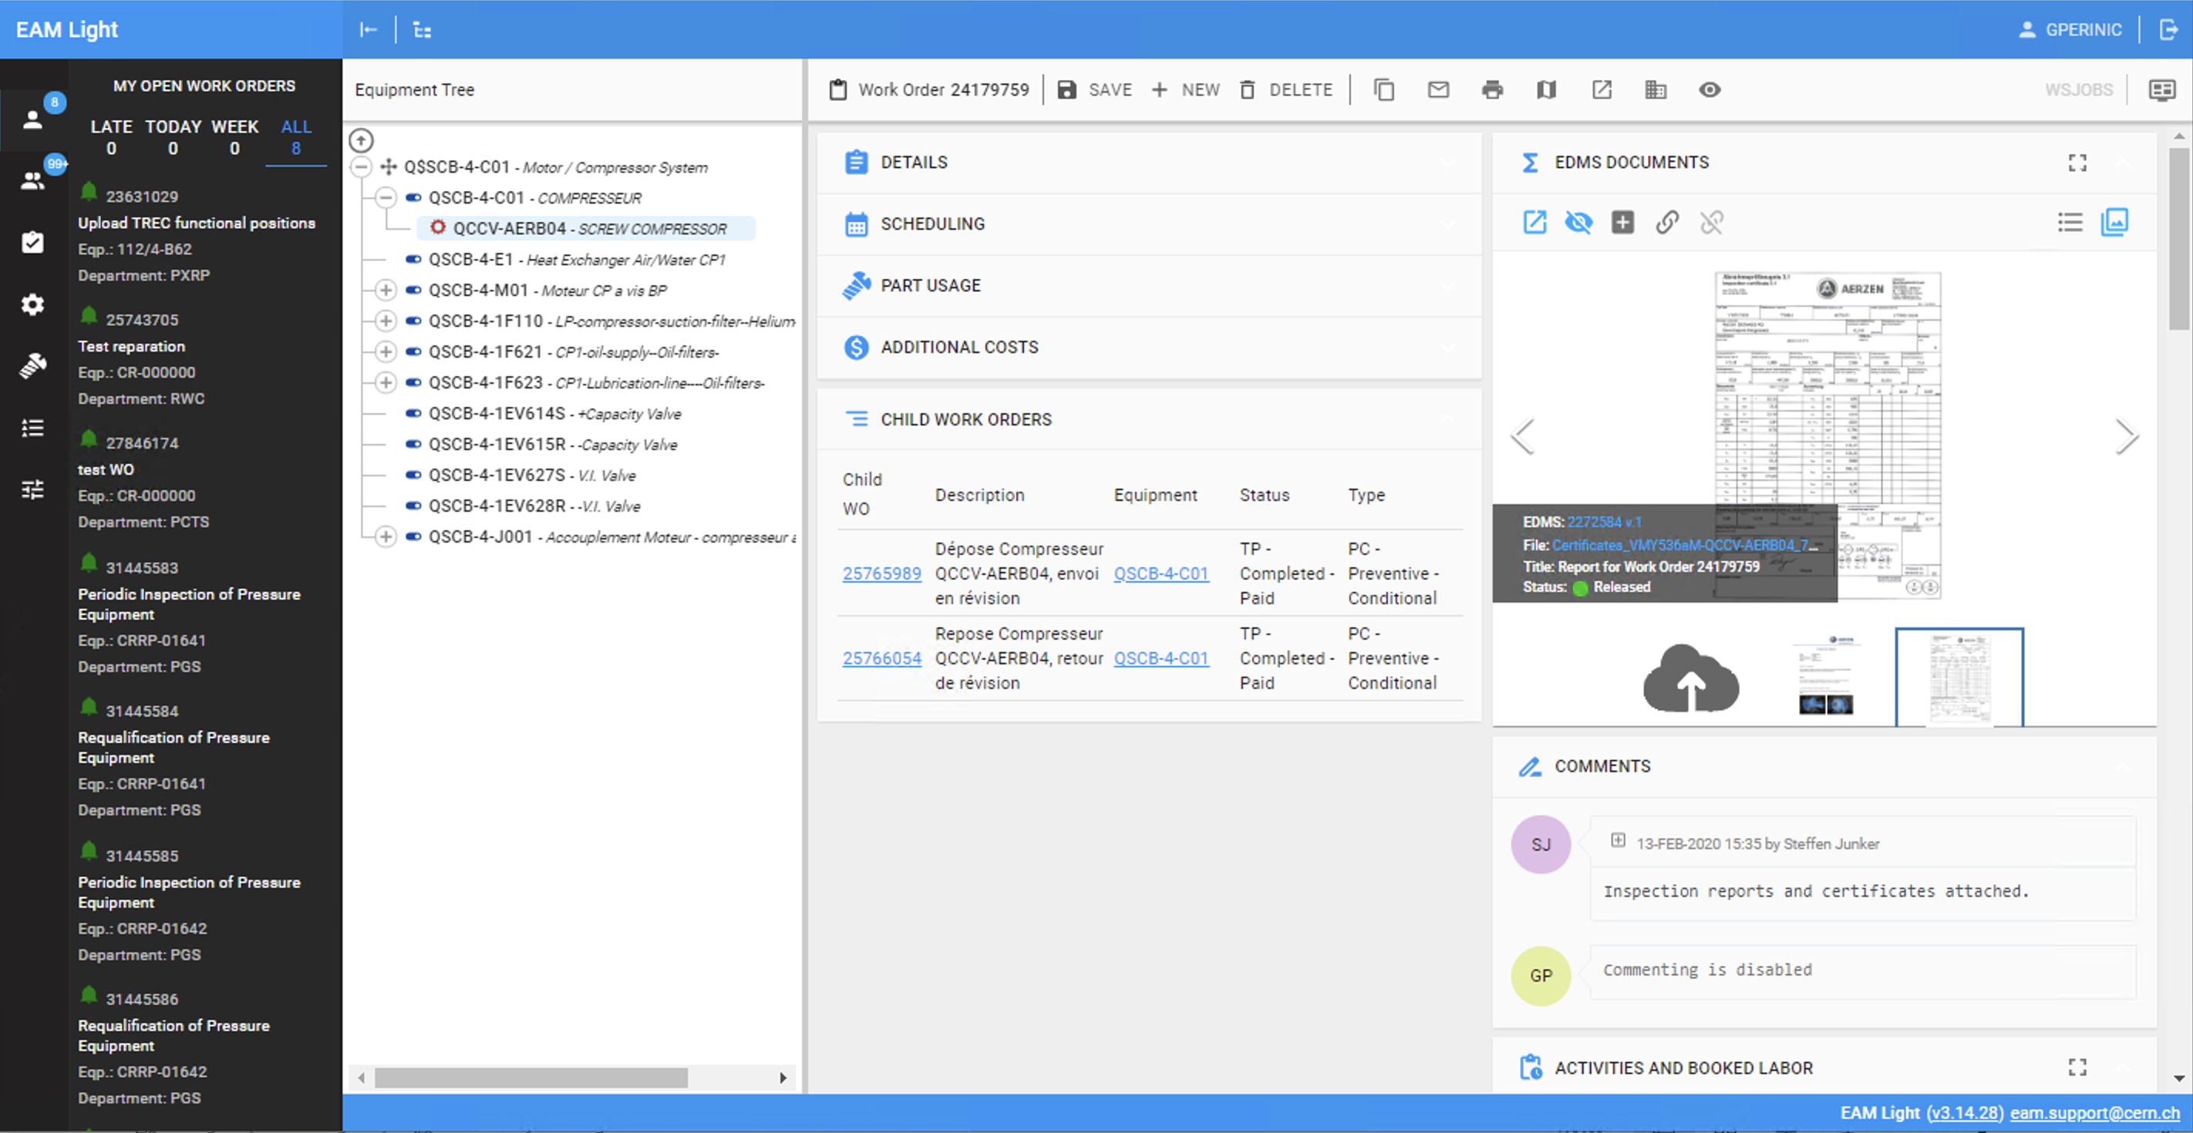
EAM Light
Field interface for
Consulting and updating equipment information
Structure operations
Completing work orders including
Activities
Checklists
Booking part usage and hours (contractors)
Uploading pictures and documents
…
Main intention: provide a user friendly and platform independent interface

Slide 16
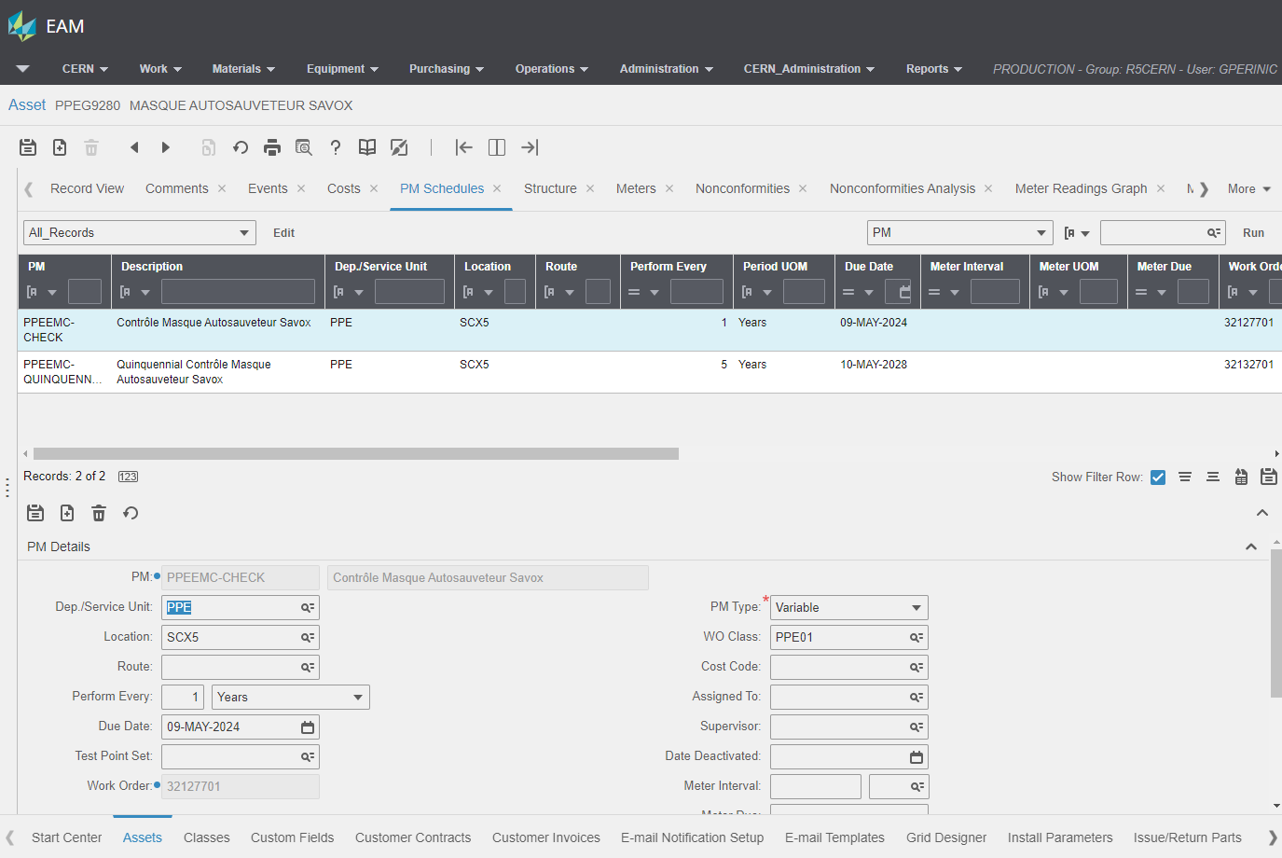
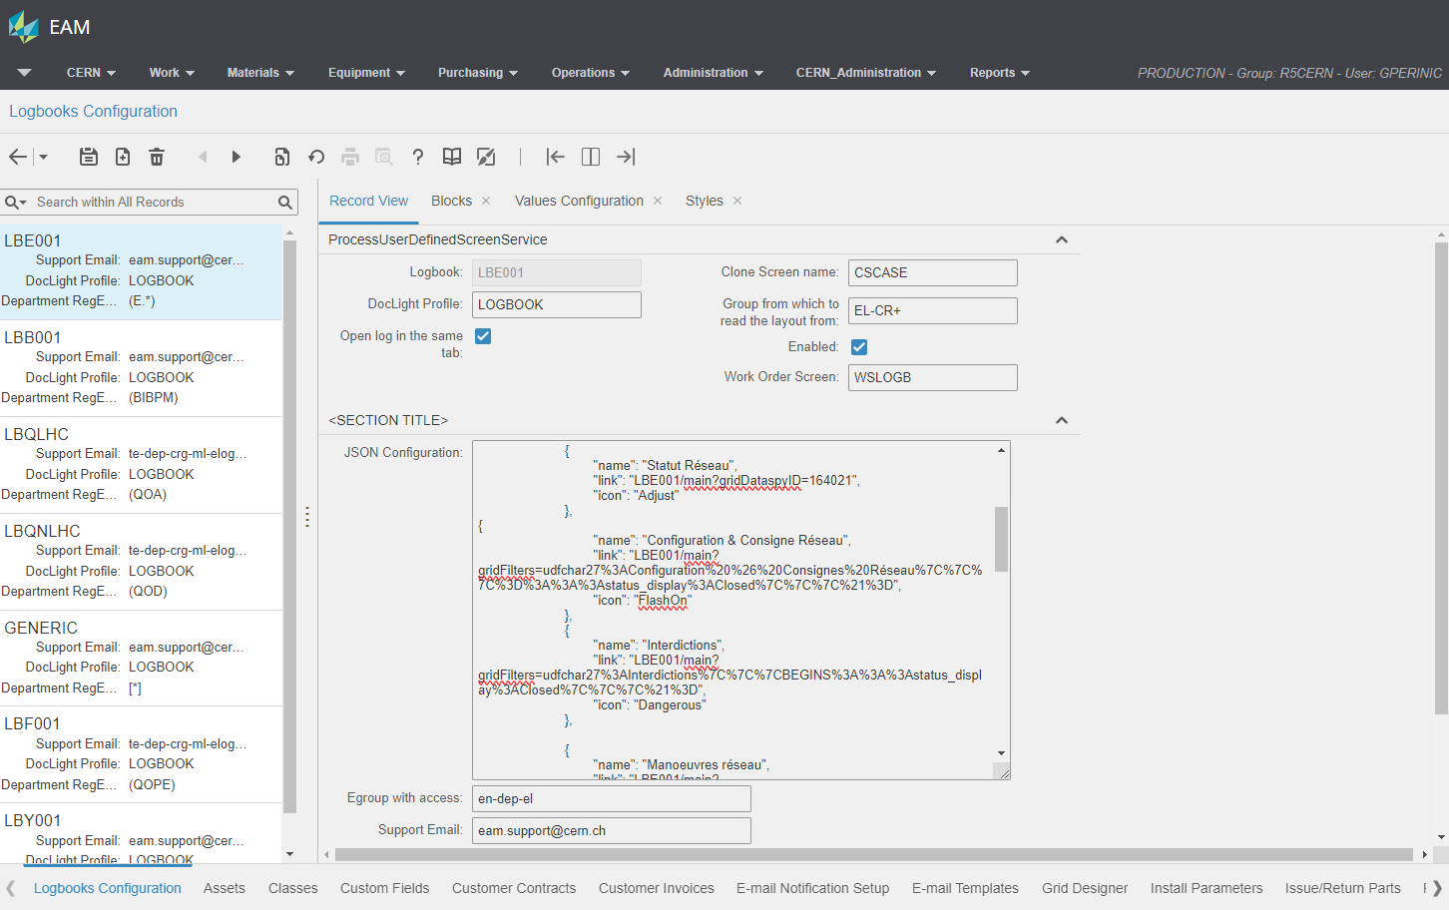
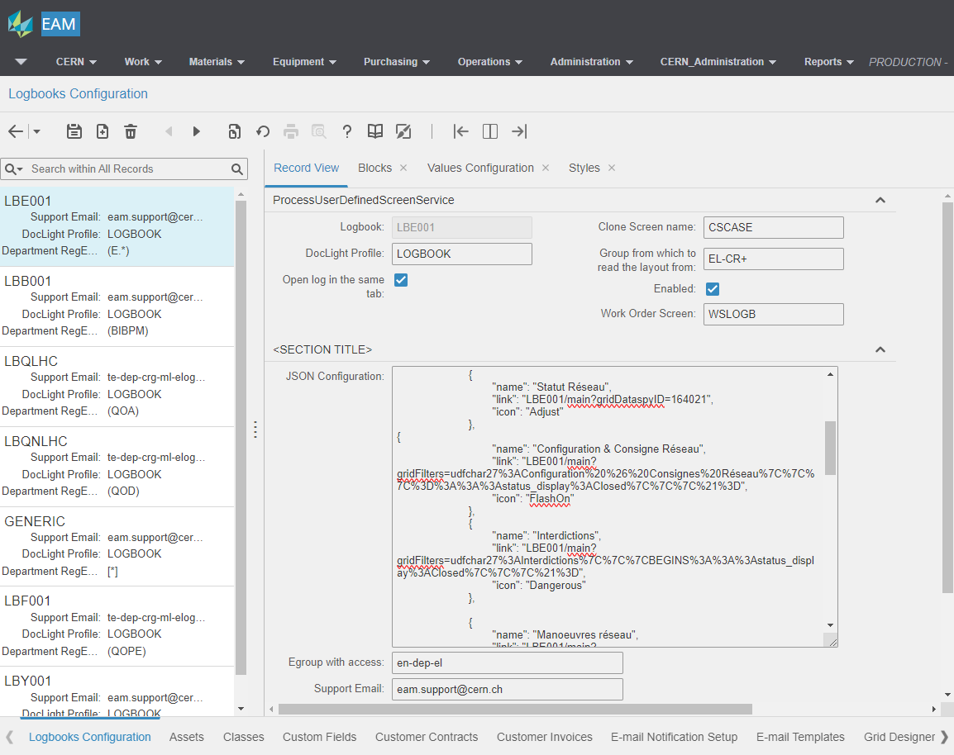
EAM (extended)
Industrial EAM system
Provides built-in functionality for a wide range of asset and maintenance management tasks
Ensures data quality by providing an extensive set of business rules
Provides webservice interface
Is used by power users and by admins for all configuration and administration tasks

Slide 17
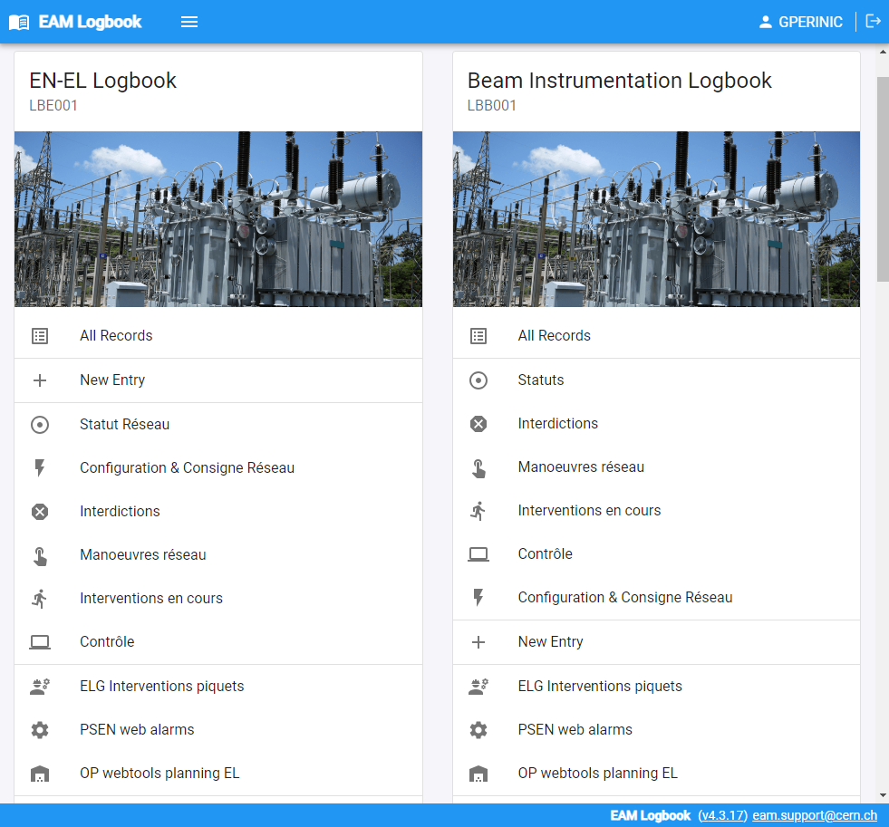
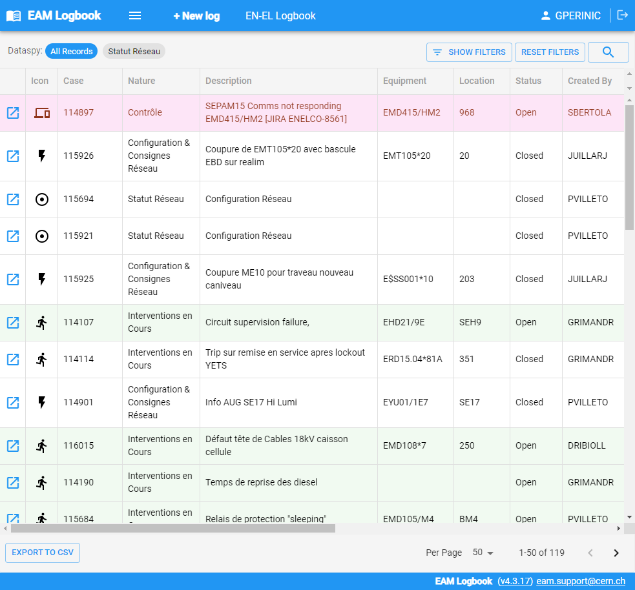
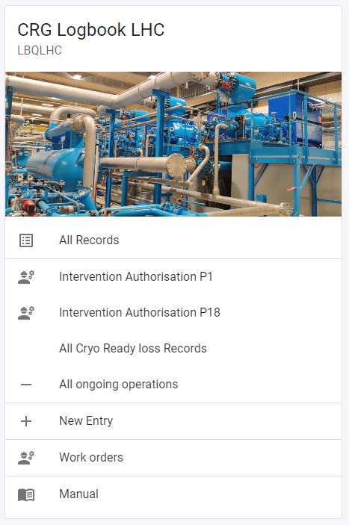
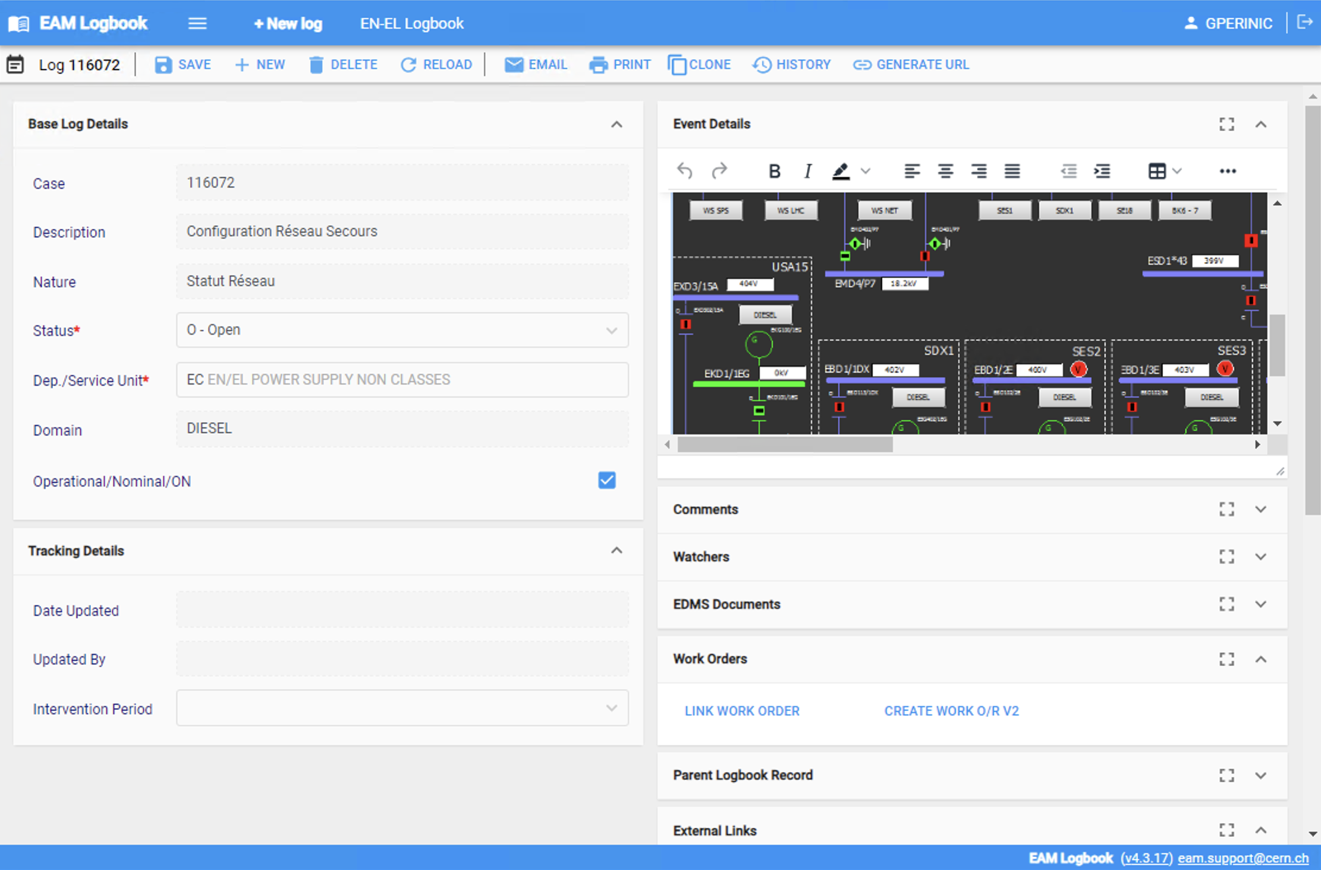
Logbook
Logbook for the technical domain
Registration of operation related observations
Shift management
Recording of system failures
Initiation of work orders

Slide 18
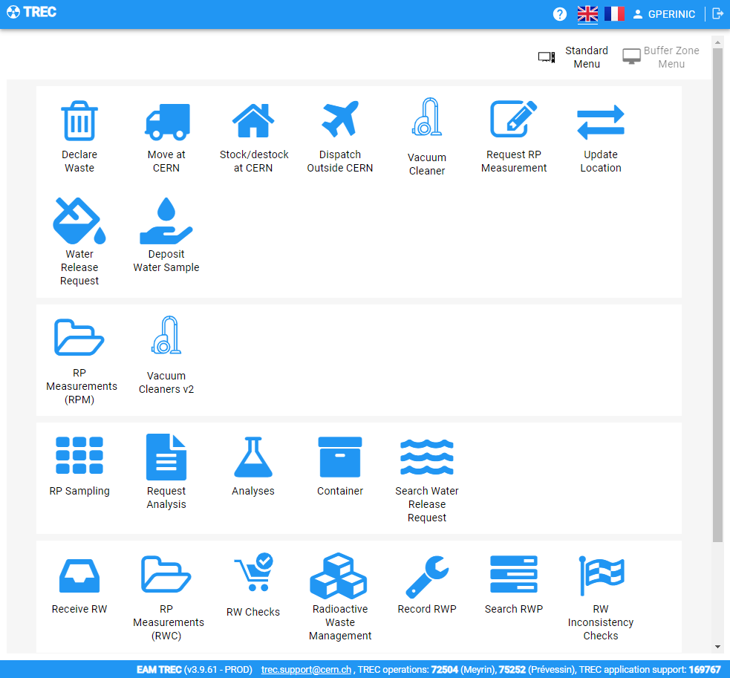
TREC
Workflows for radioprotection
Registration and management of measurements on equipment leaving the accelerator complex
Radioactive waste storage and handling management
RP analysis management
Water release management
RP vacuum cleaner rental management
Requestor interfaces with data entry wizards

Slide 19
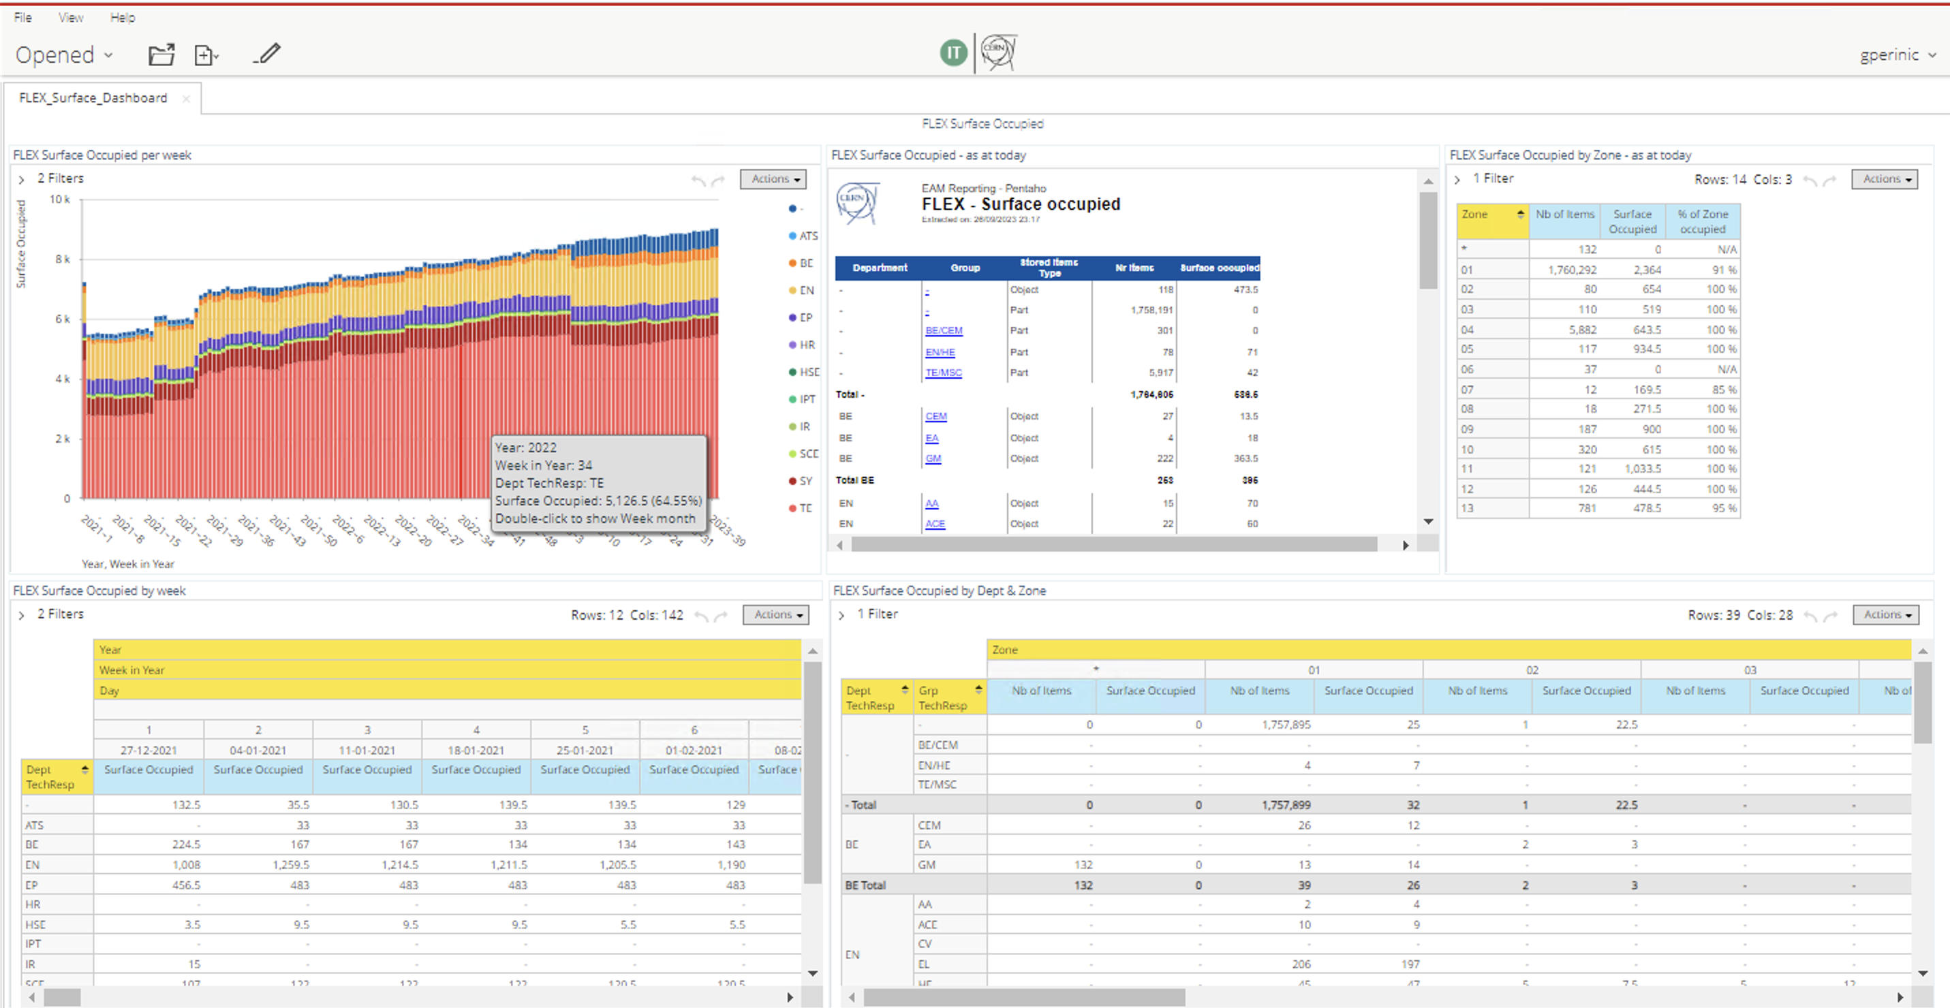
Pentaho
Open source reporting tool
There will be a presentation giving more detail by Fabio Alfeo this afternoon.

Slide 20
My questions
To CERN colleagues
Where are the current pain points in the digital thread for the lifecycle of physical assets?
What functionalities are required to master the LS3 (long shut-down 3)?
How can we assist you even further in making use of the collected data?
To EAM users outside CERN
What are our common needs for the enhancement of EAM that might be easier to obtain if we voice them together?
What can CERN do for the community?
What functionalities could we develop together?

