Slide 1
The journey to maintenance effectiveness 5th Asset & Maintenance Management Workshop ESS – Lund
M.Chiodi, D. Gain / CERN - EN-CV
28.09.2023

Slide 2
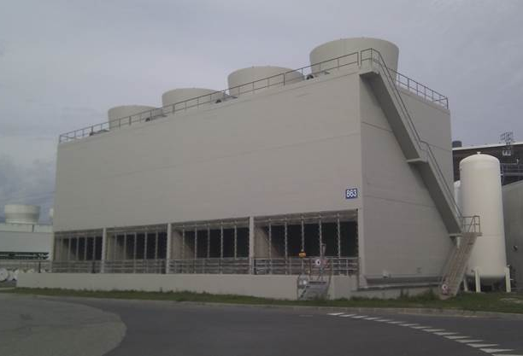
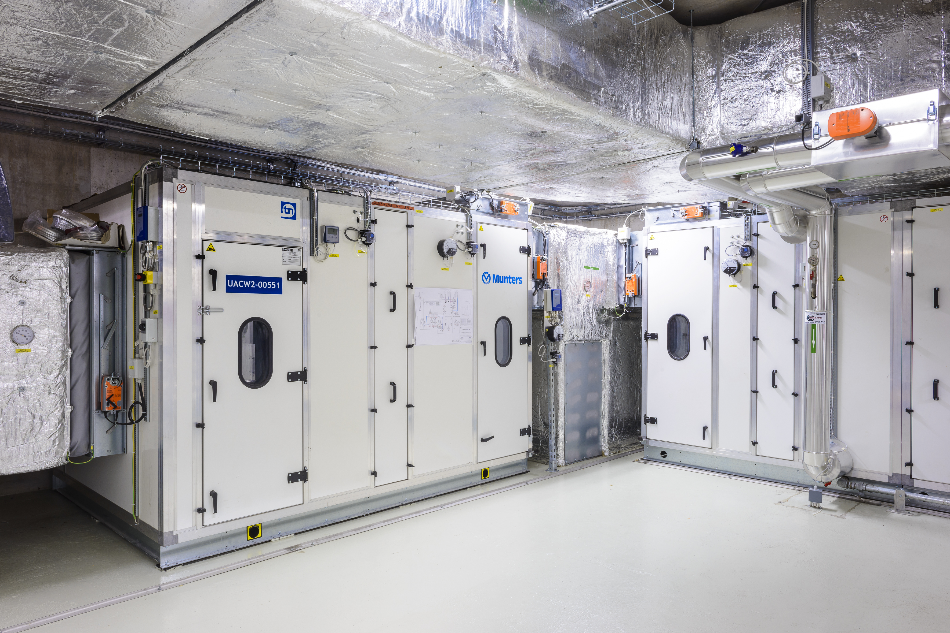
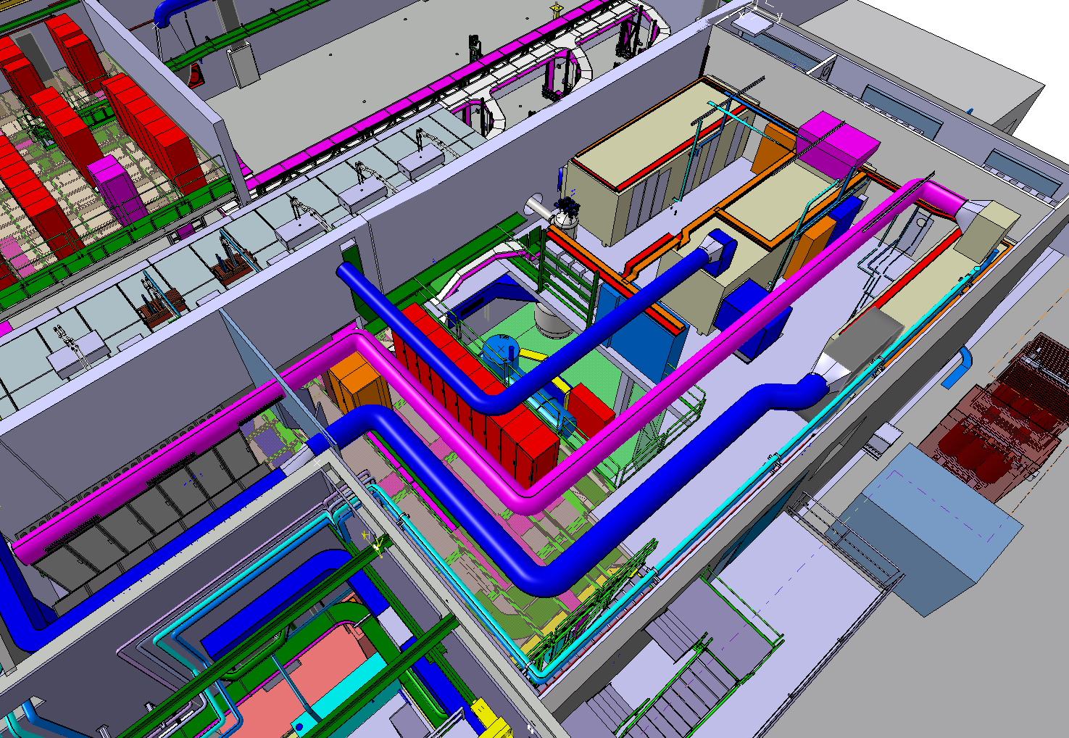
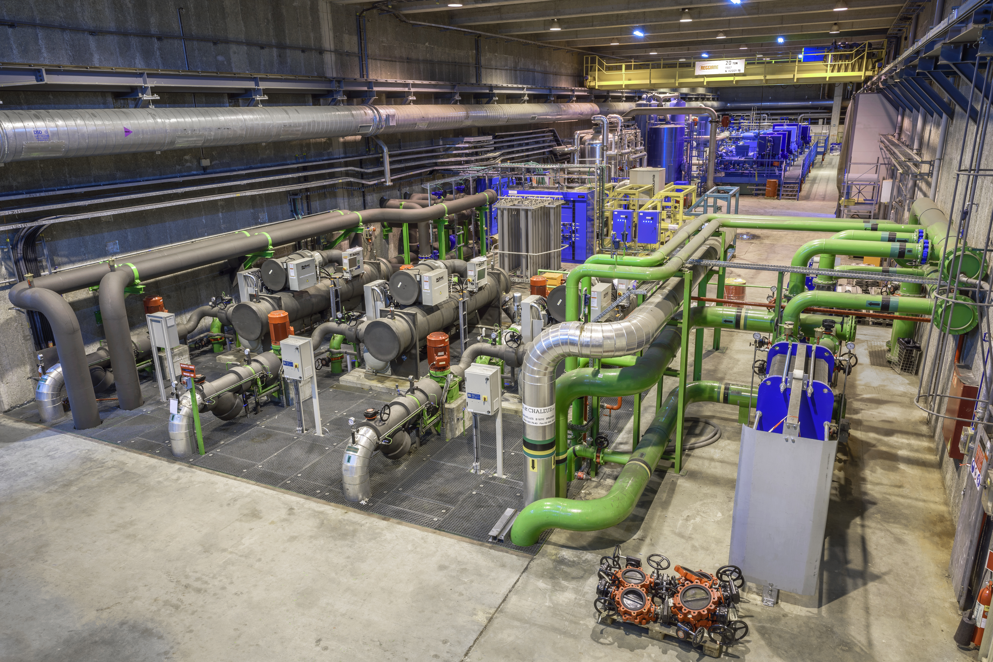
The Cooling & Ventilation Group (CV) at CERN
The CV Group is responsible for the design, installation, commissioning, operation and maintenance
of the industrial ventilation, pumping stations, cooling and fluid distribution systems for all accelerator complex and its experimental areas.

Slide 3
For over 30 years, the CV Group
has been using an Enterprise Asset Management System
to manage, plan and monitor its day-to-day operation and maintenance activities
through the installation’s life cycle.

Slide 4
EAM tools used
EAM Light
CERN

Slide 5
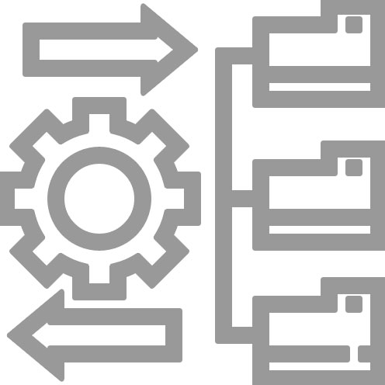
CV EAM usage and numbers
Equipment inventory/tracking
Maintenance & works management
Spare parts management
Documents management (EDMS)
Contracts management
Statistics

Slide 6
CV EAM usage and numbers
Equipment inventory/tracking
Maintenance & works management
Spare parts management
Documents management (EDMS)
Contracts management
Statistics
Objects
Assets | 4 765
Functional Positions | 128 886
Systems | 1 986
Work Orders
Work Orders registered | 260 000
Work Orders processed / year | 8 000
Spare Parts
Spare Parts catalogued | 20 000
Spare Parts in Store | 132 000
Documents
Linked Documents | 40,835
Users | 148
CV members | 80
External Contractors | 68

Slide 7
Equipment implemented in EAM over the years

Slide 8
Equipment implemented in EAM over the years

Slide 9
AS
IS
Structures not homogeneous
Different coding used depending on the generation of the installation
Inventory of some installations not fully implemented
Criticality not implemented
Maintenance procedures to create / review

Slide 10
AS
IS
Structures not homogeneous
Different coding used depending on the generation of the installation
Inventory of some installations not fully implemented
Criticality not implemented
Maintenance procedures to create / review
Daily usage of the tool not smooth
Installations data extract not straight forward
Historical data not easily accessible
KPI reporting not automatised
Breakdown analysis difficult to perform
Maintenance tasks not fully performed by the contractors

Slide 11
AS
IS
TO
BE
Structures not homogeneous
Different coding used depending on the generation of the installation
Inventory of some installations not fully implemented
Criticality not implemented
Maintenance procedures to create / review
Overcome current CMMS limitations with homogeneous, standard and complete data
Set up specific and standard functional hierarchies
Specify and implement new maintenance task plans including criticality ranking
Improve maintenance contractors' performance monitoring
Ease data exploitation (budget, ISO50001, maintenance reports, etc…)

Slide 12
AS
IS
EAM
re-engineering project
TO
BE

Slide 13
EAM
re-engineering project
maintenance effectiveness

Slide 14
The project road map
Analysis of the existing systems
New hierarchical structures HxGN EAM + (Relationship)
System / Parent Positions / Positions - Assets
Filtering criterias (Class / Categories)
Installations criticality study & ranking
New maintenance tasks including failure analysis study results (Préventive vs conditional)
Spare parts management policy & equipment material list
« Maintenance Route » adjustment (due to new structures)
Review of the preventive maintenance scheduling
Annual launch of maintenance work orders (Gantt planning)
KPI’s and continious improvement (PDCA)

Slide 15
System structure Ex: Air treatment B367 – P&ID
5 different Systems:
Ventilation and smoke extraction system
Air handling unit + cooling element water supply
Chilled water production unit + distribution circuit
Power & control electrical cabinets
Process Control Architecture

Slide 16
System structure Ex: Air treatment B367

Slide 17
In the EAM Light tool

Slide 18
System classification
#1 - Type of « Process »
#2 – Primary function
Fluids:
Raw water
Cooling water
Hot water
Gas
...
Air treatment:
Clean room
Electrical sub-station
Tertiary
Technical building
Machine
IT room
Technical galllery
...
Hydraulic:
Production
Distribution
Production & Distribution
Sump
Waste water pit
...
Ventilation:
Air handling unit
Air extraction unit

Slide 19
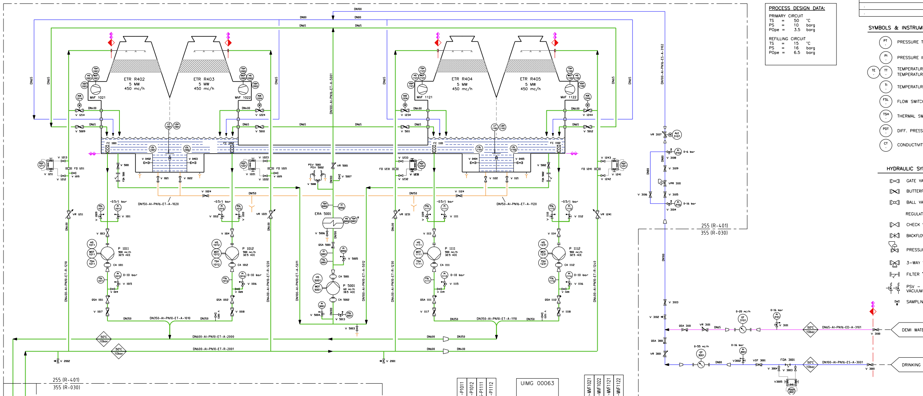
Parent position structure Ex: Cooling Towers B255

Slide 20
Parent position structure

Slide 21
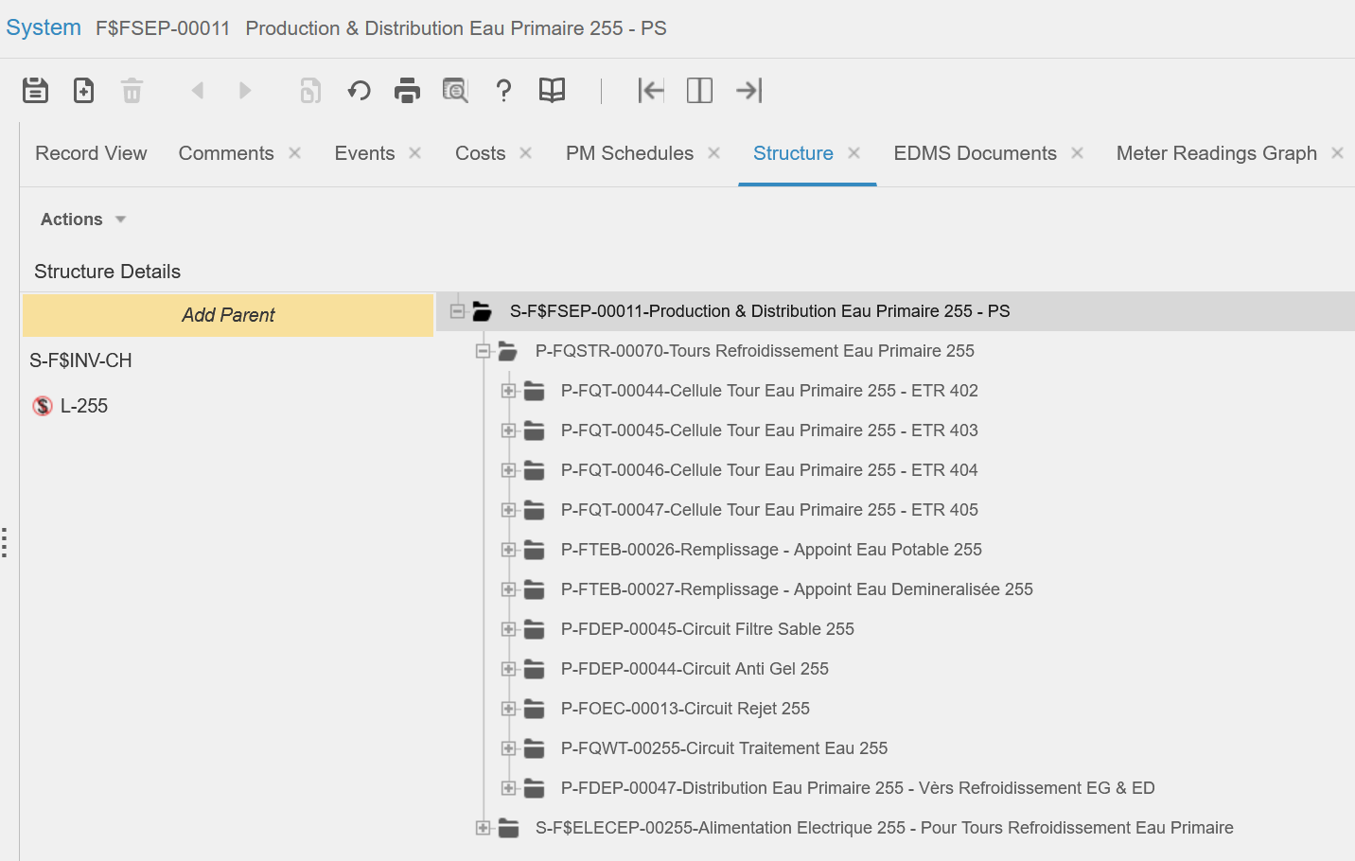
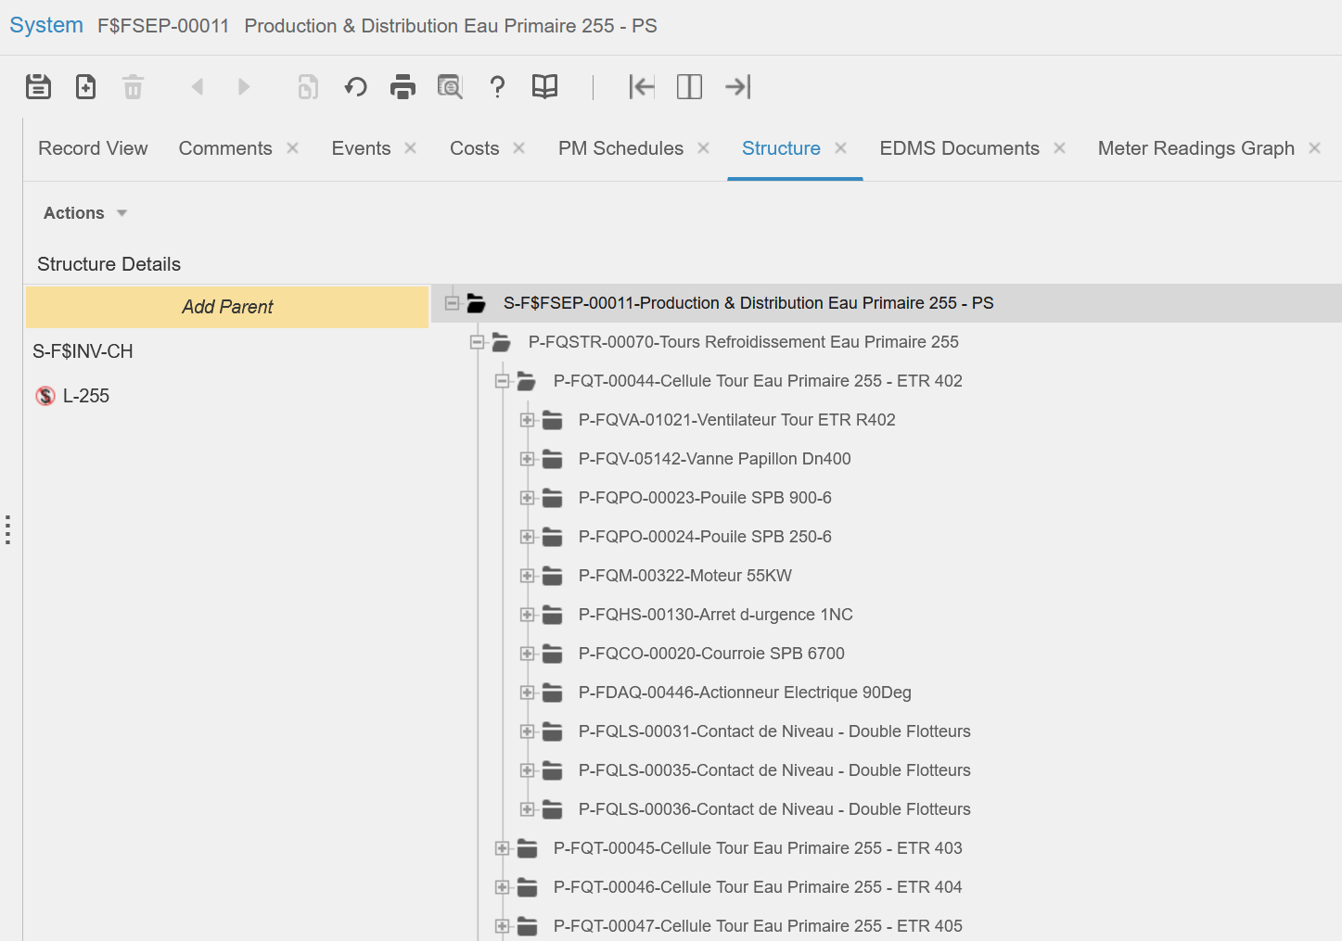
CMMS hierarchy details
Location / System / “Top Parent” / Parent Position
Parent Position / Position or Asset

Slide 22
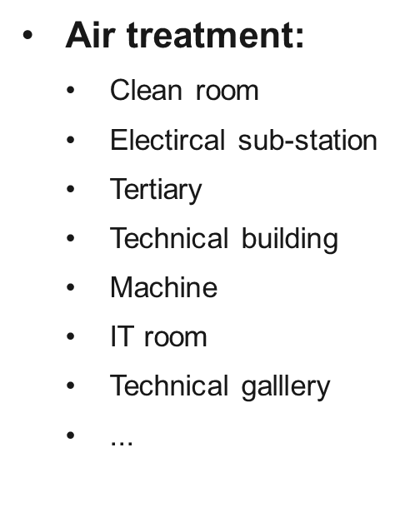
Parent position classification
#1 - Type of « Process »
#2 – Function performed
Fluids:
Raw water
Cooling water
Chilled water
Mixed water
Demineralized water
Hot water
Gas
...
Air treatment:
Ventilation simple flow unit
Ventilation double flow unit
Déshumidification Unit
Ventilation extraction unit
Air Mixing unit
...
Hydraulic:
Production
Distribution
Production & distribution
Sump
Waste water pit
Cooling tower
Water filling panoply
…

Slide 23
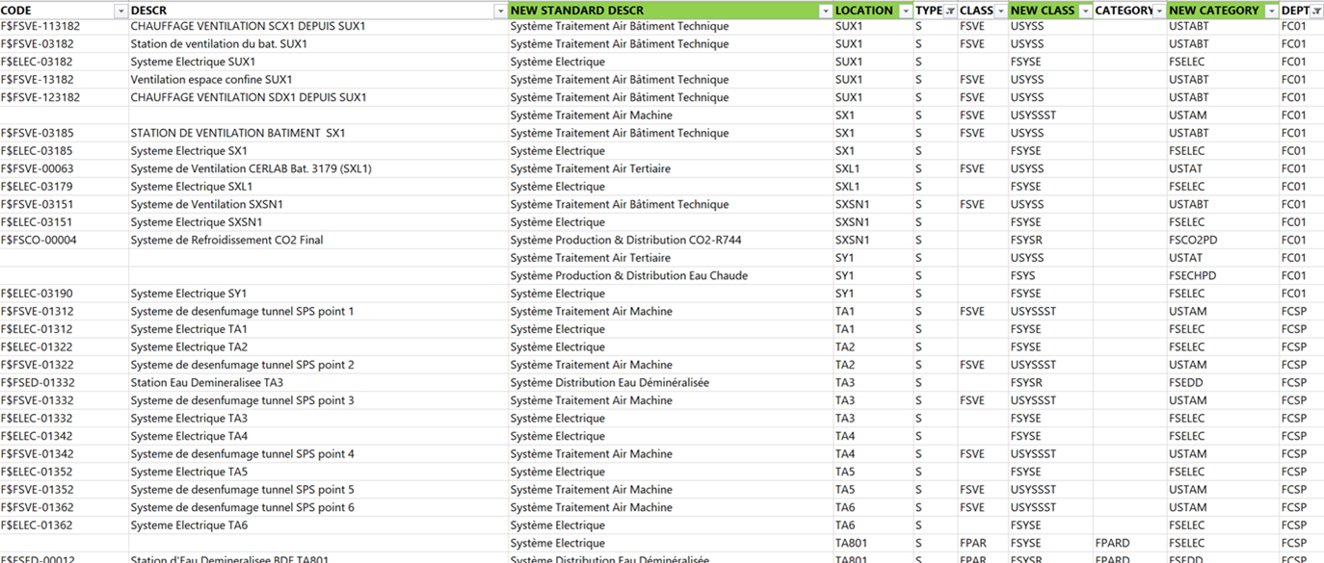
Sorting easily…
Systems:
Hydraulic / Ventilation / Electric
Function performed by the systems
Physical machine location (surface / underground / surface for underground)
Acronyms designed for easy searching
A standardized description of systems and parents

Slide 25
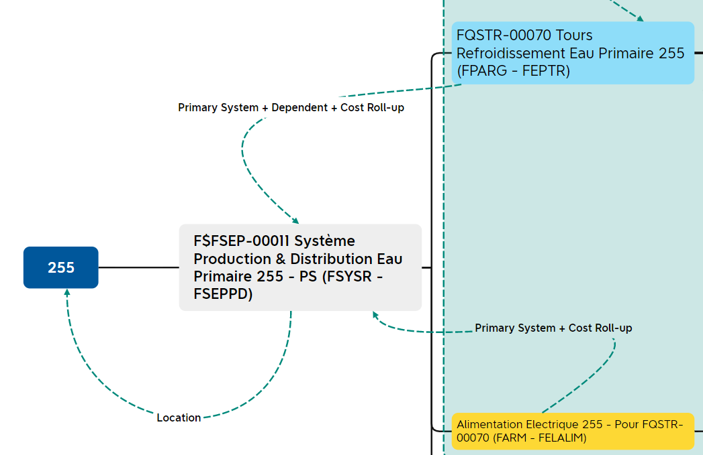
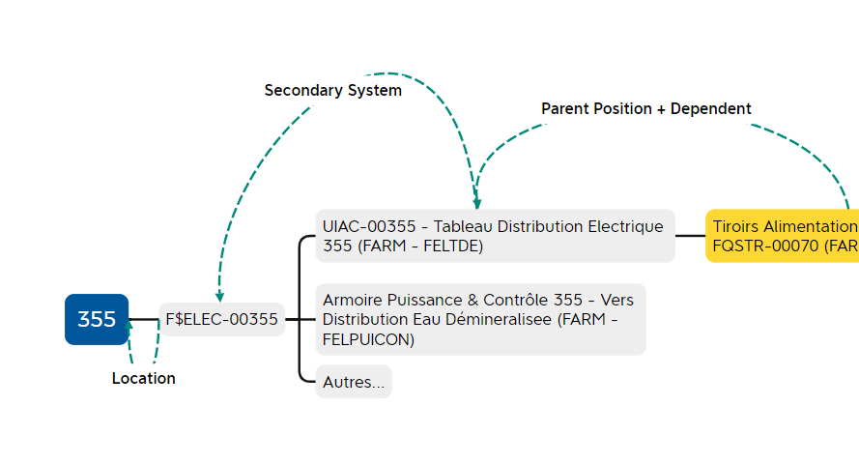
Relationship between objects
Event historic:
Location
Primary System position
Secondary System position
Parent position
Dependent
Budget:
Cost Roll-up
Working together:
Powered by...
Controlled by...

Slide 26
Criticality definition

Slide 27
Conclusions
First phase observations:
Project is progressing…
Operation requirements need to be challeged due to CMMS implementation constraints;
Be focused on our final needs;
It takes some iterations to define correctly the classification criterias;
Consider «Systems» as sets of functions not equipments.
Definition of the functional structure standard rules – Done
Implementation of the new «phylosophy» is on going – It takes more time than expected…
Defining the criticality criterias specific to our of facilities;

