Slide 1
Digital spare part management in practice
Peter Jurcso CERN Engineering Department
26.09.2023

Slide 2
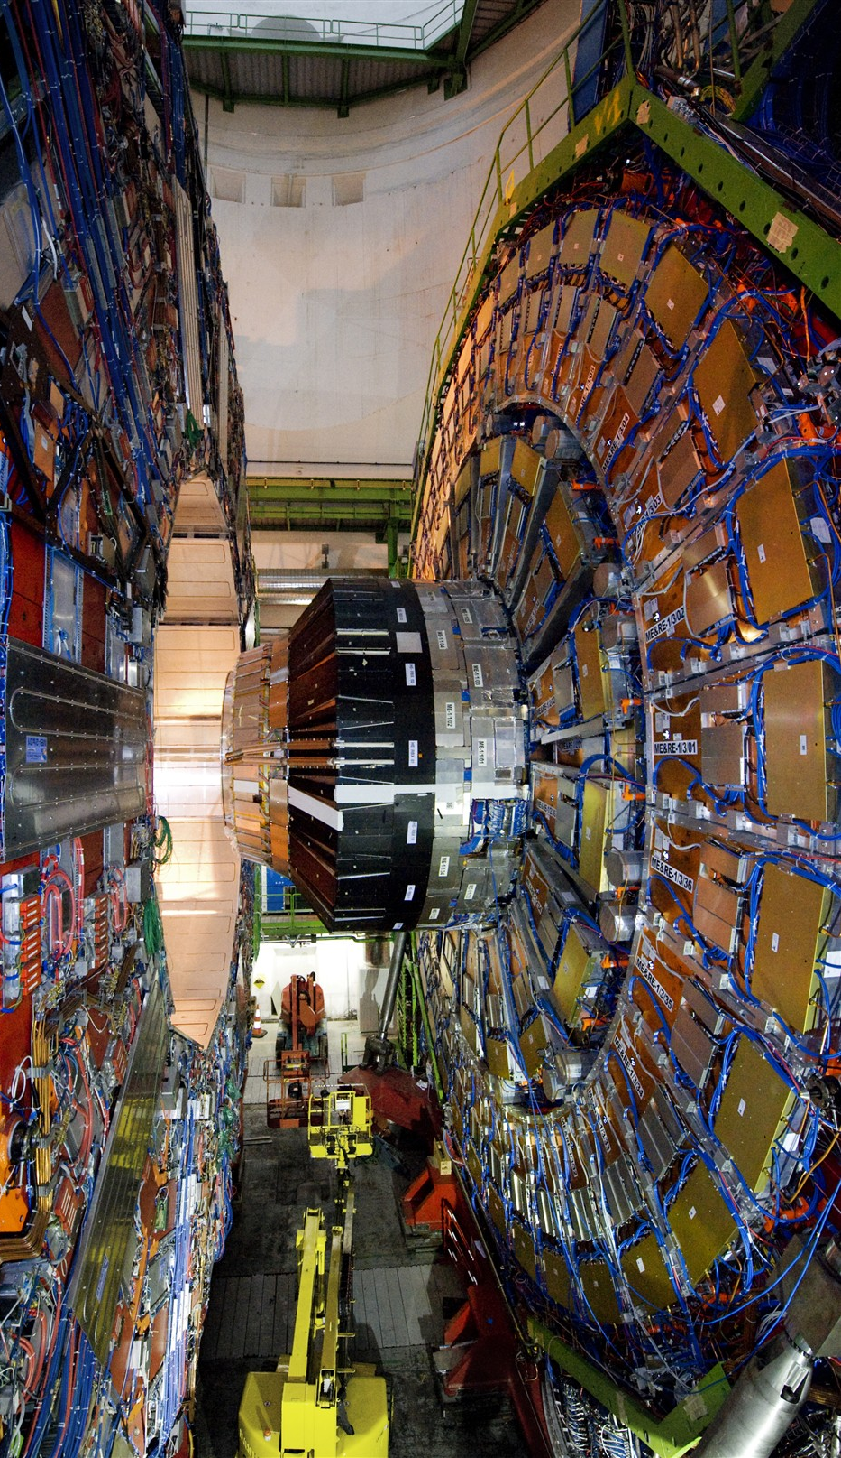
Data: The key to “Going Digital”
Digital Twins, Digital Realities, AR and AI will never unlock their full potential without managed quality data
Understand and focus on your data:
  Data Capture
  Data Quality
  Data Formats
  Data linked across systems
  Data managed over time

Slide 3
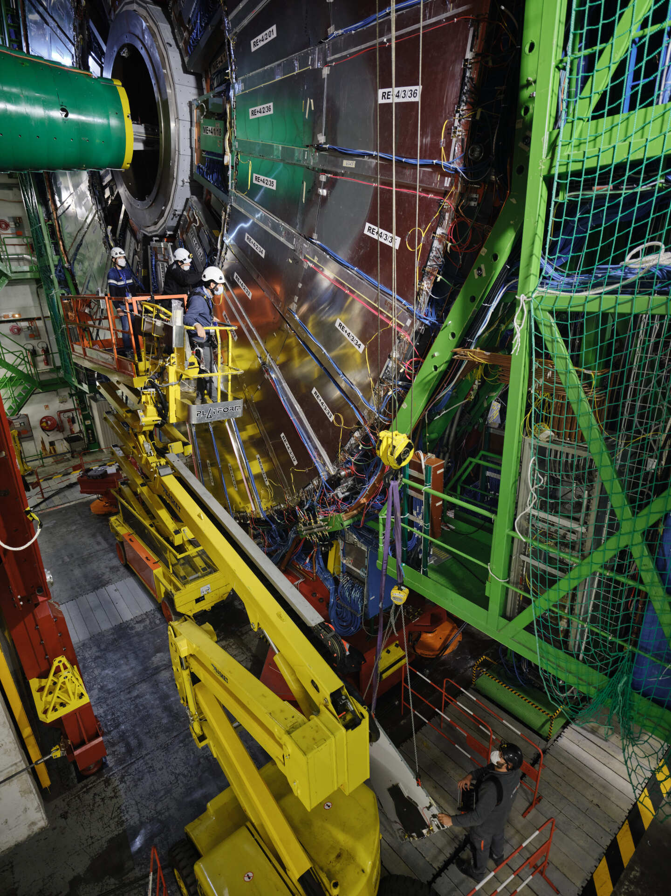
Data: The key to “Going Digital”
With large, complex and expensive assets with long lifecycles the real focus is the digital data
The software can change - the data stays
Our installations are often designed and built by one generation
Operated and maintained by the next generation
1989
Rapier
1994
R5
1998
MP5
2007
D7i
2009
Infor EAM
2022
HxGN EAM

Slide 4
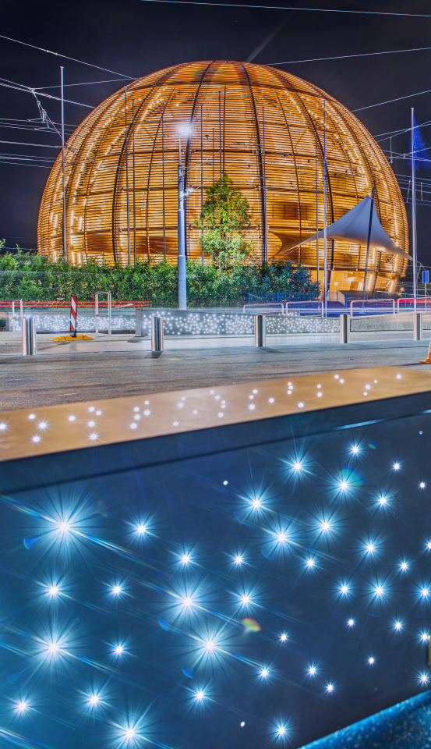
What is CERN?
CERN is the world’s largest research center for particle physics since 1954
Our mission is to provide scientists with tools to study the building blocks of matter and the origins of the universe.
How: By building and operating huge particle accelerators.
23 Member States
>10k People On-site
>80 Collaborating Countries
€1.5 bn Annual Budget (kr 17.8 bn)

Slide 5

The Large Hadron Collider
Located outside Geneva,
Switzerland
100 million components
27km circular tunnel
100m below ground
Speed of particles:
  99.999999% of speed of light
  11 000 revolutions / second
Cost: ~ €7.5 bn (~90bn kr)
CMS
ALICE
ATLAS
LHCb
Notes:
This is a map of the complex of main accelerators of CERN.
The dotted line is the French-Swiss border.
The 2 main CERN sites are Meyrin and Prévessin (as big, but not as built nor populated)
The PS is the tiny 600m ring on the Meyrin site, the SPS goes accross the border and the LHC takes all the space between Geneva airport and the Jura (dark green on the left).
The 4 red dots represent where the 4 detectors are located.

Slide 6
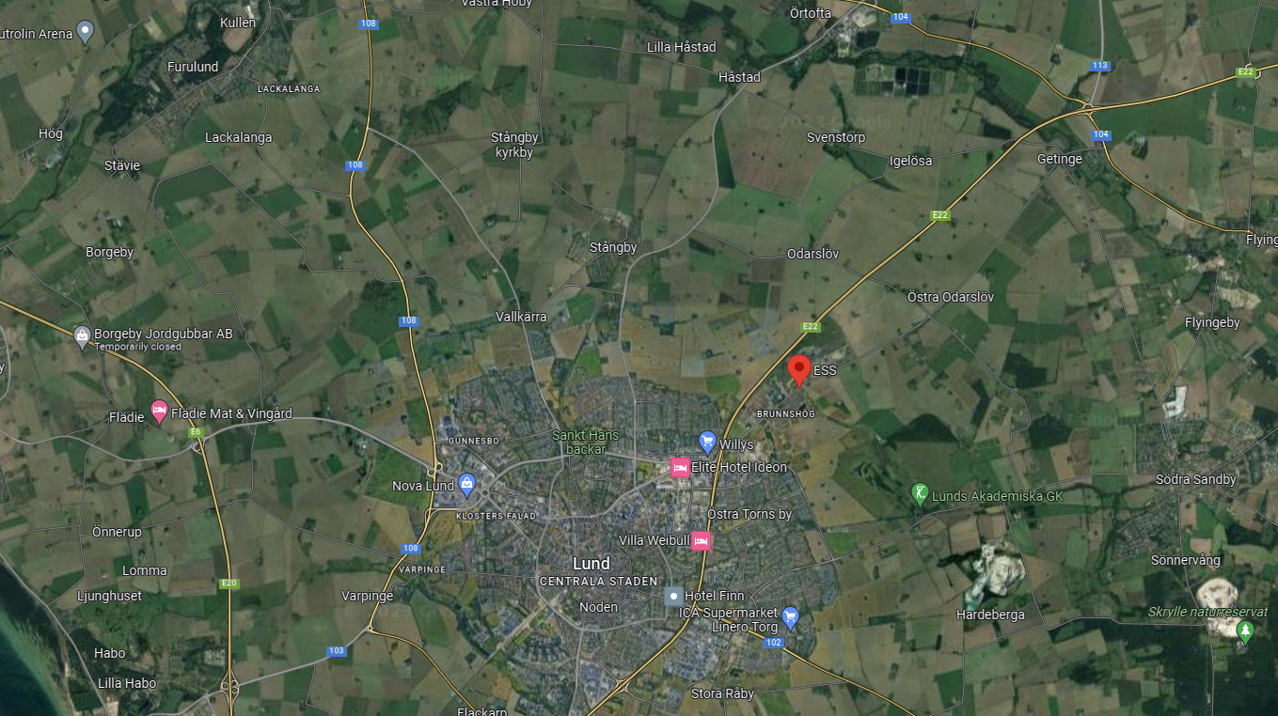

Slide 7







EAM at CERN in 2023
3.1 M Equipment
1.7 M Assets 1.2 M Positions 0.2 M Systems
4.6 k Classes 33 k Categories
2.3 M Document links
350 k Work Orders / Year
1 M Checklist Items / Year
3600 Annual Users
100 k Part References
150 k Store Transactions / Year
0 Customizations

Slide 8
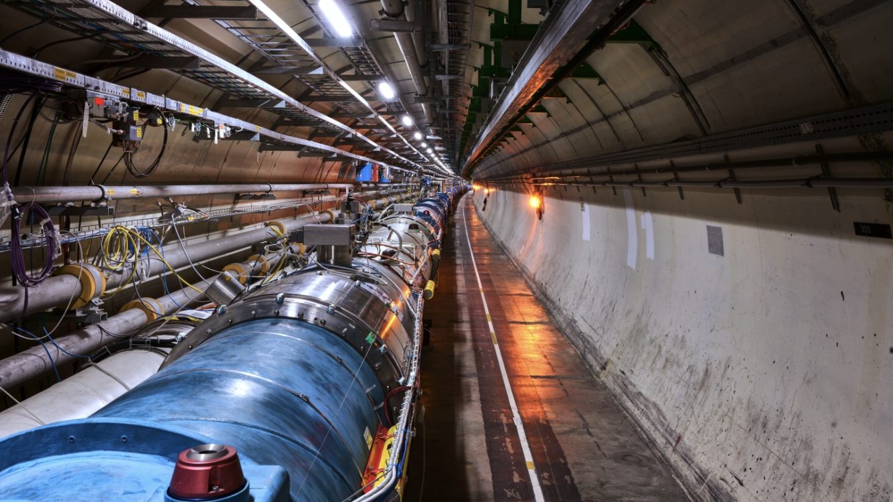
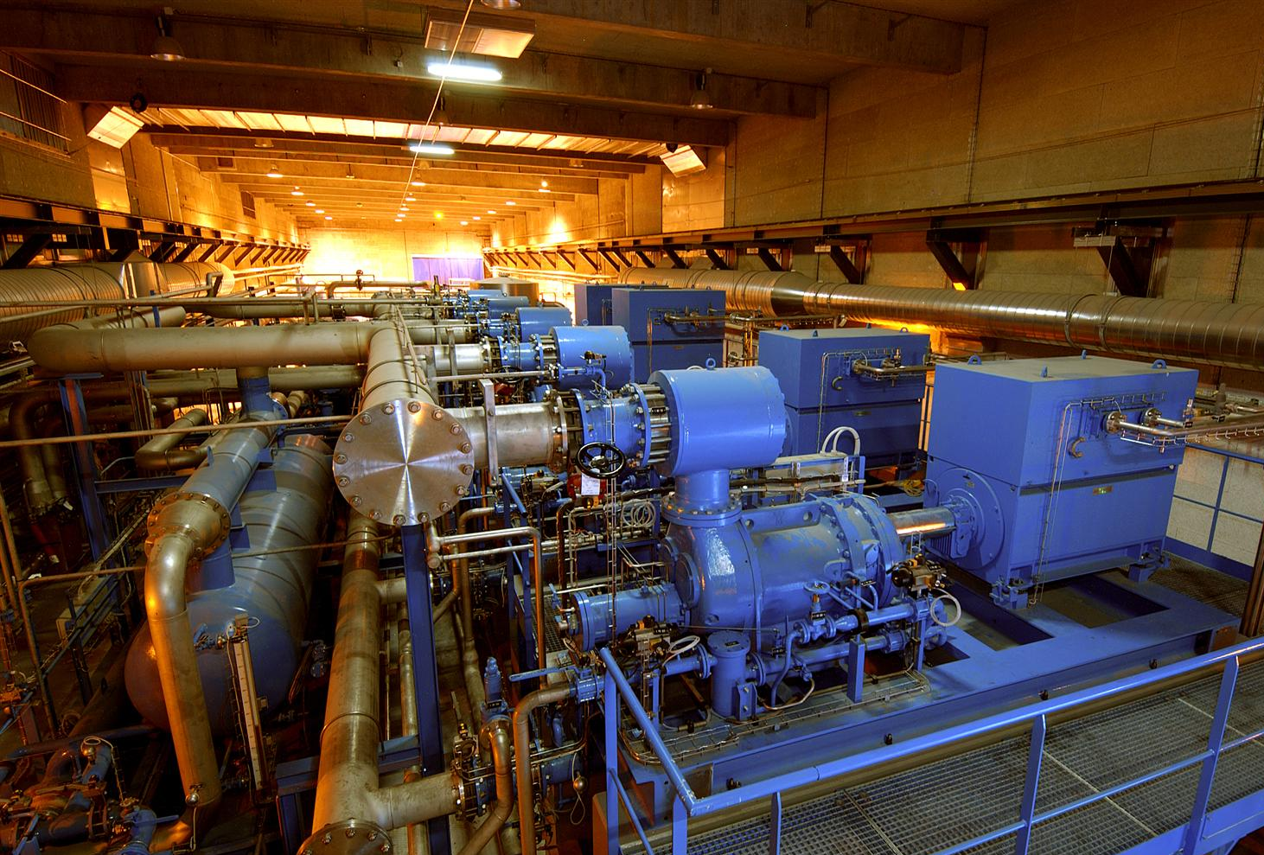
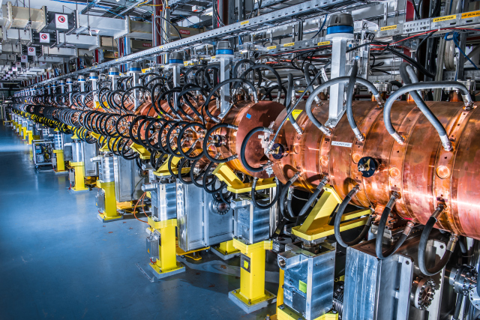
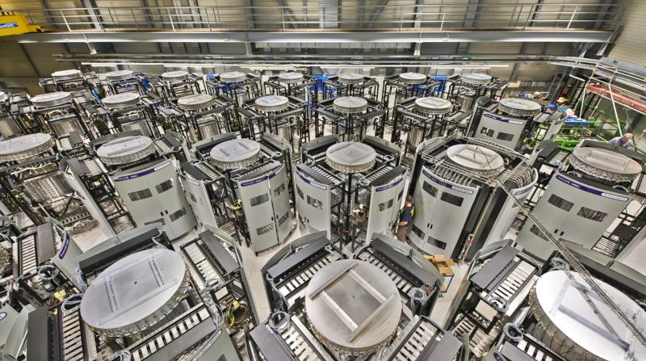
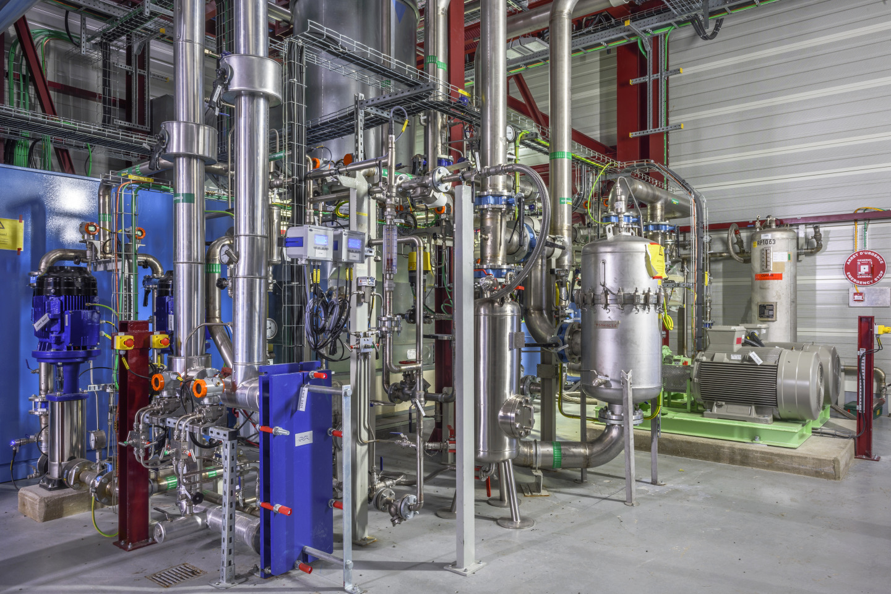
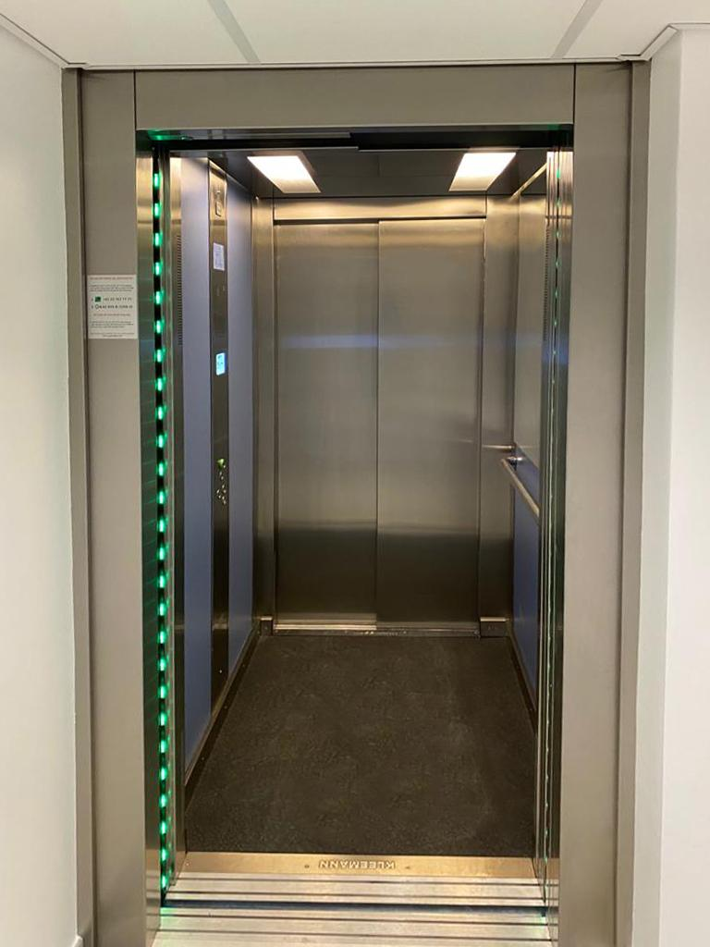
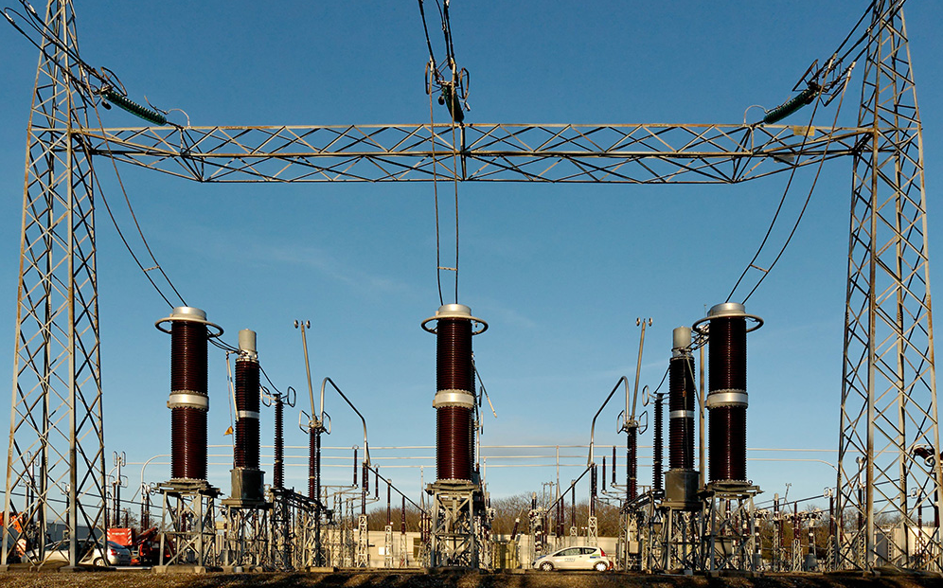
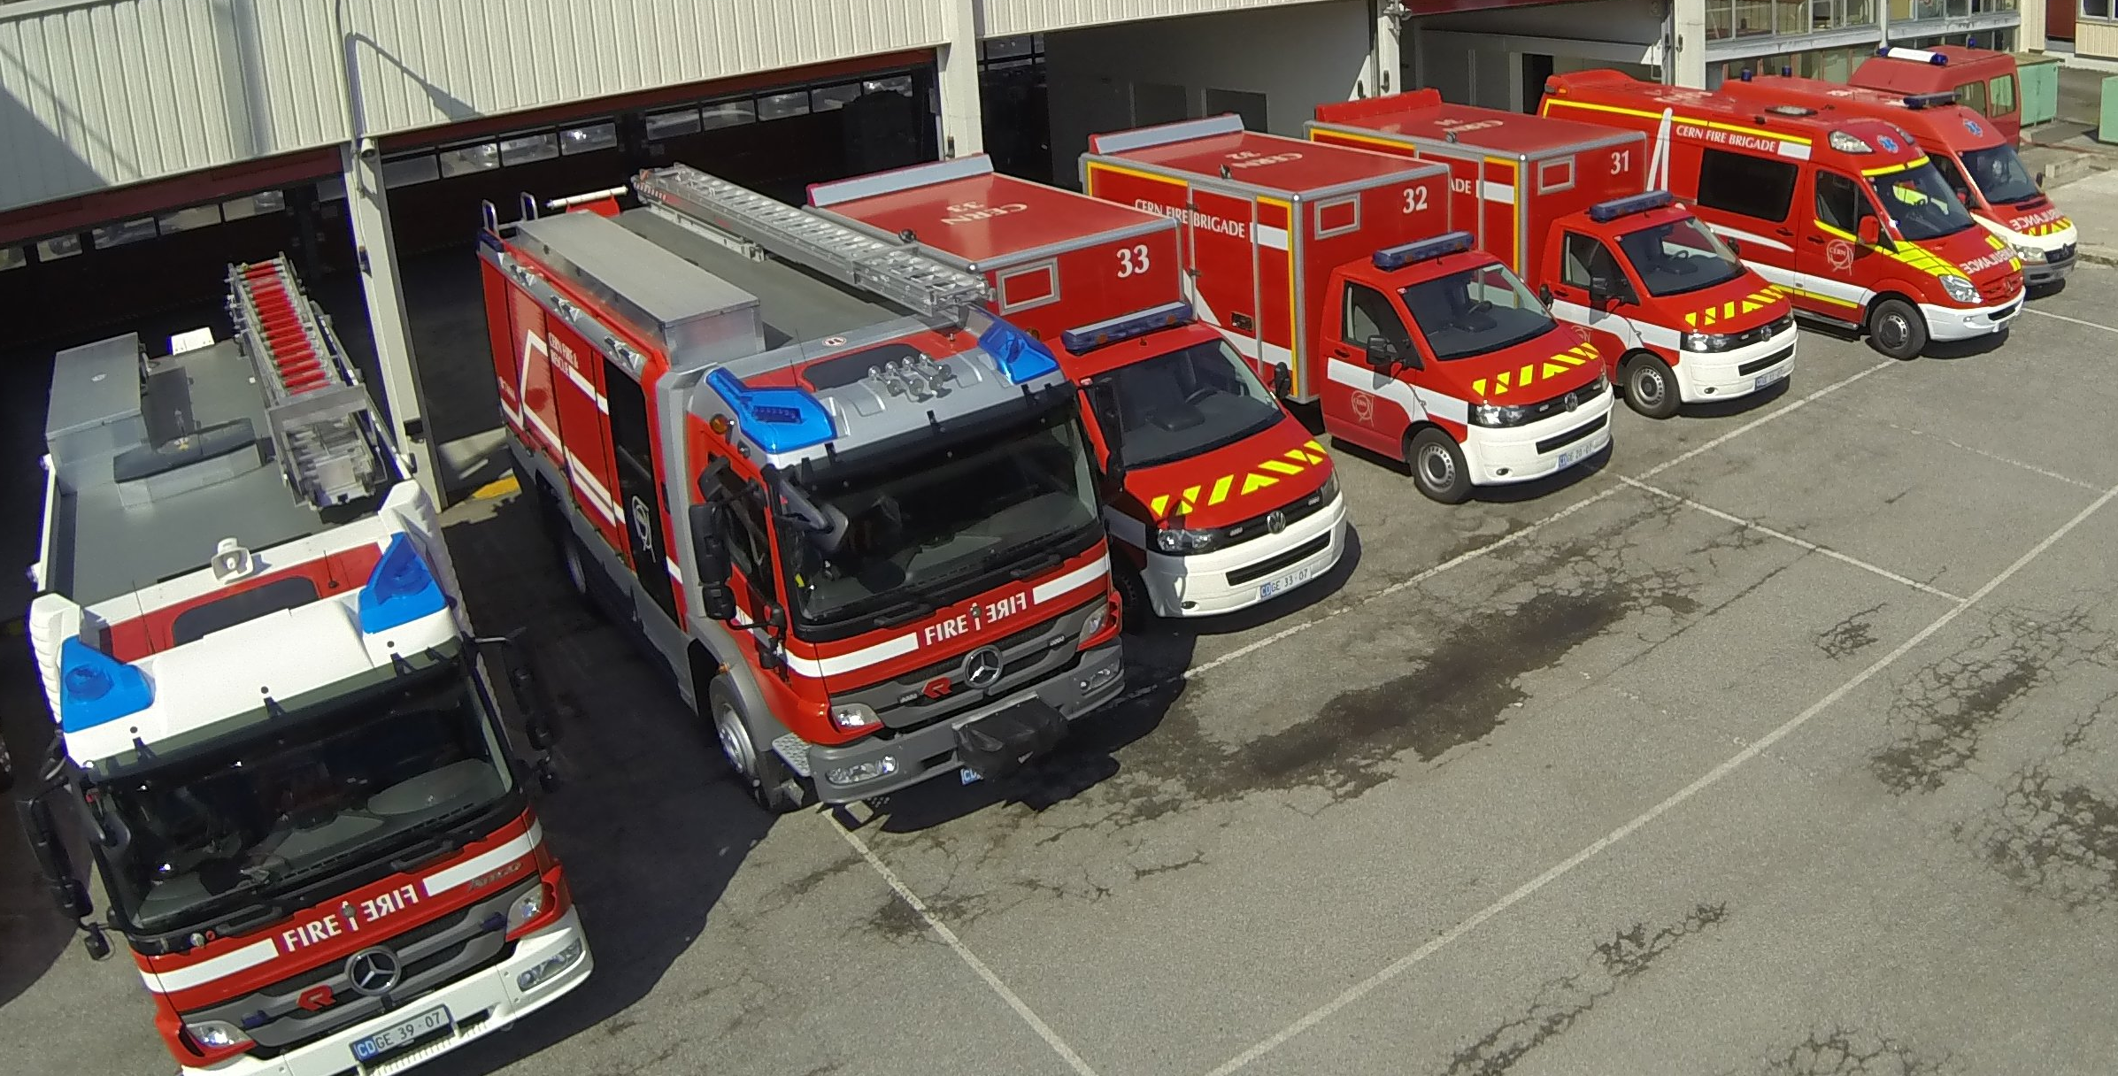
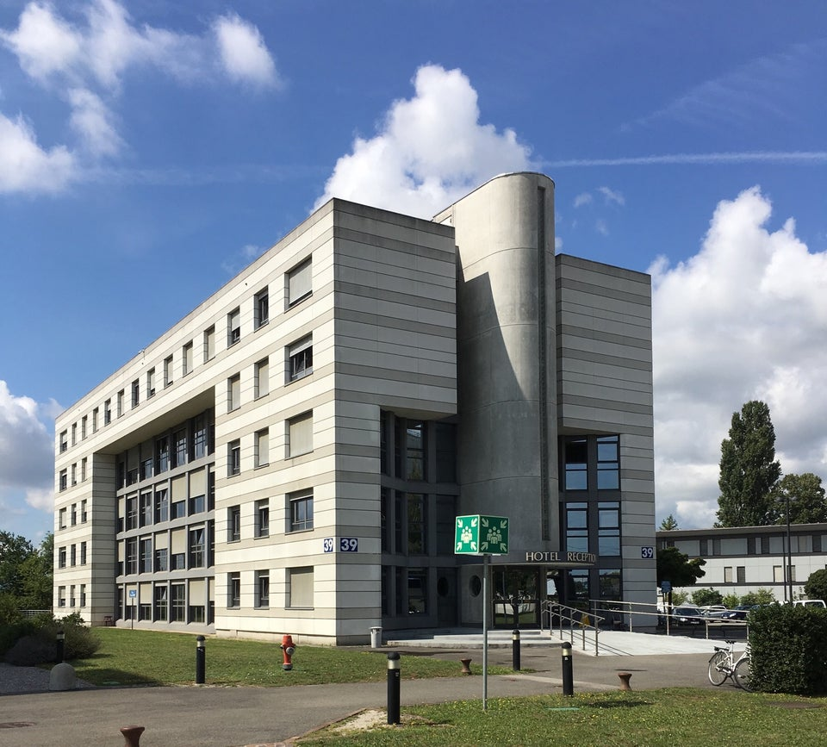
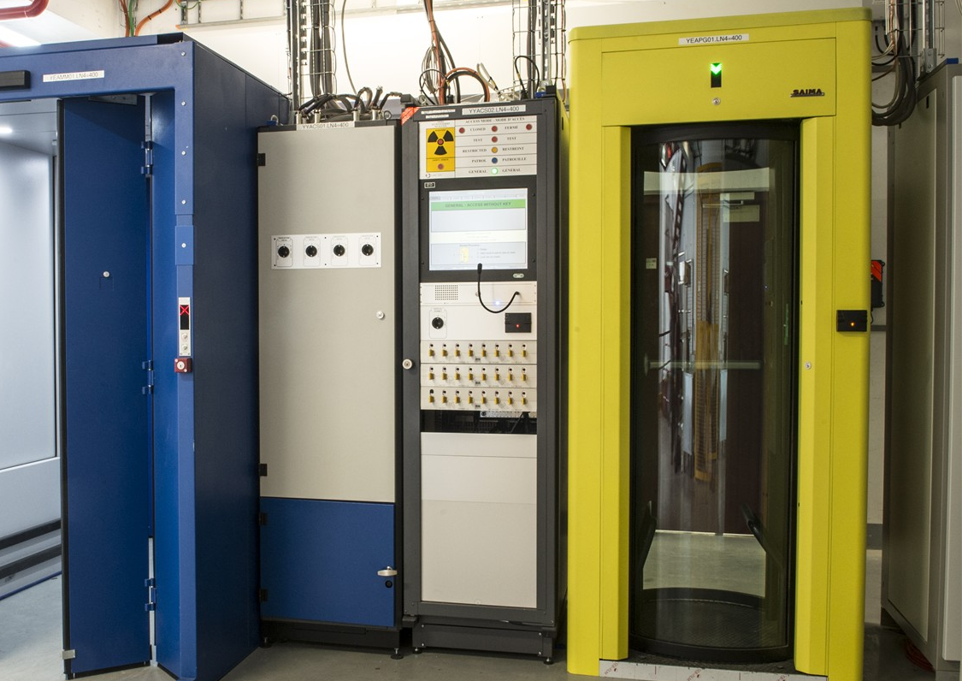
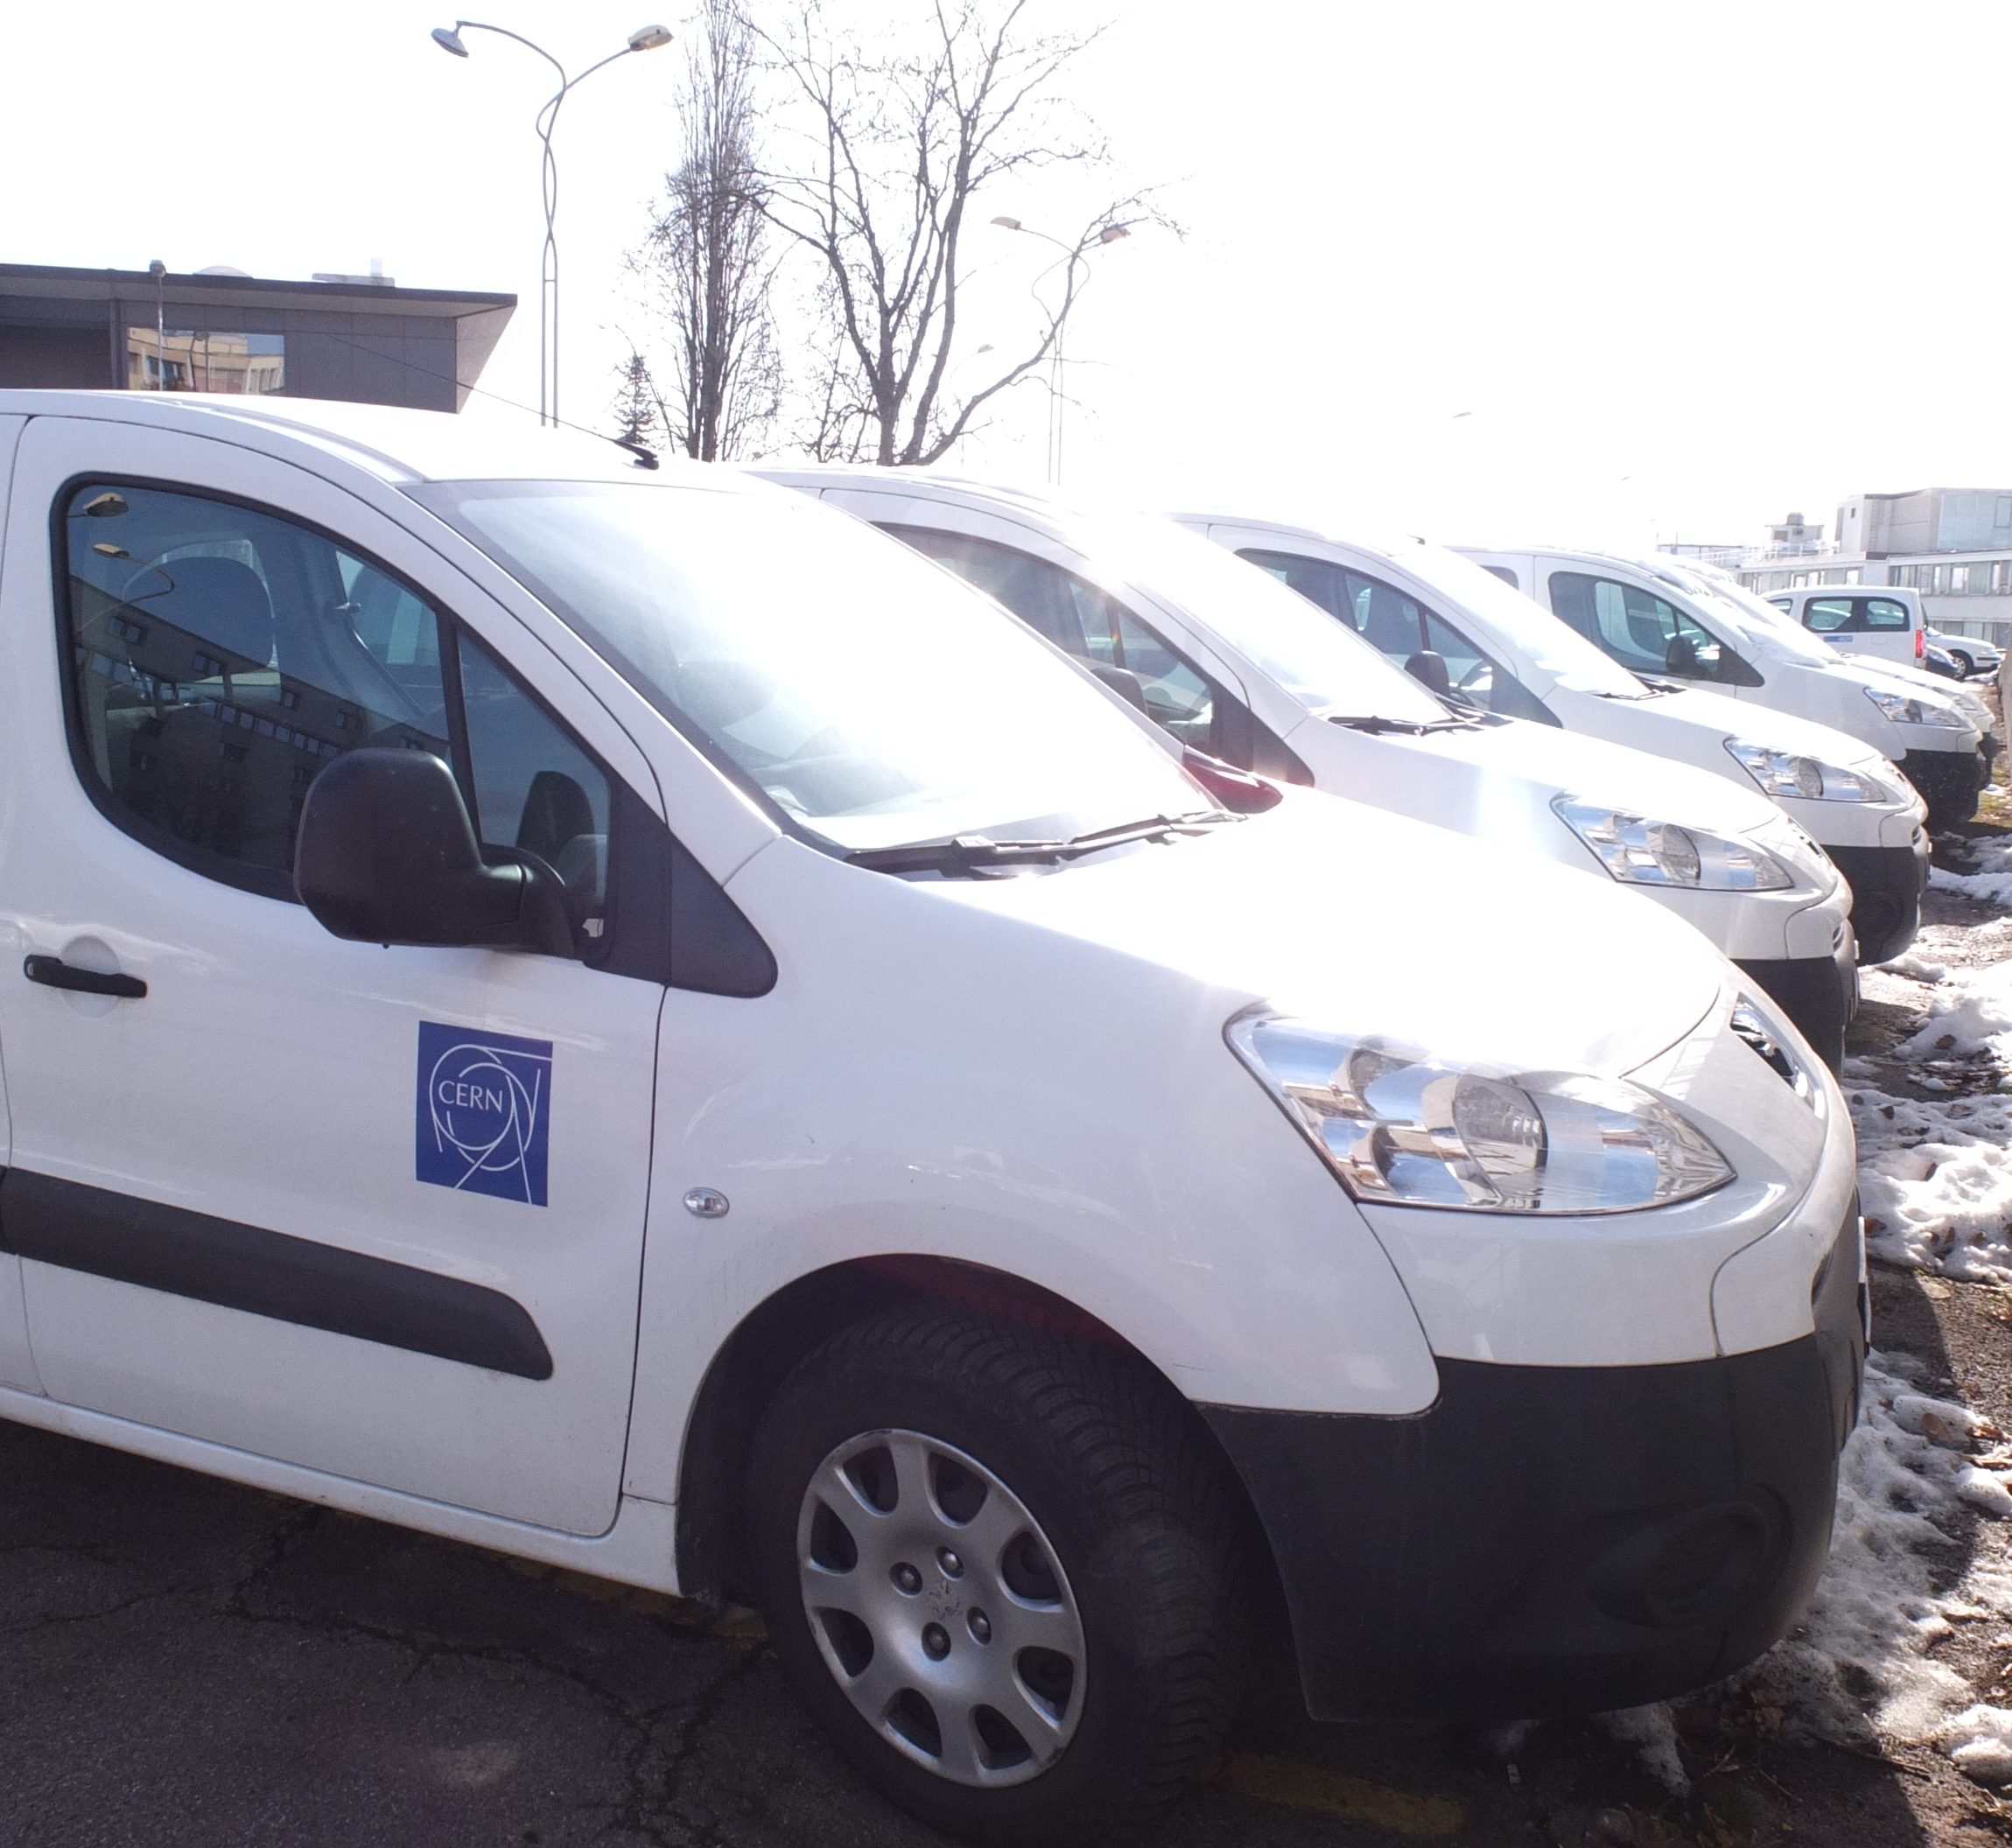
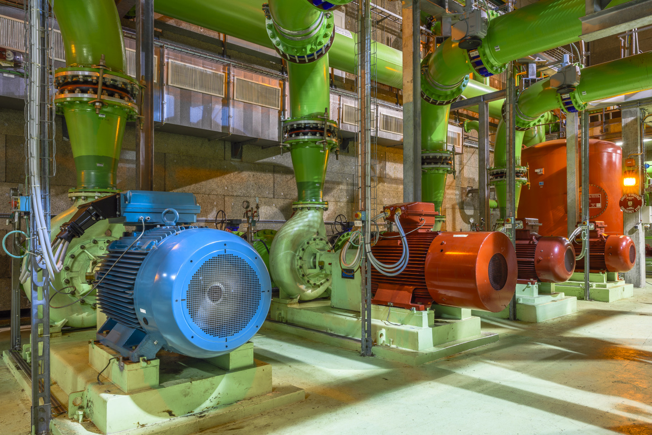
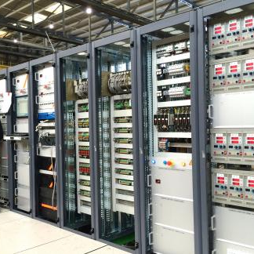

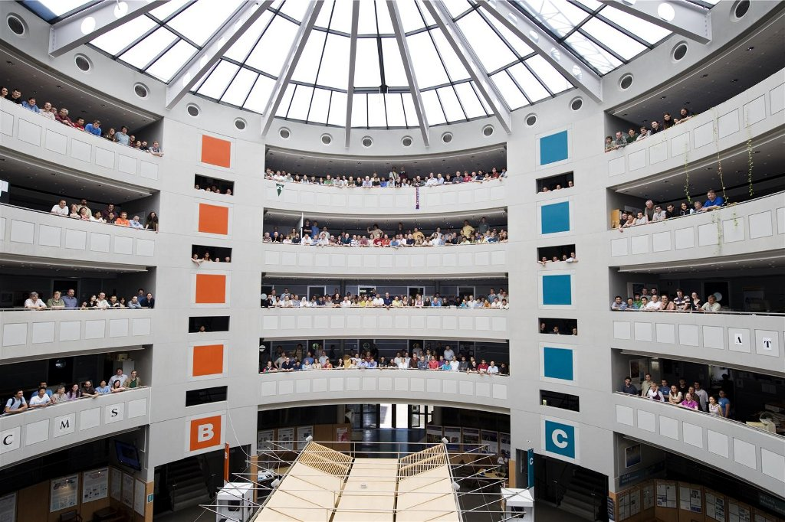
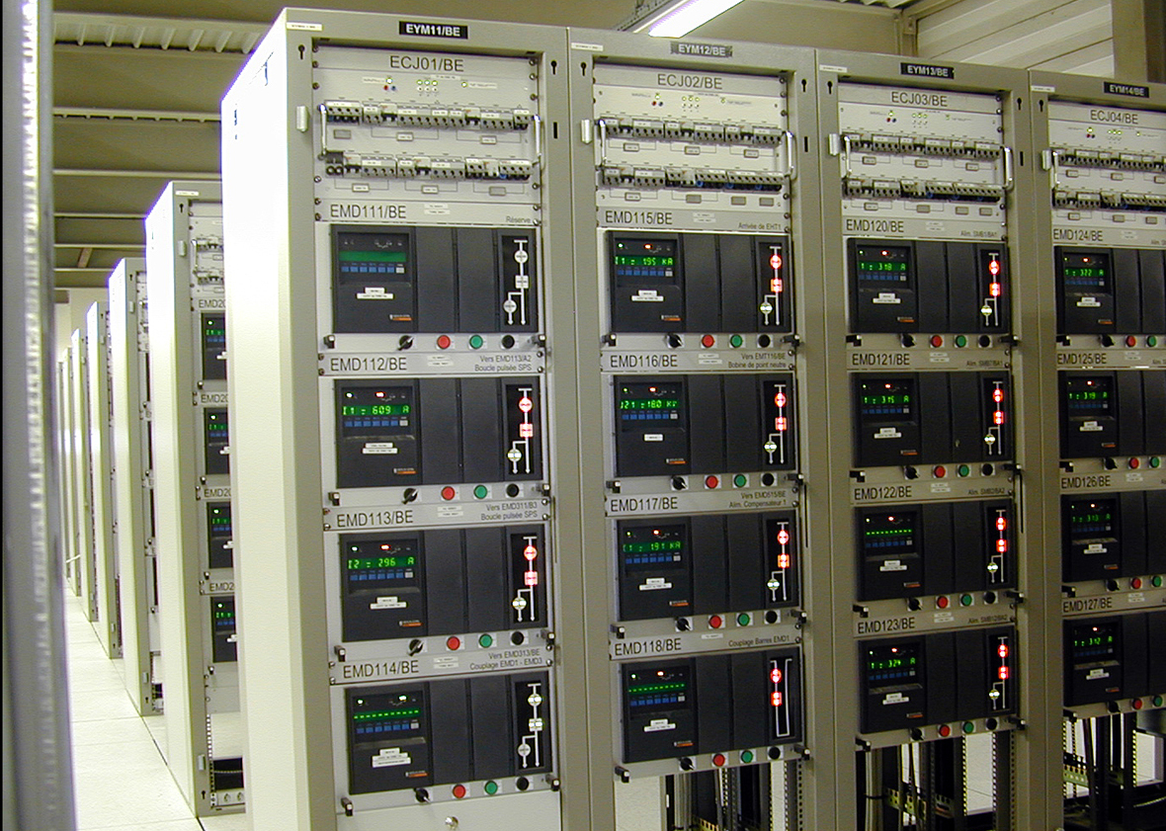
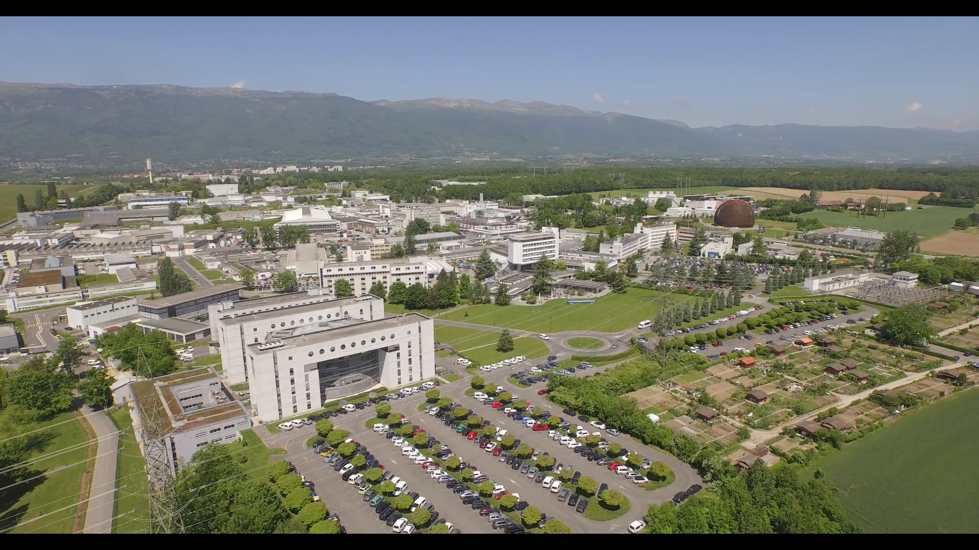
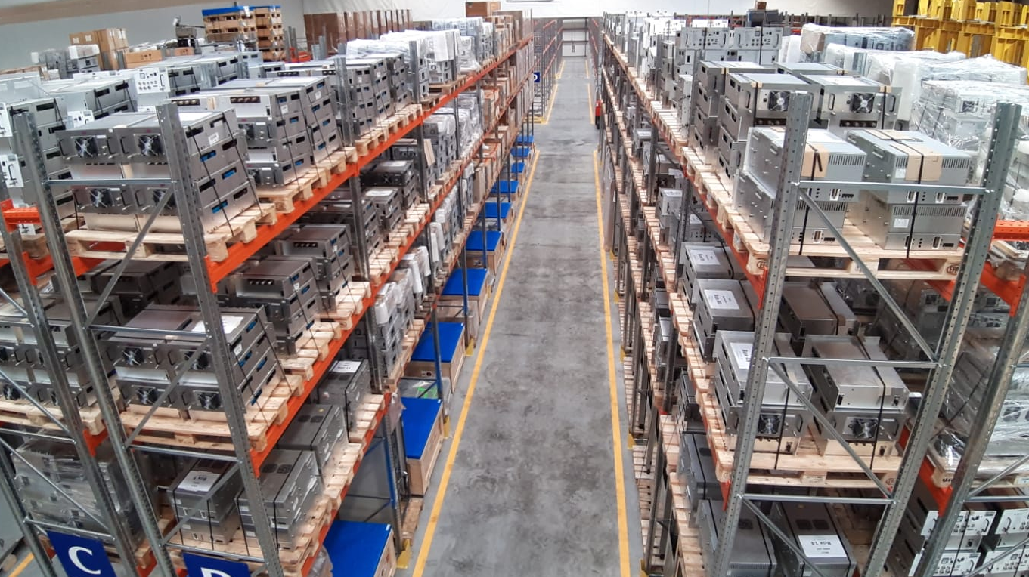
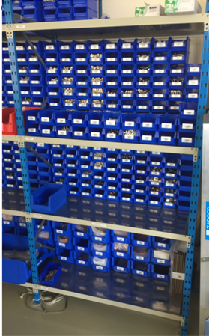
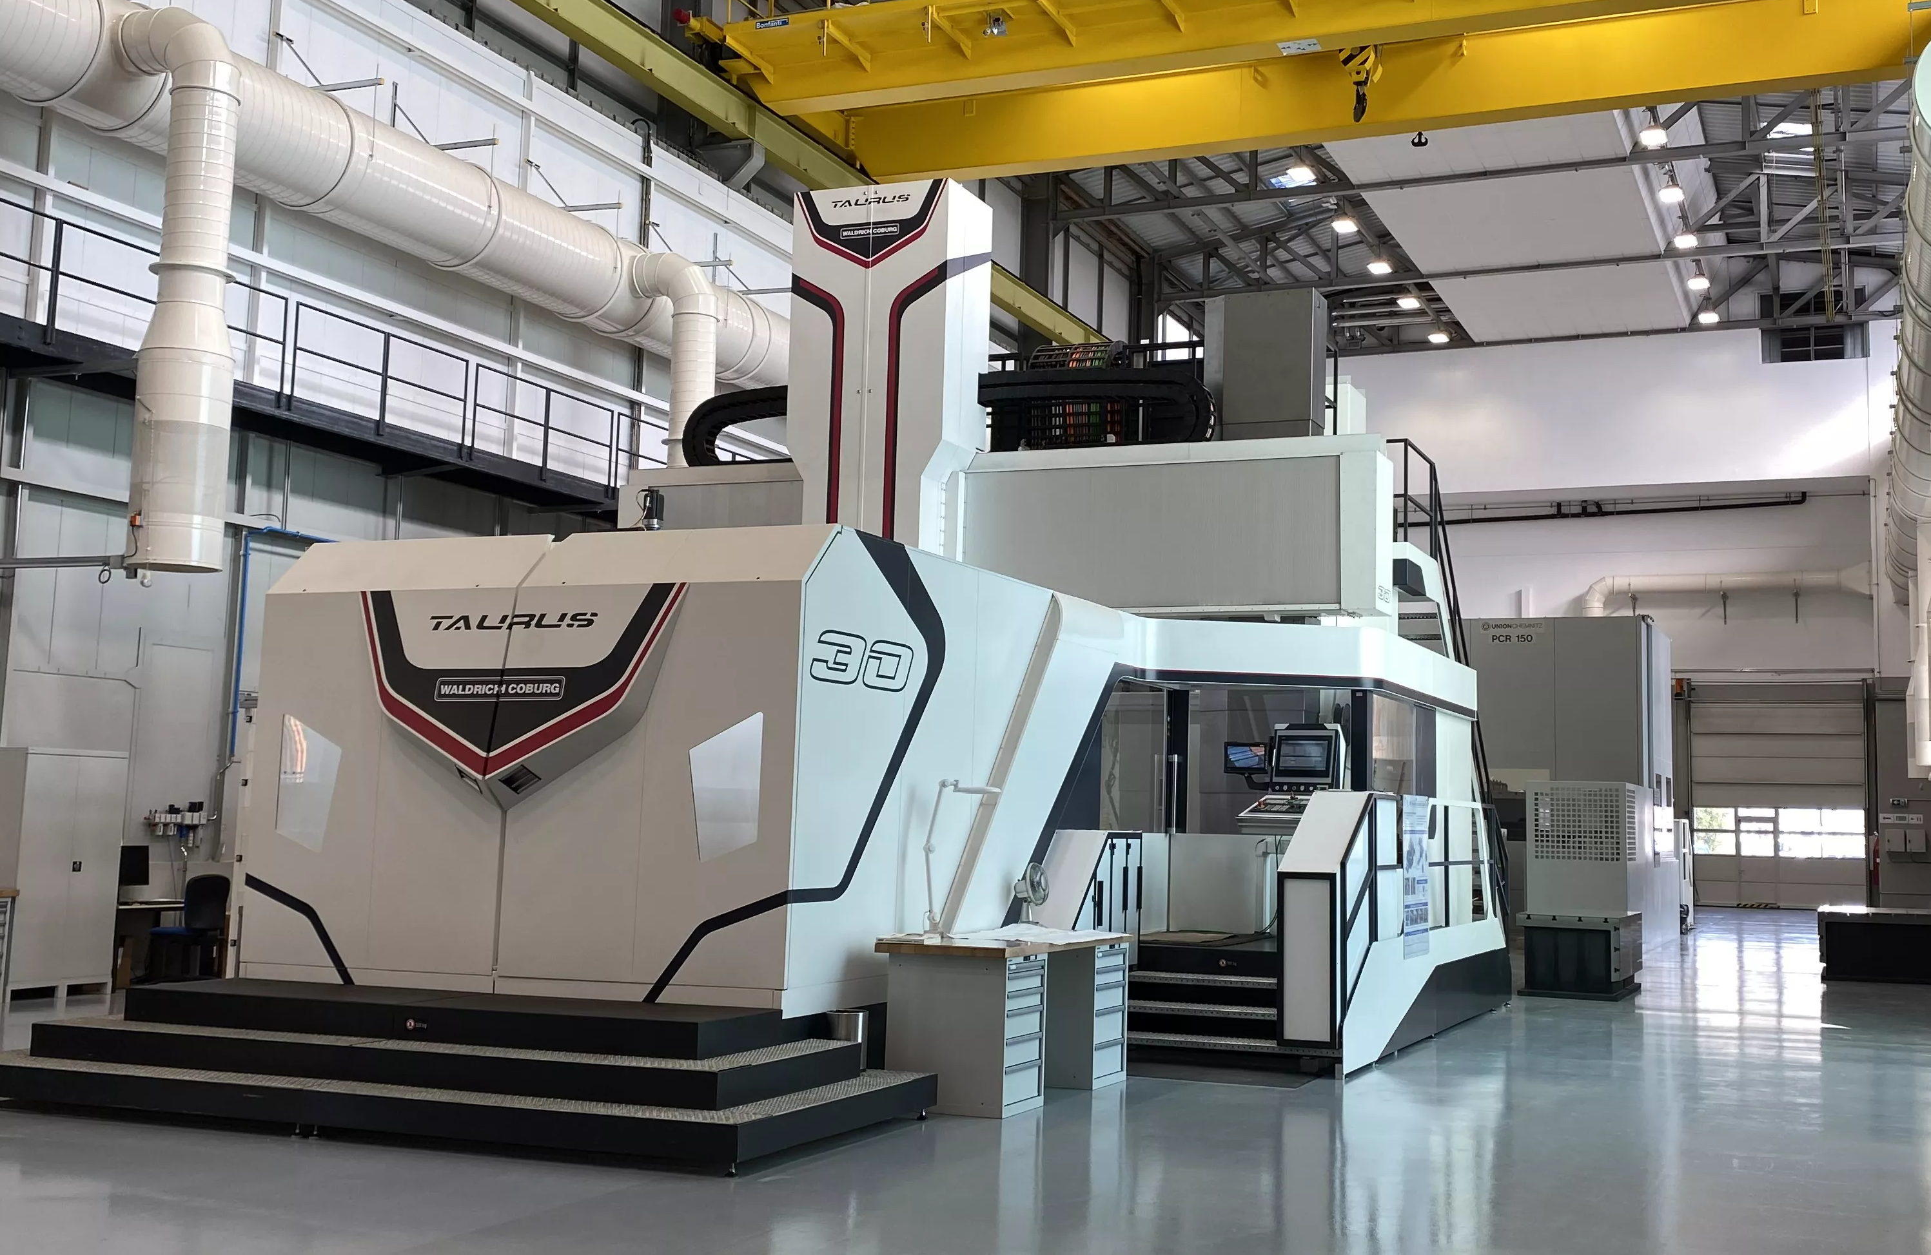
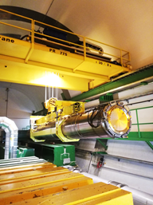
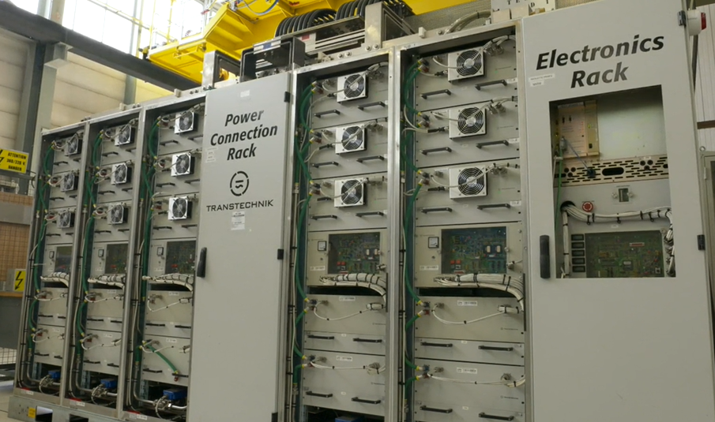
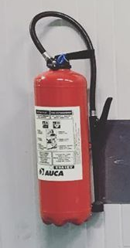
Parts required everywhere

Slide 9
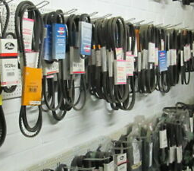
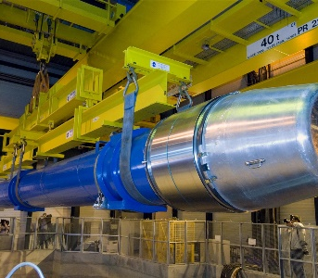
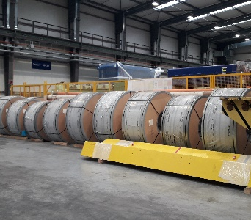
Spare part tracking concepts
Lot
Quantity
Individual objects

Slide 10

Main spare part inventory challenge: correct current stock visibility
The intention is for the work order
  To have the required spare and
  To know where is the spare
Usual obstacles are
  Non-registration of movements
  Human error
  Data entry mistakes
  Obsolete parts

Slide 11

5S Method for spare parts
Sort (seiri 整理)
  Remove no longer needed and not usable parts
Set in order (seiton 整頓)
  Structure the storage place and label the items
Shine (seiso 清掃)
  Use naming conventions for spares and lots,
  follow limited shelf-life items
Standardize (seiketsu 清潔)
  Attempt to reduce the number of different spares and the overall inventory
Sustain/self-discipline (shitsuke しつけ)
  Engage everybody to keep information up-to-date

Slide 12
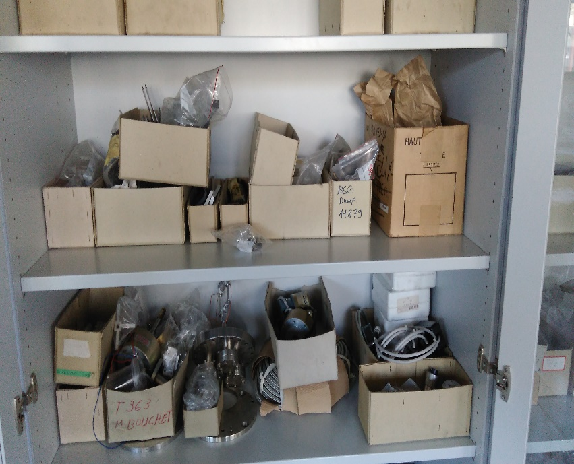
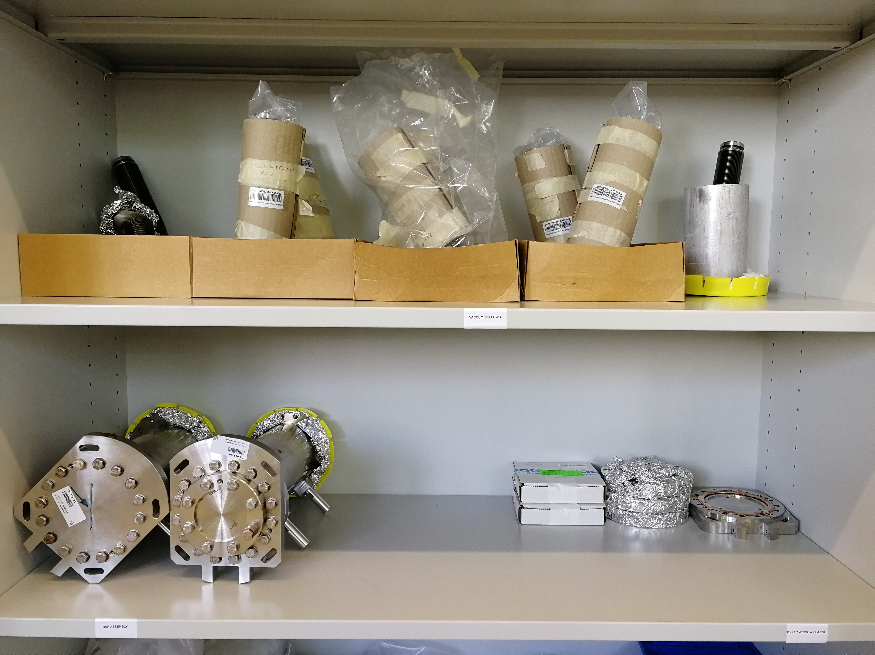
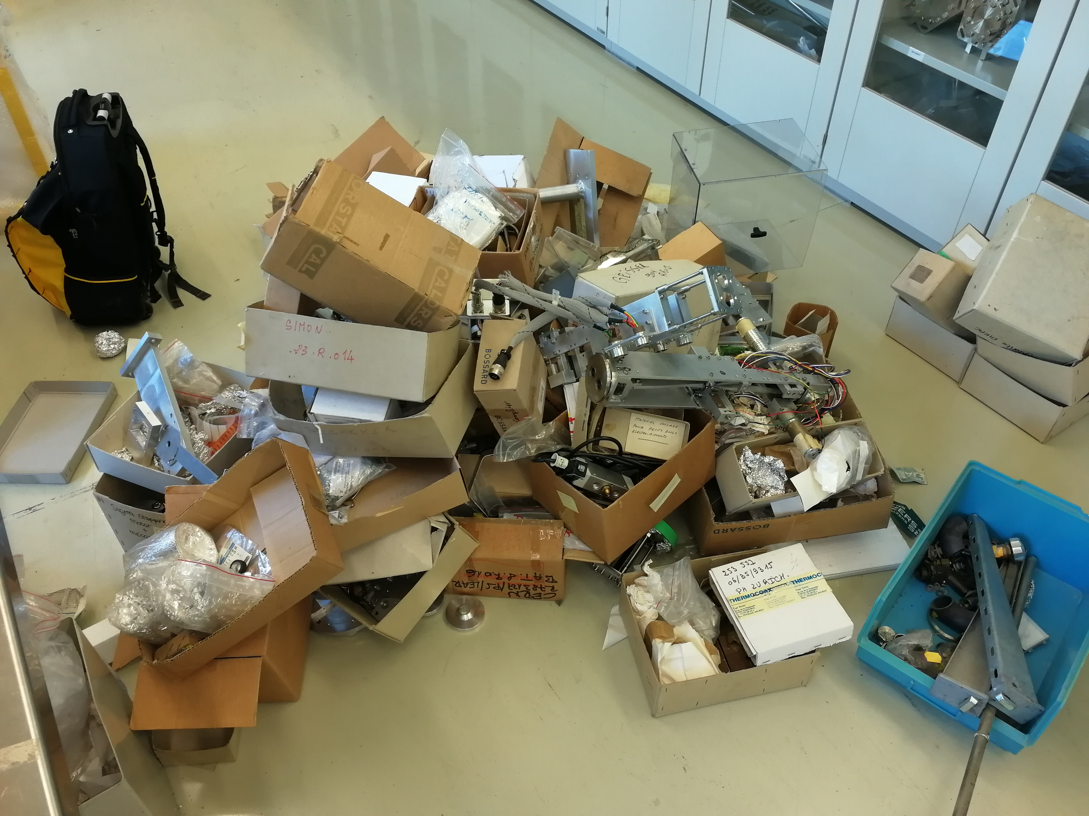
Store cleanup: before, after … and the garbage
Crucial to only keep what is really needed

Slide 13
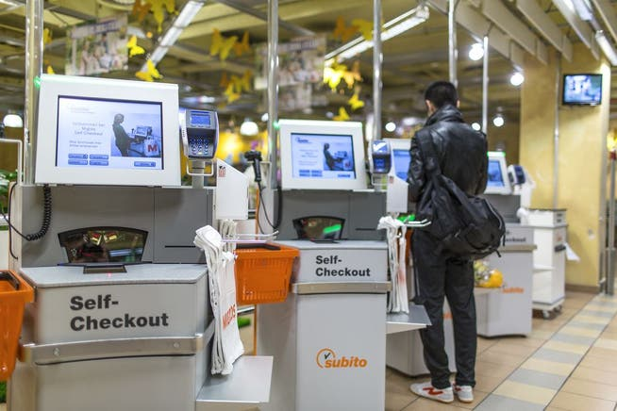
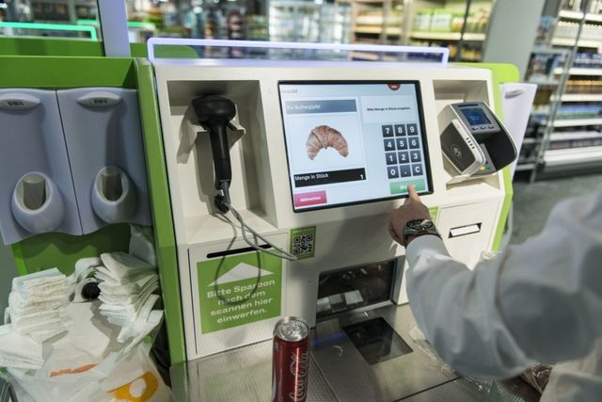
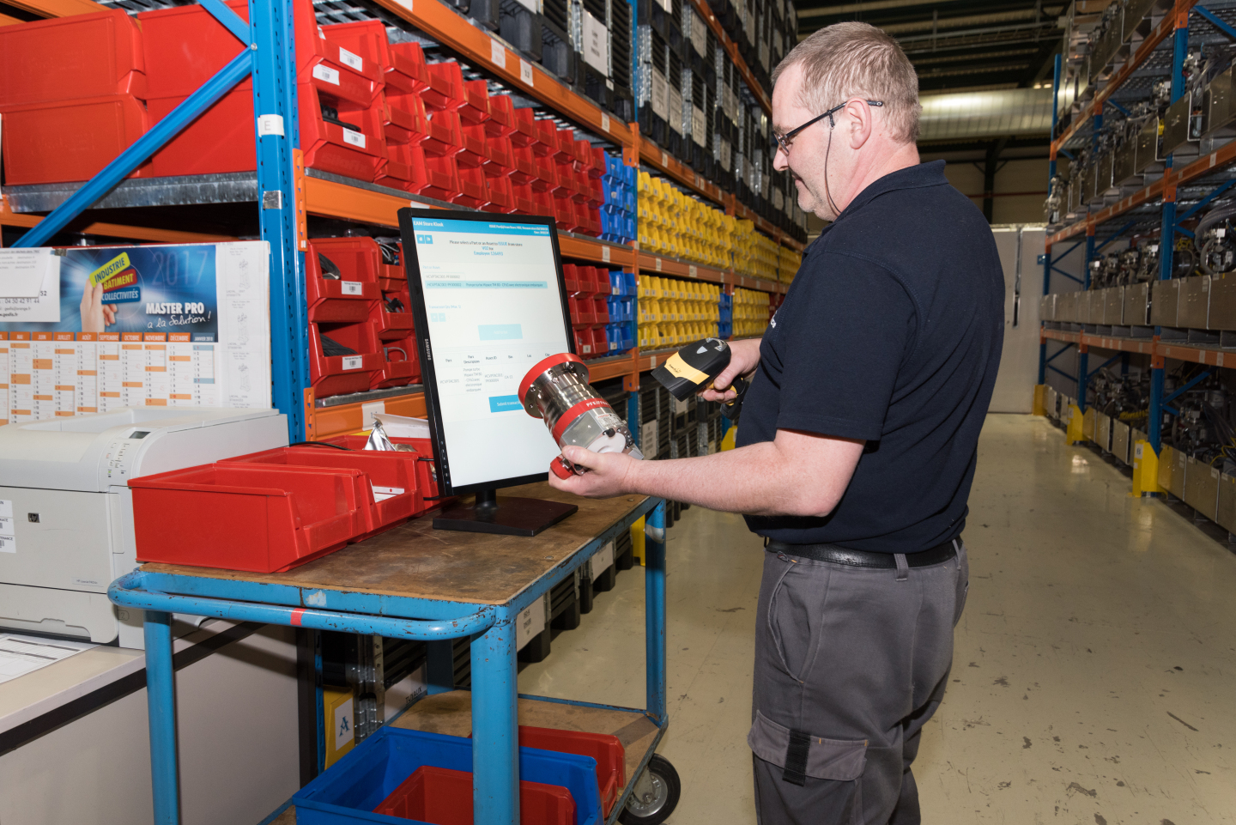
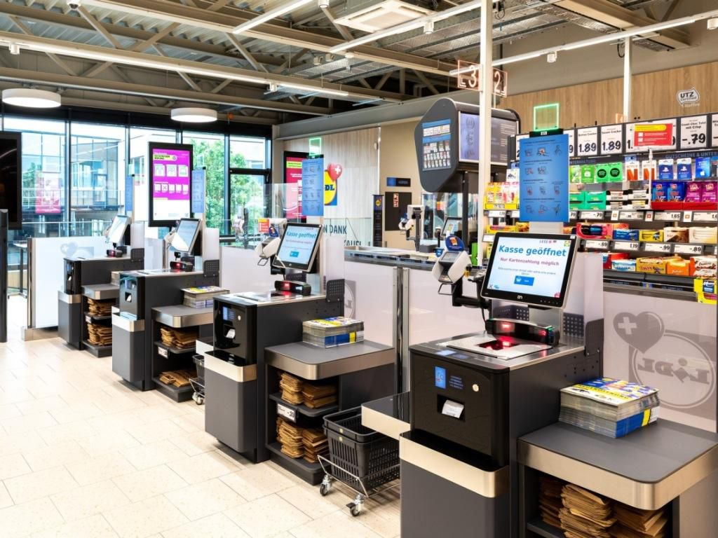
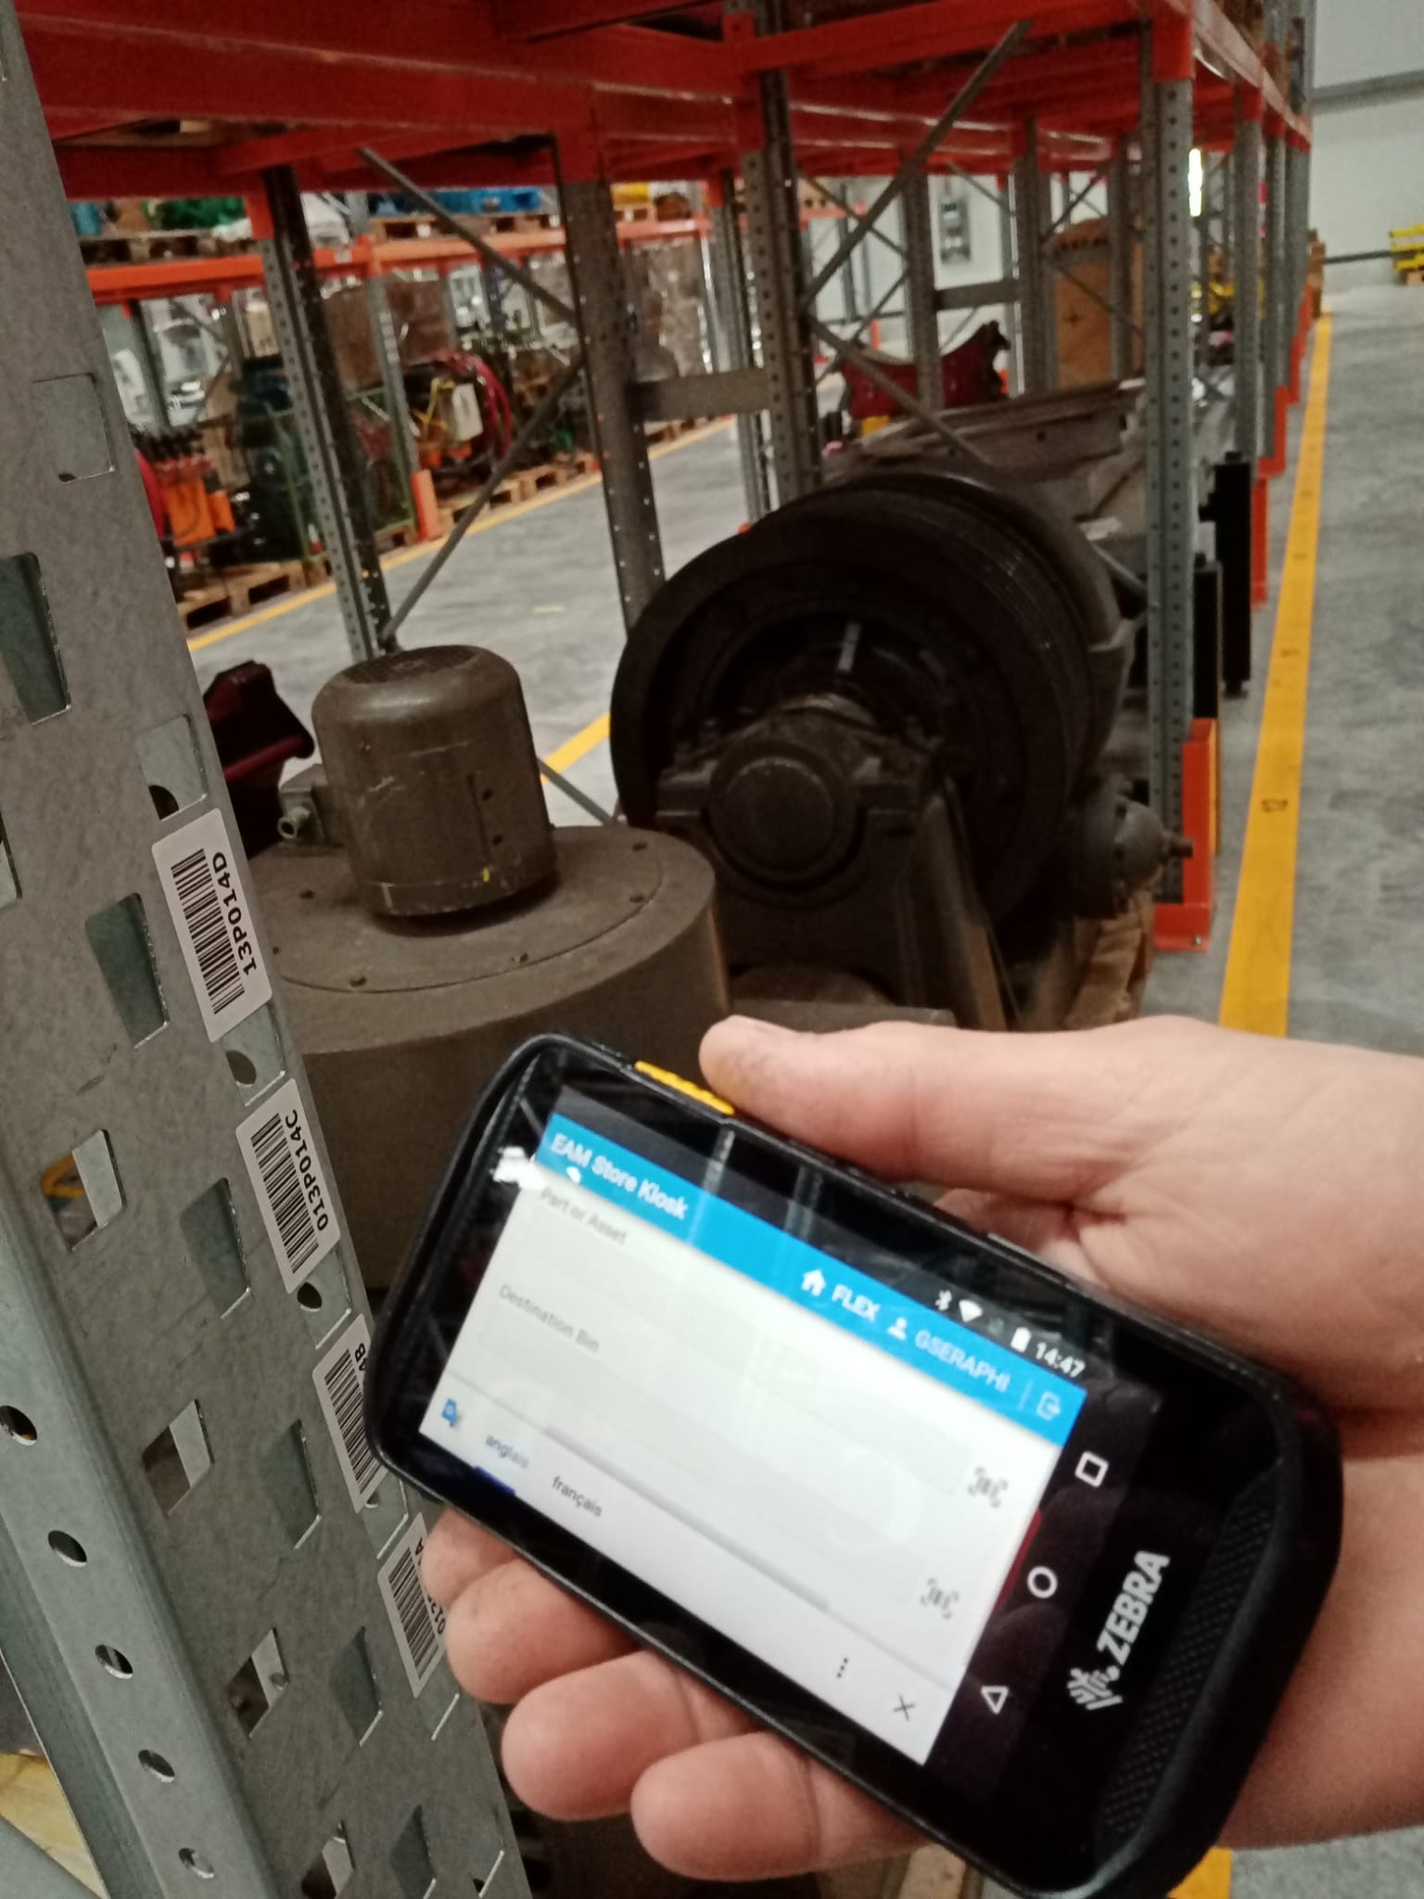
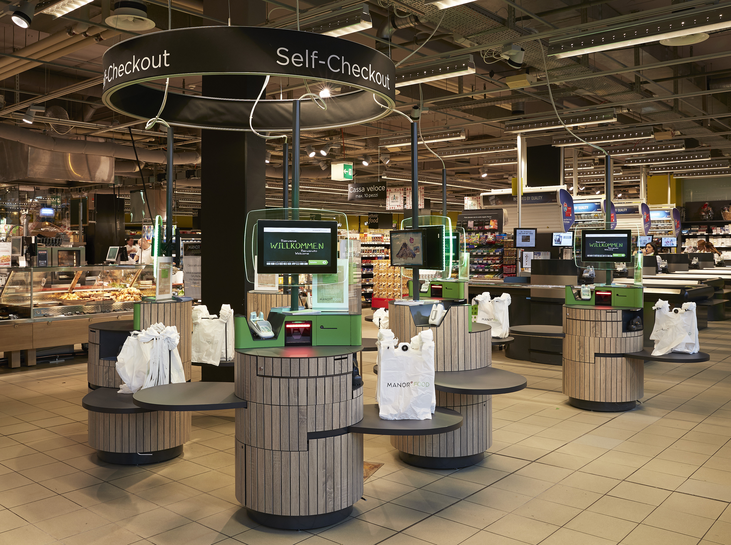
Simple self-service part access is key to sustain
Like in the retail everywhere
Everybody can use it
Providing simplicity and efficiency
Part usage registration directly on work order
Nothing should leave the store without registration

Slide 14
The practical digital tool
Responsive web application
  No installation required – great for “Bring Your Own Device”
  Adaptation to the available screen size
Specific interfaces for
  Field workers favouring smart phones
  Self-service store users, including storekeepers

Slide 15

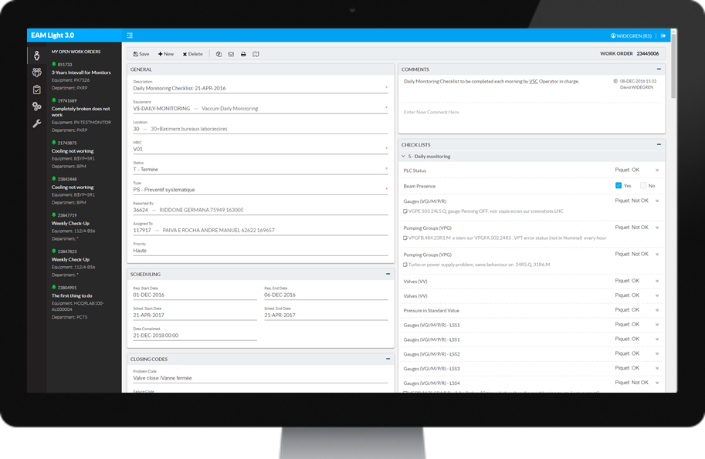
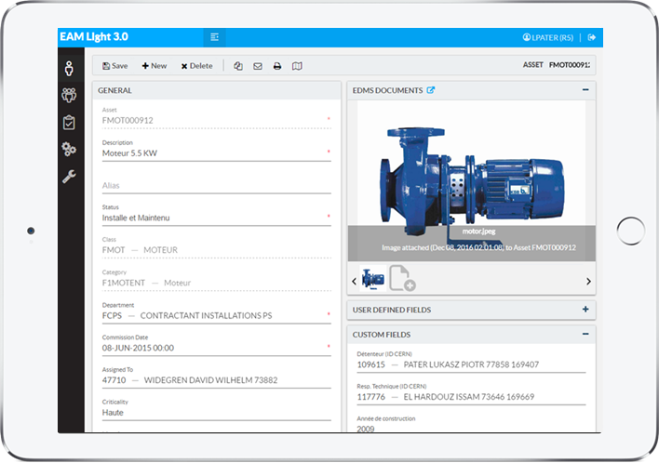
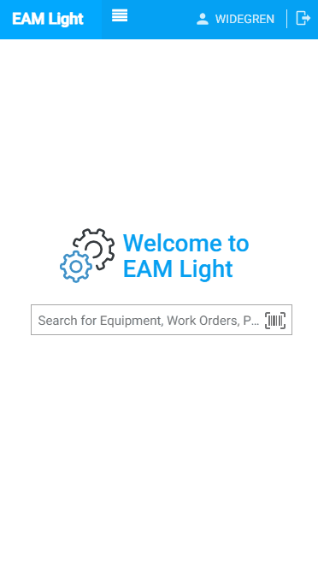
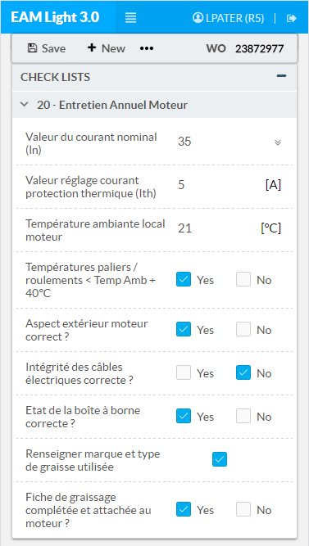
EAM Light
Simplified easy to use EAM interface including spare part information and part usage registration on work orders

Slide 16
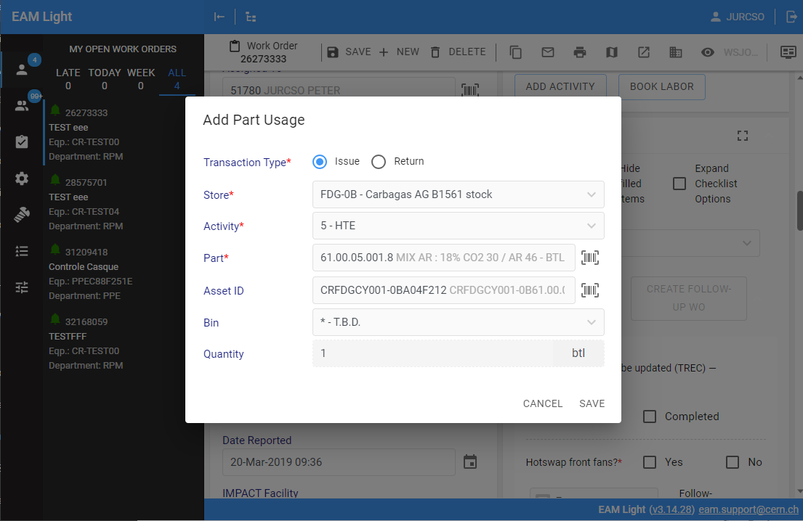
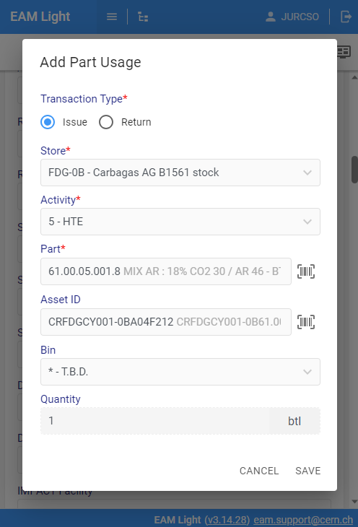
EAM Light – On the field
Spare part usage directly registered on work order

Slide 17
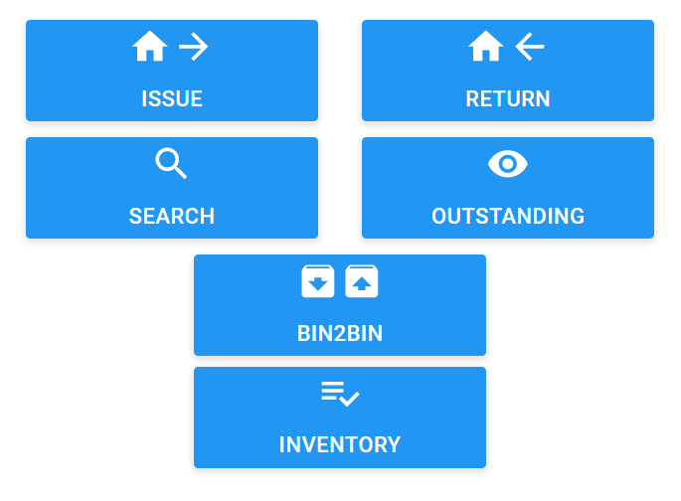
EAM Store Kiosk
Interface for generic self-service usage and storekeeper functionality

Slide 18
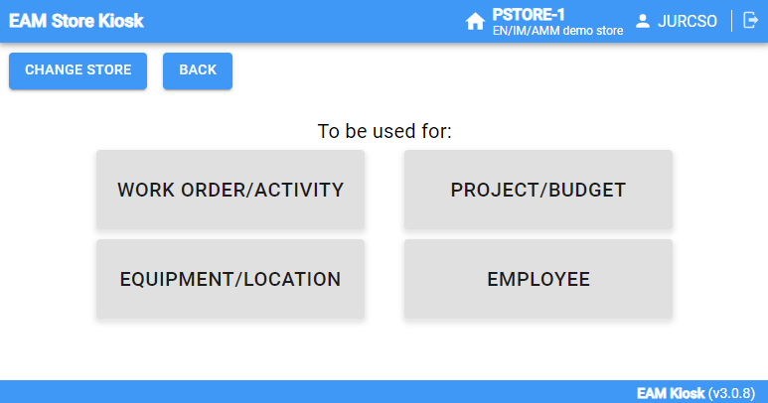
EAM Store Kiosk – In the store room
Spare part usage registered in the store room:
Nothing should leave without registration

Slide 19
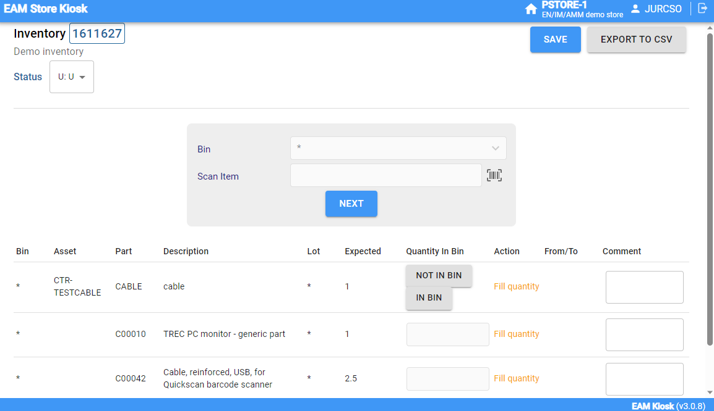
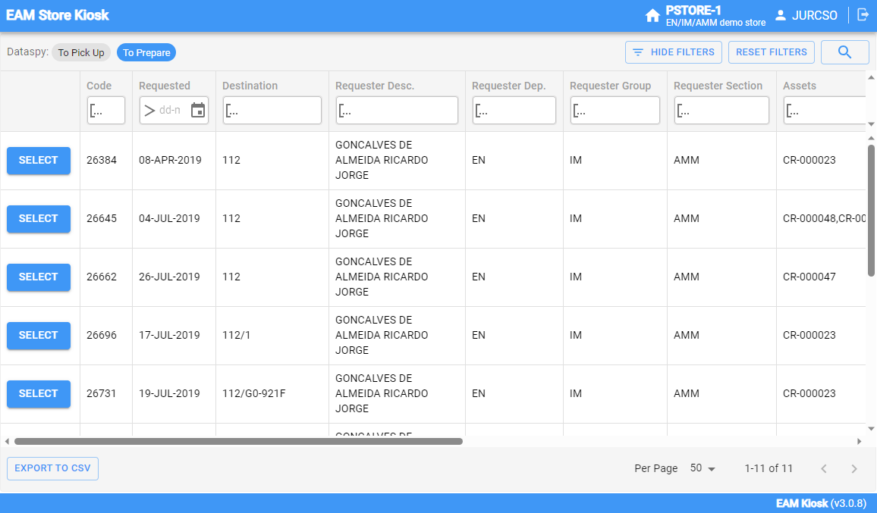
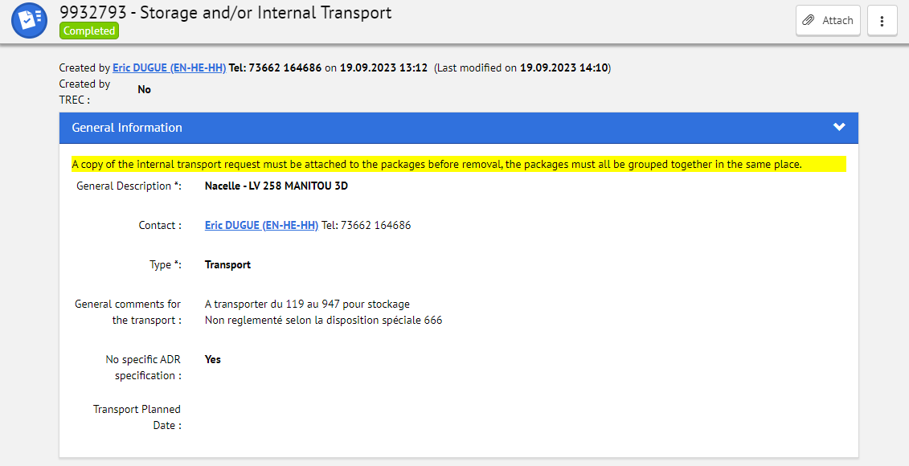
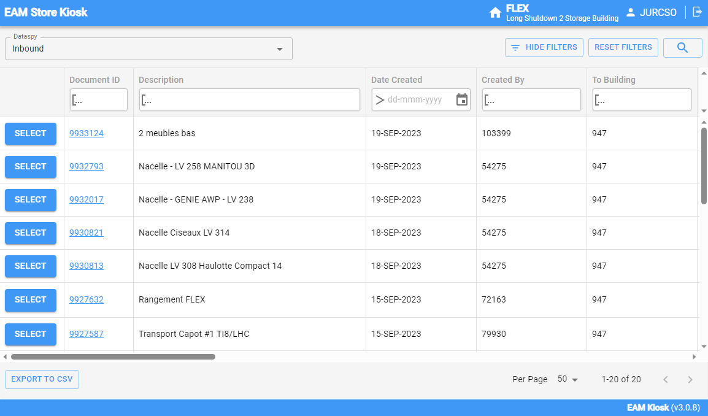
EAM Store Kiosk – For storekeepers
Specific functionalities to facilitate daily operation:
Inventory
ERP integration for transport documents
Inbound and outbound process

Slide 20







Store Management: Large and small storerooms

Slide 21
Replenishment process
Based on real usage including future reservations
Reorder level, order quantity, minimum & maximum quantities, EOQ can be calculated too
ERP integration is key
Generate from store stockouts
Compose manually
ERP Generate internal requisition
Generate from WO part list
EAM Requisition
EAM purchase order
ERP Generate purchase request for external supplier
Compose manually

Slide 22
Elements of digital spare part management
Simple part access
  Self-service kiosk in store ✓
  Registration to work order on mobile device ✓
Managed stores
  Anticipate demand for parts ✓
  Inbound and outbound processes with logistics integration ✓
Parts information in EAM for re-ordering from ERP
  Detailed description including supplier information ✓
  Calculated orders based on predicted data
  Generation of ERP purchase order document ✓
Data analysis
  Reports and KPIs ✓

