Slide 1
Operations and Work Coordination at ESS
Marc Munoz

Slide 2
ESS linac: overview
Accelerator-to-Target (A2T)
Parameter | Value
Ave power (design) [MW] | 5
Max energy (design) [MeV] | 2000
Peak current [mA] | 62.5
Pulse length [ms] | 2.86
Rep rate [Hz] | 14
Duty factor [%] | 4
RF freq [MHz] | 352.21/704.42
Milestones:
Ready for Beam on Target: April 25
Beam on Target: May 25
Instruments commissioning: 25/27
Users: End 2026
Upgrade to 5 MW: From 2027
Notes:
physica scripta

Slide 3
ESS Timeline
Facility RBOT
BOT
EOC
14 Apr '25
15 May '25
31 Dec '27
2023
2024
2025
2026
2027
ACC, Target, NSS - Installation, Testing, Commissioning - Before BOT
Pre-BOT
SRR5
Beam Commissioning to Target (pre-BOT)
BOT
ACC Commissioning + Test Beamline (post-BOT)
Hot Commissioning 1
Shutdown 1 (Instrument Install in Bunker)
Hot Commissioning 2
Shutdown 2 (Instrument Install in Bunker)
Post-BOT
Hot Commissioning 3
Shutdown 3 (Instrument Install in Bunker)
Users 1
Shutdown 4 (Instrument Install in Bunker + CM Install)
Recommissioning
Users 2
Buffer

Slide 4
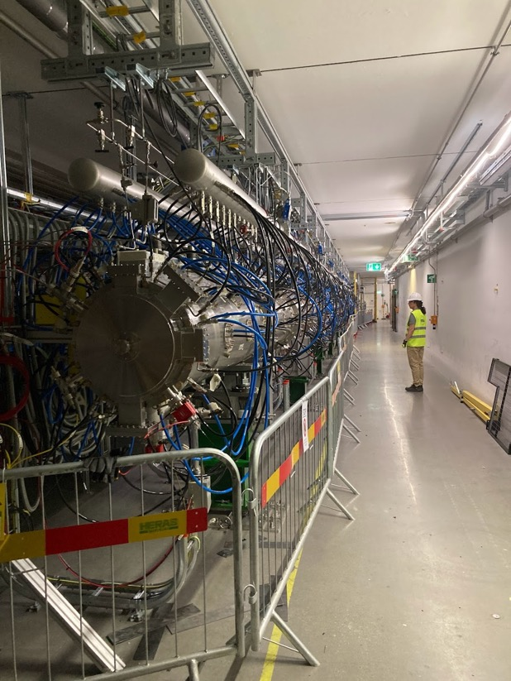
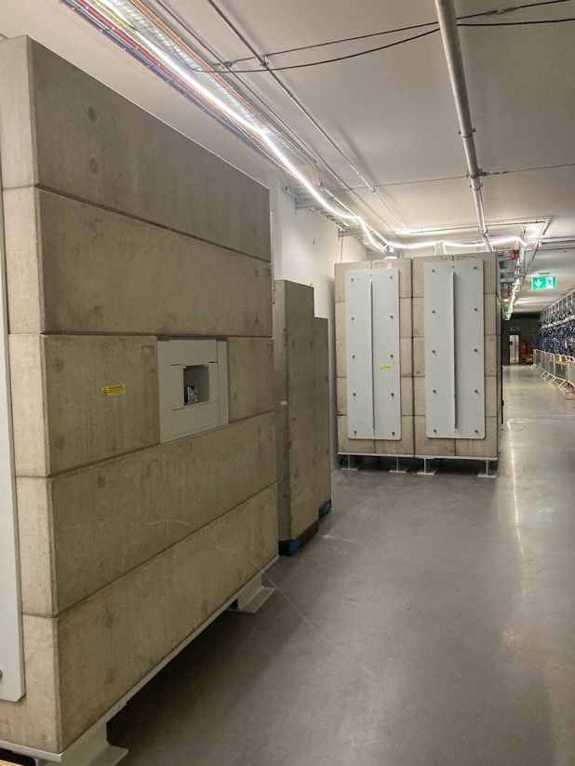
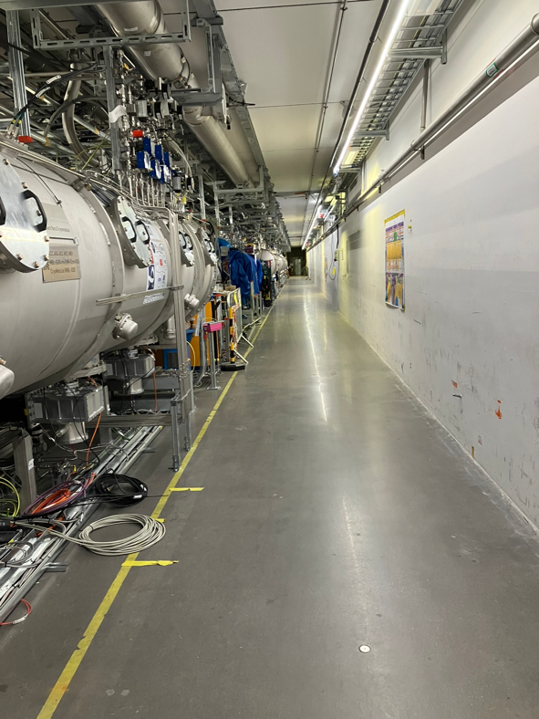
Tunnel Status

Slide 5
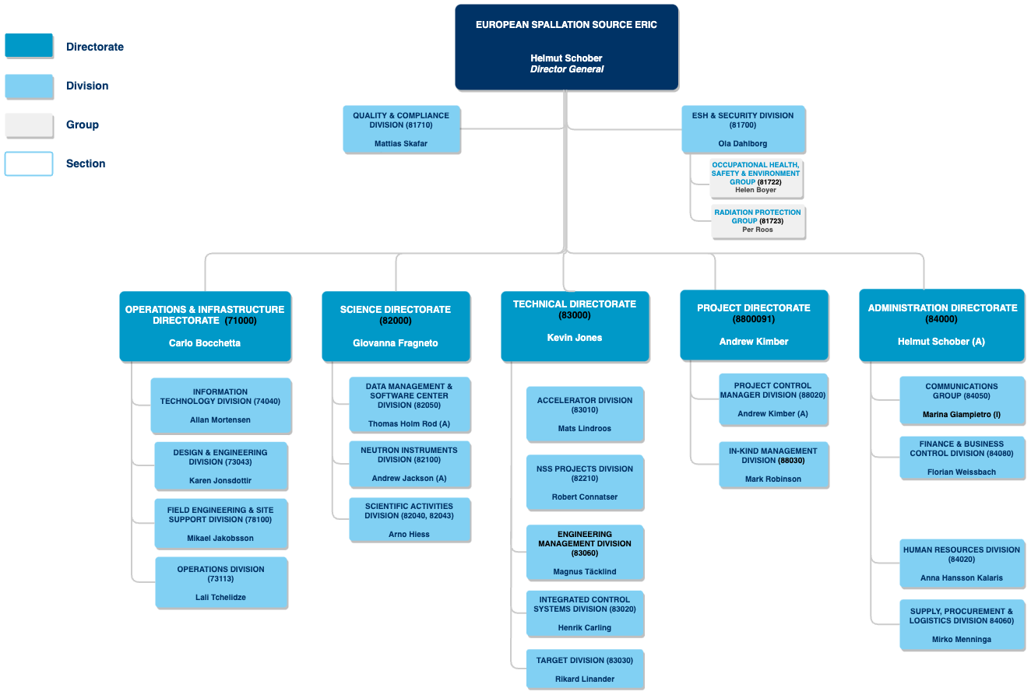
Reorganization for Operations

Slide 6
Operations Division
Responsibilities:
Operations processes and procedures, operational roles
Operational Limits and Conditions
Facilitate preparations for required technical support
Establish the required technical support
Control Room Operations
Infrastructure Operations & Maintenance
Work Coordination and Planning
Responsibilities:
Support to safely test and commission the neutron source (accelerator, target) and related systems (24/7)
Safely and reliably operate (24/7) the neutron source
CR operations procedures
Shift planning
Training
Requirements for operational tools provided by other teams
Operational tools (development)
2nd projects
Interact with:
Beam physics
Technical systems teams
Work Coordination and Planning
Infra Operations & Maintenance
ESH, RP
Other control rooms/centers
Responsibilities*:
Support in work coordination and planning.
Shutdown coordination and planning.
Define requirements to lead development and optimization for machine fault tracking (tool)
Coordinate machine performance tracking, analyses and reporting
Interact with:
Stakeholders for planning and work coordinating
CR operations
*Current scope is G01 and G02 areas.
Electrical Systems
Cooling, HVAC and sprinkler Systems
Responsibilities:
Own, develop, operate and maintain electrical, water cooling, fire and sprinkler, HVAC and instrument air systems ESS Electrical Operations Leader (direct delegation from DG)
Own service contracts
Maintenance planning
Provide technical support (scope TBD)
Interact with:
Work Coordination and Planning
Control Room Operations
Technical systems teams

Slide 7
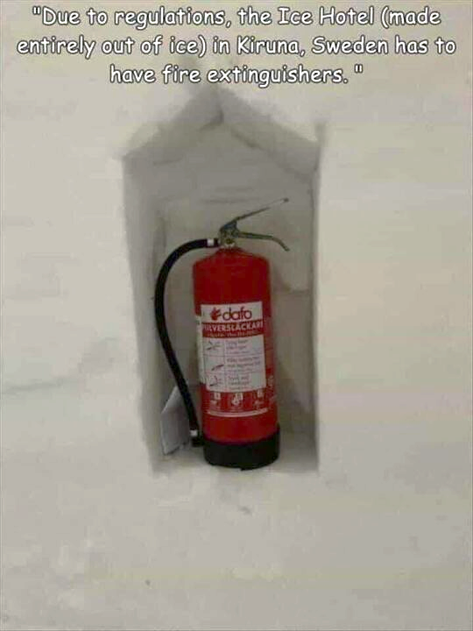
Work Coordination and Planning
Functional group inside Operations
At present:
1 full time
2 25%
Dealing with coordination of activities in operational areas
At the present: Linac Tunnel and Klystron Gallery
Coordination between installation, commissioning and maintenance
Approval and scheduling of work orders
Revision of permits
Planning of maintenance periods
Access control to the buildings
Processes

Slide 8
Areas covered by WC&P
G02
G01
NCL

Slide 9
Weekly Planning
WO created in EAM
Work Package informs the WC&P about their plans for the following week (optional)
WC&P will review WO and plans
Check interferences between WOO
Escalate issue if needed to Machine Section Coordinators
Meeting with OHS+RP+EAM every two weeks for feedback
Initial plan shared in the Stakeholders meeting Thursday evening
Plan finalized on Friday Operations Morning meeting
Shared in Confluence

Slide 10
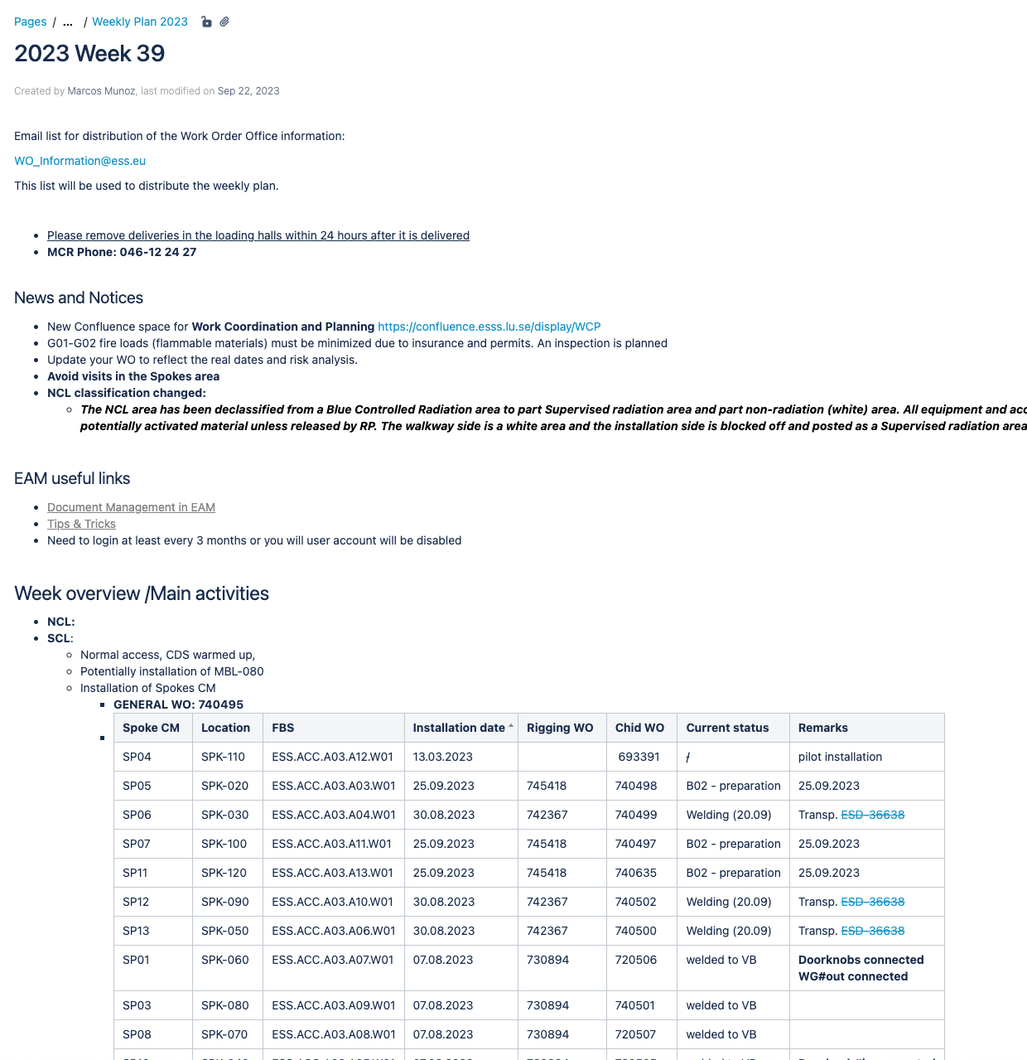
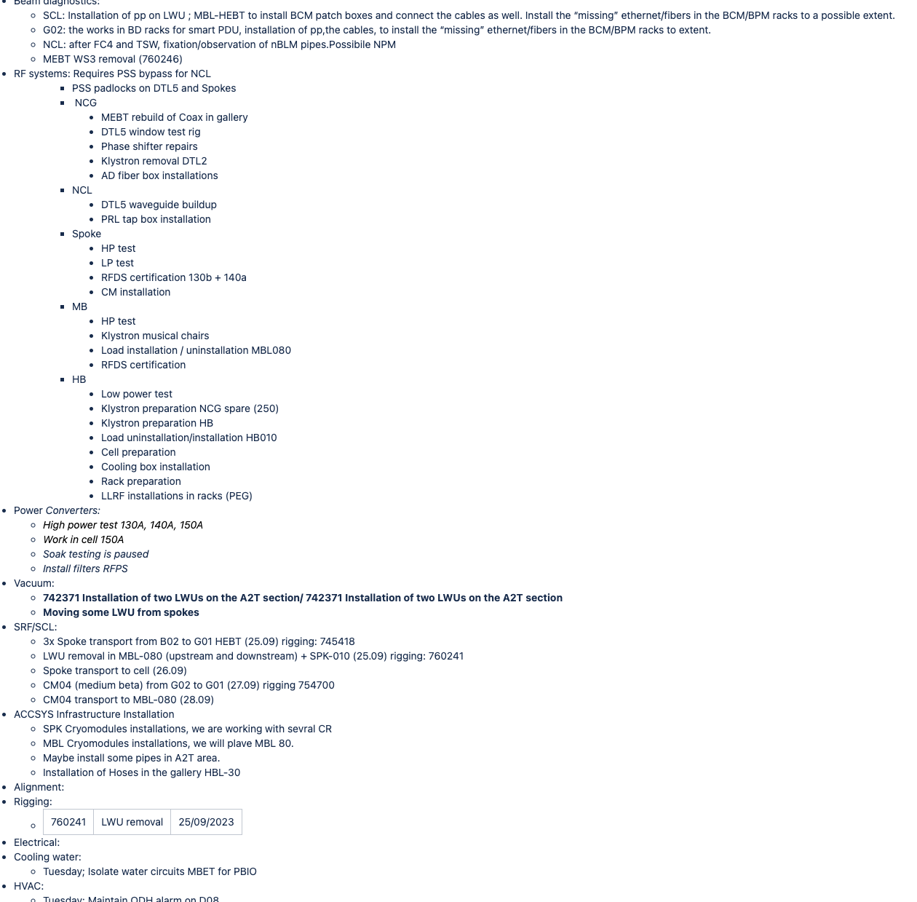

Slide 11
Work Orders
Any work in ESS needs to be under the umbrella of a Work Order
Main types
Installation: Long standing wide WO. Review every few month to update the risk
Maintenance: Dedicate WO
Immediate Corrective Action: Approved by MCR
Inspections
Rad Work Permit link to PSS

Slide 12
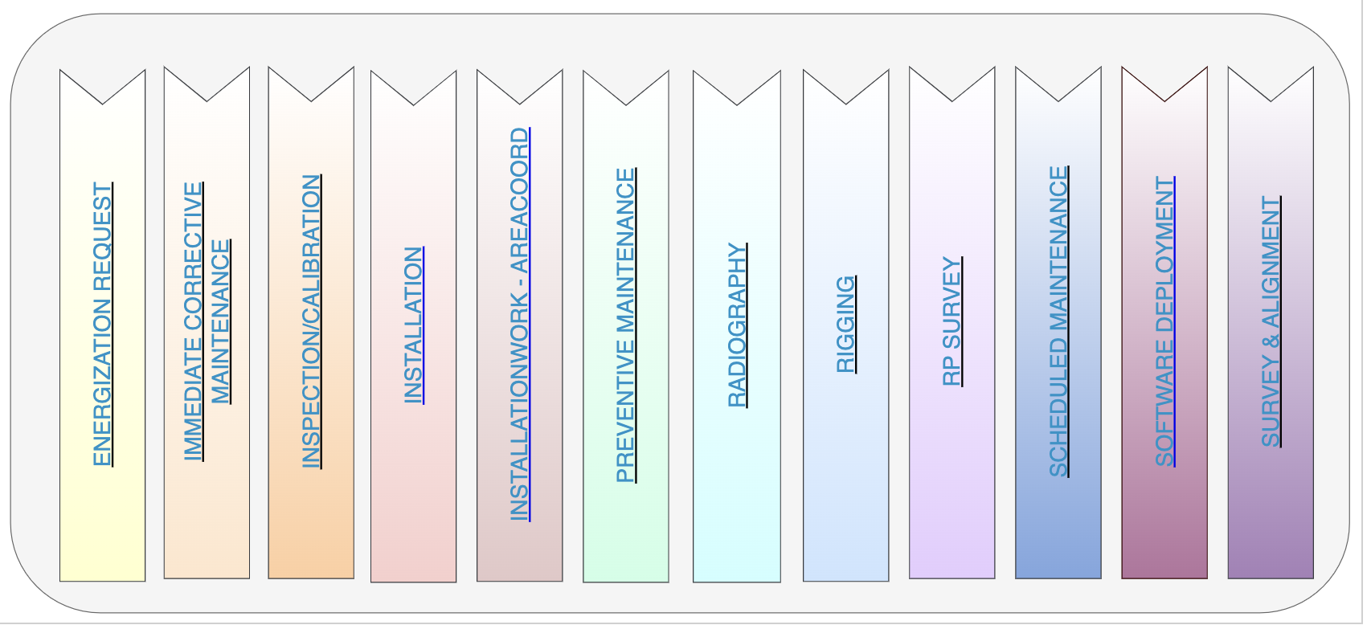
Work Orders
We are having multiple type of activities going at the same time>
Installation
Maintenance
Commissioning
They require different types of workflows:

Slide 13
Basic Workflow
New
Accepted
Prepared
Planned
Released
Ongoing
Completed
Closed
ESS worker, Possibility of pause
ESS Worker
System Owner
Includes Risk Analysis, Permits, request for Scheduling
WC&P, review of the WO, Scheduling
WC&P, on the day of the start of the work
Finish of the work
Closing documentation, root cause analysis, etc

Slide 14
Immediate Maintenance Workflow
Created
Accepted
Prepared
Ongoing
Completed
Closed
Released
By the Shift Leader or WC&P

Slide 15
Permits
Some WO require a Work Permit to be attached
At present Electrical Work Permit and Radiation Work Permit
RadWork is also linked to access to the PSS controlled area
Permits are approved by the relevant authority at ESS
RadWork by Radiation Protection Group
Electrical by Electrical Operations Leader or Electrical Safety Leader

Slide 16
Areas to improve
EAM training and information sharing with system owners and workers
Simplification of the interface
Management of Work Orders
To find the good balance between WO length and detail
Too many long standing WO for installation
WO with 2 or more years
Risk analysis
Filling the EAM database
WO for systems being installed and not yet included in EAM
Related to WO: access control and permits

Slide 17
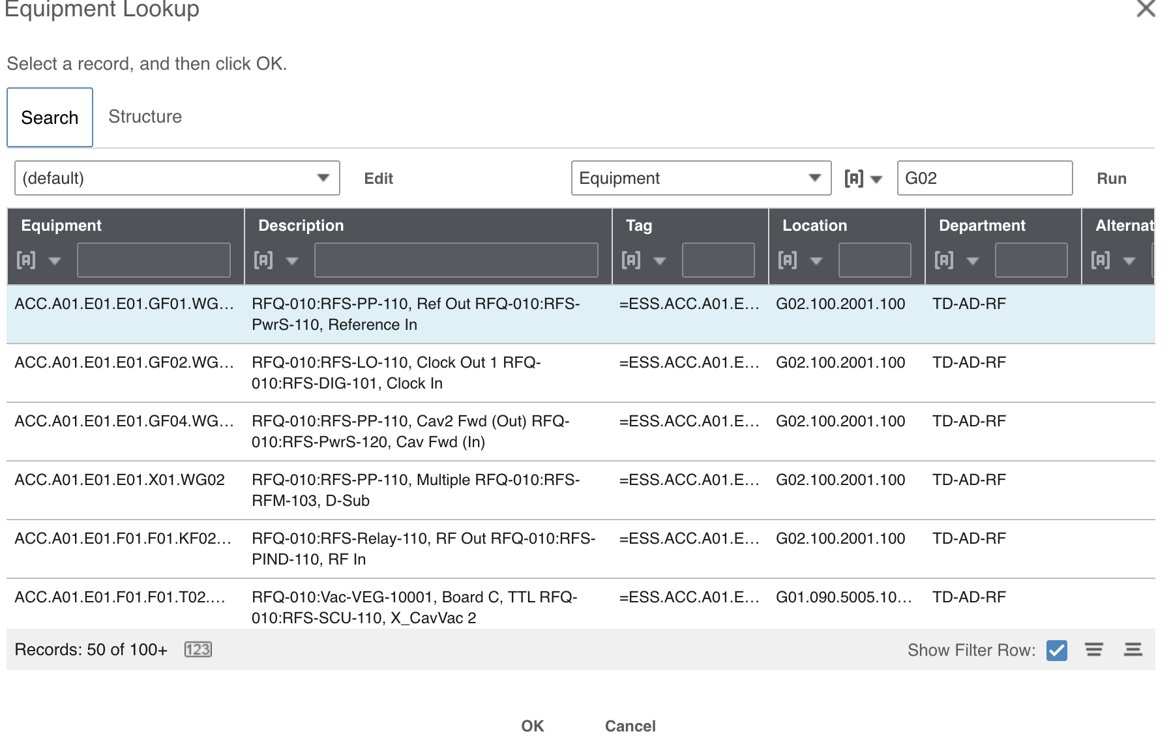
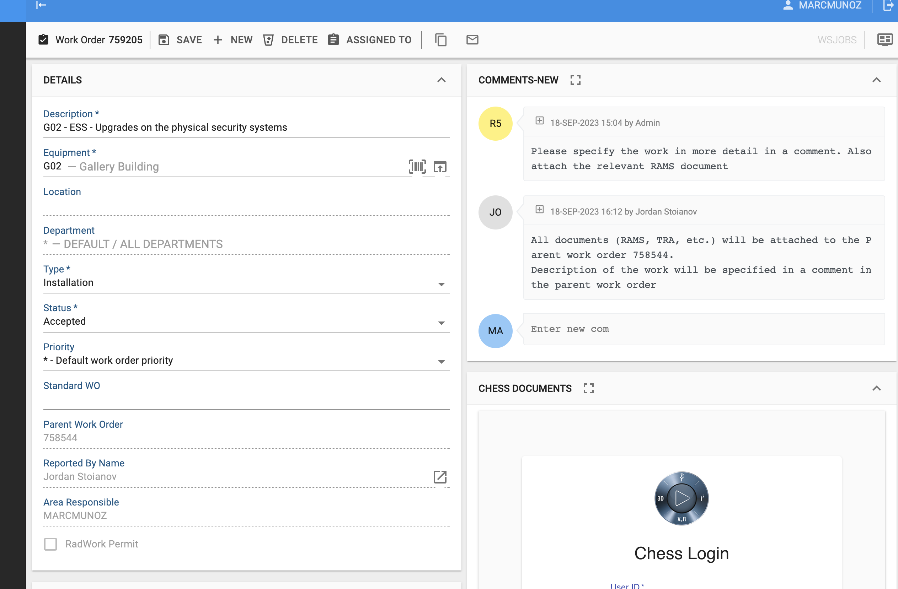
Interface

Slide 18
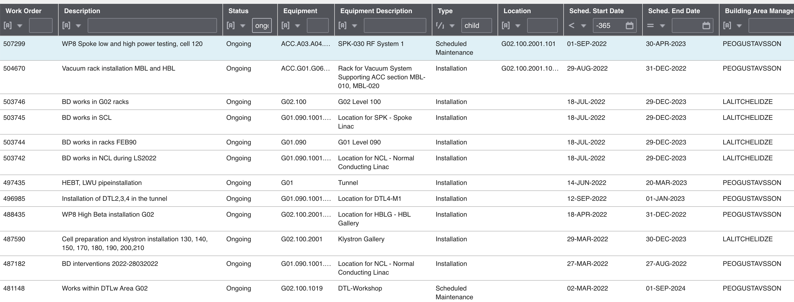
Discipline with WO

Slide 19
What is needed to enter PSS
Access to FEB90
Training -> Sabacloud
Access -> Access Portal
Personal Dosimeter
Acquire EPD
Card registered on Dosiserv
Be included in a valid RPW
User needs to be an active user in EAM
RPW needs to be attached to an ongoing WO
Pass the Stanley system
Training
Access
Only the worker can access
Needs to know exactly which trainings are need
Only the worker or AR can access
Confusing to know what is rejected
Only the RP can access
Not integrate in the LDAP/IAM
Needs the help of EAM team to add a new user
You don’t know if he has the other

Slide 20
Shutdown Planning (thanks to Olle)
Shutdown Co-ordination
Agree on sequence and plan for a shutdown program
5 years look ahead, focus on the coming year
Agree on plan/scope
Evaluate scope of work, prioritization
Organize and optimize the work
Identify/Organize stakeholders
Communication
Ownership
Ensure ways of working
Engineering handbook
Passed reviews, minimize risks
Installation binders, etc
Operations/WOO
Issuing permits and WO
Integrating shut down work into the daily planning and normal workflows
Planning 2-4 weeks look ahead
WOO coordination meeting
WOO to be involved in shutdown co-ordination as detail planning takes form

Slide 21
Jul 31 - Aug 2
Jul 31
Jul 31
Aug 7 - Aug 11
Aug 7 - Aug 9
Aug 2 - Aug 4
Aug 1 - Aug 2
3 days
3 days
2 days
5 days
3 days
3 days
4 days
5 days
5 days
5 days
2 days
2 days
5 days
3 days
1 day
1 day
2 days
1 day
1 day
1 day
2023
2023
Today
2023
31/07
01/08
02/08
03/08
04/08
05/08
06/08
07/08
08/08
09/08
10/08
11/08
Jul 31
Maintenance Switchgears H05
Electrical Operation and Maintenance
Maintenance Switchgears H06
Jul 31 - Aug 2
Aug 1 - Aug 4
Maintenance Switchgear J17 G04
Aug 7 - Aug 11
Aug 9 - Aug 11
Maintenance Switchgear J16 G04
Jul 31 - Aug 4
BMS update
Aug 7 - Aug 11
Sectioning IAR upgrade
Cooling, HVAC and sprinkler systems
Motioning Valves
Motioning Valves
Maintenance Pumps
Cleaning Filters
Network upd.
Firewall upd.
ICS Infrastructure
Jul 31
Move Servers H01
Jul 31
Aug 3 - Aug 4
Reinstall Servers D02 MCR
Aug 1 - Aug 2
Storage upgrade
Aug 3 - Aug 4
Maintenance temporary power main station
Maintenance temporary power barracks, part 1
Aug 7 - Aug 11
FM Site and Security
Maintenance temporary power baracks, part 2
Change light fixtures in G02
Change light fixtures in G02

Slide 22
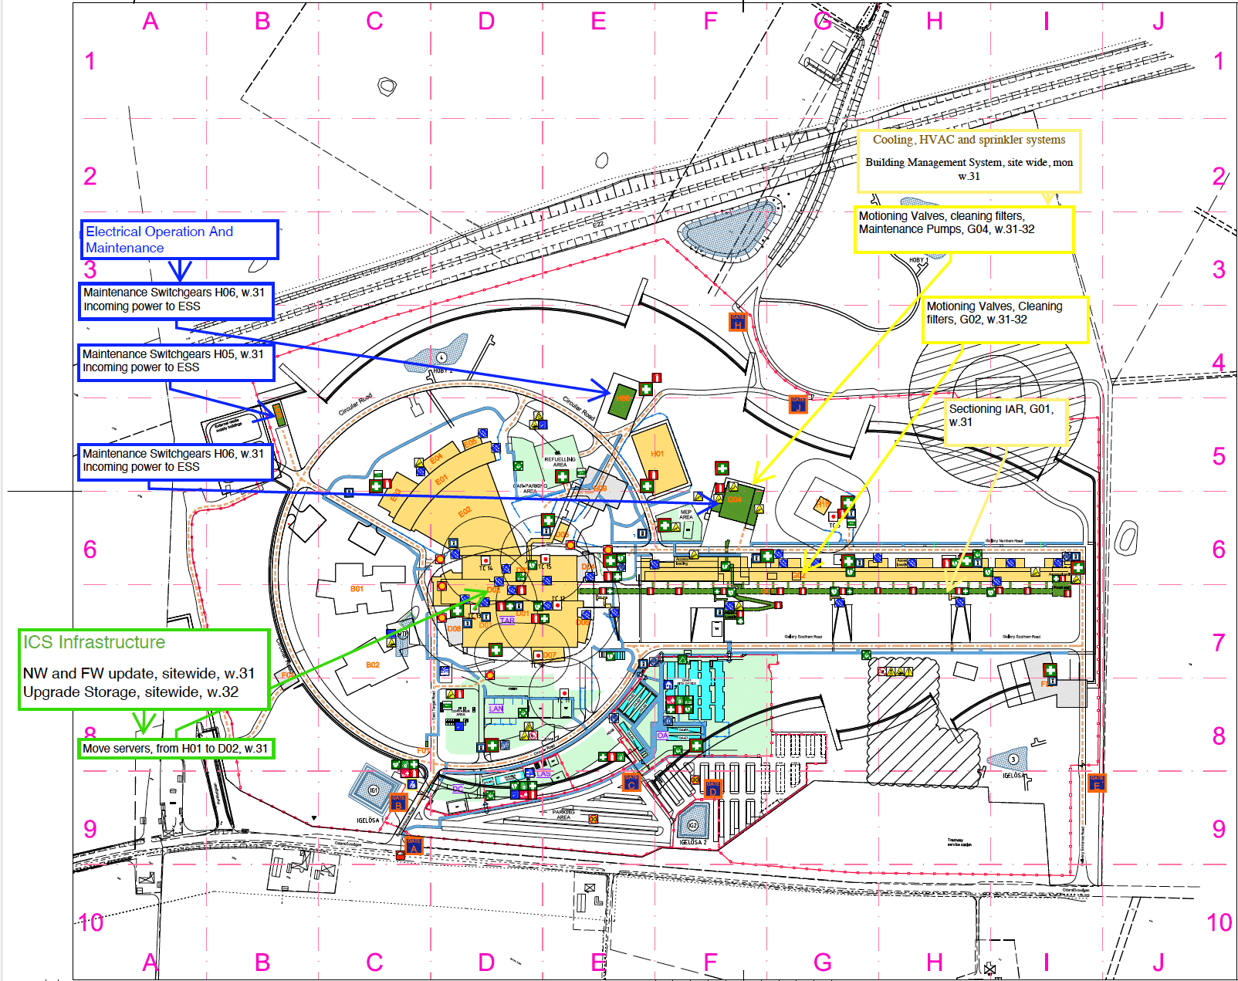

Slide 23
Scope for Shutdown 2023
Electrical Operation and Maintenance
Maintenance building H05, H06, incoming power, week 31
Designed with redundancy
Switchgear supporting G04 (cryogenic plant), week 32
Affects the cryogenic plant operation, ensure power to recovery system by generator
Affects fire detection and suppression in G04, to be supported by generator
Affects TS2 activities, to be co-ordinated with the shutdown
Cooling, HVAC and sprinkler systems
Building Management System update, week 31
Affects visibility of buildings systems
Maintaining pumps, cleaning filters and motioning vales in G buildings, week 31-32
Affects CWM and CWH cooling systems and supported ACC equipment
Smaller work in G02 as system to be updated
CWL unaffected
Sectioning of air system
ICS infrastructure
Network and firewall update, week 31
Short stop, should be unnoticeable
Move servers from H01 to D02, week 31
Redundancy
Upgrade storage, week 32

Slide 24
Scope for Shutdown 2023
Building Maintenance, w.31
Blue area, 1 August 12.00-16.00
Pink area, 2 August 12.00-16.00
Green area, 3 August 12.00-16.00
Lack of lights, hot showers and fire detection (Skånsk Larmtjänst, will be on site to overview)
Lights G02, w.31-32
Changing the lights in the roof, warranty
Local affect
Done by Assemblin, experienced people

Slide 25
Ongoing work
Electrical
Contractor identified, One Nordic to preform work, with experience from the facility
Fully manned team from ESS
Ensure procedure/switch-plan and LOTO is in place
Discussions with Kraftringen as incoming provider to
Looking at renting required generator, from Skanska Direkt to ensure compressor and fire detection/suppression functionality
WO in EAM working on adding procedures to ensure repeatability
Process and piping
Inhouse personal
EOn as contractor
BMS update affect site wide, but no know conflicts
Substations updates ongoing
WO to be created
PMS to be added to EAM
Network
Inhouse personal
Redundancy
Detailed plan in Jira and then by WO EAM, confluence page to gathered info to be created

Slide 26
Going forward
Looking forward, operation and commissioning activities will intensify
Still we will have installation
and need for maintenance, as sys. goes into operation
and over time they need upgrades and modifications
Typical Electrical/Process and piping for 2023 is preventive maintenance stops
Known, scheduled, periodic,
To be captured in EAM, adding PMS
We avoid corrective and breakdown maintenance, costly stops
Don’t necessarily need downtime
Network for 2023, is updates and finalizing installation
To existing systems/components
To meet higher requirements
To meet unknown requirements
Extend life length
Minimize corrective and breakdown maintenance
Safety related and or regulatory

Slide 27
Shutdown Co-ordination
Create a program that gathers all that needs to be done to ensure high availability
Tight schedule
Work towards the exciting organisation
WOO/Permits/daily planing
Installation Coordinators
Commissioning Coordinators
MSC/WP/Sub projects
Maintenance organisation
Operations
Gather information > Prioritize > Optimize > Plan > Communicate
Iterate…Iterate…

Slide 28
The Baseline
Establishing the baseline for maintenance stops, understood through EAM (PMS)
Procedure ESS-1162328, ESS Maintenance Handbook
Clarifying roles, responsibilities
Ownership and ctrl of installed eq
Supervision and inspection
Avoid corrective and breakdown maintenance
ESS-3185783 Rules for Equipment Criticality
Ways to capture and describe, “things that happens”, we´re not perfect at first go
ESS-3243953 ESS guideline for Spare Parts Management
Waiting time when something happens
Understanding the remaining known installation work
Impact on commissioning and operation
Close work with MSC/WC&P/WP
Capture and prioritize unknow Updates/Changes/Ad-on
Ensure working towards ESS procedures
Engineering handbook > Approved Reviews > Minimize delays
Cost time today saved time tomorrow
Risk minimize
Availability
Main objective to ensure and plan for controlled shutdowns under one program
Goal 95% reliability

