Slide 1
EAM Reporting, KPIs and Analytics at CERN
AMMW 2023 – Fabio Alfeo – CERN
2023-09-27

Slide 2
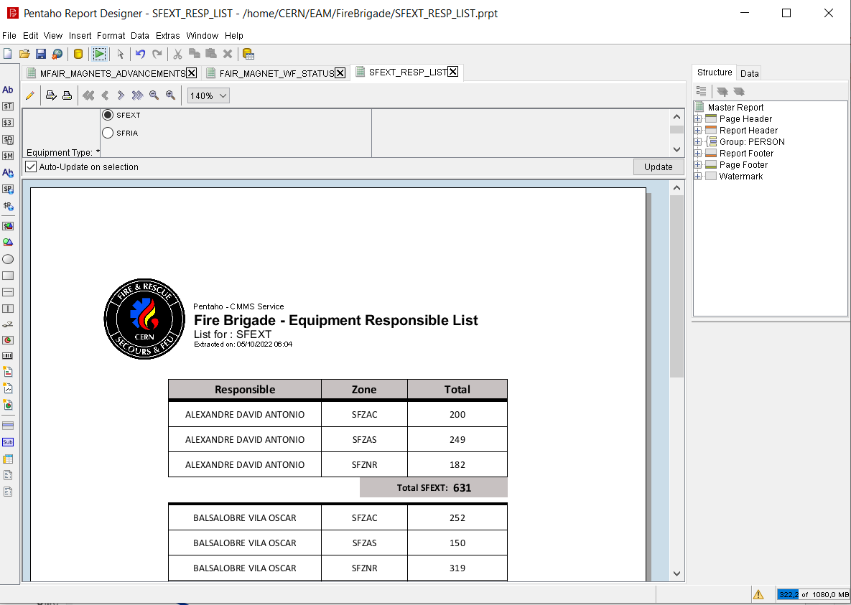
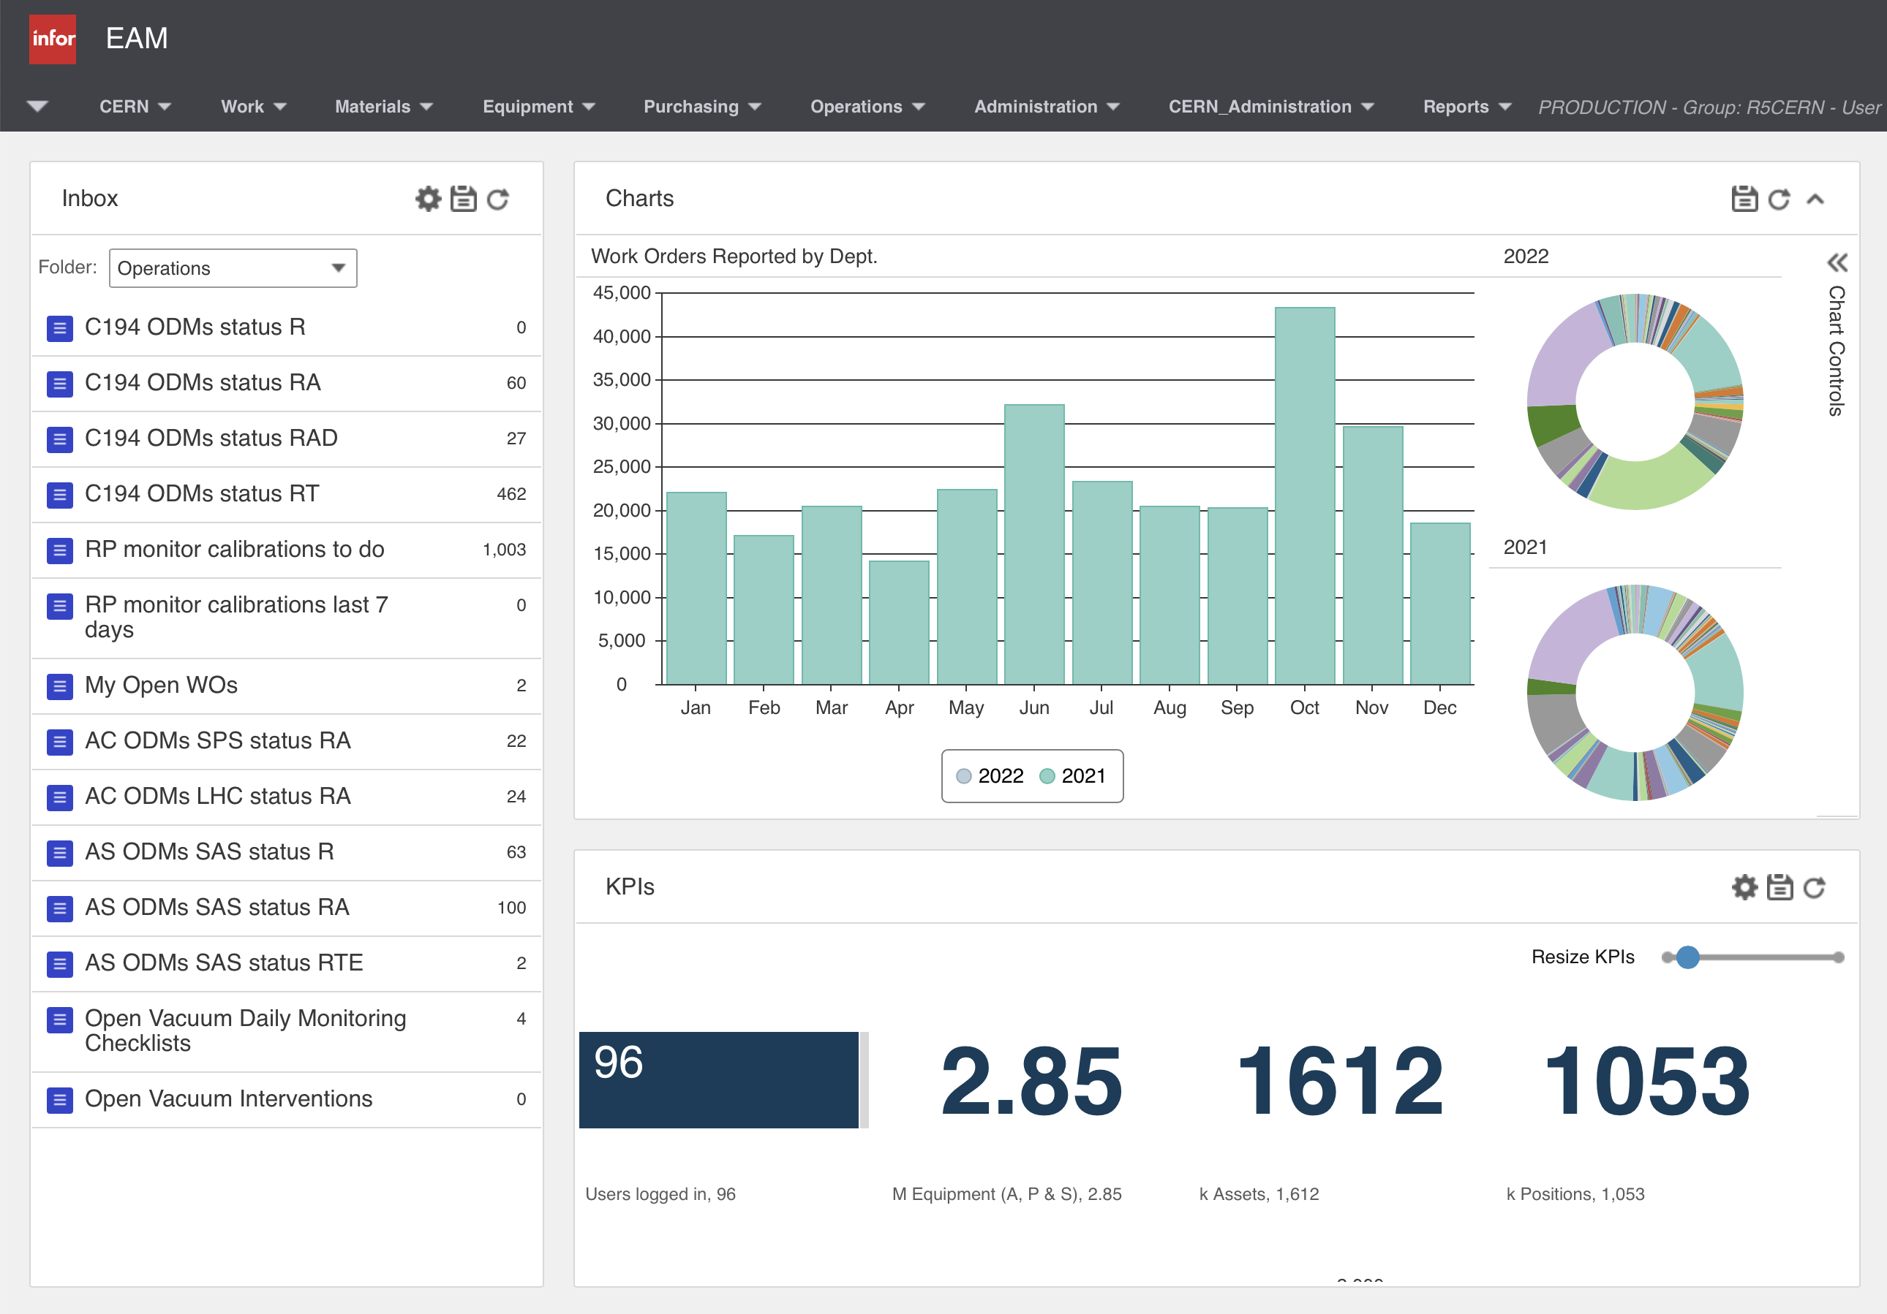
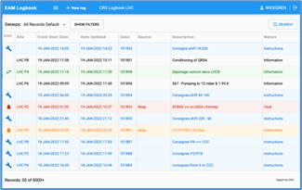
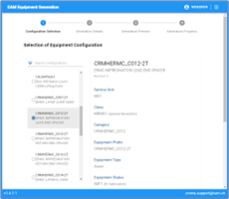
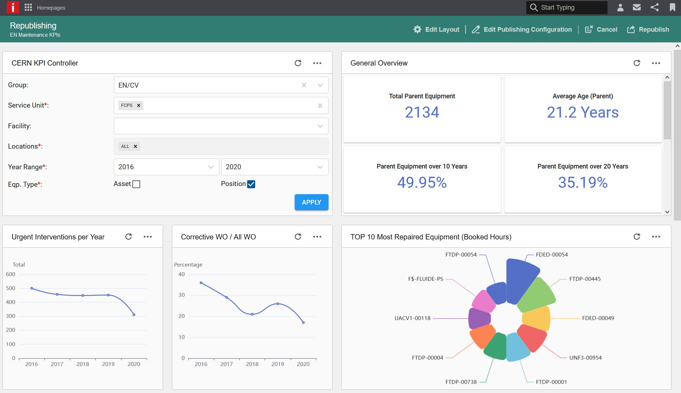
Tools Overview
EAM Database
Pentaho Tools Professional Reporting Tools
3.1M Equipment
150k Store Transactions / Year
350k Work Orders / Year
800k Checklist lines / Year
EAM Reporting Tools InforOS & EAM - Start Center
EAM Light Mobile/Simplified Interface
EAM Store Kiosk Store Management
TREC Radioactive Traceability
EAM Logbook Issue Management
EAM Eqp. Generator Equipment Creation
EAM Asset Management

Slide 3
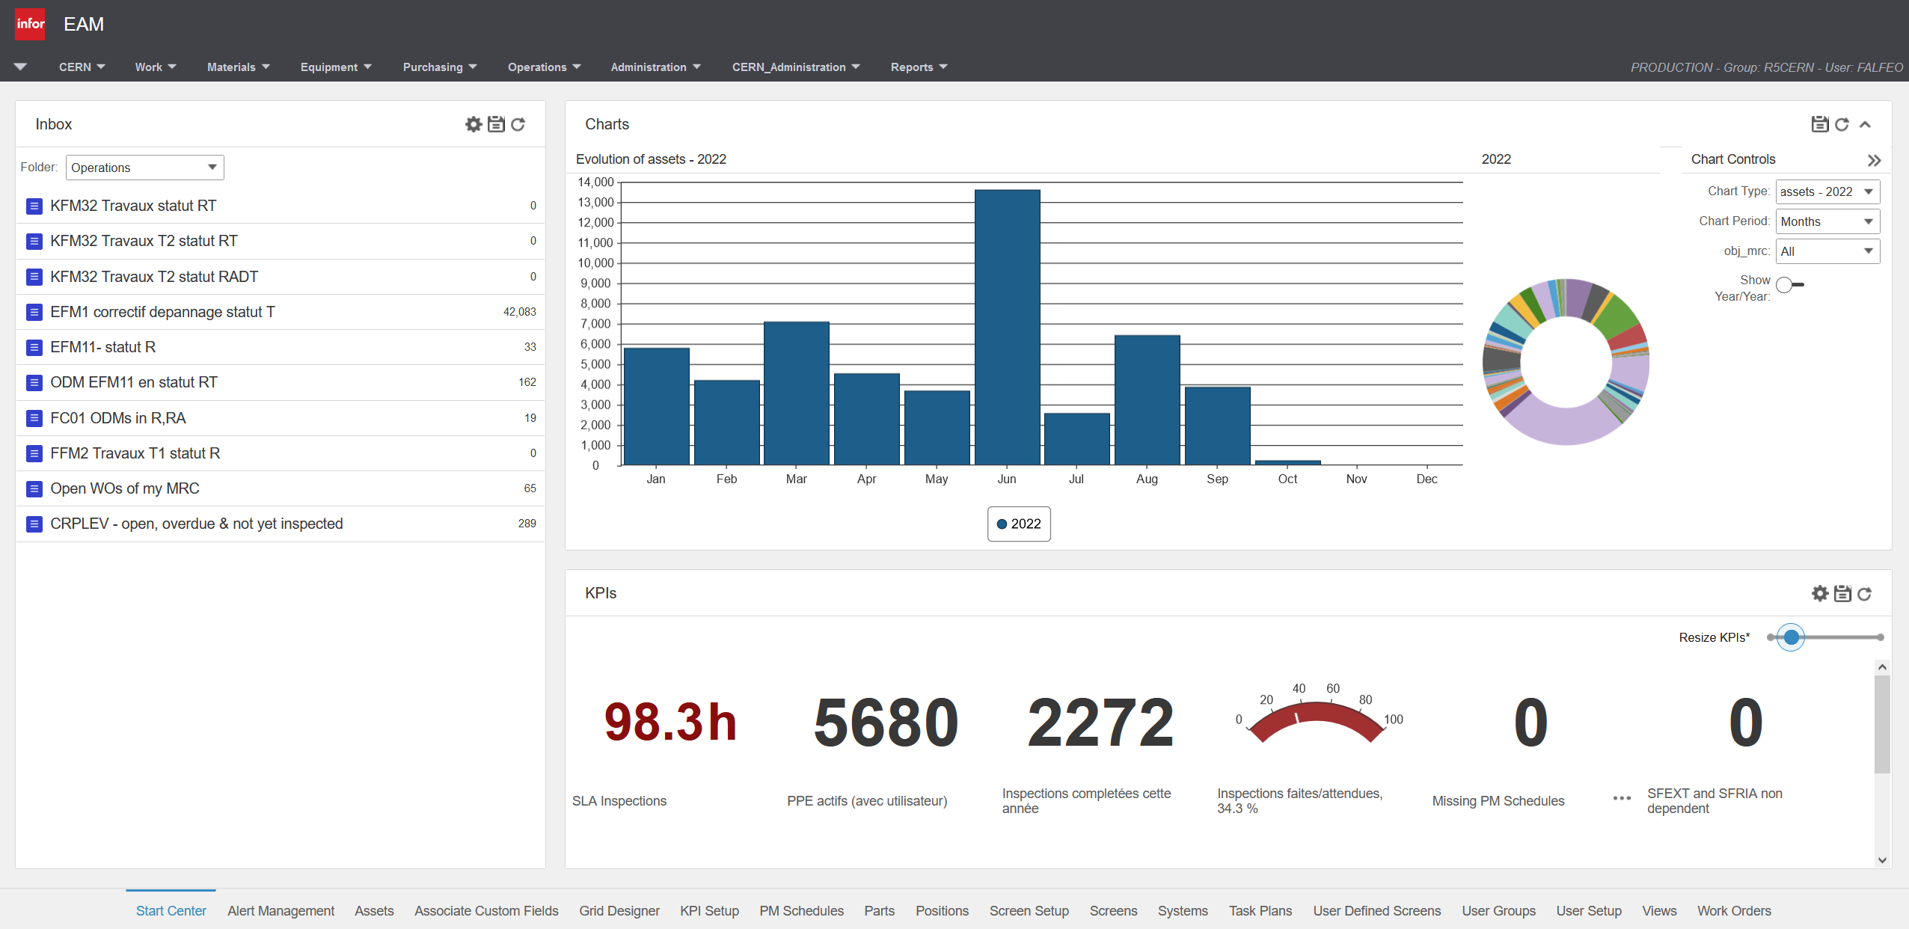
EAM - Start Center
Charts Graphical representation of data evolution
Inbox Quick links to a list of filtered records
KPIs Result of advanced calculations

Slide 4
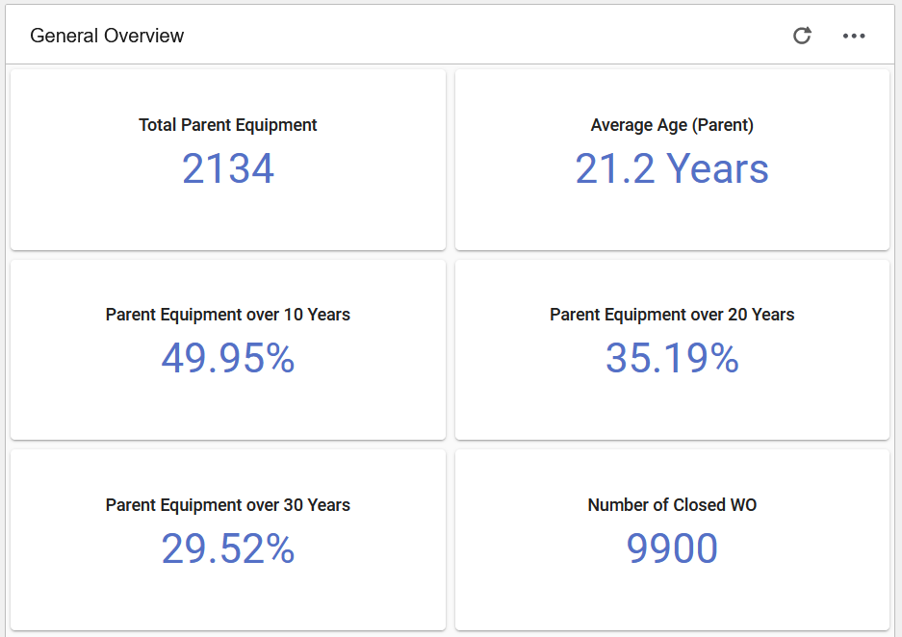
KPIs Types
Inconsistencies Checks
The advantage of KPIs is the instant understanding of your data.
Overview on the equipment situation
Statistics about maintenances and inspections

Slide 5
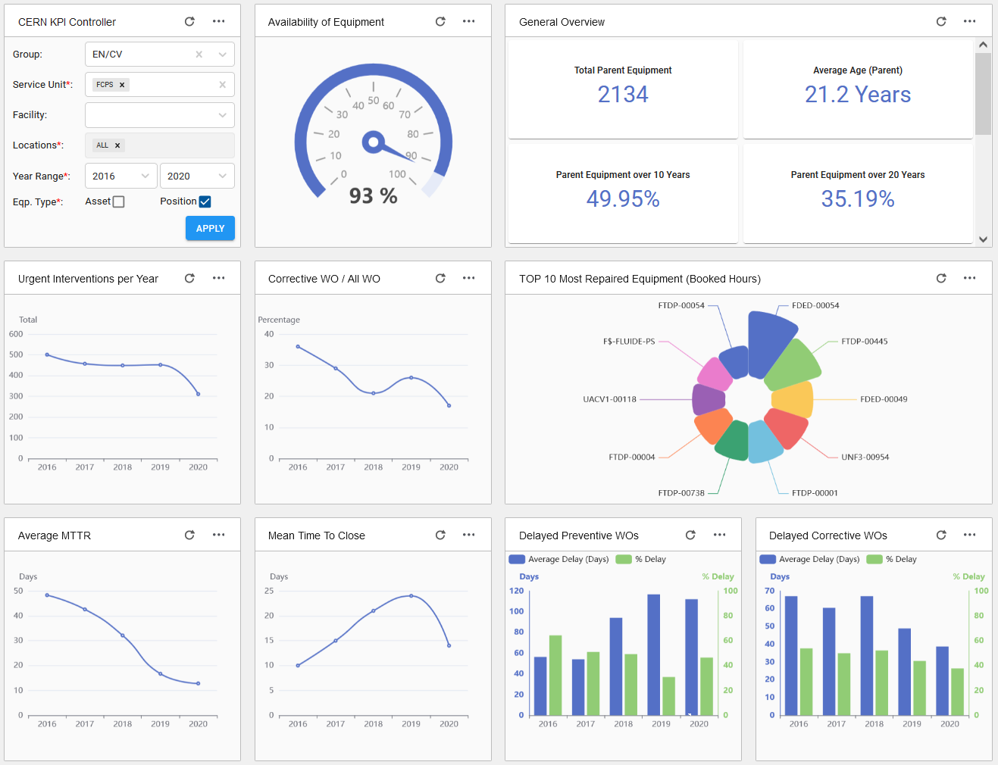
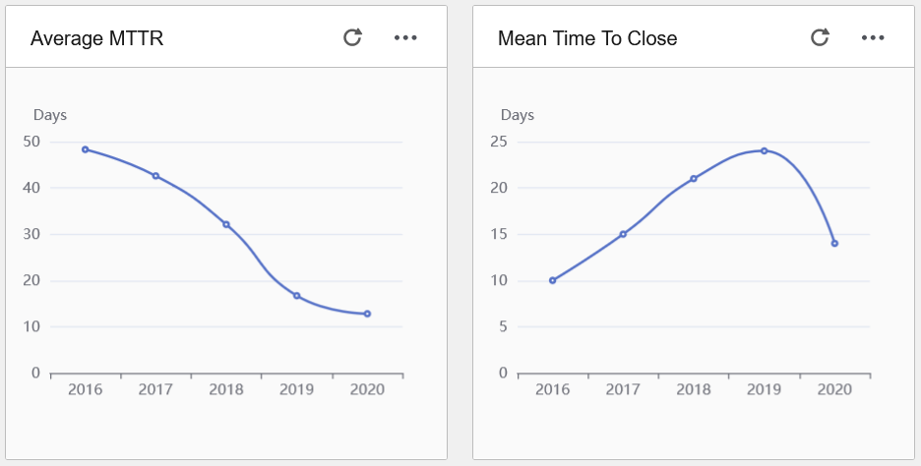
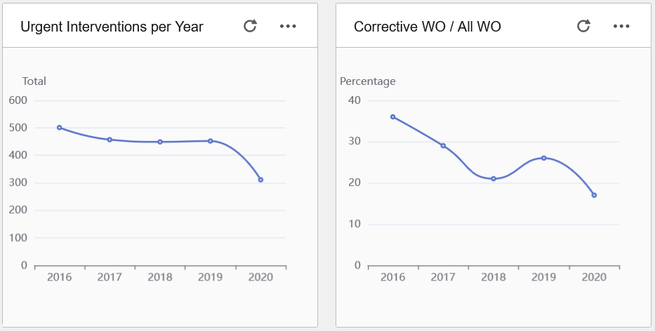
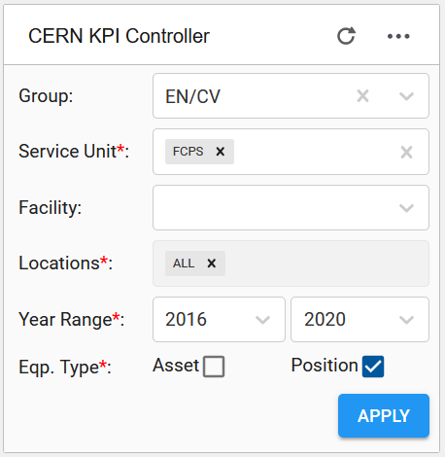
InforOS - Dashboard
Most Maintained Equipment List the most resource-consuming equipment in order to understand if some preventive maintenance plan needs to be reviewed.
Dynamic KPIs and Charts Parameters are available in the “KPI Controller” for better flexibility. A dashboard of this type can be used by several Groups.
Maintenance Evolution Representation of corrective maintenance in the time.
MTTR and MTTC Indicators of maintenance efficiency.

Slide 6
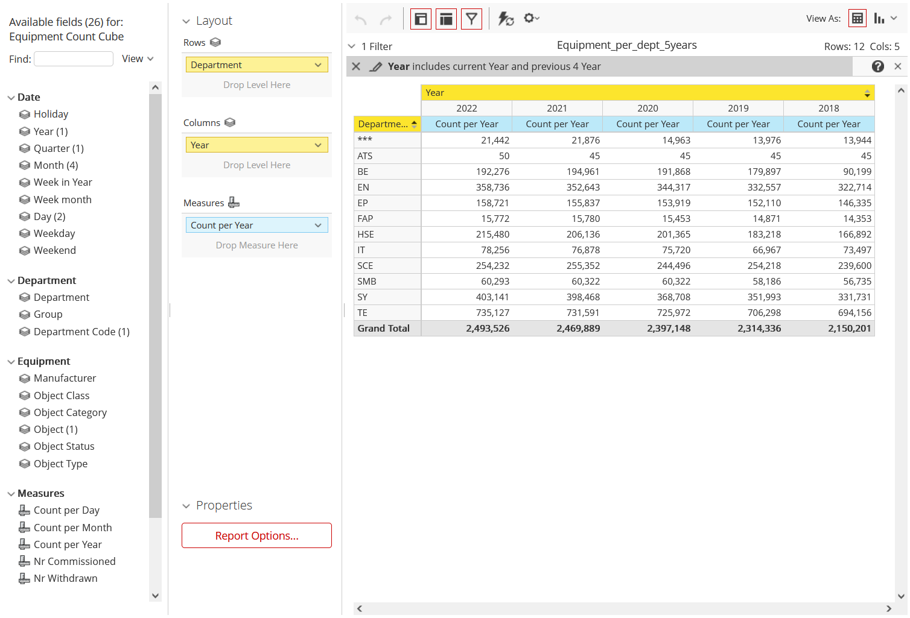
Pentaho Analyzer
Data Extraction Easy-to-use tool for data extraction and tables creation. Available to all CERN users even without SQL experience.

Slide 7
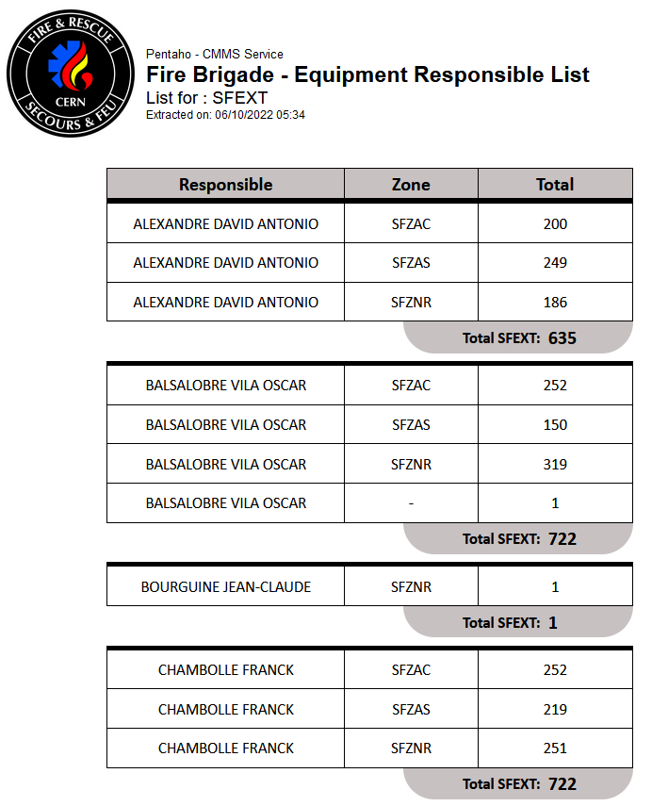
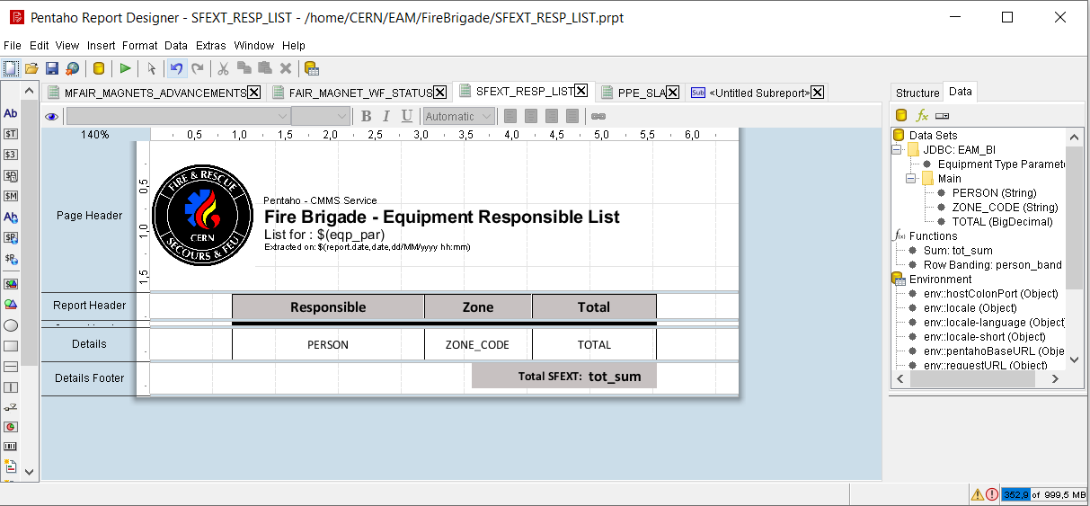
Pentaho Report Designer
Workload Distribution Allow the maintenance manager to see the amount of equipment per responsible in order to redistribute the workload per person.

Slide 8
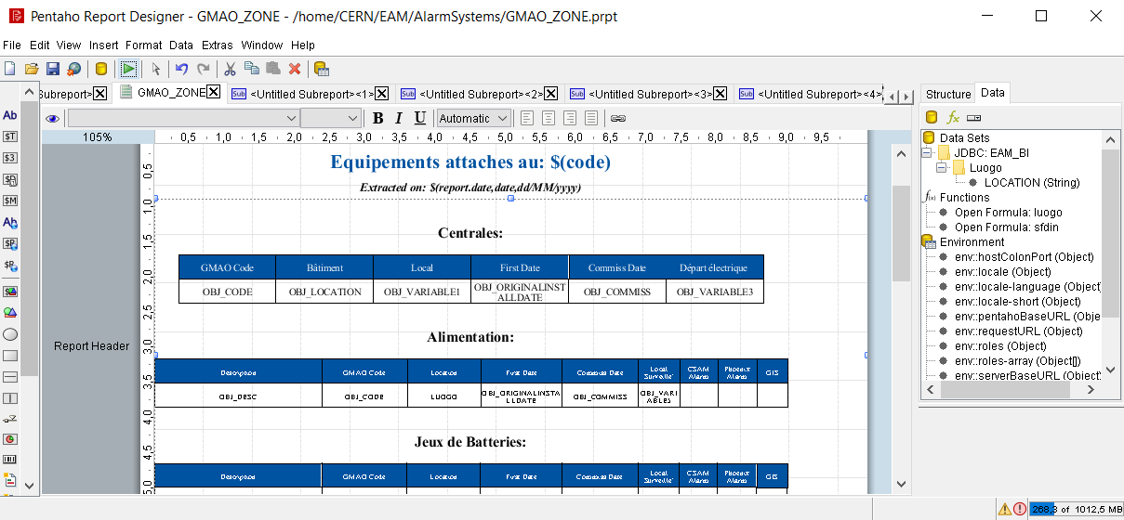
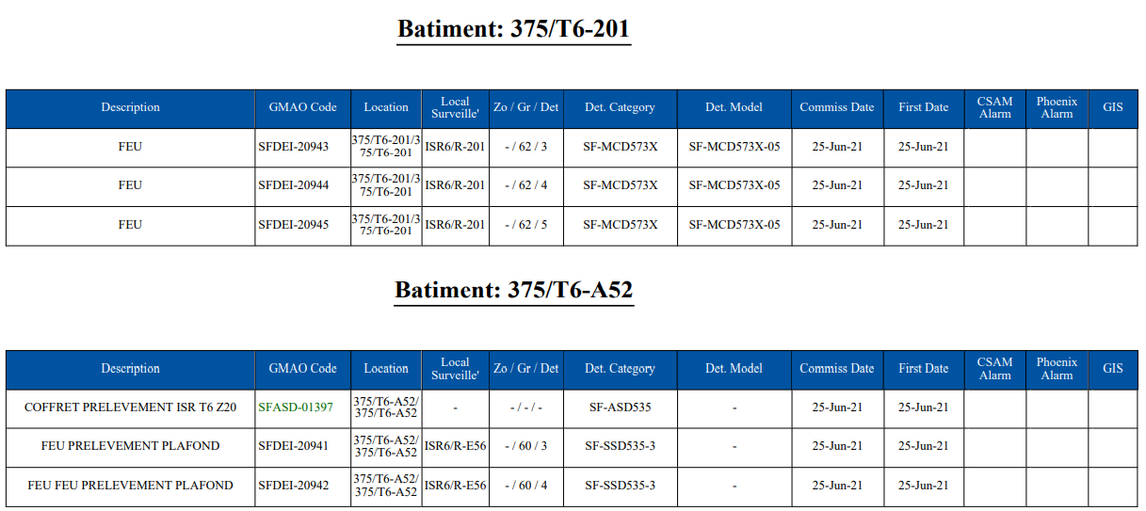
Pentaho Report Designer
Work Planning Display the list of equipment to maintain, ordered by location. The aim is to optimize the time for the inspections of equipment structures.

Slide 9
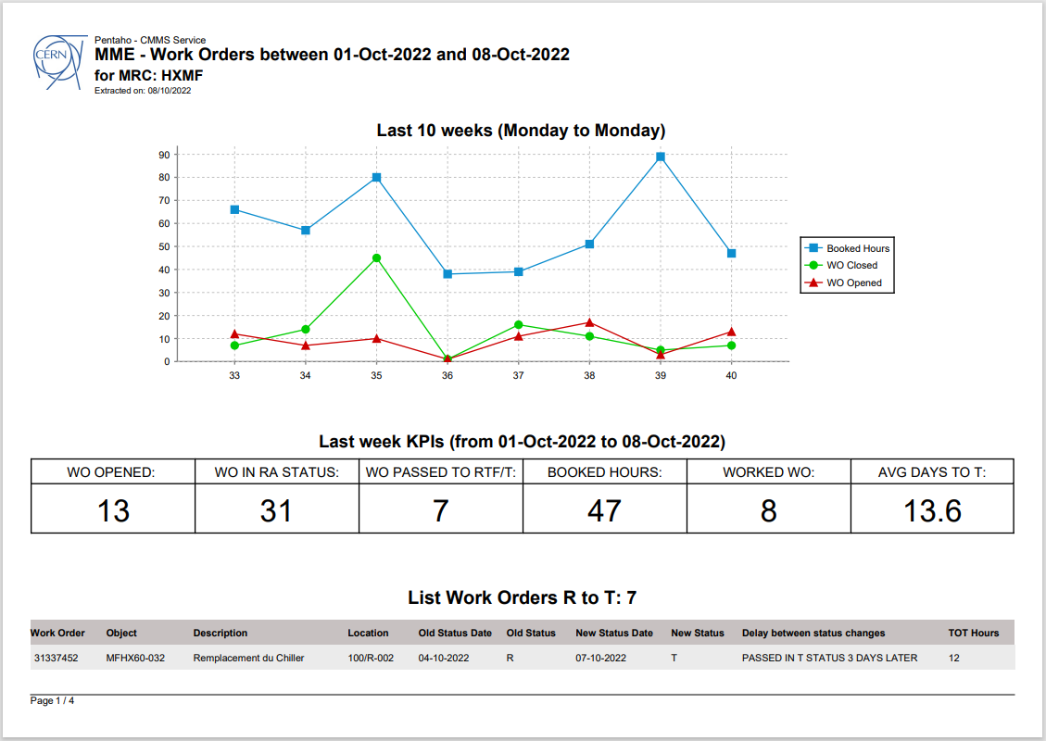
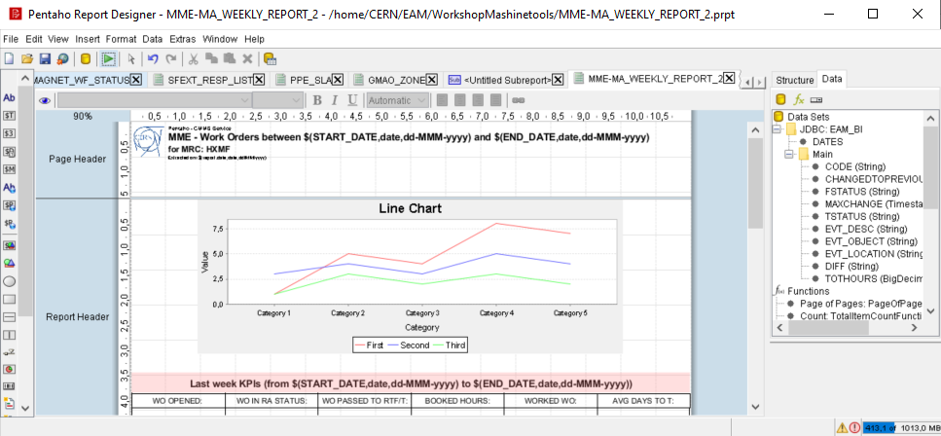
Pentaho Report Designer
Weekly Maintenance Summary Report used during weekly meetings where maintenance performances are analyzed.

Slide 10
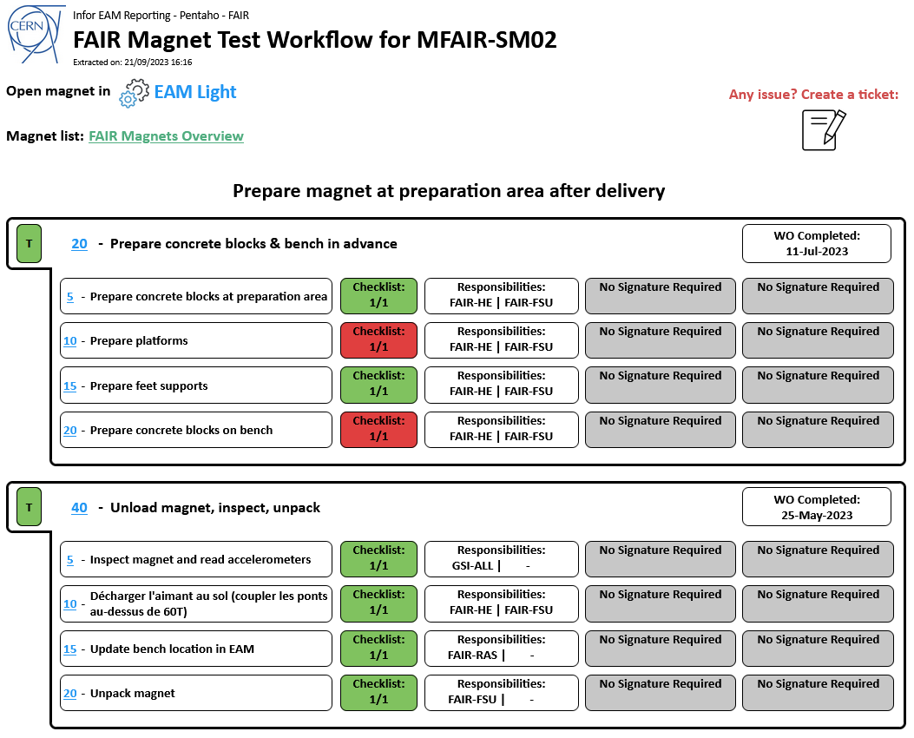
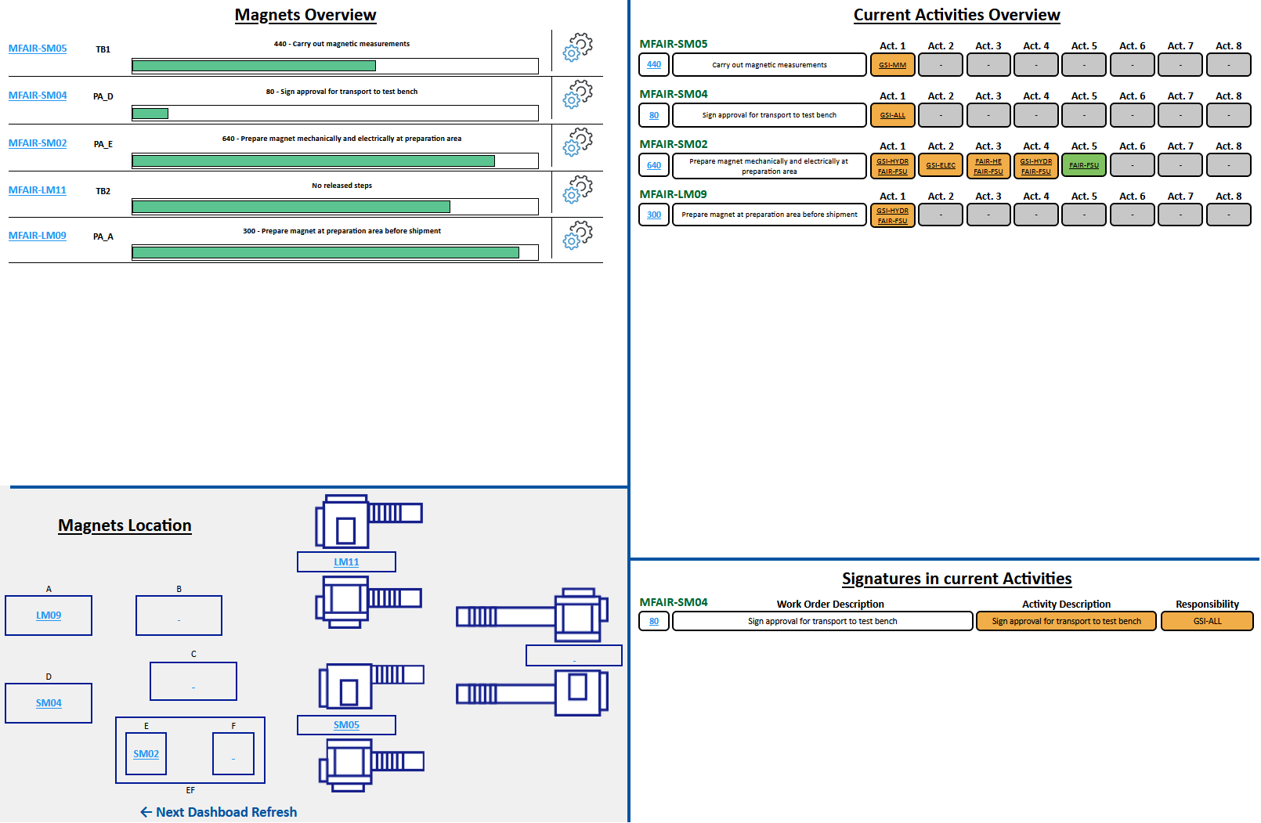
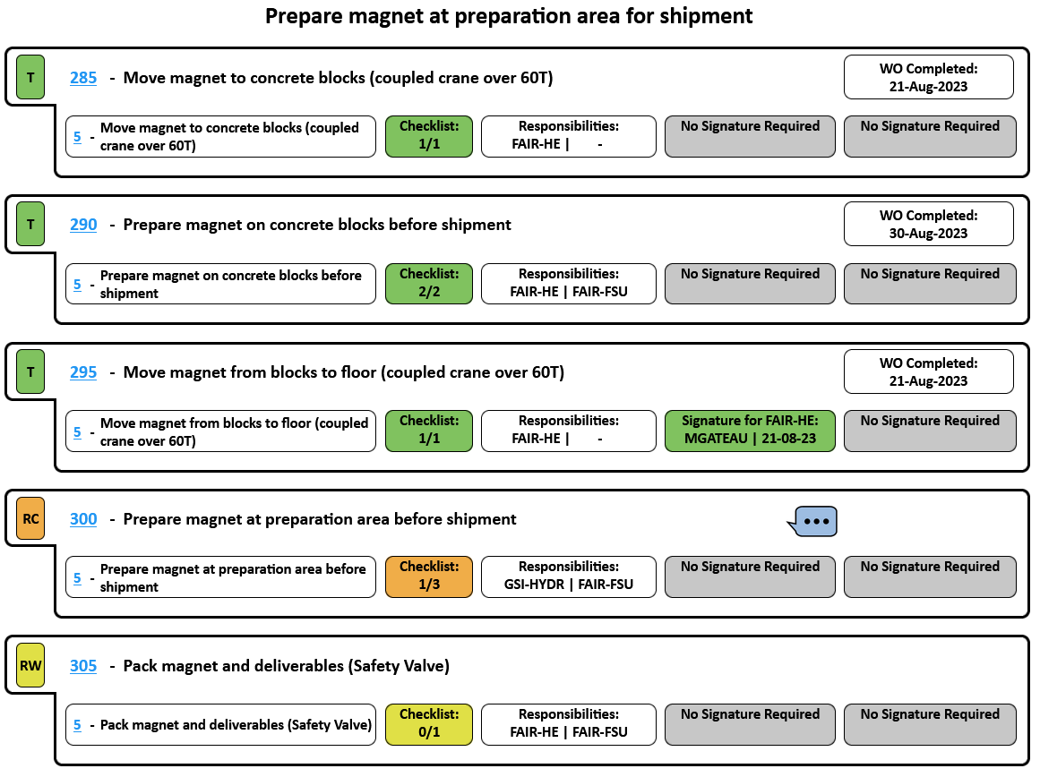
Pentaho Report Designer
Manufacturing and Testing Dashboard and workflow reports used while manufacturing or testing magnets at CERN.

Slide 11
Thanks for your attention!
fabio.alfeo@cern.ch

