Slide 2
Asset & Maintenance Management @ MAX IV – Present and Future
AMMW 2023 @ European Spallation Source
Johan Thånell & Magnus Klingberg, Date: September 27-29, 2023

Slide 3
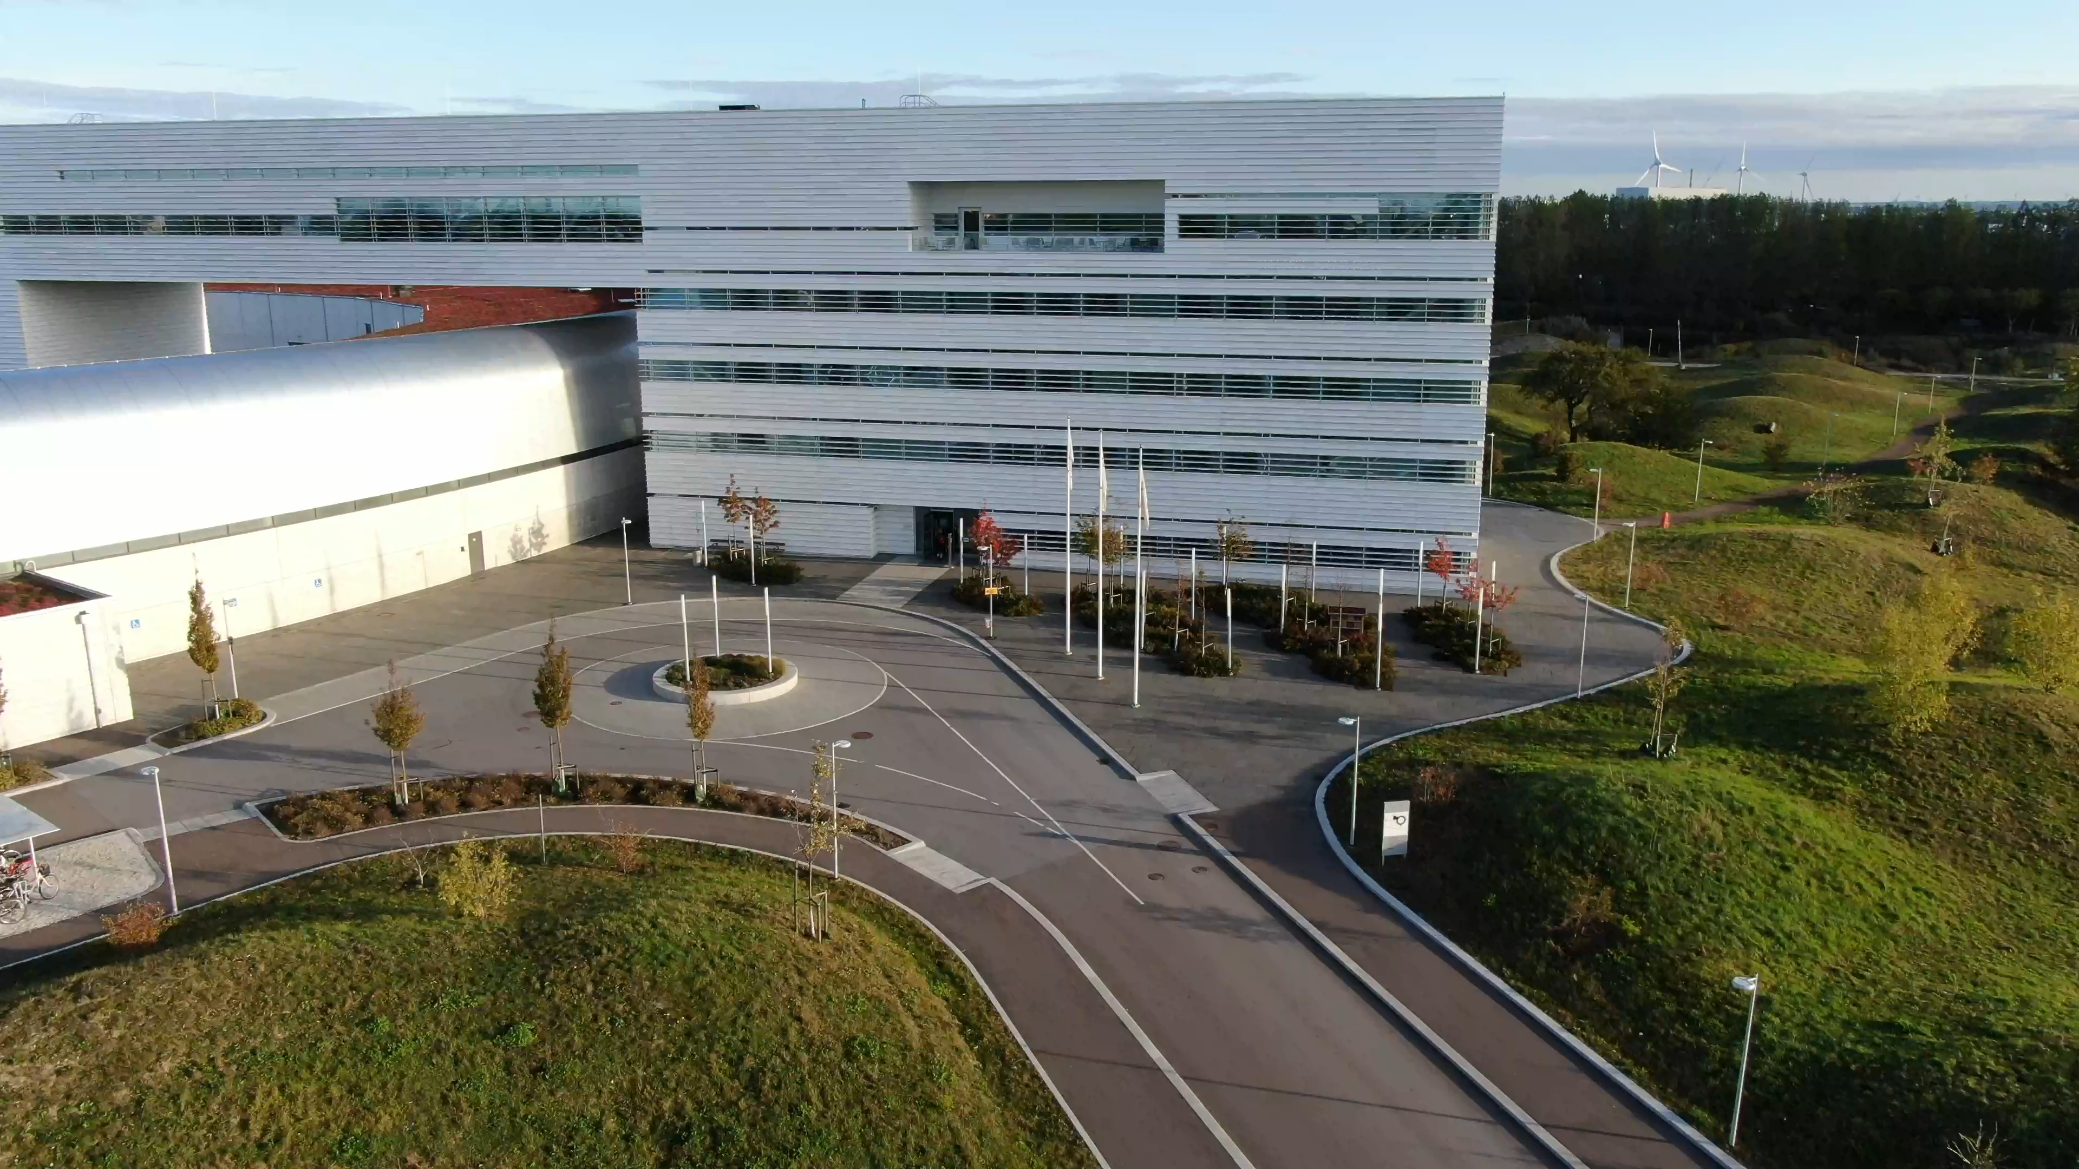
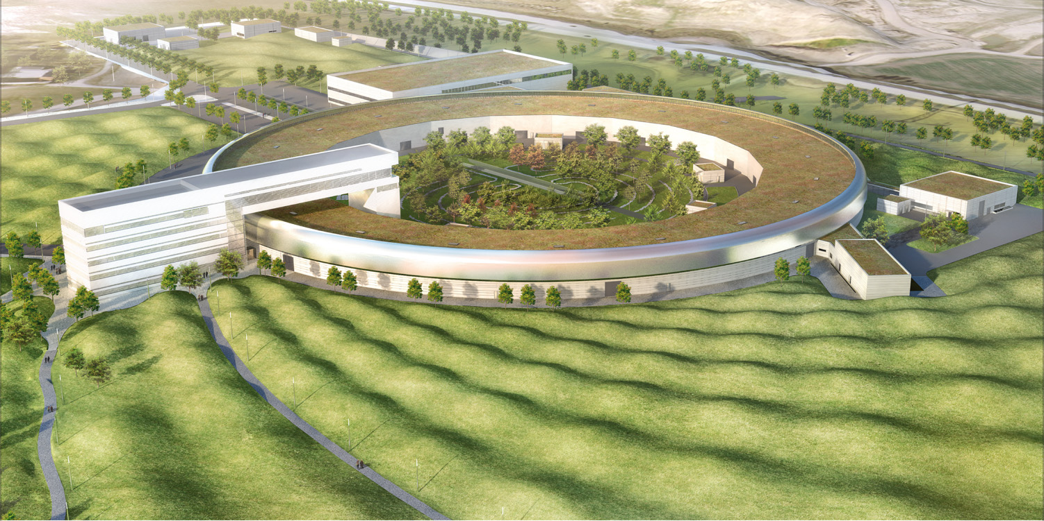
Outline
MAX IV in brief
The context - current state
The maintenance project 1.0
  Objectives & outcome
The maintenance project 2.0
  WP1: Maintenance Management System
  WP2: MAX IV Maintenance Strategy
  WP3: Way of Working

Slide 4
History of MAX Laboratory
1962 | The electron accelerator LUSY (Lund University Synchrotron) is constructed at KTH and moved to Lund.
1982 | The Swedish Government supports the MAX project in the Finance Bill, and MAX receives its first funding.
1983 | MAX laboratory moves into the M-building at LTH and the construction of MAX I starts based on the experiences of the accelerator physicists at LUSY.
1987 | MAX I is inaugurated. The storage ring has a circumference of 32 meters.
1992 | The construction of MAX II begins. The facility requires a new building so the M-building is extended.
1995 | MAX II is inaugurated. The new storage ring has a circumference of 96 meters and is specifically designed to create synchrotron light.
2008 | MAX III is inaugurated. The ring, which has a circumference of 36 meters, is used to test some of the technology that will be used in MAX IV.
2009 | The financing for MAX IV is finalized.
2011 | The construction of MAX IV starts at Brunnshög in the north of Lund. The first beamline programme is launched.
2016 | MAX IV is inaugurated. MAX IV becomes the first of 4th generation of synchrotrons and represents a major leap forward in terms of its capabilities and produce extremely bright and focused X-ray beams for a wide range of scientific applications.
MAX IV in brief
Notes:
Brief overview of history:
1982 Max project got its first funding
1987 MAX I was inaugurated
1995 MAX II inaugurated
2011 construction of MAX IV starts
2016 becomes the first 4th generation synchrotron facility.

Slide 5
MAX IV Key Figures
Situated in Lund, MAX IV was the first synchrotron to provide science with 4th generation of brilliant X-rays.
Short Facts:
A national funded Swedish research facility.
Inaugurated in June 2016.
~300 employees.
~1400 users annually.
~750 proposals submitted annually.
~30 industry user groups conducting 90 experiments annually (approx. 700 hours of proprietary research)
160 peer-reviewed articles
MAX IV in brief
Notes:
In 2022
1399 users
696 proposals submitted

Slide 6
MAX IV Basic Layout
Linac
Thermionic RF gun (storage ring injections)
Photoemission RF gun (SPF pulses)
39 S-band accelerating structures with
18 power systems (klystrons, modulators & SLED cavities)
Length: 300m
Full-energy top-up to both rings
Storage rings
3 GeV Ring (528m, hard X-ray)
400mA, 10-minute top-up, 20 MBA, 0.3 nm rad
1.5 GeV ring (96m, soft X-ray & UV)
500mA, 10-minute top-up, 12 DBA, 6 nm rad
Beamlines
15 beamlines in user operation
1 in commissioning phase
MAX IV in brief
Notes:
LINAC
Running at 10 Hz
Two pre-injectors
Soft X-ray Laser
STORAGE RINGS
1.5 GeV storage ring, 96 m circumference
The MAX IV 1.5 GeV storage ring is based on a compact double-bend achromat lattice
Nominal current, nbr of achomats, Horizontal emittance
The 3 GeV storage ring with a circumference of 528 m
The MAX IV 3 GeV storage ring is based on a novel multibend achromat lattice
Compactness of the lattice: 7 bend magnets with NEG cotad copper vacuum system
Nominal current, nbr of achomats, Horizontal emittance

Slide 7

Beamlines at MAX IV
Imaging
MAXPEEM
NanoMAX
DanMAX
SoftiMAX
Diffraction & Scattering
Balder
DanMAX
CoSAXS
FemtoMAX
ForMAX
Spectroscopy
HIPPIE
FlexPES
SPECIES
Bloch
Veritas
FinEstBeAMS
MX (Macromolecular Crystallography)
BioMAX
MicroMAX
MAX IV in brief
Notes:
ForMAX and SoftiMAX was put into user operation in 2022
MicroMAX will be commissioned in 2023

Slide 8
Beamlines at MAX IV
Imaging
MAXPEEM - photoelectron microscopy beamline (SPELEEM).
NanoMAX - hard X-ray BL for imaging and diffraction studies at the nanoscale.
SoftiMAX - for study the morphology, chemical and/or magnetic states (STXM / CXDI).
Spectroscopy
HIPPIE - beamline designed for time resolved spectroscopy (AP-XPS).
FlexPES - flexible PES beamline caters for Surface/Material Science and LDM.
SPECIES - soft X-ray beamline for AP-XPS and RIXS experiments.
Bloch - dedicated to high resolution ARPES (Micro-ARPES, spin-ARPES).
Veritas - high resolution RIXS beamline for the soft X-ray region.
FinEstBeAMS - UV and soft X-ray spectroscopy beamline (XPS, XAS, PLS, PEPICO, TOFMS).
Diffraction & Scattering
Balder - multimodal beamline dedicated to hard X-ray spectroscopy (XES/XAS).
DanMAX - offers a flexible PXRD instrument and full field imaging (XRD - Tomo).
CoSAXS - SAXS instrument and high coherence for XPCS.
FemtoMAX - designed for ultrafast laser pump/x-ray probe experiments.
ForMAX - research on new and improved materials based on components from wood (tomography, SWAXS)
MX (Macromolecular Crystallography)
BioMAX – highly automated MX experiments.
MicroMAX - rotational crystallography.
MAX IV in brief
Notes:
ForMAX and SoftiMAX was put into user operation in 2022
MicroMAX will be commissioned in 2023

Slide 9
Current state of user operation
2021’s statistics:
R1- Availability: 97.22% (planned delivery: 3888h, MTTR: 2.16h, MTBF: 77.76h)
R3 - Availability: 96.88% (planned delivery: 3744h, MTTR: 2.54h, MTBF: 81.39.00h)
SPF - Availability: 94.84% (planned delivery: 2952h, MTTR: 0.66h, MTBF: 12.78h)
327 reported failures
2022’s statistics:
R1 - Availability: 98.41% (planned delivery: 4848h, MTTR: 1.40h, MTBF: 88.15h)
R3 - Availability: 98.19% (planned delivery: 4464h, MTTR: 1.30h, MTBF: 72.00h)
SPF - Availability: 97.04% (planned delivery: 4272h, MTTR: 0.39h, MTBF: 13.14h)
442 reported failures
2023’s statistics (to date):
R1 - Availability: 98.59% (planned delivery: 3600h, MTTR: 1.41h, MTBF: 100.00h)
R3 - Availability: 98.44% (planned delivery: 3232h, MTTR: 1.37h, MTBF: 89.78h)
SPF - Availability: 96.37% (planned delivery: 3168h, MTTR: 0.36h, MTBF: 9.99h)
395 reported failures
The Context
Notes:
2021 planned delivery affected by COVID-19
Goals
R1 - MTBF 72 hours
R3 - MTBF 72 hours
SPF - MTBF 24 hours
Planned deliveries falls 20% short of planned goals
Tend more failures per year, but improved on handling?

Slide 10
Current state of maintenance management
MAX IV in user service since June 2016. Transitioned from a build-up phase to stable operation. Critical assets are reaching end-of-life.
The responsibility of assets and maintenance management is distributed:
  Machine: System owners delegate to sub-system owners.
  Beamlines: BL’s own the equipment. Get help from subject matter experts when requested.
Asset information is scattered. Info stored on multiple platforms.
Inventory of spare parts based on gut-feeling and self-organised by the groups/teams.
Preventive maintenance is often self-initiated and not driven by a policy or conscious decision.
The Context
Notes:
MAX IV in service to users since 2016.
End to life
Power supplys
Network switches (all changed)
Wifi AP upgraded this year
modulator in Linac
Different teams /sub-systems
Vacuum
Technical infrastructure – Water, ventilation and gas
Electrical & Power supply systems
ICT
IT infrastructure
Software
Electronics
Maintenance work in controlled areas:
During user operation: Restricted to once a month. (more time if requested)
Outside of user operation: 2 x shutdown periods.

Slide 11
Maintenance project 1.0
The Maintenance project 1.0 started in 2019.
Triggered by MAX IV needing a way to manage all equipment that require maintenance.
After an evaluation, J5 was chosen as asset management system.
Functional and Technical Specifications was created with the input from key stakeholders.
With the assistance of Hexagon, an internal resource set up and configured J5 in accordance with the Functional and Technical specifications.
To test the J5, a pilot was performed with one of the BL front ends and for the machine was one of the achromats in the R3 used.
Proof-of-concept was produced; J5 test-populated with equipment.
The project resource coordinating & monitoring the J5 development quit, and the project went into a slower pace.
Maintenance project 1.0
Notes:
Max IV needed a way to manage work with maintenance in a structured way.
J5 was chosen as asset tool.
After the functional and technical specifications was gathered J% was configured for our needs. One BL frontend was used as pilot for
Sub –system owners started to test J5 with their assets
Unfortunately, my college quit we could not hire a new person because of hiring freeze

Slide 12
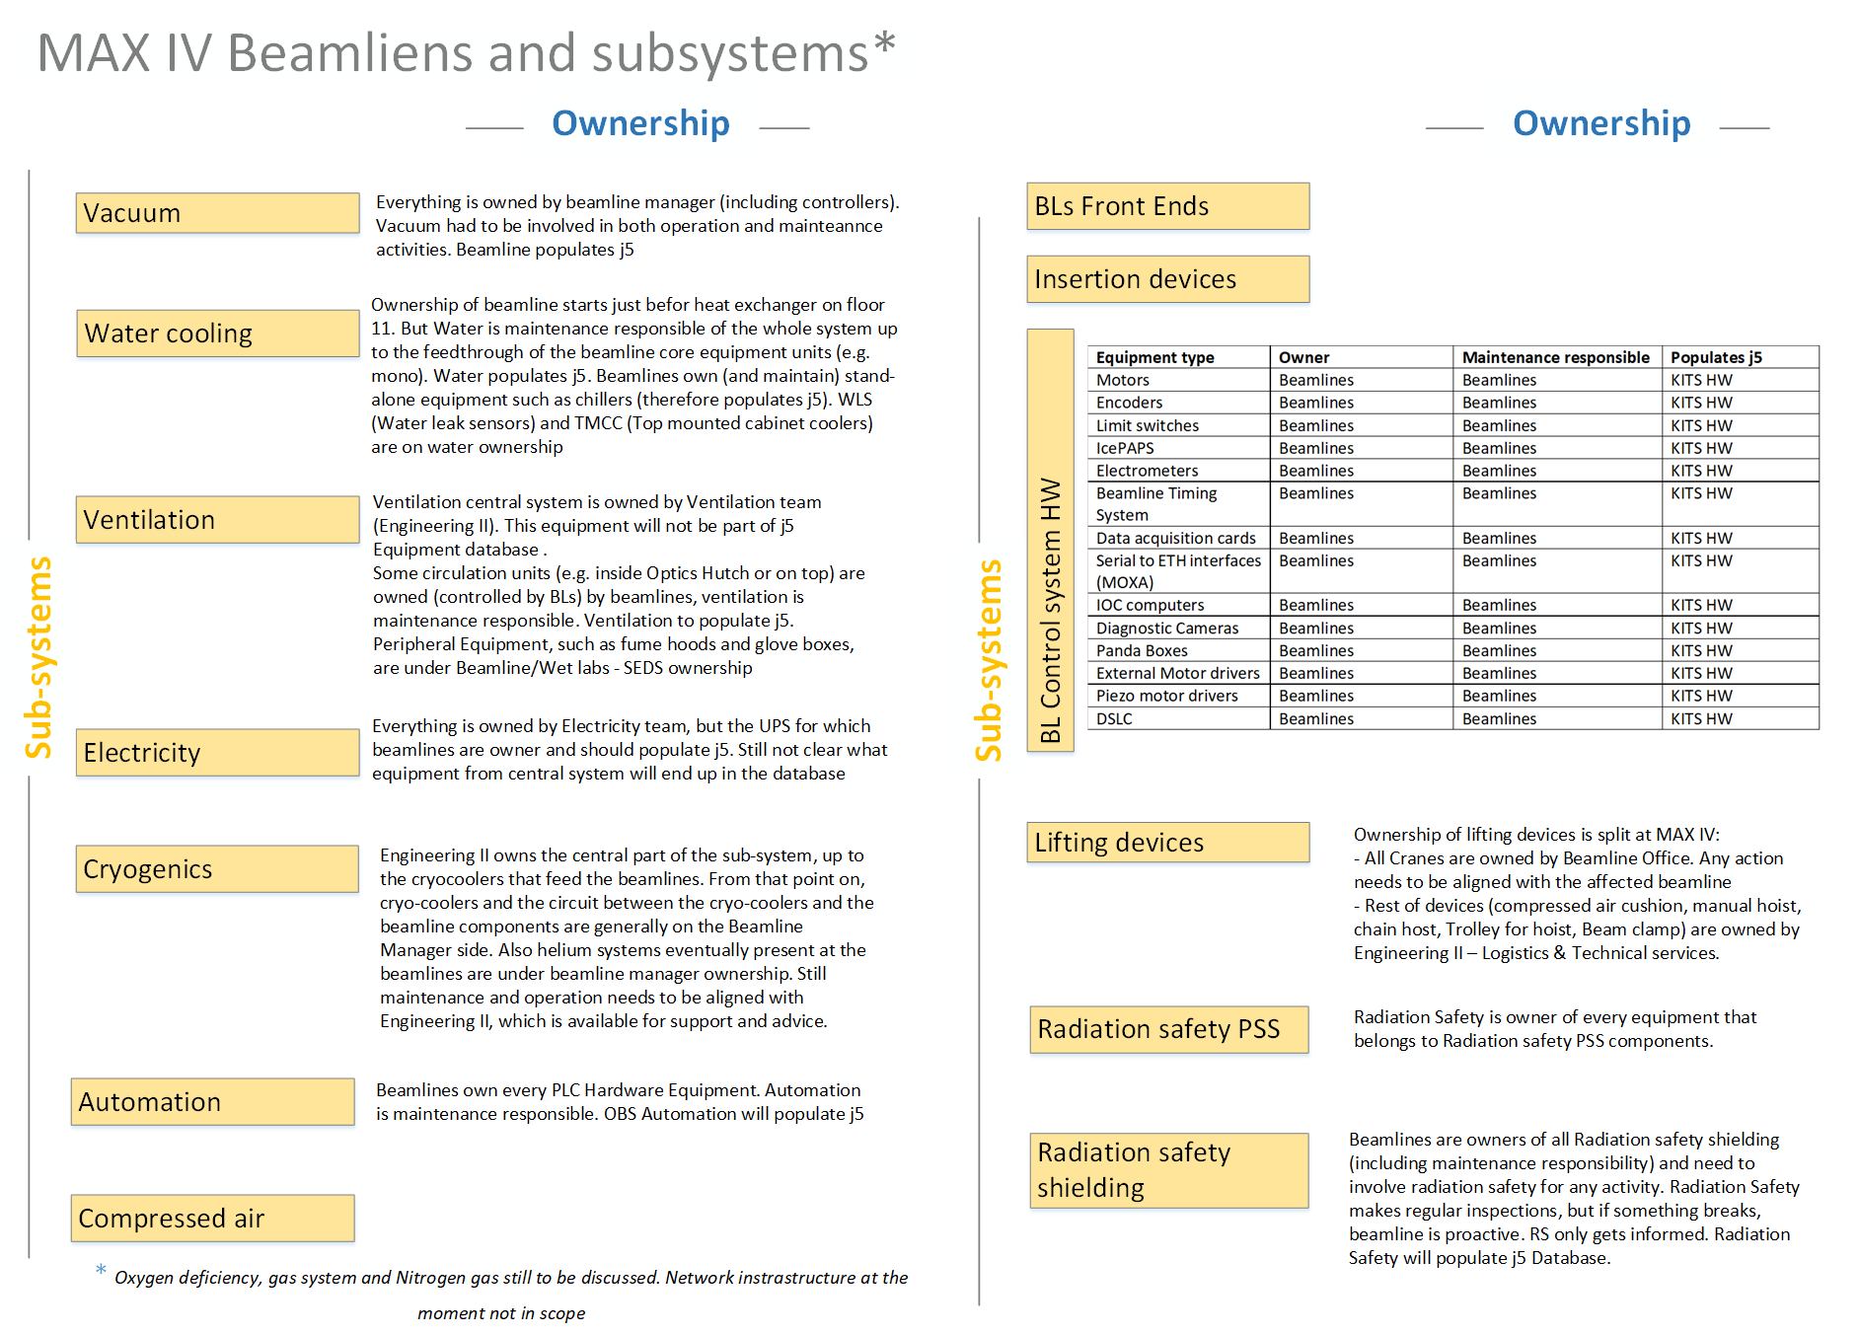
Agreement of Asset Ownership
Maintenance project 1.0
Notes:
95% of asset ownership is agreed
Equipment in scope
Corner cases of ownership still remains to be resolved.

Slide 13
MAX IV Naming Convention
Eq. Unit | Components in scope | Owner | Maintenance responsible | MAX IV naming convention | Manufacturer | Product/drawing number
Heat absorber | Heat Absorber | Front End | Front End | B310A_FE_VAC_HA01 | TOYAMA | 1AJ-00545_3
 | Thermocouple | Front End | Front End | B310A_FE_DIA_TCO09 | Sakaguchi E.H | T35162H
 | Thermocouple | Front End | Front End | B310A_FE_DIA_TCO10 | Sakaguchi E.H | T35162H
 | Safety limit switches | Front End | Radiation Safety | B310A_FE_VAC_HA01_BSL01/2/3/4 | Rockwell | 440P-MDPB22B
 | Pneumatic actuator | Front End | Front End | B310A_FE_VAC_HA01_ACT01 | CAMOZZI | 31M2A063A020V
 | Solenoid valve | Front End | Front End | B310A_FE_VAC_HA01_SOV1 | CAMOZZI | EN531-16-P13
 | Normal machine Limit switches | Front End | Front End | B310A_FE_VAC_HA01_LSW05/06 | Rockwell | 440P-MDPB22B
MAX IV naming convention name:
      B310A_FE _ DIA_TCO09
CoSAXS
(system)
Front End
(location)
Diagnostic (subsystem)
Thermocouple (type)
Where?
What?
Maintenance project 1.0

Slide 14
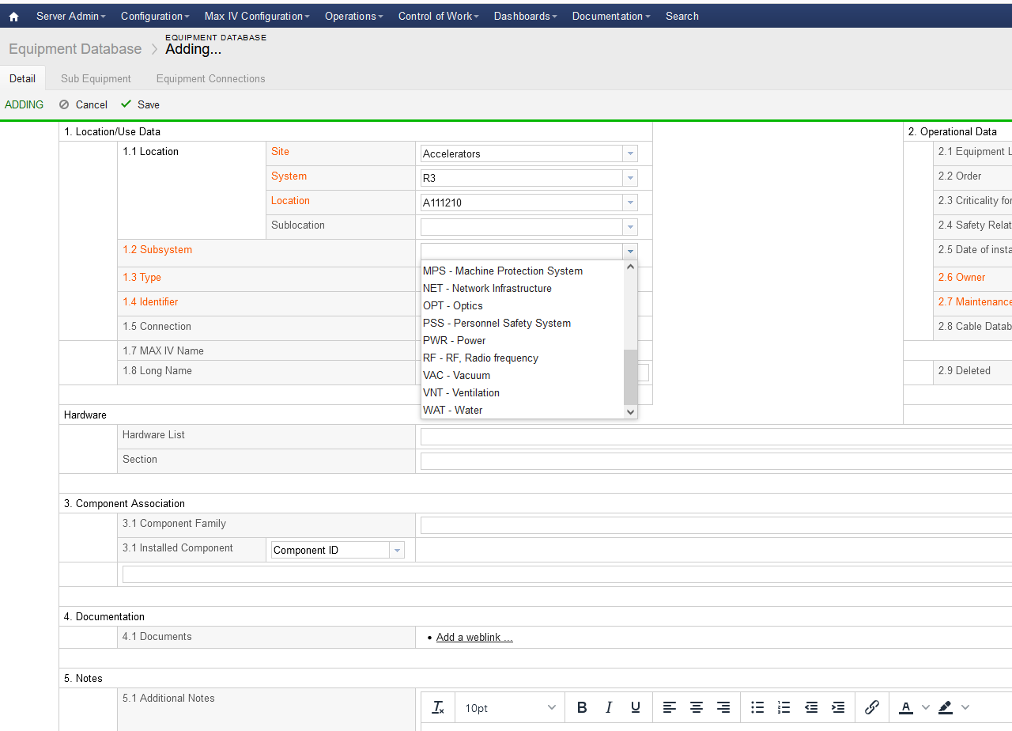
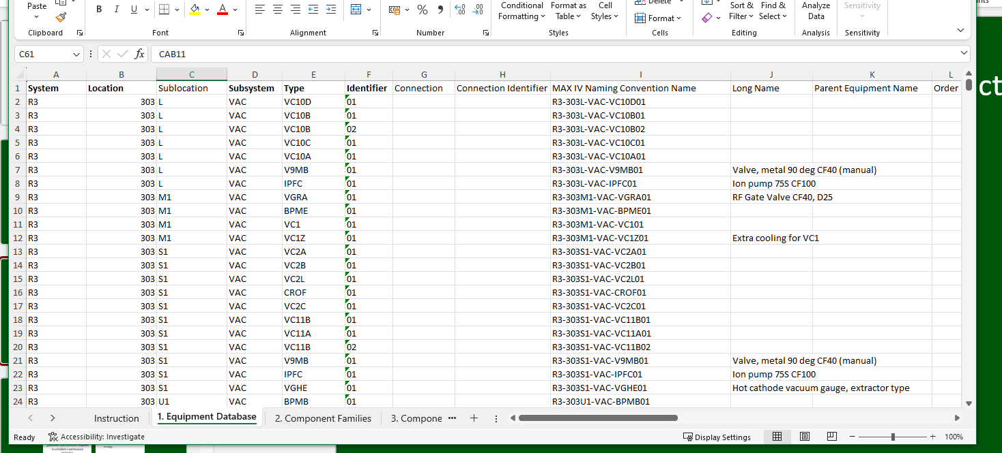
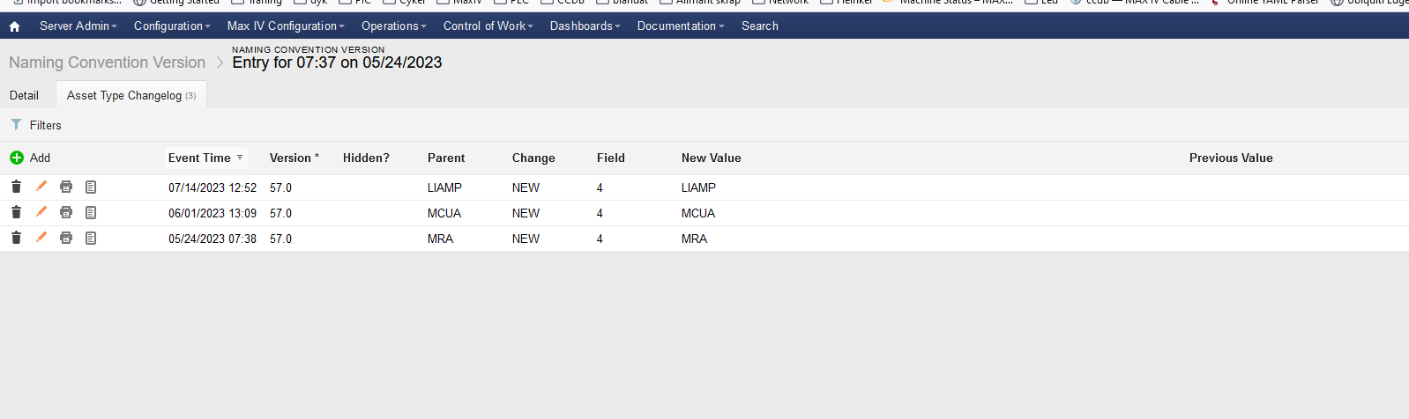
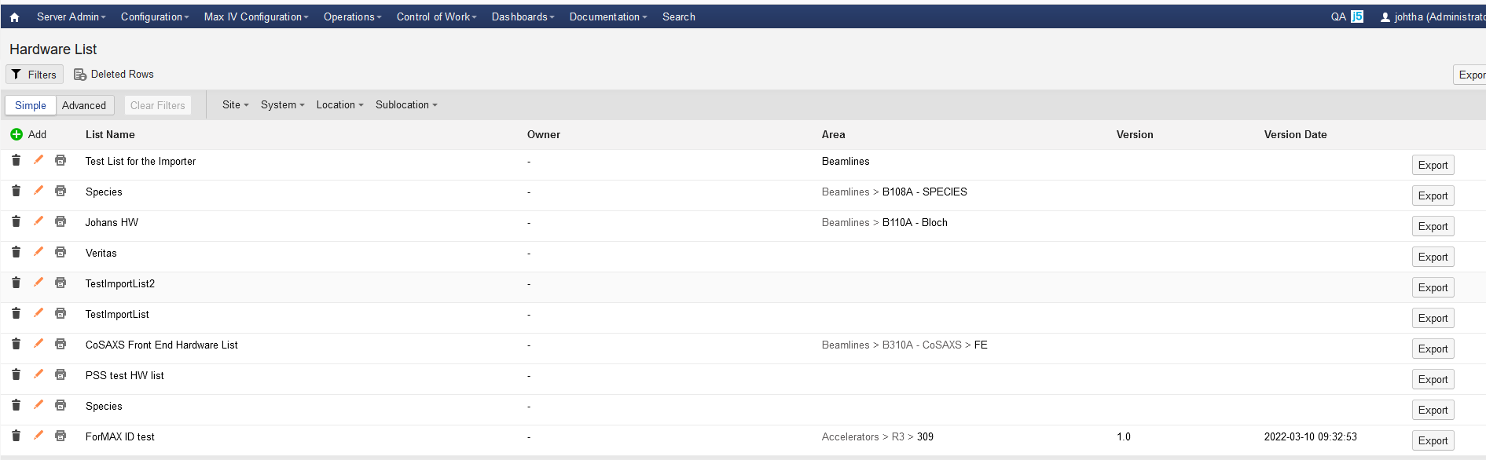
Status of J5
Notes:
Add equipment via import file, if you have many equipment's
Or direct in J5
Hardware lists are used for the technical teams on how to connect equipment to different control systems
Naming convention are built up / published in J5

Slide 15
Maintenance Project 2.0
Restart of project in essence to:
Develop a MAX IV Maintenance Strategy that shifts MAX IV approach to maintenance management from predominantly a reactive approach, to a systematic proactive approach.
Roll-out a cross-functional process and Way-of-Working cohesively, coordinated and consistently with maintenance at MAX IV.
Empower staff with processes and Technology:
    One reliable and trusted source of information related to equipment.
    Gain asset and maintenance intelligence.
    Facilitate and streamline the maintenance efforts. tasks and reporting on work performed.
Maintenance project 2.0

Slide 16
The Project Roadmap
Timeline for project with requested resources available from August 1, 2023.
Team 5 – appr. ~30
Team 4
Team 3
Team 2
Team 1
Pilot
Work Package 3 – Way of Working
Maint. capacity & capabilities
Laws & regulations
KPIs
Criticality model
GAP & Plan
Work Package 2 – Max IV Maint. Strategy
GRATIS
CableDB
Config. & develop.
Work orders
Equipment DB & HW list
Populate J5
ID system
Work Package 1 – Technology
2022
2023
2024
2025
2026
2023-09-27

Slide 17
WP1: Technology
Objective
Key Tasks
Implementation of an asset id system
Development of MAX IV customizations /configurations of J5:
    Equipment database
    HW list import
    WO management
    Planning & scheduling
    Inventory management
    Log management
    Reporting & analysis
    Cable database
Population of equipment data into J5. (by resource teams/system owners/beamlines)
Introduce a maintenance management system, i.e. J5, which can serve as a single master source of data concerning the MAX IV's asset portfolio.
✔
✔
✔
✔
Activity completed
Maintenance project 2.0
Notes:
Our overall implementation plan of the functionalities we plan to do are:
Asset registration
Work order basic functionality with approval process
Work order extended functionalities, including checklists
Predictive maintenance
Reports
Spare part handling & warehouse management
Installation planning: Time plan, staff plan, space accessibility
Alerts for planned maintenance
Warranty
Risk assessment

Slide 18
Current activities
Continue the development of equipment tracking inJ5 (planning & scheduling of maintenance tasks, stock inventory, Cable database)
Population of equipment data in to J5 (by resource teams / system owners / beamlines)
and reporting on work performed.
Maintenance project 2.0
Notes:
Future development of J5, inhouse web developer plus help from Hexagon
The population of equipment in to J5 will be done during the autumn and spring 2024. Beamline office will work with one BL at the time. We will also work with one subsystem owner at the time
Subsystem owners
Automation
Vacuum
Electrical & Power supply systems
Electronics
Technical Infrastructure
IT Infrastructure

Slide 19
WP2: MAX IV Maintenance Strategy
Objective
Key Tasks
Define direction and goals for maintenance efforts to align with the MAX IV overall strategy and roadmap. Set the facility common guidelines and decisions required to establish maintenance programs.
Set strategic goals
  Assess current state & future state.
  Identify KPIs and targets for KPIs.
  Create a roadmap to reach future state
Design a MAX IV common model for assessing equipment/component criticality, incl. cost/benefit.
Identification of required organisational capacity and capability to sustain maintenance strategy.
Maintenance project 2.0

Slide 20
Current activities
Survey of staff to investigate and document the “Current state” of MAX IV maintenance management.
Agree on and establish a common vision of “Future state” of maintenance management at MAX IV in the next 3-4 years.
Conduct a GAP analysis -> identify focus areas to achieve desired future state.
and reporting on work performed.
Maintenance project 2.0
Notes:
There will be a survey in early September for different key stakeholders. The survey will be done by the consulting company to establish our “current sate” on maintenance
Max IV will continue work on the “future state” for the next three years. I
Consultant company help with current state, online interviews with key stakeholders and more indepth interviews. Kan lägga till mer när vi har haft vår workshop 30/8
Ska någon av punkterna I WP ändras?

Slide 21
WP3: Roll-out of Way of Working
Objective
Key Tasks
Training & education on j5.
Maintenance planning for each of equipment in scope:
  Evaluation, define criticality, set maintenance strategy, identify tasks & req. skill sets
Establish processes for how to work.
  GAP analysis
Set routines, evaluate and improve process.
Translate the MAX IV maintenance strategy into maintenance plans, processes and tasks relevant to each team concerned.
Key tasks in WP are repeated per team.
Pilot with an Engineering team or Gas technicians.
Maintenance project 2.0

Slide 22
Current activities
Recruitment of a maintenance engineer to drive the process of changing maintenance practices and procedures.
Maintenance project 2.0

Slide 23
What MAX IV expect from strategy driven maintenance management
One single, easily accessible and consistent master source of information for equipment portfolio:
  Retained knowledge of the assets and equipment at MAX IV.
  Logged and tracked corrective maintenance activities and equipment failures.
Common model for MAX IV to evaluate and classify of equipment/component criticality:
  Cost-benefit analysis to reduce costly repairs or replacement.
  Sustained high reliability and unnecessary downtime avoided.
  Reduced risk of single points of failure (SPoF).
Ensured compliance and safety:
  Clarified roles and responsibilities related to maintenance of equipment.
  Prove compliance with relevant laws and regulations and having readily available documented evidence in one location.

Slide 24
Questions?

Slide 26
Beamline Characteristics
Beamline | Available techniques
Bloch | Angle Resolved Photoelectron Spectroscopy (ARPES) for studies of the electronic structure of solids and surfaces.
FinEstBeaMS | Gaseous Photoelectron (and Auger) Electron Spectroscopy (GPES) of low density matter and Photoluminescence Electron Spectroscopy (PLES) of solids.
MAXPEEM | Aberration-corrected photoelectron microscopy for investigation of surfaces and interfaces in the soft X-ray range (XPEEM, LEEM, µ-XPS, µ-XAS, XMCD, nano-ARPES).
Balder | X-Ray Absorption Spectroscopy (XANES and EXAFS), X-Ray Diffraction (XRD) with emphasis on in-situ and time resolved studies.
BioMAX | Macromolecular crystallography (MX) with a high degree of automation and remote user access.
NanoMAX | Imaging with spectroscopic and structural contrast techniques on the nano scale.
HIPPIE | Near ambient pressure photoelectron spectroscopy (APXPS) on solids and liquids.
Veritas | Resonant Inelastic X-ray Scattering (RIXS) with unique resolving power and high spatial resolution.
FemtoMAX | Time-resolved hard Small Angle X-Ray Scattering (SAXS) and X-Ray Absorption Spectroscopy (XAS) methods for studies of ultrafast processes.
FlexPES | Soft X-Ray Photoelectron Spectroscopies (XPS) for studies of low density matter and solids.
SPIECES | Resonant Inelastic X-ray Scattering (RIXS) and near ambient pressure X-Ray Photoelectron Spectroscopies (APXPS).
CoSAXS | Small Angle X-Ray Scattering (SAXS), Wide Angle X-Ray Scattering (WAXS) and coherent techniques for soft matter and life science.
DanMAX | Powder diffraction (XRD) and tomographic imaging (XTM) of hard (energy) materials.
SoftiMAX | Scanning transmission X-ray microscopy (STXM) and coherent imaging methods.
ForMAX | Full-field tomography, Small/Wide Angle X-Ray Scattering (SAXS/WAXS), and scanning SAXS/WAXS.
MicroMAX | Macromolecular Crystallography with a wide range of sample delivery systems, time-resolved studies.
Available Techniques
X-ray absorption spectroscopy (near edge and extended X-ray absorption, etc.)
Powder and single crystal diffraction (powder, surface, crystallography, etc.)
FT-IR micro-/spectroscopy
Resonant inelastic X-ray scattering
Photoemission electron microscopy and low-energy electron microscopy
Photoelectron emission spectroscopy (UV, X-ray, etc.)
Small/wide angle x-ray scattering
MAX IV in brief

Slide 27
Definition of Maintenance
“
..the combination of all technical, administrative and managerial actions during the life cycle of an item intended to retain it in, or restore it to, a state in which it can perform the required function (function or a combination of functions of an item which are considered necessary to provide a given service).
Source: Swedish / European standard SS-EN 13306:2017

