Slide 1
Maintenance Contracts: Challenges in Standardization of Processes and Reporting
AMMW2023 – Cathelijne HAZELAAR-BAL - CERN
2023-09-28
EDMS no. 2942818

Slide 2
Agenda
Handling Engineering Group EN/HE
EN/HE Statistics
Maintenance Contracts – 5 years ago
Contract Features
Motivations for Change
Key Performance Indicators
Document “Terms and Definitions”
Work Processes
EAM Invoicing – Industrial Trucks
Maintenance Reports
Conclusions

Slide 3
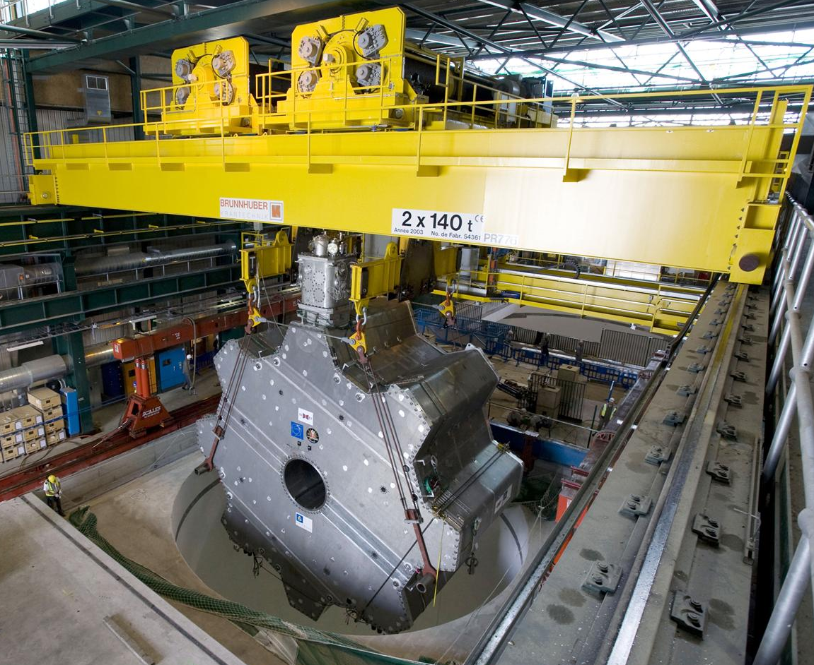
Handling Engineering Group EN/HE
Provide transport and handling services
Design, integration and feasibility studies
Tendering and procurement, installation, commissioning, operation, maintenance and decommissioning
Standard industrial and custom-built transport and handling equipment
6 maintenance contracts
1 operation contract
Notes:
Includes: horizontal transport vehicles, lifting vehicles, cranes, hoists, passenger and goods lifts.
HH: preparation, organization and coordination of transport and handling operations > operations executed by service contractor

Slide 4
EN/HE Statistics
Work Orders
~ 8’000 Created and Closed per Year
Operations in 2022
Handling Requests:19’069
Total Weight: 133’000 t
Total Value of Handled Goods: 800’000’000 CHF
Notes:
132 Lifts
378 Overhead Cranes
636 Hoists
2348 Industrial trucks
135 Road trucks

Slide 5
Maintenance Contracts – 5 years ago
Lifts (2)
Contractors working with papers
CERN internal use of CMMS (EAM)
Overhead Cranes (1)
Basic use of CMMS (EAM)
Industrial Trucks (1)
Basic use of CMMS (EAM)
Road Trucks (1)
Traceability through invoices, no use of CMMS (EAM)
Notes:
5 year ago all 4 domains were managed differently: one manager want to see this in the report, another manager wanted to see something else

Slide 6
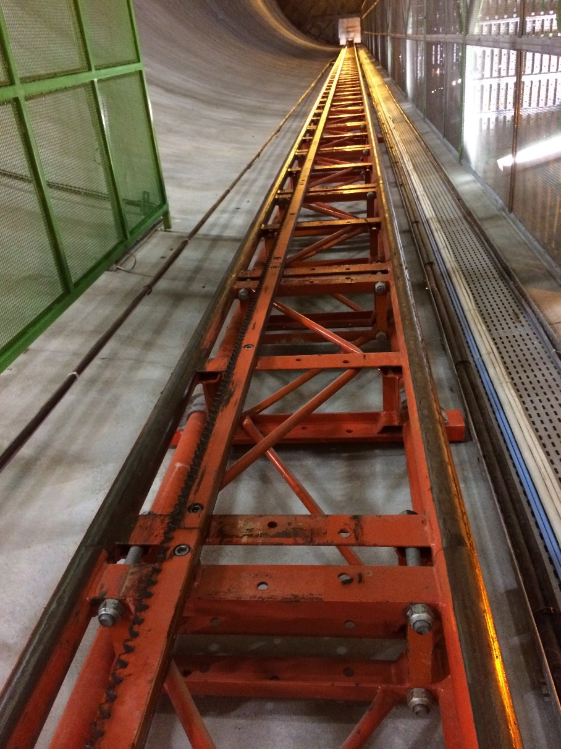
Contract Features – Lifts
Practical
Simple breakdown without spare parts: 1 WO type CD
Breakdown with spare parts: 1 WO type CD + 1 WO type CR
Financial
Lumpsum per asset per year
On-call service
Reaction time
Notes:
Lift PM18 with height of 82m
Manual entry in EAM from paper by CERN causing delay
Preventive maintenance scheduled precisely by hour
No permanent on-site presence

Slide 7
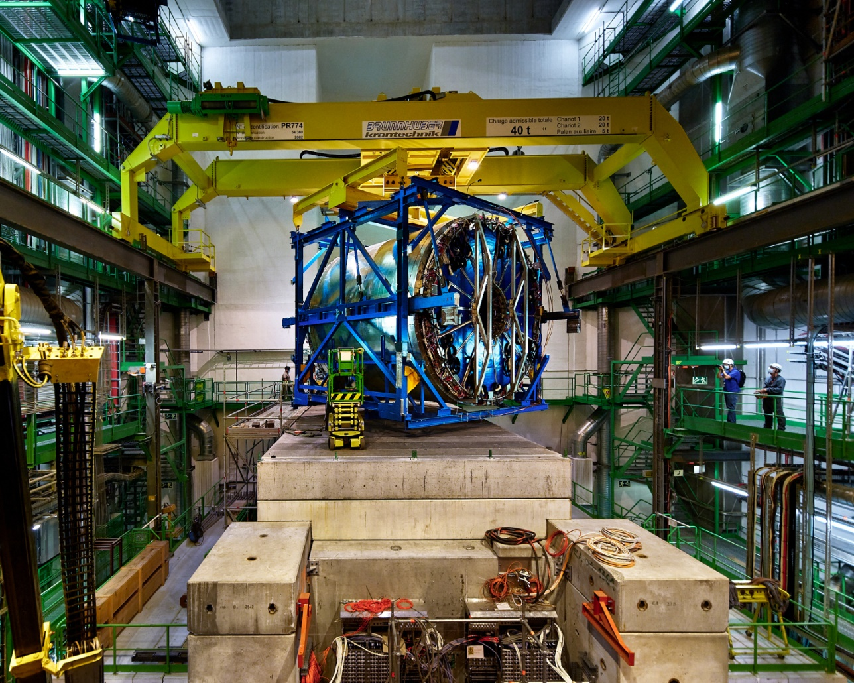
Contract Features – Overhead Cranes
Practical
Simple breakdown without spare parts: 1 WO type CD
Breakdown with spare parts: 1 WO type CD + 1 WO type CR
Financial
Annual fixed costs
Lumpsum per asset per year (CD and CR)
Fixed price per preventive maintenance
Labour costs for other works
Parts costs
Notes:
20+20=40t
Annual fixed costs for contract management
Corrective maintenance: CD + CR
Various works: CA, T1
Parts total entered in additional costs = parts price + 8% overhead on contractor’s purchase price
Labour costs = booked hours x hourly rate

Slide 8
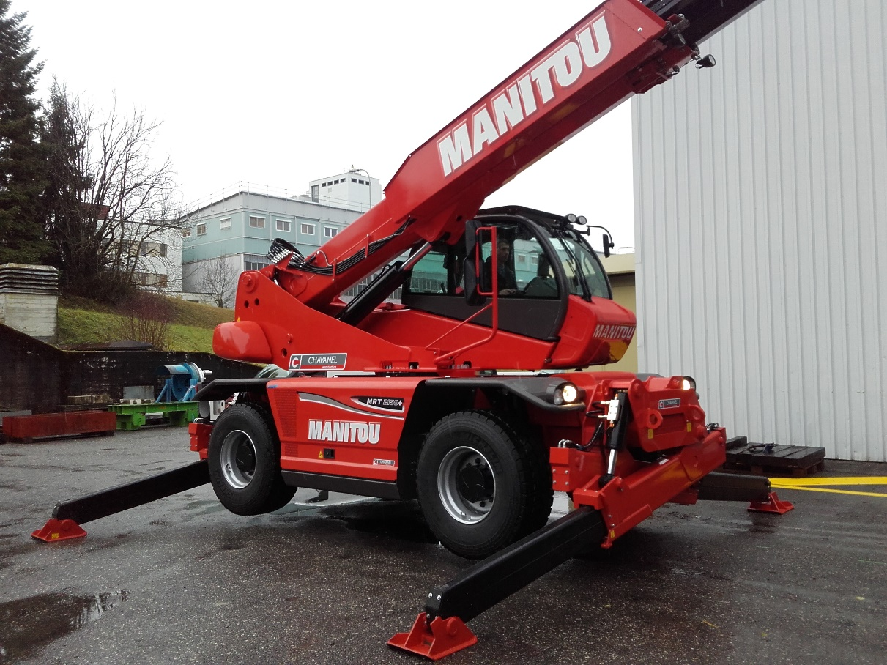
Contract Features – Industrial Trucks
Practical
Simple breakdown less than 2h: 1 WO type CD
Longer breakdown more than 2h: 1 WO type CD changed to type CR
Financial
Annual fixed costs
Fixed price per preventive maintenance
Labour costs
Parts costs
Notes:
Annual fixed costs for contract management and consumables
Labour costs = booked hours x hourly rate
Parts total entered in additional costs = parts price + 8% overhead on contractor’s purchase price

Slide 9
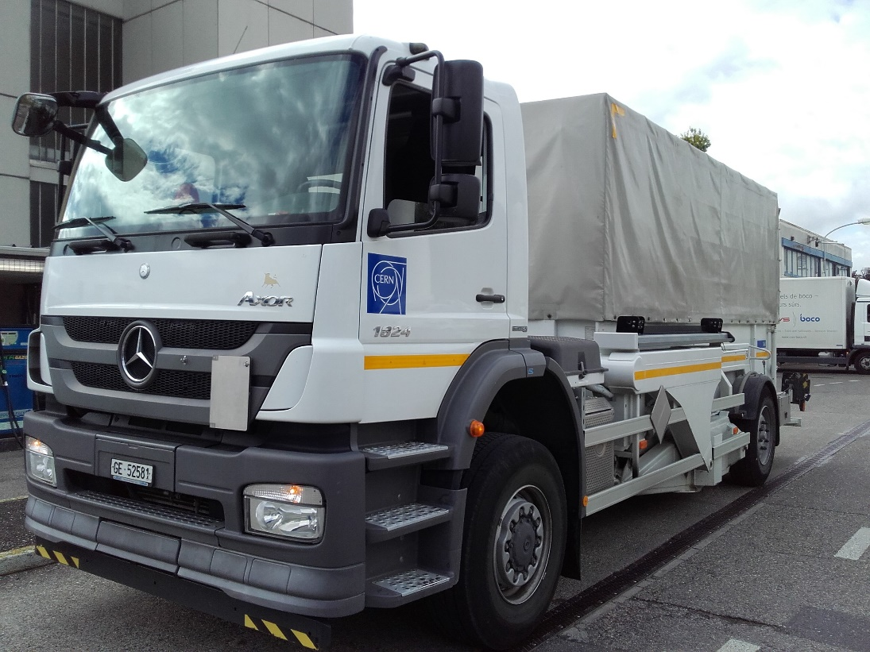
Contract Features – Road Trucks
Practical
No traceability in EAM: neither WO type CD nor type CR
Excel file to follow-up repair costs
Financial
Fixed price per intervention (catalogue)
Labour costs on various works and corrective maintenance outside catalogue prices
Parts costs
Notes:
Fixed price per intervention: based on predefined price list
Labour costs = booked hours x hourly rate
Parts costs: fixed discount on public price

Slide 10
Motivations for Change
All contracts are dealing with maintenance services but on different types of assets > common points but also differences
EN/HE management requested consolidated view on maintenance performance at group level - taking into account the EN department requirements:
Defining common KPIs
Requiring common definitions e.g. interpretation of a breakdown
Introducing new concepts like “Downtime Hours”
Optimization of reporting resources
Notes:
We started by defining the KPIs valid for all contracts
During the definition of the KPIs it appeared clearly that some common definitions were required, typically to homogenize the interpretation of a breakdown or to introduce new concepts like «downtime hours»

Slide 11
Key Performance Indicators (KPIs)
Number of breakdowns per asset per year
Number of breakdowns per month
Downtime hours per asset per year
Downtime hours per asset per month
Downtime hours per month

Slide 12
Document “Terms and Definitions”
Work Orders
Use of norm NF EN-13306 – Maintenance Terminology
Types
Classes
Status
Closing Codes
Dates
Downtime
Unplanned Downtime
Compatible with EN Department conventions
Assets
Classes
Status
Capacity
Compulsory Fields
Notes:
Use norm to define the different WO Types
Example definition breakdown: when it was taking longer than 2h, the WO CD got changed to WO type CR (due to detailed description). However, this way it’s very difficult to count the number of breakdowns. We now close the CD and then create a new WO CR, for all contracts.
Closing Codes: Problem, Cause, Failure
Example how many dates (10): Created, Reported, Scheduled Start & End, Requested Start & End, Start, Completed, Booked Hours Start & End
Example compulsory fields asset: needed for other processes e.g. criticality, location, equipment responsible for process Safety Inspections

Slide 13
Work Processes
Breakdowns
Preventive Maintenance
Various Works
Works by Offer
Intervention Planification

Slide 14
EAM Invoicing – Industrial Trucks
WO Criteria
Cost Types
Type
Class
Fixed yearly lumpsum > monthly usage charges
Sales price per Preventive Maintenance
Work Order charges
Labour costs (booked hours x hourly rate)
Direct purchases of parts
Notes:
Started with 1 contract, a lot of debugging during this year by comparing with manual extraction, we are now ready for the automatic invoicing.
Last quarter of 2023 we will configure the 2nd contract.

Slide 15
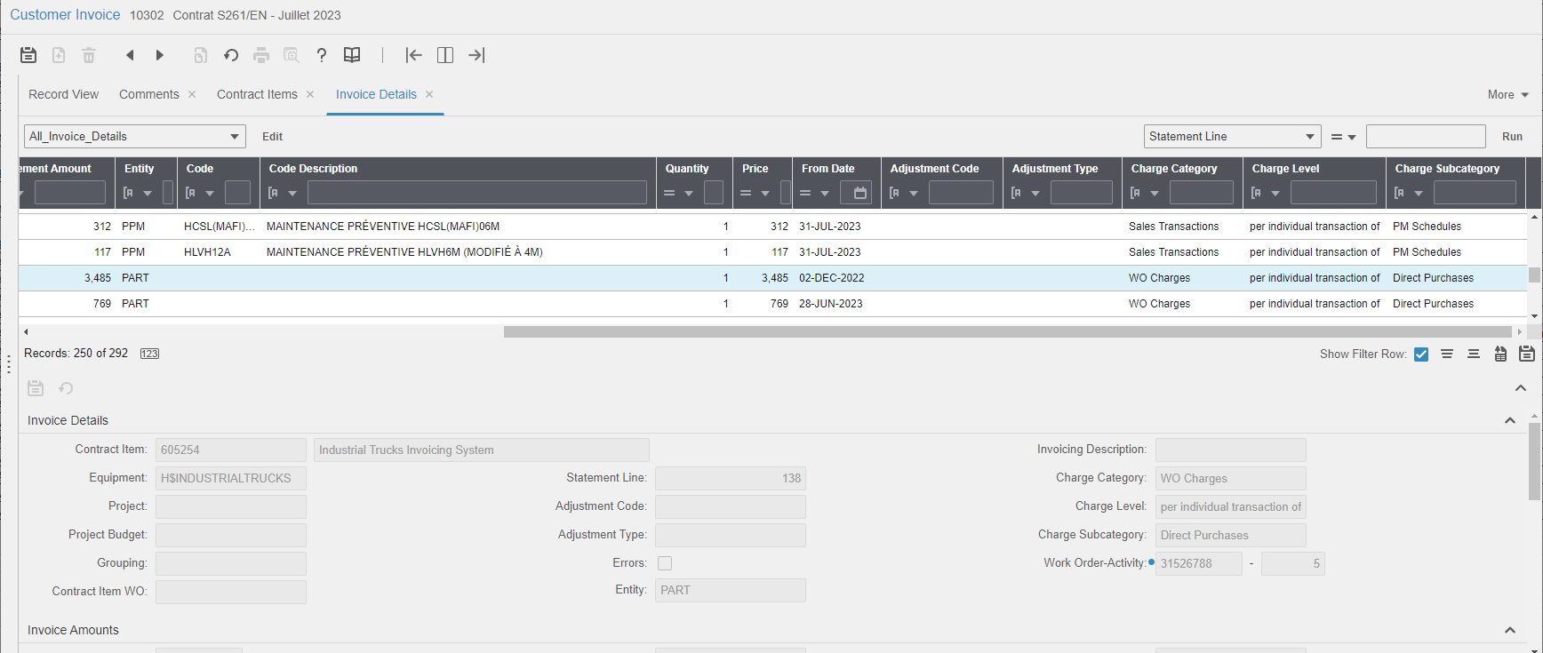
EAM Invoicing – Industrial Trucks

Slide 16
Maintenance Reports
1 monthly report EN-HE
valid for all contracts
input parameter for each contract
contains 40 sub reports
20 detailed reports
valid for all contracts
input parameter for each contract
lists from monthly report charts
Compatibility with maintenance report at department level
Notes:
When changing service unit in case of new contract, only the parameter in the main report needs to be changed and not all 40 sub reports.
Still another 20 detailed reports to be updated, but only common reports and no more contract specific reports.
Regular report specification meetings, but with all contract managers to agree on decisions e.g. filter by Date Created or Date Completed.

Slide 17
Conclusions
Succeeded in harmonizing KPIs, but implementation of changes is difficult, CERN Contract Managers reviewing data need to be involved, trained and supported to get good quality of data, filled in by contractors
Processes and definitions are standardized for all six maintenance contracts enabling the monitoring of KPIs at group level, and even at department level
Improvement of contract follow-up and maintenance performance, as well as better understanding of equipment park by using EAM
No more contract dependent reports, but common group reports resulting in reduction of reporting resources – yet some specificities cannot be ignored e.g. usage-based maintenance of cranes
Automatic invoicing is running for one contract Next steps:
Configuration of remaining contracts (limitations to standardizing cost types due to business practices)
Creation of financial reports by asset and class thanks to data from the invoicing

Slide 18
Thank you for your attention! Any questions?

