Slide 1
USAGE-BASED MAINTENANCE OF OVERHEAD TRAVELLING CRANES
AMMW 2023 – Damien Lafarge – CERN, EN-HE
2023-09-29
Reference Indico #18965

Slide 2
Agenda
Introduction
Existing situation
Requirements for the solution
Technical solution using « IoT » trackers
Results
Conclusions

Slide 3
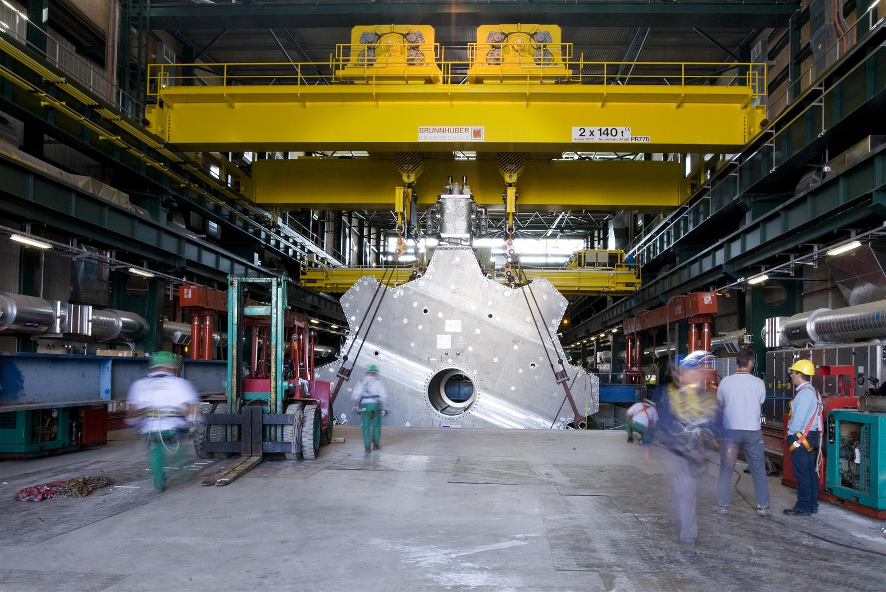
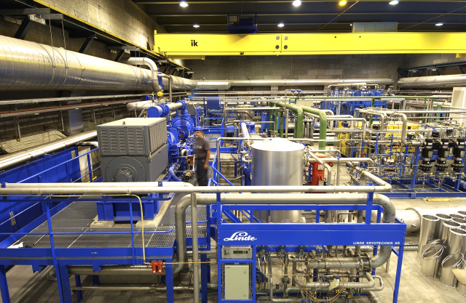
Introduction
370 cranes at CERN, 480 preventative maintenance interventions per year (until 2022);
Cranes usage is quite low with respect to manufacturer’s assumptions;
Following an analysis in 2020 : maintenance can be reduced in many cases;
New opportunity in 2020 : usage of « Internet of Things » (IoT) trackers.
Project : using trackers to trigger maintenance = better maintenance + savings

Slide 4
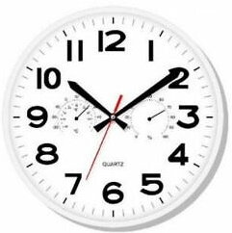
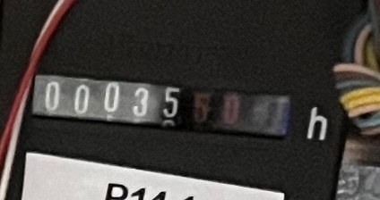
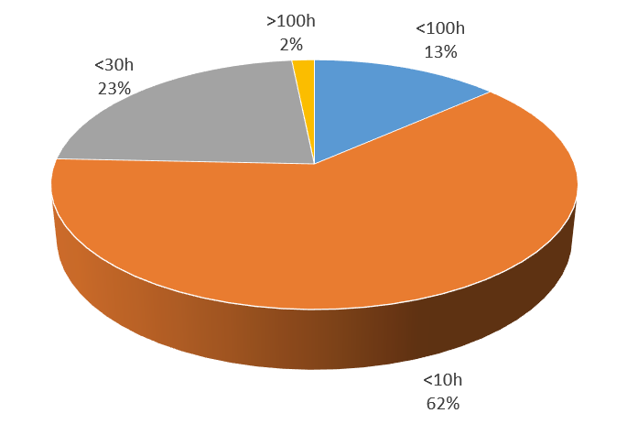
Existing situation
Maintenance of cranes is defined in CERN rule GSI-M-1 (manufacturers recommendation);
Manufacturers recommend a preventative maintenance intervention every 30h of usage;
CERN already has electromechanical horometers installed on all cranes ;
Usage of cranes at CERN is in most cases very low : between 1h/year and 177h/year.
30 h

Slide 5
Existing situation (until 2022)
Following a first simulation, regarding maintenance on overhead cranes :
230 preventative interventions per year (usage-based approach) Vs 480 with previous strategy (fixed periodicity, once or twice a year)
61% of savings per year on preventive maintenance costs for usage-based approach compared to fixed periodicity approach.
EN-HE currently uses CERN EAM system (Enterprise Asset Management)

Slide 6
Requirements for the solution
The requirements for the system to be implemented are the following:
Know the real usage of each crane. Minimum periodicity for maintenance = 15 days, periodicity of readings = 1 day (3 days acceptable);
Trigger maintenance work orders based on the automatic readings (EAM system already supports it);
Monitor preventative maintenance interventions to guarantee the conformity with GSI-M-1;
Detect the failures of the system to avoid missing any intervention.

Slide 7
Requirements for the solution
Some successful proof of concept tests were performed with the support of IT-CS (network) in spring 2021.
The cost of development and implementation of the system was evaluated as follows:
60 kCHF to purchase the IoT trackers;
60 kCHF to install the trackers on the cranes;
80 kCHF for extra personnel to develop the system.
Total cost of 200 kCHF and a return over investment evaluated to 2 years.

Slide 8
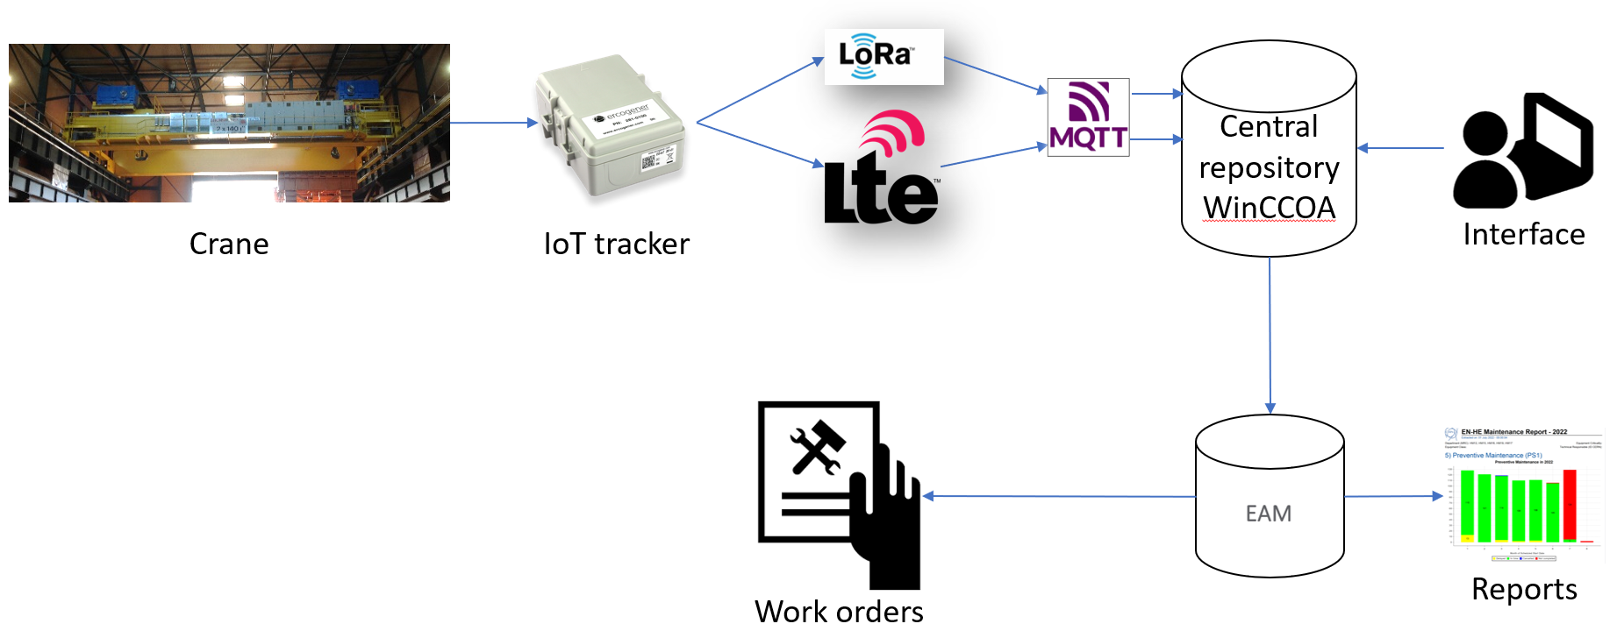
Technical solution using IoT trackers
The global view of the system:
Trackers connected to cranes via dry contact, accumulate locally the total usage
Trackers send data through LoRa (surface) or LTE-M (underground) networks
WinCC OA converts data, archives it, monitors the communication
EAM reads data from WinCC OA (NxCALS), generates work orders
LoRa «Long Range» : network for devices using little data
LTE-M «Long Term Evolution - Machine»: network for IoT devices based on mobile network
WinCC OA : supervision system used for many equipment at CERN including accelerators

Slide 9
Technical solution
Quite long information workflow for such a «simple» application but:
Very robust against loss of data
Reusable for other applications, e.g. inside EN-HE, the monitoring of the usage of the lifts, the monitoring of the location of mobile assets
The system has all maintenance capabilities to detect loss of communication etc.
Fulfils completely the specifications

Slide 10
Results
System in production since December 2022.
Problems of wiring and coverage were discovered (~100 cranes), analysed, and solutions were deployed for ~70 cranes (EN-HE + IT-CS), coverage issues still need to be addressed for the remaining 30 cranes.
All procedures are in place and tested to add/remove/replace trackers.
The cost of the project is close to the initial estimate, the troubleshooting induced 20kCHF of additional costs (+10%).
Final savings after the first year correspond to 70% of the financial volume corresponding to preventive maintenance (initial estimate 61%).
Final return over investment is of 1,5 years including the over costs for the troubleshooting.

Slide 11
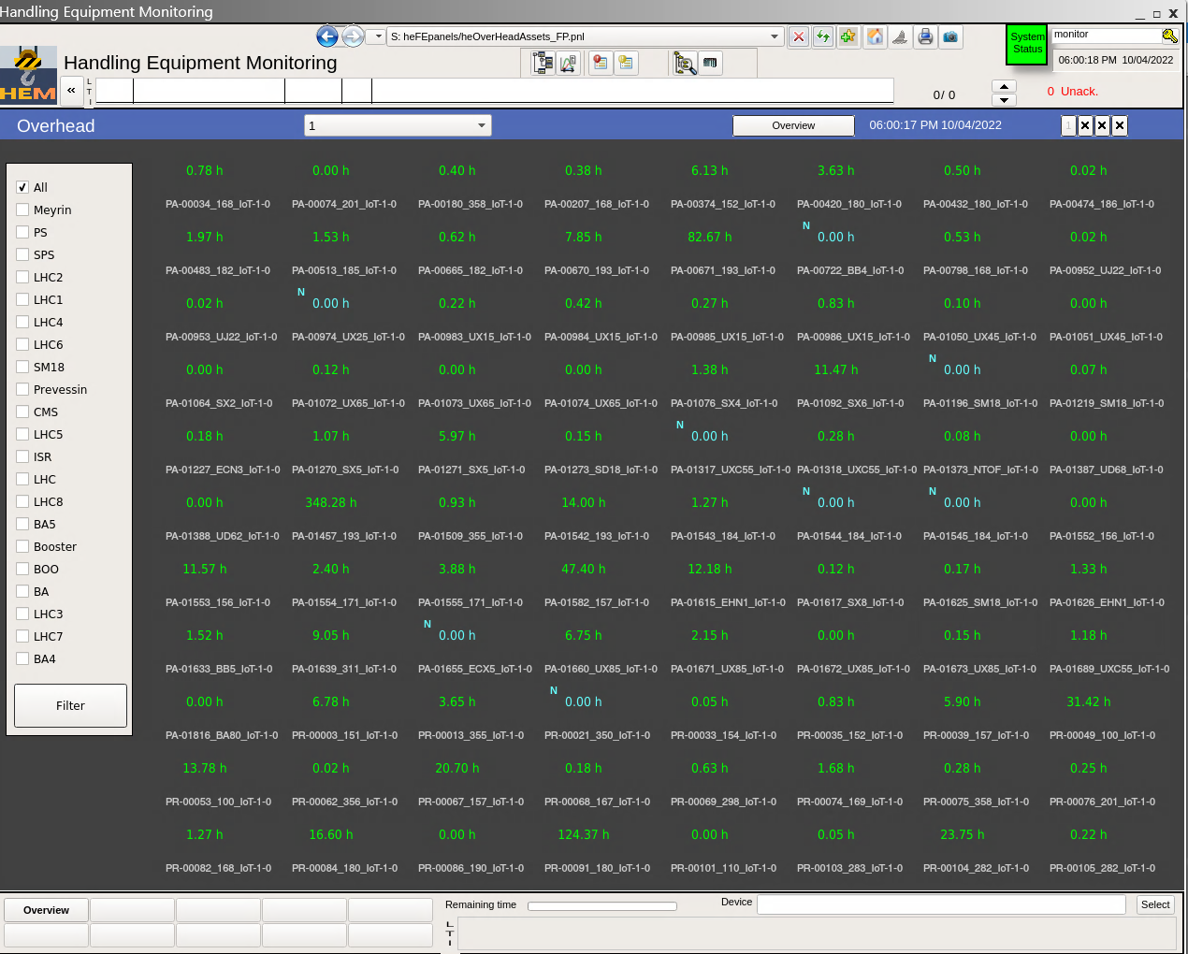
Results

Slide 12
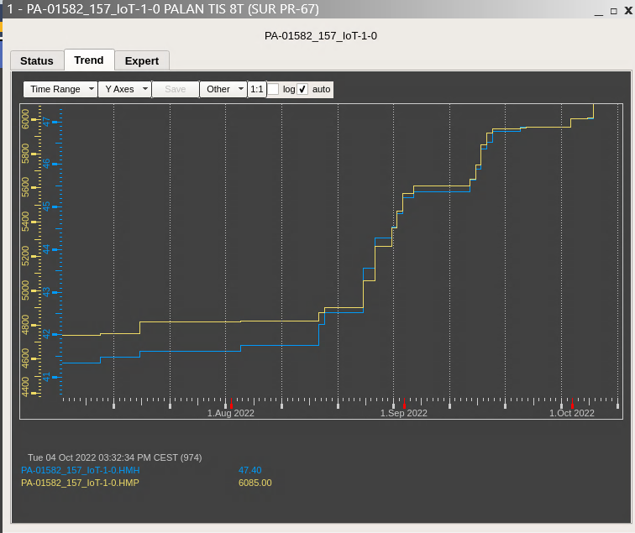
Results

Slide 13
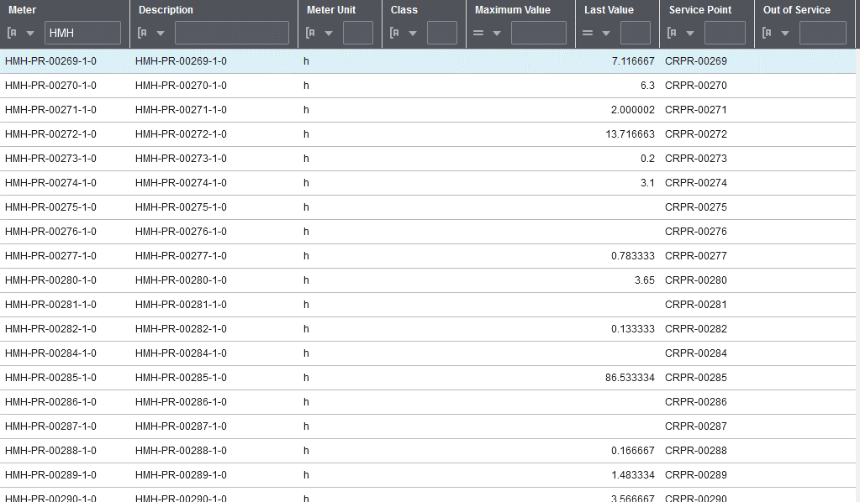
Results

Slide 14
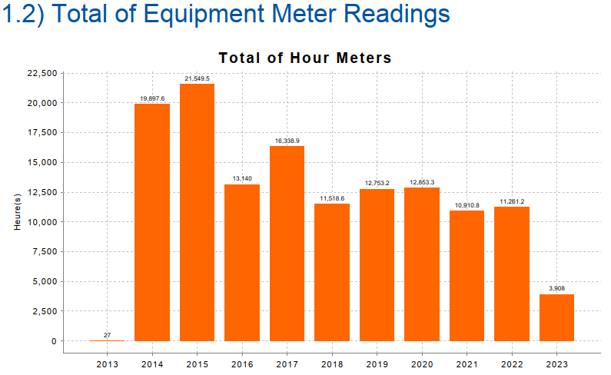
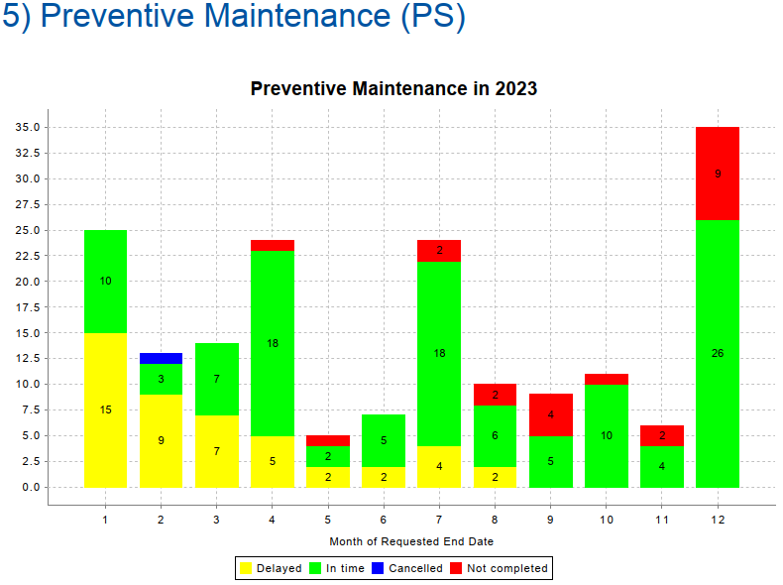
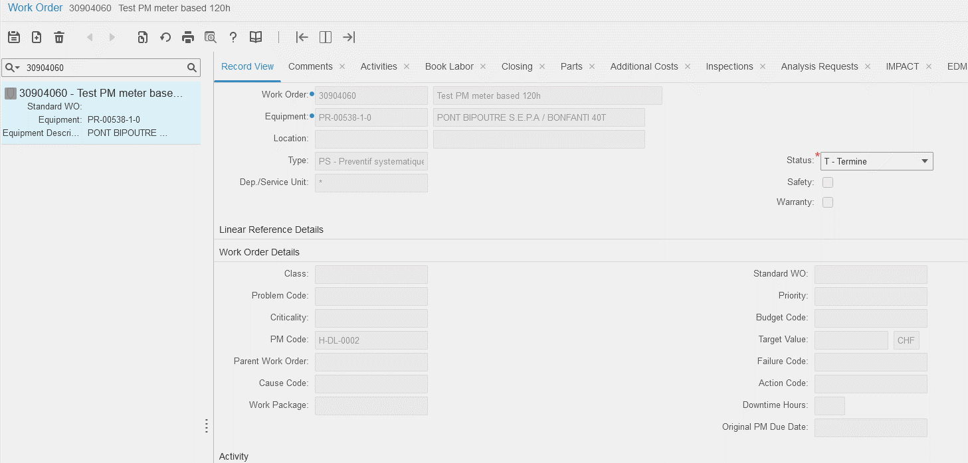
Results
Maintenance interventions not completed (red) correspond to cranes where maintenance periodicity is greater than 2 years. Maintenance for all cranes is in line with CERN rules

Slide 15
Conclusions
New maintenance strategy implemented and in production.
The system works and savings are here, impact on failures to be monitored in the future.
System developed relying on CERN well-known applications.
System flexible, scalable and cheap :
Without development : monitoring of usage / GPS coordinates of any equipment
With limited development : monitoring of temperatures, energy consumption…
Tracker costs ~100 CHF / unit, LoRa connection is free at CERN
Scalability limited for application with “live” data or big data : LoRa network allows 1 message per 10 minutes, LTE-M offers a good alternative but with costs for connection.

Slide 17
Spare slides

Slide 18
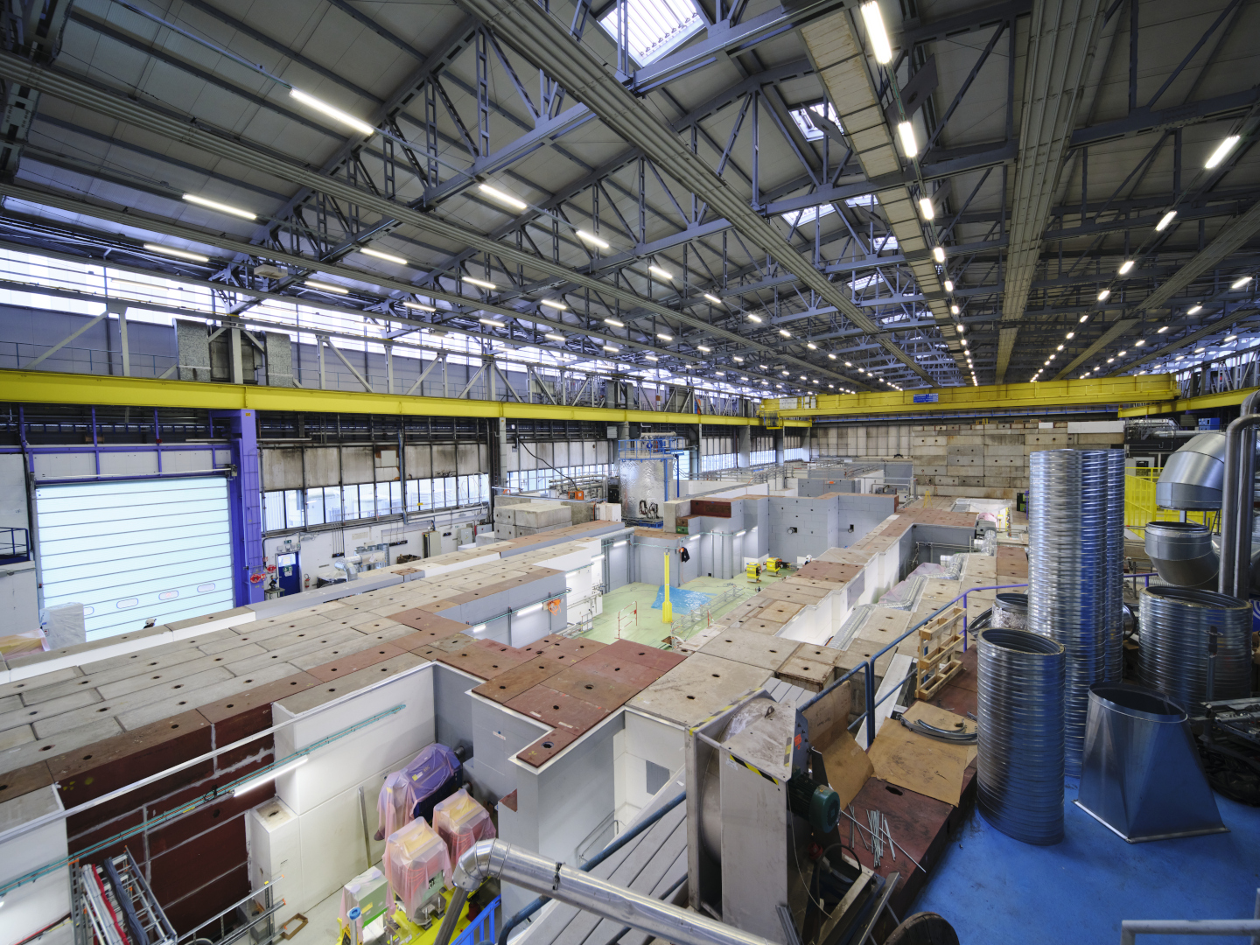
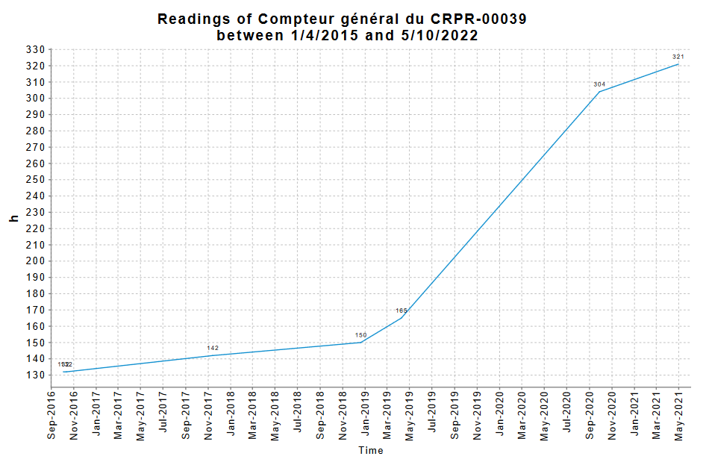
Existing situation
Importance of monitoring crane usage = some cranes have a variable usage (example of East Area during LS2)

Slide 19
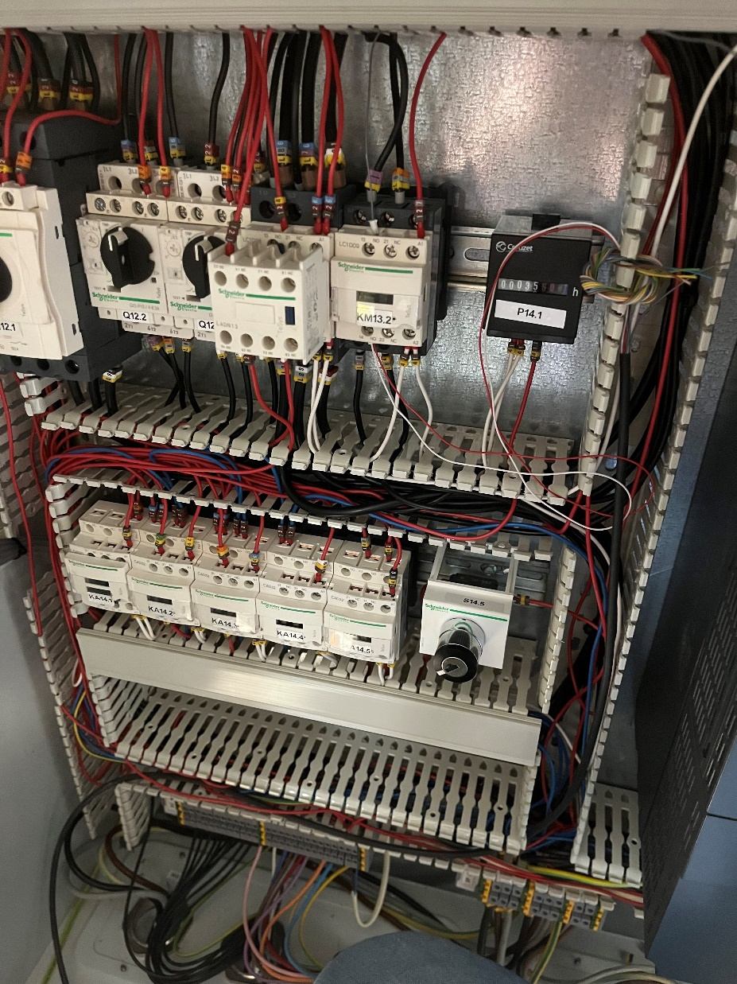
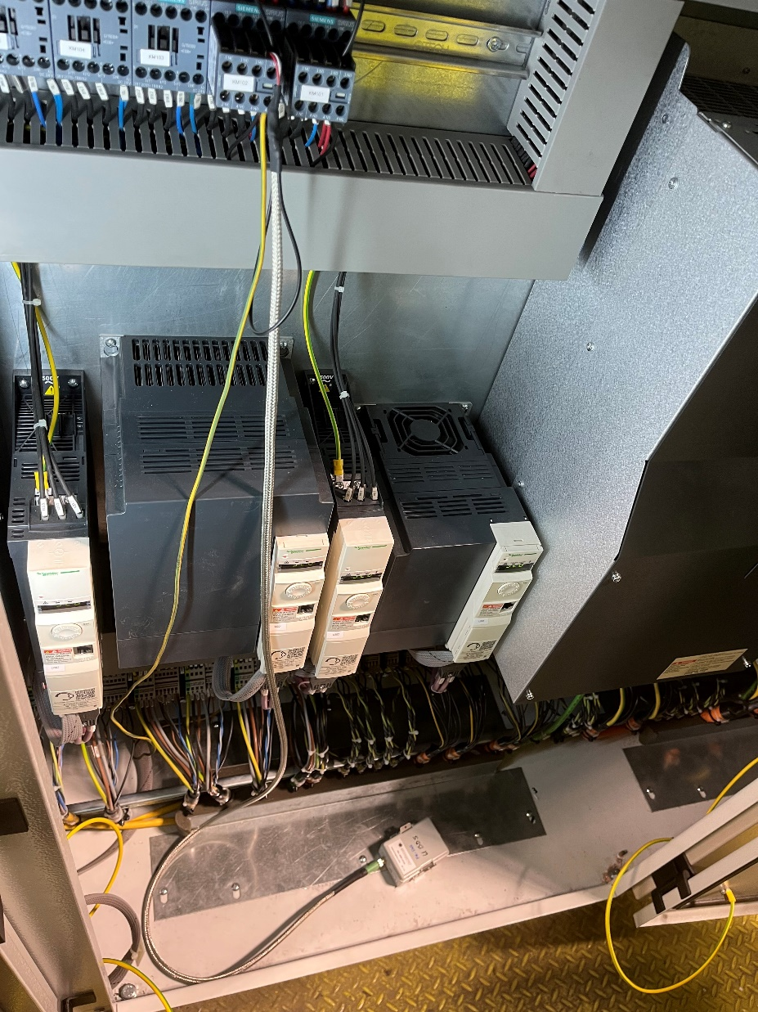
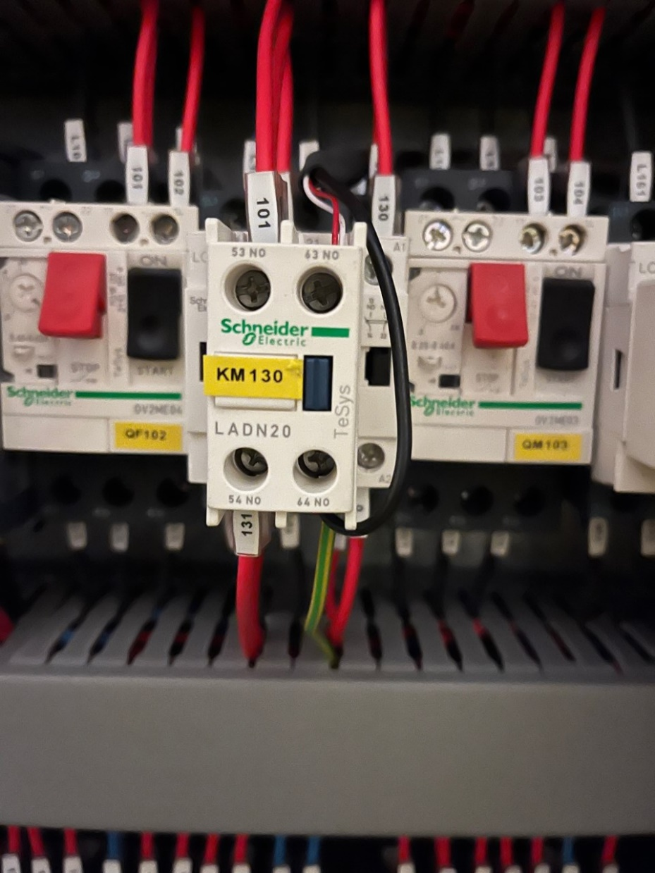
Results – wiring problems
Wiring problems were discovered during the installation phase due to EMC perturbations, solution was the grounding of the dry contact circuit

Slide 20
GPS applications – under implementation in production

