Slide 2
ESS Maintenance Program
PRESENTED BY ola nanzell

Slide 3
1
As-Is

Slide 4
How we work today
Due to ESS project state nature, there is very little central maintenance coordination and planning today.
Most sub-projects maintain already installed equipment in isolation
As ESS commissioning more integrated systems, central maintenance coordination becomes more and more important
In 2023 the first summer maintenance shutdown was conducted
Work Order Coordination exists for accelerator tunnel and klystron gallery

Slide 5
ESS Maintenance Working Group
Formed in 2020
Cross functional working group
Drive the implementation of the Maintain Way of Working in the ESSMS
Main stakeholder for requirements on EAM
Example documents
Closing codes
Criticality classing
Procedure for Work Order Management
Procedure for Immediate Corrective Maintenance
Equipment dependencies
Equipment statuses

Slide 6
2
Criticality Classing

Slide 7
Criticality Classing
Analysis
An equipment criticality analysis needs to be performed for all systems with the purpose of identifying how a disturbance to the function affects:
Safety (risk of injury to people)
Environment (risk of environmental damage)
Radiation Protection (effect on radiation protection upon failure)
Usage (how frequent the equipment is used)
Production of neutrons (loss of production)
Probability (the probability of failure during a period in time)
Cost (Cost of a failure)

Slide 8
Three Classes
To identify criticality
Class A equipment shall be maintained using preventative maintenance with focus on minimizing disturbances to the equipment. Regular inspections and monitoring shall be applied. RCM can be used as input to the preventive maintenance arrangement.
Class B equipment shall be maintained using preventive maintenance but the cost and the impact of a failure shall be taken more into consideration compared to a Class A equipment. The preventive maintenance arrangement can be based on what's stated by the manufacturer.
Class C equipment shall use preventive maintenance if it's considered to be more cost effective than corrective maintenance. Preventive maintenance can be done at a lesser extent than what the manufacturer recommends. Cost is the main driver.
Notes:
RCM - Reliability Centered Maintenance
FMEA - Failure modes and effects analysis

Slide 9
Evaluation Factors
Evaluation factor | Class A | Class B | Class C
Safety Risk of injury on people | Failure causes severe injury | Failure may cause injuries | No injuries
Environment Risk of environmental damage | Failure on equipment will cause severe environmental damages | Failure on the equipment may cause environmental damage | No environmental impact upon failure
Radiation Protection Effect on radiation protection upon failure | Failure on the equipment will affect radiation protection / will expose people to ionizing radiation | Failure on the equipment may cause effect on radiation protection / may expose people to ionizing radiation | No impact on radiation protection / no exposure to ionizing radiation
Usage How frequent the equipment is used | Used 24 h/day | Used more then 12 h/day | Used sometimes
Production of neutrons Loss of production | Failure will cause beam to be considered unavailable for experiments according [5] | Failure will cause important systems to stop functioning or beam being unavailable according to [5] | Redundancies exists or it's cheaper to run to failure
Probability The probability of failure during a period in time | High probability that the equipment will fail more than once during a 6-month period | Low probability that the equipment will fail more than once during a 6-month period | The probability is low that the equipment will fail within 12 months
Cost Cost of a failure | Time to repair is long and the cost is very high | Time to repair is long and the cost is high | Time to repair is short and the cost is low

Slide 10
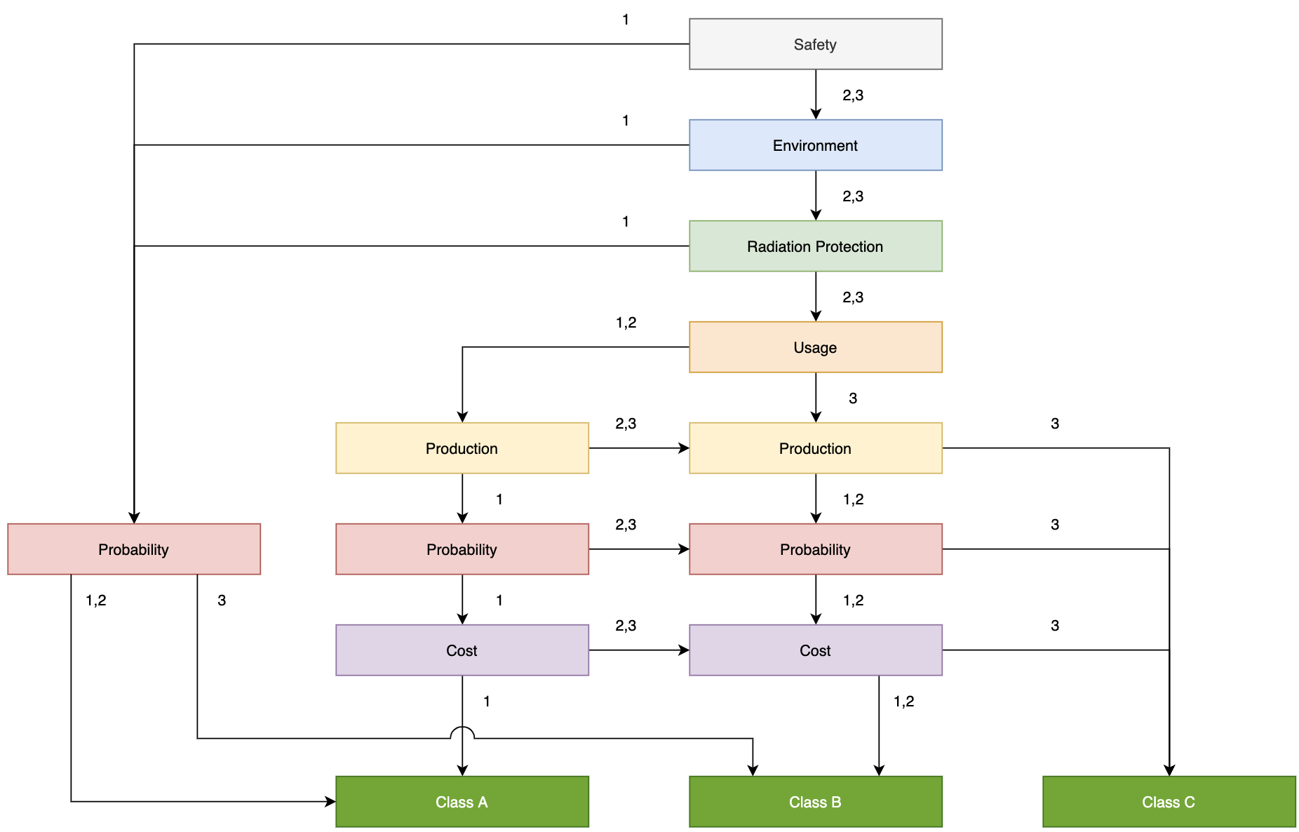
Evaluation Methodology
A starting point

Slide 11
Spare Part Analysis
Example where criticality becomes important
It's not required to have a lot of spare parts for all equipment that has been classed as A.
The need for spares needs to be governed by the acceptable duration of a stand still as well as the possibility to acquire spares.
The cost of a stand still needs to be calculated against the cost of having spares on the shelf, how many years the spare will be in storage and what will it cost?
Critical input to logistic operations.
For Class A equipment where spares are not available on shelf, it's recommended to have at least two documented ways of acquiring a spare. Drawings needs to exists in order to manufacture
For Class B equipment it's recommended to have an alternative supplier for spare parts.
For Class C equipment spares will only be stored if the cost is lower than acquiring when needed. No alternative supplier is needed.

Slide 12
3
Criticality for work coordination

Slide 13
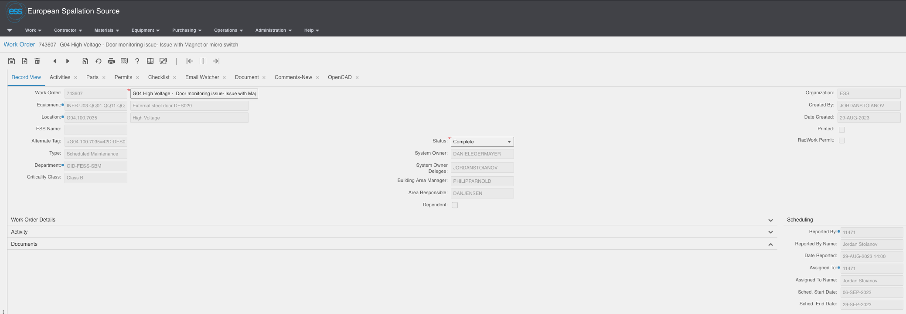
Work Order
Quick input to planning

Slide 14
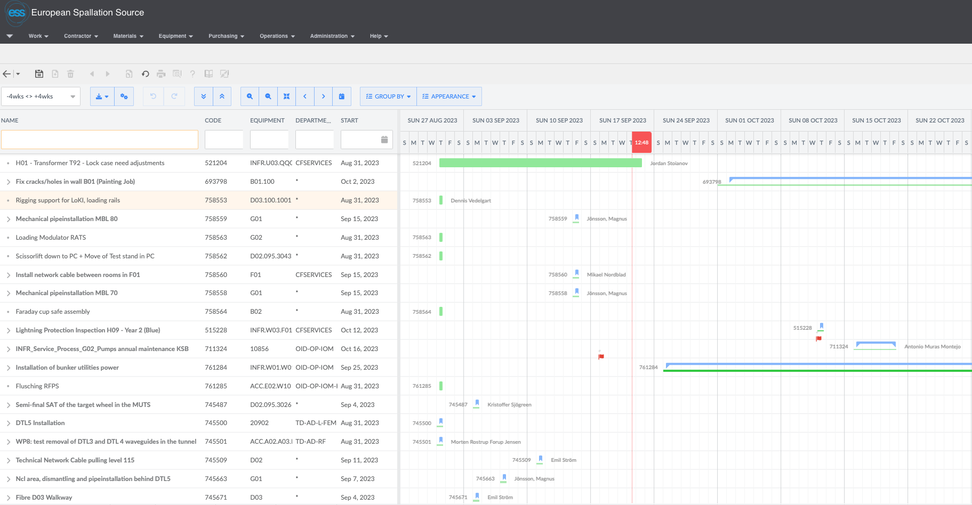
Work Order
Quick input to planning

Slide 15
4
Connection to engineering

Slide 16
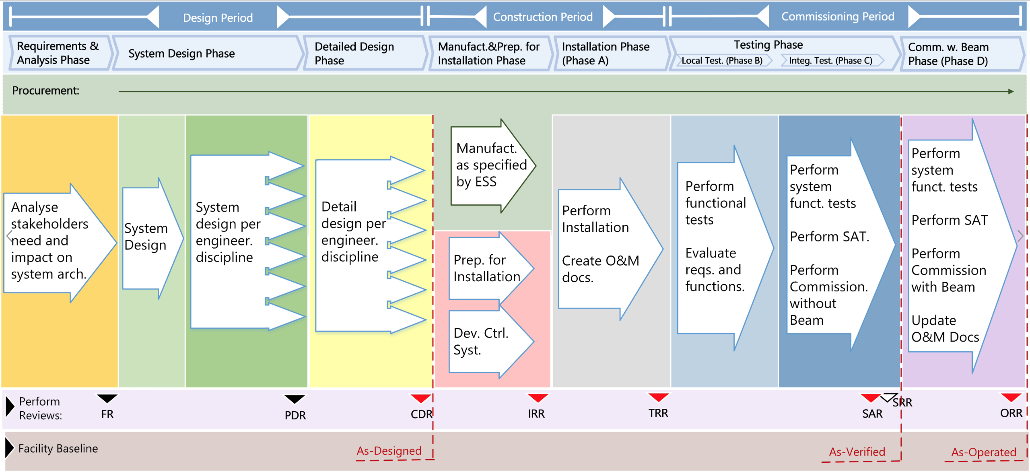
Engineering Workflow
Design for maintainability

Slide 17
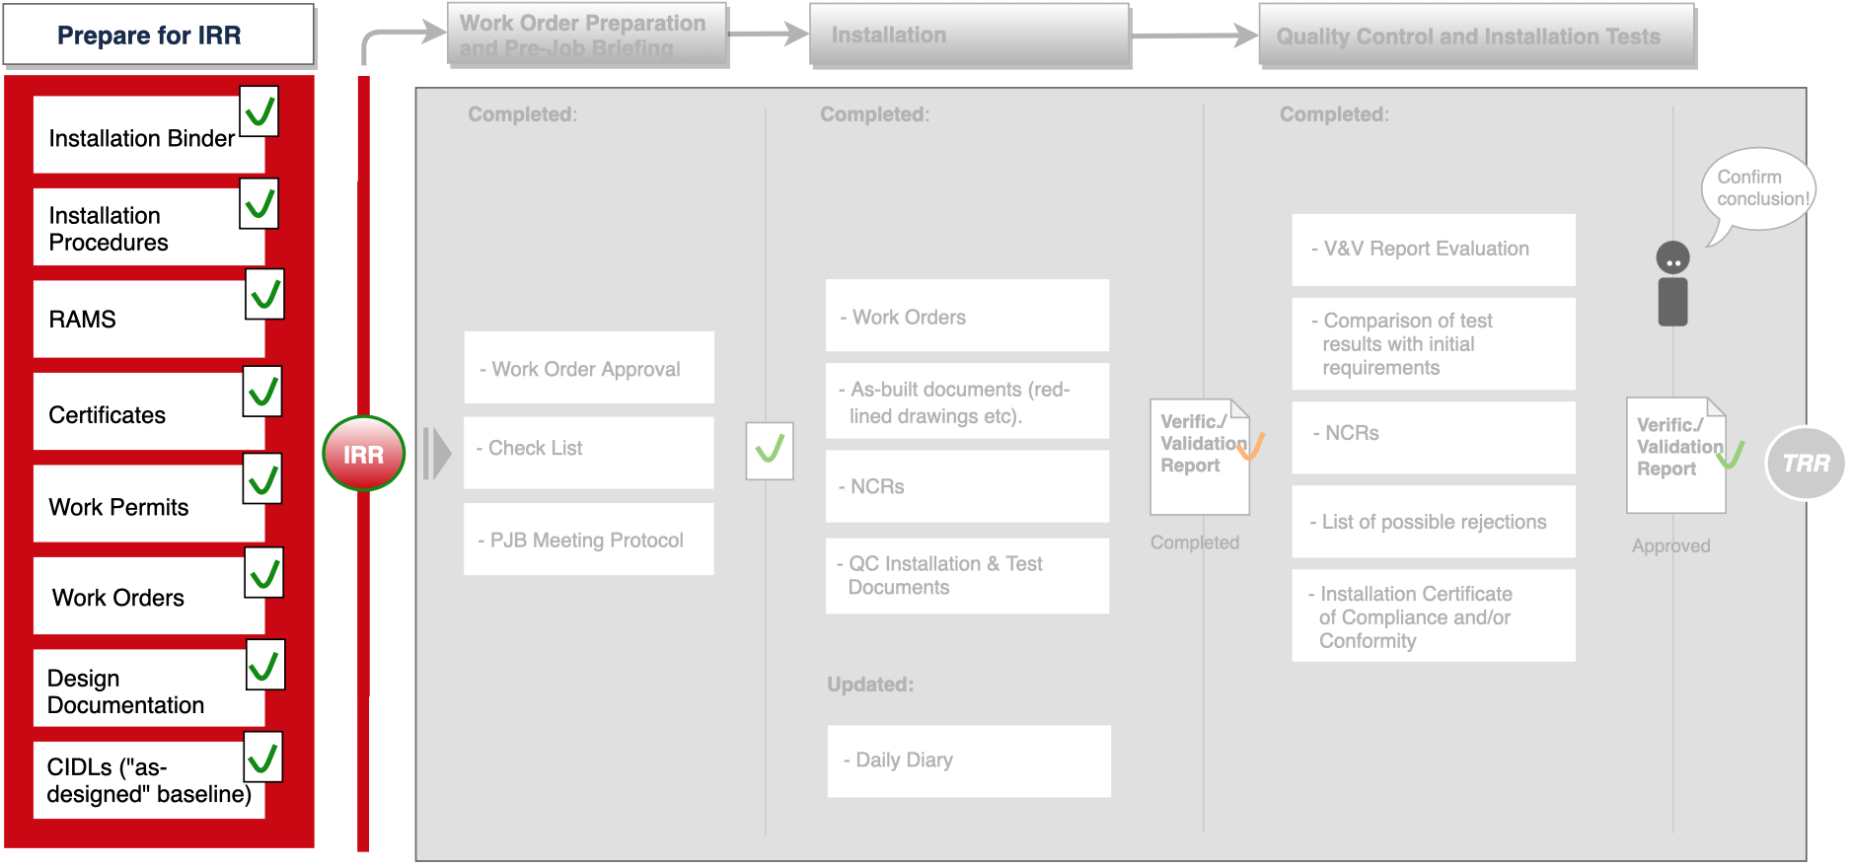
IRR - Installation Readiness Review
Deliverables

Slide 18
5
Maintenance Management

Slide 19
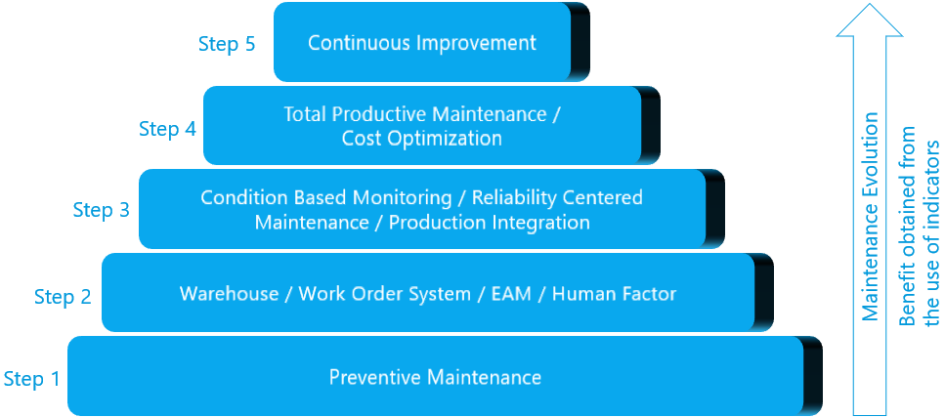
Maintenance Management Process
Literature ( Wireman 1998 ) suggests that each step should be implemented before moving to the next step working one’s way upward.
This means, as an example, that before considering the application of Reliability Centered Maintenance (RCM), predictive maintenance programs, the involvement of staff in maintenance functions, appropriate WO systems and management of maintenance resources are required.
The involvement of operators and employees constitutes the next stage.
Finally, optimization techniques will complete the organizational structure necessary for continuous improvement

Slide 20
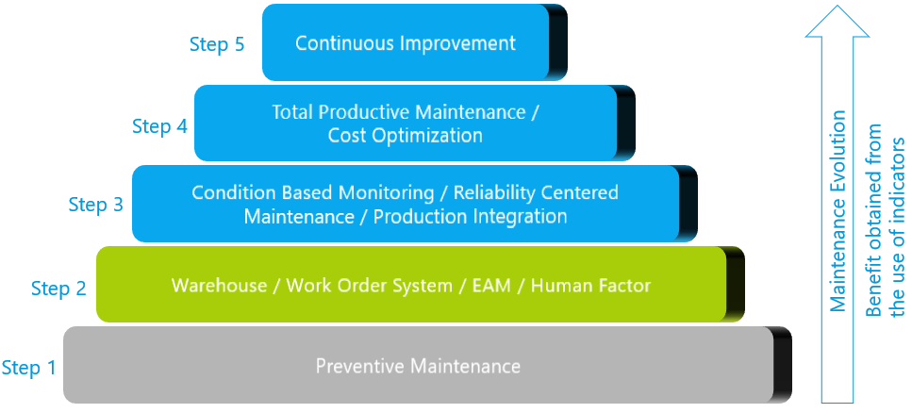
Maintenance Management Process
Situation at ESS
The implementation of the Enterprise Asset Management system including logistics, warehouse management and work order system together with the subsequent work on processes and procedures with the Maintenance Working Group has led to a large degree of completeness of step 2
However there is no formal preventive maintenance strategy nor program in place

Slide 21
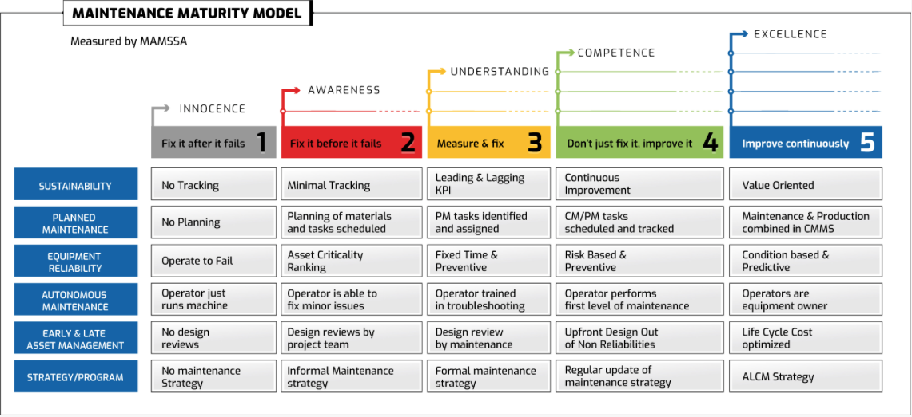
Maintenance Strategy
What will fit with ESS requirements
Will a “run to failure” maintenance strategy support and allow us to achieve our uptime requirement?
Will a Preventive Maintenance strategy allow us to achieve our uptime requirement?
Will a Predictive Maintenance strategy allow us to achieve our uptime requirement?

Slide 22
Key maintenance Performance Indicators (KPI’s)
Maintenance process/ effort indicators
Maintenance results indicators
Work
identification
Work planning & scheduling
Work execution
Equipment effectiveness
Maintenance cost-effectiveness
Safety and environment
% Available man hours used in proactive work.
Number of work requests
% Scheduled man hours over total available man hours
% WO with due date compliance
% WO assigned for rework
% WO in backlog
MTTR
Number of unplanned maintenance interventions
Breakdown frequency
MTBF
Unscheduled maintenance downtime
Number of shutdowns
Availability
Overall Equipment Effectiveness
% Maintenance cost over replacement value
%Maintenance cost over sales revenue
Maintenance cost per product unit
Number of safety incidents
Days since last injury
Number of injuries this year
Number of environment incidents
Number of health incidents

Slide 23
6
End-To-End Process

Slide 24
ESS Maintenance Program
How we transition
Enabling the projects to be integrated to the ESS Global Maintenance Program by supporting them and achieve a maintenance ready facility.
Design Period
Construction Period
Commissioning Period
Operations &
Maintenance
De-Commissioning
Requirements &
Analysis Phase
System Design Phase
Detailed Design Phase
Manufacturing & Preparation for
Installation Phase
Installation Phase
(Phase A )
Testing Phase
Commissioning
With Beam Phase
(Phase D)
Local Test (Phase B)
Integ Test (Phase C)
Perform
Reviews:
FR
PDR
CDR
IRR
TRR
SAR
SRR
ORR
Operations &
Maintenance
De-Commissioning
Disposal of equipment
RCM
Meter readings
Inventory optimization
Continuous adjustments to maintenance program
Criticality classification
Design for maintenance concept
Closing Codes
Disposal Requirements
Spare part list
Maintenance program created
Criticality classification update
Spare part strategy defined
Asset registration
Maintenance Manuals
Initial spare part classification
Build-up of information – end to end process for assets
Secure continuous improvement

Slide 25
Finish presentation

