Slide 1
WHY SHOULD YOU INVEST IN ASSET MANAGEMENT? A FIRE AND GAS USE CASE

Slide 2
CERN EN-AA-AS SERVICE
The CERN Alarm System service is responsible for the installation, the maintenance, and the renewal of safety alarm systems at CERN. This includes fire and gas detection systems (Flammable Gas, Oxygen Deficiency, Toxic Gas), emergency telephones (Red Telephones) and evacuation systems.
Transmission systems to CERN main control rooms (SCR-CERN Fire Brigade, CCC-CERN Control Centre and XCR-Experiment Control Rooms).
There were in 2023 10,515 automatic smoke detectors, 817 automatic gas detectors, 2451 manual break-the-glass devices and 422 emergency telephones installed all over CERN sites and covering from office buildings to accelerator complexes and experimental halls.
In total 28500 equipment declared in EAM under our responsibility

Slide 3
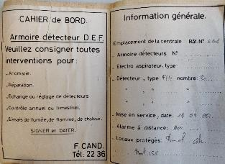
A bit of history
Paper records
Rapier
MP5
D7i
INFOR
50 years of data !!
(of varying quality)

Slide 4
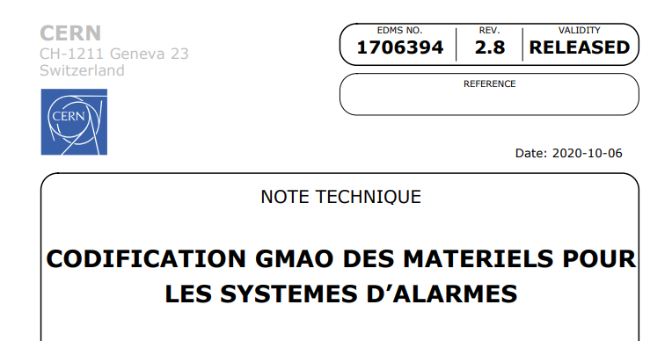
Data (re)structuring
Many variations in the quantity and quality of the data entered over the years
Difficult to extract useful data e.g. PPE (Plant, Property, equipment)
Main problems related to
  The age of the equipment
  The type of equipment
It was decided to do a complete restructuring and define how the data should be structured before changing anything in INFOR

Slide 5
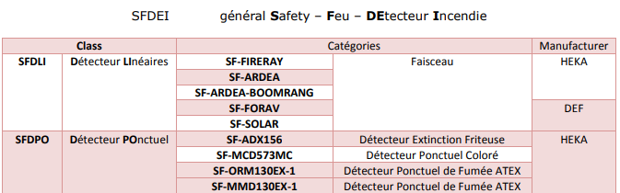
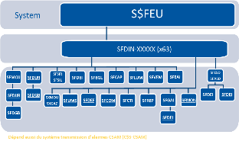
Data (re)structuring
The document is divided into six main chapters
Systems
Codes
Classes and Categories
Hierarchies
Attributes
Closing Codes

Slide 6
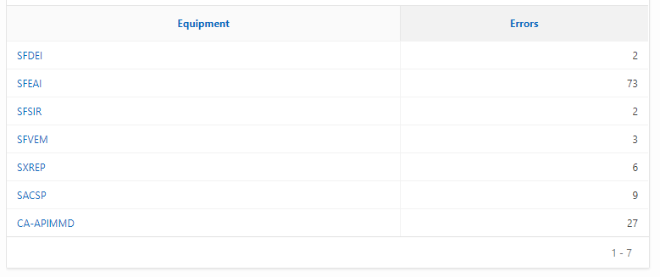
Validation
Because everything is formalized it is relatively easy to run scripts to verify that the information in INFOR follows the definitions in the document.
E.g.
  All equipment’s must have a class.
  An equipment type should all have assigned a class of a certain subset

Slide 7
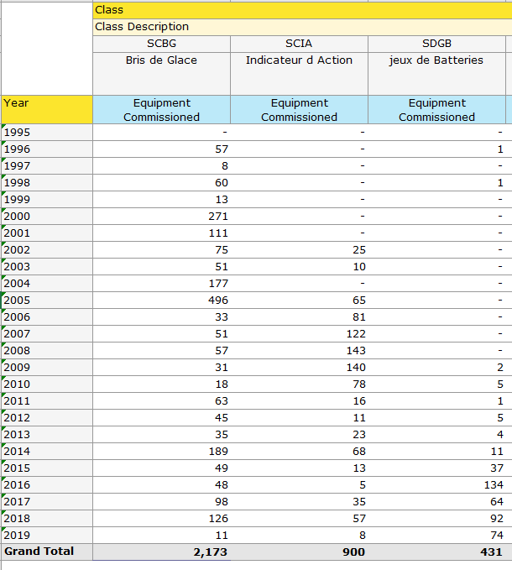
Reporting
PPE
All report are also defined in a document before development
PPE (Plan, Property and Equipment) report calculates the values of our installation based and an average price calculated per class of equipment and a deprecation value (age of equipment).
Pentaho analytics report

Slide 8
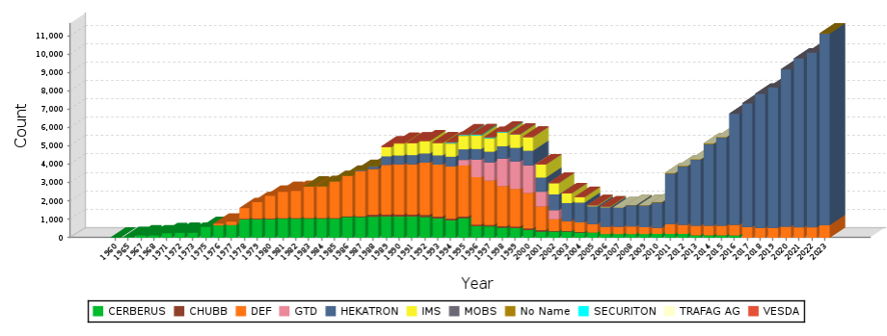
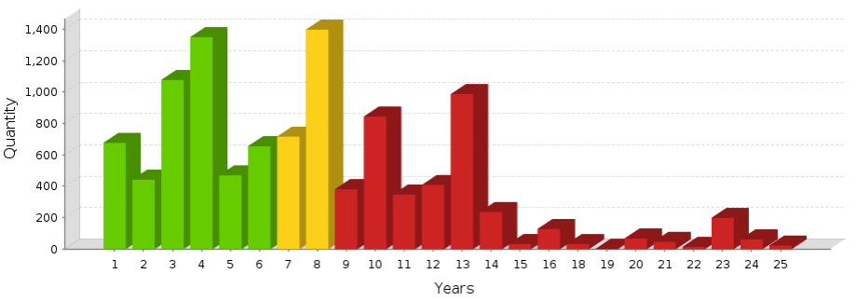
Reporting
Number of detectors per year
Age of detectors

Slide 9
Closing Codes

Slide 10

Web services
Important for us that that the same data is not entered twice in two different places. Time waste and difficult to maintain data consistency. Data synchronized from alarms database to INFOR
Detector addresses
What location the detector monitor (can be different from installed location)
Description
Safety zone
(Facility)
Alarm DB
INFOR DB

Slide 11
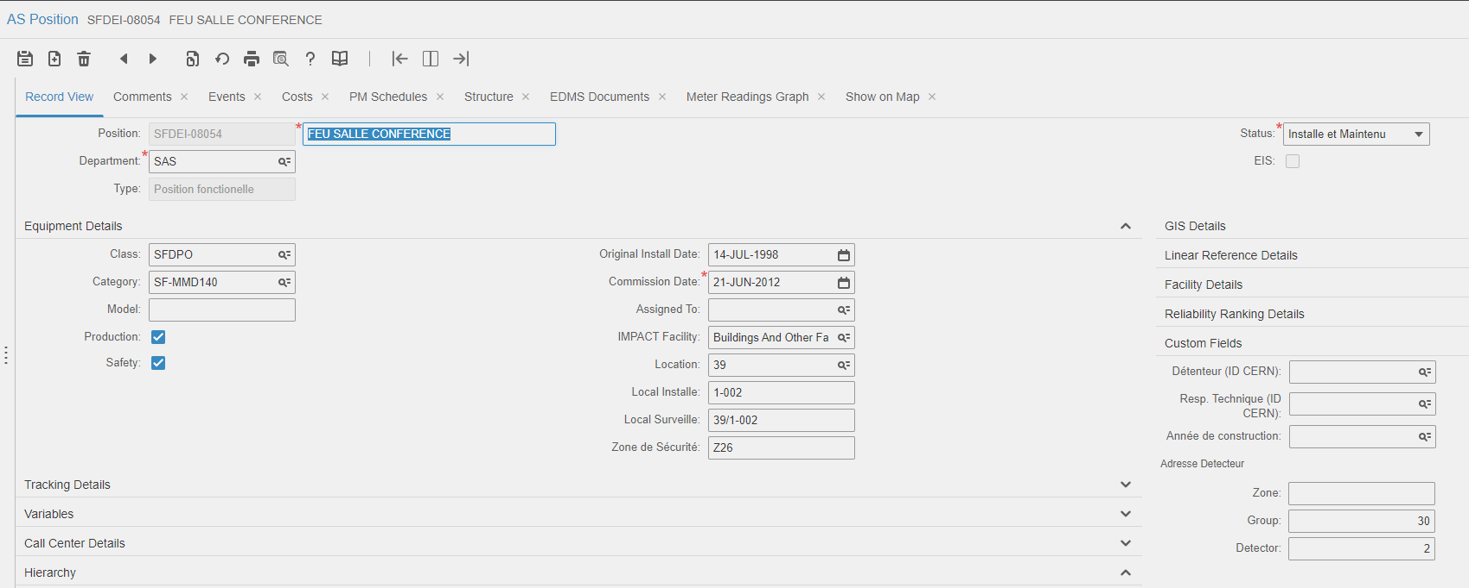
Personalized screens

Slide 12
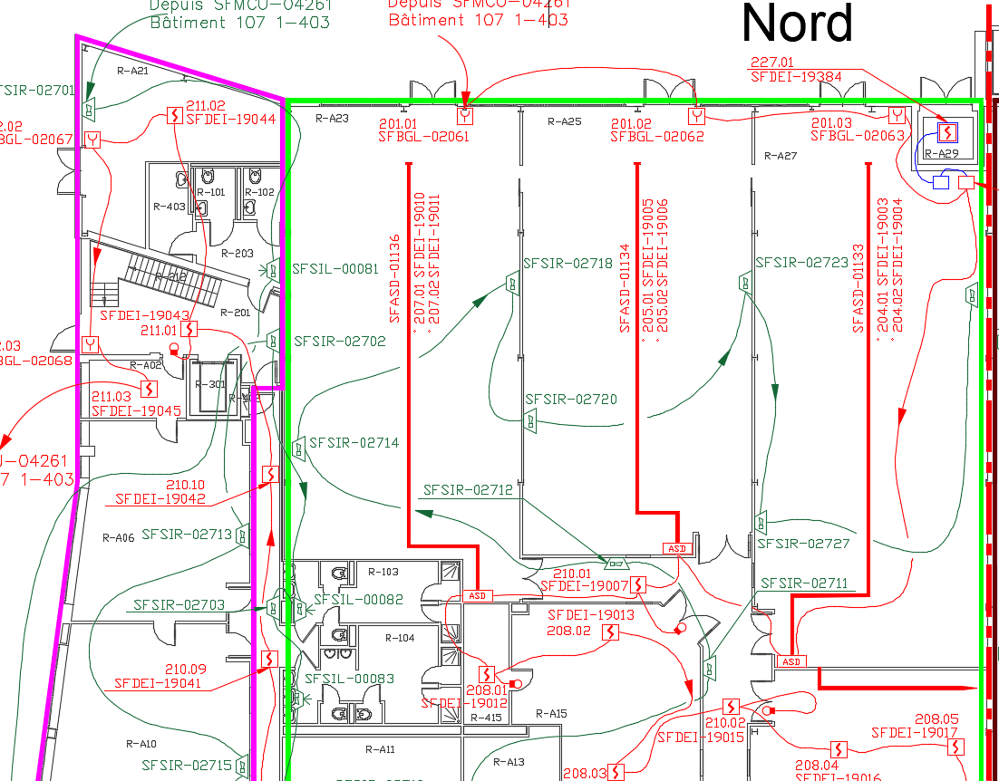
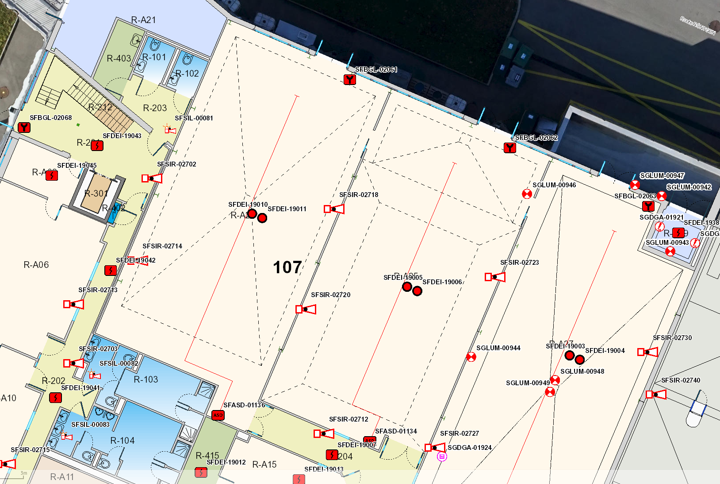
Automatic GIS update

Slide 13
What next
Currently working on introducing dependencies. First electrical but would like to extend to signal to other systems e.g., evacuation signals
Investigate if we can extend our use of checklist
Predictive maintenance !!! Lots of talk but not much result yet. Would like to have automatic ODM based machine learning solution.

Slide 14
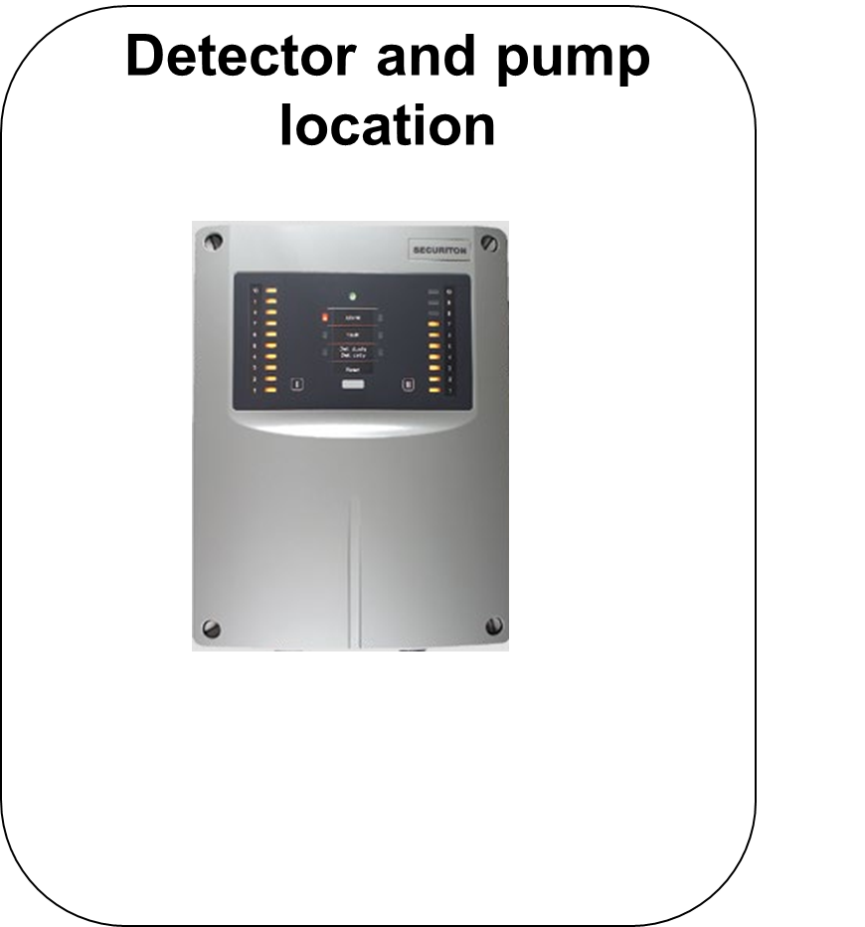
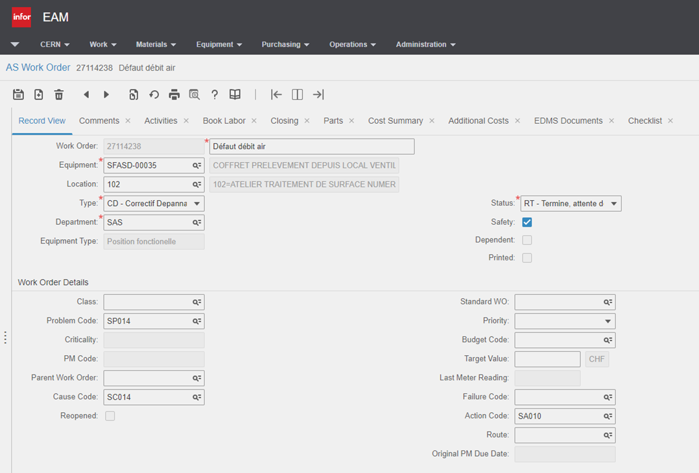
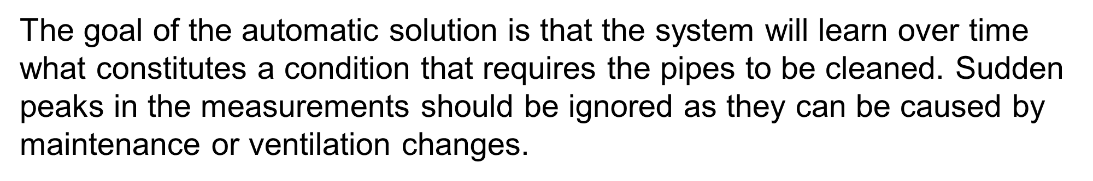
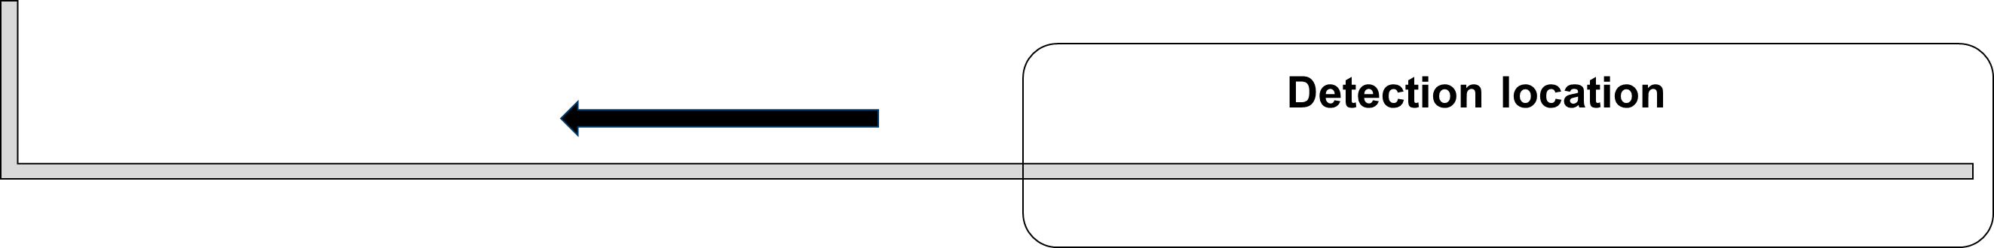
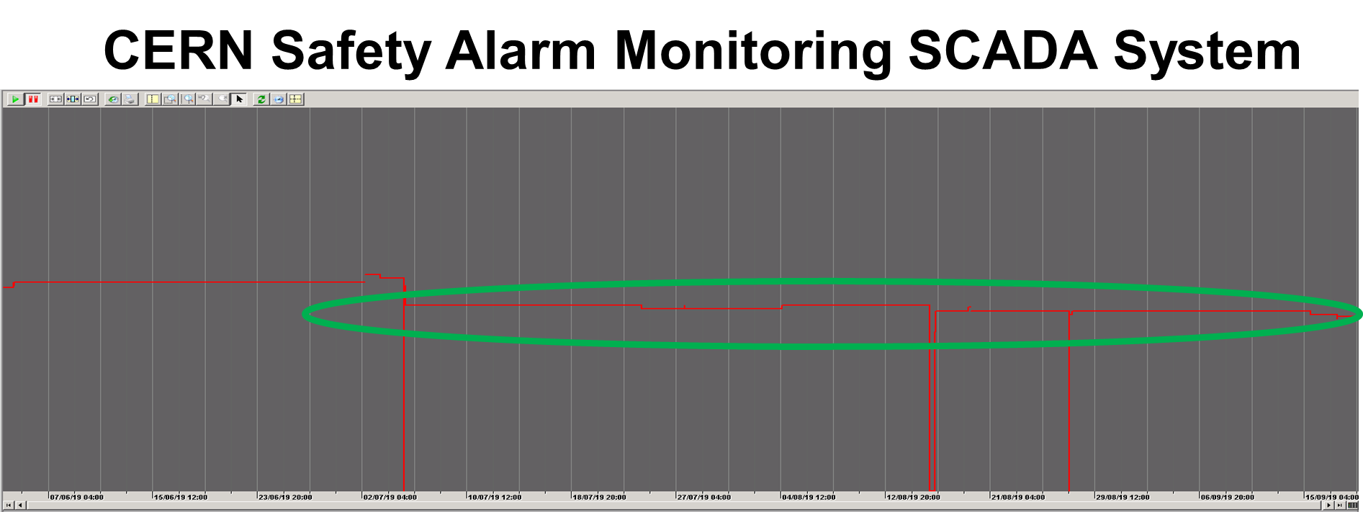
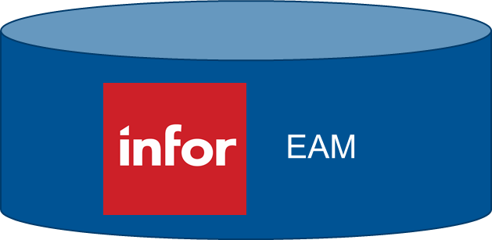

Predictive maintenance use case

Slide 15
Conclusion
It takes a lot of work and discipline ! But we are now capable of basing our decisions on data instead of assumptions and experiences.
You need the support and commitment from your management.
Without this data to visualize the growth and age of our park we would not have obtained more funding for the maintenance.
Correct closing codes is a valuable tool in analyzing the state of your installations.
Predictive maintenance can save money on maintenance but strict coding rules between the EAM and SCADA must be followed

