Slide 2
Doing right from the start?
Challenges in implementing efficient maintenance planning at ESS
AMMW 2023
PRESENTED BY Michael Sjöholm, ESS, Design & Engineering Division

Slide 3
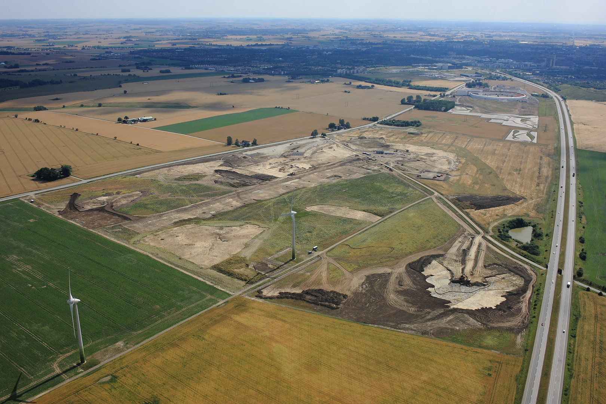
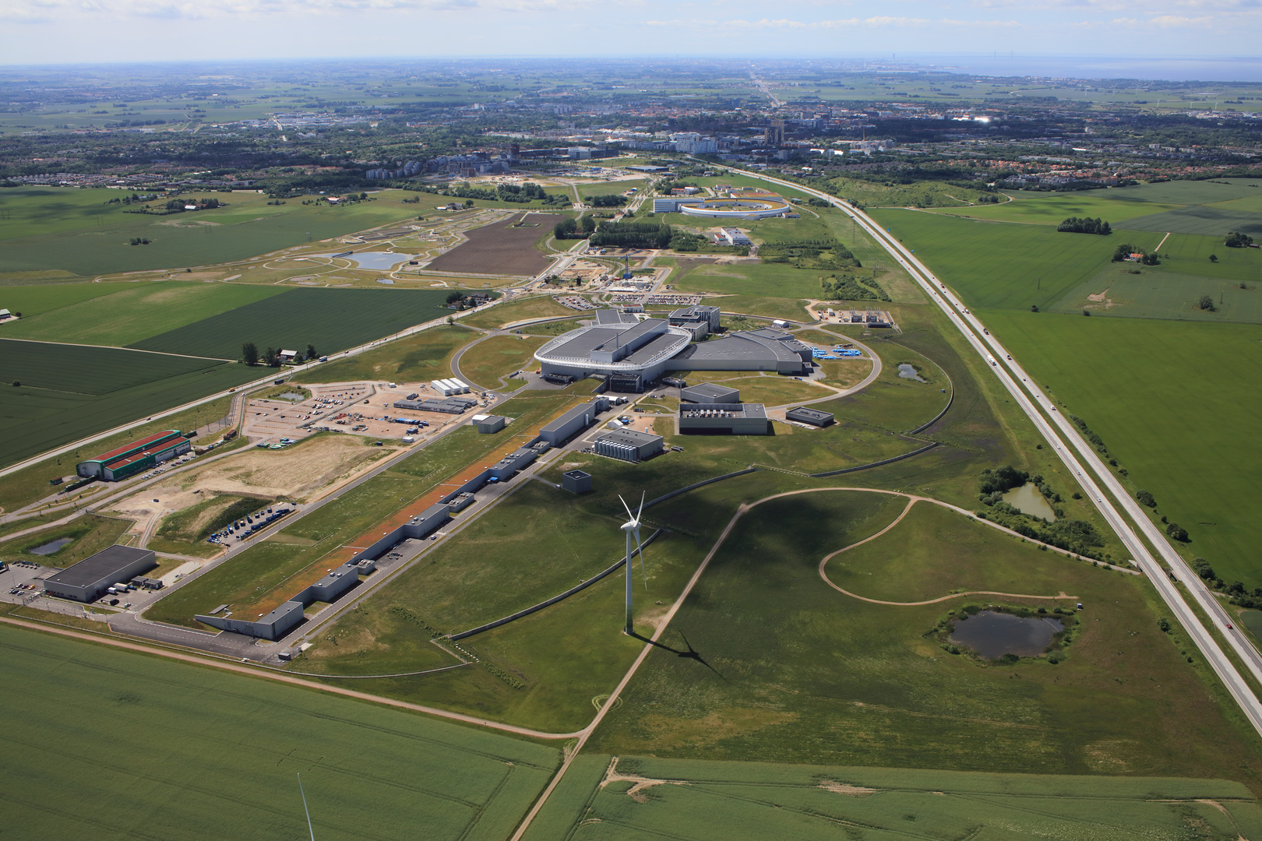
Greenfield project
We still have the possibility to do right…
2014, June
2022, June
Notes:
June, 2014

Slide 4
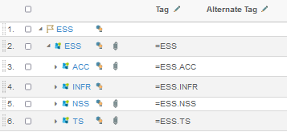
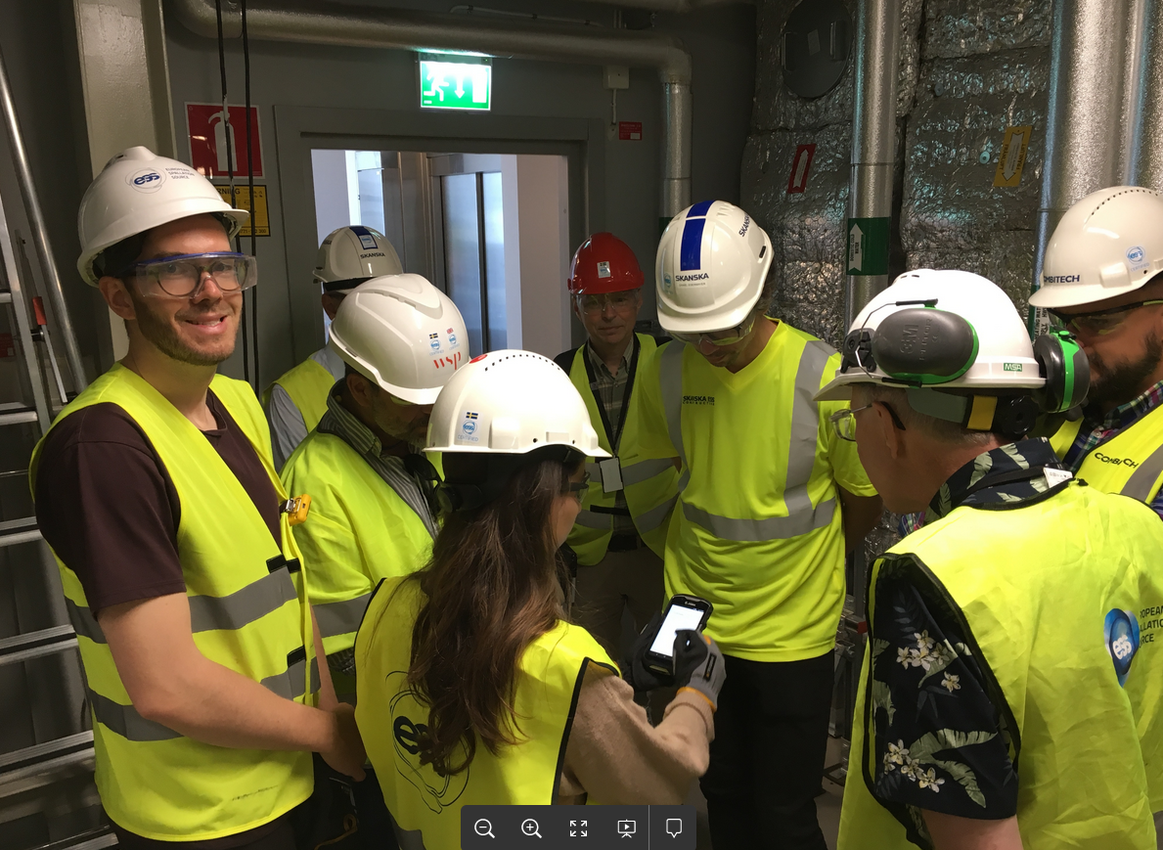
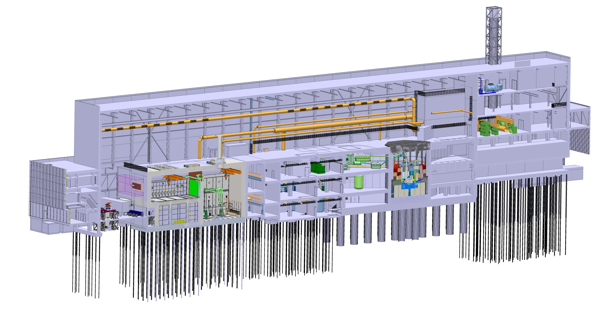
Greenfield project
We still have the possibility to do right…
Getting rid of papers and excel planning
Visualising planned activities manned with resources in the system
3rd party suppliers seamlessly accessing and working with ESS data
Applying condition based maintenance based on input from the facility
Visualising information for easy user access
Continuously following up on performance using KPIs
Workorder workflow supporting ESS safety culture
Good tools
Good structures
Great people
Good data

Slide 5
Greenfield project
We still have the possibility to do right…
LIMITATIONS
PLM platform by ENOVIA, from Dassault (”CHESS”)
Asset management by HxGN EAM
Functional breakdown of systems
Product data & construction data delivered from the project
… but every decision we make takes us further from the perfect solution
Notes:
June, 2014
Organisation is 10y old, but continously moving to new phases

Slide 6
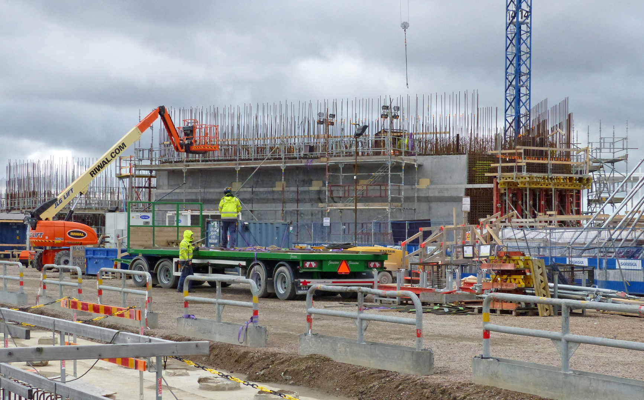
Transition phase for facility infrastructure
Between civil construction project and O&M
Construction project
Facility
Operation & Maintenance
Peak: 200+ designers, 800 contractors
Staff: 15+5+4
RESOURCES
First buildings ready
EAM Live
Facility Management Division
Re-org → Operation & Infrastructure Directorate
2014 | 2015 | 2016 | 2017 | 2018 | 2019 | 2020 | 2021 | 2022 | 2023 | 2024 | 2025 | 2026 | 2027 | 2028 -
TRANSITION PHASE
Huge amount of data
Architectural & Structural
Process cooling system
HVAC
Electrical and I&C
Transport
Landscape
Build an organisation for facility O&M
Plan maintenance based on strategy
Implement the tools and routines
Structure data in tools

Slide 7
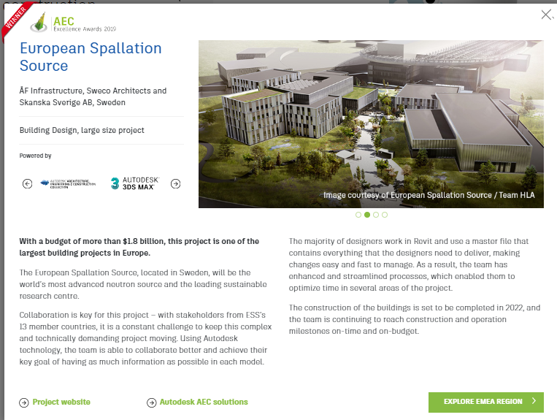
High ambitions for Building Information
Autodesk Excellence Awards 2019 winner

Slide 8
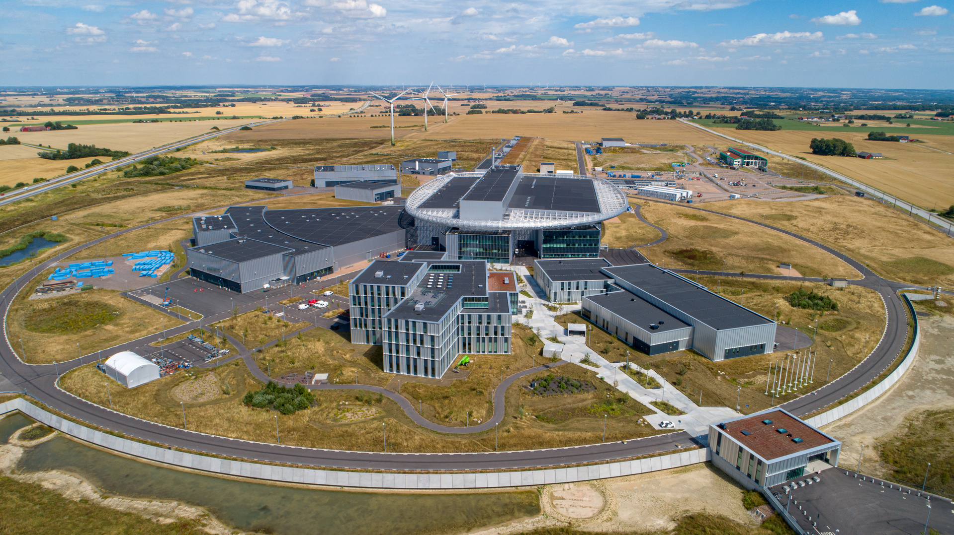
Challenges
Obstacles when implementing maintenance planning
Organisation & procedures
Immature organisation
Implementing the tool introduces roles & checkpoints
When to introduce control in the system, creating treshold for users?
Lack of maintenance strategy
Large amount of data
→ Maintaining the data
Change of structure (BSAB96 for the civil construction Project)
Quality issue
Resources and rules
Poor alignment between strategy and decisions
Lack of resources, central vs decentralised
Rules and routines limitating access
Lack of interest from organisation (focus on installation / commissiong

Slide 9
Approach for implementation
6 guiding principals when we implement facility maintenance
Pro-active planning, prioritising and bulking work
Applying a graded approach to system implementation
Involving system owners in the implementation
Launching pilots to test and show examples
Using ”low hanging fruit” to present good examples
Lowering the treshold – start with light implementation

Slide 10
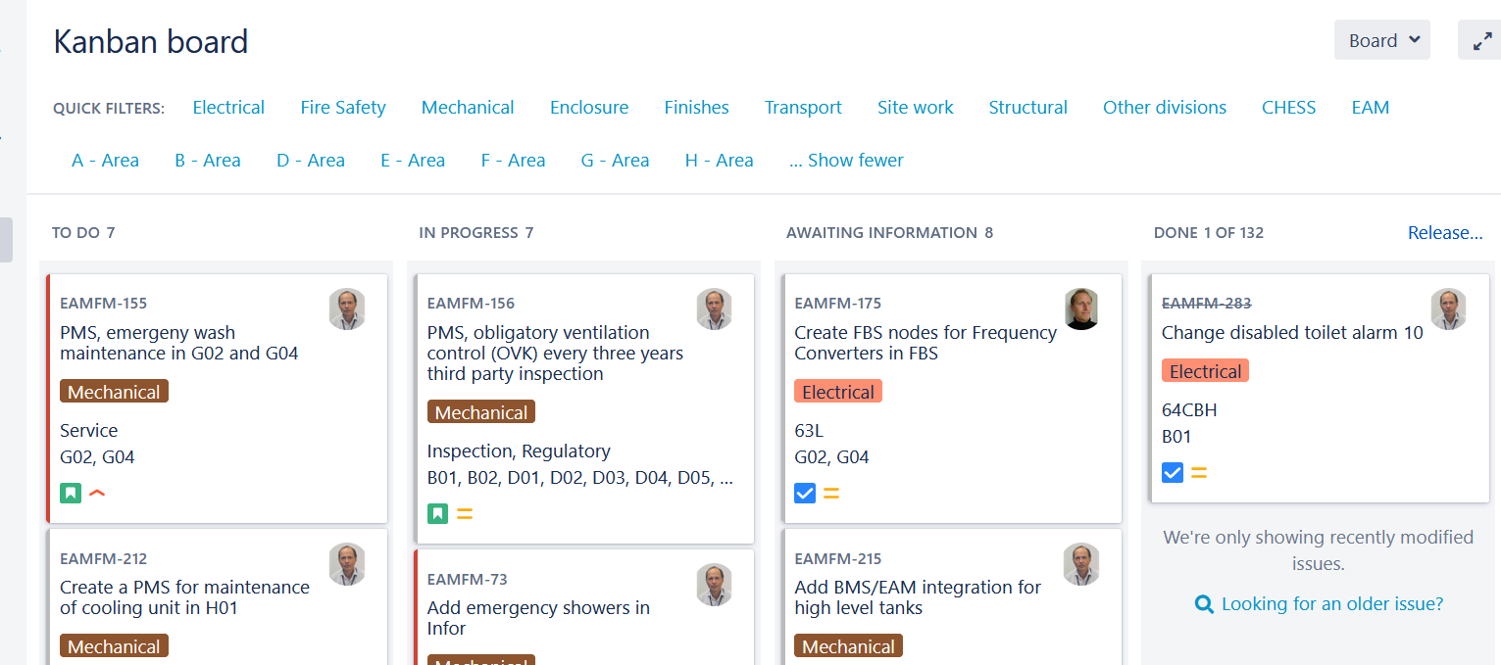
Approach for implementation
6 guiding principals when we implement facility maintenance
Pro-active planning, prioritising and bulking work
Using JIRA kanban to plan the implementation work
Applying a graded approach to system implementation
JIRA provides transparency
Still re-active
Difficult to package the work
Need to plan for quality issues
Involving system owners in the implementation
Launching pilots to test and show examples
Using ”low hanging fruit” to present good examples
Lowering the treshold – start with light implementation

Slide 11
Approach for implementation
6 guiding principals when we implement facility maintenance
Pro-active planning, prioritising and bulking work
Creating ownership of the data by having the users prepare it
Applying a graded approach to system implementation
Difficult to facilitate
Tool administration is only one part of the work - knowledge in documentation is needed
No routines for how to use the system
Technicians busy with operation
Involving system owners in the implementation
Launching pilots to test and show examples
Using ”low hanging fruit” to present good examples
Lowering the treshold – start with light implementation

Slide 12
Approach for implementation
6 guiding principals when we implement facility maintenance
Pro-active planning, prioritising and bulking work
Getting people into the system
Using existing routines and tools (e.g. inspection protocols from the sub-contractor)
Applying a graded approach to system implementation
Lowering the treshold
Gaining experience from the system
Involving system owners in the implementation
Launching pilots to test and show examples
Using ”low hanging fruit” to present good examples
Lowering the treshold – start with light implementation

Slide 13
Approach for implementation
6 guiding principals when we implement facility maintenance
Pro-active planning, prioritising and bulking work
Stop treating all systems equally – ambition for system implementation based on needs
Applying a graded approach to system implementation
Criticality
Safety
Complexity
Costs
Strategy
Involving system owners in the implementation
Launching pilots to test and show examples
Using ”low hanging fruit” to present good examples
Lowering the treshold – start with light implementation
Not clear how to transfer this to system implementation

Slide 14
Approach for implementation
6 guiding principals when we implement facility maintenance
Pro-active planning, prioritising and bulking work
Start using the system to see the capability of it
Stop expecting to get everything right from the start
Learning from the experience and adapting implementation
Applying a graded approach to system implementation
Involving system owners in the implementation
Launching pilots to test and show examples
Move forward, avoid getting stuck on technical details
Get buy-in from the organiation
Gain experience
Time-consuming
Using ”low hanging fruit” to present good examples
Lowering the treshold – start with light implementation

Slide 15
Approach for implementation
6 guiding principals when we implement facility maintenance
Pro-active planning, prioritising and bulking work
Avoiding ”creating a monster”
Limiting the amount of Assets created – possible to add in the future
Taking baby steps
Focusing on Workorders and Schedules
Applying a graded approach to system implementation
Involving system owners in the implementation
Launching pilots to test and show examples
Limit the administration of today
Using ”low hanging fruit” to present good examples
Lowering the treshold – start with light implementation

Slide 16
Approach for implementation
6 guiding principals when we implement facility maintenance
Pro-active planning, prioritising and bulking work
JIRA provides transparency
Quality issues time consuming
Criticality?
Complexity?
Strategy?
Applying a graded approach to system implementation
Involving system owners in the implementation
Launching pilots to test and show examples
Technicians don’t want to prepare the data
Avoid technical details
Gain experience
Using ”low hanging fruit” to present good examples
Gets users into the system, increase the acceptance
Limiting the amount of assets,
”baby-steps”,
Focus workorders & ”Schedules”
Lowering the treshold – start with light implementation

Slide 17
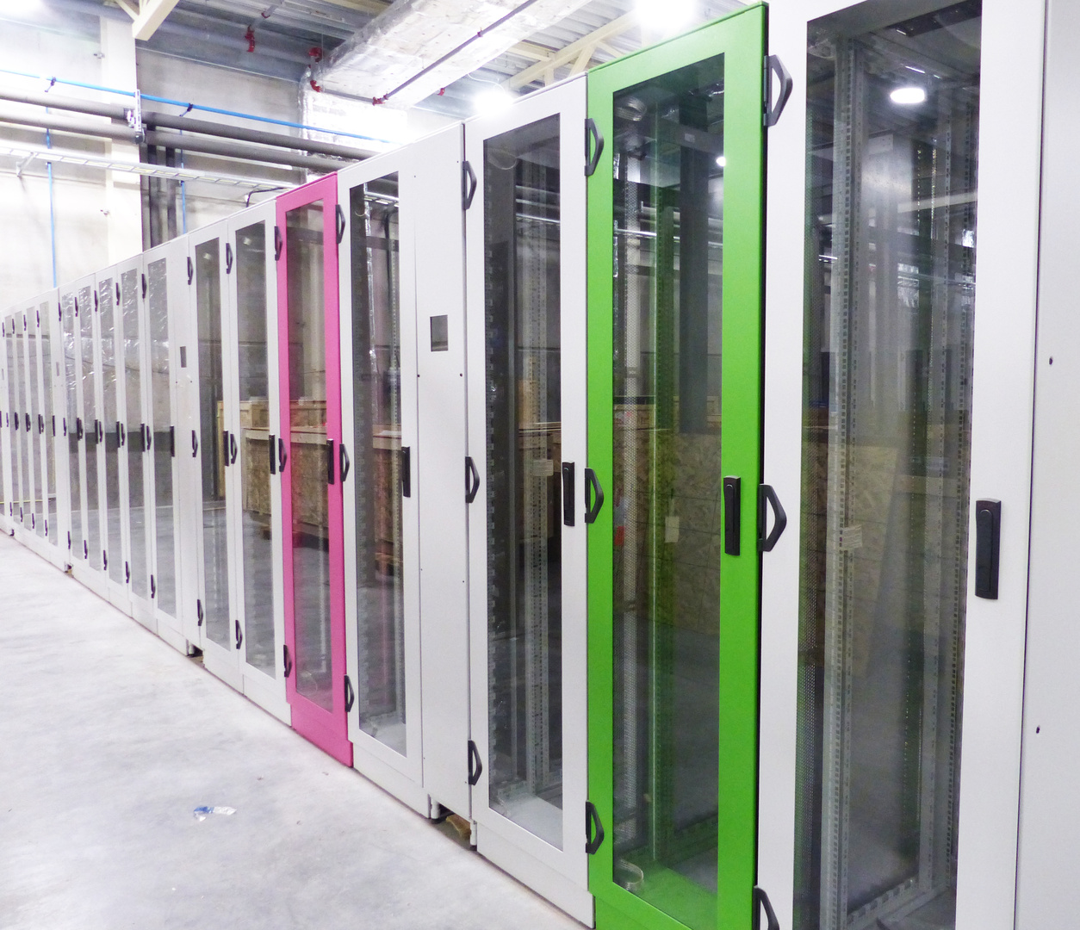
Success stories to share
Examples that give me energy
PMS_220ACC_ Maintenance_
Accelerator Rack Cooling_55D_ Monthly
Yearly maintenance through monthly visits by subcontractor (1/10 units maintained per visit)
EAM manage the planning
Subcontractor uses handheld units for accessing the workorder and adding data
”Pull effect” from the organisation
Approached by the System Owner asking for support to implement EAM

Slide 18
Finish presentation

