Slide 2
Lesson Learned From EAM Logbooks for Cryogenic Operation at CERN
Lionel Conan, Nicolas Bonetti, Frederic Ferrand, Philippe Gayet – TE-CRG-ML
Presentation on behalf of Cryogenics Group
Notes:
20 minutes presentation 10 minutes questions

Slide 3
Introduction & Outline
This presentation exposes the lessons learned from the EAM based Logbooks that have been presented in
“Case Management as Logbook for the Cryogenic Installations at CERN”
AMMW2018, S.Knoops.
Outline
Rapid recall of the aim of a Logbook
Logbooks deployment and interesting features
Analysis of the statistics
Conclusion & Perspectives
Notes:
Follow up of a previous presentation

Slide 4
Needs, Definition and History
One of the challenges for the operation and maintenance of cryogenic installations is to trace as precisely as possible WHAT-WHEN-HOW.
To do so we use LOGBOOKS as tracking tools of all activities related to operation
They are daily used by the operators and thus needs to be easy to use
They can also be used as technical interface between operation & support teams In case of interventions.
They traces and follows up events and proposes an easy way to retrieve information on past events. ALL type of events, not only work requests.
Logbooks are the “Operation Bible” of the installation.
Logbook History @ CERN
<1996
APEX LHC
and IN, NLHC
2009
2011
Filemaker Pro
1996
Paper logbook
2018
EAM Logbook
2006
Logbook LHC
New EAM Logbook
2023
Local
Shared on server
On-line
Notes:
What when How
History
Focus on last period

Slide 5
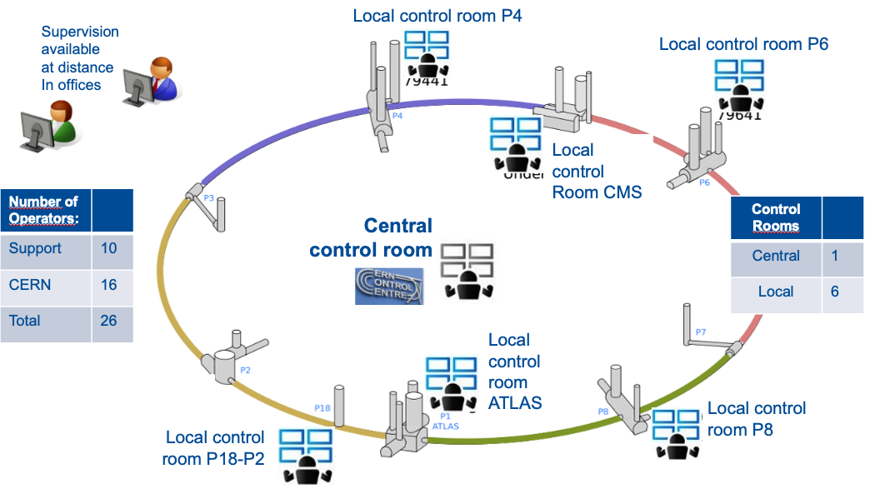
Operation Logbooks Today
Non LHC Installations
Result Oriented Support
LHC Installations
Task Oriented support
Notes:
The scope of the installation are
LHC installations : Task oriented maintenance contract 1 central control room and 6 Local control room
NLHC installations : Result oriented maintenance contract 2 control room

Slide 6
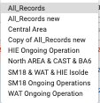
Logbook List view
When opening a logbook, it present a list of existing events sorted according to their contents
Thanks to this view the operators can :
Create new events;
Select a list of the predefined filters (dataspy);
Open the filters and introduce criteria
Export to Excel the content of the table;
Use color codes to identify the events types
Sort the columns by clicking on one column-head;
Notes:
Predefined filters (Dataspy): that has predefined filters for instance on installations, nature or equipment.

Slide 7
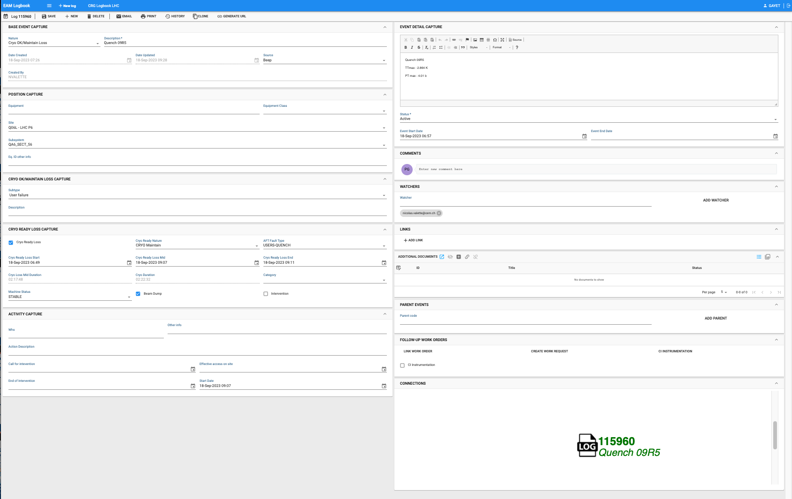
Logbook Record View
To capture a maximum of information in a structured way within different blocks
What &When
Event Details
&
Status
Which Equipment
Comments
Subtype
Who will be informed of modification
Links to other data systems
Impact on Load
Documents related to the Event
Is there another Event linked
Operator Activity
Related EAM Work Orders
Graphical Connection
Schema
Depending on the Nature, some blocks will be opened, to guide the operator
7
Notes:
What has occured,
Then on wich equipment, … and eventually several kind of documents of information that can be attached to the event.

Slide 8
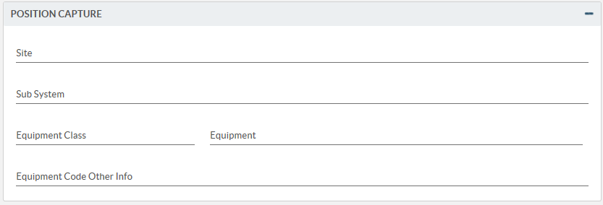
Facilitated Classification Through Predefined Lists
SUBTYPES : To refine the event “Nature” hence they are different for each “Nature”: e.g., identify the origin of a fault, precise the lockout or the modification request type.
NATURE : To categorise what has happened
Three categories : Failures, Operation, Communication;
Fault: When an equipment needs an intervention or if an equipment stops to work properly
Cryo OK/Maintain: When a Fault impact the load
Lock Out: When an access restriction is needed for a facility.
Intervention authorization: To allow a physical action on a facility.
Ongoing Operation: To inform other people that a particular operation is ongoing and must be carefully followed.
Modification requests: To request a modification on the cryogenic system (documentation, control logic, synoptic, mechanics).
Report: To communicate after an inspection /patrol, a specific test, or to summarise an operation period.
Instruction: To transmit instruction to other people (from point to Central control room, new shift, Gas transfer…).
Information: any information useful for other people not entering in the previous case. (e.g., a beep with no fault is an information, …)
SOURCE : To indicate from where the event was detected & generated.
Beep
SCADA Alarm
CCC call
Ronde/Inspection
Other sources
POSITION : To attach an Event to an existing item in the EAM Cryogenic Hierarchy.(Site, Subsystem. Equipment.
Notes:
4 Predefined lists
Nature : 3 categories : Failures Operation Communication
Subtypes to refine the events
Source of the event
Position can be a hierarchy composed of a site, subsystem and an equipment

Slide 9
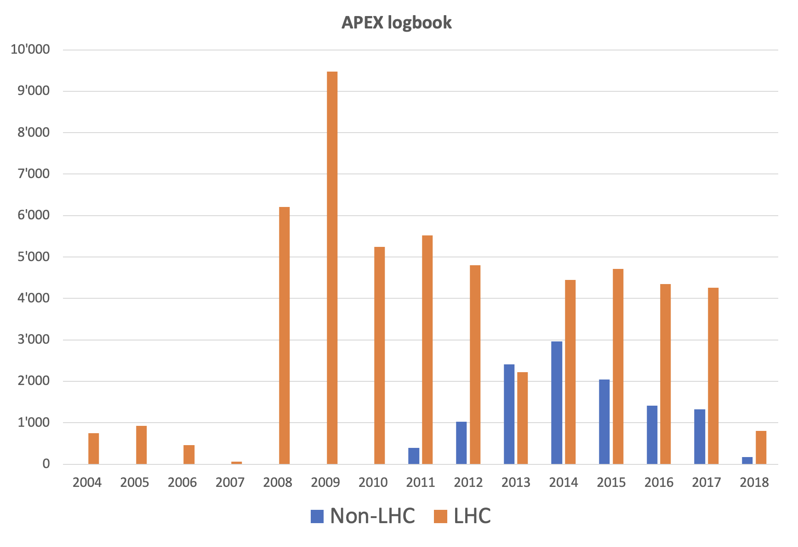
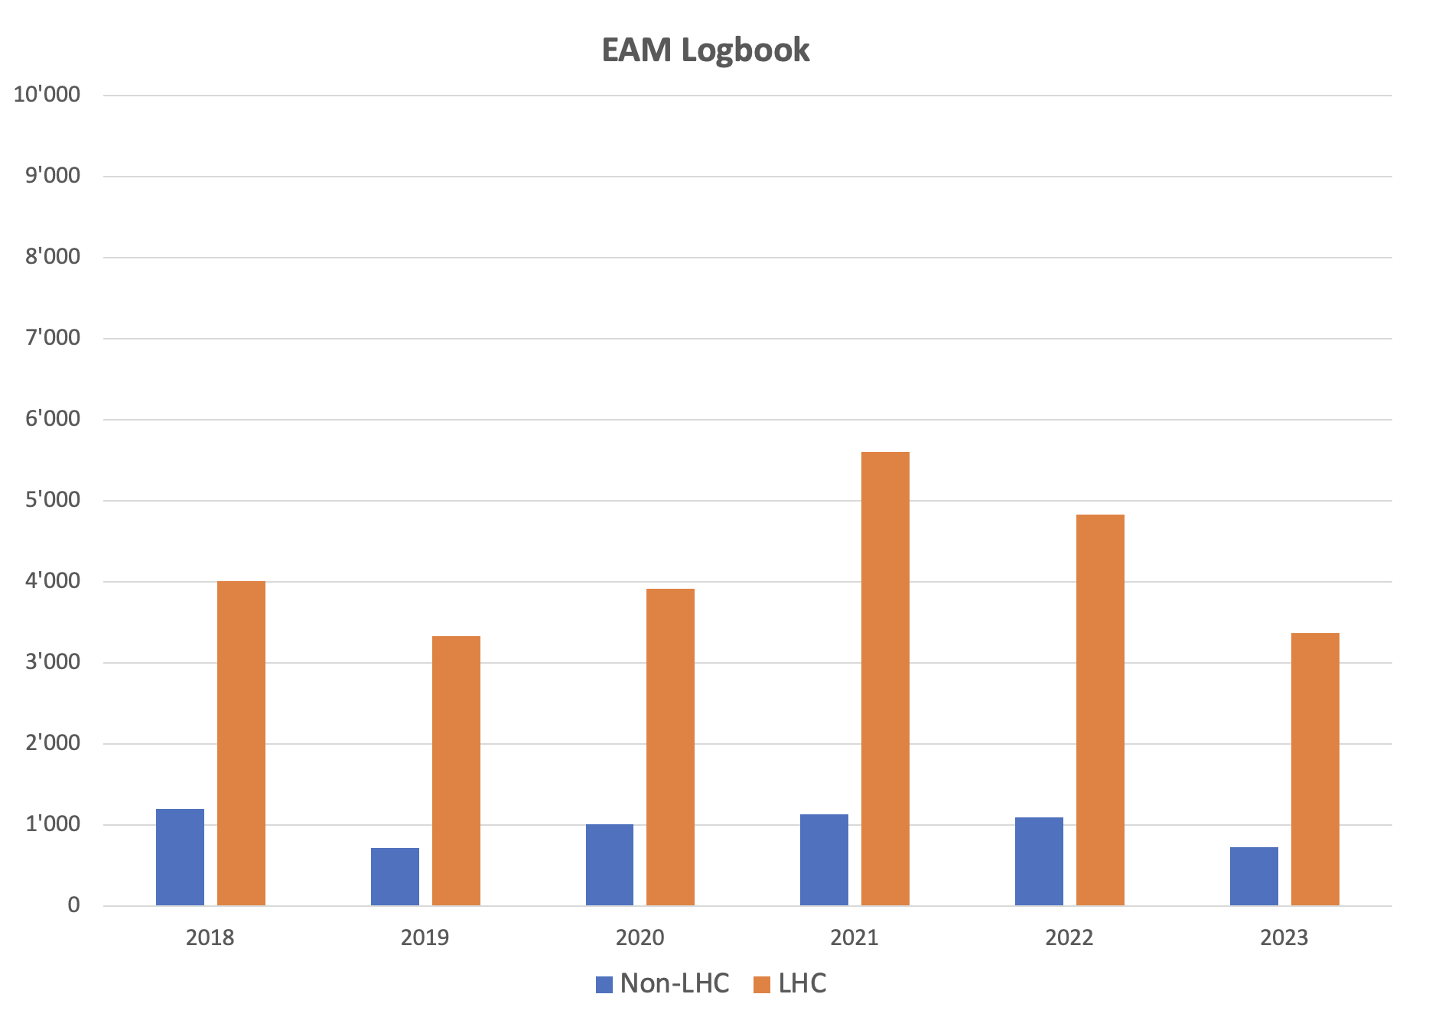
Evolution of Number of Events Capture
LS1
LS2
LHC :
Event Capture has not been affected by the current EAM logbook > around 4 500 events/year
The Long Shutdown 1 (LS1) has affected the Event Capture (↓) but not the LS2
Non-LHC :
Small reduction of the Event Capture by the current EAM logbook => now around 1000/year
The Long Shutdown 1 (LS1) has affected the Event Capture (↑) but not the LS2
Notes:
Evolution of number events over the years since 2004.

Slide 10
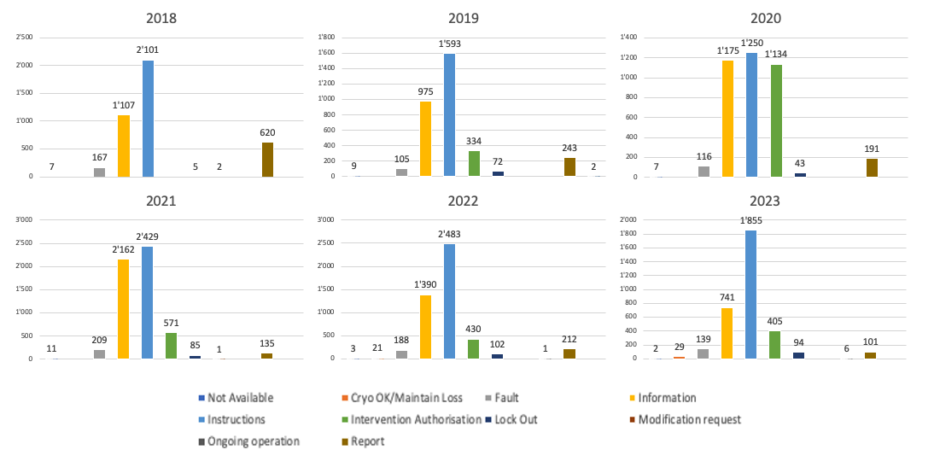
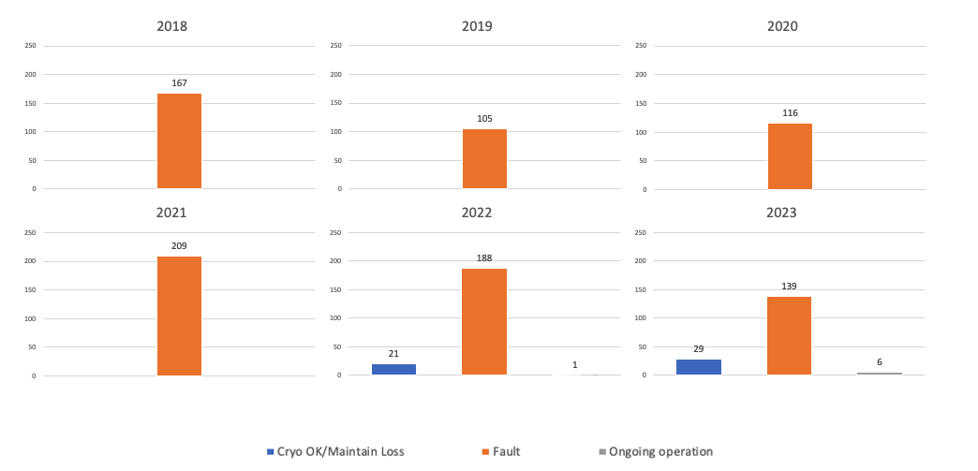
Event Nature Evolution for LHC
All Event Natures
Clear instructions have been given to the Operation team to fill the Logbook.
From 2018 to 2023 the Information & Instructions Events dominates.
From 2019 the Intervention Authorisations have increased to follow the support teams activities.
Operation Events
The Operation related Events are a small percentage of the captures.
The main part of the Operation events are the Failures.
Note :Up to this year the Ongoing operation events were transferred once finished to Information. Now they will only be closed.
Notes:
LHC: clear instructions. Information and Instructions events dominates.
Operation events consist of Cryo Loss, Fault and Ongoing operation

Slide 11
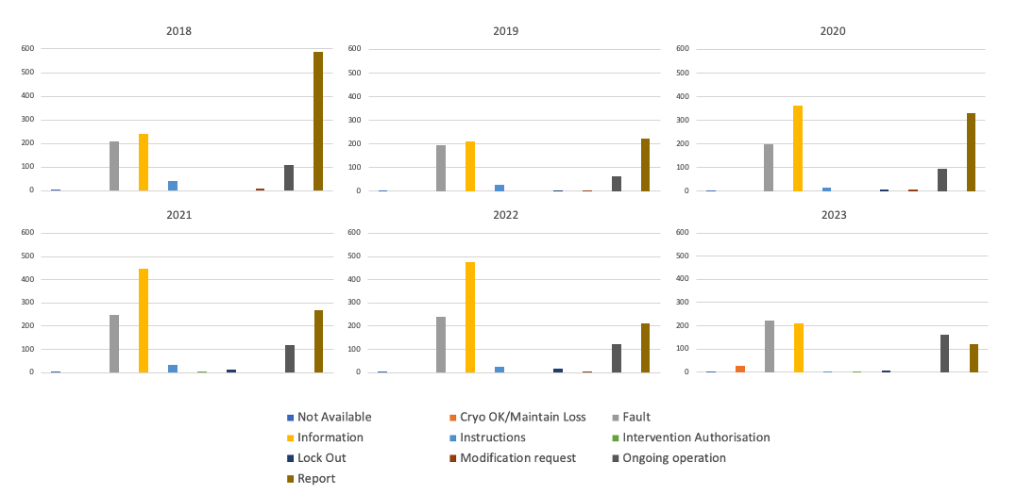
Event Nature Evolution for Non-LHC
All Event Natures
None homogeneous and clear recommendations have been transmitted to the operation teams, making this Logbook more difficult to analyse.
Information and instructions are not as used as for the LHC Logbook.
However, it can be noted that the number of Fault is almost constant and proportionally higher than in LHC.
Very few Intervention or Lock-out have been registered but the teams were using a paper version to manage the authorisation.
The Ongoing operations are used at a higher level than in LHC probably related to the purpose of some facilities (Test installations).

Slide 12
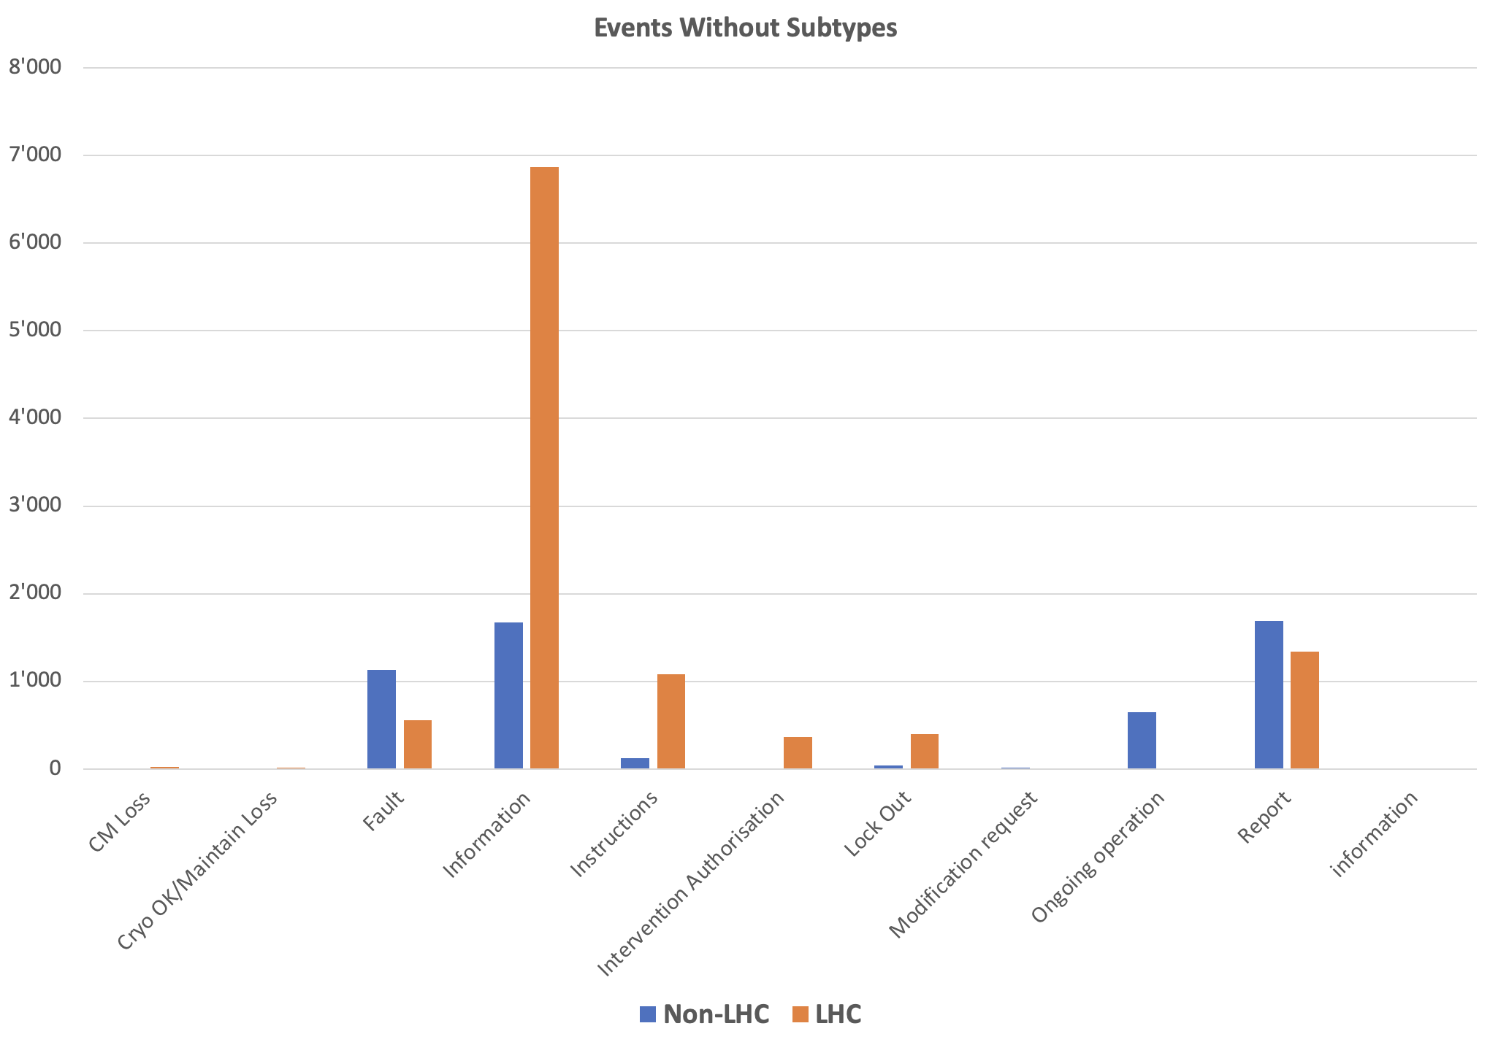
Lack of Subtype and Source capture 2018-2023
Subtypes : To refine the event “Nature” hence they are different for each “Nature”: e.g., identify the origin of a fault, precise the lockout or the modification request type, etc
Source : To indicate from where the event was detected & generated.
Beep
SCADA Alarm
CCC call
Ronde/Inspection
Other sources
Many Events were captured without :
- the nature subtype
- the source that have originated them.
For these values:
They were no advice in the LHC recommendations,
Their capture was not mandatory.
Notes:
We can see a lack of Subtype and source capture
There was a lack of recommendation given to the operation Teams

Slide 13
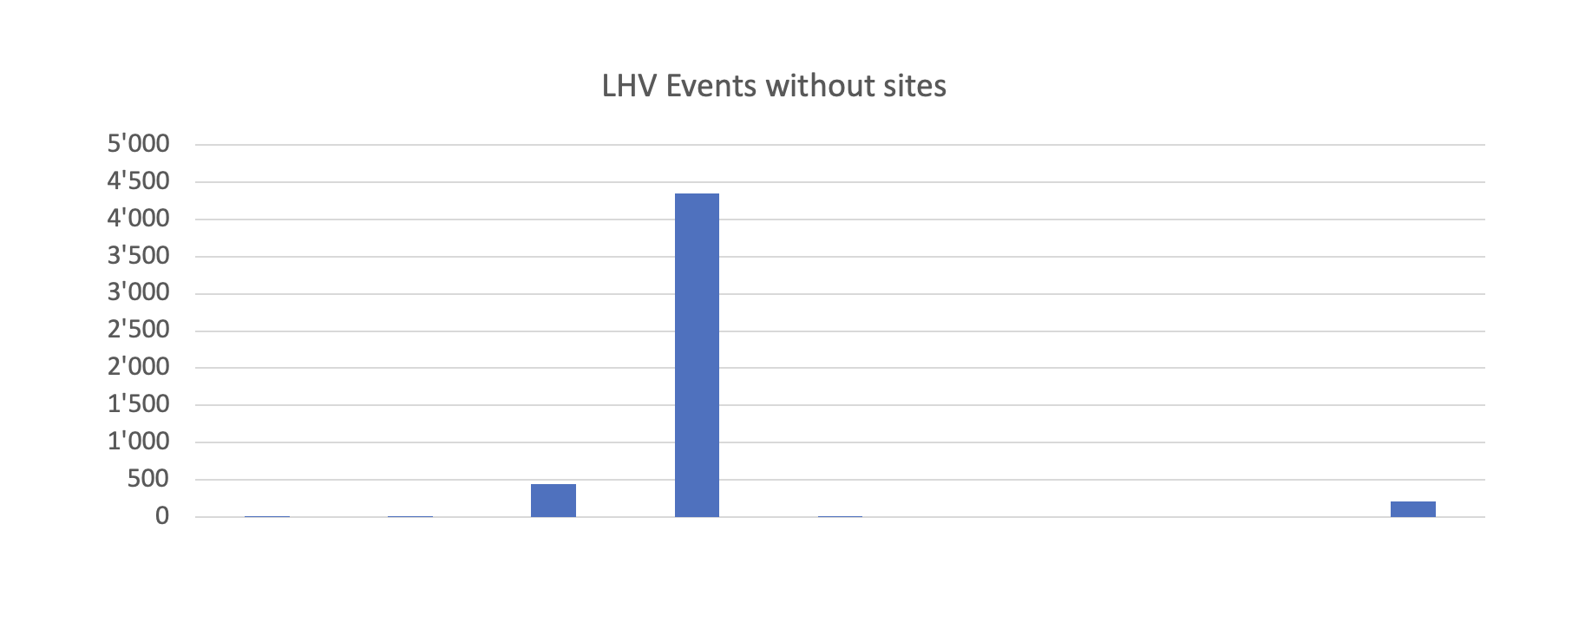
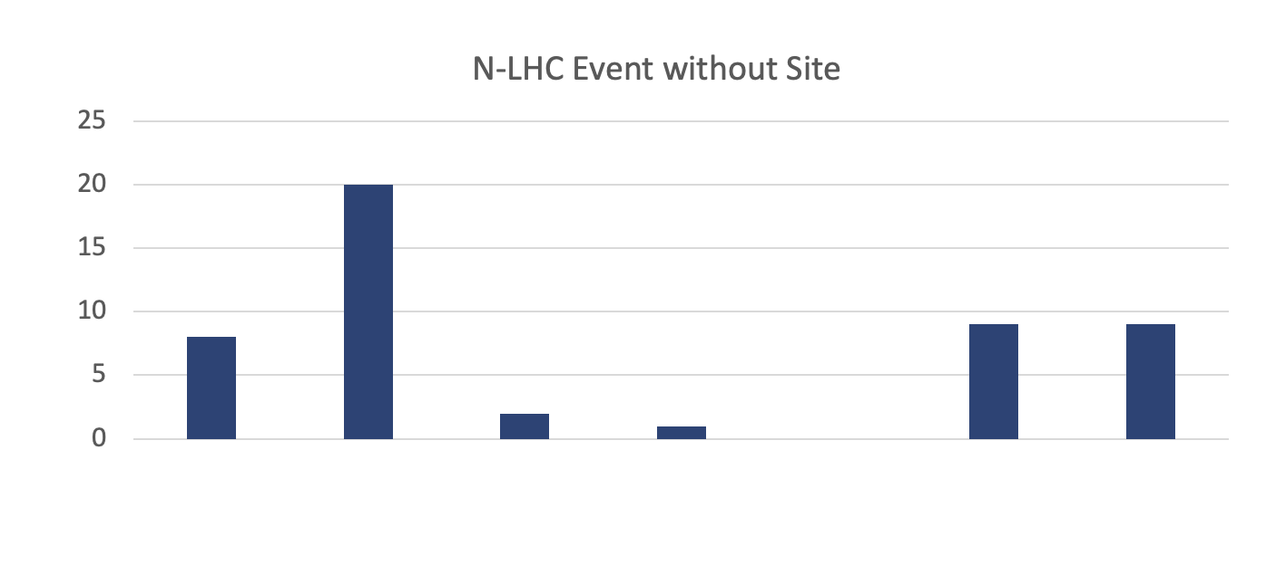
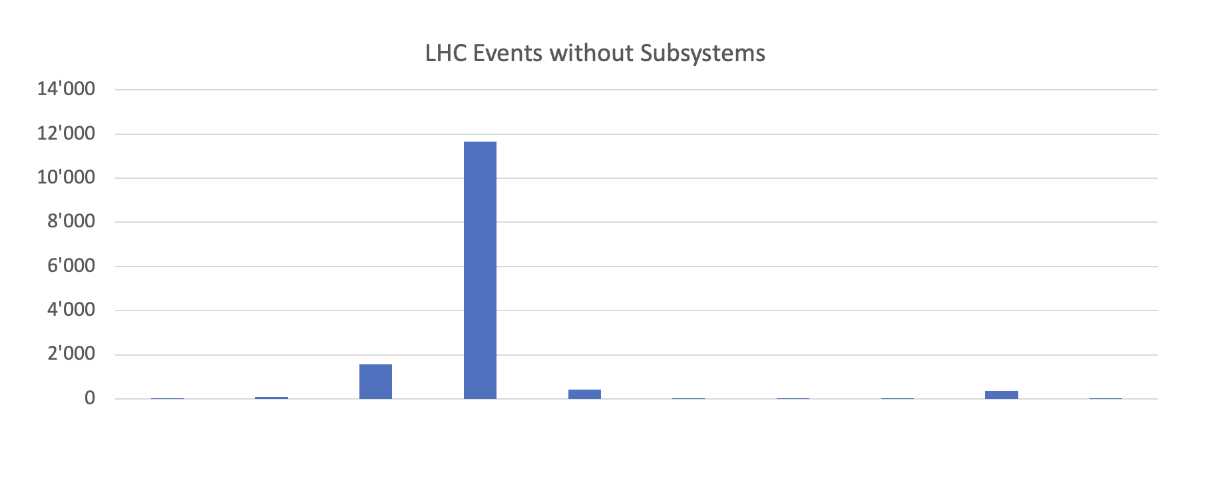
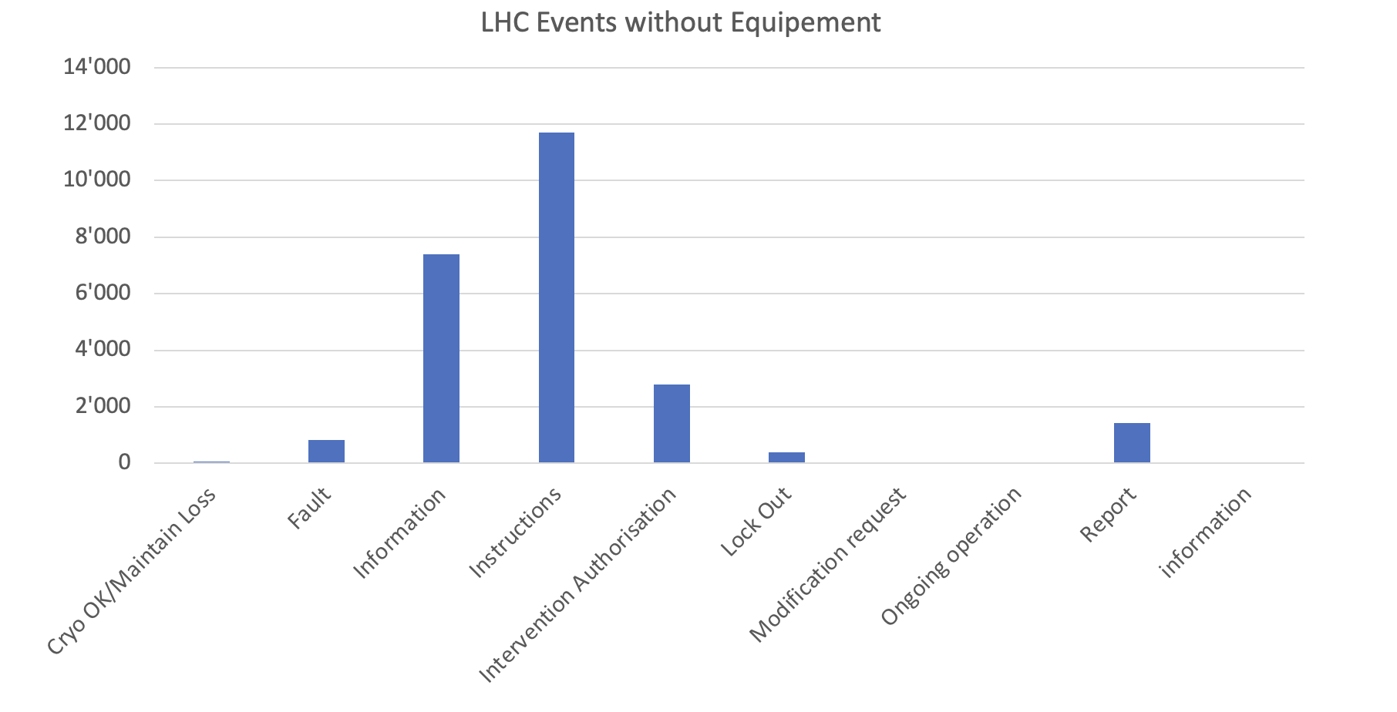
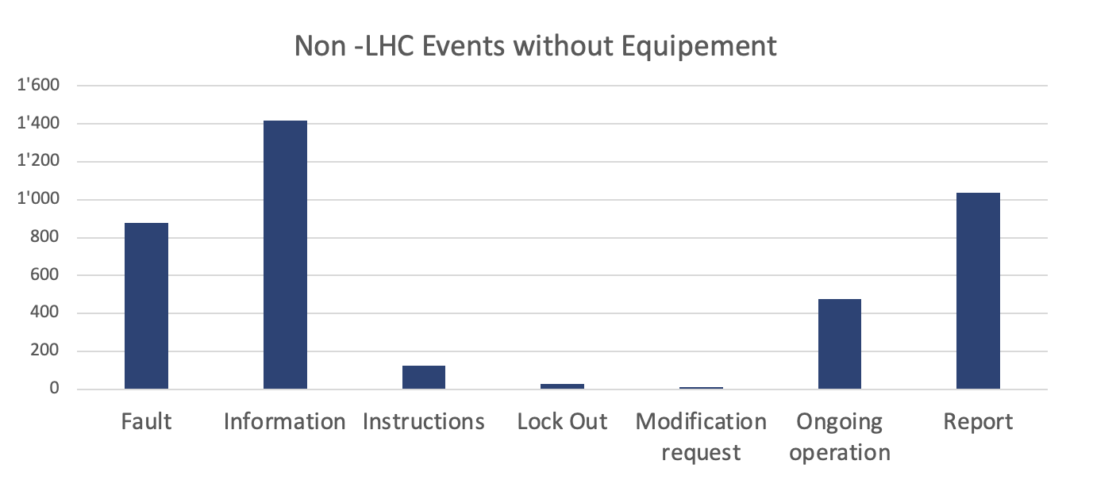
Lack of Position Capture 2018-2023
The Position Capture is not an easy issue as :
Equipment captures are necessary to localise the origin of a failure event
Site or Subsystems captures are sufficient for communication purposes
Recommendations to fill these fields need to be provided to the operation Teams
Notes:
We have a lack of Site, subsystems and equipment Positions.

Slide 14
Feedback from the LHC Operation Team
The Operation Team value :
✅ The look & feel is nice, appreciated by all operators.
✅ The reaction time is generally appropriate.
✅ The predefined-filter of events (Dataspy) fits their needs.
✅ The filtering of events is efficient.
✅ The linking between events and EDMS/EAM Work worders works correctly and is appreciated (several past problems have been corrected).
To be Improved (Bugs remaining today) :
❌ Filtering is not always adequate in some columns (e.g., impossible to filter between 2 dates)
❌ Automatic search of equipment sometimes does not working properly
❌ When equipment are selected, the site and subsystem auto-filling may not always be done correctly.
❌ Sometimes, the reaction time can be to slow (e.g., Changing a colour, dropping menu choices,…).
❌ A link between the logbook and the CERN system to manage co-activities (IMPACT) for the cryo lockout or interventions would be welcomed.

Slide 15
Evaluation of present Logbooks
From the operation :
Most of the requested improvements in 2018 have been implemented.
The operation teams are satisfied and use the logbooks.
From CRG logbook support :
Modifications of record views are impossible by local administrator.
Modifications of predefined filters have been given very lately and are tricky to create.
Field capture enforcement impossible by local administrator.
Requests to central EAM logbook support was frequent (lack of autonomy), delay in implementation

Slide 16
Perspectives for NG Logbook
Configuration of the Next Generation (NG) Logbooks has been prepared.
It is In test phase with Operation teams.
Will go to production Mid-October 2023.

Slide 17
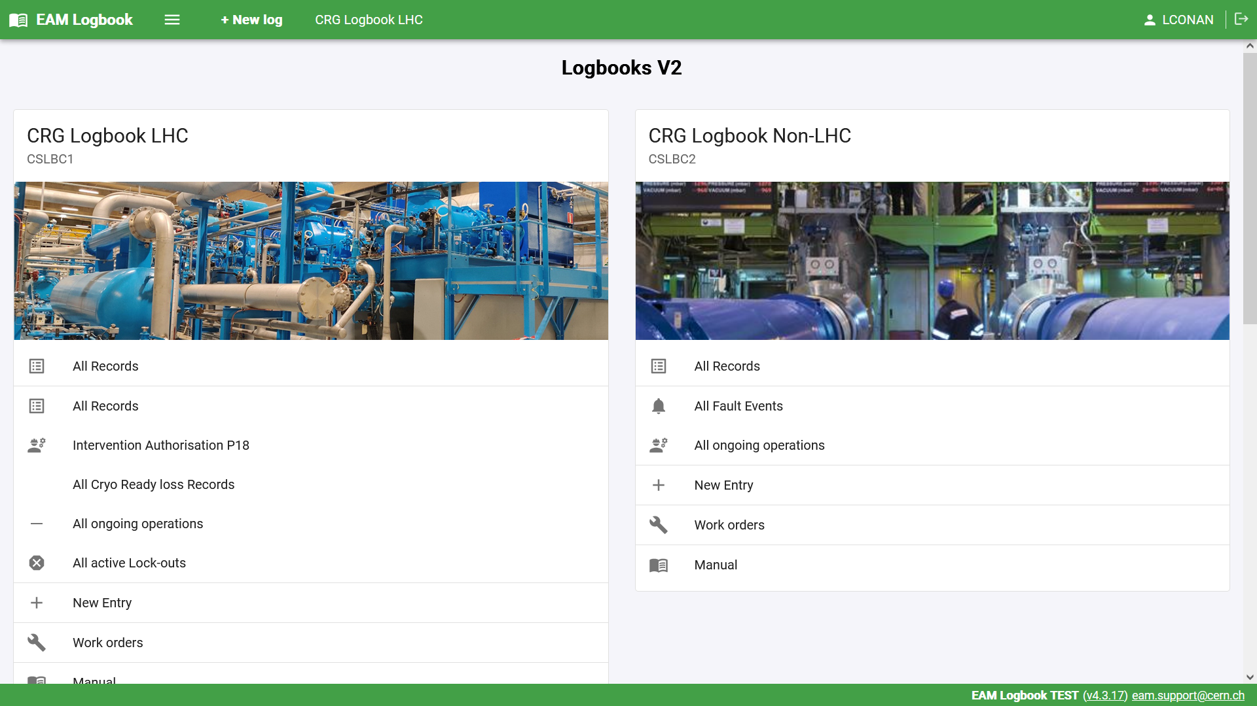
NG Logbook Configuration feedback
Predefined filters (Dataspy) are easier to create than in the present Logbook
Better customisation by local administrator as the following items can now be modified:
The Record views
The Predefined list of values
Field capture enforcement
The Logbooks Homepage can be customized with
A photo of the installation
Direct link to predefined filters
Links to online tools (EAM )
Link to online Documentation

Slide 18
Conclusion
Present usages between LHC and Non-LHC operation teams are different :
LHC : Heavily used for communication purpose (Instructions and Interventions) and failure are better documented.
Non-LHC : Used for all types of events but quality of capture needs to be improved (lack of subtypes, source, positions).
Event captures are incomplete.
In the NG version, many field captures will be mandatory
More exhaustive recommendations will have to be given to operation teams.
The NG Logbook will be improved thanks to the feedback of users.
The Local administrator autonomy evolution will allow faster evolution
After deployment of the NG operation Logbooks, we plan to design and integrate the existing Instrumentation logbook with the NG Logbook in collaboration with our Instrumentation Section.

Slide 19
Questions?
Thanks for listening

Slide 21
Improvements since 2018
✅ Clone an event
✅ Possibility to create and save predefined filters (Dataspy) from the EAM application (2023)
✅ Reports (Pentaho reporting) : Statistics and save all information of an event in a pdf for printing or sharing
✅ Improved predefined lists for filtering use and statistics (nature field : Cryo loss)
❌ Open the logbook for read-access to non-EAM users and review write access.
Notes:
Maybe to be put before the analysis
Jusrt(nature field : Cryo loss) hes^fre

