Slide 1
Step 6 Classification
It is actually 3 sub-steps
  Step 6a – Categorization of RSFs
  RSFs, not SSCs.
  RSFs have a Categorization (Cat 5, Cat 1, Cat 2, or Cat 3).
  We have one categorization report for all ESS RSFs (ESS-3730670).
  Step 6b – Classification of SSCs at the system level
  SSCs (structures, systems, components), not RSFs.
  This is only classification for radiation safety.
  This is discipline-specific for Mechanical, Electrical/I&C, HVAC, Civil disciplines.
  SSCs have a Classification (MQC4, MQC3, EIC0, EICPA, EICW, etc.) that is discipline-specific.
  Shielding does not have a classification.
  Step 6c – Classified component list (SSC)
  This is also only classification for radiation safety.

Slide 2
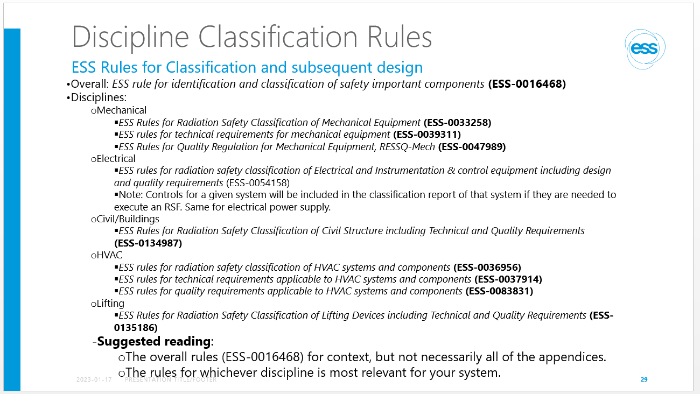
What does a SSC classification mean?
It is not just letters (MQC4, MQC3, EIC0, EICPA, EICW, etc) …
It means that you apply dicipline specific standards
The standard provide requirements that needs to be verified.
Compliance to standards is checked at reviews (CDR,TRR and SAR).
If you have followed the ESS management system and its templates you should be ok
Note: Standards are not only from a radiation safety point of but is applicable on all SSC’s. But we need to focus on the operational/safety SSC’s for now.

Slide 3
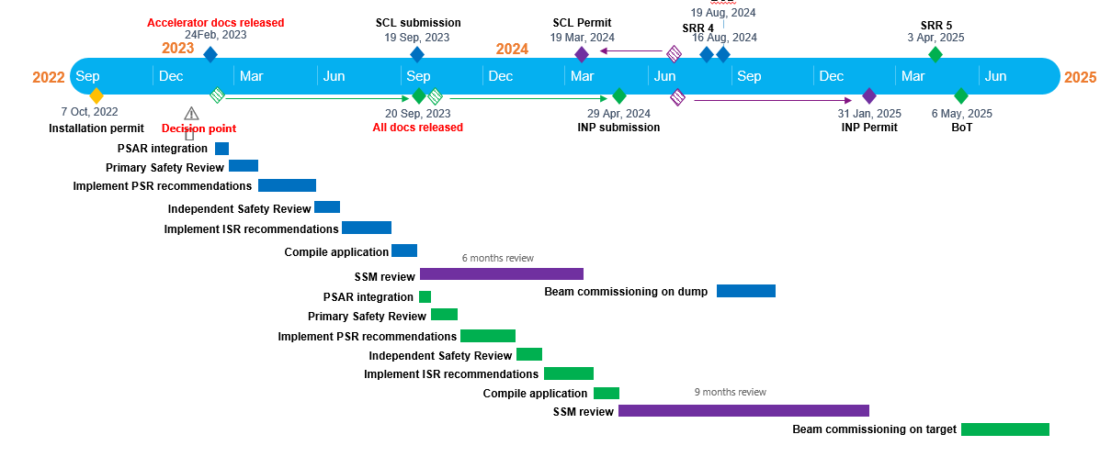
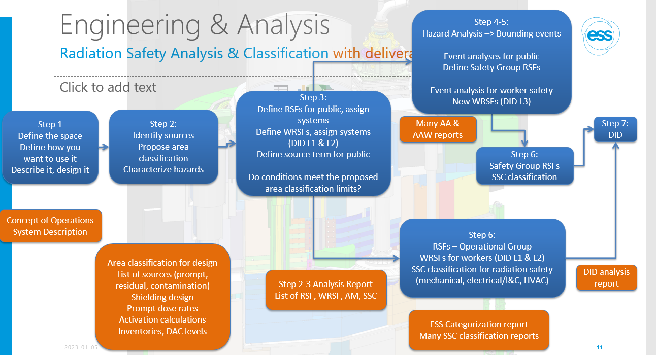
Time to bring the work together
Application
We need to reference specific engineering documentation as part of the application
Licensing
PSAR
1st order references
2nd order references
Rad taskforce
RSF/WSRF -> implementing SSC (i.e. FBS-tag)
Accelerator docs released
7-step process
Same templates
FBS-tag to identify SSC’s
24Feb, 2023
29 Nov 2023
This has taking us years (with a limited team) and we are still critized by SSM on quality and compliance with our ESSMS
All docs released
For operational/safety SSC’s
Engineering process
Same templates
Technical documentation (reviewed/approved by appropriate functions and in released state (as-built))
Conops
System design description
V&V report (or plan)
FBS Tag being carrier during its lifecycle
WP’s engineering teams across ESS need to comply and give proof on the standards we have set.
We need good quality on the operational/safety SSC’s
WP’s
Tag
1
2
3
3
Design
Installation
Test
Commissionoing

Slide 4
Common Engineering workflow
Common engineering workflow described on Confluence and documented in:
  Engineering Handbook (ESS-0092276)
  Develop methodology Handbook (ESS-1106469)
For each SSC: Required set of system documentation shall at a minimum contain in respect of licensing
  Concept of Operations Description (ConOps)
  System Design Description
  Verification/Validation Plan or Verification/Validation Report
  Requirement specification (if requirements are not explicit in the V&V plan/report
Documentation shall be released in CHESS and linked to the appropriate FBS node.

Slide 5
After the workshop
When the SSC classification workshop is finalized (16-17 January) Magnus Täcklinds team will
  Pull out status on all operational/safety SSC’s being identified
    Linda to send the list to Peter Rådahl
  Check FBS and the technical documents per SSC’s and deliver a report on status and quality
The report will be our common references on the technical documentation
  For actions
  To verify status and deliverables

