Slide 1
SSC Classification Workshop for Accelerator and Target Radiation Safety
2023-01 -16, 17
PRESENTED BY linda r coney

Slide 2
1
Welcome & logistics

Slide 3
Welcome
Logistics
The workshop is at Medicon village, Scheeletorget, Lund: Building Inspira - entrance via Inspira Restaurant. Come to Conference Room Allvar (ground floor)
  Bus stop Lund Sparta is the closest one to where we’ll be.
  Hopefully you have happy memories from when our offices were here!
On Monday afternoon (13:00 – 17:00) and Tuesday morning (09:00 – 12:00), we will also have a Focus room: Carol (1st floor) and the lounge area to work in.
  Lunch is included with the workshop, as are several coffee breaks
Bring your laptop
For lead authors (see attached spreadsheet), make sure you can write a document in Microsoft Word on the laptop you have.

Slide 4
Welcome
Workshop Goal
The goal is to write/update our classification reports for the SSCs involved in radiation safety for Accelerator and Target and have them ready to start CHESS review by the end of the workshop.
  The reports are written by system experts (engineer, owner, designer) with support from the Step 2-3 (planned ops/maintenance) radiation safety analysts, discipline classification experts, and rad safety experts.

Slide 5
Welcome
Agenda
Day 1 Allvar (09:00 – 17:00) (Ground floor)
  Start & Welcome – 9:00
  Introduction to how we classify SSCs with respect to Radiation Safety – 9:10
    Guidelines, classification rules
  Coffee break – 10:30
  Introduction continued – 11:00
    Classification report template, Examples
Lunch at Medicon Village restaurant – 12:30
  Break out into small groups to write SSC classification reports – 13:15 (Allvar (Ground floor), Carol (1st floor)
  Coffee break – 15:30
  Classification report writing – 15:45
  End of Day 1 – 17:00
Day 2
  Restart – writing classification reports – 9:00
  Question & Answer session – 9:45
    You may continue writing if you do not have questions
  Coffee break – 10:30
  Classification report writing – 11:00
Lunch at Medicon Village restaurant – 12:30
  Q&A session – 13:15 (Allvar – ground floor)
  Classification report writing – 13:45
  Coffee break – 15:30
  Preparing CHESS review workflow for classification reports – 15:45
  End of Day 1 – 17:00

Slide 6
2
Context of SSC classification

Slide 7

Context
What is it for?
SSM conditions to ESS appendix 1 chapter 4 section C
All structures, systems and components of importance to safety shall be classified based on their function and safety significance.
Structures, systems and components of importance to safety shall be designed, constructed and maintain in such a way that their quality and reliability are consistent with their importance to safety.
The classification package is a tool to ensure that the SSCI2S will receive adequate attention in accordance with their safety significance during the whole life cycle.

Slide 8

What is the classification package?
Comprehensive list
Discipline | Document
General classification | ESS-0016468 ESS rule for identification and classification of safety important components
Mechanical | ESS-0033258 ESS rules for radiation safety classification of mechanical equipment
 | ESS-0039311 ESS rules for technical requirements for mechanical equipment
 | ESS-0047989 ESS rules for quality requirements for mechanical equipment
 | ESS-0091757 Required submittals for mechanical safety systems
Electrical and I&C | ESS-0054158 ESS rules for radiation safety classification of Electrical and I&C equipment including technical and quality requirements
 | ESS-0135373 ESS rules for design of electrical power systems
 | ESS-0015433 ESS rules for electrical design
 | ESS-0118082 ESS rules for qualification of electrical and I&C equipment
Civil | ESS-0134987 ESS rules for radiation safety classification of civil structure including technical and quality requirements
HVAC | ESS-0036956 ESS rules for radiation safety classification of HVAC systems and components
 | ESS-0037914 ESS rules for technical requirements applicable to HVAC systems and components
 | ESS-0083831 ESS rules for quality requirements applicable to HVAC systems and components
Lifting | ESS-0135186 ESS rules for radiation safety classification of lifting equipment including technical and quality requirements
Contain also requirements applicable to “standard” SSC based for example on conventional safety

Slide 9
SSC Classification Package
Documents & logical links
SSC
Quality level based on risk according to Graded approach ESS-0055446
Important to safety
Safety classification according to ESS-0016468
Quality class Q1 or Q2 (quality assurance activities requirements)
General design requirements (RFPD)
Loads to withstand (H1 to H5 events)
Category 1 to 5
Disciplines (technical area)
 | Mechanical | Electrical and I & C | Civil | HVAC | Lifting
Classes | ESS-0033258 ESS rules for radiation safety classification of mechanical equipment | ESS-0054158 ESS rules for radiation safety classification of Electrical and I&C equipment including technical and quality requirements | ESS-0134987 ESS rules for radiation safety classification of civil structure including technical and quality requirements | ESS-0036956 ESS rules for radiation safety classification of HVAC systems and components | ESS-0135186 ESS rules for radiation safety classification of lifting equipment including technical and quality requirements
Design | ESS-0039311 ESS rules for technical requirements for mechanical equipment |  |  | ESS-0037914 ESS rules for technical requirements applicable to HVAC systems and components
Quality | ESS-0047989 ESS rules for quality requirements for mechanical equipment |  |  | ESS-0083831 ESS rules for quality requirements applicable to HVAC systems and components

Slide 10
Radiation Safety & Classification at ESS
Radiation safety functions & safety analysis
The facility generates radiological hazards and it is mandatory to protect people’s health and the environment from harmful effects of ionizing radiation.
The protection level is defined through dose limits and reference values provided by the national regulation and SSM conditions.
ESS-0000004 rev 5 (January 2017)
Operating conditions Initiative event likelihood | Workers limit (effective dose) | Public limit (effective dose)
Normal operation - H1 | 2 mSv/year (average) 10 mSv/year (max) | 0.1 mSv/year (0.05 mSv/year GSO)
Anticipated events - H2 F > 10⁻² | 10 mSv/event | 0.1 mSv/occurrence
Unanticipated events - H3 10⁻⁴ < F < 10⁻² | 20 mSv/event | 1 mSv/occurrence
Improbable events (DBA) – H4 10⁻⁶ < F < 10⁻⁴ | 20 mSv/event | 20 mSv/occurrence
Highly improbable events – H5 F < 10⁻⁶ | 250 mSv/event | 100 mSv/occurrence
The safety functions are the functions implemented to fulfil these requirements
Events and circumstances that affect the facility shall be divided in 5 event classes based on frequencies
The safety functions are identified through the radiation safety analysis

Slide 11
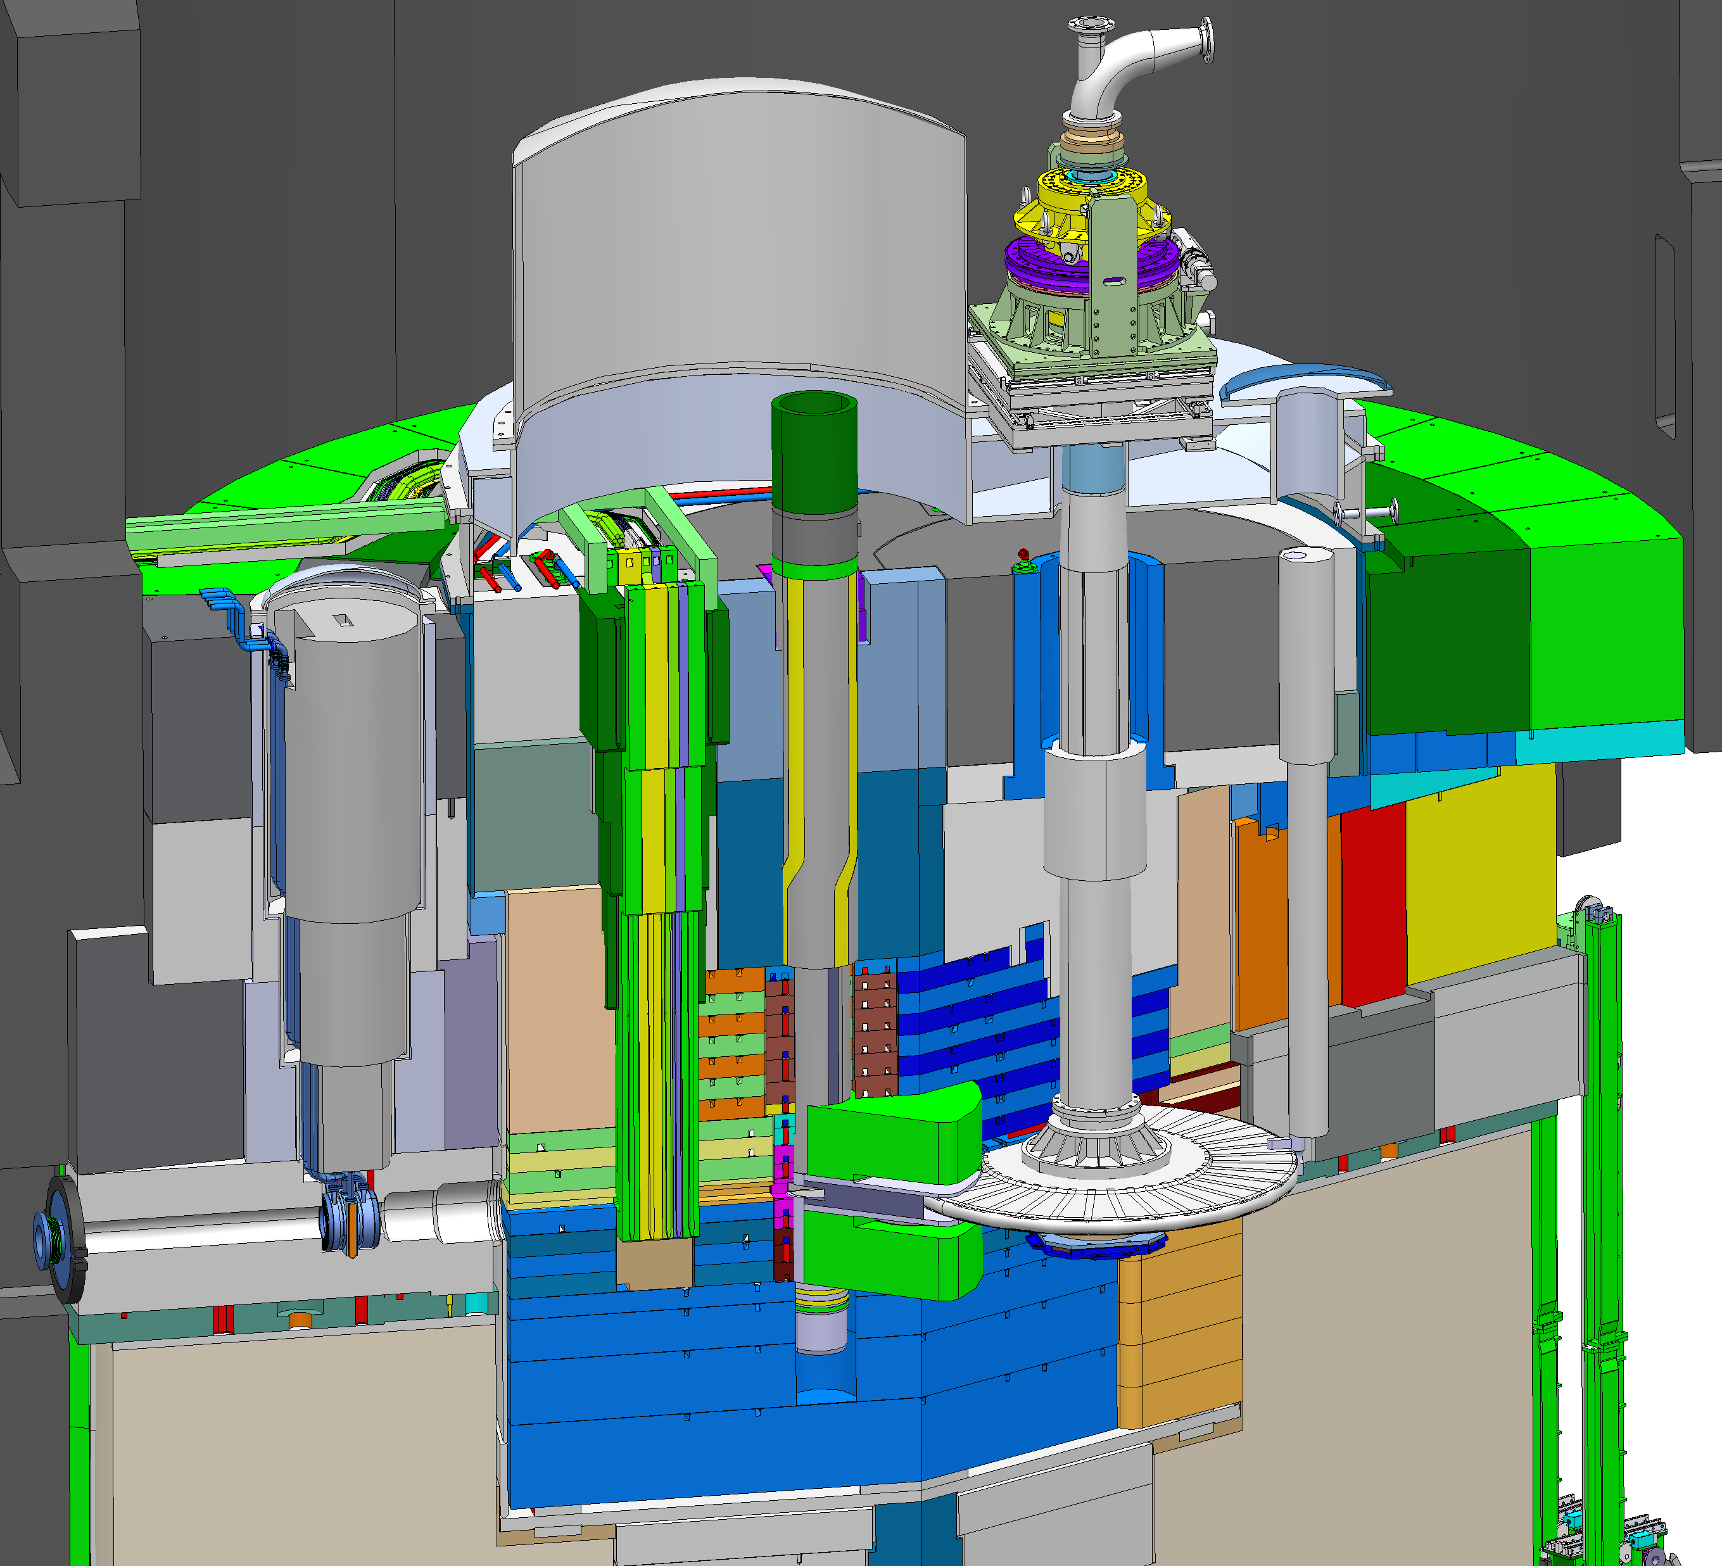
Engineering & Analysis
Step 4-5:
Hazard Analysis –> Bounding events
Event analyses for public
Define Safety Group RSFs
Event analysis for worker safety
New WRSFs (DID L3)
Radiation Safety Analysis & Classification with deliverables
Step 3:
Define RSFs for public, assign systems
Define WRSFs, assign systems
(DID L1 & L2)
Define source term for public
Do conditions meet the proposed area classification limits?
Step 1
Define the space
Define how you want to use it
Describe it, design it
Step 2:
Identify sources
Propose area classification
Characterize hazards
Many AA & AAW reports
Step 7:
DID
Step 6:
Safety Group RSFs
SSC classification
Concept of Operations
System Description
Step 6:
RSFs – Operational Group
WRSFs for workers (DID L1 & L2)
SSC classification for radiation safety
(mechanical, electrical/I&C, HVAC)
Area classification for design
List of sources (prompt, residual, contamination)
Shielding design
Prompt dose rates
Activation calculations
Inventories, DAC levels
Step 2-3 Analysis Report
List of RSF, WRSF, AM, SSC
DID analysis report
ESS Categorization report
Many SSC classification reports

Slide 12
Engineering & Analysis
Step 4-5:
Hazard Analysis –> Bounding events
Event analyses for public
Define Safety Group RSFs
Event analysis for worker safety
New WRSFs (DID L3)
Radiation Safety Analysis & Classification with iterations
Step 3:
Define RSFs for public, assign systems
Define WRSFs, assign systems
(DID L1 & L2)
Define source term for public
Do conditions meet the proposed area classification limits?
Step 1
Define the space
Define how you want to use it
Describe it, design it
Step 2:
Identify sources
Propose area classification
Characterize hazards
Many AA & AAW reports
Step 7:
DID
Step 6:
Safety Group RSFs
SSC classification
NO
YES
Concept of Operations
System Description
Step 6:
RSFs – Operational Group
WRSFs for workers (DID L1 & L2)
SSC classification for radiation safety
(mechanical, electrical/I&C, HVAC)
Area classification for design
List of sources (prompt, residual, contamination)
Shielding design
Prompt dose rates
Activation calculations
Inventories, DAC levels
Step 2-3 Analysis Report
List of RSF, WRSF, AM, SSC
DID analysis report
ESS Categorization report
Many SSC classification reports

Slide 13
Guidelines
To understand the process
Classification is Step 6 in the process. The guidelines for the full Radiation Safety analysis process are:
  ESS Guideline for Radiological Hazard Analysis Dedicated to Protection of Workers (ESS-1408051)
    This has the best description of the 7-step process.
    Suggested reading:
      Chapters 1, 2, 3 for an overview
      Section 6.5 about Defense in Depth with respect to workers
      Chapter 6 - Step 6: Classification, with a focus on Section 8.2 about SSC classification and Section 8.4 – Step 6 deliverables
  ESS Guideline for Radiological Hazard Analysis (ESS-0041755)

Slide 14
3
General Classification

Slide 15
Safety Function Grouping
Defense in Depth
The DiD shall be tailored to the activities and associated safety stakes
A failure of one level shall not be able to propagate to a subsequent level
DiD level 3 shall be independent of DiD level 1 and 2
DiD level 4 shall be independent of DiD level 1-3

Slide 16
Safety Function Grouping
Classification and Requirements

Slide 17
ESS Classification Rules

Slide 18
SSC Classification Package
Documents & logical links
SSC
Quality level based on risk according to Graded approach ESS-0055446
Important to safety
Safety classification according to ESS-0016468
Quality class Q1 or Q2 (quality assurance activities requirements)
General design requirements (RFPD)
Loads to withstand (H1 to H5 events)
Category 1 to 5
We are here
Disciplines (technical area)
 | Mechanical | Electrical and I & C | Civil | HVAC | Lifting
Classes | ESS-0033258 ESS rules for radiation safety classification of mechanical equipment | ESS-0054158 ESS rules for radiation safety classification of Electrical and I&C equipment including technical and quality requirements | ESS-0134987 ESS rules for radiation safety classification of civil structure including technical and quality requirements | ESS-0036956 ESS rules for radiation safety classification of HVAC systems and components | ESS-0135186 ESS rules for radiation safety classification of lifting equipment including technical and quality requirements
Design | ESS-0039311 ESS rules for technical requirements for mechanical equipment |  |  | ESS-0037914 ESS rules for technical requirements applicable to HVAC systems and components
Quality | ESS-0047989 ESS rules for quality requirements for mechanical equipment |  |  | ESS-0083831 ESS rules for quality requirements applicable to HVAC systems and components

Slide 19
3
Discipline Classification

Slide 20
Discipline Classification
  Mechanical – Cecilia
  Electrical/Instrumentation & Control – Mikael Olsson
  Civil – Michael Sjöholm
  Lifting – Michael Sjöholm
  HVAC – Dawid Jodlowiec

Slide 21
3
Practical Application

Slide 22
Step 6 Classification
It is actually 3 sub-steps
  Step 6a – Categorization of RSFs
  RSFs, not SSCs.
  RSFs have a Categorization (Cat 5, Cat 1, Cat 2, or Cat 3).
  We have one categorization report for all ESS RSFs (ESS-3730670).
  Step 6b – Classification of SSCs at the system level
  SSCs (structures, systems, components), not RSFs.
  This is only classification for radiation safety.
  This is discipline-specific for Mechanical, Electrical/I&C, HVAC, Civil disciplines.
  SSCs have a Classification (MQC4, MQC3, EIC0, EICPA, EICW, etc.) that is discipline-specific.
  Shielding does not have a classification.
  Step 6c – Classified component list (SSC)
  This is also only classification for radiation safety.

Slide 23
Step 6 Classification
More about the 3 sub-steps
  Step 6a – Categorization of RSF.
  Simply put, it states which functions are Operational Group (Category 5) and which are Safety Group (and, for the Safety Group RSFs it identifies which ones are Category 1 or 2 or 3).
  Step 6b – Classification of SSCs at the system level
  A classification report is written by the system expert(s).
  The classification report is where you find the justification for the classification. This is the link between RSF and SSC.
  We have a template for this report.
  Step 6c – Classified component list (SSC)
  We have a template for this report.
  It has been applied to show TSS system components (ESS-0191808 TSS classification list) and their classification.
  It has been applied list the mechanical systems we have in the target station and what their classifications are (ESS-0258523 ESS Target Mechanical Systems Classification list).

Slide 24
Step 6 Classification Report
How does it work?
  First, the system owner looks in the Step 2-3 documents to find her system identified as an SSC.
  Then the system owner looks at the ESS Categorization document to find out what the category of the RSFs are that her system is executing.
    In other words, is her system executing an RSF that is Category 5?
    Or is it executing an RSF that is Category 1?
  Let’s assume that this system owner is Annika and her system is the MPS system.
    MPS is executing an Operational Group RSF, so it is in Category 5.
    Based on that information, she writes the classification report (or delegates to Johannes).
    It is an electrical/I&C system. Therefore, the electrical and I&C class for this system is EIC0.
    Now, based on the information in ESS-0054158 ESS rules for radiation safety classification of Electrical and Instrumentation & control equipment including design and quality requirements, she knows what design rules to follow.

Slide 25
Defining the SSC Classification
Inputs
  Step 2-3 analyses
  Accelerator – Daniel Noll
  Target Utility Block/Monolith – Mikael Olsson
  Target High Bay/Transport Hall/Casks – Mikael Olsson
  Active Cells Facility – Kazim Raza Syed
  ESS categorization document
  One for all ESS

Slide 26
Step 2-3
Planned Operations & Maintenance, RSF identification
Step 2-3 Reports: These are where we have identified the RSFs (radiation safety functions that apply to both public and workers) and WRSFs (RSFs that only apply to workers) that we need for planned operations and maintenance of the ESS. In these reports, the RSFs are named along with the SSCs that execute them. Here SSCs are identified in a very simple way, including an FBS tag if it is known.
  Identification of Radiological Hazards Resultant from Normal Operation of the Accelerator and Corresponding Radiation Safety Provisions (WRSF, RSF, AM) (ESS-2512573)
  Radiological hazards induced in the target utility block during normal operation and corresponding radiation safety provisions (ESS-2027007)
  Normal Operation Radiation hazard and Safety provisions in Active Cells Facility (ESS-1949562)
  Radiological hazards induced in the target high bay during normal operation and corresponding radiation safety provisions (ESS-2725102)
  Suggested reading:
    Chapters 5 and 6 of the four Step 2-3 reports. Look for where your SSC is mentioned.

Slide 27
Categorisation Report
Operational Group – Cat5
Categorisation Report: This is where the RSF category is determined. This is then input to the classification of the SSCs executing the RSF. The RSFs identified in the Step 2-3 reports are Cat5.
  Categorisation of ESS radiation safety functions (ESS-3730670)
  Suggested reading:
    Chapters 1, 2, 3 for an overview
    Section 6.1 about Categorisation of Operational Group RSFs (these are what are identified in the Step 2-3 reports)
    The first part of Chapter 7, Summary of RSF Categorisation
    @John Michael, Morteza, and Annika – Chapter 8 about WRSFs. We will talk separately about systems executing WRSFs in DIDW-L2 and DIDW-L3.

Slide 28
Practical Application
Template
Template for SSC classification Report (ESS-0390389) (Attached here)
  Suggested reading: the whole template

Slide 29
Discipline Classification Rules
ESS Rules for Classification and subsequent design
Overall: ESS rule for identification and classification of safety important components (ESS-0016468)
Disciplines:
Mechanical
  ESS Rules for Radiation Safety Classification of Mechanical Equipment (ESS‑0033258)
  ESS rules for technical requirements for mechanical equipment (ESS-0039311)
  ESS Rules for Quality Regulation for Mechanical Equipment, RESSQ-Mech (ESS‑0047989)
Electrical
  ESS rules for radiation safety classification of Electrical and Instrumentation & control equipment including design and quality requirements (ESS‑0054158)
  Note: Controls for a given system will be included in the classification report of that system if they are needed to execute an RSF. Same for electrical power supply.
Civil/Buildings
  ESS Rules for Radiation Safety Classification of Civil Structure including Technical and Quality Requirements (ESS‑0134987)
HVAC
  ESS rules for radiation safety classification of HVAC systems and components (ESS‑0036956)
  ESS rules for technical requirements applicable to HVAC systems and components (ESS‑0037914)
  ESS rules for quality requirements applicable to HVAC systems and components (ESS‑0083831)
Lifting
  ESS Rules for Radiation Safety Classification of Lifting Devices including Technical and Quality Requirements (ESS-0135186)
  Suggested reading:
    The overall rules (ESS-0016468) for context, but not necessarily all of the appendices.
    The rules for whichever discipline is most relevant for your system.

Slide 31
The End

