Slide 1
Mechanical classification
PRESENTED BY Cecilia Lowe

Slide 2
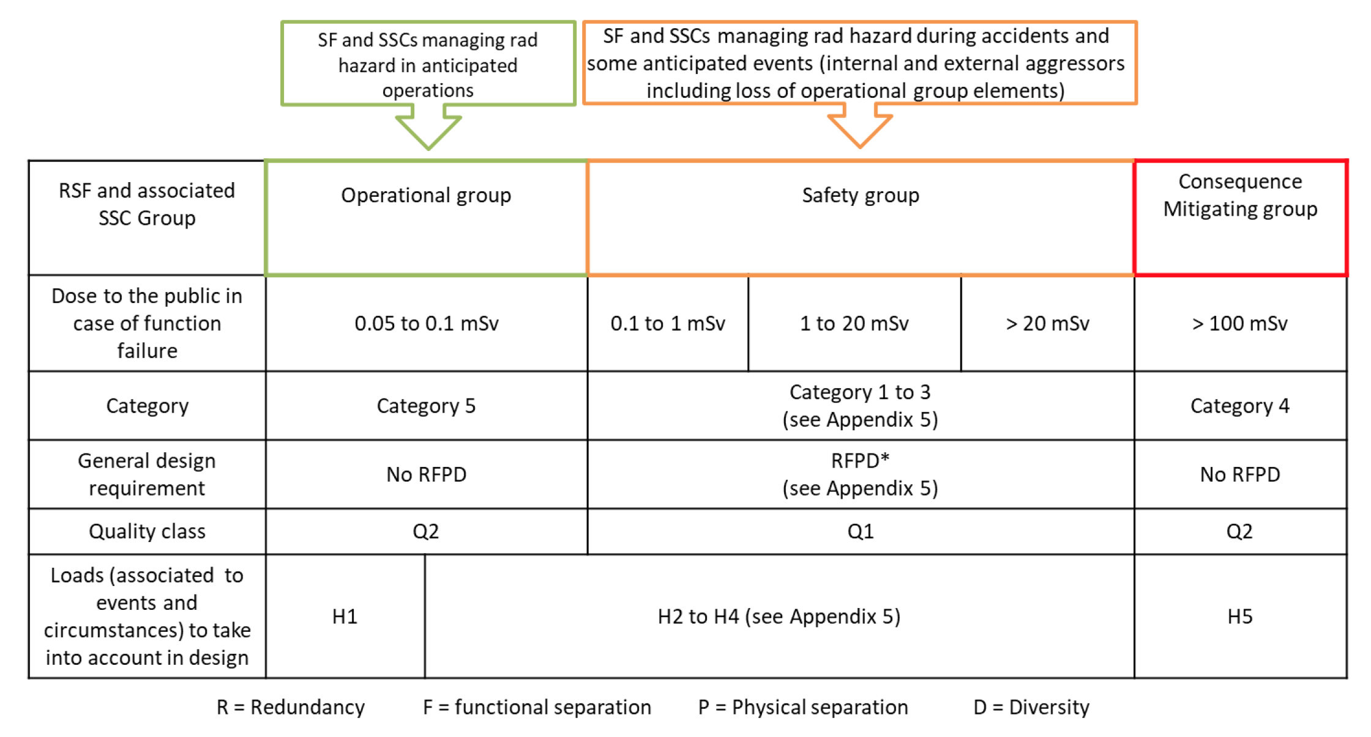
Identification and classification
of safety important classification
Safety functions are appointed according to the accident analyses and defence in depth studies.
Categorisation is then done using the ESS rule for identification and classification of safety important components ESS-0016468

Slide 3
Classification to Mechanical Quality Class
Output after identification and classification of safety important components, ESS-0016468
Radiation Safety Classification of Mechanical Equipment, ESS-0033258
Cat 1
MQC 1
SSM requriemens
(RCC-MRx)
Cat 2
MQC 2
Safety Group
Cat 3
MQC 3
Consequence Mitigation group
Operation group
Cat 4
MQC 4
Industrial requirements
Cat 5
Non-safety

Slide 4
Definition of Mechanical Devices
Mechanical Equipment is defined in the special SSM conditions as devices or parts of devices with the purpose to carry outer or inner pressure, carry mechanical load, protect such devices that carry internal or external pressure or load, or hold or control components in the intended way.
Typically, mechanical equipment includes components such as
vessels, pipes, pumps, valves, heat exchangers and supports for such components.
It also includes internal and external components that protect or may damage such components if it fails, e.g. flow guides and mixers.
Supports, holders, hangers, locking devices and similar SSCs are also mechanical equipment.

Slide 5
What does MQC4 mean?
Rules to get a safe product
Industrial requirements:
PED 2014/68/EU – European Pressure Directive (AFS 2016:1)
Harmonised EN standards e.g EN 13445, EN 13480, EN 13458
Eurocodes 1993 and EN 1090
CE-marking if applcable
Mechanical parts within an machine shall follow PED or harmonized standards
Classifications of MQC4
Manufacturing:
PED categorisation 0, I, II, III, IV
Operation:
AFS Inspection class A, B or C

Slide 6
Governing rules
Mechanical
Classification documents:
ESS-0016468 - ESS rule for identification and classification of safety important components
ESS-0033258 - ESS Rules for Radiation Safety Classification of Mechanical Equipment
Steering document for design, manufacturing and installation:
ESS-0039311 - ESS rules for technical requirements for mechanical equipment
ESS-0047989 - ESS Rules for Quality Regulation for Mechanical Equipment, RESSQ-Mech
ESS-0091757 - Required submittals for mechanical safety systems
ESS-0127031 - ESS Rules for CE Marking

Slide 7
Finish presentation

