Slide 2
Electrical and I&C classification
Scope, rules & examples
PRESENTED BY Mikael Olsson

Slide 3
Scope of the classification
Electrical and I&C
  Examples:
  Parts of BPCS that contribute to perform radiation safety functions
    Examples: cooling, rotating, ventilation, lifting, etc.
  Parts of Machine protection that perform radiation safety functions
    Examples:
      Detect loss of cooling, detect loss of rotation, detect beam losses, etc.
      Stop beam
  Systems that monitor and display radiation safety data to the operator
    Examples: status of cooling, rotation, ventilation, etc.
  Electrical supply systems

Slide 4
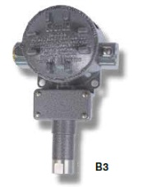
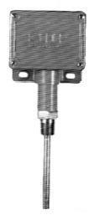
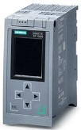
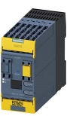
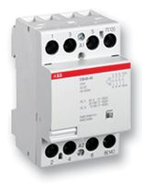
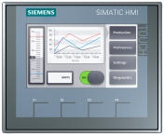
Examples of equipment
Electrical and I&C
  Electrical and I&C systems can include
    Process control systems realised with industrial automation technology
    Sensors, logic solvers (electronic relays, PLC, etc.), actuators (power breaker, motors, etc), communication equipment (cables), electrical components (relays, fuses, etc.), HMI, etc.
  Equipment that do not fall within the Electrical and I&C discipline
    Pipes, pumps, heat exchangers, valves, compressors, etc.

Slide 5
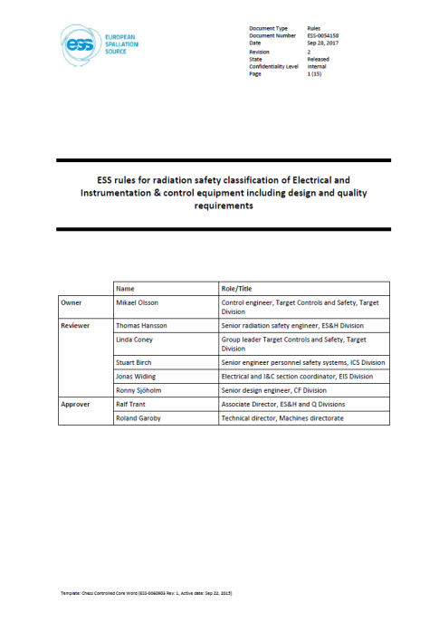
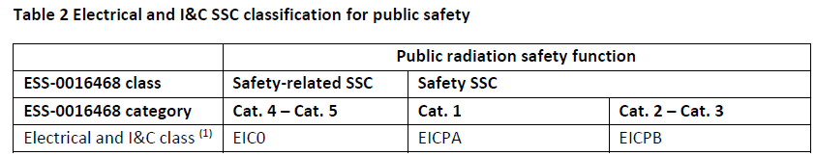
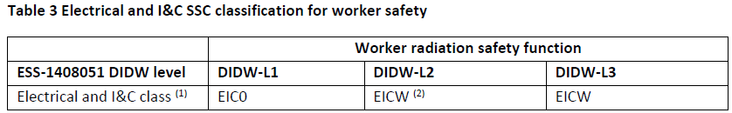
Governing rules
Electrical and I&C
ESS-0054158
‘ESS rules for radiation safety classification of Electrical and Instrumentation & control equipment including design and quality requirements’

Slide 6
What does EIC0 mean?
Electrical and I&C
  I&C system and software: ‘application of conventional standards or practices’
    In practice: ESS Handbook for engineering management of control systems (ESS-0054678)
    Process control systems realised with industrial automation technology
    No safety standard required
  For electrical detail design: ESS rules for electrical design (ESS-0015433)
    View of legislation, rules, standards to ensure electrical safety practices
    Workflow, CAD and engineering tools, naming and tagging, cable database, etc.
  For electrical power system design: ESS rules for design of electrical power systems (ESS-0135373)
    high and low voltage systems used to generate or distribute electrical power across the ESS facility from the point of intake to the end users

Slide 7
Finish presentation

