Slide 1
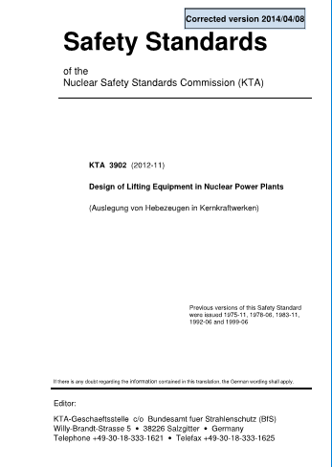
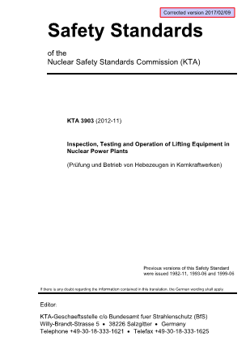
Classification of lifting devices
ESS-0135186 ESS Rules for Radiation Safety Classification of Lifting Devices including Technical and Quality Requirements
CLASSIFICATION
DESIGN
INSPECTION
QUALITY
Consequences to Public?
Requirements with reference to KTA 3902
Requirements with reference to KTA 3903
Category 1
Safety
Y
L2
Q1
Y/N
Guidance SSMFS-L on lifting devices in nuclear facilities (ESS-00112080, §3)
L1: Lifting device with a controlled load-bearing part that handles spent nuclear fuel…
L2: A lifting device that, in case of failure, may result to the release of radioactive substances outside the facility…
L3: A lifting device that, …, may result in an event that can lead to the release of radioactive substances within the facility…
Requirements with reference to
KTA 3902
KTA 3903
AFS 2003:6
Category 2
Safety
N
L3
Category 3
Safety
L3
Category 4
Safety-related
Conventional crane
Q2
AFS 2008:3
Category 5
Safety-related
Conventional crane
AFS 2003:6
Notes:
KTA 3902, Design of Lifting Equipment in Nuclear Power Plants, Nuclear Safety Standards Commission (KTA), Nov. 2012. Corrected version 2014/04/08.

