Slide 2
This is a title for a PowerPoint presentation
Optional subtitle
PRESENTED BY <NAME NAMESON>

Slide 3
Scope of the classification
Which HVAC systems and equipment may require classification?
  Parts which fall under definition of nuclear ventilation systems per ISO 17873, and which provide the following funtions, either directly to radiologically classified areas or to equipment serving such ares:
  Contributing to static confinement and providing dynamic confinement (pressure cascade) between rooms/enclosures characterizing with different radiological classification (risk levels) and between the facility and the external atmosphere
  Providing purification or filtration of potential contaminants
  Participating to monitoring of potential releases (through organization or air flow, dedicated extraction points, etc.)
  Renewing air within the served volumes
  Conditioning of room atmosphere (cooling, heating), when it contributes to the correct operation of critical machines and safety of otherwise hazardous processes occuring in served volumes
  In certain configurations and situations, guaranteeing comfort to the operators for the work undertaked in served rooms

Slide 4
Examples of equipment
HVAC equipment and most common functions they take contribute to
  Air handling units, including air supply fans, outside air filters, heating and cooling coils (functions a, d, e, f)
  Local air cooling and heating units (functions c, e, f)
  Ductwork and air disctribution/exhaust devices (functions a, b, c, e, f)
  Exhaust fans (functions a, d, e, f)
  Fitration units (a, b)
  Isolation dampers and fire dampers (a)
  Systems such as fire protection, cooling and heating water distribution, potable water distribution, drainage, etc. fall under mechanical and not HVAC classification.

Slide 5
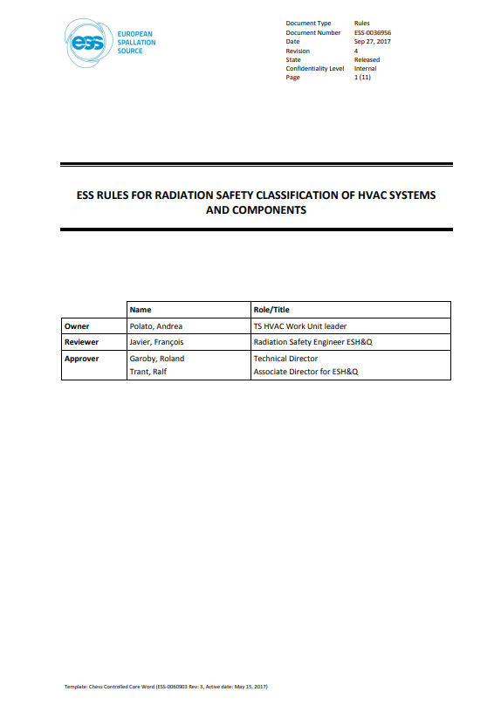
Governing rules
HVAC systems and equipment
ESS-0036956
HVAC classification for public radiation safety function
Cat 1, 2 and 3 (safety SSC) per ESS-00016468 VQC1
Cat 4 and 5 (safety-related SSC) per ESS-0016468 VQC2
HVAC classification for worker radiation safety function
DIDW-L1 per ESS-1408051 VQC2
DIDW-L2 per ESS-1408051 VQC2
DIDW-L3 per ESS-1408051 VQC2
‘ESS rules for radiation safety classification of HVAC systems and components’

Slide 6
What does VQC2 means?
HVAC systems and equipment
  Industrial level components, applicable design requirments are derived from EN and ISO standards, no specific safet standards are used
  Main differences between VQC1 and VQC2 limit to quality requirements
    ESS-0037914 - ESS rules for technical requirements applicable to HVAC systems and components
    Identifies technical requirements applicable to all typical components, depending on classification of served area (based on ISO 17873 categorization) and type of risk
    Does not cover mechanical, electrical nor automation components
    ESS-0083831 - ESS rules for quality requirements applicable to HVAC systems and
    components

Slide 7
Finish presentation

