Slide 1


BEER
Instruments status update
PRESENTED BY Jochen Fenske & Gregor Nowak & Premek Beran

Slide 2


BEER
General status update
Joining the common chopper project
    All choppers and lower enclosures will be handled
    Support for 80 m chopper also included
A restart of the E02 guide installation
    The cleaning process was approved & Installation was done by now
Installation in D03 started
    All goes fine
    Finalisation is expected in End of March
Shutter
    TG3 approved & In manufacturing & Delivery in July-August
CTV documents for cave approved
Engagement in CUP and CEP
The deformation rig delivered to ESS from NPI

Slide 3
BEER
General status update
  Again, retendering of the 6-axis Robotic arm => 03.2023
  Results from IDRs (RC, Hexapod+rotary stage+sample tower)
  Kick-of-Meeting for Bi-spectral switch
  Kick-of-Meeting for Chopper-assembly (day-1)
  Next IDR’s/sub-TG3 (Bi-spectral switch, Chopper assembly(day-1), in-Bunker optics, Detector support,…)
  A new method of converter tensioning in ¹⁰B₄C-MWPC => Status will be given by Joerg
  Decision on BEER detector technology made on 16.12.2023 => ¹⁰B₄C-MWPC
  Approaching BMBF regarding cost increase
  Software
    A tune-up of the McStats model was made
    Future communication and exchange were arranged

Slide 4
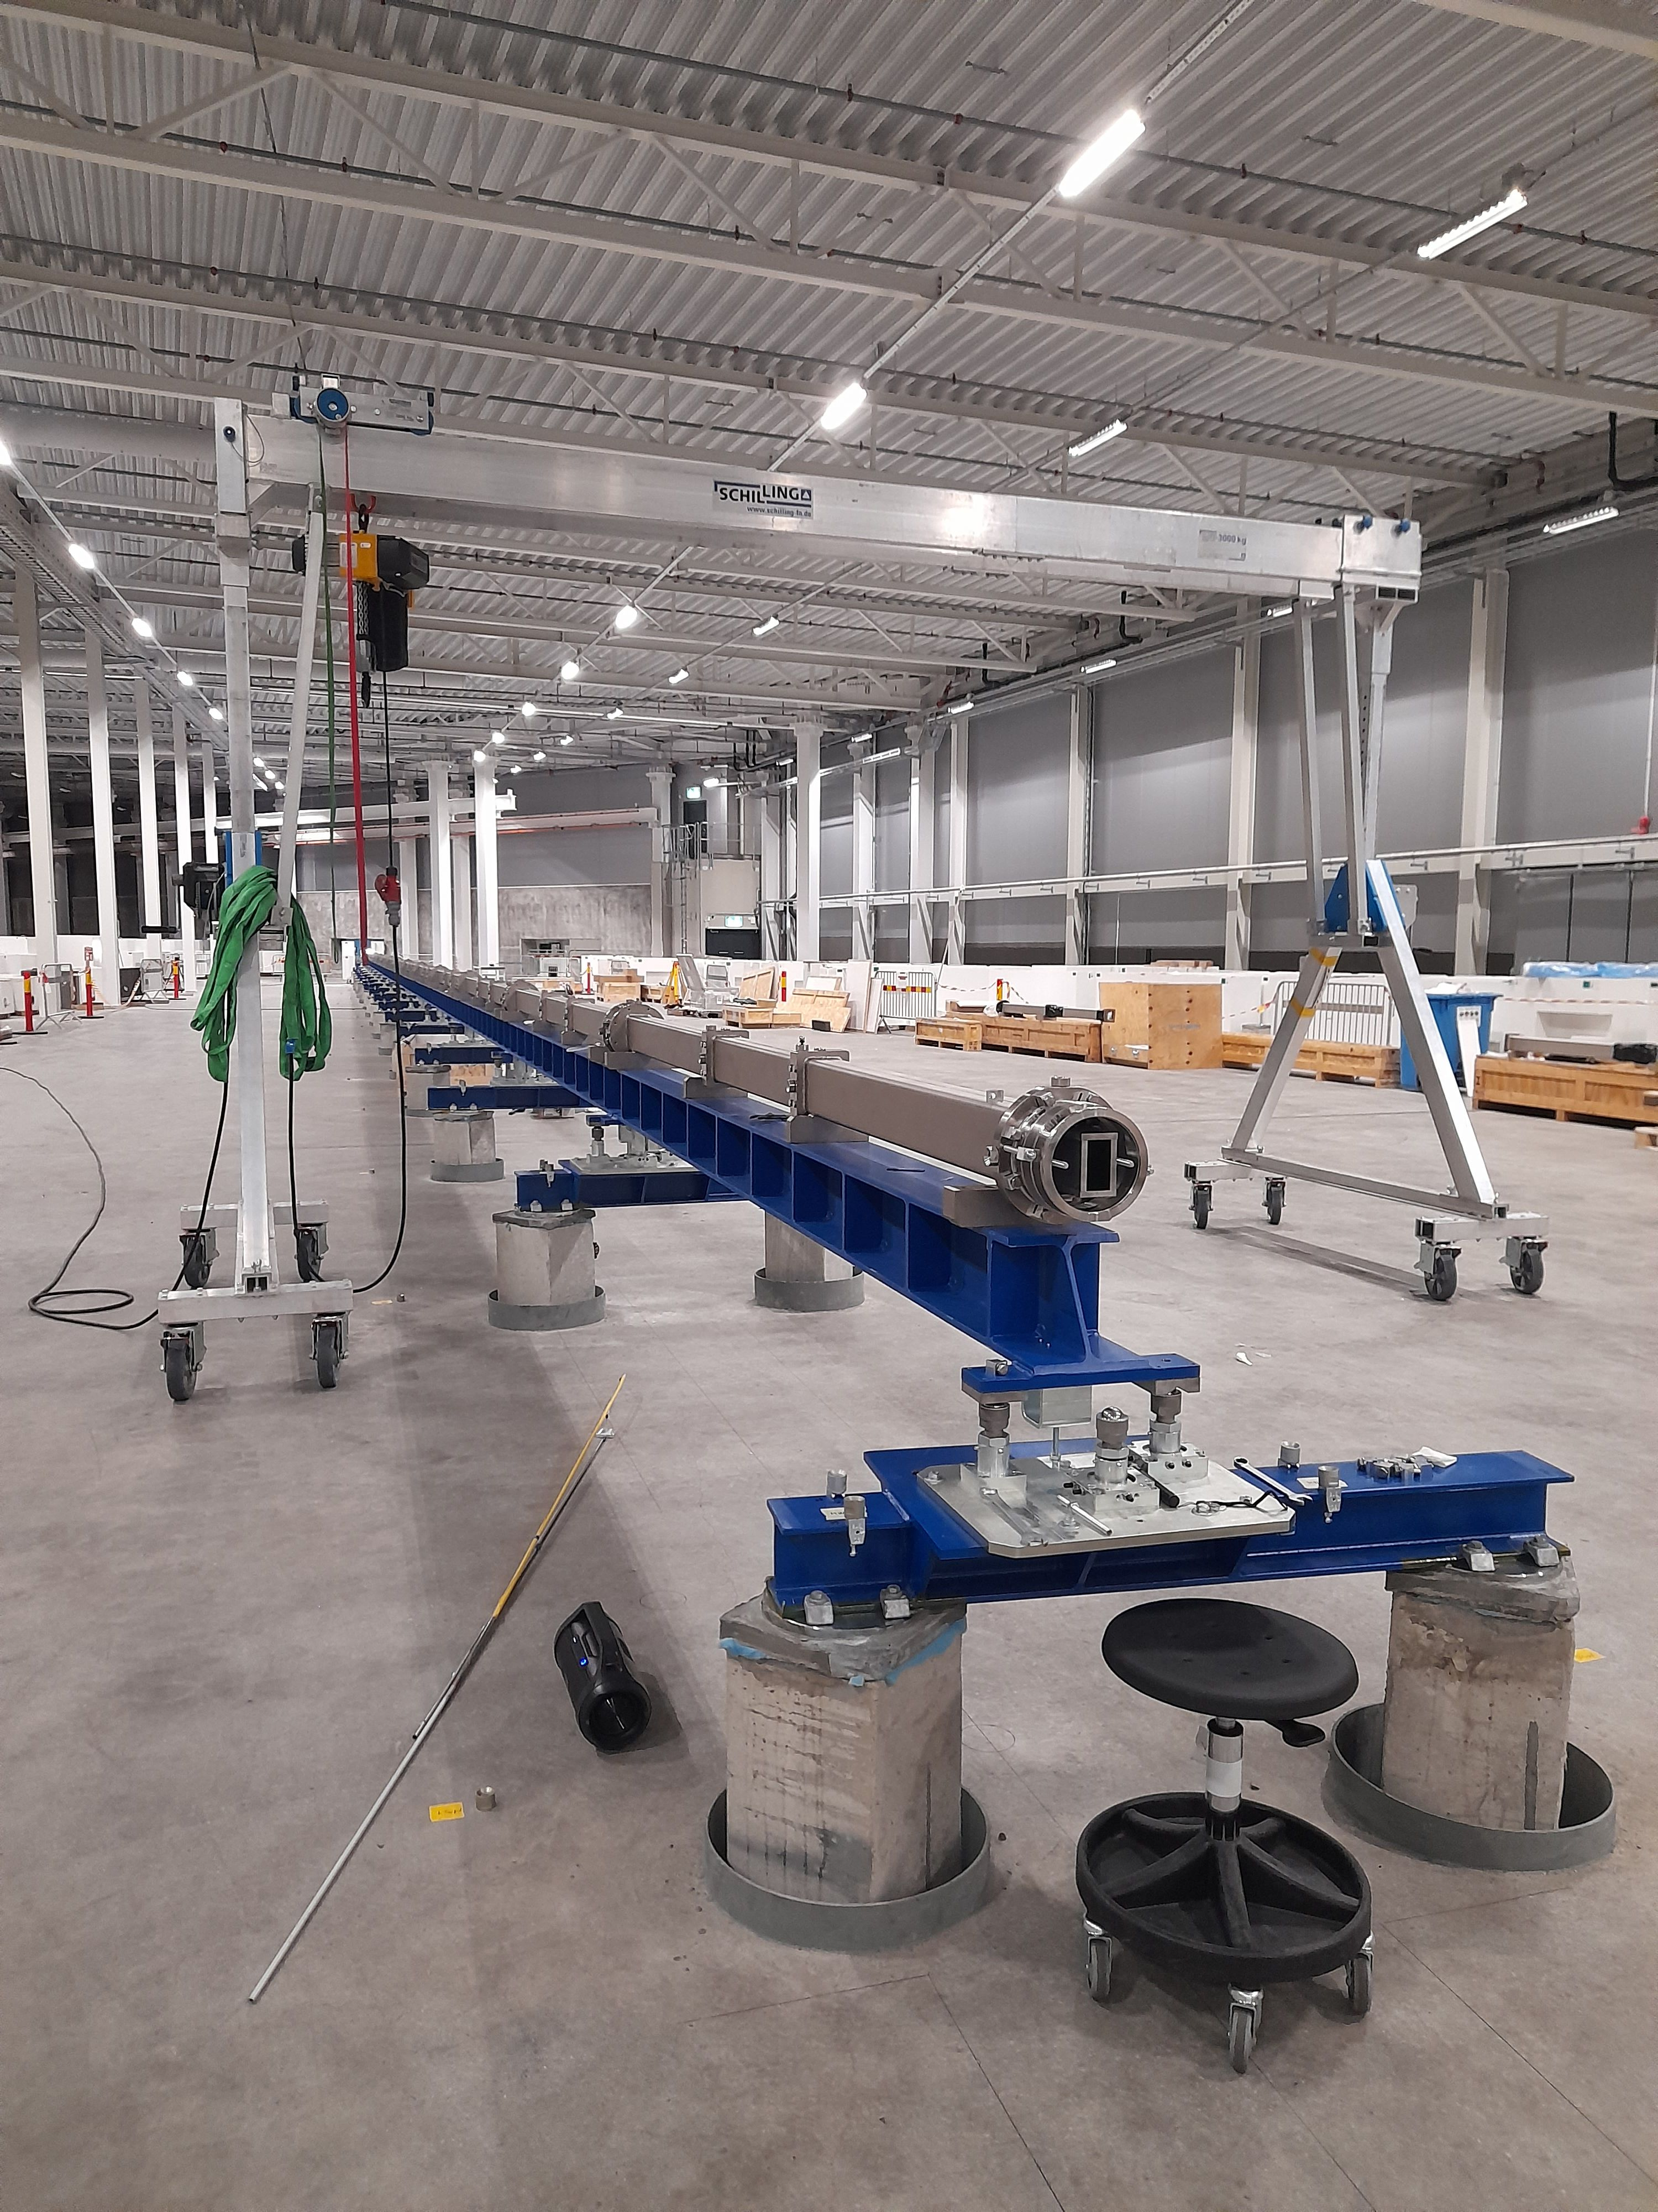
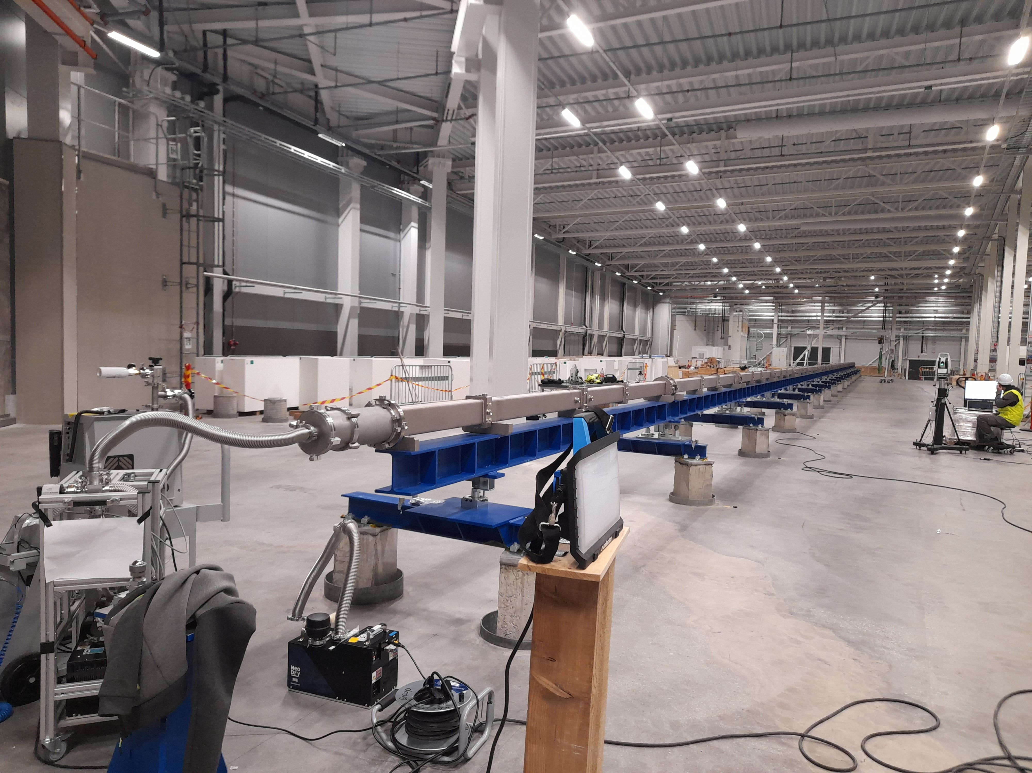
BEER
NPI update
Neutron guide out of the bunker (slight delay)
    Re-installation of Sector 2 in E02
Notes:
Pictures show slit system SL1 on the guide below the E02 shielding (left) and guide exchanger (right) during the FAT in June.

Slide 5
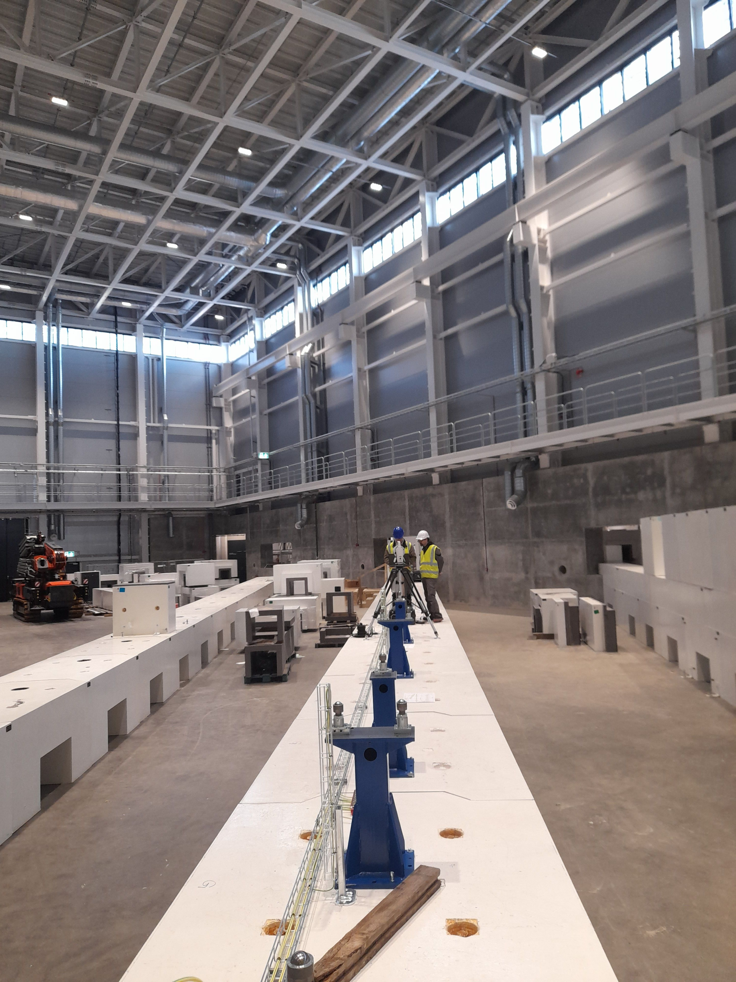
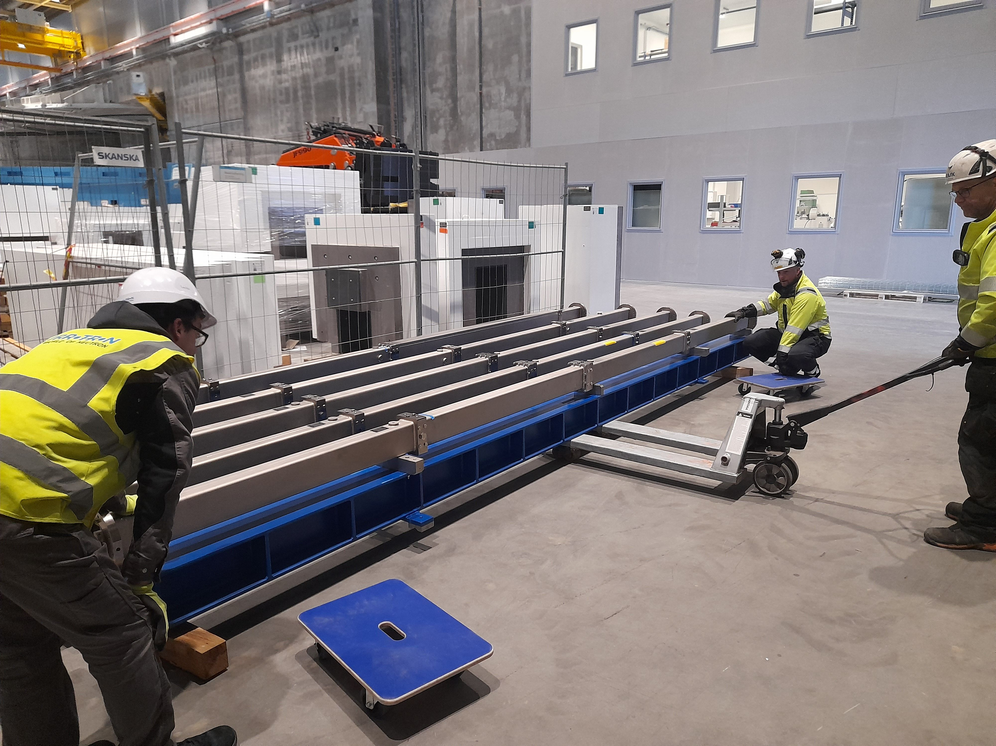
BEER
NPI update
Neutron guide out of the bunker (slight delay)
    Re-installation of Sector 2 in E02
    Sector 1 (D03), all parts delivered to ESS
    Start of installation 20/03
Notes:
Pictures show the installation of the guide system in E02.

Slide 6
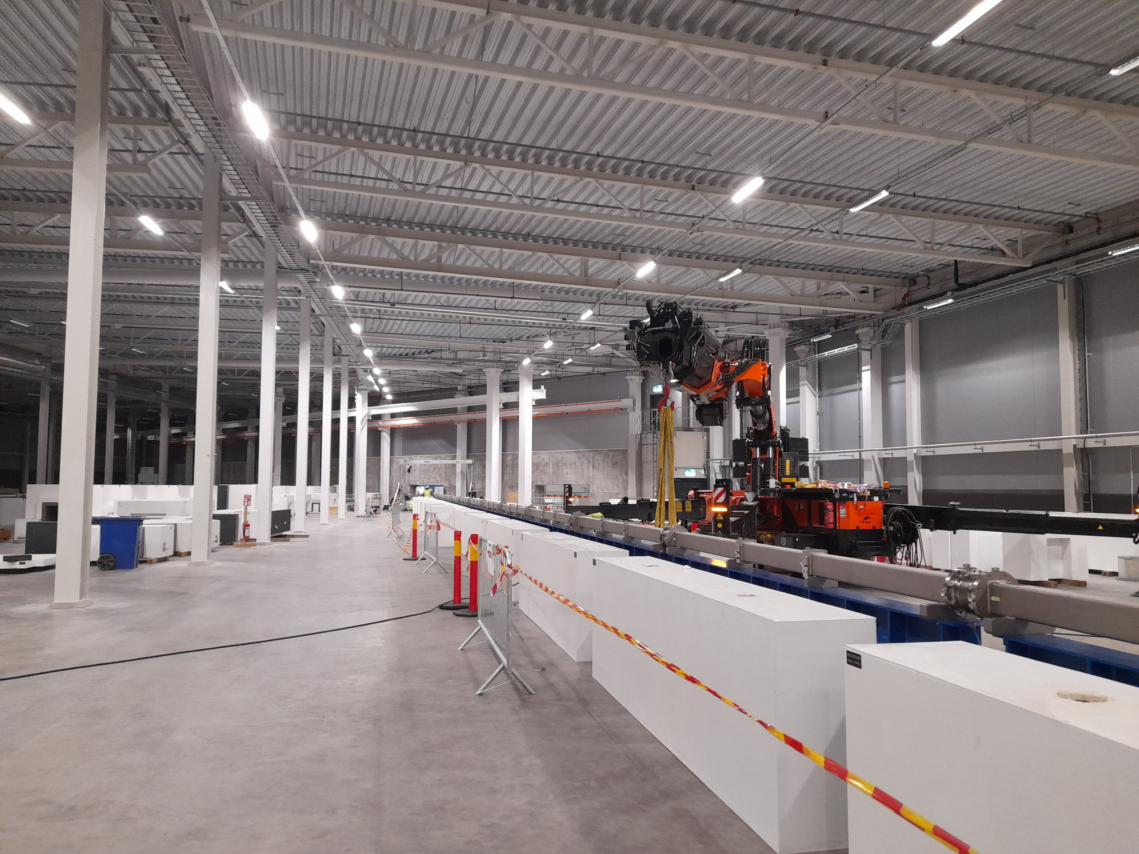
BEER
NPI update
Neutron guide out of the bunker (slight delay)
    Re-installation of Sector 2 in E02
    Sector 1 (D03), all parts delivered to ESS
    Sector 1, the start of installation 20/03
    Grounding of Sector 2 done
    Installation of common shielding in E02 in progress
    Sectors 1&2 (87% of the guide out of the bunker)
      can be installed by the end of March 2023
Notes:
The picture shows what stays there after the guide return.

Slide 7
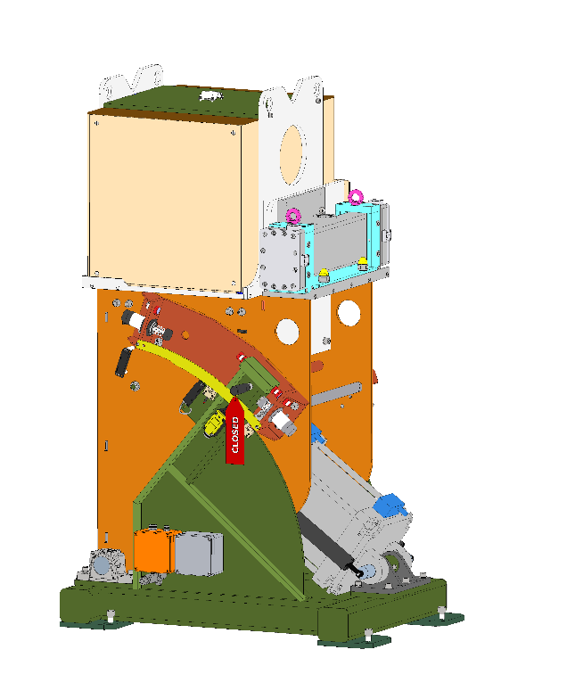
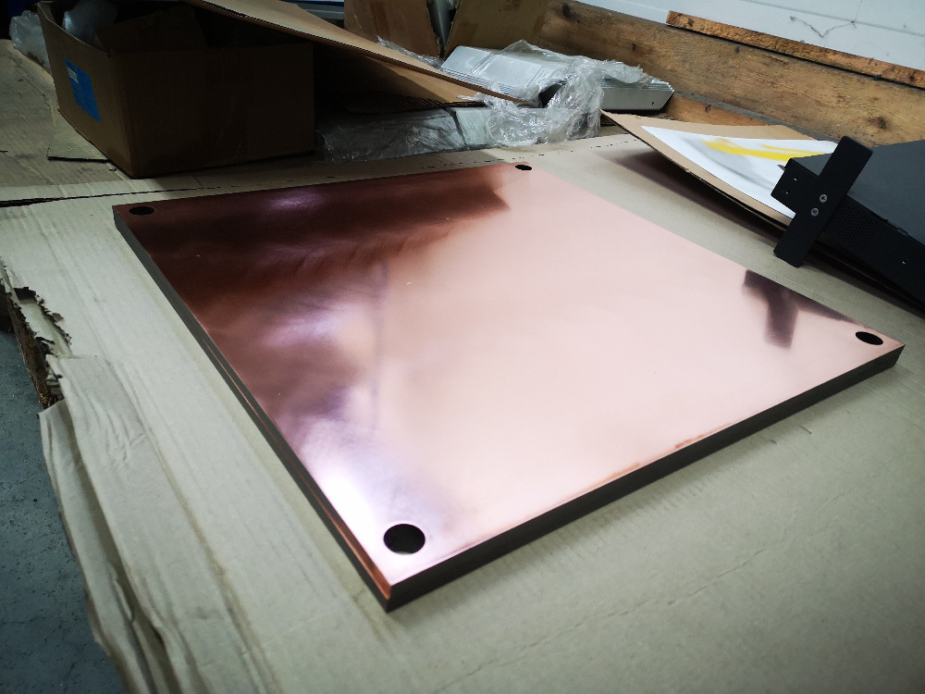
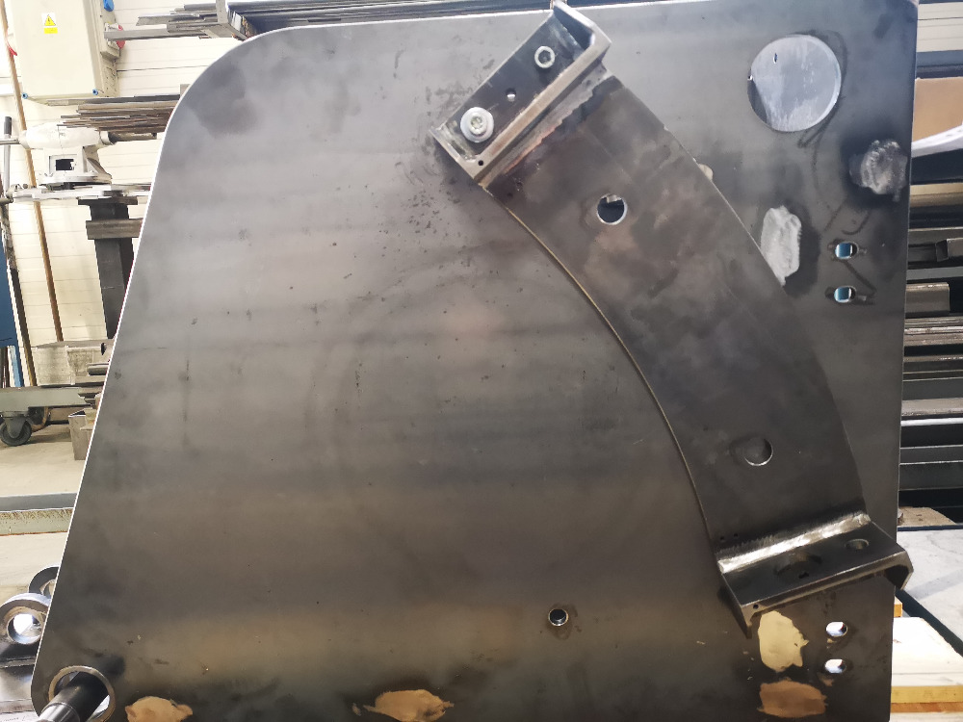
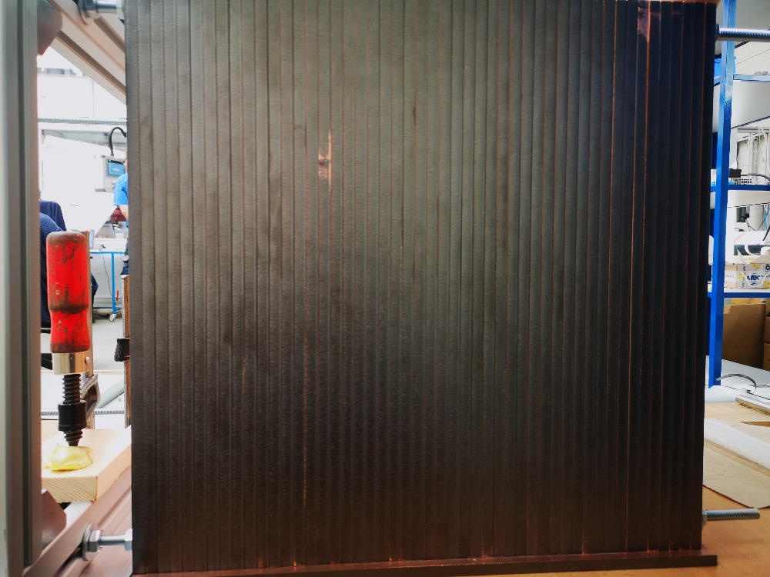
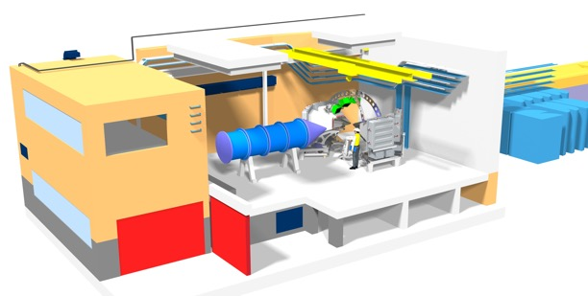
BEER
NPI update
Instrument shutter (on track)
    CDR/TG3 approved November
    In manufacturing, FAT planned for June
    Delivery in July/August
Cave and hutch (delay by 4 months)
    CTV approved
    The tender will start soon
Notes:
The picture indicates the changes in the design of the old (left) and new (right) instrument shutter.

Slide 8
BEER
Hereon update
  Again, retendering of the 6-axis Robotic arm =>03.2023 => Lack of offers:
  -unattractive call-for-tender for robot arm-suppliers:
  Low budget availbility vs. high flying ESS-requirements (10 years warranty, material
  list, detailed design models, …)
  2. Results from IDR’s (RC+Manipulator and Hexapod+rotary-stage+sample-tower)
    - RC: No design changes by ESS requested; decide on storage until TG4; Request for verification of:
    i)Gd₂O₃-coating homogeneity; ii) Analysis of activation of steel comp and mech. hazards
    - Hexapod+RS+ST: No design changes by ESS requested; z-limitation (max. +/- 200 mm) by inflexible
    ST was pointed out by ESS; long lead-time items (Hexapod+RS) identified;
    controlling interface (EPICS or EtherCAT) under detailed discussion between ESS-
    Hereon-Symetrie; Synergy-effects in sample position tracking systems
    ODIN<-> BEER? (not foreseen in the budget! STAP-advice!)

Slide 9
BEER
Hereon update
3. Kick-of-Meeting for Bi-spectral switch:
    - Envelop definition and first promising mechanical design
    - in parallel: development of detailed wafer stacking design and manufacturing procedure
4. Kick-of-Meeting for Chopper-assembly (day-1-scope):
- Crowded multi-supplier (ESS/Mirrotron/S-DH/Hereon)-interfaces and envelopes
defined
- detailed design of Chopper-housing (ESS) and adjacent NG’s (S-DH) as well as
interface to Bi-spectral switch (Mirrotron) in progress.
5. Next IDR’s/sub-TG3 in preparation (Bi-spectral switch, Chopper assembly(day-1), in-Bunker
optics, BWI, Detectorsupport,…):
- maturity level of design and provided documents determine the dates for next
IDR’s/subTG3-meetings with the ESS
  Significant cost increase for some components (about 30 % and more) caused by the increase in energy costs (inflation) and shortage of raw materials (Al, Cu, ….)
  The issue has been discussed with ESS. Results: Chopper will be supplied by ESS Chopper Group. Instrument Teams have to deal with extra costs on national level

Slide 10
BEER
Hereon update
6. RC-manufacturing started at JJ-xray
7. Decision on BEER detector technology made at 16.12.2023 => ¹⁰B₄C-MWPC

Slide 11
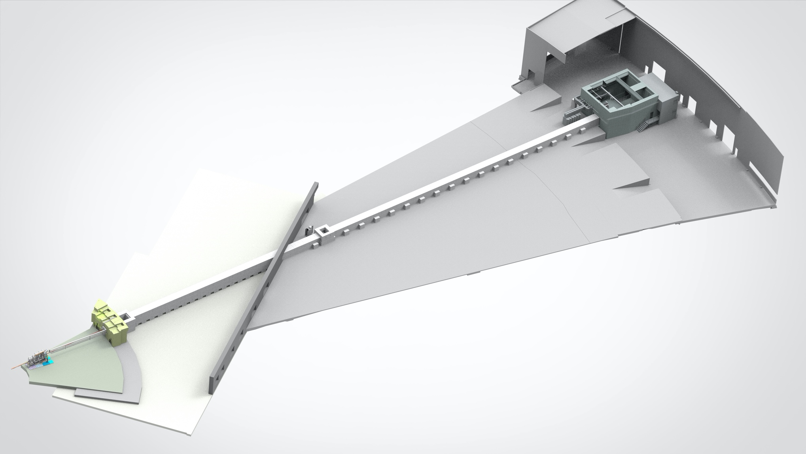
BEER
Experimental cave
CDR: Aug 23
SAT: Mar 24
Components status
Choppers at 80 m
Delivery: Jul 24
Installation: Oct 24
Neutron guide E02
Delivery: Nov 21
SAT: Mar 23
Control hutch
CDR: Jul 23
SAT: Mar 24
Instrument shutter
CDR: Nov 22
SAT: Apr 23
Neutron guide D03
Delivery: Nov 22
SAT: Mar 23
Choppers cascade
Delivery: Jul 24
Installation: Sep 24
Sample tower and detectors
Delivery: Feb 24
Installation: Mar-Oct 24
Common shielding
Installation
Bottom part: Sep 22
Upper part: Q1 23
TG5 on Mar 25
Hereon
NPI
In-bunker guide
Delivery: Mar 24
Installation: Apr 24
BWI
Delivery: Mar 24
Installation: Apr 24

