Slide 2
Monitoring – status and plans at DST
PRESENTED BY Jesper Rude selknæs

Slide 3
Agenda
1 First subject
2 The second issue
3 Third thing to address
4 The fourth action point
5 The fifth matter
6 Discussion point six
7 Topic number seven

Slide 4
Scope of DST monitoring
Overall purpose
The overall purpose of monitoring (from a DST perspective) is to ensure the continues operations of systems and services and to be able to gather post mortem information.

Slide 5
Monitoring
Prioritized areas of scope
INFOSEC
Intrusion detection
Vulnerability scanning
Hardware failures – including early warning for preventive maintenance
Service / application issues
Performance
Post mortem data collection

Slide 6
Monitoring
Systems and technologies currently in place
Monitoring area | Monitoring system | Status
INFOSEC | OSSEC / WAZUH + Graylog ZEEK | IMPLEMENTED PARTIALLY IMPLEMENTED (ICS)
Hardware failures | Icinga GPFS monitoring OpenStorage manager ZFS monitoring -> Icinga | IMPLEMENTED IMPLEMENTED IMPLEMENTED PARTIALLY IMPLEMENTED
Service and application issues | Icinga Foreman / Gitlab runners | PARTIALLY IMPLEMENTED PARTIALLY IMPLEMENTED
Performance | Ganglia PerfSonar (network perf) Storage monitoring Icinga | PLANNED PARTIALLY IMPLEMENTED Needed – no detailed plans PARTIALLY IMPLEMENTED
Post mortem data collection | Graylog | PARTIALLY IMPLEMENTED
Supportive systems | Graphite/Graphana syslog | IMPLEMENTED

Slide 7
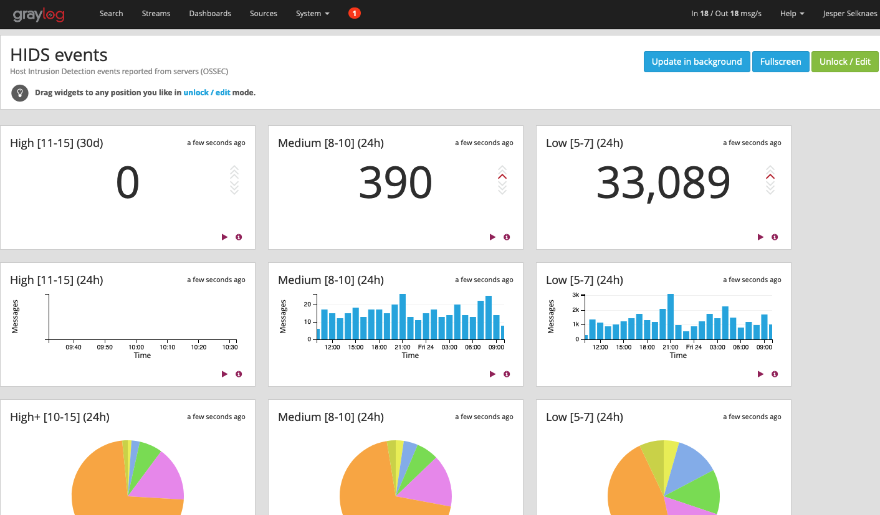
OSSEC / Wazuh
Host Intrusion Detection (HIDS)
Uses log scanning and kernel message inspection
Logs warnings and alerts to Graylog
Implemented on all prod systems

Slide 8
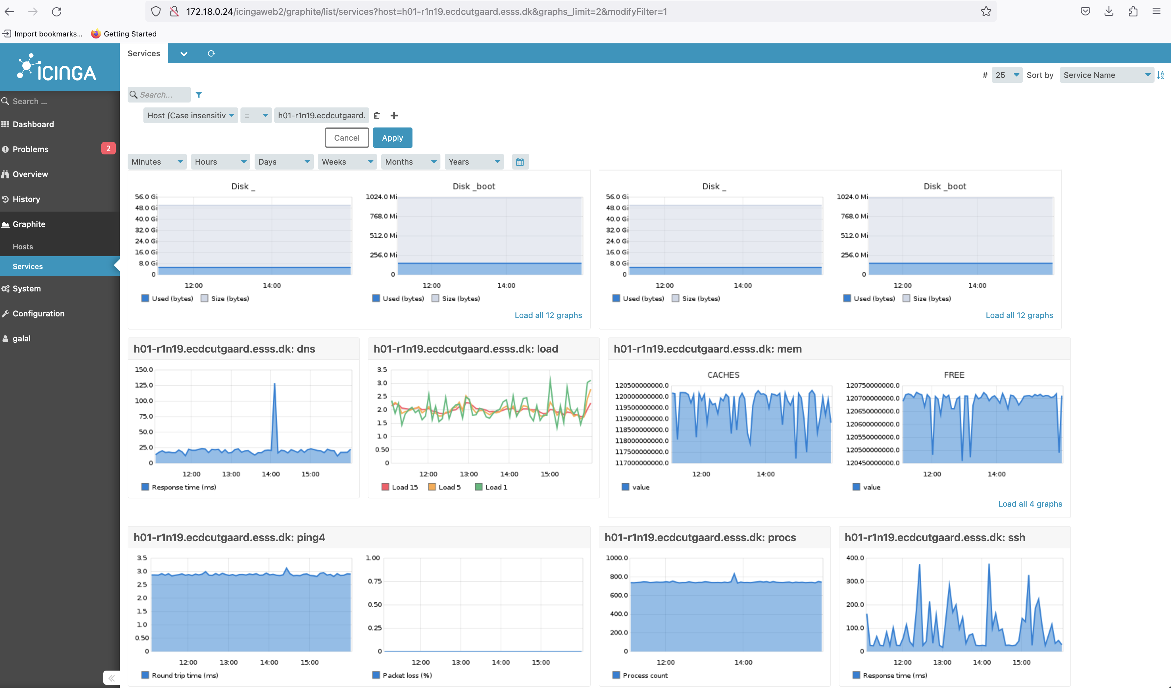
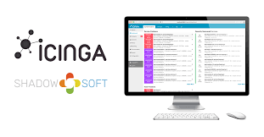
Icinga
General monitoring system
Tests / inspections executed on clients
Integrates with Graphite/Graphana
Alerts and notifications send by email
Implemented on all prod systems

Slide 9
Icinga
General monitoring system

Slide 10
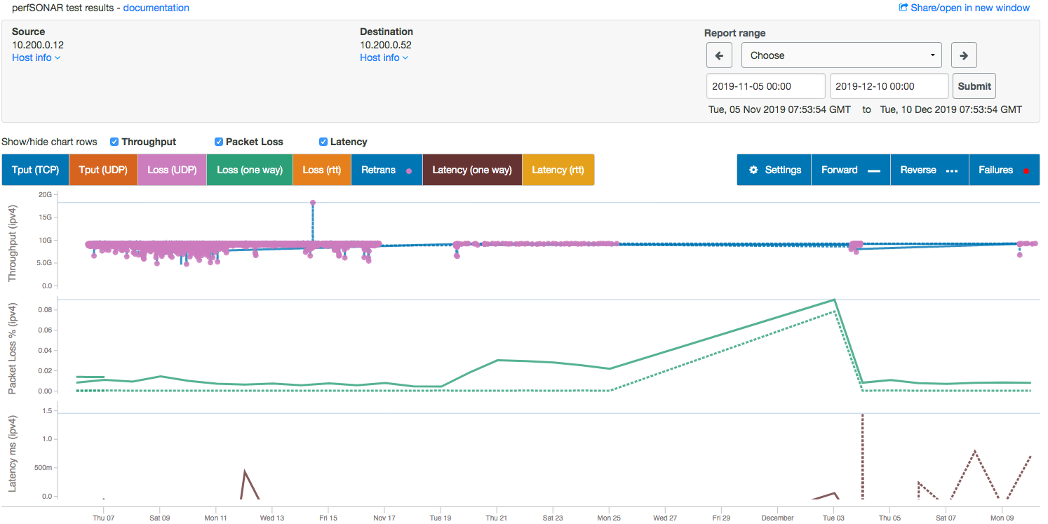
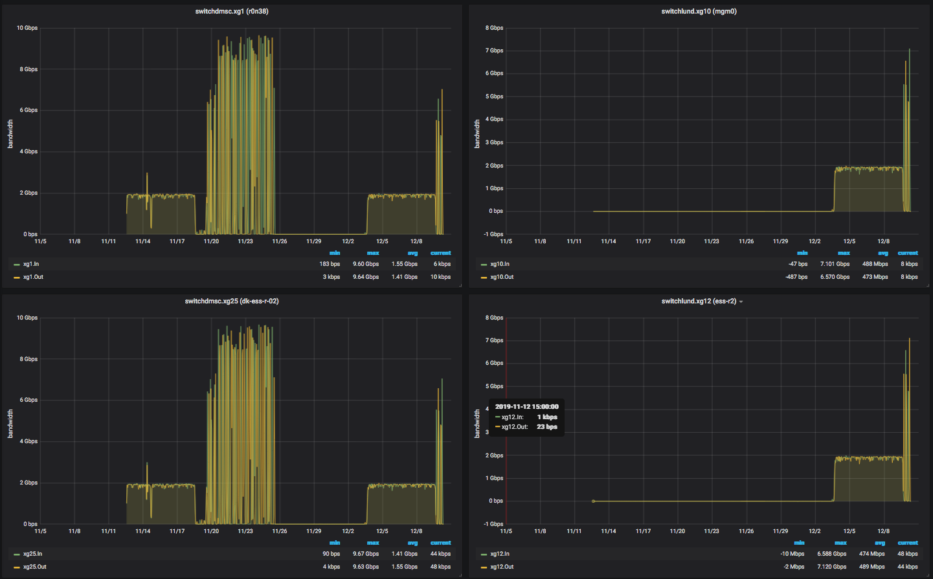
PerfSonar
Network performance monitoring
Active bandwidth and latency tests
Intrusive tests
Used for the site-to-site link
Can be considered for other networks

Slide 11
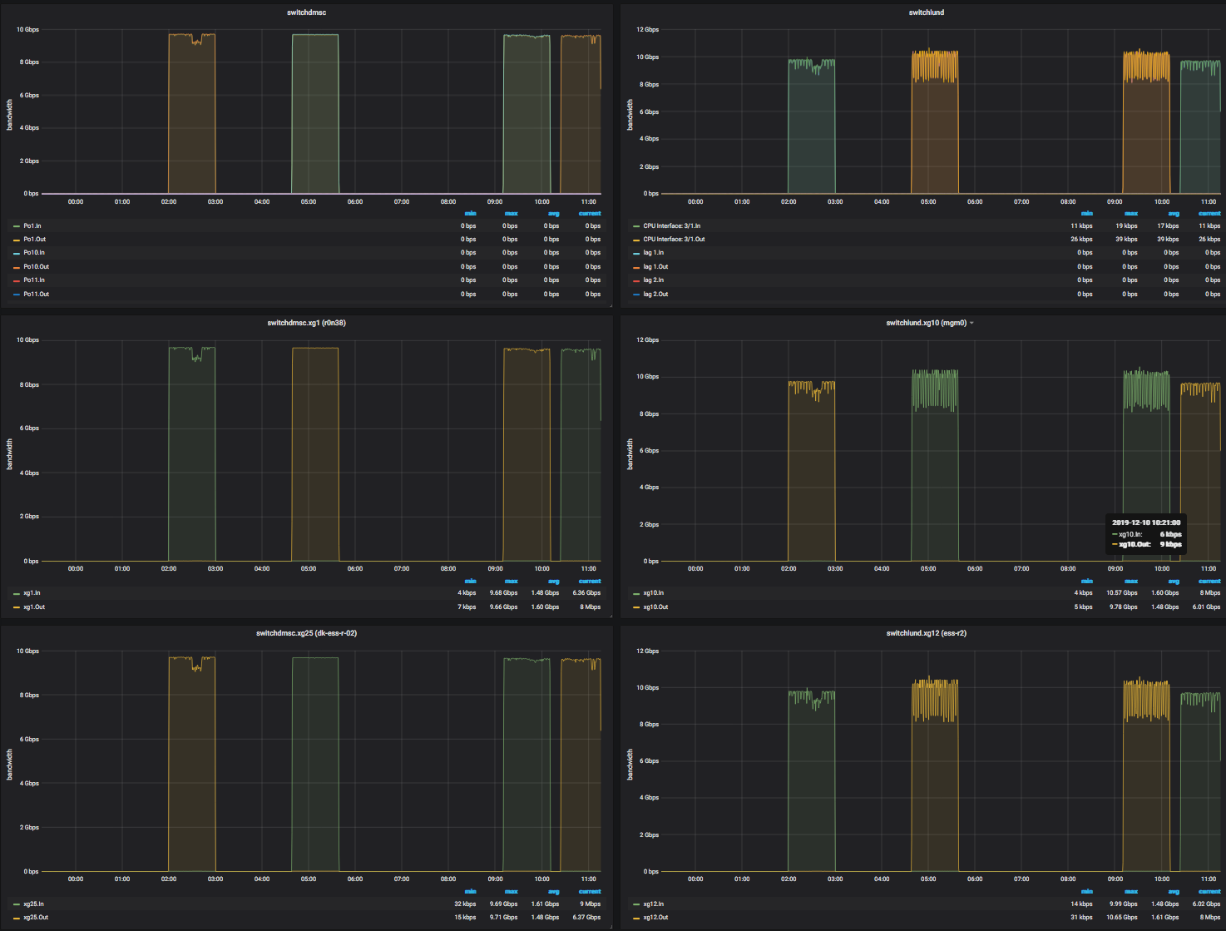
PerfSonar
Network performance monitoring

Slide 12
Plans
Tentative with respect to available resources
System | Work | Approx. schedule
Ganglia | Implement from scratch | Nice to have – perhaps student work in 2023
ZEEK (INFOSEC) | Expanded to all DMSC networks | To be phased with migration of existing networks to the NiN range. Hopefully at least 2 networks in 2023.
Graylog | More system to be added | 2023
Icinga | More tests implemented ZFS monitoring -> Icinga User application tests Performance tests | 2023 -> 2023 2023 -> in collaboration with ECDC and DRAM 2023 ->
PerfSonar | Regular tests of all networks* | 2023 ->
OSSEC (HIDS) | Implemented on workstations | 2023 -> Q2 2024
Performance for storage systems | Implement from scratch | Late 2023 ->

Slide 13
Finish presentation

