Slide 1
48

Slide 2
48
Systems Monitoring at ECDC

Slide 3
48

Slide 4
48( )
(▲)

Slide 5
48( )
(▲5)

Slide 6
48( )
(▲5)

Slide 7
Answers we should have
If I want a quick look at the system where do I go?
Are all system components represented?
Is everything working nominally?
Has something changed?
the last woking day
the past week
Are things improving, degrading or unchanged?
If I see something wrong what do I do?

Slide 8
What information do we have?
Commissioned servers
physical
virtual
Application status
Graylog
Grafana
Ad-hoc APIs
Software related metrics
repository activity
build, test and coverage results

Slide 9
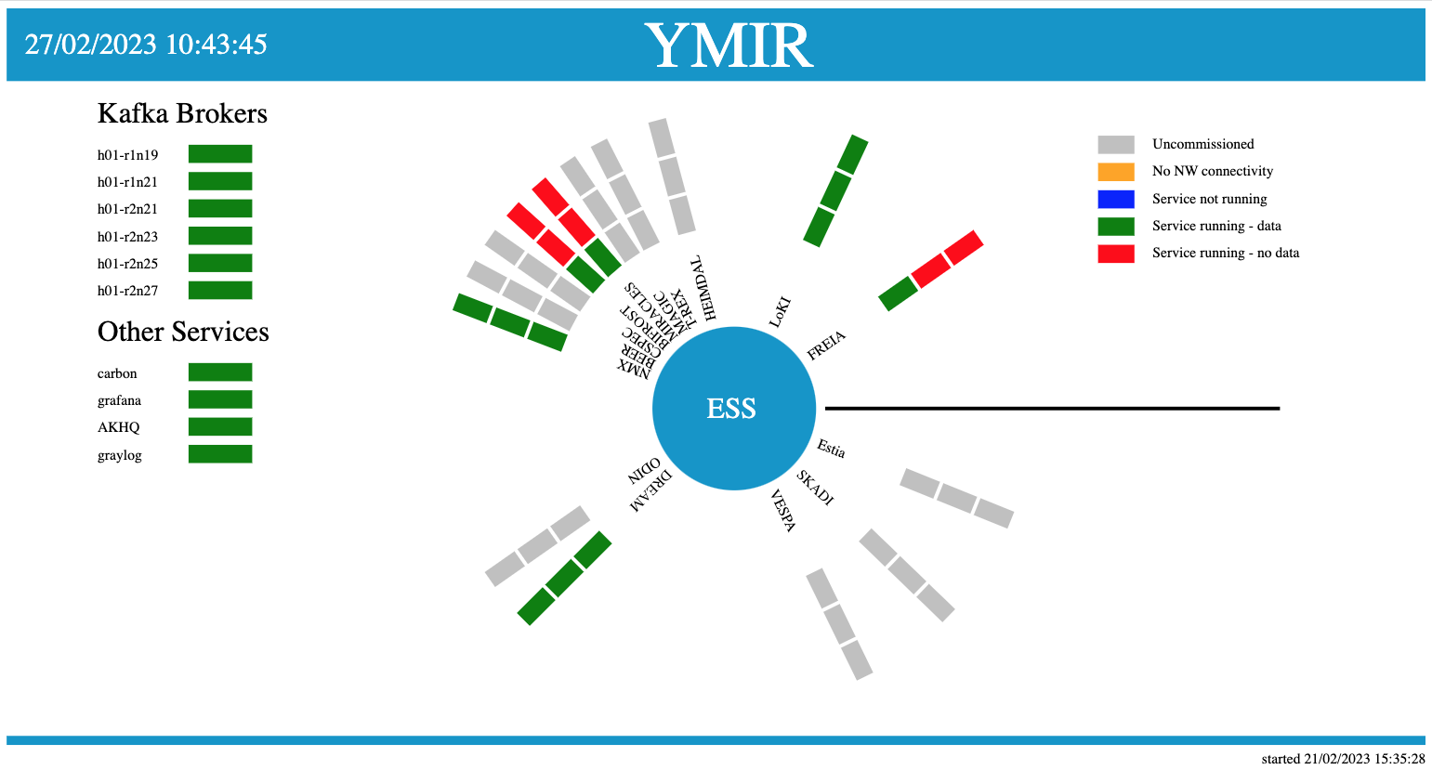
Dashboards?
LinkedIn article on developing the server Dashboard

Slide 10
Cool dashboards?
RM EFUs Kafka Filewriters Lund CPH
MIRACLES

Slide 11
Have log, need dashboard?

Slide 12
Have log, need dashboard?

Slide 13
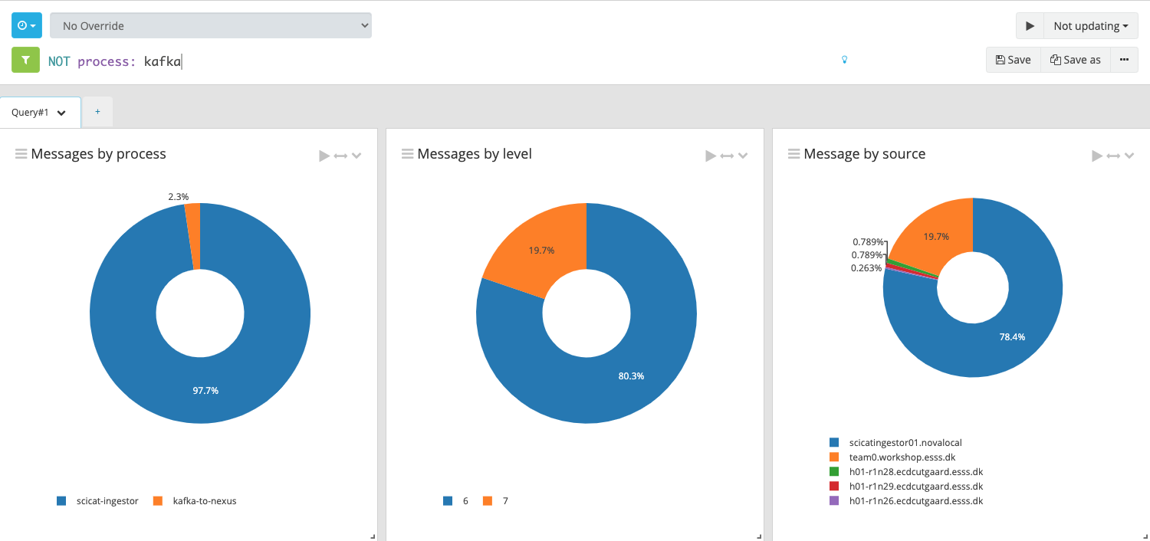
Have log, need dashboard?

Slide 14
Have log, need dashboard?

Slide 16
Formulate ambitions (ideas)
Common source of information (at top level)
Easy access!
Aim for global status at a glance
Look at dashboard regularly (daily)
Minimum required 'verboseness'
Normal operations should produce moderate log message rates
Log is for logging, not for stats

Slide 17
49( )
(▲1)

Slide 18
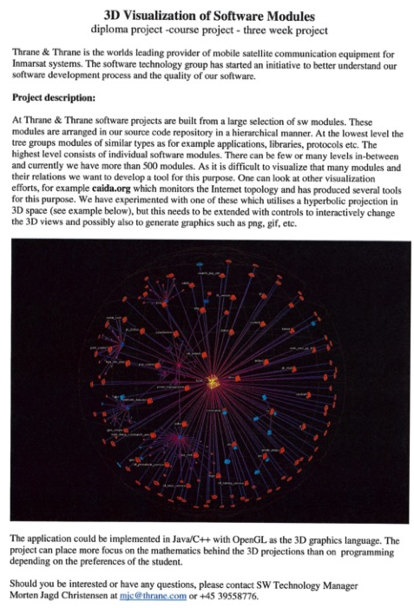
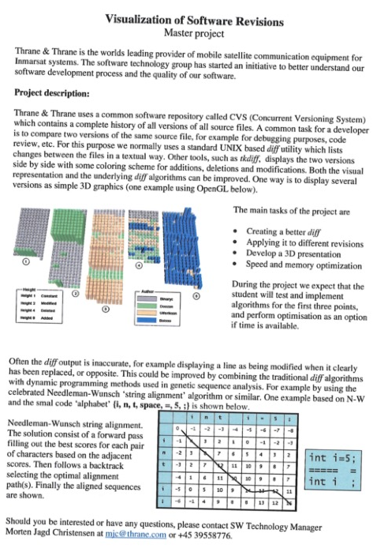
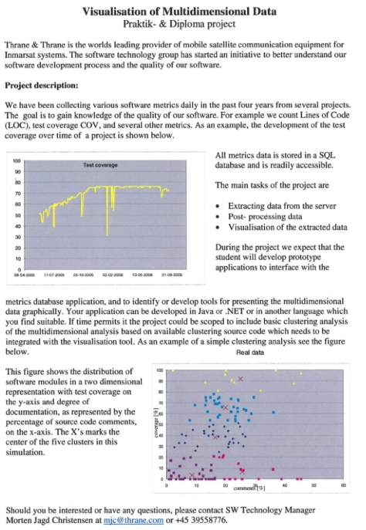
From the attic (2007)

Slide 19
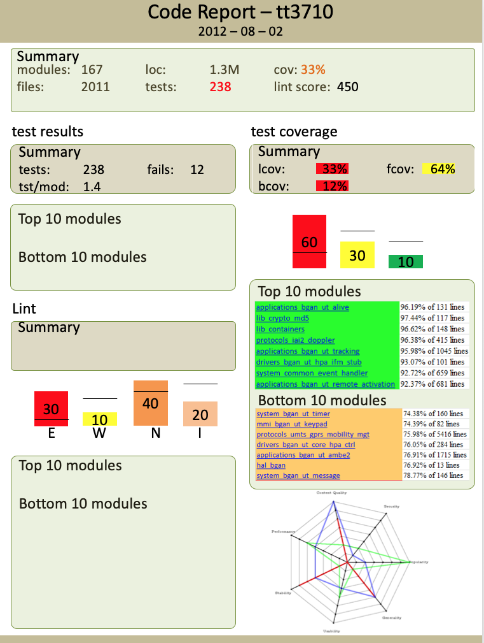
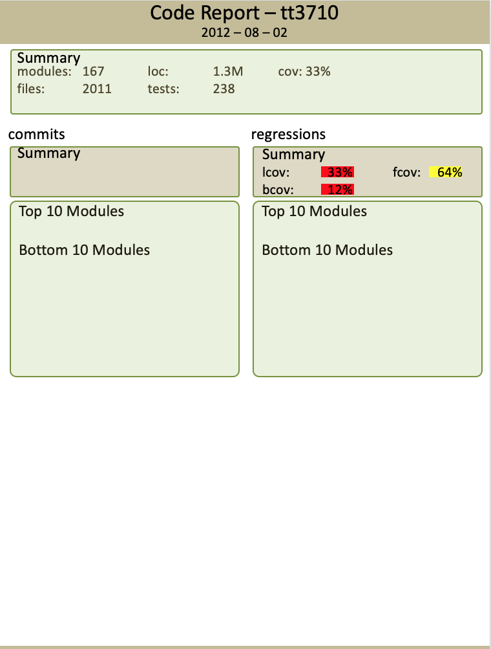
From the attic (2012)

