Slide 2
SWAP DevOps
PRESENTED BY Fredrik Bolmsten

Slide 3
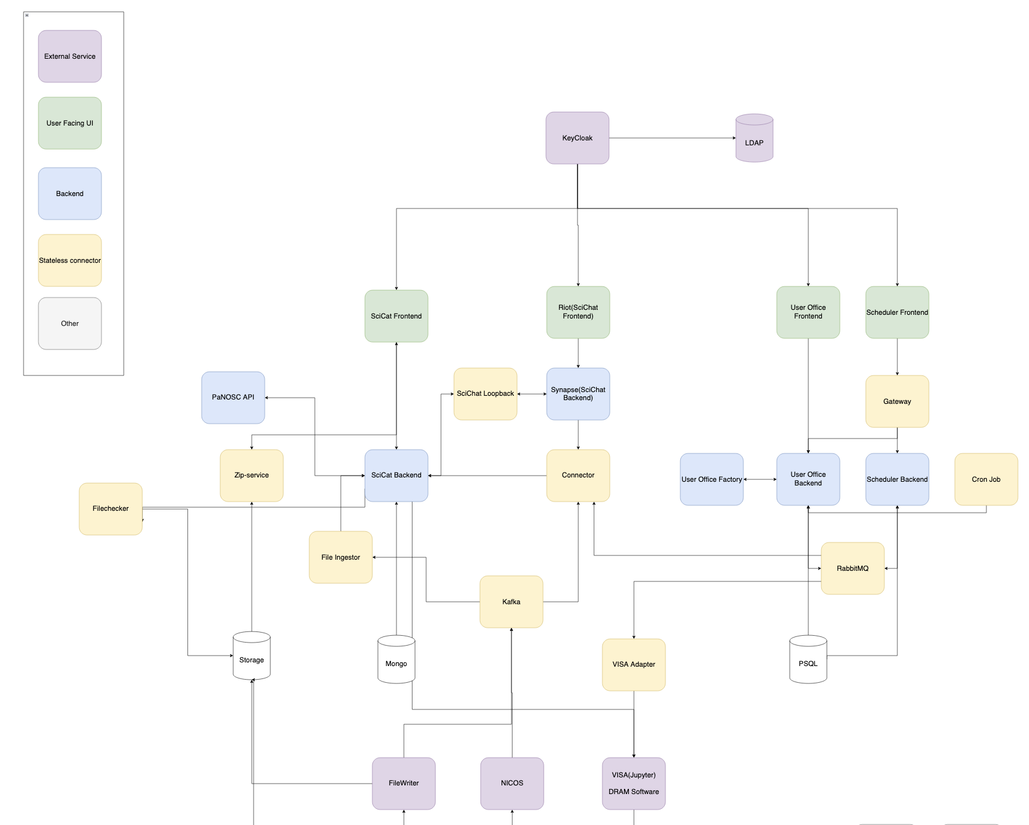
Presentation headline
Managing complexity
Sub-headline to strengthen the headline above

Slide 4



Overview
From repository to deployment
Github
Code
Automated testing
Build
Container repository
https://github.com/UserOfficeProject
https://github.com/SciCatProject
Deployment
Environment variables
https://gitlab.esss.lu.se/swap
Kubernetes
Run
Scale
Monitor
Alarms

Slide 5
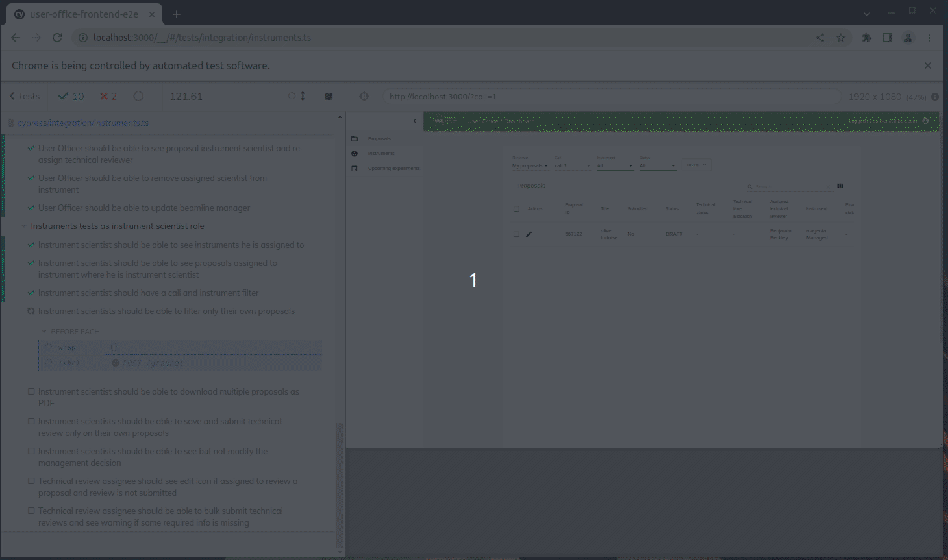
Automated testing

Slide 6
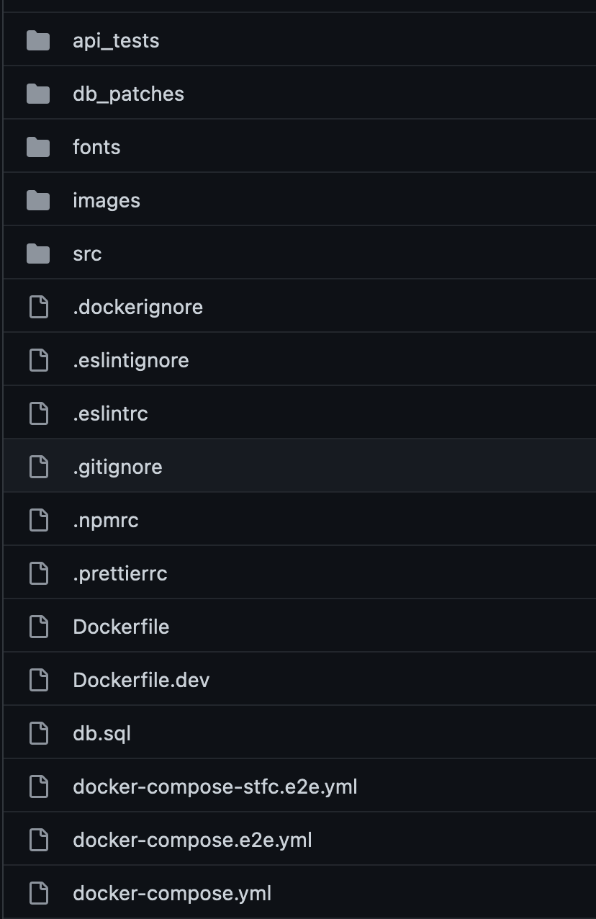
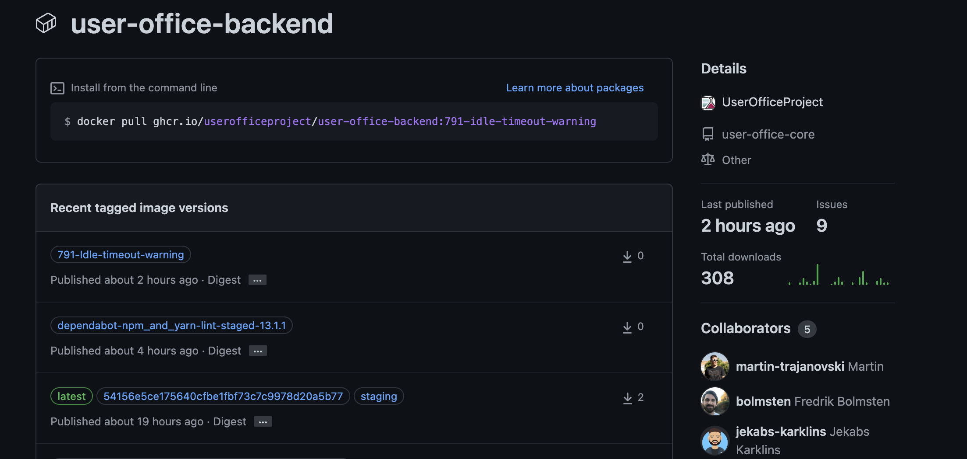
Containers
It works on my computer
Each software has a docker file and all projects contain a docker-compose file with all dependencies for local development
Tags and Actions

Slide 7
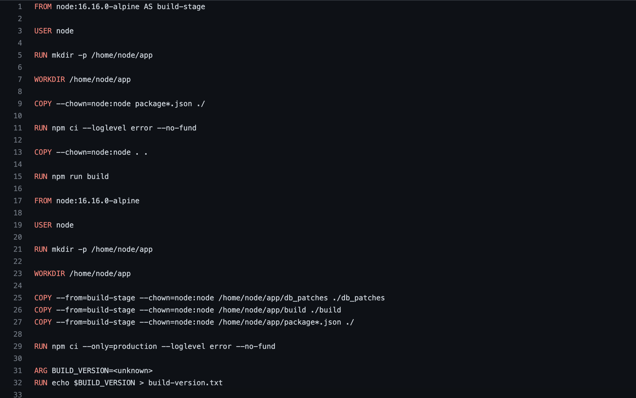
Base images
Notes:
The user office software (UOS) is the main tool through which the access policy will be implemented. There are three core tenants for the development of UOS.
First, and most significant is that the software is dynamic. It should be possible for the user office to create, edit and activate workflows and templates independent of the software development team.
Second is that the software is focussed on the needs of each user, from those submitting proposals, to those reviewing them for feasibility, safety and excellence, through to the scheduling and planning of individual experiments.
Third is that the software should appear to be integrated. Independently of where and how ESS stores data, it should all be clearly accessible through via UOS to the user, via specific displays or quick links.
NO ACTION

Slide 8
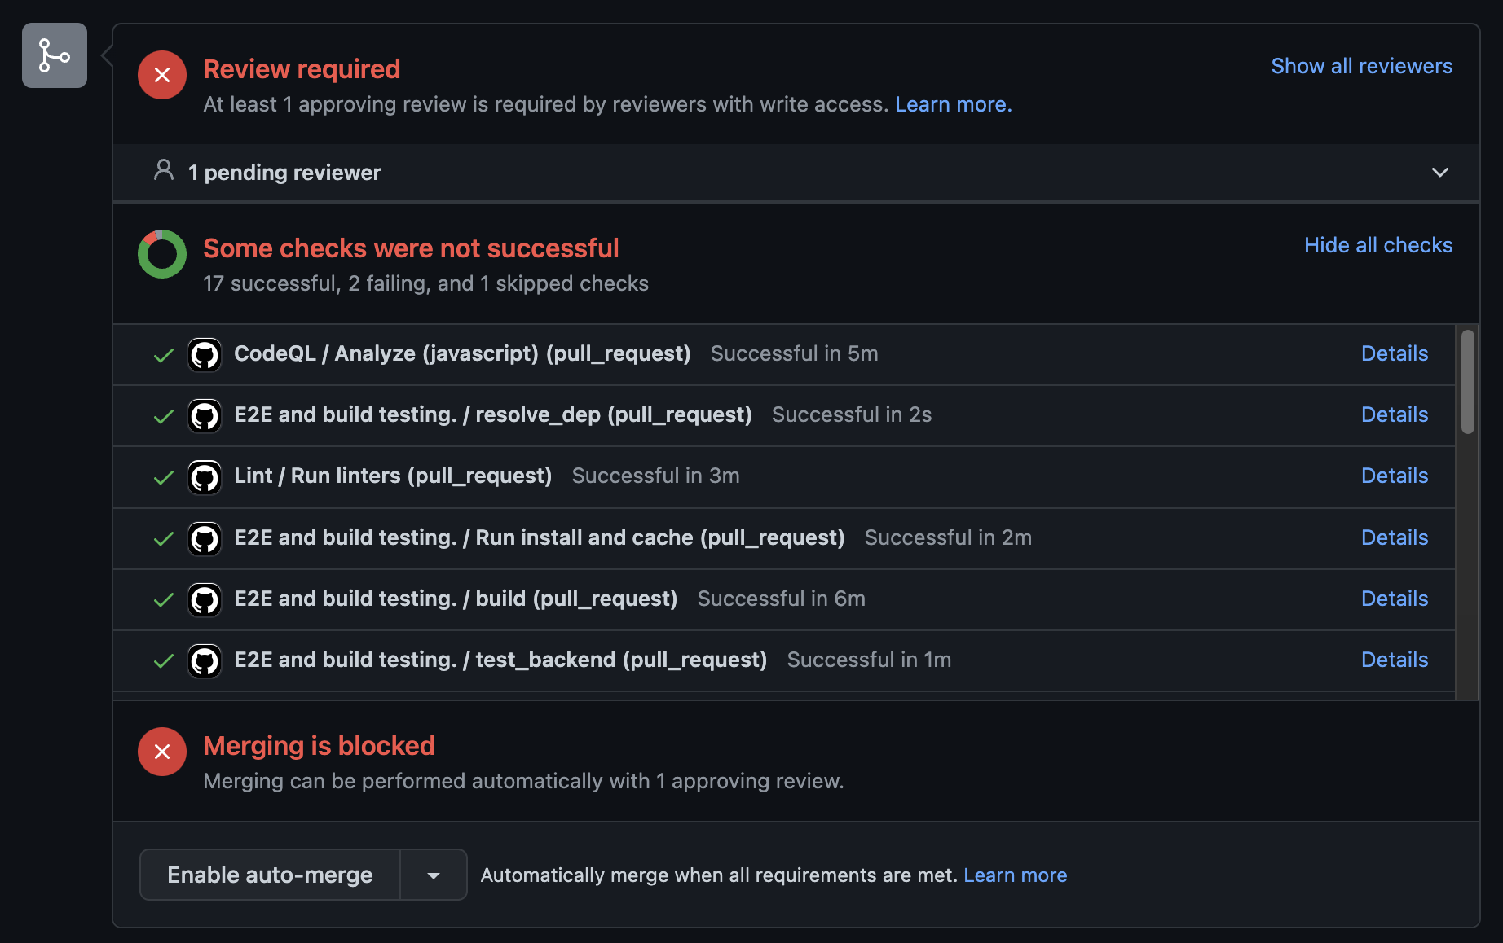
Merge Requests/Actions

Slide 9
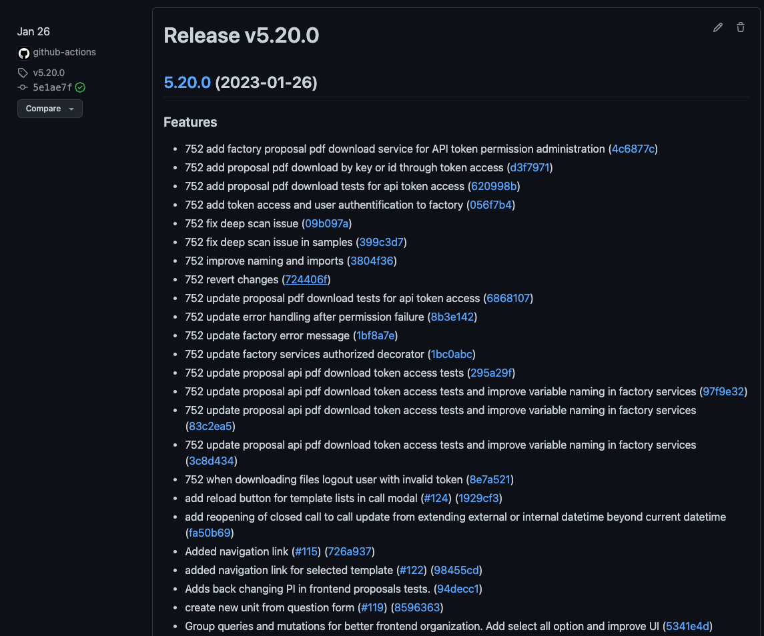
Tags

Slide 10
Production
Staging
Development
Updated manually
All deployments uses images with release tags in Github
Updated automatically
Released when merge into staging branch on Github. All deployments are tagged with staging and git hash
Updated automatically
Released when merge into develop branch on Github.
Notes:
The user office software (UOS) is the main tool through which the access policy will be implemented. There are three core tenants for the development of UOS.
First, and most significant is that the software is dynamic. It should be possible for the user office to create, edit and activate workflows and templates independent of the software development team.
Second is that the software is focussed on the needs of each user, from those submitting proposals, to those reviewing them for feasibility, safety and excellence, through to the scheduling and planning of individual experiments.
Third is that the software should appear to be integrated. Independently of where and how ESS stores data, it should all be clearly accessible through via UOS to the user, via specific displays or quick links.
NO ACTION

Slide 11
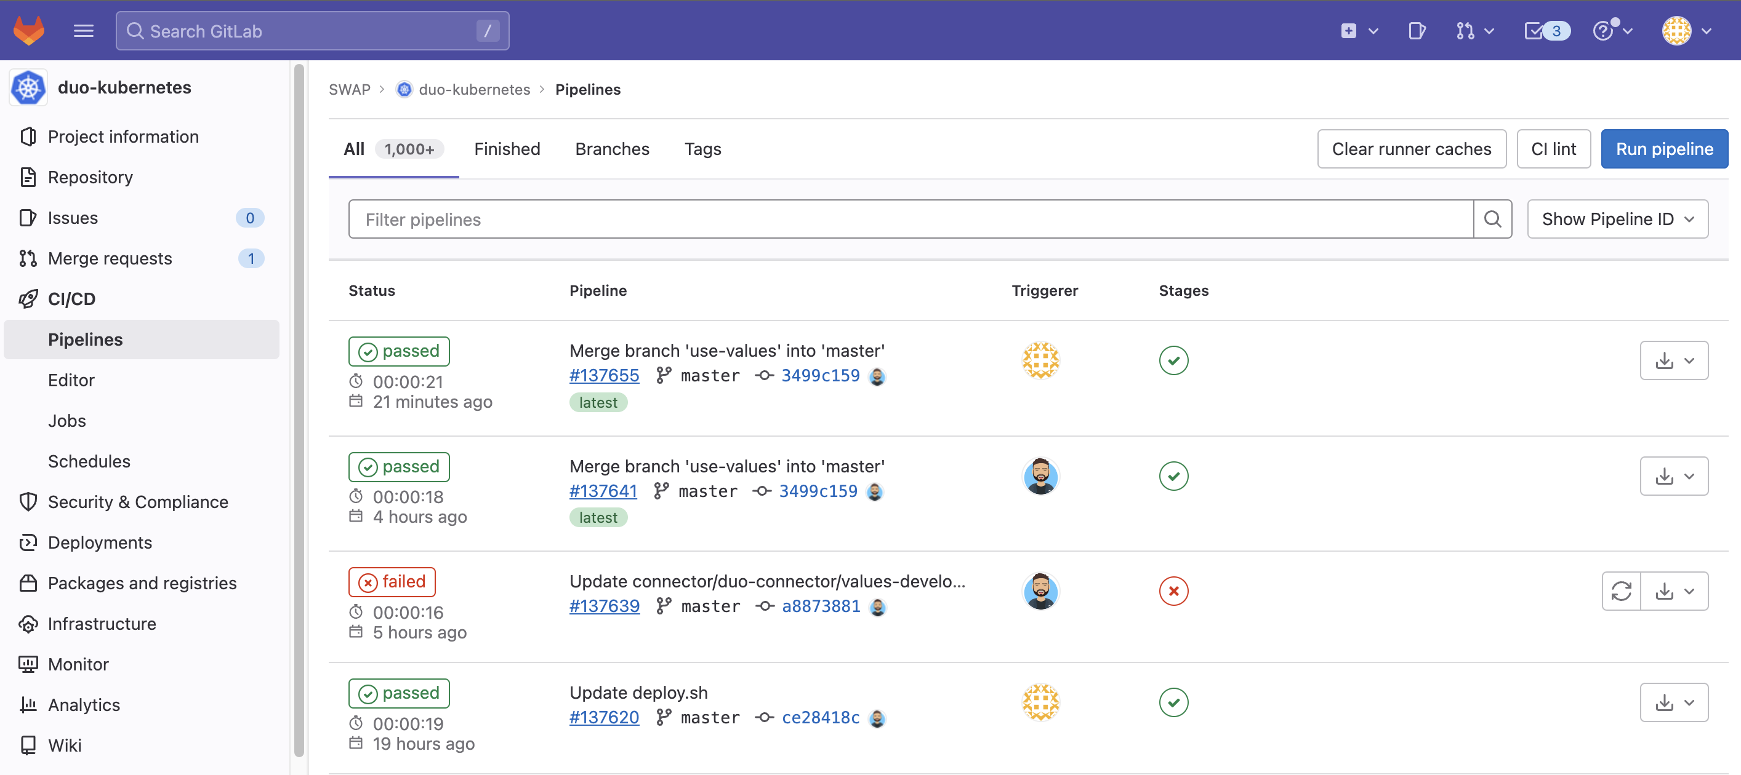
Deployment

Slide 12
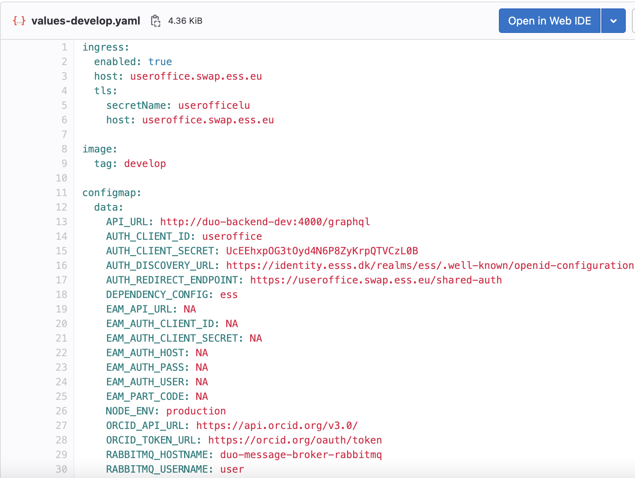
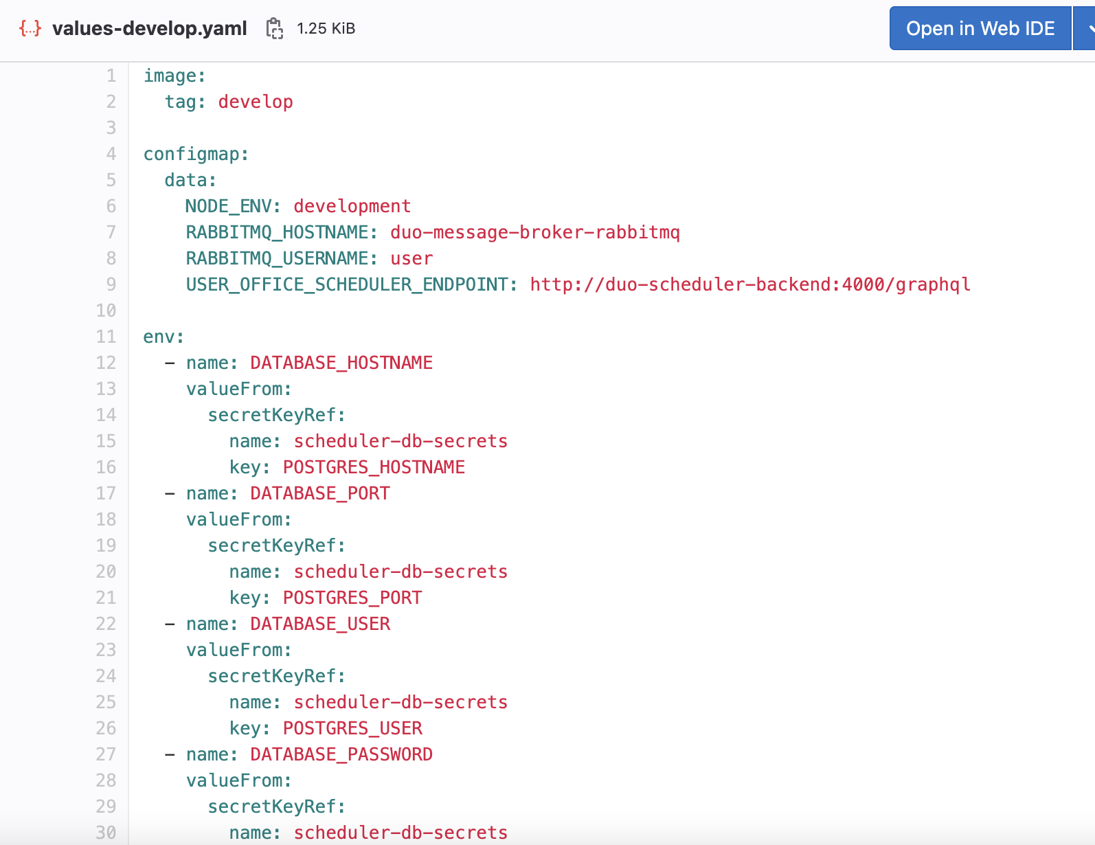
Configmaps
Notes:
The user office software (UOS) is the main tool through which the access policy will be implemented. There are three core tenants for the development of UOS.
First, and most significant is that the software is dynamic. It should be possible for the user office to create, edit and activate workflows and templates independent of the software development team.
Second is that the software is focussed on the needs of each user, from those submitting proposals, to those reviewing them for feasibility, safety and excellence, through to the scheduling and planning of individual experiments.
Third is that the software should appear to be integrated. Independently of where and how ESS stores data, it should all be clearly accessible through via UOS to the user, via specific displays or quick links.
NO ACTION

Slide 13
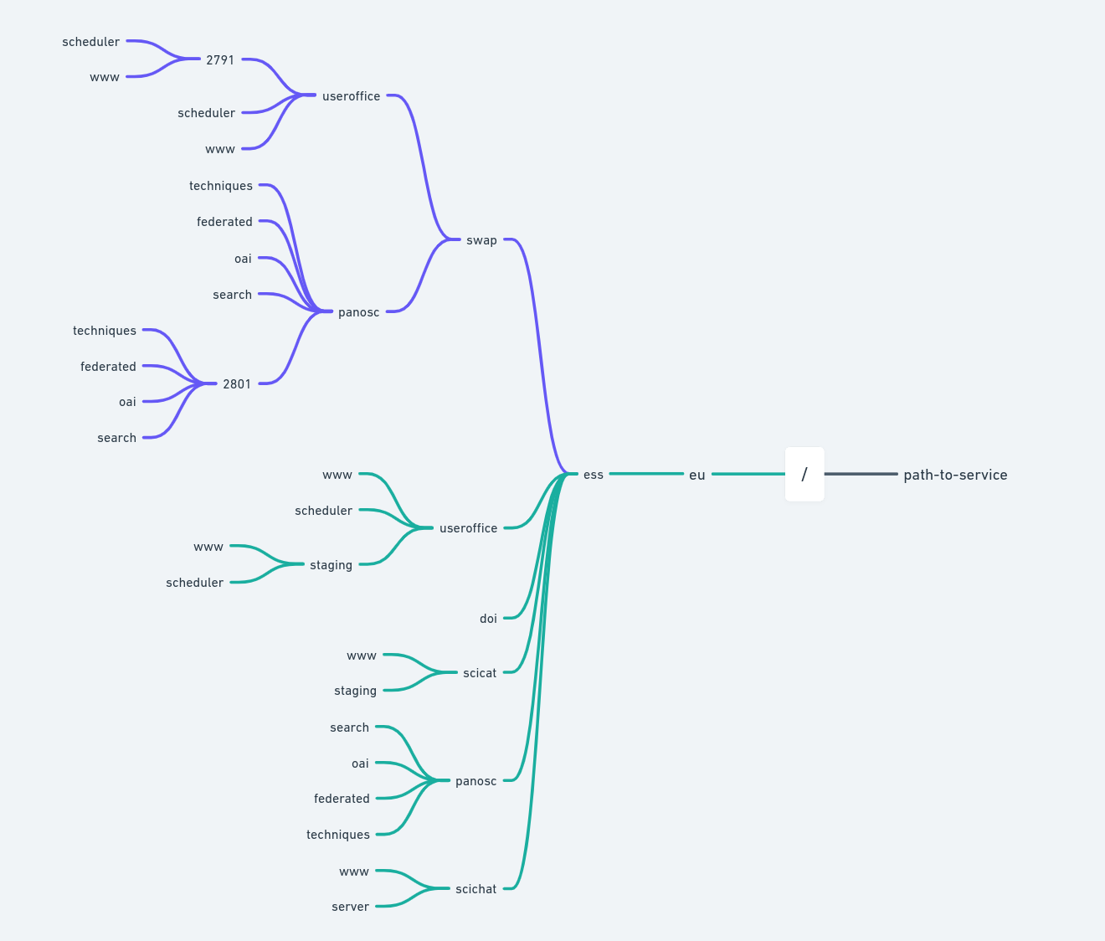
Pathways
Notes:
The user office software (UOS) is the main tool through which the access policy will be implemented. There are three core tenants for the development of UOS.
First, and most significant is that the software is dynamic. It should be possible for the user office to create, edit and activate workflows and templates independent of the software development team.
Second is that the software is focussed on the needs of each user, from those submitting proposals, to those reviewing them for feasibility, safety and excellence, through to the scheduling and planning of individual experiments.
Third is that the software should appear to be integrated. Independently of where and how ESS stores data, it should all be clearly accessible through via UOS to the user, via specific displays or quick links.
NO ACTION

Slide 14
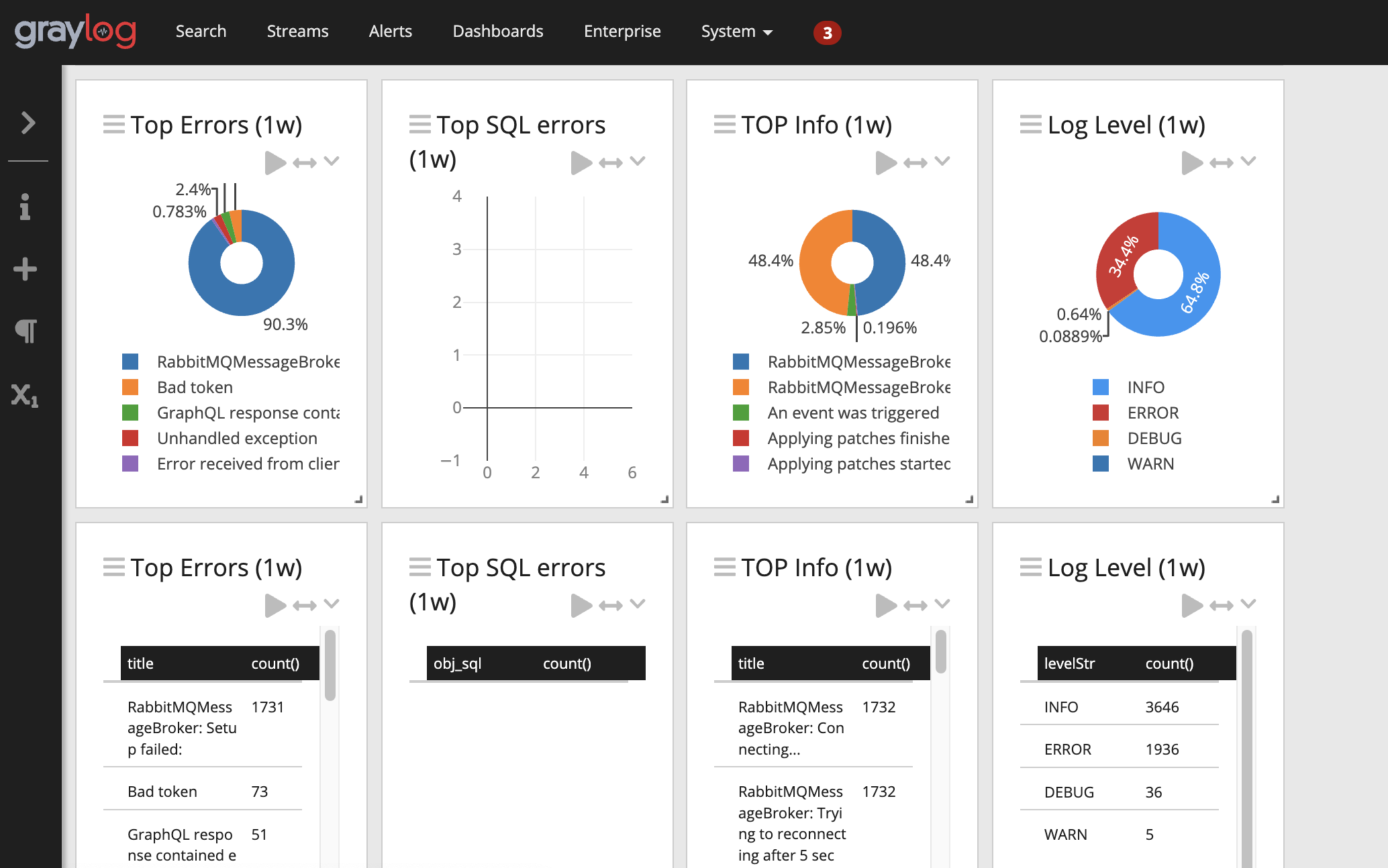
Logs
Sub-headline to strengthen the headline above

Slide 15
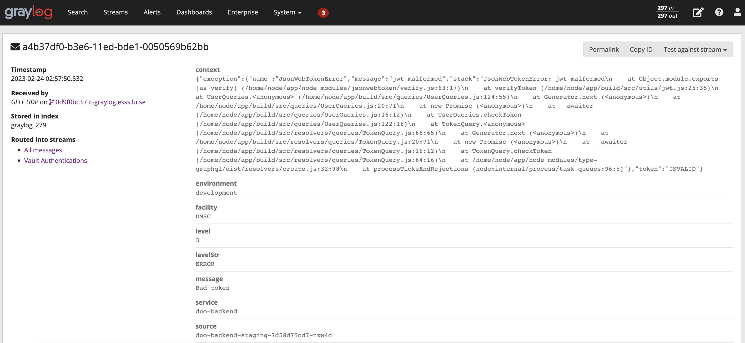
Logs

Slide 16
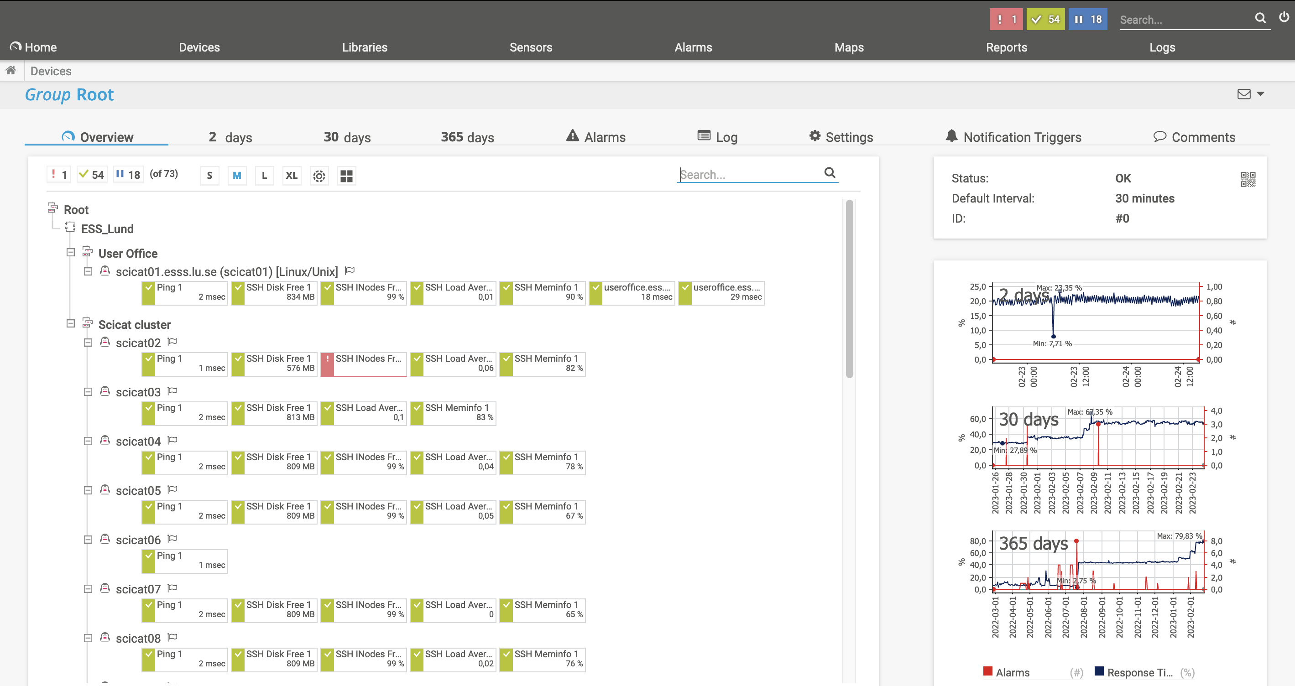
Cypress Video

Slide 17
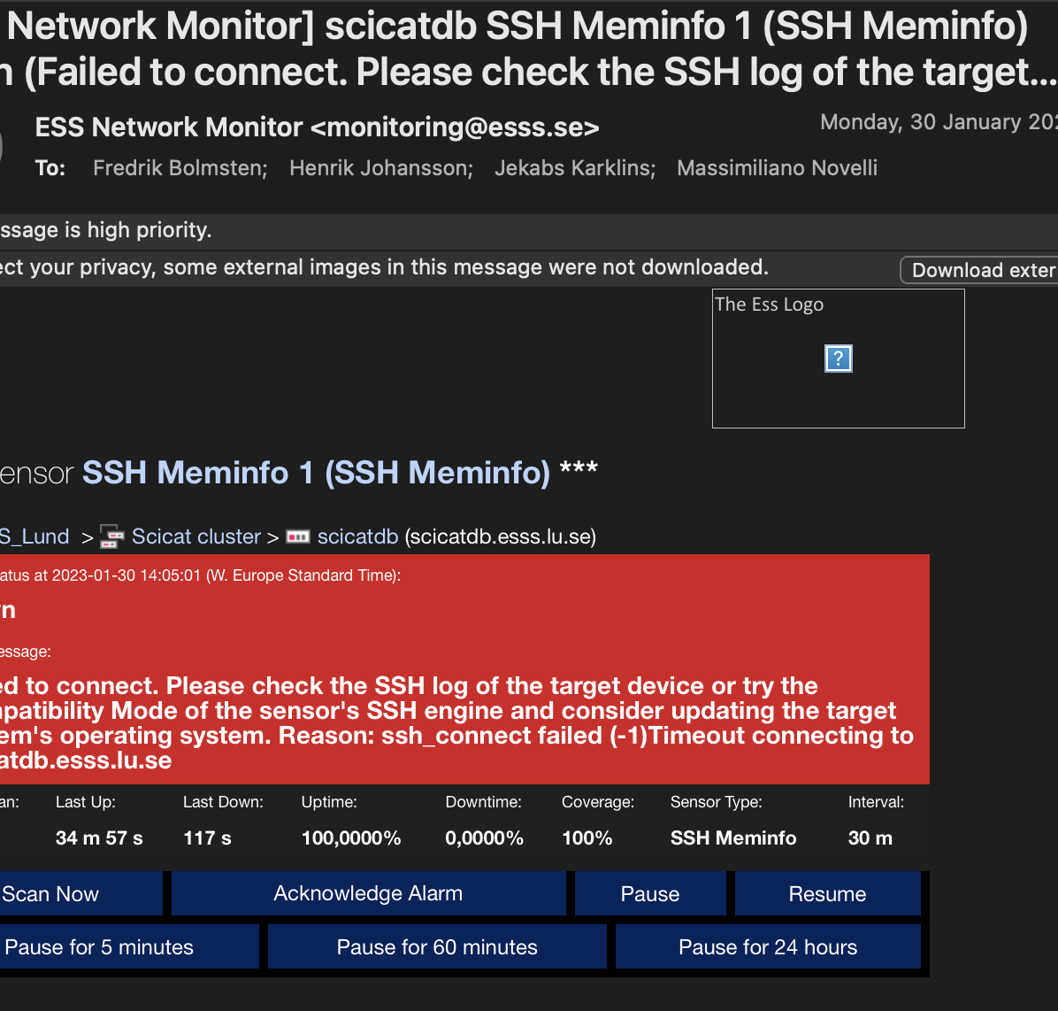
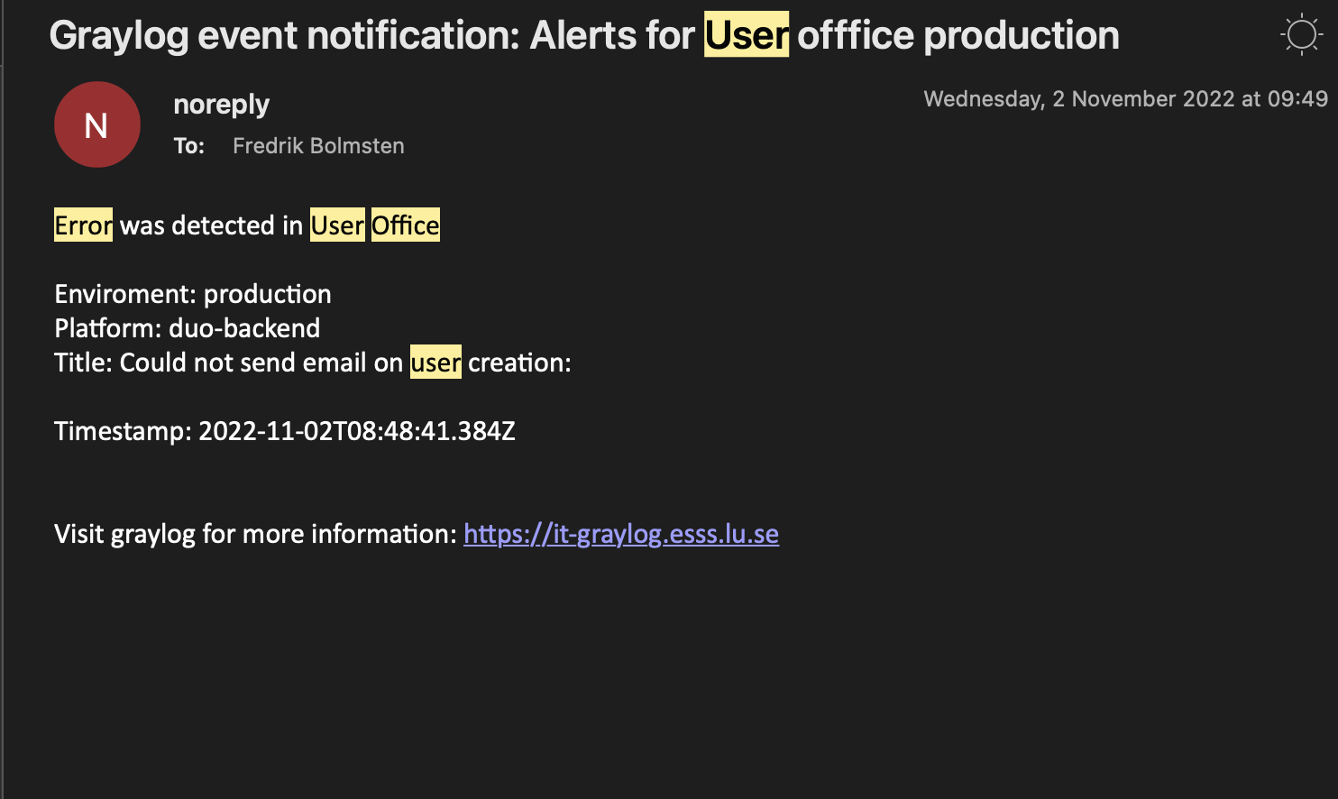
Alarms

Slide 18
Links
https://it-graylog.esss.lu.se/
https://paessler.esss.lu.se
https://gitlab.esss.lu.se/
https://www.npmjs.com/~esss-swap
https://github.com/orgs/UserOfficeProject/teams/swap

Slide 19
Finish presentation

