Slide 2
Streamlining the deployment process
PRESENTED BY Afonso Mukai

Slide 3
Agenda
1 Software deployment in ECDC
2 Aims
3 Possible tools
4 Where do we go from here?
5 Questions and discussion

Slide 4
Software deployment in ECDC
The environment
A layered approach:
  Foreman/OpenStack
  Puppet
  Ansible

Slide 5
Software deployment in ECDC
What we deploy
  ECDC software:
  EFU
  File Writer
  Forwarder
  …
  SWAP software:
  Scipp File Writer Ingestor
  External software:
  Kafka
Assumptions:
  Server provisioned and configured with Foreman/OpenStack and Puppet
  SSH and sudo permissions for ECDC group members to deploy

Slide 6
Software deployment in ECDC
Ansible
  Playbooks: map groups of hosts to roles
  Roles: define deployment tasks and file templates
  Inventories: define groups of hosts and variables
  Sample command with wrapper script from the dm-ansible repository:
  python ecdc-dh.py -u afonso.mukai -i inventories/site -j site -x '' -l 'bifrost*' deploy -p yuos.yml -s
LDAP username
Ansible inventory
Jump host
Hosts
Playbook

Slide 7
Software deployment in ECDC
A typical deployment
Create service users and directories
Deploy binaries from Jenkins/localrepos or source code from Git repository
Install configuration files from Ansible templates
Install and enable systemd service files from Ansible templates
Restart any services affected by changes

Slide 8
Aims
Motivation for improvement
  Main goals for improvement:
  Nicer user interface:
    Guide users that are not very familiar with the deployment process through the steps
    Make clear what is being deployed to prevent mistakes
    Offer visibility on source of configuration
  History of deployments:
    Allow users to check what versions are/were deployed to each host/environment
    Allow easy rollbacks in case of problems

Slide 9
Possible tools
What can we use?
Command-line scripts
AWX
GitLab
Foreman
Puppet
Something else? ARA, Ansible Semaphore?

Slide 10
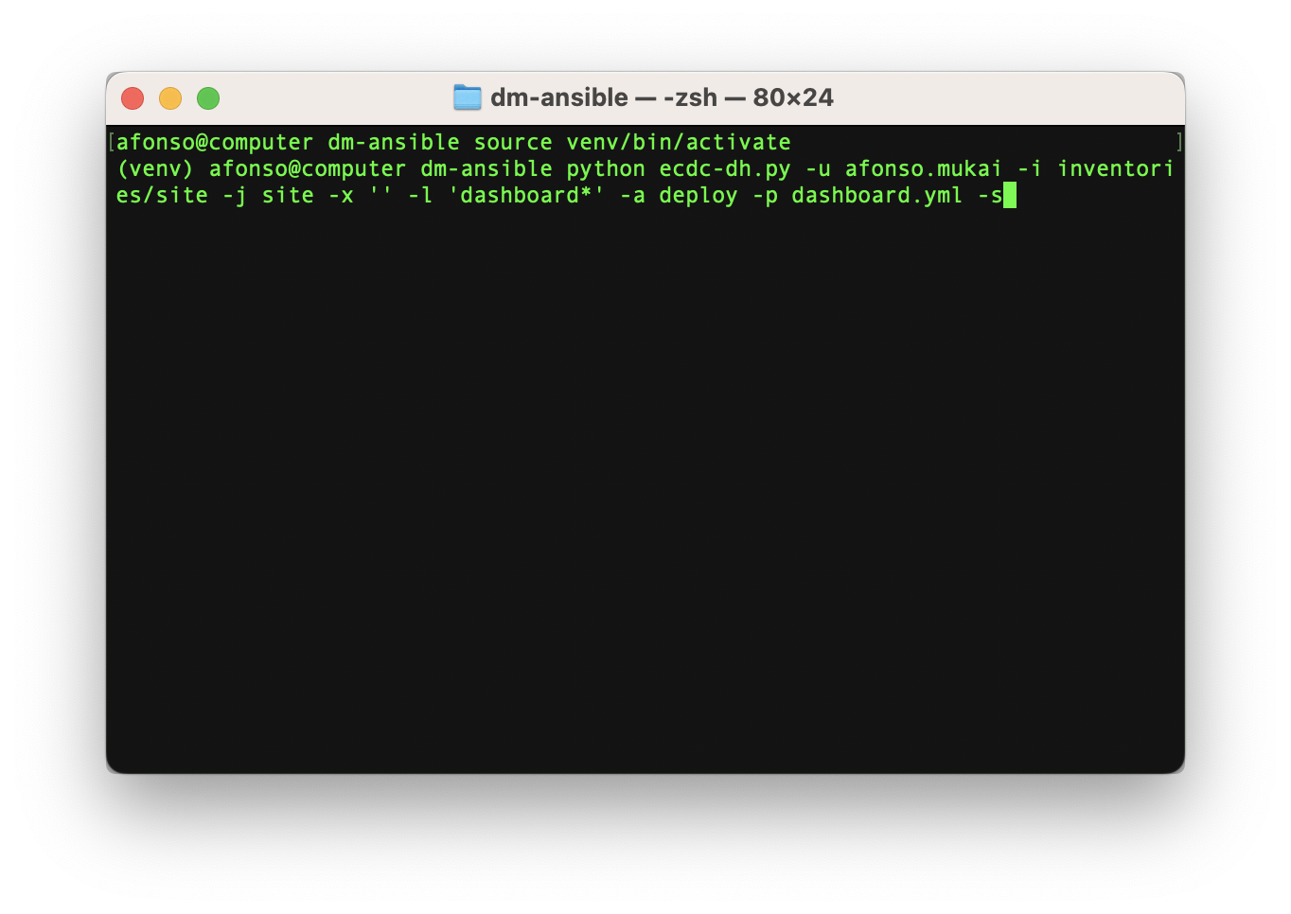
Possible tools
Command-line scripts
  No additional infrastructure required
  Simple to write and maintain
  Customisable
  Needs to be kept up to date manually in case of changes
  Might be less user-friendly initially
  History is only kept locally

Slide 11
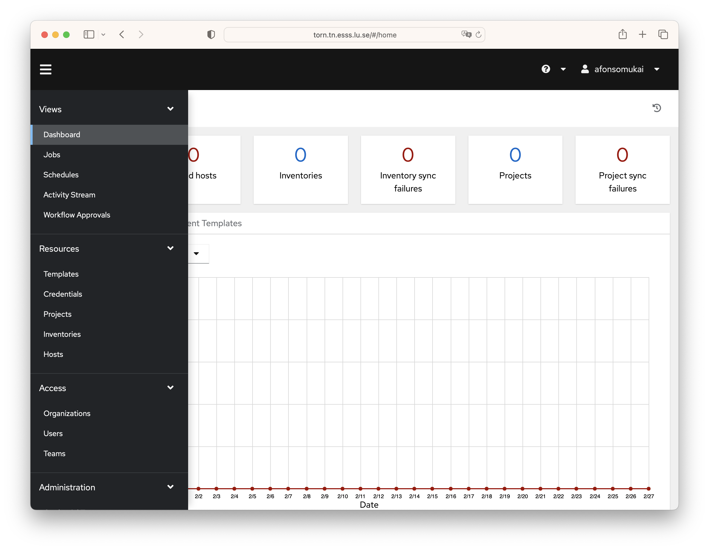
Possible tools
AWX
  Part of the Ansible ecosystem
  Used by ICS
  More complex to run
  Could cause conflicts with Puppet/Foreman DST setup?

Slide 12
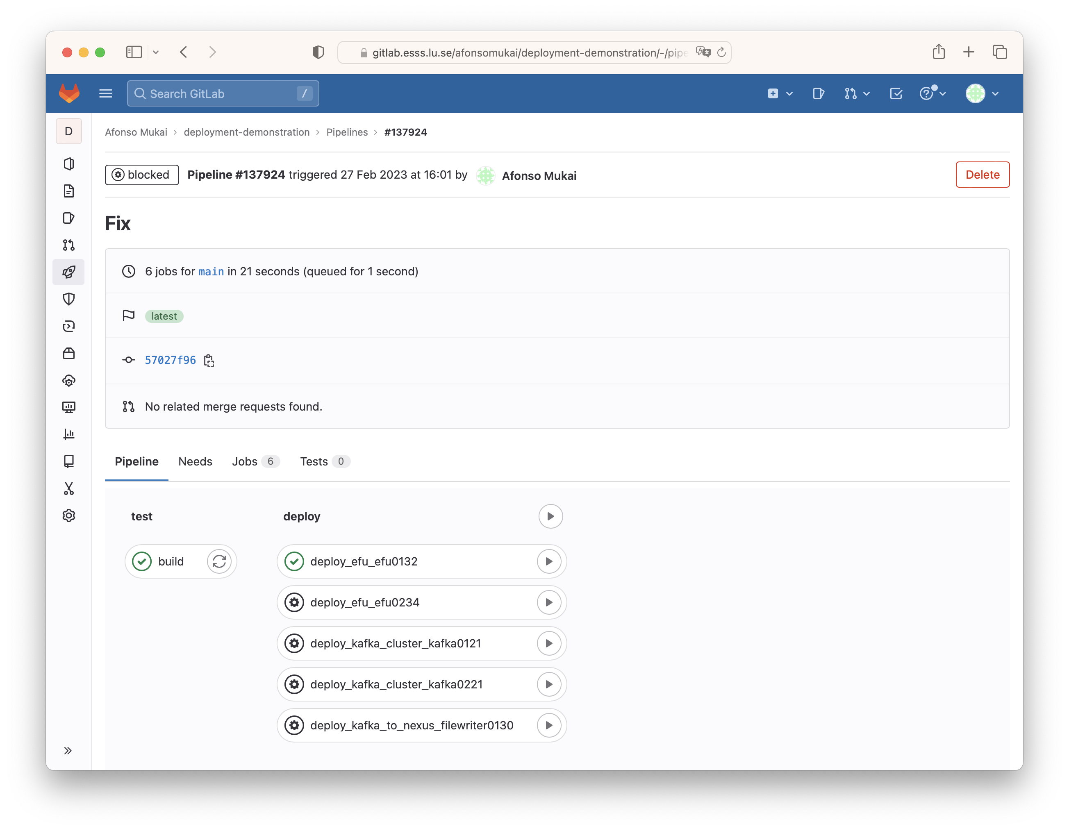
Possible tools
GitLab
  Already available at ESS
  Integration with CI: maintains history linked with commits and builds
  Supports environments for deployments
  How to map environments to our deployments?
  How to reach the appropriate networks?

Slide 13
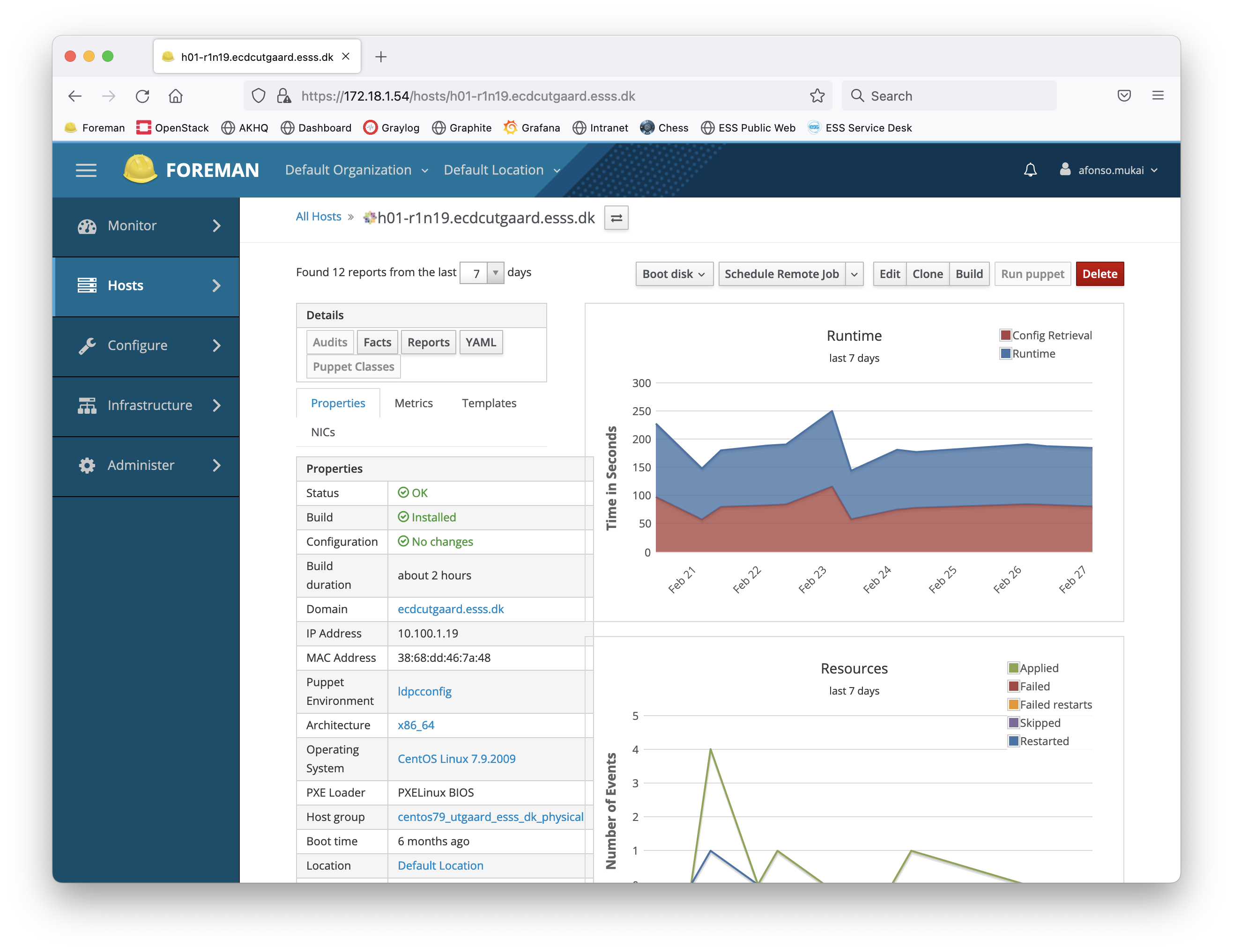
Possible tools
Foreman
  Single place for server configuration/deployment
  Offers remote job scheduling
  Keeps history (currently limited)
  Used by DST
  Remote job scheduling functionality not tested for this purpose
  Dedicated to Puppet setup

Slide 14
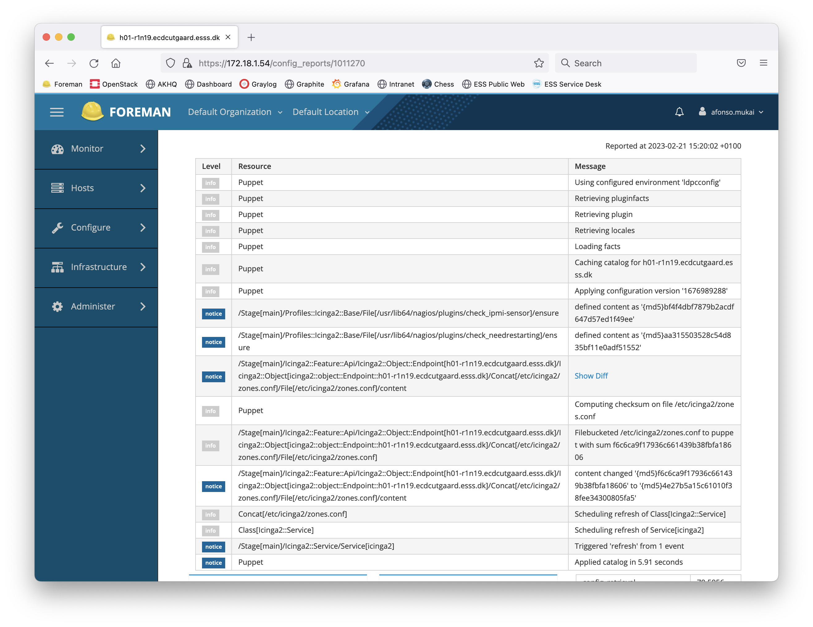
Possible tools
Puppet
  Available on the hosts we deploy to
  Used by DST
  Relies on pull model where changes are applied after merging to specific branches corresponding to environments
  Harder to learn: has its own language

Slide 15
Possible tools
What it could look like
The following examples show some of the tools that could be used for deployments. They don’t represent how we currently deploy, nor are they necessarily the best choice. The intent of the demonstration is to illustrate possible ways of achieving the aims presented earlier.

Slide 16
Questions and discussion

