Slide 1
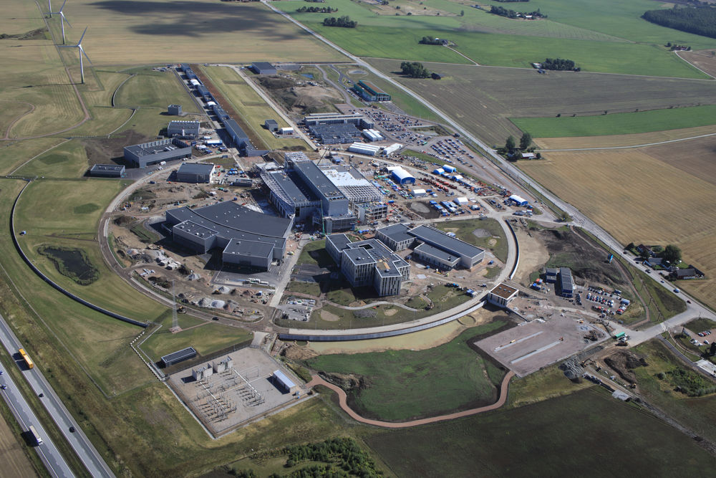

Designing SD2 UCN converter in the moderator cooling block at the ESS
Blahoslav Rataj
On behalf of the HighNESS consortium
LENS/ELENA WG3 meeting 23-24 March 2023, Garching

Slide 2
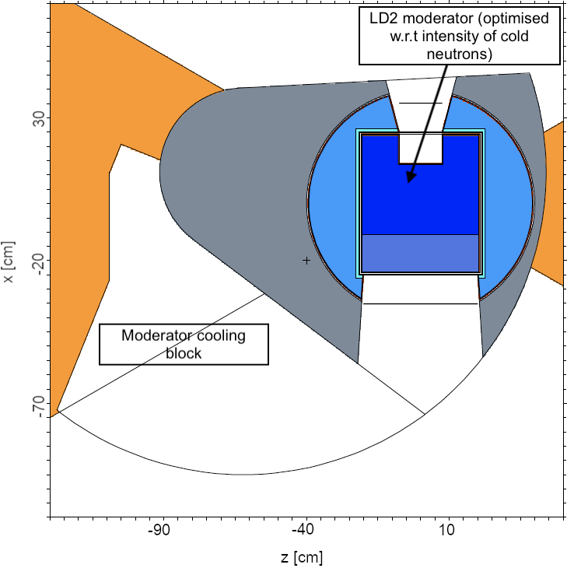
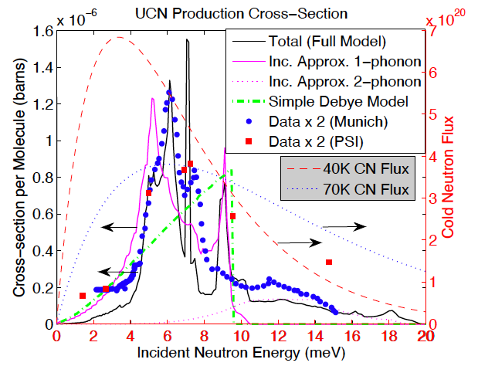
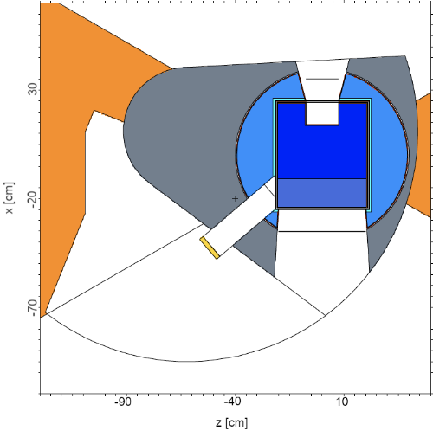
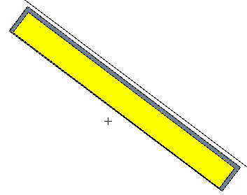
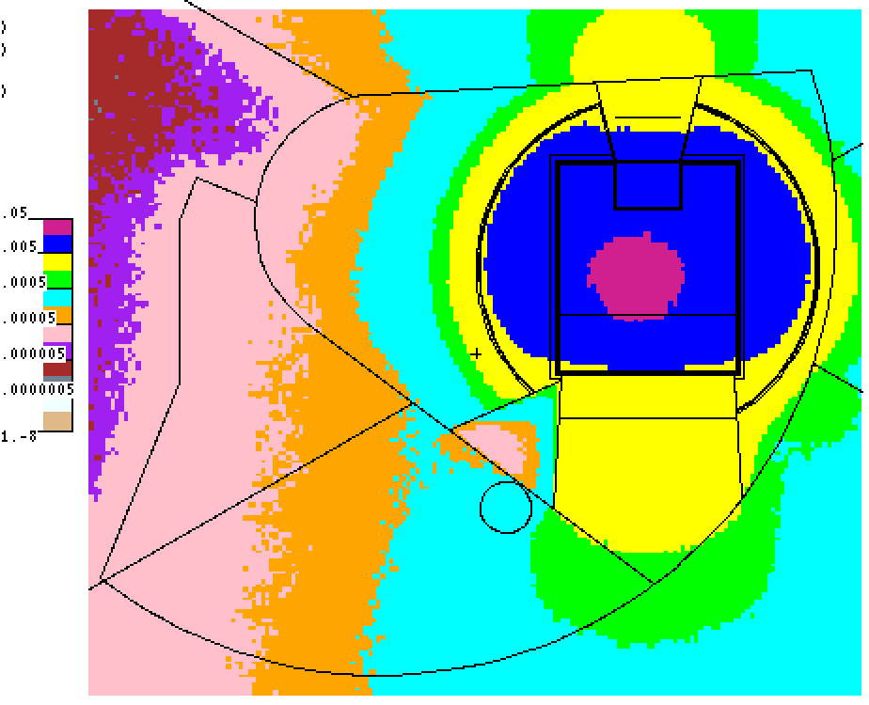
Outline of the presentation
(i) A location of moderator moderator cooling block in the baseline model
(ii) Calculating P_{UCN} using the UCN production cross-section in SD2
(iii) Designing the UCN source (SD2 converter) with a cylindrical channel through twister
(iv) Designing the UCN source (SD2 converter) with a direct view on the NNBAR emission surface
(v) Testing the gamma shielding made of Bismuth
Notes:
Aggiungi international collaboration

Slide 3
Current baseline model with the moderator cooling block
Possibility to design a solid deuterium converter in the moderator cooling block (MCB) that would make use of the cold neutrons streaming from the LD2 moderator to produce ultracold neutrons (UCNs)
NNBAR FOM for the baseline model
  2.53 x 10¹⁷ n⋅Å²/s/sr
NNBAR experiment
Notes:
Aggiungi international collaboration

Slide 4
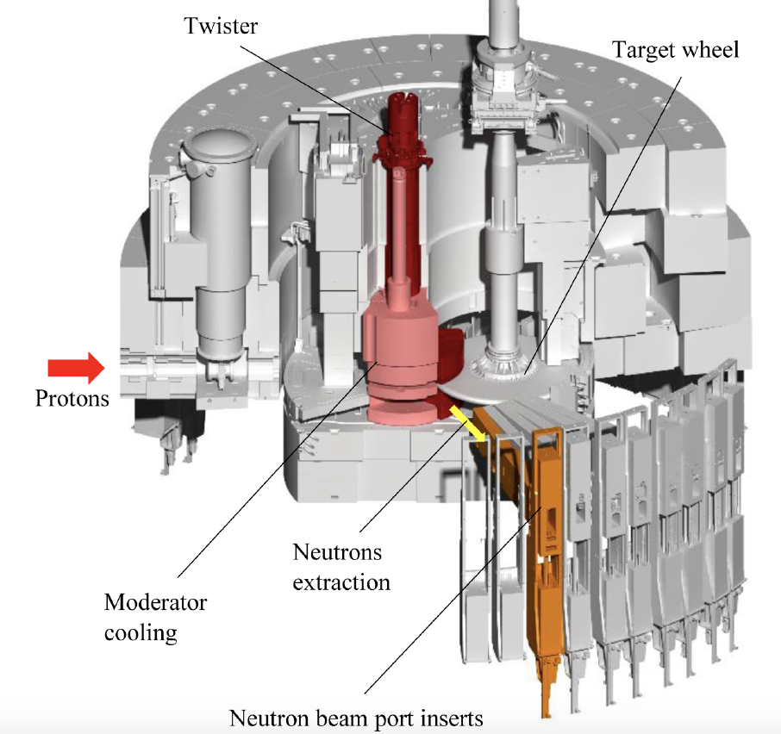
The position of moderator cooling block in the target monolith
Adapted from Santoro, V., et al. "Development of a high intensity neutron source at the European Spallation Source: The HighNESS project." arXiv preprint arXiv:2204.04051 (2022).
Notes:
Aggiungi international collaboration

Slide 5
Selecting the UCN production cross-section for solid deuterium
MCNP cannot transport UCNs
  Ultracold neutron production rate P_{UCN} [n/s/cm³] can still be calculated using a UCN production cross-section for solid deuterium
  Investigated various available UCN production cross-sections for the solid deuterium
Notes:
Aggiungi international collaboration

Slide 6
Selecting the UCN production cross-section for solid deuterium
Used in our calculations of P_{UCN}
Adapted from Gutsmiedl, E., et al. "Production of ultra-cold neutrons in solid α-oxygen." Europhysics Letters 96.6 (2011): 62001.
Notes:
Aggiungi international collaboration

Slide 7
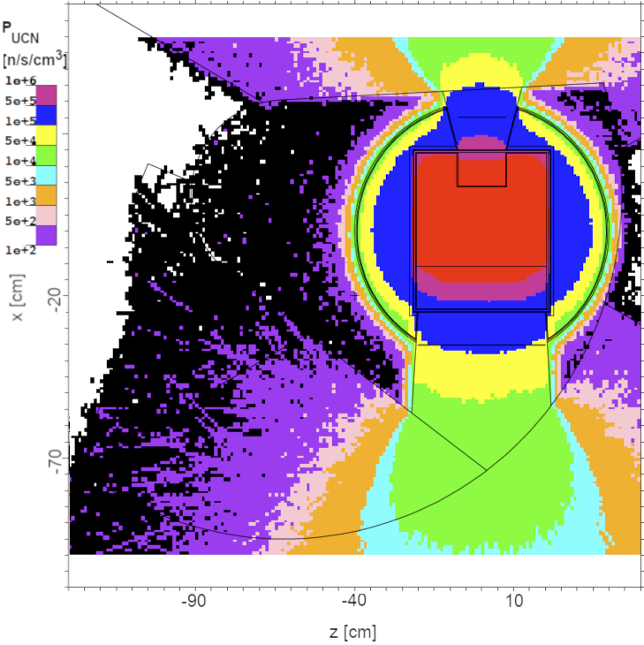
Map of P_{UCN} for the baseline model calculated with the Munich cross-section
Notes:
Aggiungi international collaboration

Slide 8
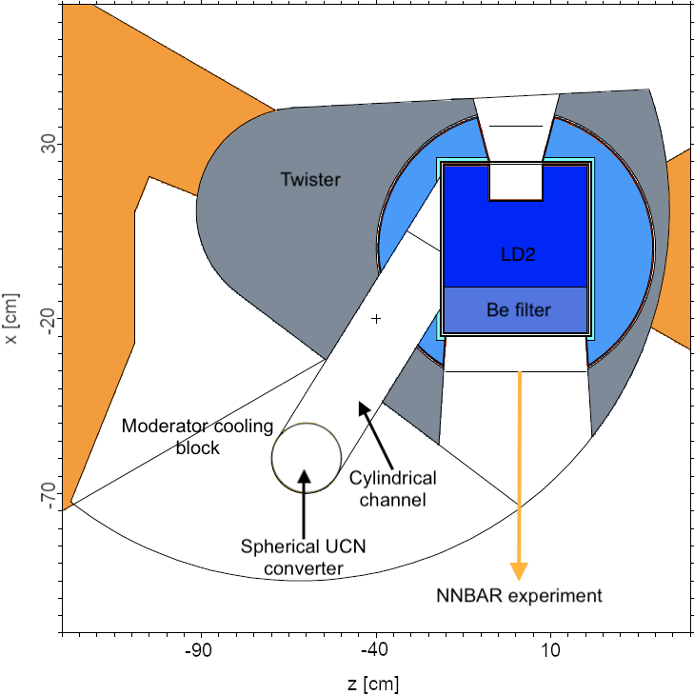
Designing the solid deuterium UCN converter with a channel - initial idea
Initial idea: Designing a cylindrical channel through the twister to supply cold neutrons to the solid deuterium converter in MCB
Created a parametric model of the channel and UCN converter
Measured P_{UCN} in the spherical UCN converter and NNBAR FOM simultaneously
The goal of optimisation:
  Maximize P_{UCN} and minimize the loss in NNBAR FOM at the same time
Notes:
Aggiungi international collaboration

Slide 9
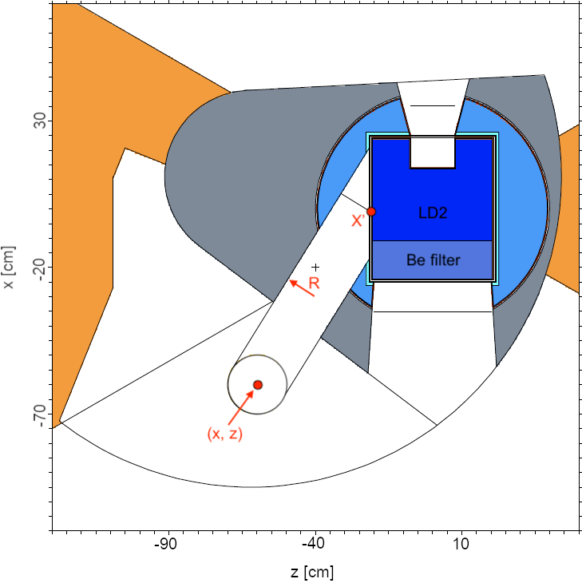
Designing the solid deuterium UCN converter with a channel - initial idea
4 parameters were varied in this model:
  Spherical UCN converter
    x coordinate of the centre
  Spherical UCN converter
    z coordinate of the centre
  Cylindrical channel
    radius R
  Cylindrical channel
    position of opening x’
Notes:
Aggiungi international collaboration

Slide 10
Designing the solid deuterium UCN converter with a channel - initial idea
Conducted a general study where the parameters were varied
Findings:
  A bigger channel radius gave rise to a higher P_{UCN}, but at the cost of loss in NNBAR FOM
  Altough the Be filter cut a part of the neutron spectrum (2.5 – 4 Å) that contributed to the UCN production cross-section, the highest P_{UCN} was measured when the channel opening was aligned with the Be filter. In this case, the distance between the LD2 moderator and spherical UCN converter was minimised.
  A smaller loss in NNBAR FOM if the channel opening was closer to the NNBAR emission surface.
  5 mm thick layer of nanodiamonds that covered the walls of channel increased measured P_{UCN} by approximately 2 %
Notes:
Aggiungi international collaboration

Slide 11
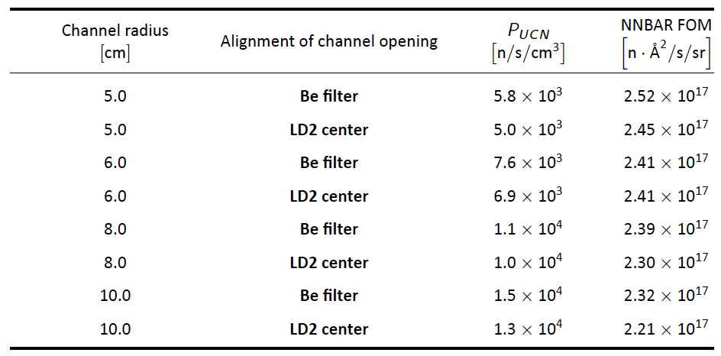
Designing the solid deuterium UCN converter with a channel - initial idea
Conducted a general study – fixed R while varying the position of UCN detector sphere and channel opening
  Reported highest P_{UCN} for a given case in the table below
    The position of the UCN detector sphere that minimised the channel length led to the highest P_{UCN} for each case
Notes:
Aggiungi international collaboration

Slide 12

Designing the solid deuterium UCN converter with a channel - initial idea
Conducted a general study – fixed R and varied position of the UCN detector sphere and channel opening
Selected as a reference model for the cylindrical channel option
Maximal acceptable loss in NNBAR FOM
Notes:
Aggiungi international collaboration

Slide 13
Designing the solid deuterium UCN converter with a channel - initial idea
  Selected as a reference model for the cylindrical channel option
    Replaced the spherical UCN converter with a 2 cm thick disc-shaped UCN converter filled with solid deuterium
      Now taking into account the scattering of cold neutrons in the solid deuterium within the UCN converter
        P_{UCN} = 1.10 x 10⁴ n/s/cm³
        NNBAR FOM = 2.41 x 10¹⁷ n⋅Å²/s/sr
        V = 0.91 l
        Prompt heatload = 60 W
Notes:
Aggiungi international collaboration

Slide 14
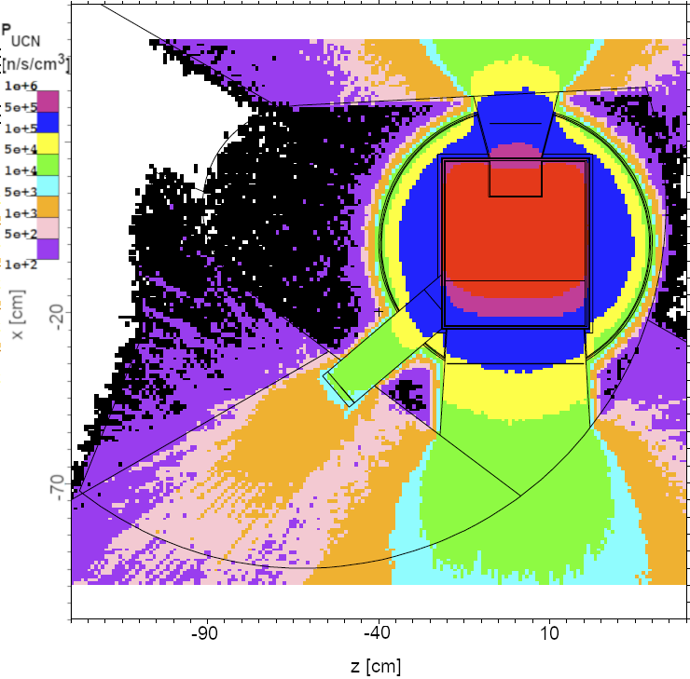
Designing the solid deuterium UCN converter with a channel - initial idea
  Selected as a reference model for the cylindrical channel option
    Replaced the spherical UCN converter with a 2 cm thick disc-shaped UCN converter filled with solid deuterium
      Now taking into account the scattering of cold neutrons in the solid deuterium within the UCN converter
        P_{UCN} = 1.10 x 10⁴ n/s/cm³
        NNBAR FOM = 2.41 x 10¹⁷ n⋅Å²/s/sr
        V = 0.91 l
        Prompt heatload = 60 W
Notes:
Aggiungi international collaboration

Slide 15
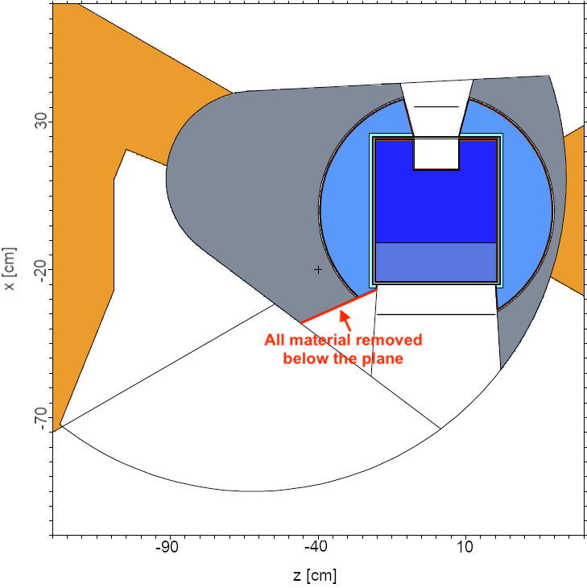
Designing the UCN converter with a direct view on the NNBAR emission surface
The previous results pointed out the possibility of designing the UCN converter with a direct view on the NNBAR emission surface
  All material was removed below a plane in the twister to accomplish that
Notes:
Aggiungi international collaboration

Slide 16
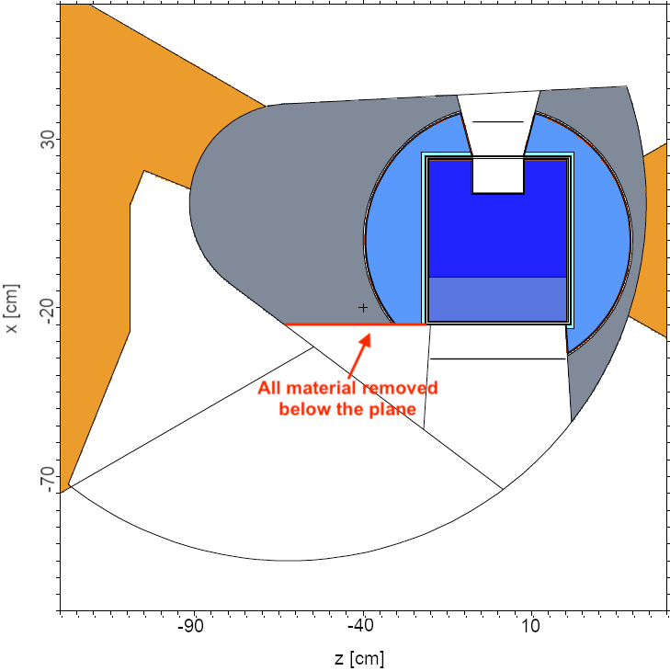
Designing the UCN converter with a direct view on the NNBAR emission surface
The previous results pointed out the possibility of designing the UCN converter with a direct view on the NNBAR emission surface
  All material was removed below a plane in the twister to accomplish that
Notes:
Aggiungi international collaboration

Slide 17
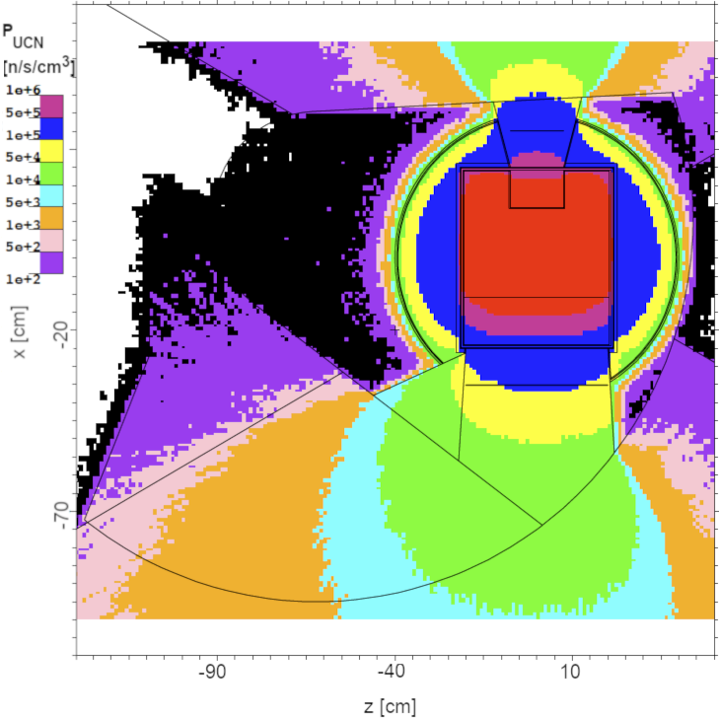
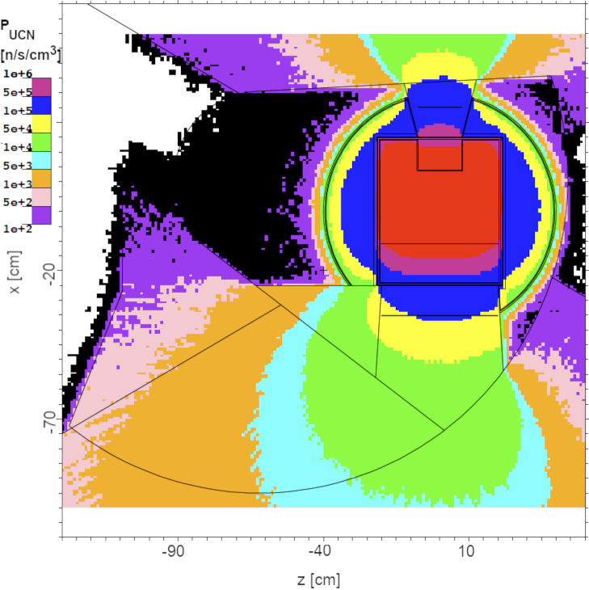
Designing the UCN converter with a direct view on the NNBAR emission surface
Map of P_{UCN} for both scenarios
Notes:
Aggiungi international collaboration

Slide 18
Designing the UCN converter with a direct view on the NNBAR emission surface
Map of P_{UCN} for both scenarios
About 10 % higher P_{UCN}
Notes:
Aggiungi international collaboration

Slide 19
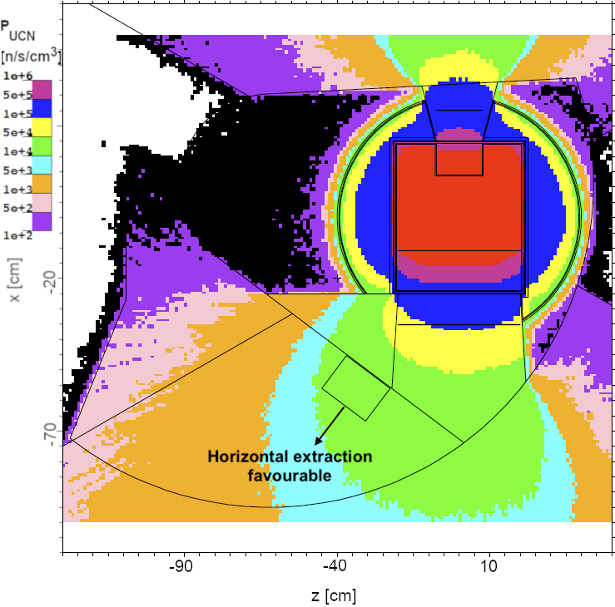
Designing the UCN converter with a direct view on the NNBAR emission surface
Placed the UCN converter to the green-shaded area in MCB. Can expect P_{UCN} of the order of 10⁴ in this region.
Notes:
Aggiungi international collaboration

Slide 20
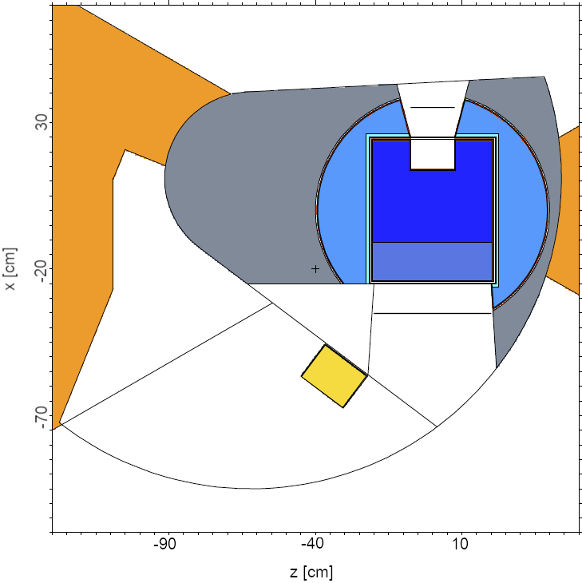
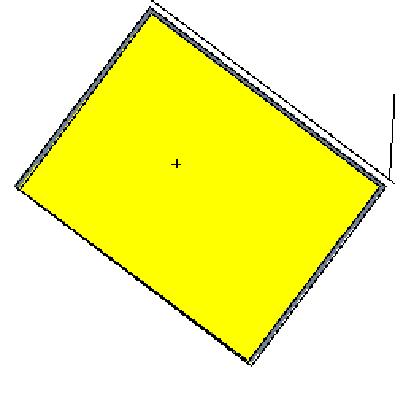
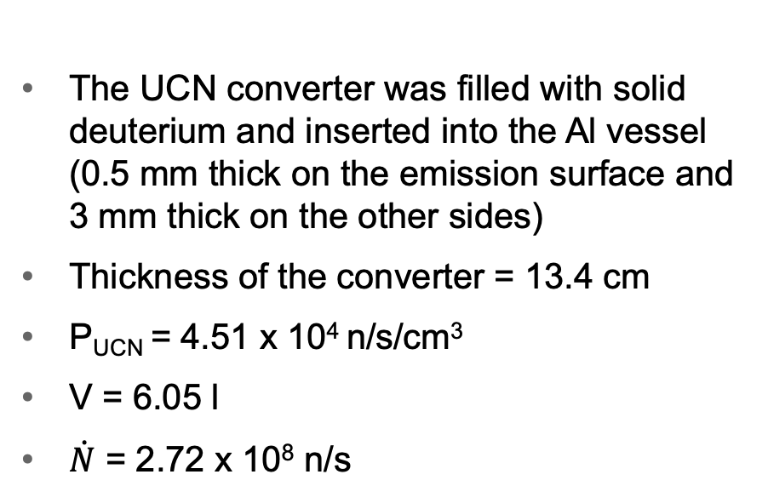
Designing the UCN converter with a direct view on the NNBAR emission surface
The UCN converter was filled with solid deuterium and inserted into the Al vessel (0.5 mm thick on the emission surface and 3 mm thick on the other sides)
Thickness of the converter = 13.4 cm
P_{UCN} = 4.51 x 10⁴ n/s/cm³
V = 6.05 l
$\dot{N}$ = 2.72 x 10⁸ n/s
The SD2 UCN converter inside the Al vessel
Notes:
Aggiungi international collaboration

Slide 21
Designing the UCN converter with a direct view on the NNBAR emission surface
The UCN converter was filled with solid deuterium and inserted into the Al vessel (0.5 mm thick on the emission surface and 3 mm thick on the other sides)
Total prompt heatload = 440 W
  Prompt heatload in the converter = 309 W
Total heatload photons = 200 W
Total heatload neutrons = 220 W
The SD2 UCN converter inside the Al vessel
Notes:
Aggiungi international collaboration

Slide 22
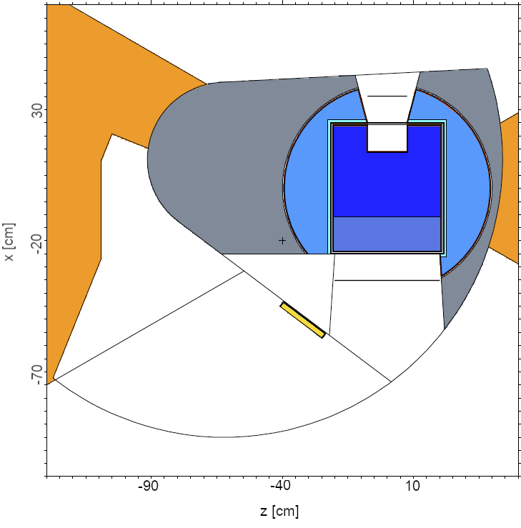
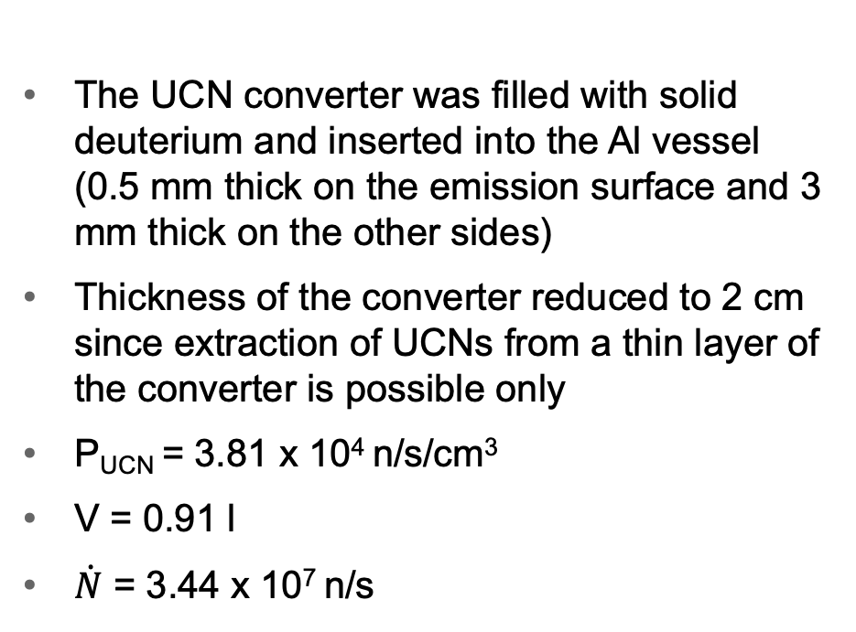
Designing the UCN converter with a direct view on the NNBAR emission surface
The UCN converter was filled with solid deuterium and inserted into the Al vessel (0.5 mm thick on the emission surface and 3 mm thick on the other sides)
Thickness of the converter reduced to 2 cm since extraction of UCNs from a thin layer of the converter is possible only
P_{UCN} = 3.81 x 10⁴ n/s/cm³
V = 0.91 l
$\dot{N}$ = 3.44 x 10⁷ n/s
The SD2 UCN converter inside the Al vessel
Notes:
Aggiungi international collaboration

Slide 23
Designing the UCN converter with a direct view on the NNBAR emission surface
Thickness of the converter reduced to 2 cm since extraction of UCNs from a thin layer of the converter is possible only
Total prompt heatload = 150 W
  Prompt heatload in the converter = 74 W
Total heatload photons = 80 W
Total heatload neutrons = 60 W
The SD2 UCN converter inside the Al vessel
Notes:
Aggiungi international collaboration

Slide 24
Designing the UCN converter with a direct view on the NNBAR emission surface
 | Beta particles | Gamma particles
Decay power Al vessel | 9.40 W | 13.5 W
Decay heat Al vessel | 6.61 W | 0.476 W
Decay heat SD2 converter | 1.22 W | 0.139 W
Total prompt heatload (Al vessel + SD2 converter) = 150 W
Calculating additional contribution to heatload due to the beta decay Aluminium 28 in the Al vessel:
  27Al + n → 28Al → 28Si* → 28Si
  The decay heat due to Al 28 beta decay was 9 W
About 70 % (6.61/9.40) of beta particles deposited their energy within the source cell (Al vessel). Most of the gamma particles escaped.
Notes:
Aggiungi international collaboration

Slide 25
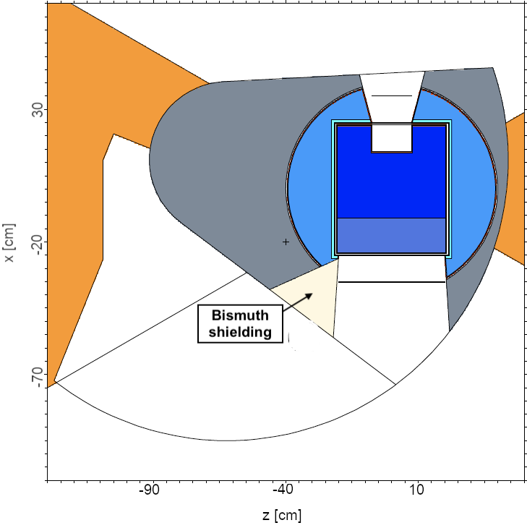
Testing a gamma shielding made of Bismuth
Photon flux
(arbitary units)
Notes:
Aggiungi international collaboration

Slide 26
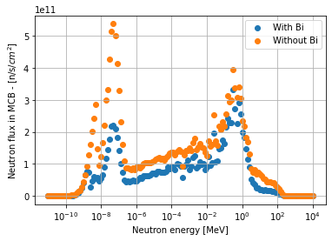
Testing a gamma shielding made of Bismuth
The gamma shielding was efficient but suppressed the spectrum of cold neutrons simultaneously.
  As a result, a large drop in P_{UCN} can be expected since the cold spectrum of neutrons contributes to the UCN production cross-section.
Notes:
Aggiungi international collaboration

Slide 27
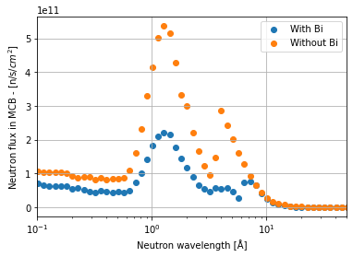
Testing a gamma shielding made of Bismuth
The gamma shielding was efficient but suppressed the spectrum of cold neutrons simultaneously.
  As a result, a large drop in P_{UCN} can be expected since the cold spectrum of neutrons contributes to the UCN production cross-section.
Notes:
Aggiungi international collaboration

Slide 28
Summary of the presentation
(i) A location of moderator moderator cooling block in the baseline model
(ii) Calculating P_{UCN} using the UCN production cross-section in SD2
(iii) Designing the UCN source (SD2 converter) with a cylindrical channel through twister
(iv) Designing the UCN source (SD2 converter) with a direct view on the NNBAR emission surface
(v) Testing the gamma shielding made of Bismuth
Notes:
Aggiungi international collaboration

