Slide 1
Brightify: A tool for calculating brightness in neutron sources
Mina Akhyani
This project has received funding from the European Union’s Horizon 2020 research and innovation programme under the Marie Skłodowska-Curie grant agreement No. 754354.
24th March 2023

Slide 2
Content
Brightness/brilliance
Liouville’s theorem
Methods for brightness calculation
Methodology of Brightify
Applications of Brightify

Slide 3
Definition Brightness / Brilliance
For neutron sources, the terms ‘brightness’ and ‘brilliance’ are used interchangeably
Given in the units of [n cm⁻² s⁻¹ sr⁻¹ ] or [n cm⁻² s⁻¹ sr⁻¹ Å⁻¹ ]
In simulations:
in the units of [n p⁻¹ cm⁻² sr⁻¹ ] and [n p⁻¹ ] can be converted to [n s⁻¹ ] by proton/particle current.
The relative error for the brightness value:
$$r.err= \frac{σ}{\sqrt{N}\overline{X}}=\frac{\sqrt{\frac{\sum_{i=1}^{N}{{(w_{i}/\overline{w})}^{2}−N\overline{X^{2}}}}{N−1}}}{\overline{X}\sqrt{N}}$$

Slide 4
Brightness: constant of motion Liouville’s theorem
“The particle phase-space distribution function is constant along the trajectories of the system—that is, the density of system points in the vicinity of a given system point traveling through phase-space is constant with time.”
The phase space distribution is the neutron flux per unit area per unit solid angle and this is the definition of brightness, so the brightness is a constant of motion.
The brightness remains constant while transferring by an ideal guide from the moderator to the sample.
It can act as a figure of merit for neutron source optimization.

Slide 5
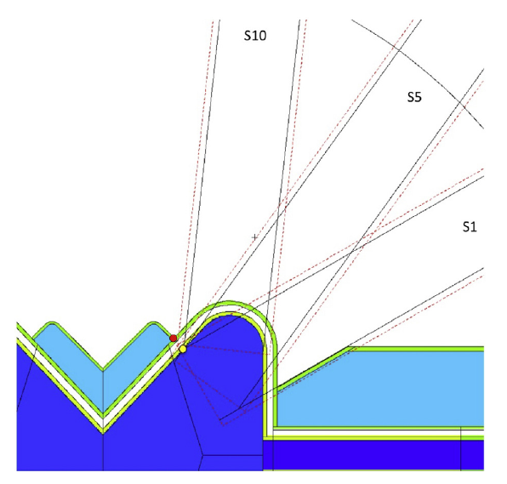
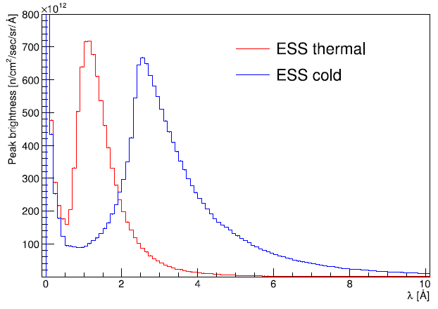
Brightness in simulations
There is no direct and unique way to calculate brightness in the simulations:
Perturbed brightness (presence of an extraction window on the moderator)
by a point tally in a distance which is far enough compare to the dimension of the moderator
Limitations:
requires collimator definition.
needs to transport particles to a far distance and can be potentially computationally heavy
Type of particle (only photons and neutrons)
High energy range limitation
*Nuclear Inst. and Methods in Physics Research, A 925 (2019) 33–52

Slide 6
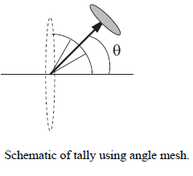
Brightness in simulations
There is no direct and unique way to calculate brightness in the simulations:
Unperturbed brightness (no extraction window)
By surface-crossing tally and measuring angular current
Limitations:
only measures wrt the normal to the surface of the defined tally
Depends on the shape of the tally
*DOI: 10.1016/j.nima.2013.07.031
* PHITS manual

Slide 7
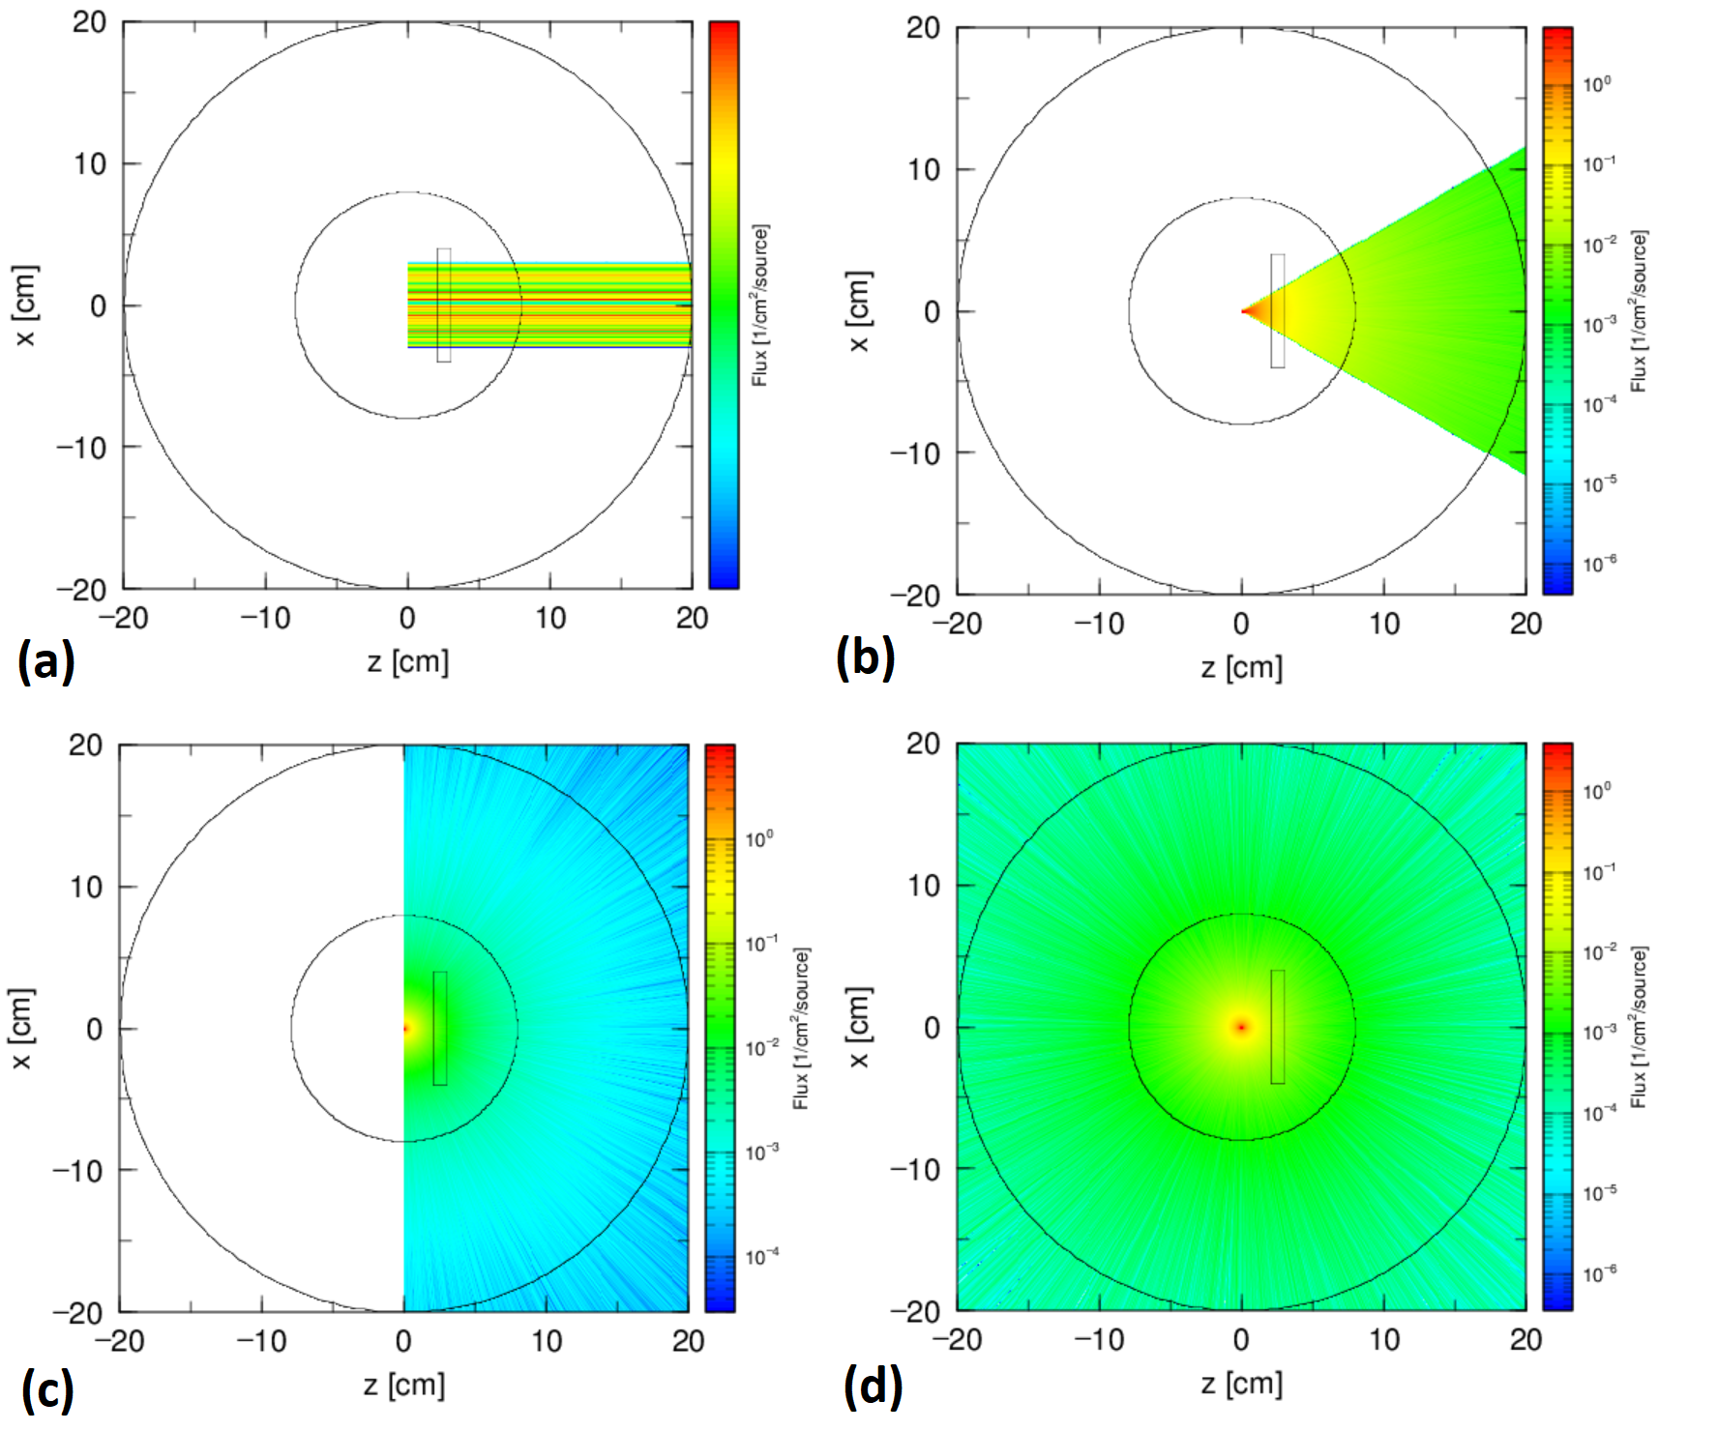
Two methods in practice
Parallel beam
A dome source with 30 degree opening solid angle
Hemisphere source
Isotropic source
Method 1:
a tally 5 m away covering a solid angle 2π.cos(10°)
Method 2:
a tally 2 cm away calculating angular current within 10 degrees.
 | Method 1 | r.err | Method 2 | r.err
(a) | 9.9991e-1 | 0.0 | 9.9991e-1 | 0.0
(b) | 1.1333e-1 | 0.0051 | 1.1429e-1 | 0.0051
(c) | 1.5233e-2 | 0.0147 | 1.5356e-2 | 0.0146
(d) | 7.7333e-3 | 0.0207 | 7.7900e-3 | 0.0208

Slide 8
The bothering part! Inconsistency
4
The direction of the beam is $30°$ wrt to the z-axis (normal direction of the first tally)
The angular current is calculated within $10°.$
beam
$$θ=30°$$
 | Tally Value | r.err
1 | 0.0 | 0.0
2 | 5.5634E-01 | 0.0016
3 | 9.9834E-01 | 0.0
4 | 9.9834E-01 | 0.0
1
2
at 2 cm
at 20 cm
3
at 200 cm

Slide 9
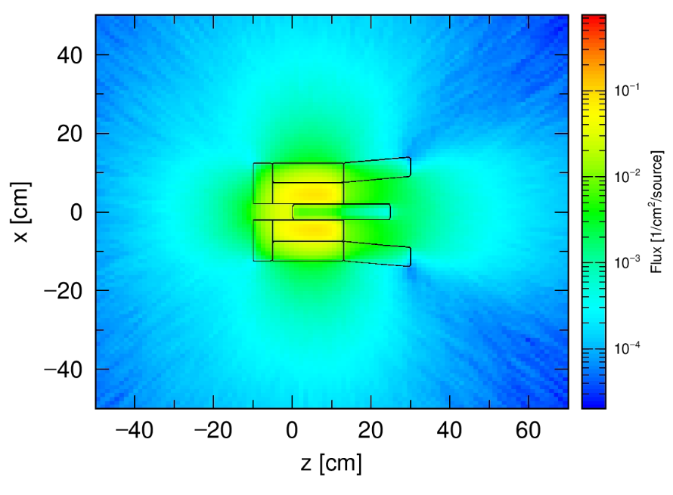
A need for a consistent computational tool for brightness calculation
Neutron guide
Brightify is going to answer a typical question:
where should we put the guide in order to receive the maximum number of neutrons?

Slide 10
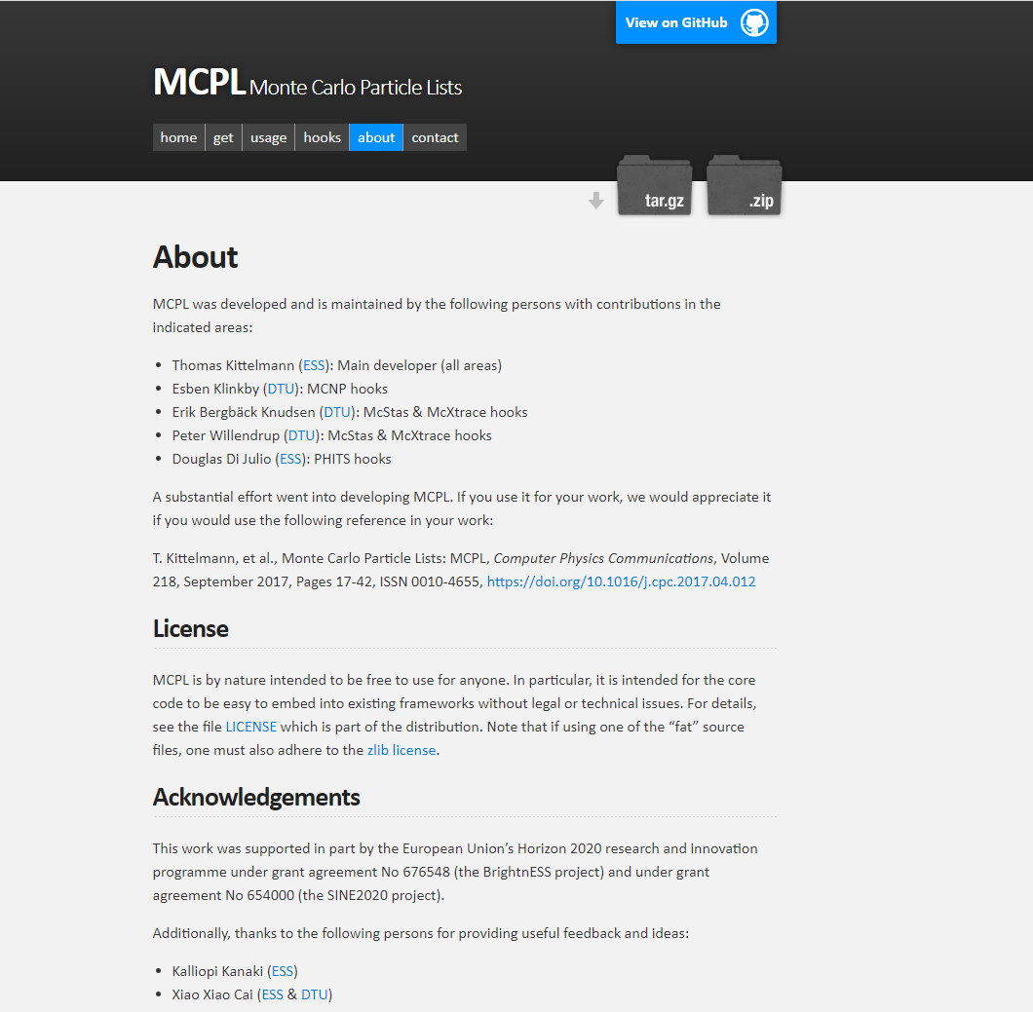
Prerequisite
Mctools.github.io/mcpl
* DOI: 10.1016/j.cpc.2017.04.012

Slide 11
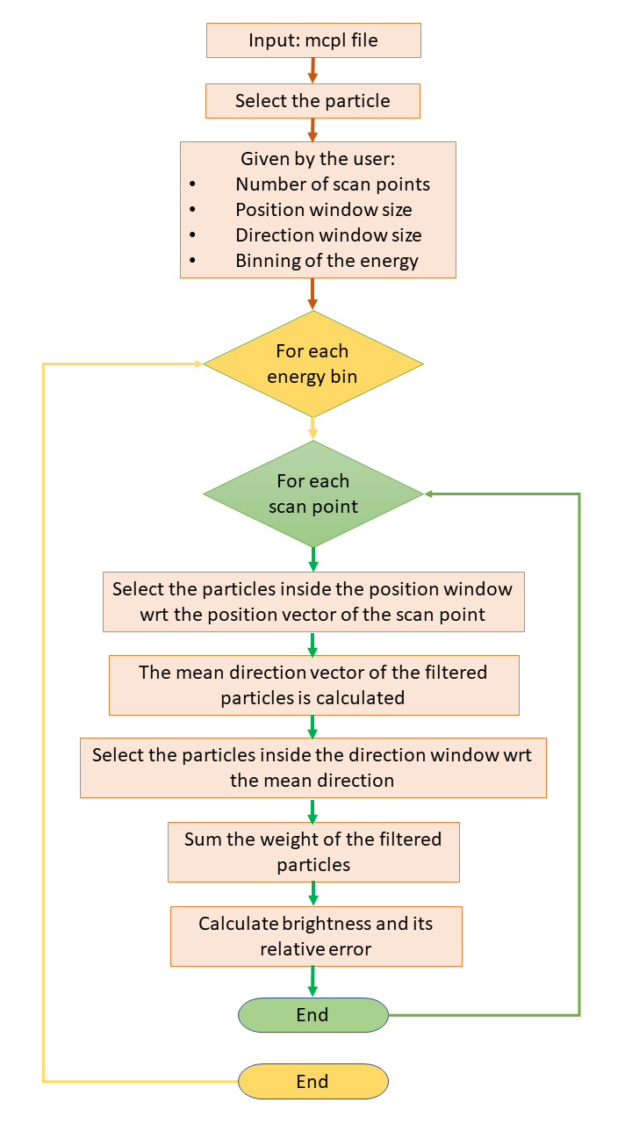
How the brightness tool works?
Assume we have a TMR assembly and neutrons are coming all in 4π
we dump all the neutrons on a sphere around the TMR
We are going to scan this sphere with selected scan points
The neutron guide can transport neutrons
in a limited area (position window)
In a limited divergence (direction window)
In each scan point, a selection of neutrons will be done.
The population of neutrons for each scan point will appear by a color in the figure.
The scan point which has the maximum number of neutrons corresponds to the maximum brightness.

Slide 12
Back to the examples we had before
 | Method 1 | r.err | Method 2 | r.err | Brightify | r.err
(a) | 9.9991e-1 | 0.0 | 9.9991e-1 | 0.0 | 1.0 | 0.0018
(b) | 1.1333e-1 | 0.0051 | 1.1429e-1 | 0.0051 | 1.1334e-1 | 0.0054
(c) | 1.5233e-2 | 0.0147 | 1.5356e-2 | 0.0146 | 1.524e-2 | 0.0148
(d) | 7.7333e-3 | 0.0207 | 7.7900e-3 | 0.0208 | 7.7e-3 | 0.0208

Slide 13
Back to the examples we had before
4
 | Tally Value | r.err | Brightify Value | r.err
1 | 0.0 | 0.0 | 1.0 | 0.0018
2 | 5.5634E-01 | 0.0016 | 1.0 | 0.0018
3 | 9.9834E-01 | 0.0 | 1.0 | 0.0018
4 | 9.9834E-01 | 0.0 | 1.0 | 0.0018
beam
$$θ=30°$$
1
2
3

Slide 14
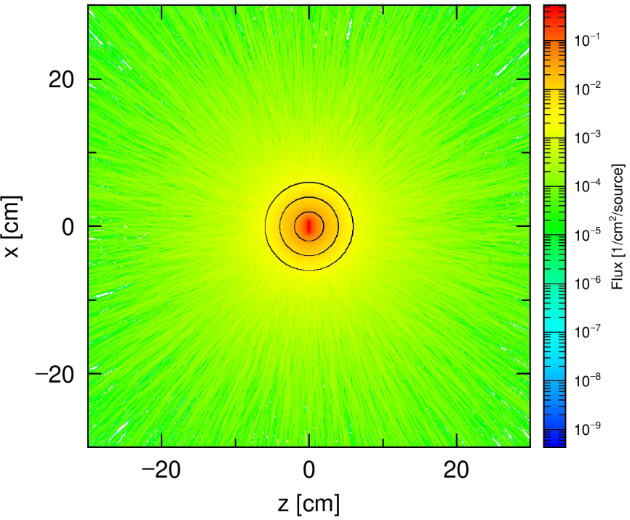
Case-Study No.1 Point source
1 MeV point source in the center of 6-cm spherical H2O moderator
Brightness map for
different energy ranges

Slide 15
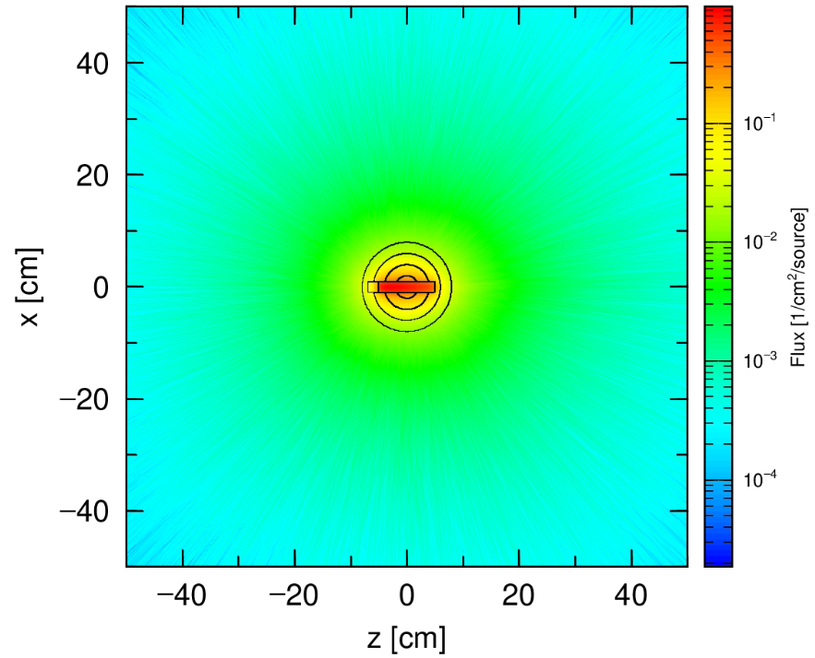
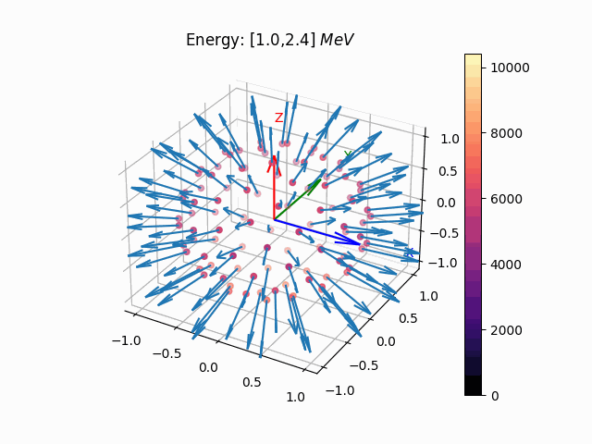
Case-Study No.2 Superfast (> 1 MeV) neutron brightness
moderator
2 GeV beam
target
2 GeV proton beam shooting into a tungsten target inside a 6-cm radius spherical water moderator

Slide 16
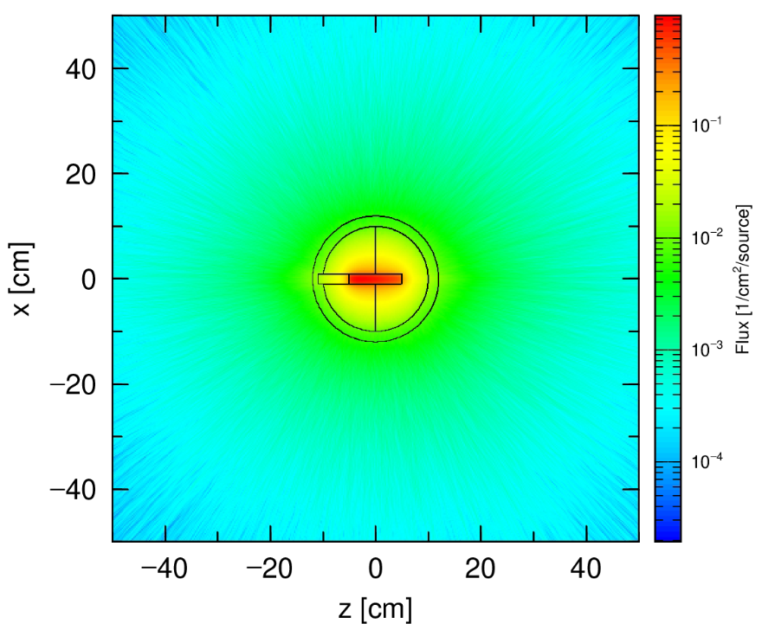
Case-Study No.3 2 GeV beam, Bispectral moderator
H2O moderator
(300 K)
2 GeV beam
H2O moderator
(20 K)
target

Slide 17
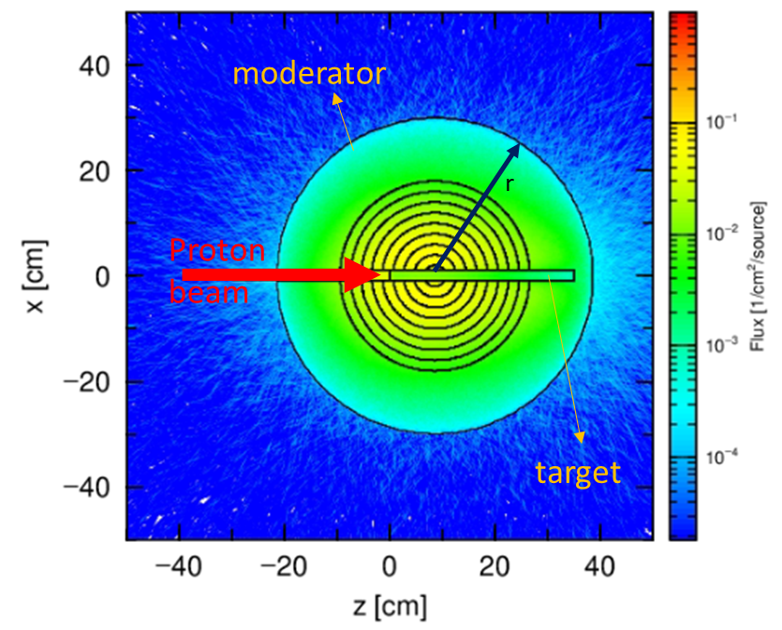
Case-Study No.4 brightness inside the moderator
Brightness for 5 MW, 2 GeV proton beam, 3e5 nps, 50 cm2 position window, 0.018 sr direction window

Slide 18
Conclusion
Brightify is developed for calculating brightness. It is based on MCPL file (independent of the MC code)
By the developed tool, the brightness can be calculated:
on any surface
in any distance
for any energy range
for any particle
by flexible mesh size in phase-space
Brightify can help to optimize the source design directly based on brightness rather than the flux.

Slide 19
Thank you for your attention!
If you find this tool useful,
here is my contact ☺
Email: Mina.akhyani@epfl.ch

Slide 20
Sensitivity to the position window mesh size

