Slide 1
Cryostats and Magnets for MPS
STAP meeting April 2023
PRESENTED BY Alex Holmes

Slide 2
Agenda
1 Pumping cart
2 Bifrost cryostat
3 8T magnet
4 Warm bore magnet
5 15T magnet
6 Spectroscopy magnet
7 Cryostats
8 Other projects
9 Helium Management (JF)

Slide 3
Acknowledgements
Many thanks to:
  Richard Ammer
  Philipp Arnold
  Niklas Ektröm
  Xavier Fabrèges
  Jarek Fydrych
  Andreas Hagelberg
  Karl Hampus Lenton
  Hal Lee
  Karl Hampus Lenton
  Laurence Page
  Anders Pettersson
  Tobias Quispe
  Nathalie de Ruette
  Lauritz Saxtrup
And of course the guidance and support of Caroline Curfs
Not forgetting the valuable wisdom from the STAP members and input from many other ESS staff.

Slide 4
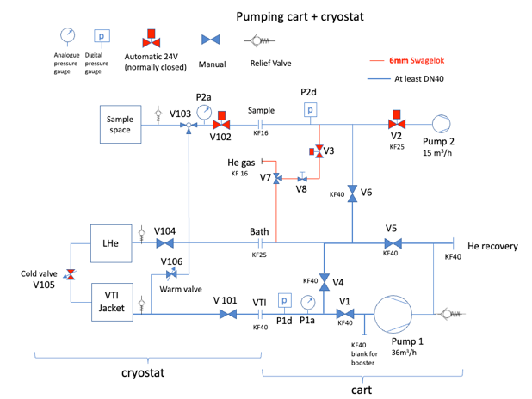
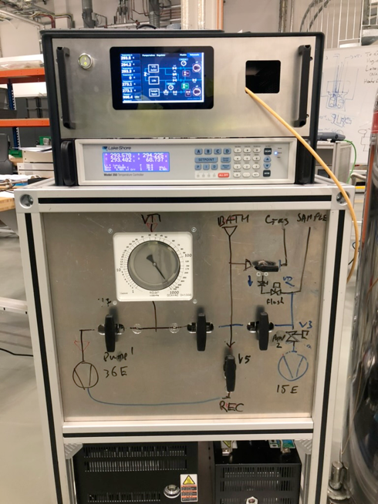
Pumping cart
Prototype tested and working
Key features:
  Modular - Electronics & gas handling racks separate. Can be operated without PLC.
  Analogue & digital gauges for easy monitoring
  Automation via Beckhoff/LS336/octopy of needle valve and flushing cycle
  Touch screen interface
  Manual valve state readable at a glance
  Separate VTI and sample space pumps.
  (36/15 m³/h)
  Semiautomated pump/ flush of whole system during preparation
  To do – integrate LN2 & He monitoring
  Now building first 5 more (with vacuum group help)

Slide 5
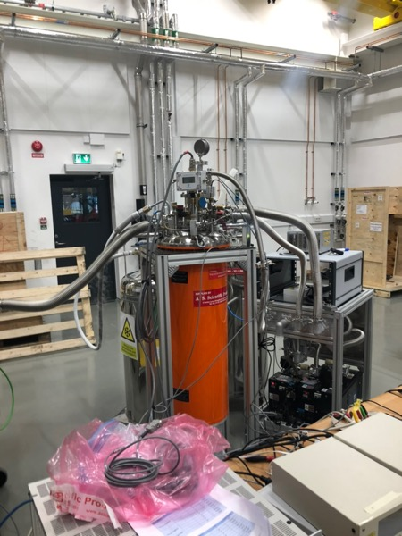
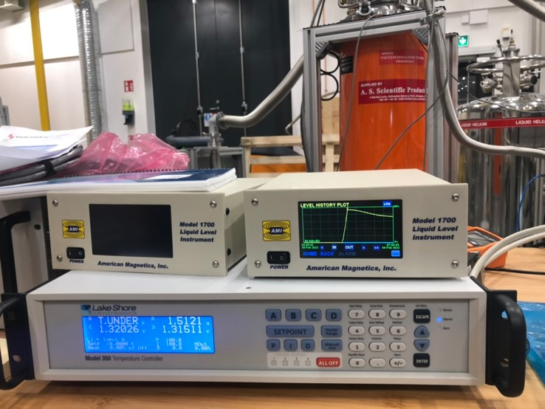
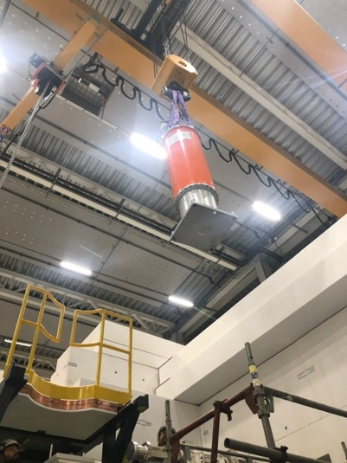
BIFROST cryostat
SAT passed - finally
Two rounds of fixing –dimensions of tail & leak (due to indium seal between OVC and VTI insert).
Tested, with new pumping cart.
Base temperature of 1.32K reached at heat exchanger (assuming calibration is correct, definitely <1.4K)
  Mechanical integration complete and test mounted on BIFROST instrument stack.
Needle valve motor remains to be integrated into ESS Beckhoff control (or replaced with ESS standard motor).

Slide 6
8T Magnet
LLB in-kind contribution to ESS
  Critical Design Review passed 11/4
  Manufacture now starting
  Delivery due July 2024
  Discussions with Quality division prompted a lot of internal debate, hopefully leading to workable rules
Dilution insert: Tender in preparation (XF@LLB)

Slide 7
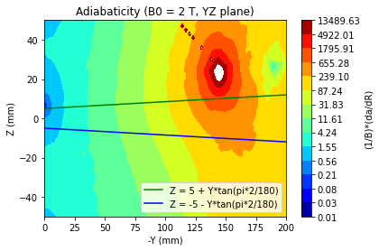
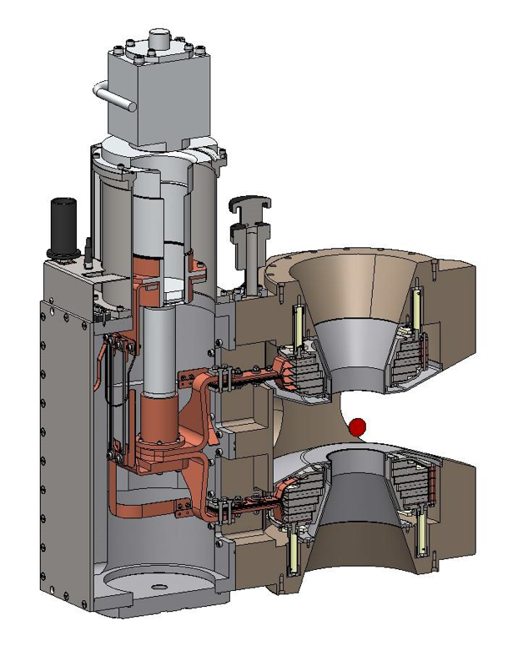
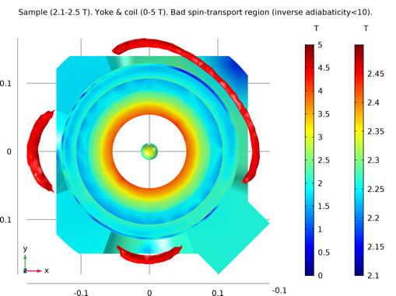
Warm bore magnet
2.1 T Assymmetric warm bore for ESTIA, LOKI, SKADI (and others)
Based on TOFTOF magnet design with updated for polarisation compatibility
Design study completed by HTS110, significant help from Hal Lee, Artur Glavic.
Settled on pure assymmetic system
Full procurement to be released imminently
Delivery Q3/24

Slide 8
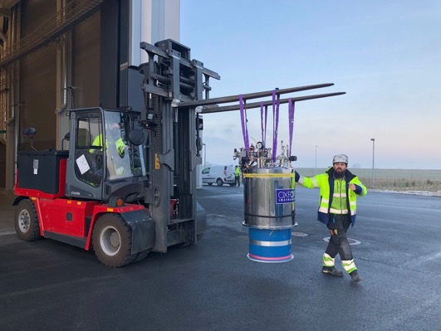
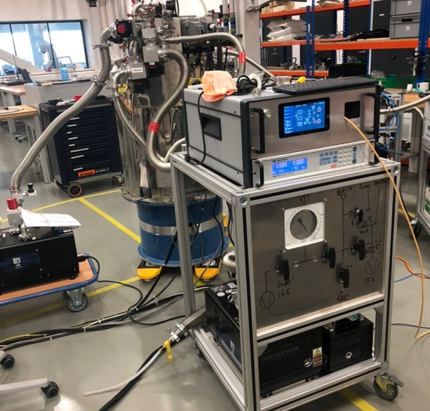
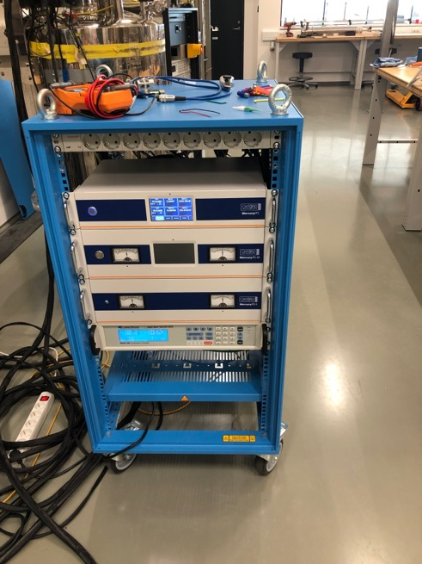
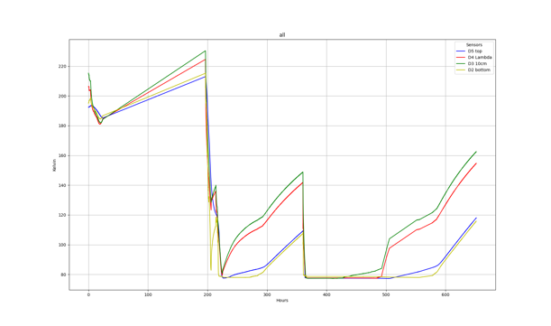
15T Magnet (ex HZB VM1B)
To be used on Bifrost
Refurbished (fresh MLI on tail, new o-rings
Dry run carried out moving to cold box hall to be able to recovery helium during cooldown – deemed a bit too risky (forklift rebooted!!).
Leak tested at 300K
Precooled with Nitrogen, leak tested at 77K
Cart with Mercury controllers set up and integrated into octopy.
Full cooldown to be done once helium recovery available in E03 (next few weeks)

Slide 9
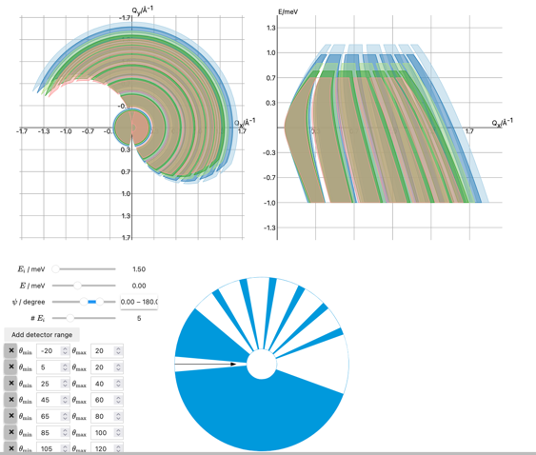
Spectroscopy Magnet
Next new magnet – a novel high field magnet for direct geometry spectroscopy
Kick-off meeting held with ESS instrument stakeholders.
Tool from Greg Tucker (DMSC)
Priority from instruments (CSPEC, TREX) is low background and high field, more than largest possible aperture.
Traditional designs have thick Al rings to support forces between coils – high background.
Newer designs (e.g. 8T magnet) have open segments, at expense of field or coverage.
Time of Flight means some obstructions in openings can be tolerated without loss of too much (q,E) coverage. Broad spectroscopic features can be fitted even with some missing data.
➙ Radial supports.
https://g5t.github.io/tof-tools/lab?path=accessible.ipynb
Preliminary discussions with OxInst. Design study quoted, to be started ASAP followed by open procurement.
Notes:
How to do procurement

Slide 10
Pool & Instrument Cryostats
Cryo meeting held – information gathered from instrument stakeholders
Instrument | Type | Top/floor loading | Interface | Tail/ window material | Rotation (Insert/ stack) | Other alignment | ULT | Cryofurnace | Typical measurement time | IVC size | Special geometric constraints | No OVC option? | Compatibility group
ODIN | IMG | FL | L0 | Al | Stack rotation available, stick needed also. | XYZ | N | Y | hours |  | Close as possible to detector | N | 1?
MAGIC | DIFF | FL | L0 | Al | stick | XYZ stage below equipment. Sample in rotation centre. Cryostat needs alignment too. | Y | N <5% >300K | Measurement2-3h, expt days. | 50mm | Coils - reduced tail. 120mm diam | N | 1
BIFROST | SPEC | FL | Own/L1 | Al | Stack | no | Y | N | 1-7 days | 70mm | none | N | 1
CSPEC | SPEC | TL/FL | L1*,L2 | Al | Insert | Fixed xyz | Y | Y | Measurement hours, expt days | 70mm | 700mm diam | y | 1,2
MIRACLES | SPEC | TL | L3* | Al | insert | Fixed xyz | y | y |  | 70mm | 400mm pot | n | 2
TREX | SPEC | TL | L1 | Al | Insert | Fixed xyz | Y | y |  | 70mm | Coils – need response | y | 2
LOKI | SANS | FL | L1 | Si | Stack Could be done but no rotation stage yet | Xyz motor | (y) | (y) | 20 mins | 50mm | Same as odin. Fit in WMB <80mm. | n | 3
ESTIA | REFL | FL | L2 | Sapphire (optical alignment), Al or Si ok for diff. | Stack | Hexapod L2, rotation L1, L0 fixed | N | Y | Hours-minutes |  | Side loading flow. 2nd spin filter limits size |  | 3
FREIA | REFL | FL | L2 | Si |  |  |  |  |  |  |  |  | 3
SKADI | SANS | FL | L1/Lsans | Si | Stack | Xyz motor | Y | y | Minutes-Hours | 70mm | GSANS standard sample size is 2 inches. | no | 3
BEER | ENG | FL | L0 | V |  |  |  |  |  |  |  |  | 4
DREAM | POWDER | TL/FL | L2 | V | Insert | Fixed xyz (tank) | ~n | Y | Hours-minutes |  | 700mm tank diam. | no | 4
HEIMDAL | POWDER | TL/FL | L1 | V | Stack? |  |  | Y |  |  | Dream+sans |  | 4
VESPA | SPEC | TL | own | Al | No but fixed orientation | Fixed xyz | N | Y | 5min-6hour, 30 mins- 2 hours sample changes | 100mm | Special geometry |  | 5
NMX | MX | FL | own | Al | other |  |  |  |  |  |  |  | own

Slide 12
Pool & Instrument Cryostats
Oleksiy Zadorozhko to be main cryo responsible after 29/5
Instrument specific:
BIFROST Delivered and tested
MAGiC – MLZ refurbished Variox with ESS cart (possiblity for additional dilution)
ESTIA – Flow cryo PSI procurement starting June with help from PSI SE group
DREAM 20 position cryofurnace in progress by instrument team. 2x Orange Cryofurnaces coming from LLB.
CSPEC tender in preparation, limited engineering support available.
Others/Pool :
Dry cryo for diffraction & electrochemistry
Tender still in preparation 🫣
Framework agreements to be set up, starting with dry systems – task for OZ supported by ATH, JF.
ULT - OZ

Slide 13
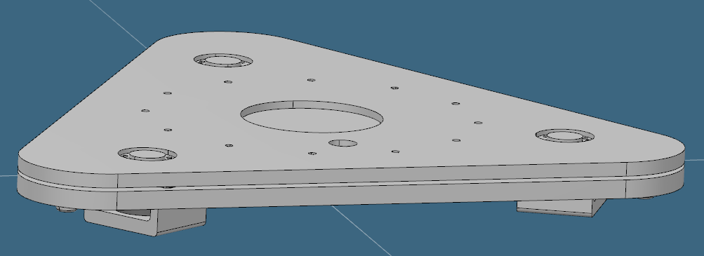
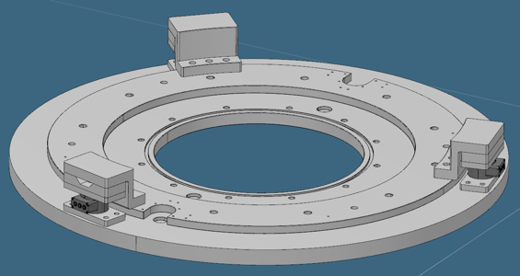
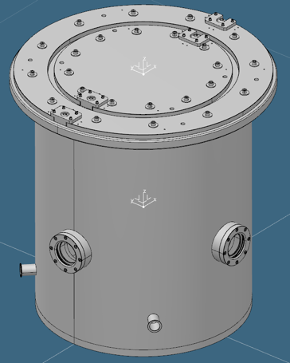
Other cryo/magnet related projects
In progress
  Sample stick rotation stages for 50/70mm cryostats/magnets
  (drawings being finalised)
  Magnetic force testing rig
  (drawings finalised, transducers bought, manufacture ready to go)
  Vacuum interface testing vessel
  (consultation with manufacturer done, design complete, being reviewed)
  Extra Huginn & adaptation to OC
  (Stick with IVC done and leak tested, 2nd Huginn assembled and in testing, software move from Utgård to E03 not trivial but now tested)

Slide 14
Helium Management
Slides from JF

Slide 15
Finish presentation

