Slide 1
Polarisation Project in MPS
Wai Tung (Hal) Lee

Slide 2
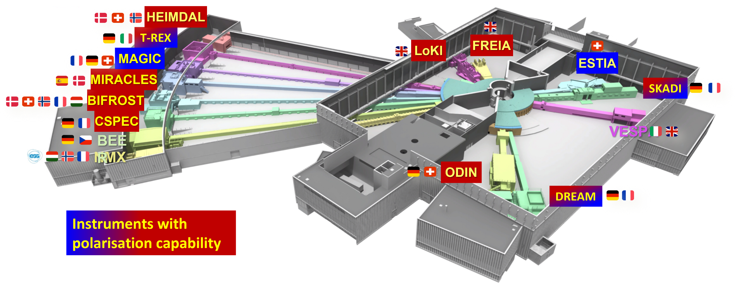
Polarisation Project in MPS
Science cases established (ESS Polarisation Workshop Report, 21-22 September 2020).
12 of the 15 approved ESS instruments will provide polarised neutrons.
Polarisation project supports 10 instruments, together with in-kind contributions and external grants.
Project incorporated into the ESS rebaselined plan for 2022-2027.

Slide 3
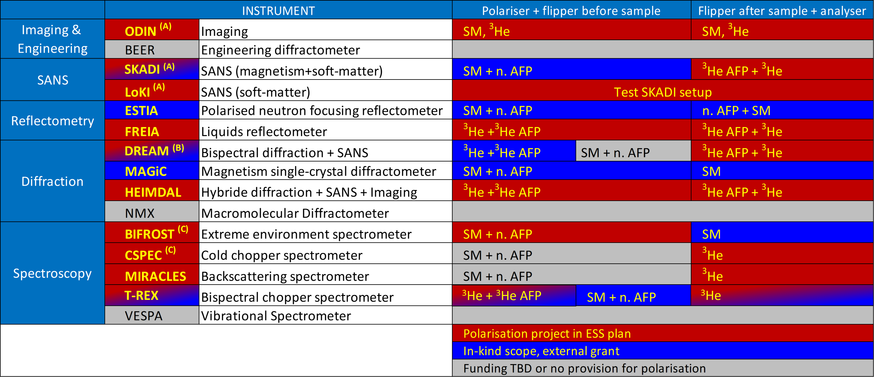
Techniques for each instrument
Polarisation equipment: polarizer, analyser, spin-flippers, guide field.
Grant acknowledgement:
(A) W.-T. Lee, E. Blackburn, T. Nylander, D. Orlov, et. al., Tillväxtverket European Regional Development Fund project SREss3 (2020-2023).
(B) M. Feygenson, E. Babcock, W. Schweika et. al, Röntgen Ångström Cluster: nPDFSAS (grant no 2019-06117_VR)
(C) E. Blackburn, M. Månsson, W.-T Lee, G. Nilsen, P. Deen, R. Toft-Petersen, M. Pascal, Swedish Research Council (VR) “Cooperation with ISIS: instrumentation and methods for ESS” Grant # 2021-06157.

Slide 4
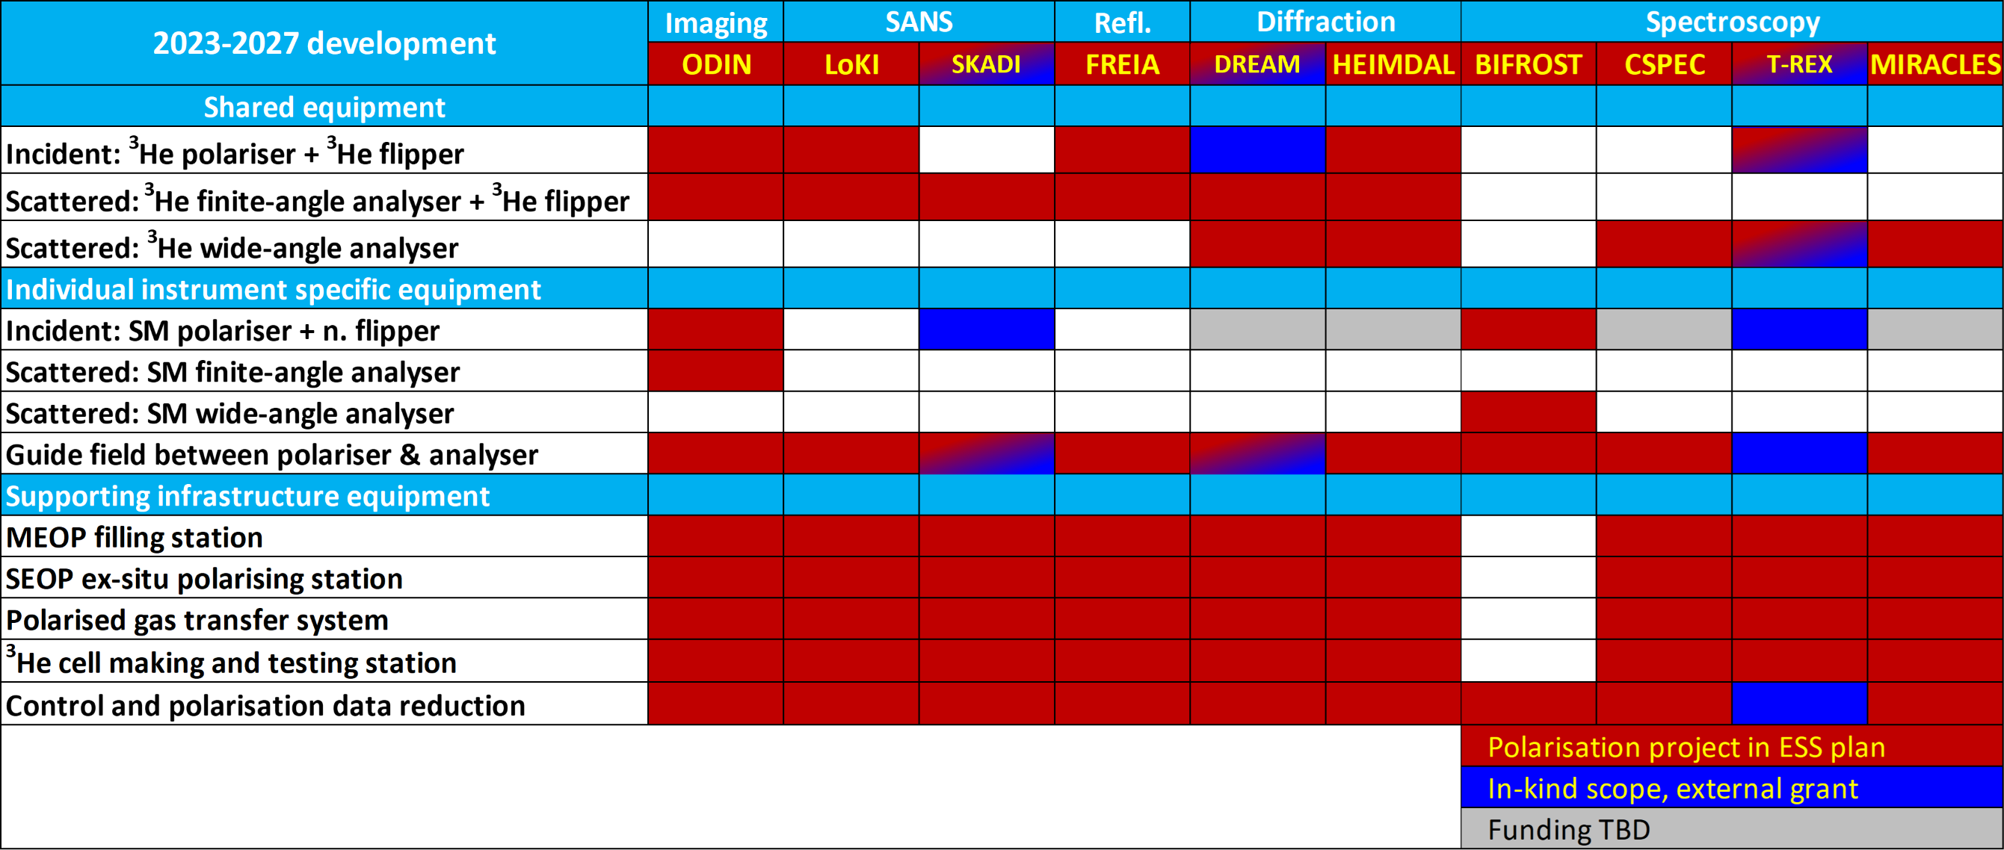
What we build
Shared and dedicated equipment, control and data reduction software.
Multiple copies of shared equipment to support 3 simultaneous experiments.

Slide 5
How we proceed
1. Parallel project to instrument construction projects.
2. Tollgates: Preliminary design, final design, procurement, construction, installation, commission.
3. Ensure the instrument construction projects are not compromised.
Project schedule anchor to instrument construction TG5 & Hot Commissioning.
  Installation to start after instrument TG5, i.e. completion of installation.
  Hot commissioning as the last item of instrument hot commissioning.
  Only proceed when instrument team gives ‘go ahead’
Project’s own resource for design, procurement, construction, test and installation.
  Outsource works to universities, other labs to reduce demand on ESS staff.
Other staff involvement
  During design, procurement, construction, test:
    Once a month coordination meeting with instrument scientist(s) of an instrument. Other staff invited based on the issues at hand.
    Keep to a minimum of information request for parameters critical for design.
  Tollgate reviews – instrument team, staff with relevant expertise.
  Installation assistance – instrument team, staff with relevant expertise (e.g. metrology, rigging, if needed).
  Hot commissioning assistance – instrument team, staff with relevant expertise.

Slide 6
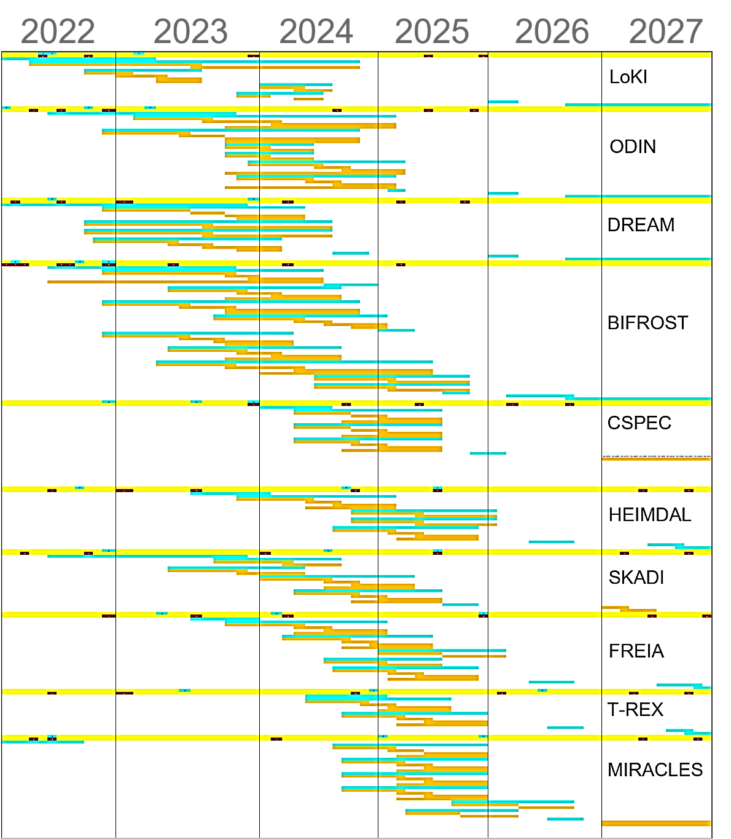
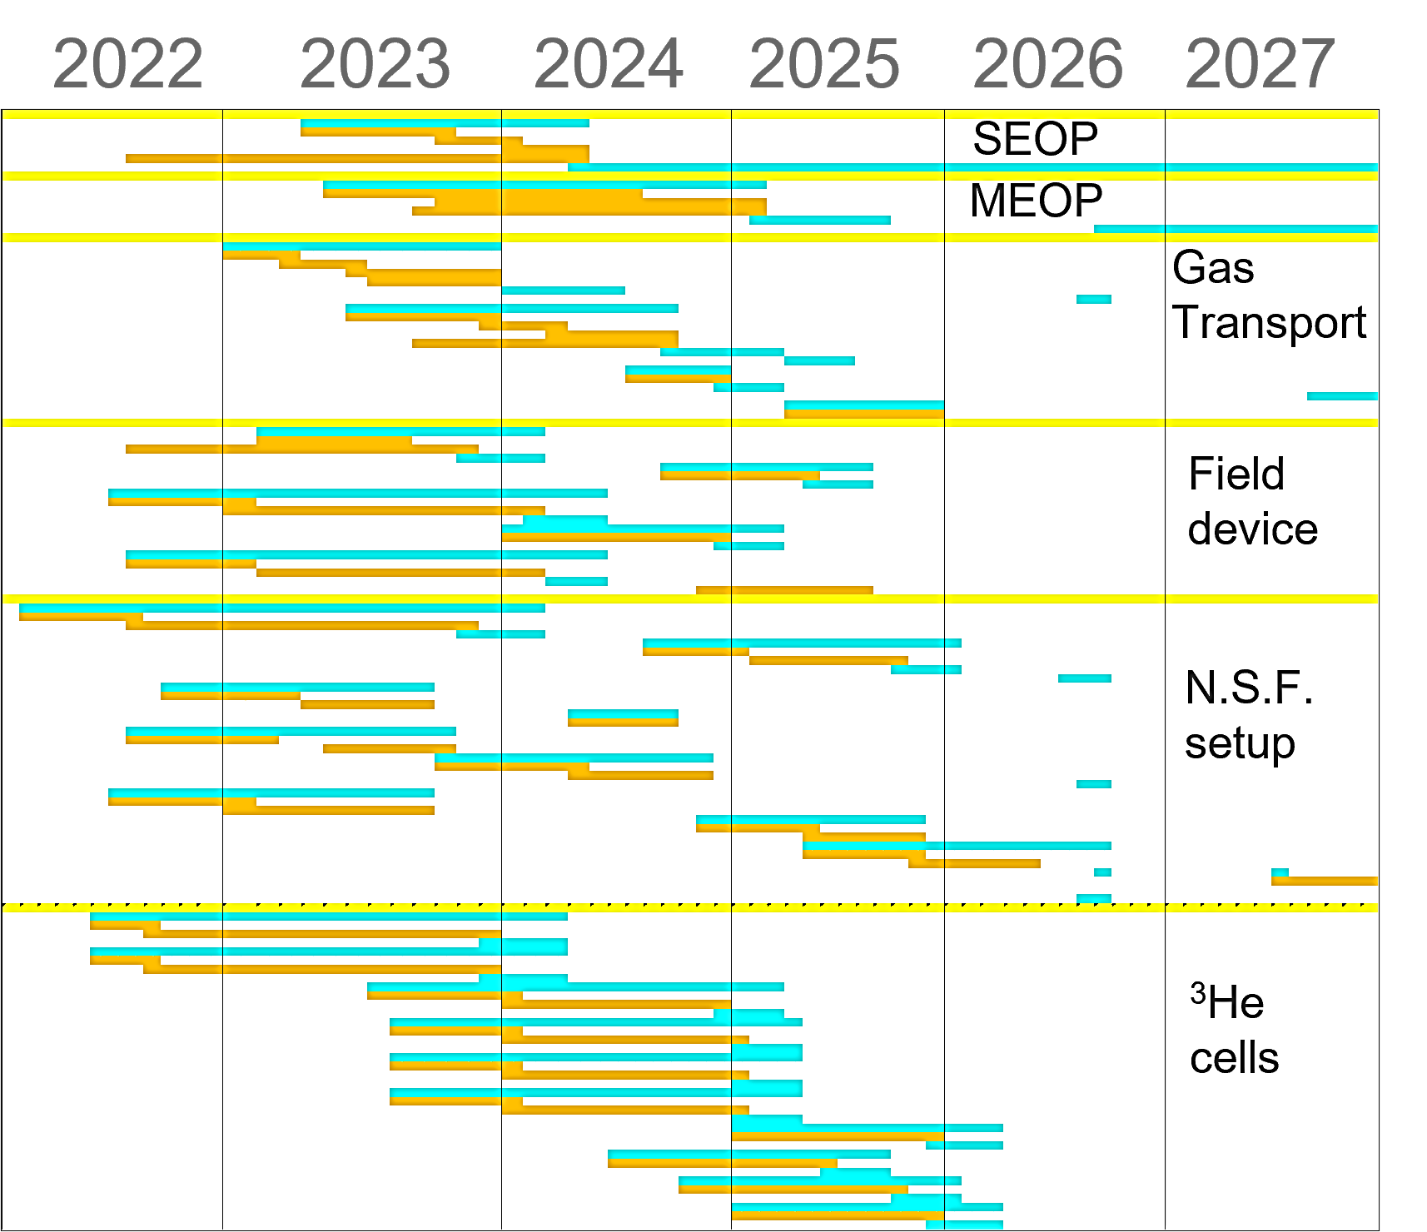
Project schedule: 2022-2027
Anchor to instrument TG5 & hot commissioning.
2023-2025 design, construction, test
2025-2027 installation, commissioning, operation
MEOP filling station: installation 2025-2026.

Slide 7
People
MPS
Hal Lee
  Subject matter expert, project manager
Joel Hagman
  Magnetic field & mechanical design & construction
MPS staff
  Support on case-to-case basis.
Annika Stellhorn (joint post-doc with Lund University, join ESS 1/9 as instrument scientist)
  Magnetic field design for SKADI, LoKI
  Polarised SANS data analysis
  Scientific experiments – feedback to instrumentation design
Alex Backs (joint post-doc with Lund University)
  Magnetic field design for ODIN
  Scientific experiments – feedback to instrumentation design
Johan Ranstad (designer, in-kind project with Lund University)
  Start in May for 10-11 months
Other groups
Instrument teams
  Monthly coordination meeting
  Short Q&A on critical design parameters
Peter Willendrup (DMSC)
  McStas code development for polarisation
Damian Martin Rodriguez (CLS)
  BIFROST, MIRACLES, ODIN polariser simulations.
Celine Durniak + instrument data scientists
  Data reduction & data analysis
ECDC, MCA
  Equipment control integration
  Additional dedicated staff for polarisation planned from 2024 & 2025.
  Outsourcing design works to universities and other labs.

Slide 8
Collaborations & grants
Tillväxtverket SREss3 grant
  2021 – 2023, just completed in March. Joint project with Lund University.
  0.5 FTE of 2 post-docs and 1 engineer to work on polarisation for SKADI / LoKI, ODIN.
On-going: Swedish Research Council “Cooperation with ISIS: instrumentation and methods for ESS”
  2022-2025. Joint project with Lund University, Royal Institute of Technology.
  Equipment for BIFROST, CSPEC, WISH (ISIS), PhD student and postdoc.
Swedish in-kind project
  2023-2025. Partners from Lund University, Royal Institute of Technology, Uppsala University.
  Contributes a wide range of polarisation equipment defined in the Polarisation Project.
  Magnetic field setup, neutron spin filter devices, instrument specific tasks for 8 instruments.
ESS-ILL collaboration
  2023-2026. Build filling station to supply polarised ³He gas for experiments.

Slide 9
Status
Dedicated staff on board – Joel Hagman. In-kind project designer begin on 1st May.
Mostly in design stage: Field calculation, McStas simulation, mechanical design, preliminary design – equipment layout. Building: 1st field coil, guide field prototype, lab-based polariser.

Slide 10
Status

Slide 11
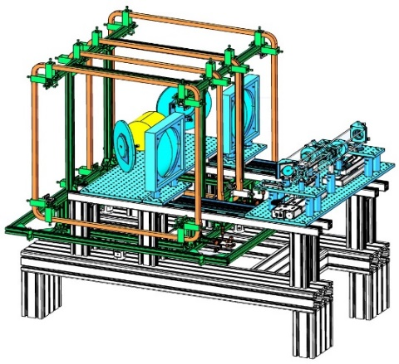
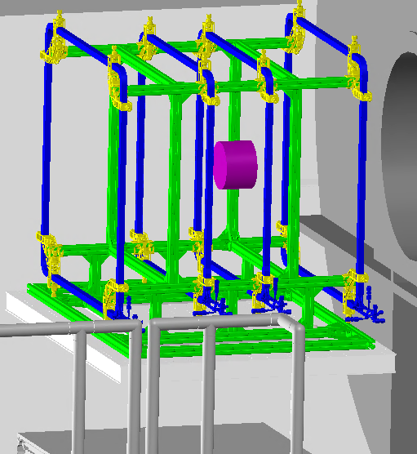
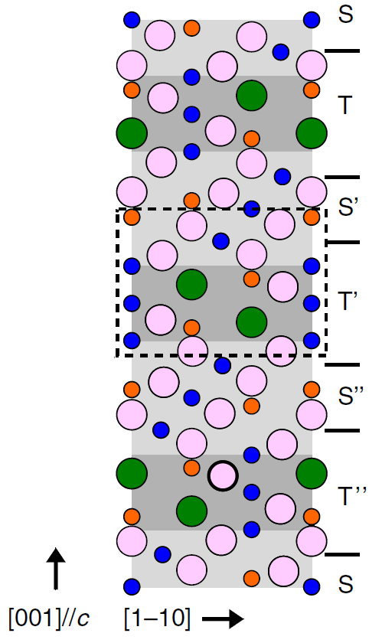
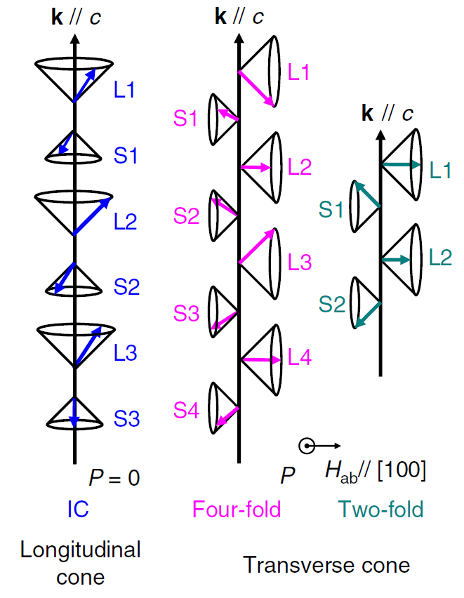
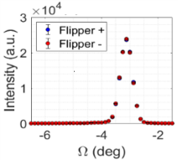
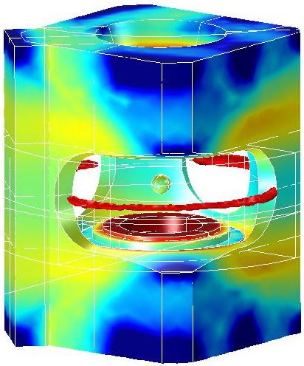
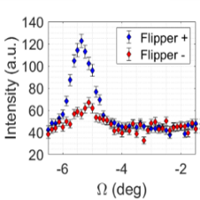
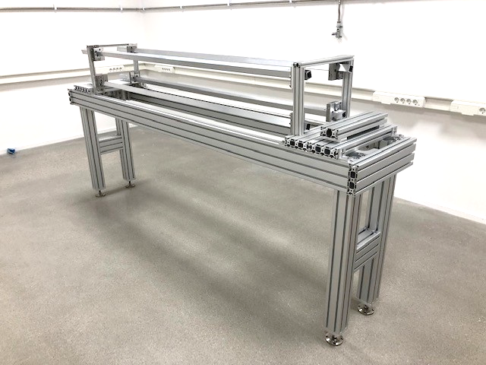
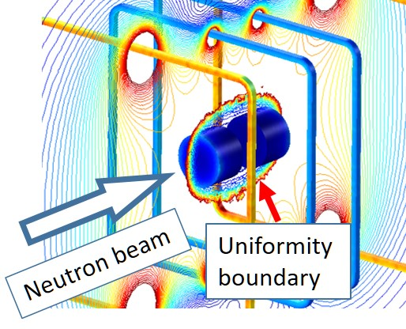
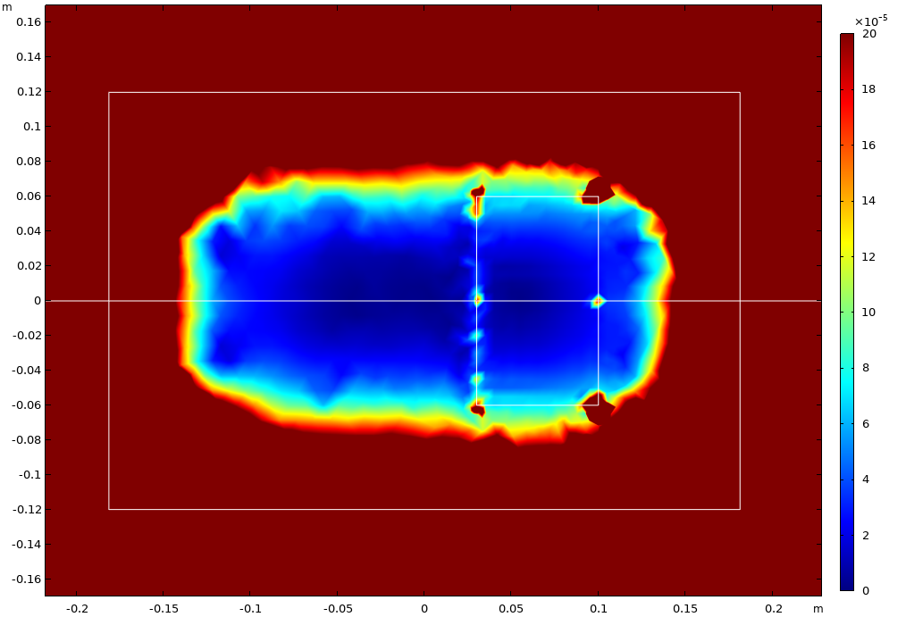
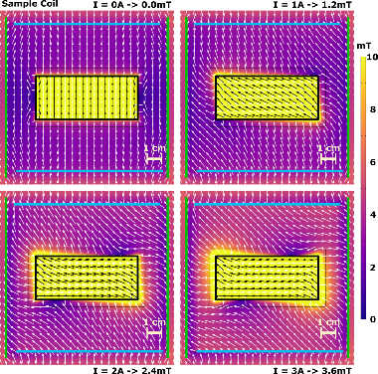
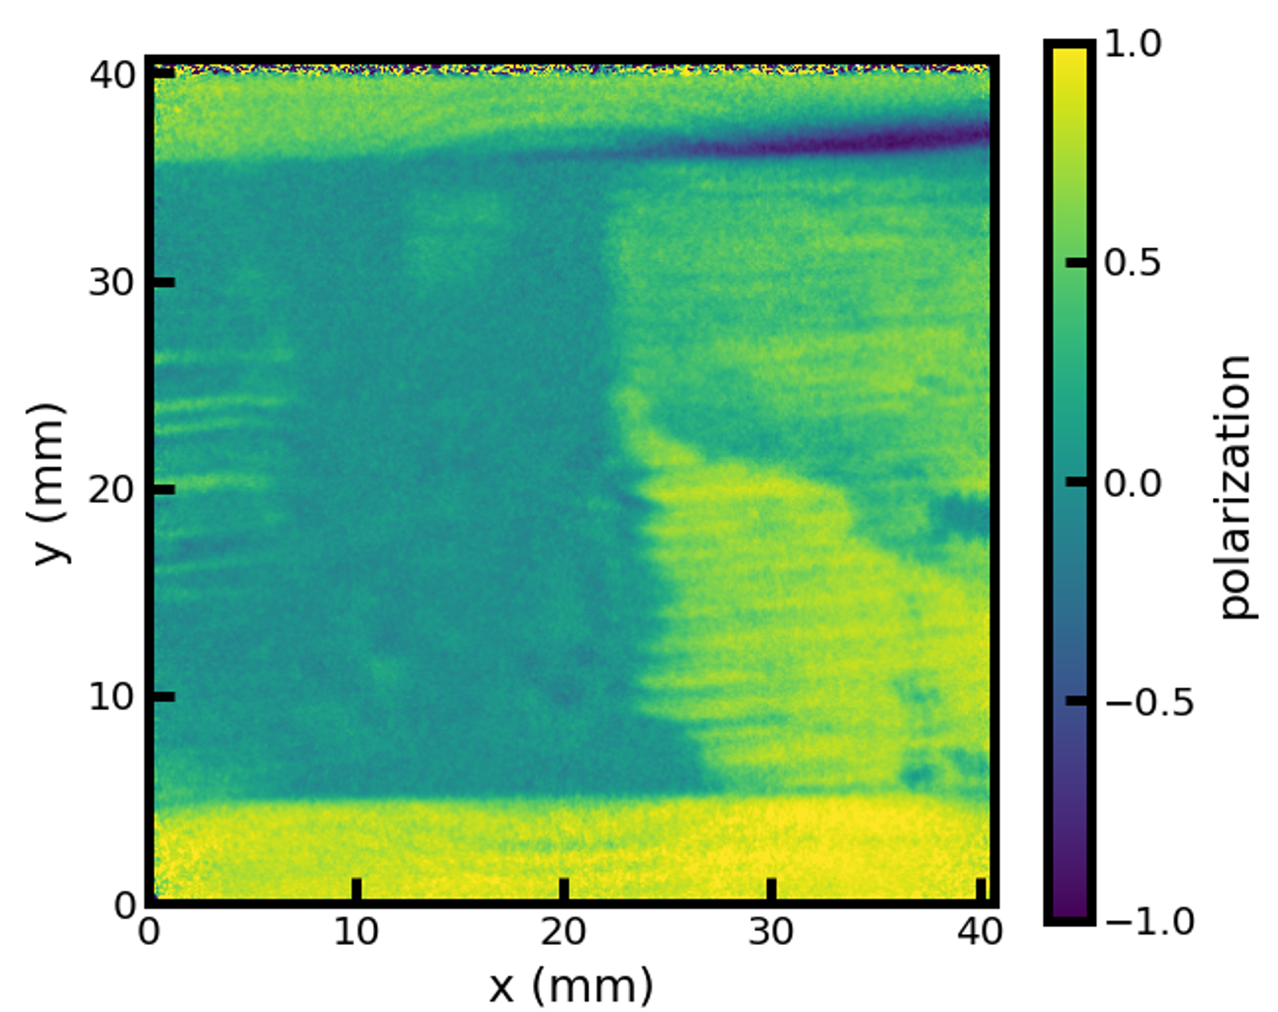
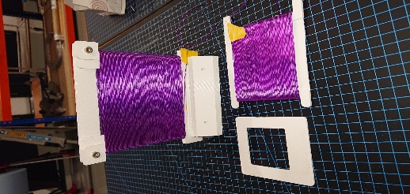
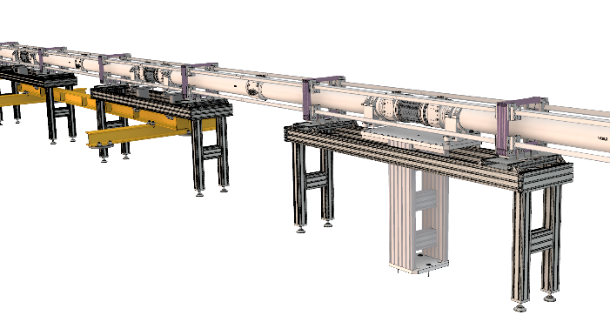
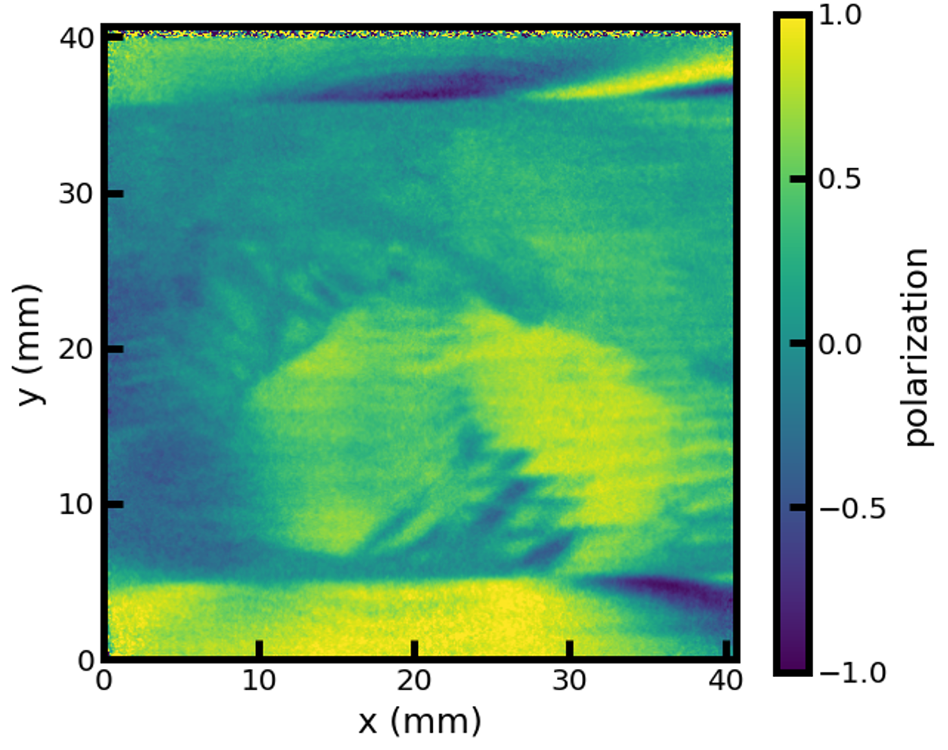
Status
Science-drive development: engage in scientific studies that feedback to instrumentation designs.
Work with MPS to evaluate magnet design for polarisation applications.
Innovation: larger uniform field volume and angular coverage than any coil design found in literature.
Evaluate design of 2T warm bore magnet for polarized neutron scattering use.
With Ale Holmes, MPS.
H=0
T=5K
H=5T
T=5K
Hexaferrite, Pol. SANS, ILL D33
Lab-based polariser
SKADI analyser
Data analysed by Annika Stellhorn. Advisor: Elizabeth Blackburn, Lund University. SREss3 grant.
1.4mT
3.1mT
Narrow-angle analyser coil
Large uniform field volume
Wide-angle analyser coil uniformity volume
Model
Design/Build
Measure
Designed by Joel Hagman. Advisor: Tommy Nylander, Lund University. SREss3 grant.
Stack of 4 round coils.
Large uniform volume and
vertical angle at ±28°
Silicon steel, Pol. Imaging, PSI BOA
BIFROST guide field design and prototype building
Measured by Alex Backs. Advisor: Dmytro Orlov, Lund University. SREss3 grant.

Slide 12
Summary
Polarisation project in MPS supports 10 instruments, together with in-kind and grant contributions.
  Runs in parallel to instrument construction projects, with the process designed to seamlessly incorporate the capabilities without compromising instrument construction process or user program.
  Regular communication with instrument teams.
  Overall project is in the design and initiation phase, with preliminary design reviews approaching.
  Adapt proven design to ensure functionality. Innovate to improve on existing design.
MPS staff – advice and help from a diverse experience.
  Dedicated staff on polarisation has started on 1st April
  In-kind project brings additional help – designer to start on 1st May
  Additional staff planned from 2024 & 2025.
Engaging external collaborators who are future users
  Keeps the user community involved.
  Grants bring additional resources.
  Feedback from future users and from doing scientific studies drive instrumentation.

