Slide 2
Projects updates
High pressure, high temperature and mechanical processing
PRESENTED BY Caroline curfs

Slide 3
Agenda
1 High Pressure
2 High Temperature
3 Mechanical processing

Slide 4
1
High Pressure

Slide 5
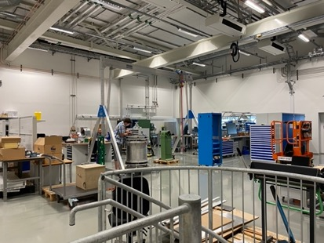
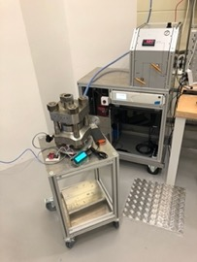
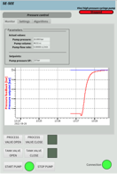
High Pressure
Update
  New High-Pressure expert
    Damian Pawolida
    Starting 02.05.2023
  Labs & Workshops
    E03 / 1st floor : 267 m² to share with mechanical workshop, control integration and prototyping
    D08/ 1st floor : 45 m² for DAC, installation to start before end 23
  Projects :
    PACE and VINCI pumps integrated in NICOS
    Diamond Anvil Cells : budget of 50 kEuros for 2024
    In Kind project for Clamps, gas and liquid systems and Paris Edinburgh systems
      Partners from LLB, Sorbonne Uni and ILL)
      Project end planned: December 24
      Budget : 690,770 Euros₂₀₁₃

Slide 6
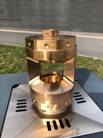
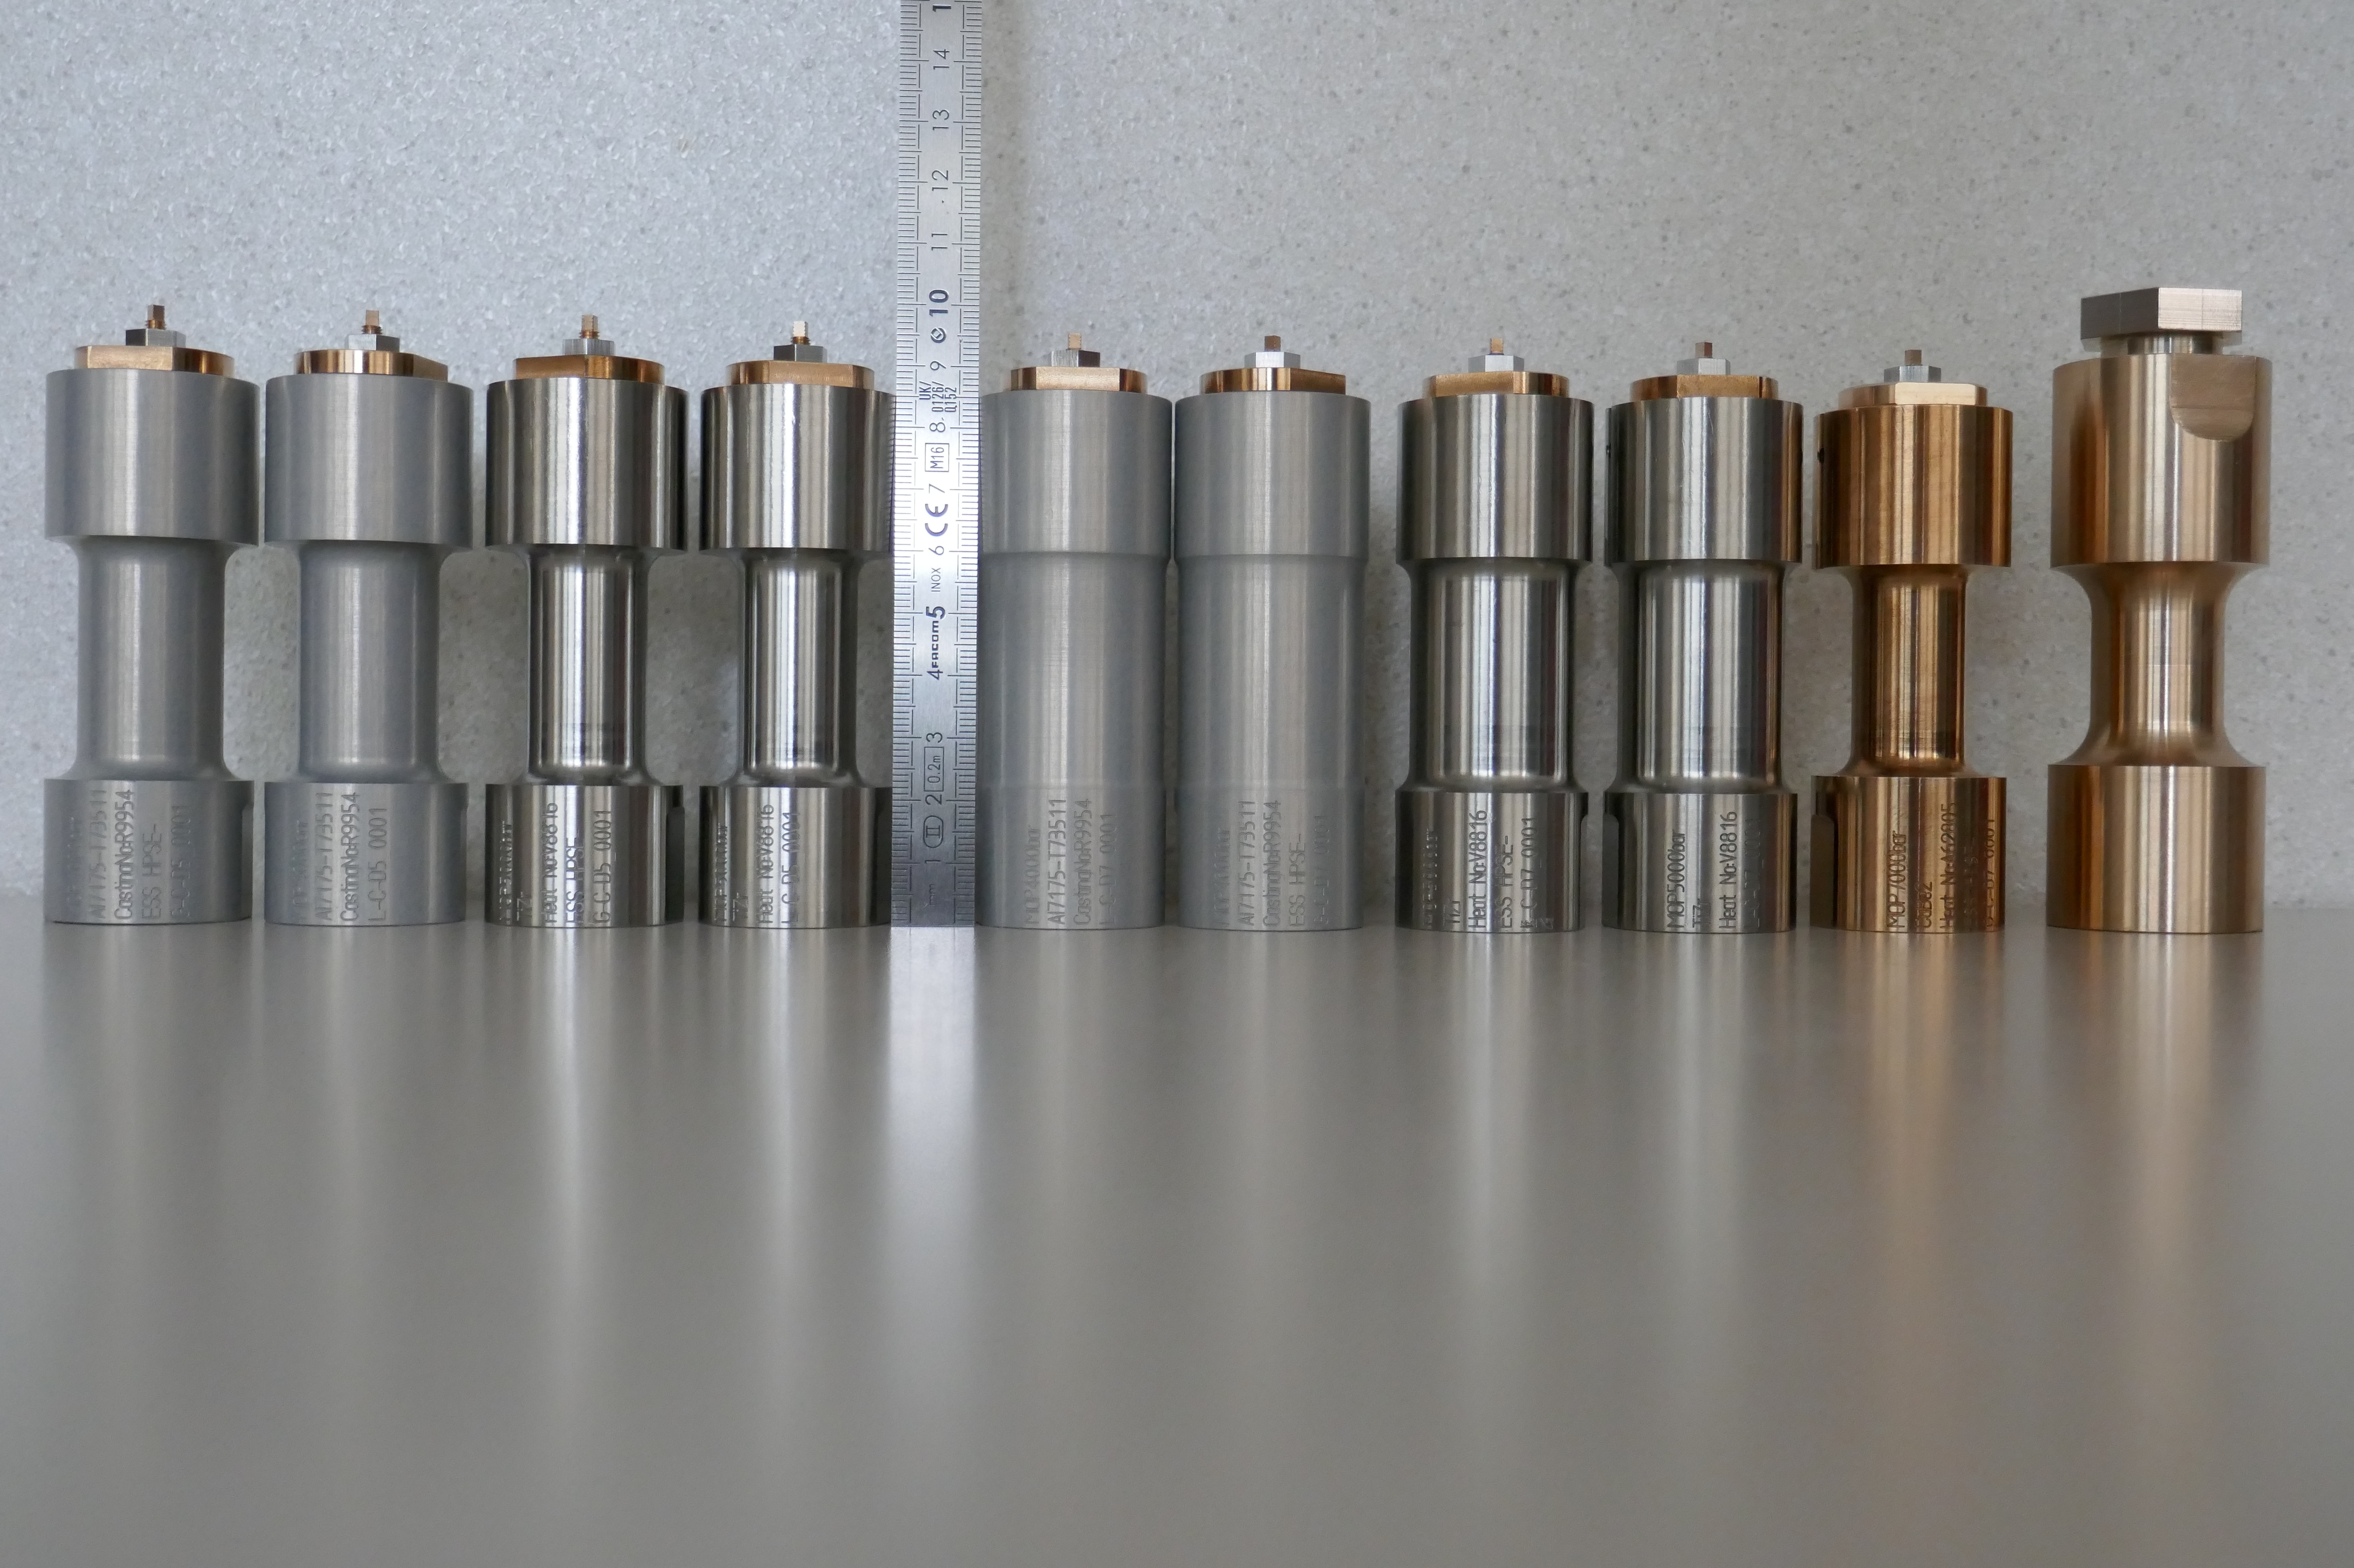
High Pressure
Update – In Kind project
  Gas, liquid and clamps systems
    Gas cells = 2x TiZr , 2x Al, 1x CuBe
      Design and fabrication done
      HP tests successful up to 1.25x MOP
      HP test for CuBe done up to 6.5 kBar (OP = 7 kBar)
      Ready to be transferred
    Liquid cells = 2x TiZr, 2x Al
      Design and fabrication done
      HP tests successful
      Ready to be transferred
    Clamp cell: 1x CuBe
      Design and fabrication done
      OP = 15 kBar
      Test to be done at ILL or when compressor available
    Training : end 23
    SITEC compressor :
      FAT successful
      SAT at ESS in Sept. 23
  Paris-Edinburgh Systems:
    PE presses: 2x VX1, 1x VX5
      VX1 delivered and successfully tested at Sorbonne Uni
      VX5 to arrive soon
    Gas loading
      To be delievered with PE presses in 09.23
    Cryostat for PE presses :
      Mounted by ILL with support from ESS personal in 01.24
      to be delivered at ESS before summer 24 for first cooling down at ESS 09.24
Notes:
MOP = Maximum Operatiing Pressure

Slide 7
2
High Temperature

Slide 8
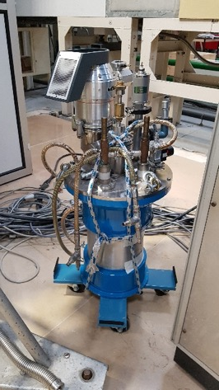
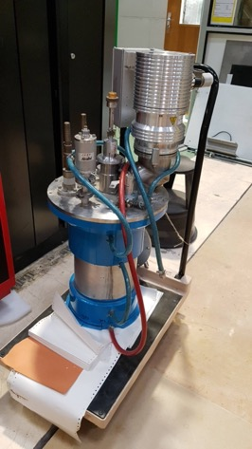
High Temperature
  ILL-type furnaces
    2nd hand from LLB
    1350 C : 1 Nb resistor with 5 Nb screens, dia. 45 mm, used on diffraction instrument
    1800 C : 1 Nb resistor with 7 Nd screens, dia 35 mm, used on spectrometer
    Will be refurbished at ESS with LLB help during fall 2023/winter 23-24
    One to be used on DREAM. The other for CSPEC?
    Do we need more ?

Slide 9
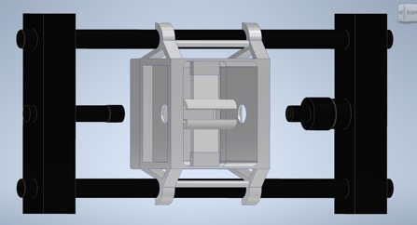
High Temperature
  UHT furnace with Chalmers & ISIS
    VR grant: design at ISIS by ISIS team and manufacturing by Chalmers Uni
    Standalone or attached to 60 kN stress rig
    Lamp furnace : max temperature 1800 C
  Induction furnace
    Parts (power supply, coils and induction generator) bought for Aarhus transferred to ESS.
    VR grant or next ESS research engineer?
  Cryostream/hot air blower
    Planned to be a full system with a glass chamber
    Hot air blower bought for Aarhus, transferred to ESS
    Used as standalone systems or combined together in air atmosphere with a sample changer?
  Others?

Slide 10
3
Mechanical processing

Slide 11
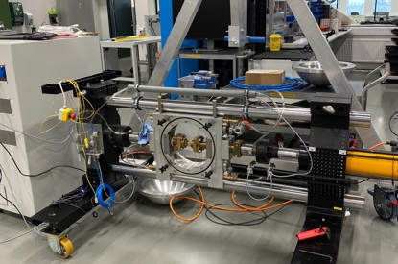
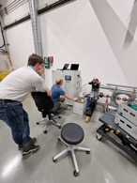
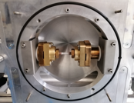
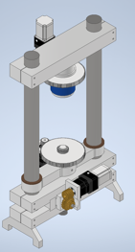
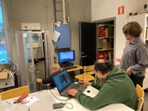
Mechanical processing
  NPI stress rig
    40kN (60kN/100 kN) uniaxial rig with joule heating and vacuum chamber
    FAT (October 22) and SAT (January 23) sucessful
    Control software still being improved with NPI
    New grips needed to reach 60 kN, new load cell to reach 100 kN
    Mechanical integration: waiting for mechanical designer
    Control integration done : Integrated via MQTT
  Torsion/rotation rig for tomography
    SREss grant with Lund University for new design/drawing and manufacturing by ESS
    3D DVC/DIC system with Malmö Uni
  Dilatometer
    Specifications on going
  Other ?
    Another rig for tomography for smaller samples?
    Same control and control software for all the rigs, based on Beckhoff and python?

Slide 12
Thank you

