Slide 1
Sample Environment for Spectroscopy – Cryo & Magnets
Spectroscopy STAP meeting April 2023
PRESENTED BY Alex Holmes

Slide 2
Agenda
1 Cryo SE provision for spectroscopy
2 Instrument interaction with MPS
3 Resolved Interface issues
4 High field magnet for spectroscopy

Slide 3
Cryo SE provision for spectroscopy
Starting provision for day 1
Instrument specific equipment (part of instrument scope):
BIFROST
Wet cryostat – delivered and tested
CSPEC
Wet Cryofurnace, He3 insert, sample changer
TREX
Wet cryofurnace
VESPA
Dry Cryostat/furnace
Pool cryo equipment:
Dilution insert
He3 sorption insert
Top loading dry cryostat for spectroscopy (CSPEC, TREX, MIRACLES)
Wet* cryo MIRACLES
Framework agreements to be prepared
Other SEE from MPS
Furnaces
High pressure esp. PE & clamp cells

Slide 4
Pool & Instrument Cryostats
Cryo meeting held Sep ‘22 – information gathered from instrument stakeholders
Instrument | Type | Top/floor loading | Interface | Tail/ window material | Rotation (Insert/ stack) | Other alignment | ULT | Cryofurnace | Typical measurement time | IVC size | Special geometric constraints | No OVC option? | Compatibility group
BIFROST | SPEC | FL | Own/L1 | Al | Stack | no | Y | N | 1-7 days | 70mm | none | N | 1
CSPEC | SPEC | TL/FL | L1*,L2 | Al | Insert | Fixed xyz | Y | Y | Measurement hours, expt days | 70mm | 700mm diam | y | 1,2
MIRACLES | SPEC | TL | L3* | Al | insert | Fixed xyz | y | y |  | 70mm | 400mm pot | n | 2
TREX | SPEC | TL | L1 | Al | Insert | Fixed xyz | Y | y |  | 70mm | Coils – need response | y | 2
VESPA | SPEC | TL | own | Al | No but fixed orientation | Fixed xyz | N | Y | 5min-6hour, 30 mins- 2 hours sample changes | 100mm | Special geometry |  | 5
Topical meetings with instruments to be held on a regular basis.
Upcoming – magnets.

Slide 5
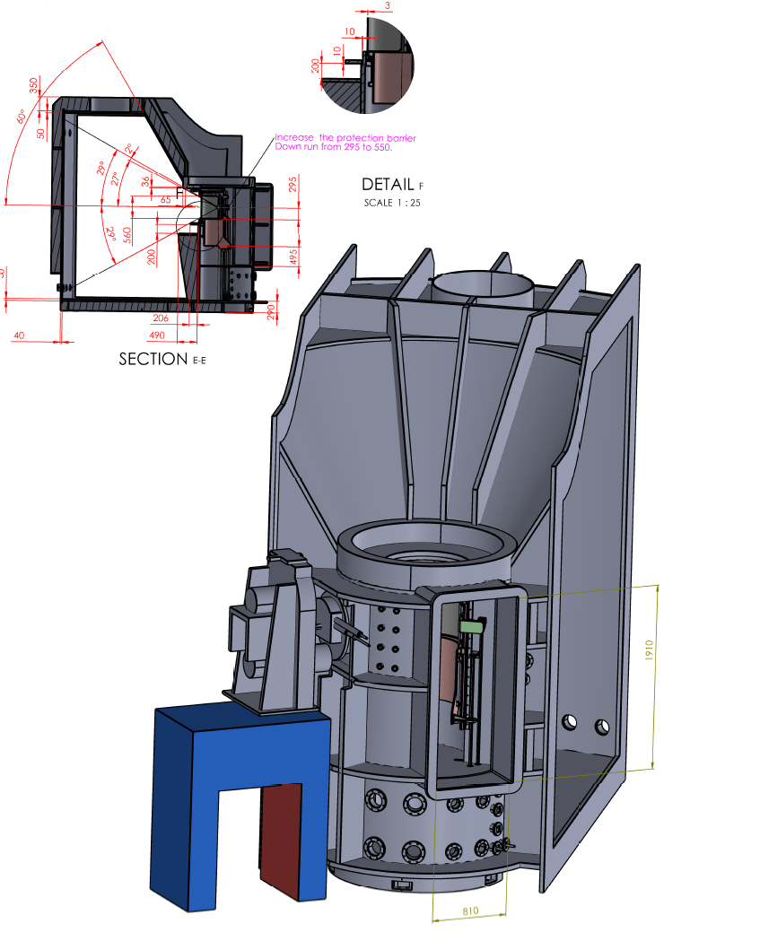
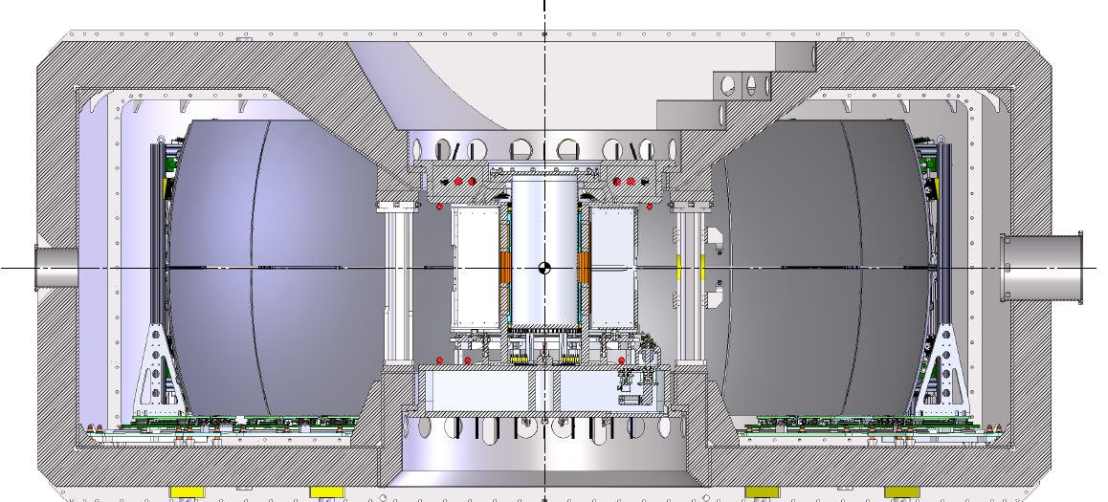
Interface issues
Resolved after discussions with instruments
CSPEC collimation and gate valve contraints < standard ⌀ 800mm:
L1 top loading interface retained
SEE limited to ⌀ 700mm
MIRACLES sample pot
Issue – sample pot has no independent pump & flushing, requires additional on SEE.
Resolution – larger equipment used without sample pot, in main detector vacuum. Smaller equipment uses additional interface adaptor with pump feedthrough.
6.5T magnet will not fit CSPEC without major modifications (i.e. new body).
Remains as plan B in case high field magnet (see next slides) delayed

Slide 6
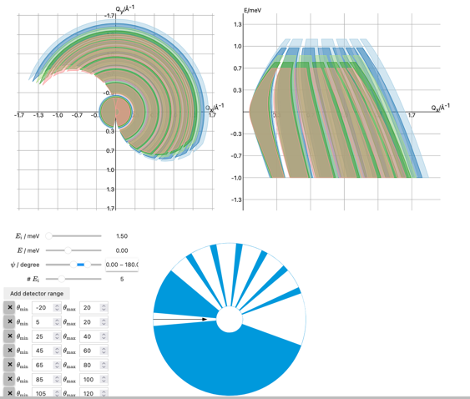
Spectroscopy Magnet
Next new magnet – a novel high field magnet for direct geometry spectroscopy
Kick-off meeting held with ESS instrument stakeholders.
Tool from Greg Tucker (DMSC)
Priority from instruments (CSPEC, TREX) is low background and high field, more than largest possible aperture.
Traditional designs have thick Al rings to support forces between coils – high background.
Newer designs (e.g. 8T magnet) have open segments, at expense of field or coverage.
Time of Flight means some obstructions in openings can be tolerated without loss of too much (q,E) coverage. Broad spectroscopic features can be fitted even with some missing data.
➙ Radial supports.
https://g5t.github.io/tof-tools/lab?path=accessible.ipynb
Preliminary discussions with OxInst. Design study quoted, to be started ASAP followed by open procurement. Target mid 2026.
Notes:
How to do procurement

Slide 7
Key specifications
11-12T minimum (12T preferably)
Sample size – up to 1cm (h)x 2cm (v) ->
Symmetric vertical field
2cm split
Homogeneity? 1-2%
Above 300K not needed. Compatible with <1K ULT inserts essential. 100-300K needed
CSPEC collimation >48.5mm -> 50mm diameter sample space
Recondensing? No.
Vertical opening: +/- 10 degrees – part of design study. 5-10 degrees, a few different configurations
Horizontal opening:
Full detector coverage (CSPEC: -30° to +140, TREX +1°to 72° (-36° to 144° full scope)), but with support wedges is OK. Not too many and avoid region where n-n scattering occurs.
Thinned incoming and outgoing beam windows. Incoming and outgoing windows 0.125 mm and the radiation shields typically 25 micron.
1mm cadmium on exposed surfaces.
Top (vacuum tank) mounted, L1 (OD restricted to 700mm below flange). + floor mounting option.
Stray field limited by M-chopper

Slide 9
Finish presentation

