Slide 1
Spectroscopy STAP - Polarisation Wai Tung (Hal) Lee

Slide 2
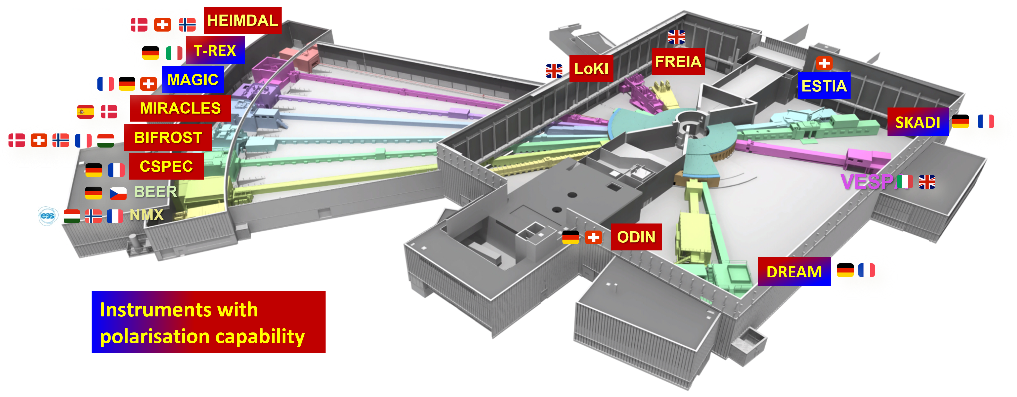
Polarisation Project in MPS
Science cases established (ESS Polarisation Workshop Report, 21-22 September 2020).
12 of the 15 approved ESS instruments will provide polarised neutrons.
Polarisation project supports 10 instruments, including 4 spectroscopy instruments.
Project incorporated into the ESS rebaselined plan for 2022-2027.

Slide 3
Techniques for each instrument
Polarisation equipment: polarizer, analyser, spin-flippers, guide field.
Notes from discussion: MEOP has fast throughput of 2 bar-litre / hour and fills wide-angle analyser. SEOP takes 1 day to reach polarisation and very challenging for wide-angle analyser.
SEOP in-situ keeps polarisation stable through the experiment. MEOP virtually impossible to have in-situ option.
Best combination: SEOP in-situ polariser, MEOP wide-angle analyser. Added benefit: only 1 cell with decaying transmission/polarisation instead of compounded effect from two.

Slide 4
How we proceed
1. Parallel project to instrument construction projects.
Tollgates: Preliminary design, final design, procurement & construction, installation, commission.
Ensure the instrument construction projects are not compromised.
Project schedule anchor to instrument construction TG5 & Hot Commissioning.
Installation to start after instrument TG5, i.e. completion of installation.
Hot commissioning as the last item of instrument hot commissioning.
Only proceed when instrument team gives ‘go ahead’
Project’s own resource for design, procurement, construction, test, installation, commssioning. Outsourcing if needed and possible.
ESS staff involvement
During design, procurement, construction, test:
Once a month coordination meeting with instrument scientist(s) of an instrument. Other staff invited based on the issues at hand.
Keep to a minimum of information request for parameters critical for design.
Software development – ECDC, DMSC data scientists (coordinator: Celine Durniak).
Tollgate reviews – instrument team, staff with relevant expertise.
Installation assistance – instrument team, staff with relevant expertise (e.g. metrology, rigging, if needed).
Hot commissioning assistance – instrument team, staff with relevant expertise.
We are codifying the project process.

Slide 5
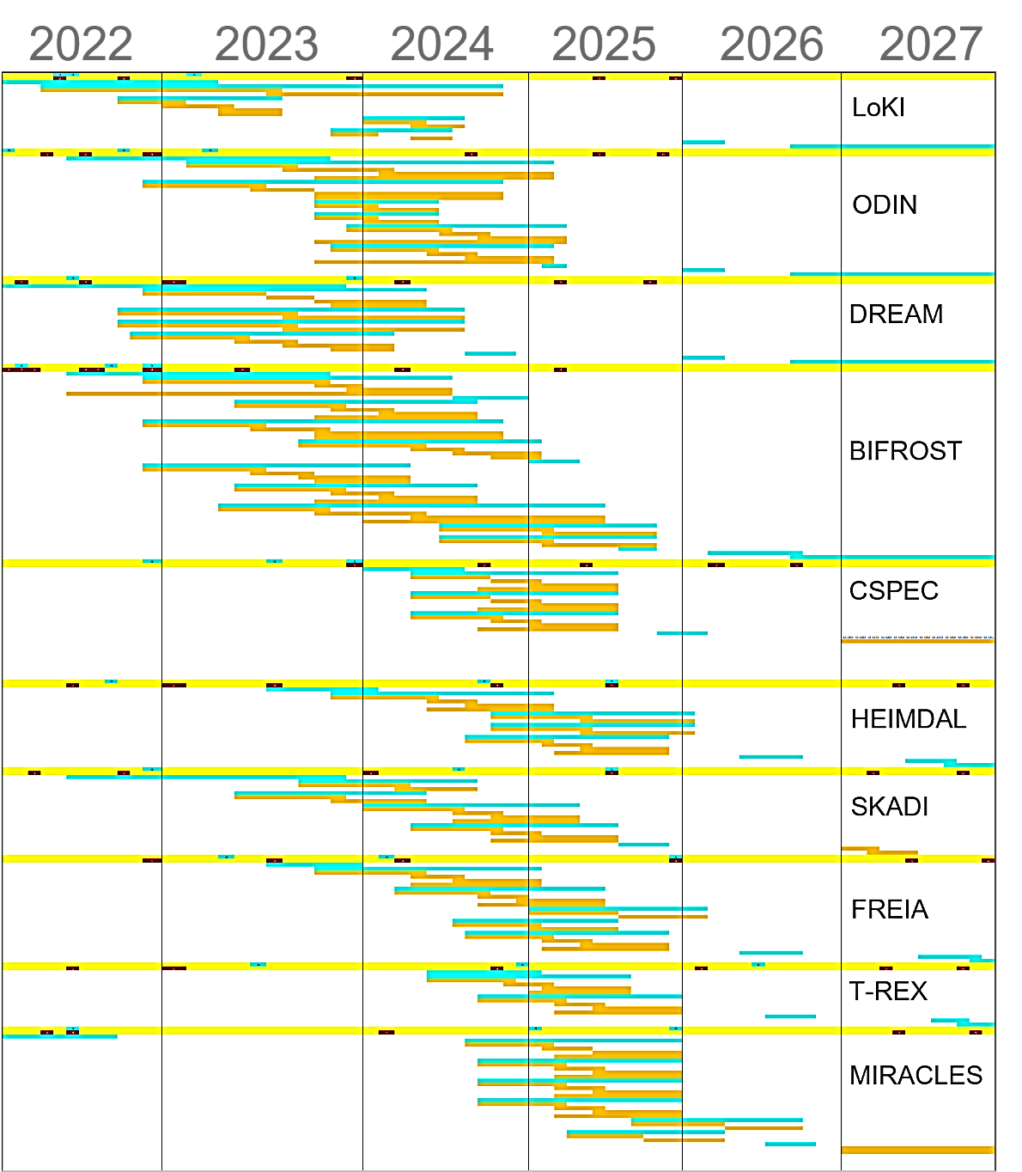
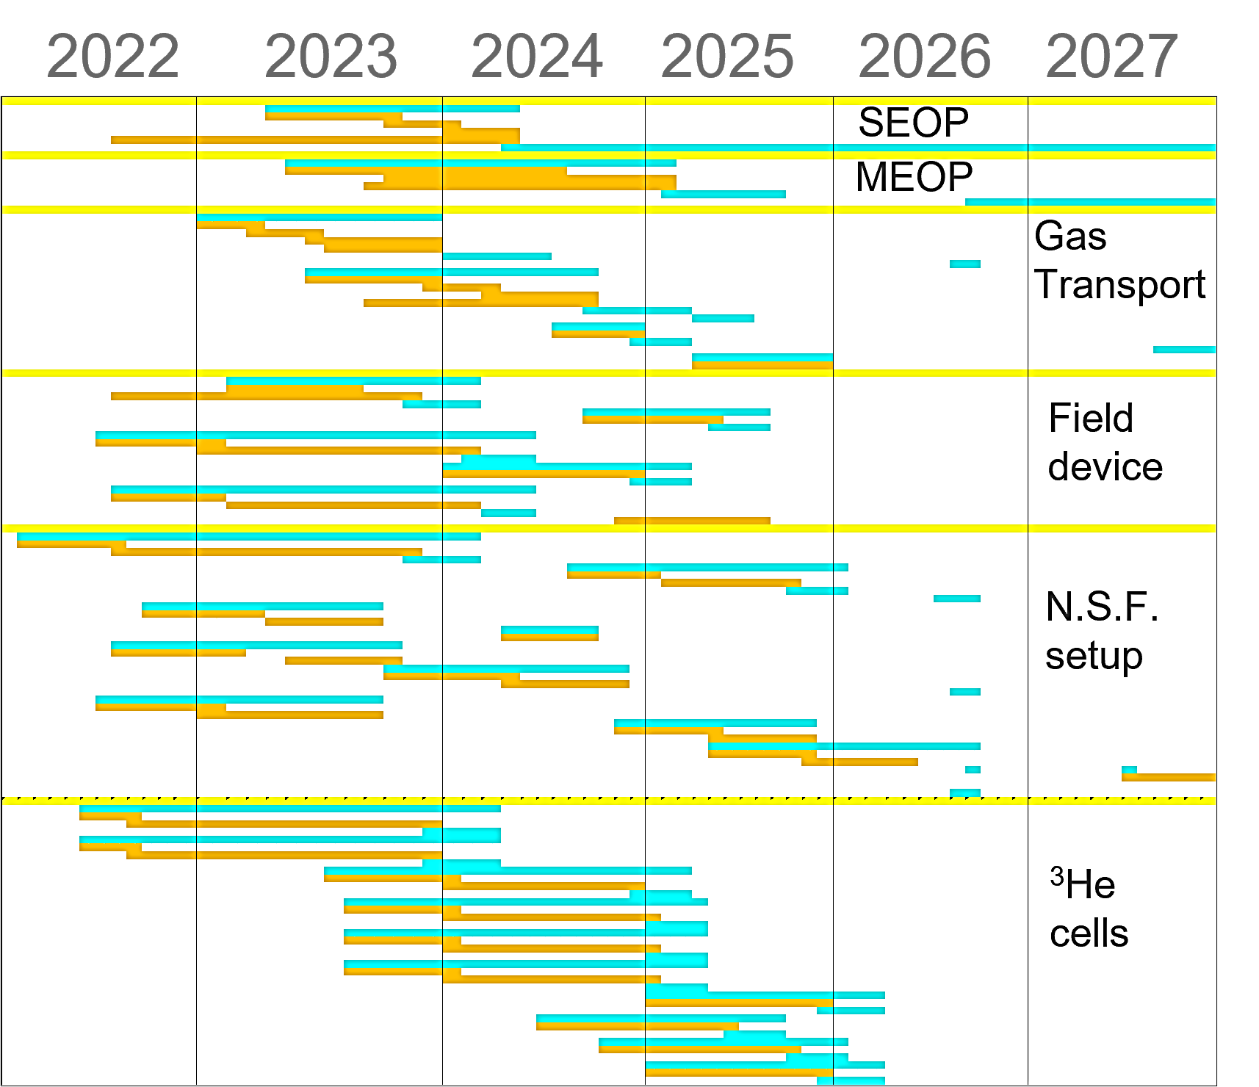
Project schedule: 2022-2027
Anchor to instrument TG5 & hot commissioning.
2023-2025 design, construction, test
2025-2027 installation, commissioning, operation
MEOP filling station: installation 2025-2026.

Slide 6
People
MPS
Hal Lee
Subject matter expert, project manager
Joel Hagman
Magnetic field & mechanical design & construction
MPS staff
Support on case-to-case basis.
Additional dedicated staff for polarisation planned from 2024 & 2025.
Other groups
Instrument teams
Monthly coordination meeting
Short Q&A on critical design parameters
Tollgate reviews
Installation, commissioning assistant
Peter Willendrup (DMSC)
McStas code development for polarisation
Damian Martin Rodriguez (CLS)
BIFROST & MIRACLES polariser McStas simulations.
ECDC
Equipment control & integration
Data scientists, coordinator: Celine Durniak (DMSC)
Data reduction & data analysis
Additional expertise
Expert advice
Tollgate reviews
Installation, commissioning assistance
Request from centralised ESS services.
Johan Ranstad (in-kind project with Lund University)
Designer for 11 months
Additional designer at Lund University
Support on case-to-case basis

Slide 7
Collaborations & grants
On-going: Swedish Research Council “Cooperation with ISIS: instrumentation and methods for ESS”
2022-2025. Joint project with Lund University, Royal Institute of Technology.
Equipment for BIFROST, CSPEC, WISH (ISIS), PhD student and postdoc.
Swedish in-kind project
2023-2025. Partners from Lund University, Royal Institute of Technology, Uppsala University.
Contributes a wide range of polarisation equipment defined in the Polarisation Project.
Magnetic field & neutron spin filter devices, instrument specific tasks for 8 instruments.
1 FTE designer expected.
ESS-ILL collaboration
2023-2026. Build filling station to supply polarised ³He gas for experiments.

Slide 8
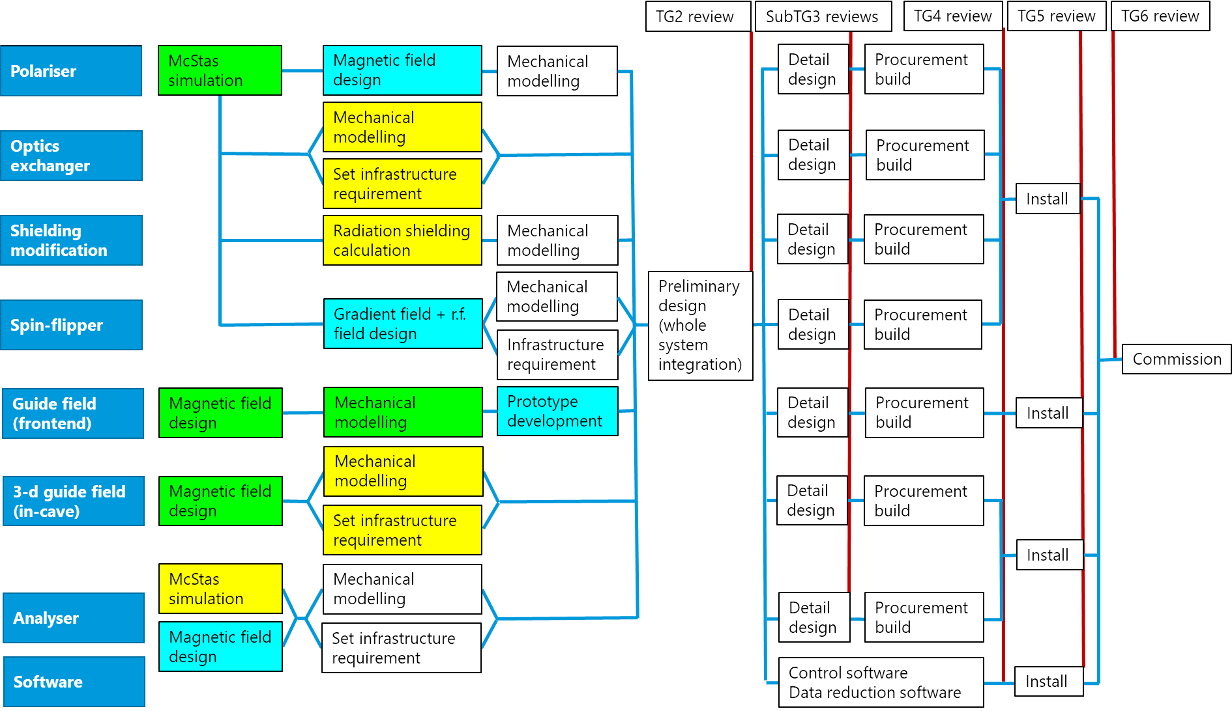
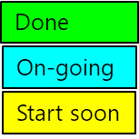
Status - BIFROST
Happening or done: McStas simulation and magnetic field design.
Soon to start: Shielding calculations, mechanical modelling and setting infrastructure requirements.
McStas simulation of BIFROST polariser.
λ= 2-6 Å, P>95%
Done by Damian Martin Rodriguez.
Cross-checking the results.

Slide 9
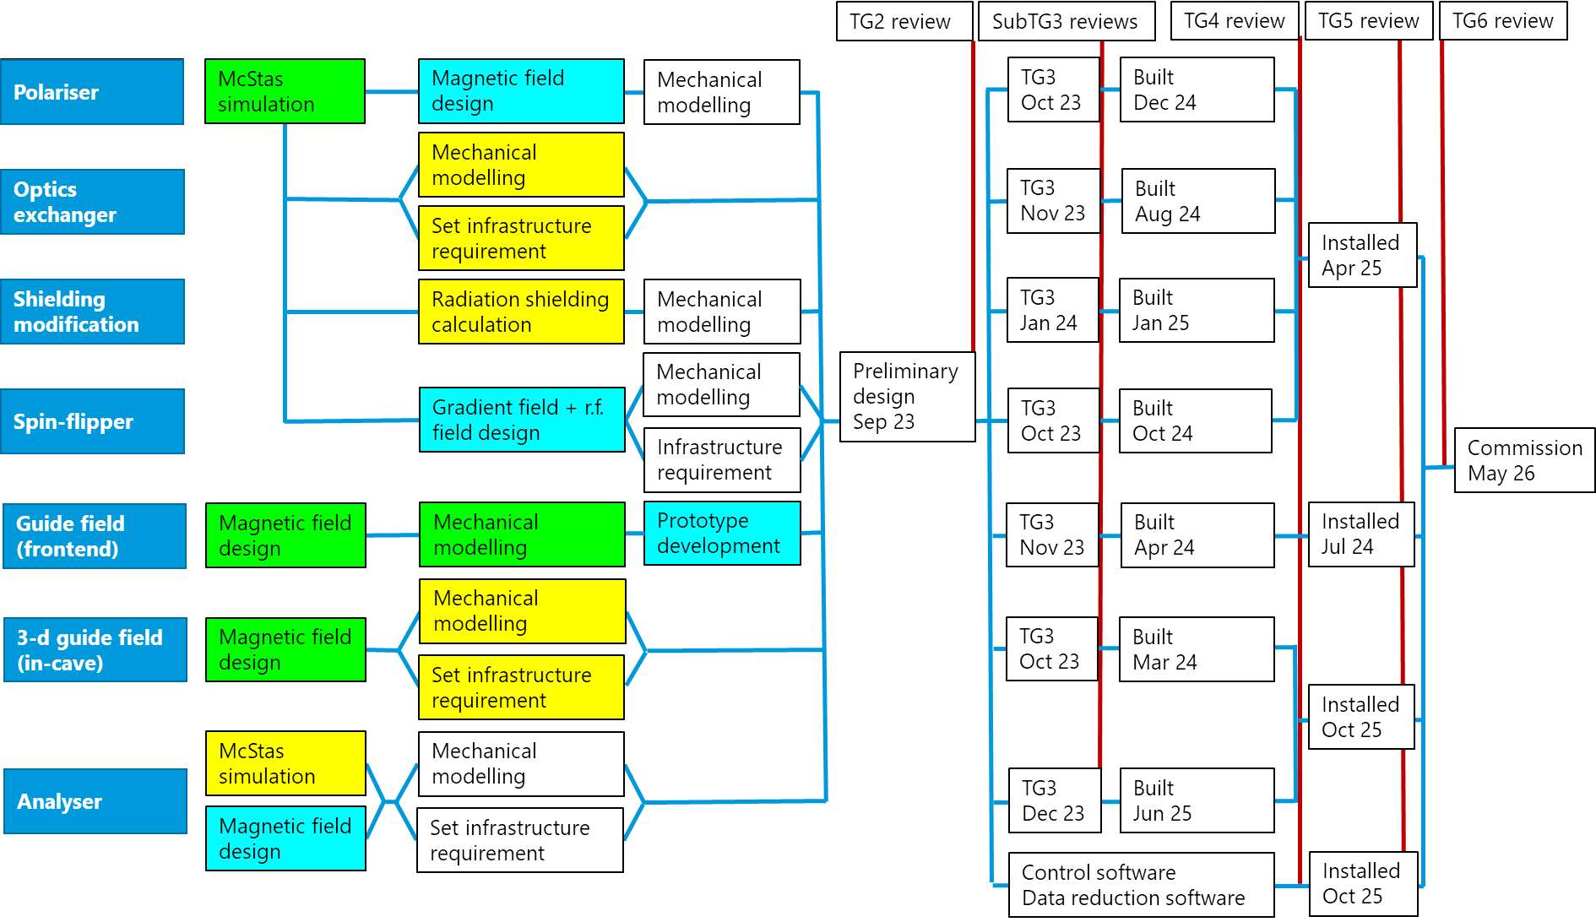
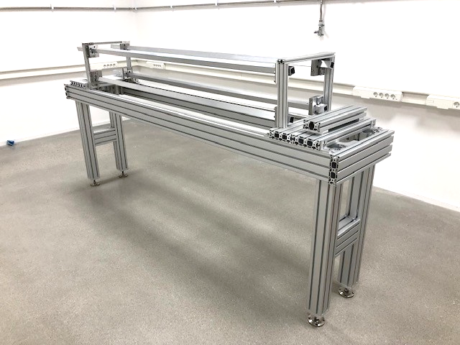
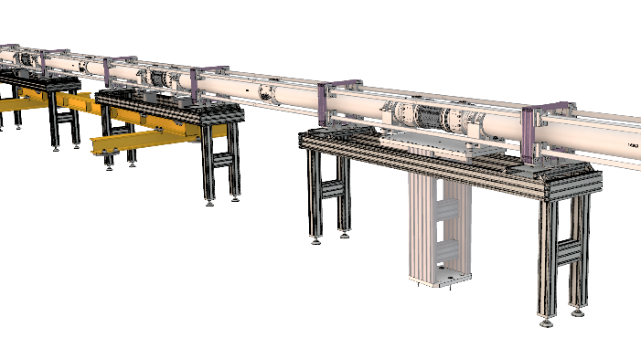
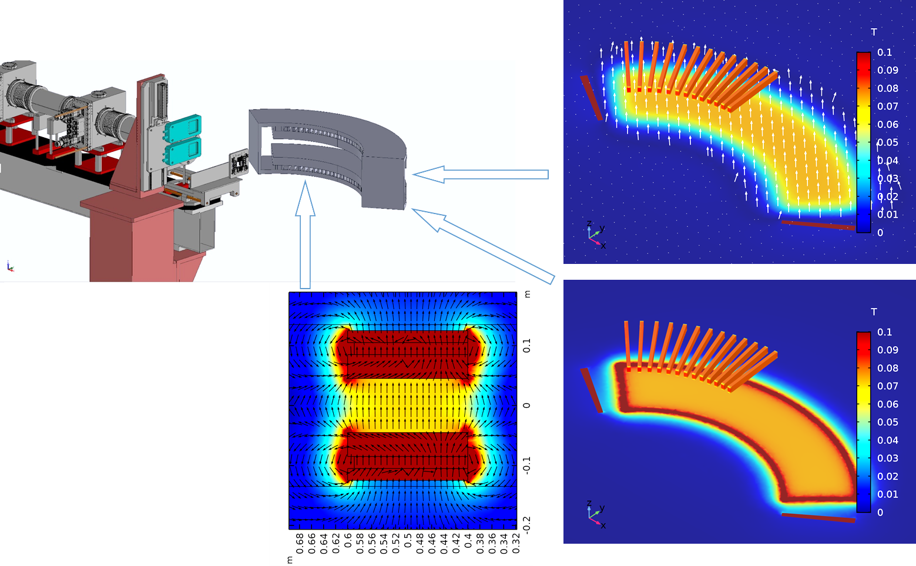
Status - BIFROST
Happening or done: McStas simulation and magnetic field design.
Soon to start: Shielding calculations, mechanical modelling and setting infrastructure requirements.
BIFROST guide field design and prototype building
BIFROST analyser magnetic field design

Slide 10
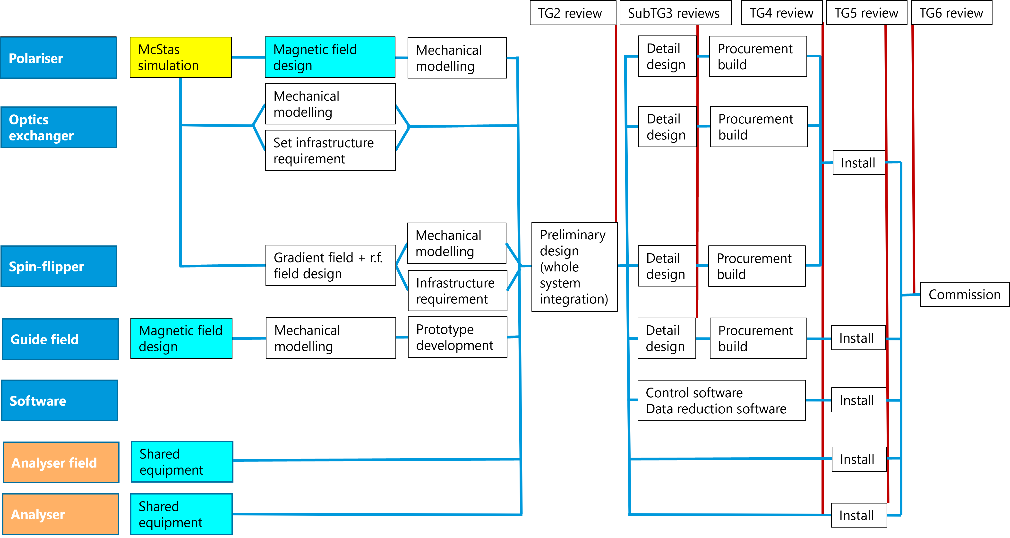
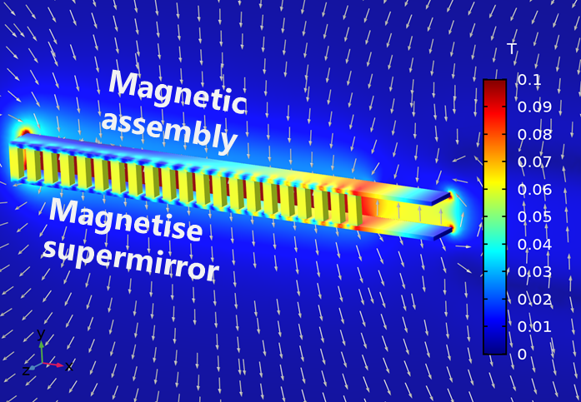
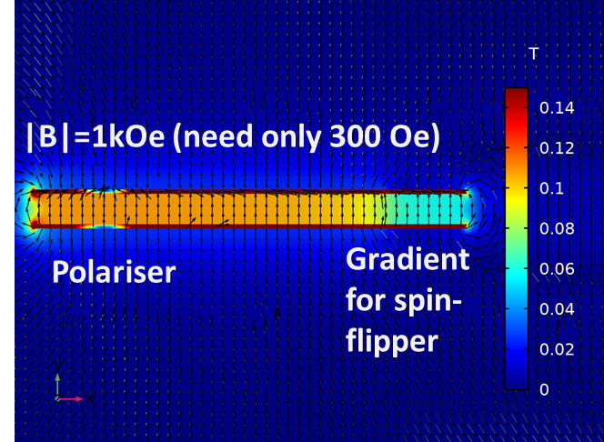
Status - CSPEC
Soon to start: McStas simulation of polariser.
Non-magnetic guide development at TUM is on-going. Monte Carlo to evaluate in case there is no guide after polarizer.
Discussion paused from September on instrument team request. Met in April.
CSPEC polariser magnetic field design

Slide 11
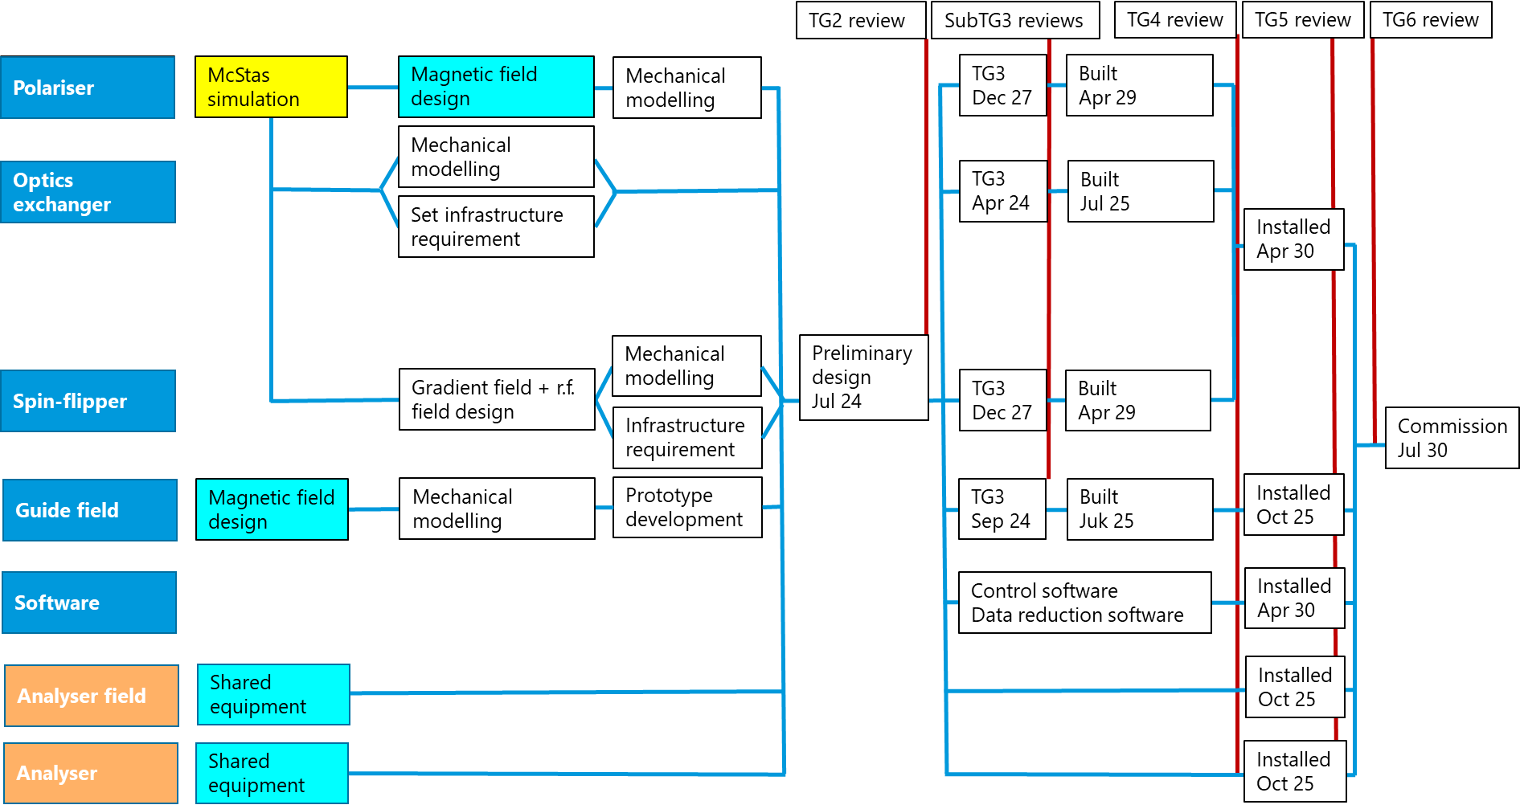
Status - CSPEC
Soon to start: McStas simulation of polariser.
Non-magnetic guide development at TUM is on-going. Monte Carlo to evaluate in case there is no guide after polarizer.
Discussion paused from September on instrument team request. Met in April.
CSPEC polariser magnetic field design

Slide 12
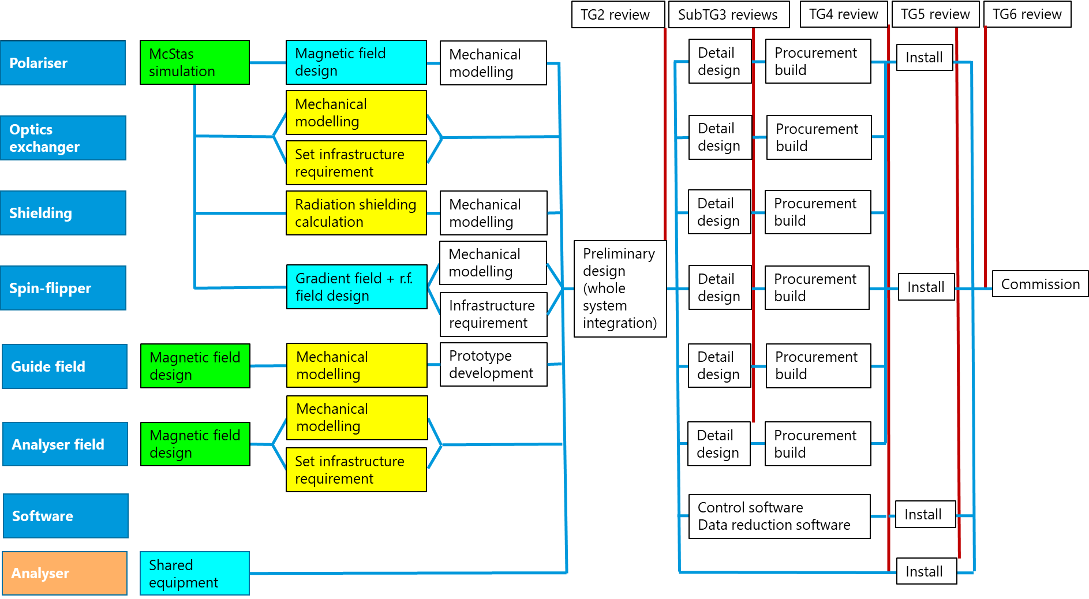
Status - MIRACLES
Happening or done: McStas simulation and magnetic field design.
Soon to start: Shielding calculations, mechanical modelling and setting infrastructure requirements.
McStas simulation of MIRACLES polariser.
λ= 5-7 Å, P>95%
Done by Damian Martin Rodriguez.
Cross-checking the results.

Slide 13
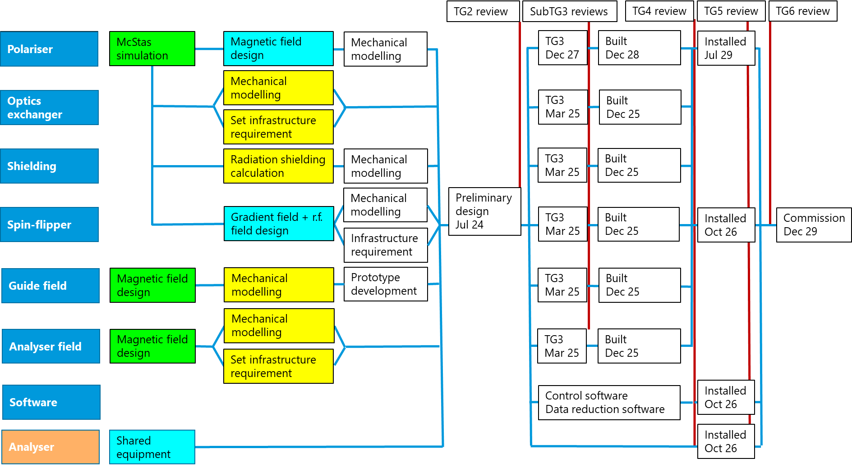
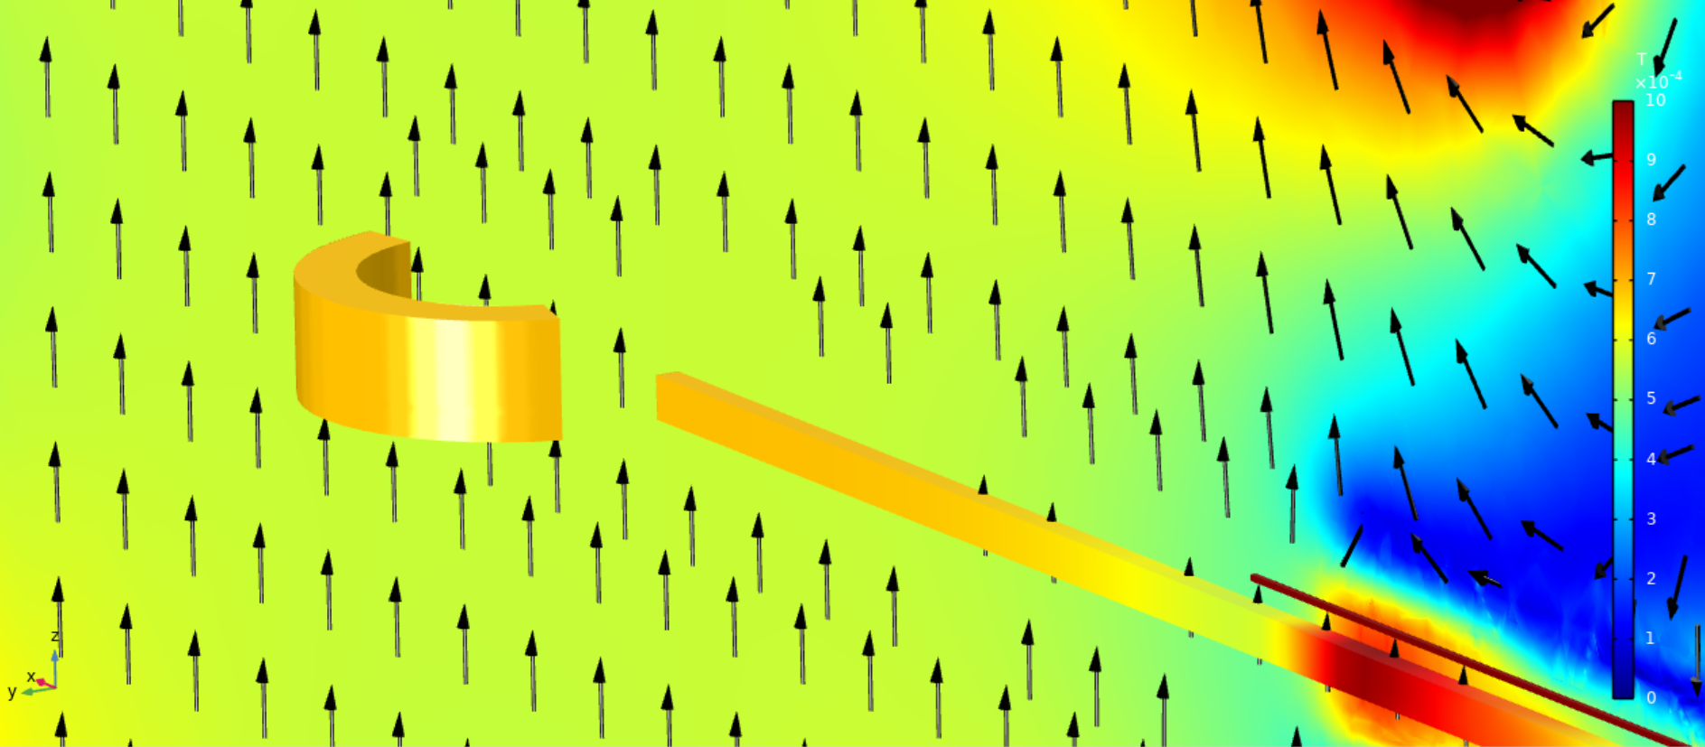
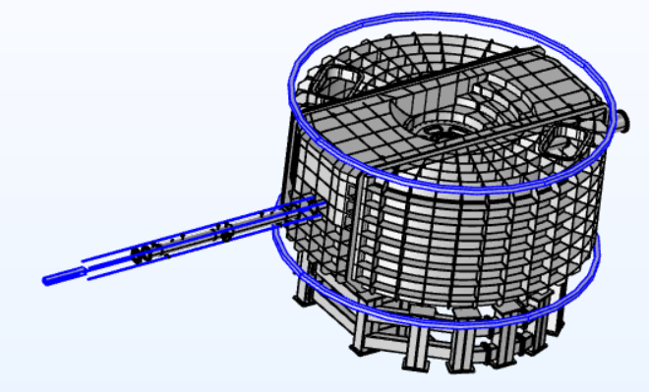
Status - MIRACLES
Happening or done: McStas simulation and magnetic field design.
Soon to start: Shielding calculations, mechanical modelling and setting infrastructure requirements.
MIRACLES analyser magnetic field design evaluation
MIRACLES polarization layout

Slide 14
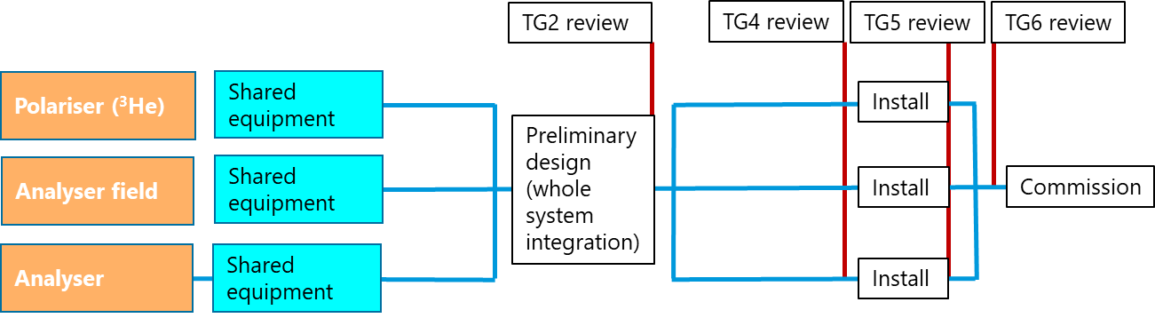
Status – T-REX
Done: Magnetic interference evaluations
Project provides backup ³He based polariser and analyser from shared equipment pool.
Review polarisation setup of T-REX.

Slide 15
Status – T-REX
Done: Magnetic interference evaluations
Project provides backup ³He based polariser and analyser from shared equipment pool.
Review polarisation setup of T-REX.
TG2 review
TG4 review
TG5 review
TG6 review
Polariser (³He)
Shared equipment
Installed
Oct 26
Preliminary design
Jan 25
Analyser field
Shared equipment
Installed
Oct 26
Commission
Oct 27
Analyser
Shared equipment
Installed
Oct 26

Slide 16
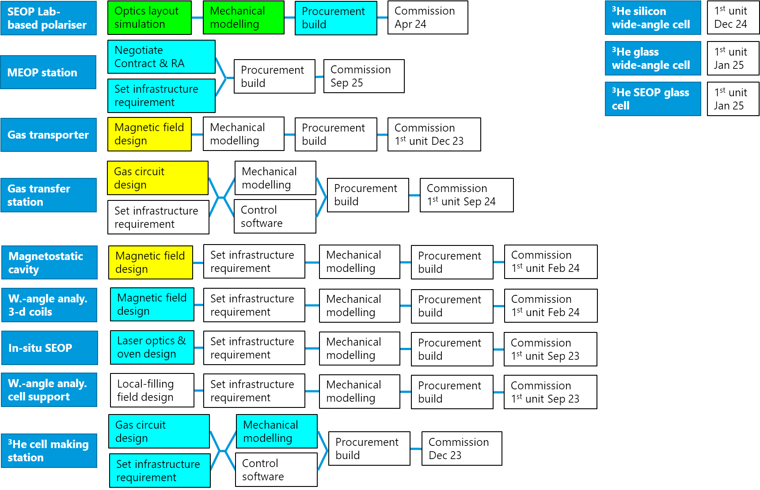
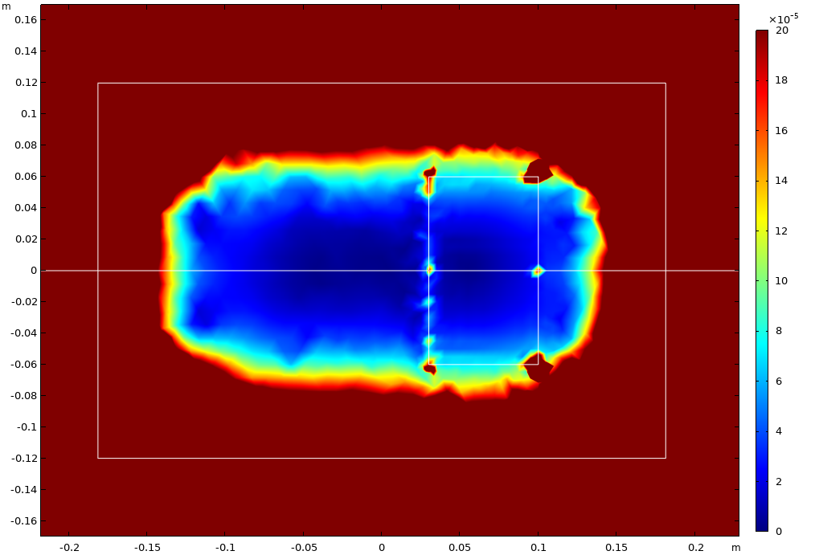
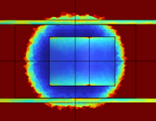
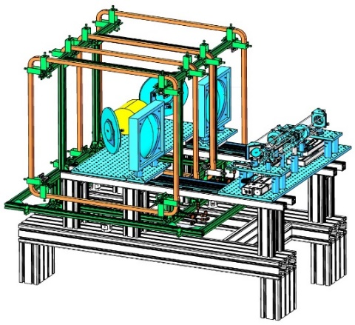
Status – Shared equipment
On-going: building lab-based SEOP station being built – provides a test bed of magnetic field devices, MEOP station negotiation, design of wide-angle analyser coil, in-situ SEOP, ³He cell-making station.
Working with in-kind project partners to design equipment. Scientific glass service 20 min from ESS. Buy or make cells.
Gradient (rad/cm)
Cell cross-section
ID 6cm, OD 20cm, H 12cm
Our design. Large uniform volume. Vertical angle ±28°
Cell cross-section
ID 6cm, OD 20cm, H 12cm
Tetracoil. Adequate uniform volume. Vertical angle ±17°
SEOP polariser design, lab-based.

Slide 17
Summary
Polarisation project in MPS supports 10 instruments, including 4 spectroscopy instruments.
Runs in parallel to instrument construction projects, with the process designed to seamlessly incorporate the capabilities without compromising instrument construction process or user program.
Overall project is in the design and initiation phase, with preliminary design reviews approaching.
In regular communication with instrument teams.
Adapt proven design to ensure functionality. Innovate to improve on existing design.
MPS staff – advice and help from a diverse experience.
Dedicated staff on polarisation has started on 1st April
In-kind project brings additional help – designer to start on 1st May
Additional staff planned from 2024 & 2025
Outsource design work where possible.

