Slide 2
ECDC for Spectroscopy
Spectroscopy STAP
PRESENTED BY Tobias richter

Slide 3
Main Activities and Scope Overview
Experiment Control and Data Curation
instrument and technique specific controls interfaces
devices controls integration - sample environment, detectors, motion control, choppers
standardised and long-time maintainable software integration
interface to detector backend, detector specific software event formation
timing and timing verification
downstream data integration to DRAM via NeXus files and live processing
Instrument Control System – Interface to ICS Deliver controls scope (for example timing system, network infrastructure, EPICS Infrastructure, IOCs, etc) to NSS Own the related requirements, milestones and priorities for activities in ICS/WP12 and NSS. Implement, evaluate, test and commission controls solutions.
Event Formation Perform near real-time processing of digitised detector signals and produce neutron event information.
Data Acquisition, Streaming and File Writing Reliably and accurately keep the scientific record of the experiments and measurements by monitoring all relevant parameters.
Engineering Interfaces Provide operator interfaces for low level commissioning and maintenance of neutron instrument equipment.
Scientific User Interface for Experiments Provide a workable solution for visiting scientists and ESS staff to efficiently control and monitor their experiments and measurements.
Data Curation (Catalogue) Index files produced from experimental runs and with their relevant metadata. Keep track of downstream processing activities.
Experiment control
Stream events & meta data
Data reduction & visualization
Data analysis
Data management

Slide 4
Scope Clarifications
Subject to discussion
Relationship to ICS/WP12:
ECDC prioritise their tasks and collaborate on a technical level. We feel responsible for the success of their work.
Exclusions
Mechanical or electrical drawings, LBS, FBS
Power consumption, instrument hardware space claims
Network design or implementation
Computing infrastructure, beamline workstations
Timestamping at source (with agreed exceptions - ODIN)
Inclusions
NeXus file writing
Event formation – Interpretation of Detector Readout
Detector slow control
(Core) NICOS support

Slide 5
ECDC Interfaces
BIFROST
CSPEC
ESTIA
MAGIC
BEER
NMX
HEIMDAL
LOKI
SKADI
ODIN
FREIA
DREAM
Experimental Control and Data Curation
(ECDC)
TREX
TBL
MIRACLES
Data Systems and Technologies
VESPA
Data Reduction, Analysis and Modelling
Control System Infrastructure
(ex ICS WP07)
Sample Environment
Neutron Instrument and Technologies Integration Support (ICS WP12)
Sample Environment II
Core technology Hardware (ICS WP04)
Detector Group
Neutron Chopper Group
Software
(ICS WP03)
Motion Control and Automation Group

Slide 6
Current Staff and Profile
Who is who in ECDC (NSS)
 | Afonso | Morten | Jenny | Jonas | Matt | Daniel | Tibor | George | Torsten | Anders | Stefanos
Event Formation |  | ● | ● |  |  |  |  | ○
Timing |  | ○ |  | ● |  |  |  |  | ● | ●
Streaming | ○ |  | ○ |  | ● | ● |  | ○ |  |  | ○
NICOS |  |  |  | ● | ● | ○ | ○ | ○ |  | ○ | ○
Device Integration |  |  |  | ● | ● |  | ○ | ○ | ● | ●
Testing | ● | ○ |  | ○ |  | ● | ○ | ○ |  |  | ●
Deployment | ● | ○ |  |  |  | ●
Instrument Contact |  |  |  |  | ● | ○ |  |  |  |  | ●
11 Staff (+ Group Leader)
6 in post at DMSC (green)
2 due to start May & August (blue)
3 in Lund (orange) associated with Motion, SE and Ymir
budget exists for 1.5 more FTE until 2027
NSS + TD staff
ICS NITIS (EPICS for NSS) at 5 staff
close collaboration with Markus from NCG
lost DetG slow controls contact in August 2022
Experiment control (NICOS)
Data streaming and file writing
ECDC
Event formation
Testing, deployment and Infrastructure
Device integration

Slide 7
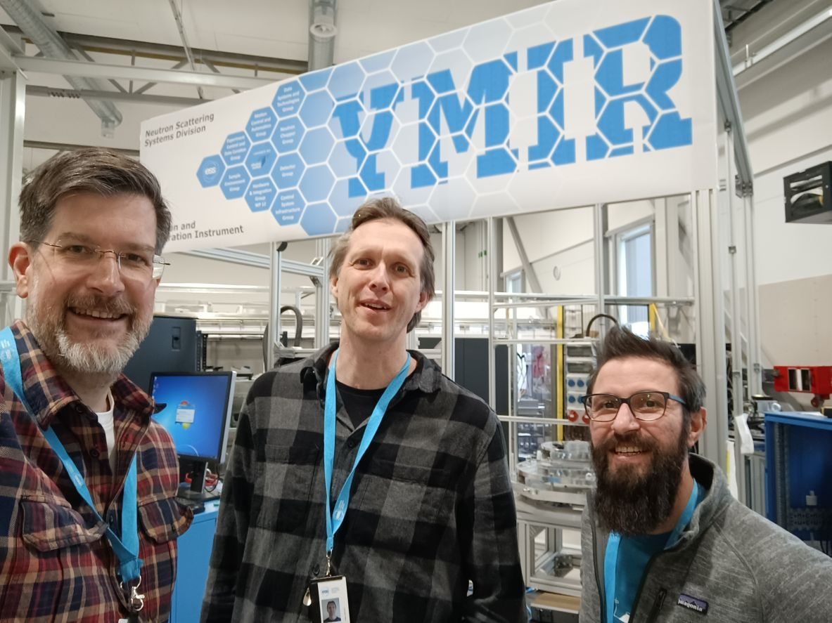
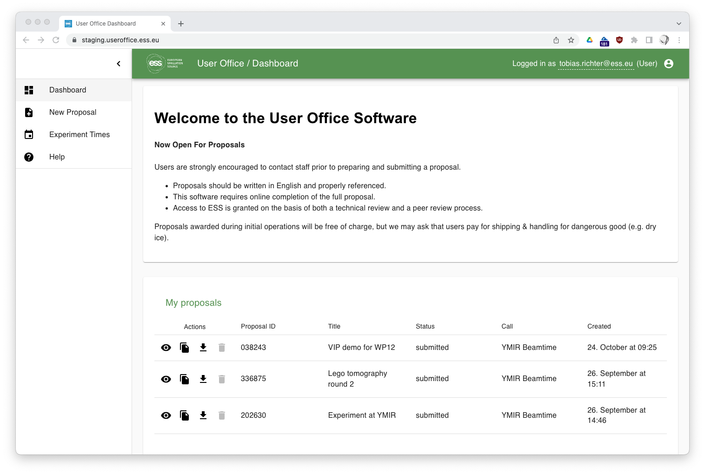
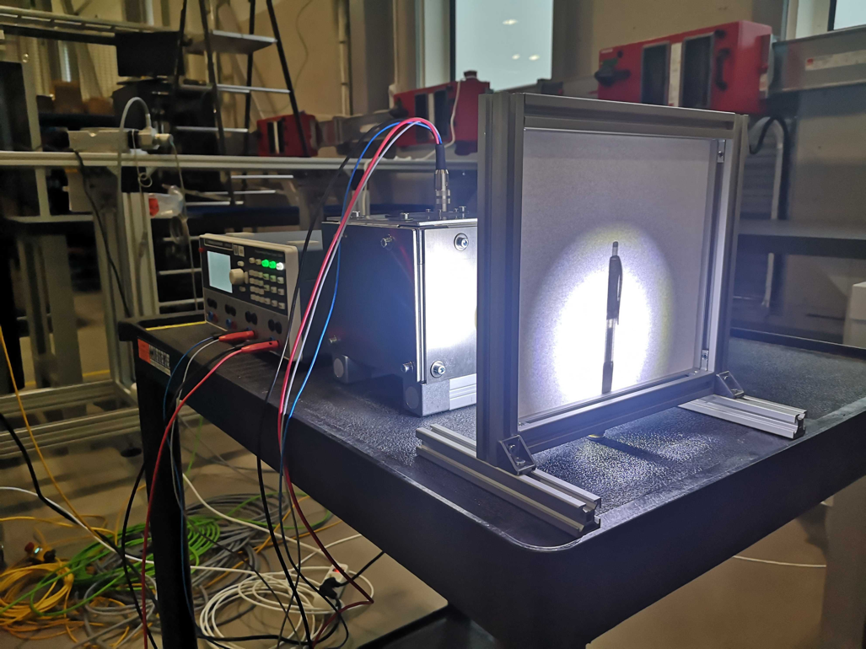
Development, Integration, Testing and Verification
167 m²
Ymir Integration Platform (Instrument) in B02
Main driver of progress across groups, through integration tests and demos
Routinely used for engagement with instrument teams for feedback and evaluation
Opportunity to run strawman experiments generating real data, like light tomography
Exercises production networks, compute infrastructure and their interfaces, like user office proposal system

Slide 8
ECDC Schedule – Milestones
Approach
Ticking off important functionality as defined milestones on a set timeline gives us confidence in our planning abilities
No benefit to have DAQ or experiment control on critical path
New milestones until the end of 2024 under development
Issues
Most ECDC deliverables depend heavily on external contributions (hardware, services, documentation, other engagement)
Inability to follow an agreed timeline only gets attention when ECDC would delay something that “ESS cares about”
Planning tools that provide benefits only once all work and resources are accounted for, will only be useful very late in the project (few subprojects currently have linkable activities for ECDC – instruments do not)
Notes:
Comparing starts and finishes with plan is odd
Average delay of planned activities?

Slide 9
Selected ECDC Milestones
Past & Upcoming
NICOS (experiment control) baseline for
LoKI ✅
DREAM ✅
ODIN 🔸
BIFROST 🔸
NeXus File (Geometry) Templates ✅
(Light) tomography
Raw data ✅
Manual reconstruction ✅
Automated processing 🔸
Hamamatsu Orca timing verification🔸
Slow control for CAEN 5560 🔸
Proposal system ready to schedule at Ymir ✅
DMSC data storage ready with permissions 🔸
Motion control available for demonstration for all standard classes🔸
Staging computing equipment available to testign and integration 🔸
Upcoming:
Detector timelines
Better linking of milestones overall with instruments and within NSS/ESS
Instrument commissioning planning

Slide 10
Main focus areas
ECDC in the next couple of years
2023
Finalise most work on critical common infrastructure with verifications
File writing
Data streaming
Overall experiment control
Verification activities (downstream, timing)
Complete scope for tranche 1 instruments
NeXus templates
NICOS interfaces
Device integration & verification
Detector and Camera integration
event formation
Slow control and calibration
More detailed planning, if possible
2024
Instrument tranche 1 rollout and cold commissioning
Scope for tranche 2
Detector and camera integration
Sample environment

Slide 11
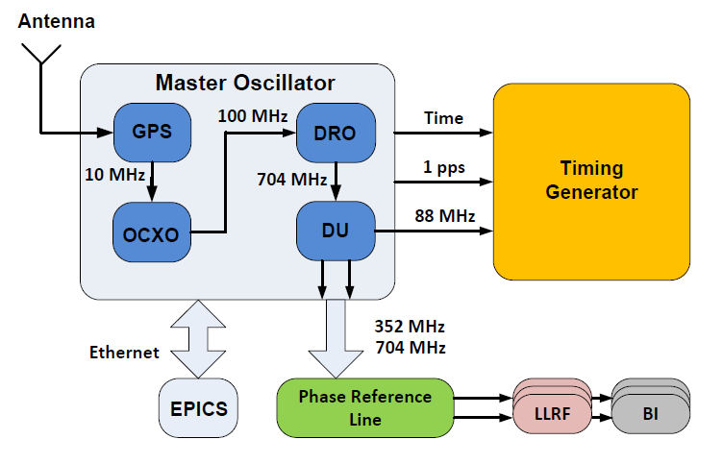
Timing System
GPS
Accuracy
NTP~10ms
PTP~10us
EVR~10ns
One Oscillator
IPC3
NTP server
Master oscillator
NTP IOC
1 Hz PPS System new second
88.0525 MHz
UTC time
IPC2
IPC1
EVG
PTP EVR IOC
EVR IOC
PCIe EVR1
PCIe EVR2
PTP GrandMaster
Sequencer
Optical fiber 14Hz & 88.0525 MHz
EVM Fanout (Repeater Hub)
Optical fiber 14Hz & 88.0525 MHz
TTL Input
TTL Output
Neutron Chopper
Setpoint
TDC
Medium accuracy PTP time stamped motion data
Motion controller
High accuracy EVR time stamped chopper data
EPICS forwarder
Low accuracy NTP time stamped meta data
Kafka cluster+NeXus+DMSC

Slide 12
Event mode data acquisition
Neutron events and motior positions on separate time axes
location
time
event
time

Slide 13
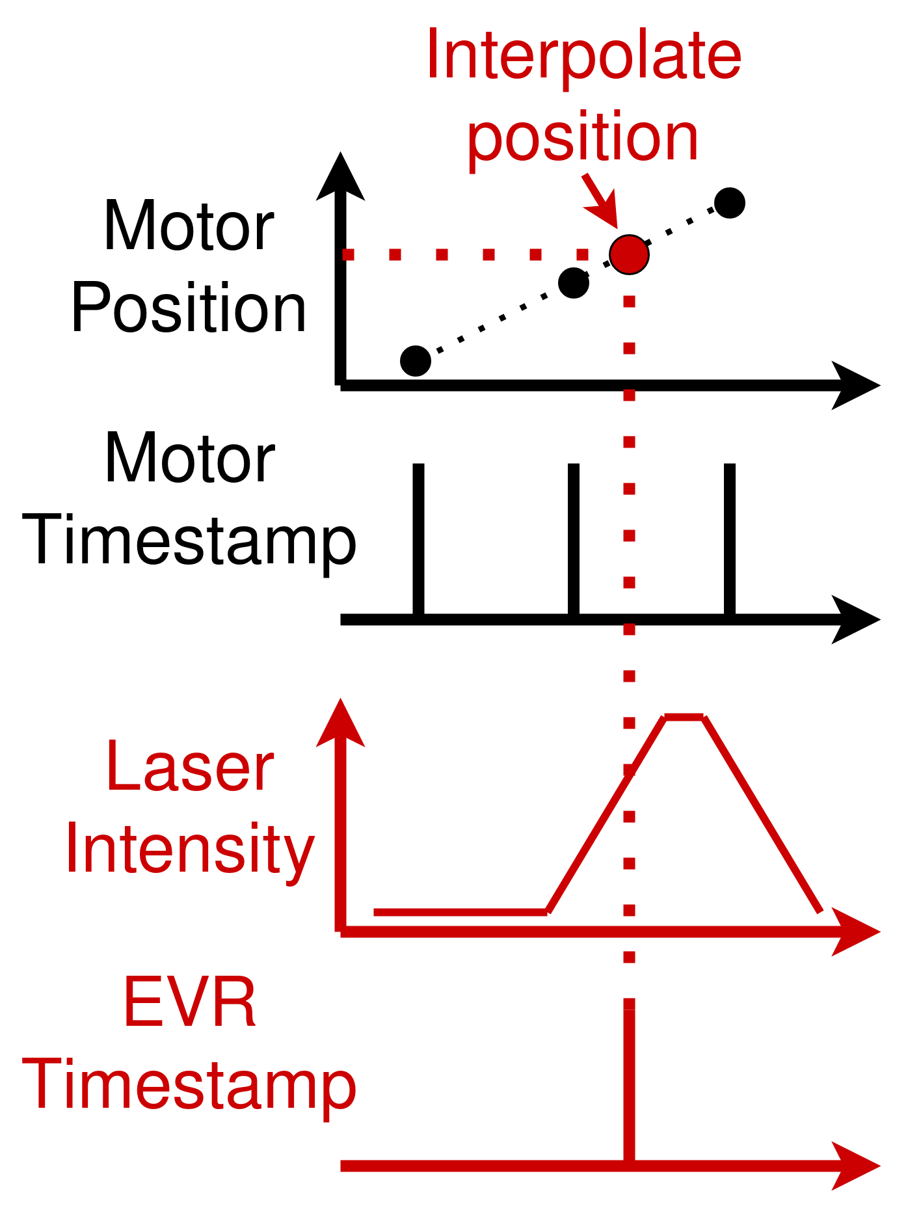
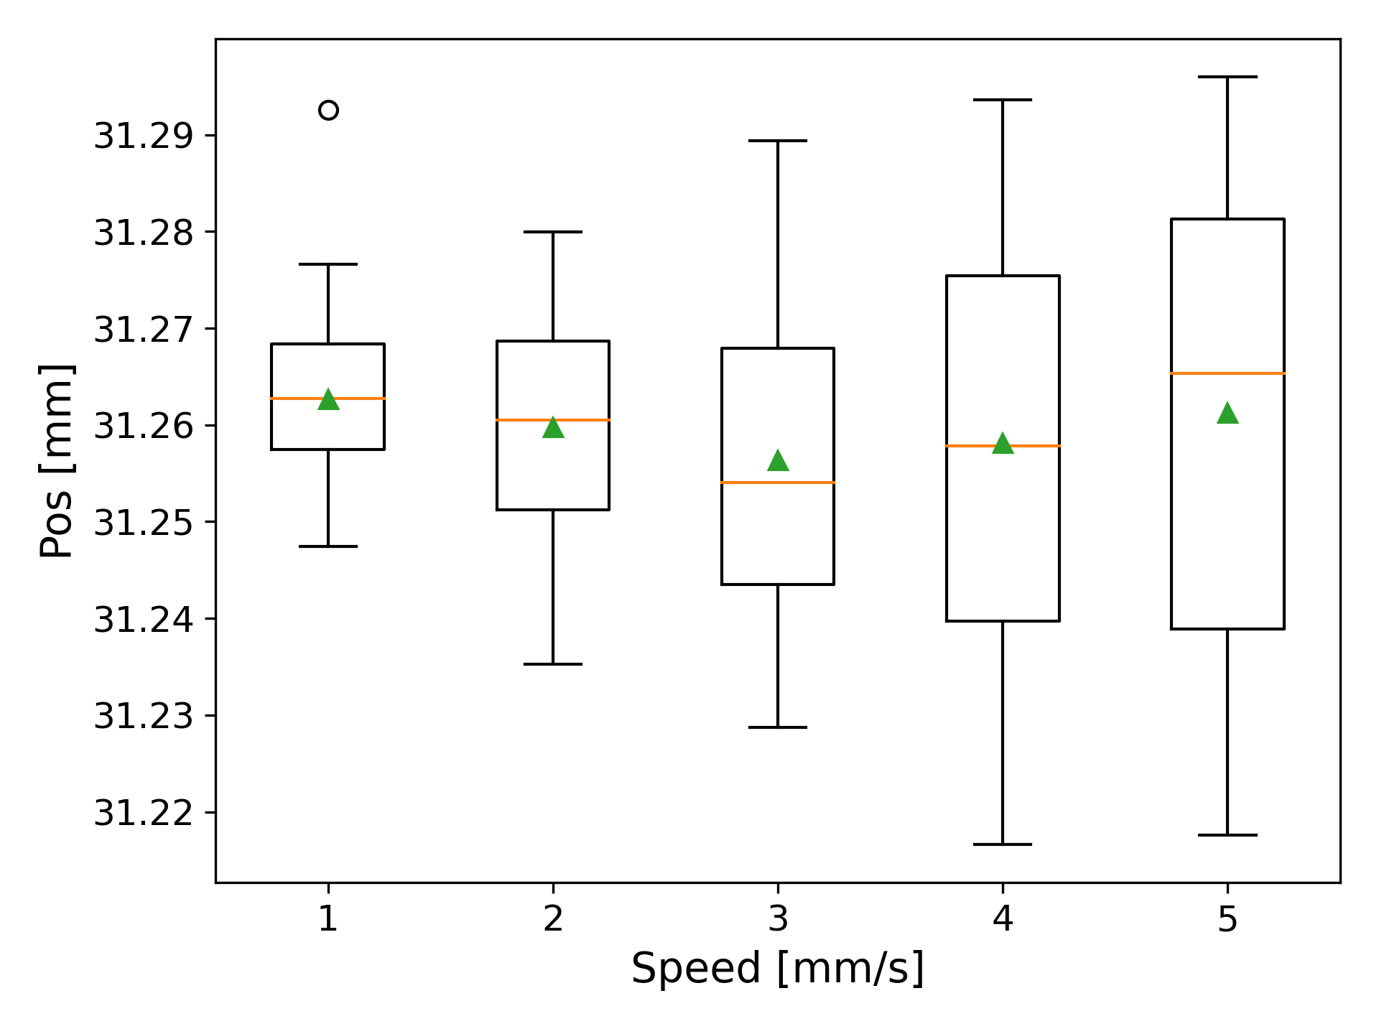
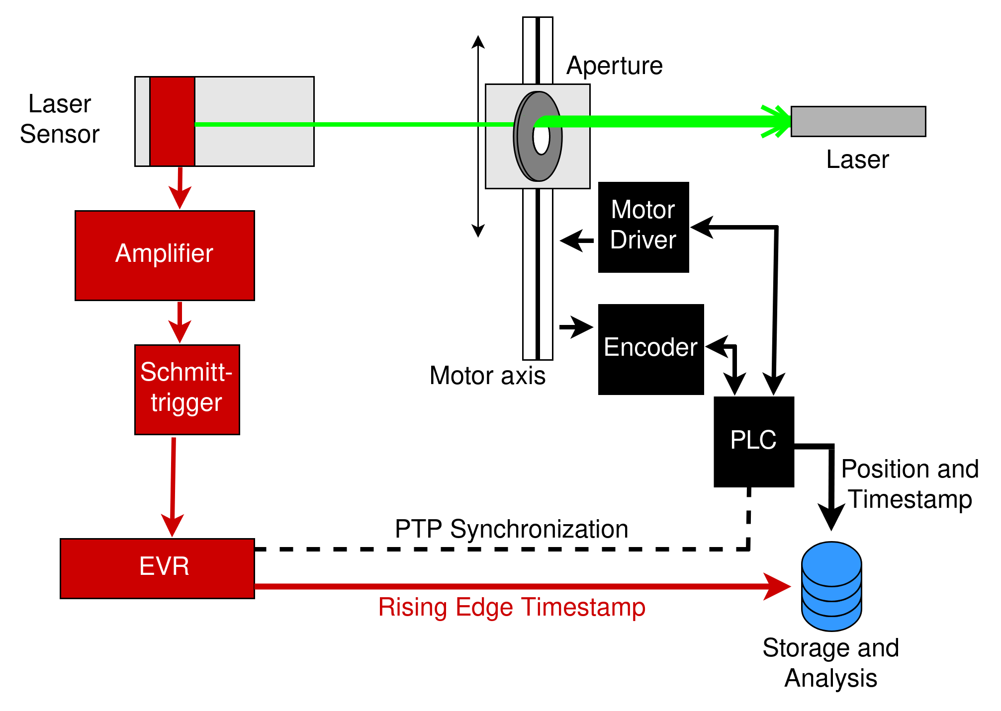
Timing Verification for Motion Control
Paper in preparation for ICALEPCS 2023

Slide 14
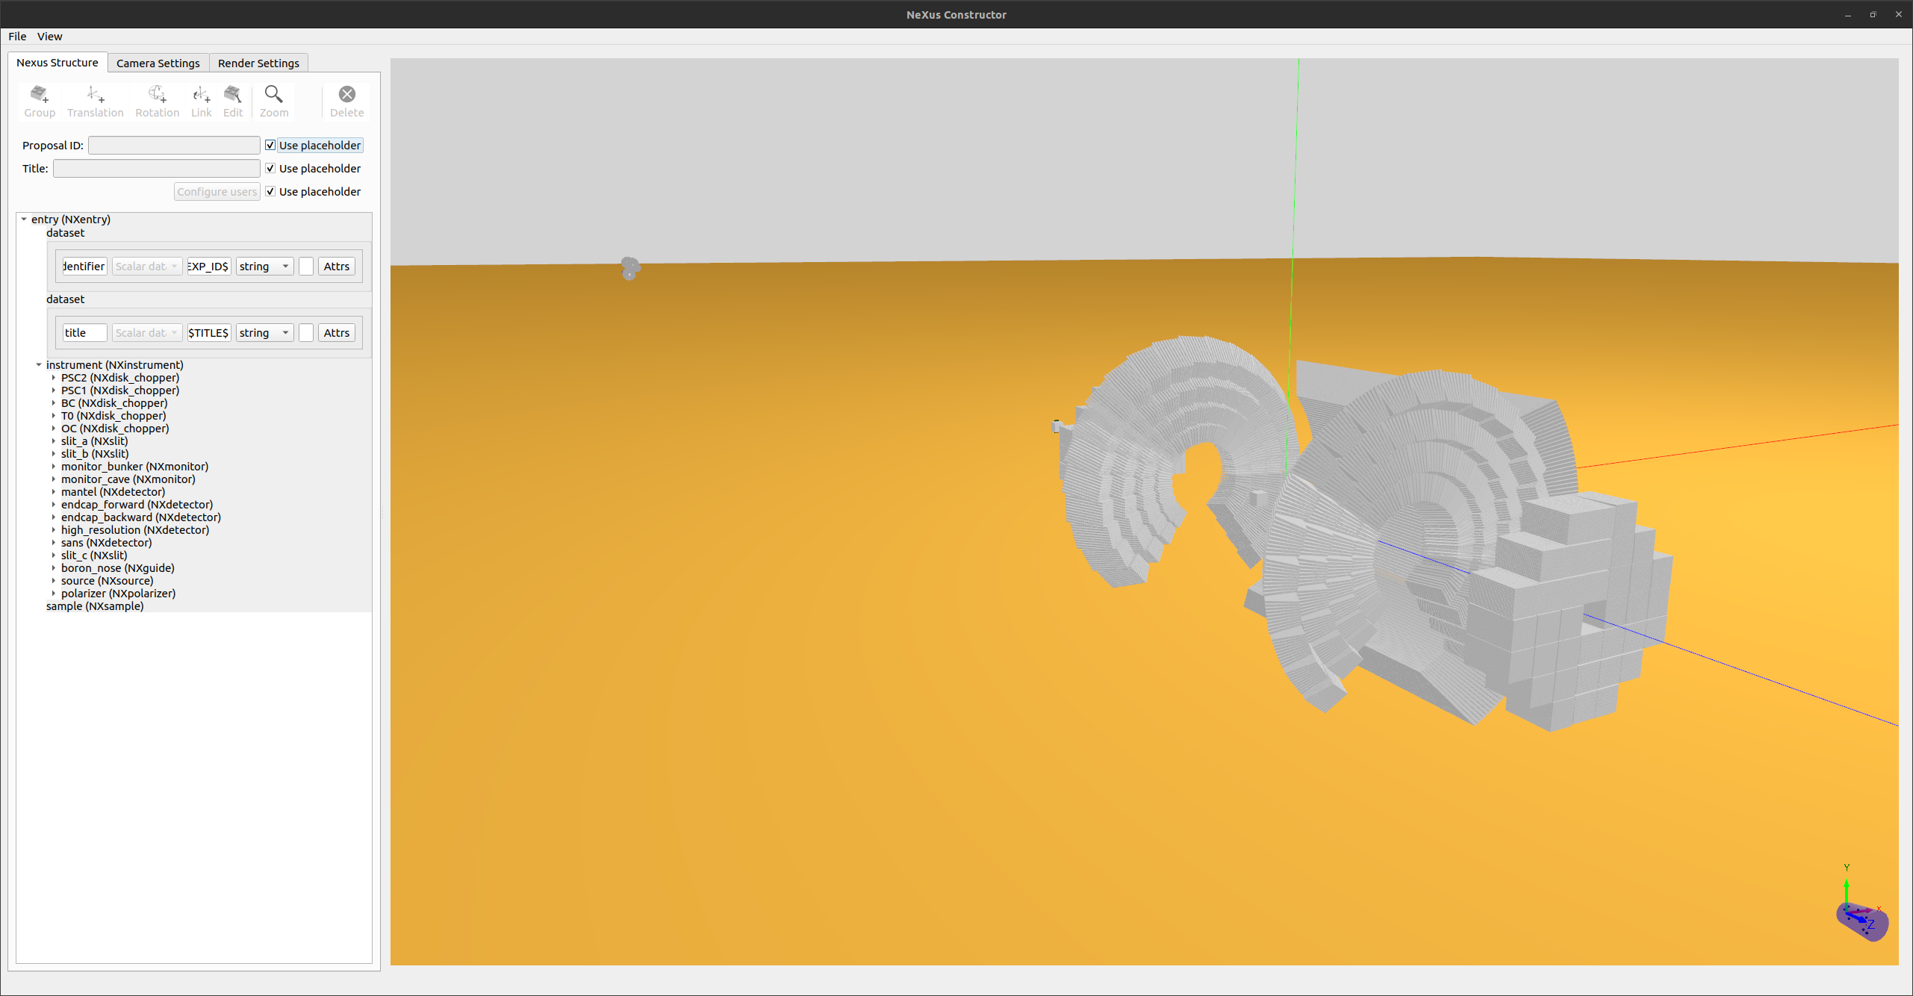
NeXus
Complete record of the experiments
Getting good engagement and feedback from scipp team (DMSC).
Issues and tasks on the roadmap:
Complex geometries are large in size (DREAM)
NeXus standard often ambiguous or incomplete
Some missing definitions: scintillator screens, optics, guides, rheometer
Alarms and connection status
Some bugs in file writer and pipeline

Slide 15
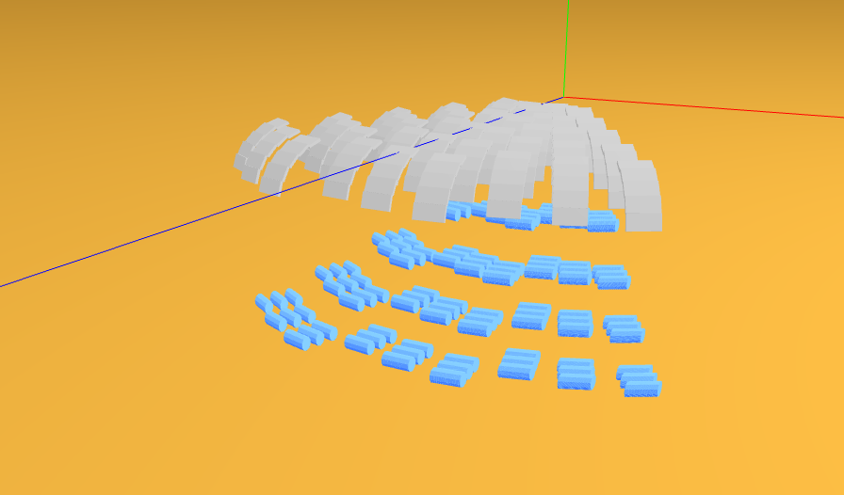
CAEN R5560 – BIFROST
PSD tubes with CAEN R5560 – also LoKI as well as C-SPEC and MIRACLES (?)
Hardware common for all tube/straw technologies
ECDC leading effort to harmonise CAEN firmwares between instruments that need them to maximise commonalities without compromising tested functionality
Development & deployment
Data format
Slow control
Different FPGA firmware need per instrument
Baseline NeXus detector geometries under discussion (BIFROST picture)

Slide 16
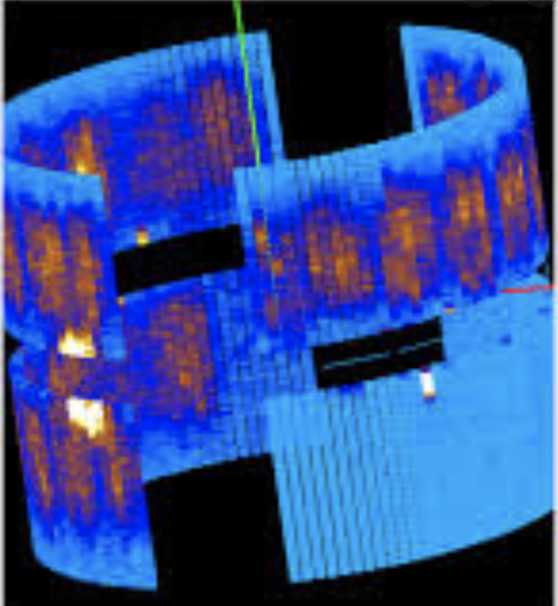
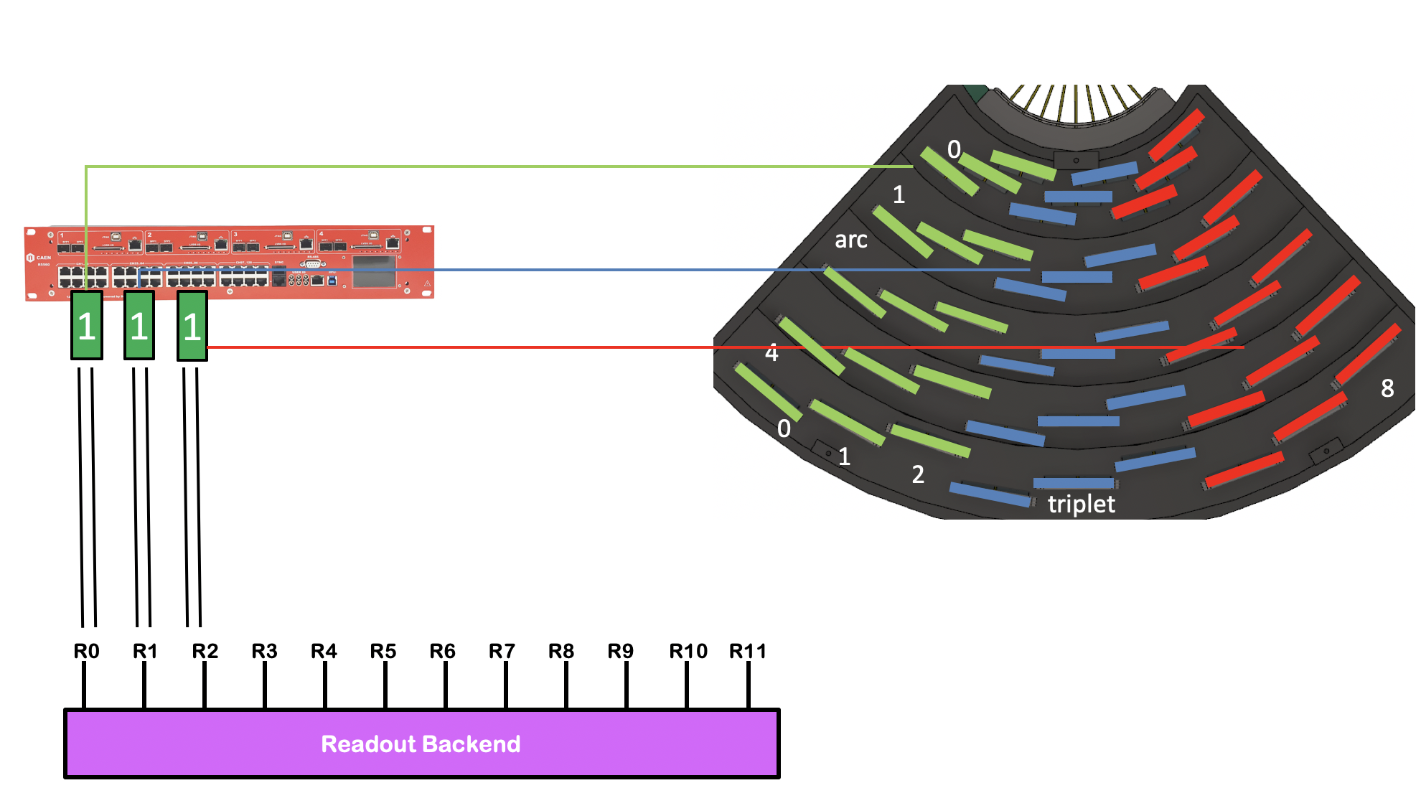
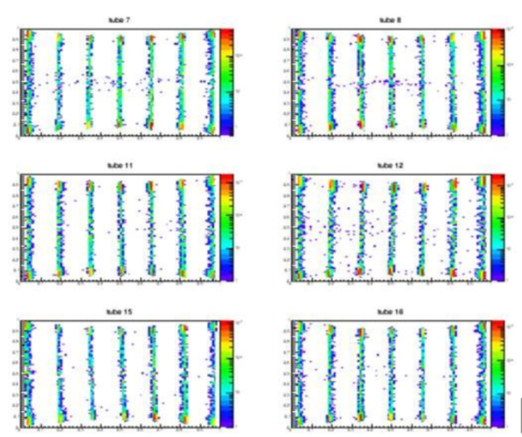
Detector Event Processing
Series of Agreed Mappings
Analog
Digital
Logical
Physical
(V(t), A(t), Ohm)
(t, FEN, RING, ch, adc)
(tof, pixel)
(tof, r, ϕ, θ)
Readout
Frontend
Readout
Backend
EFU
scipp
Conversion electronics ultimately measures charge, current or voltages.
Deals with instrument configuration identifiers such as rings and front –end nodes + other digital and digitized values: grids, wires, strips, tubes, amplitudes or ADC values.
This step abstract all information on the left away and provides a 2D (3D) detector surface which can be used for commissio-ning, monitoring and calibration.
Here, pixels are 'connected' with the physical instrument geometry: lengths, angles and detection volumes.

Slide 17
Detector Readout Chain
Used by most instruments – data path, simplified
Instrument
Detector Group
ECDC
Converter
Ring
Readout Master
Frontend
Assister
Event Formation Unit
For the data flow the ring & readout master are transparent.
The readout master provides timing and slow control to assister & frontends. Not shown.
The readout master is also agnostic to the slow control (thresholds, gains, offsets, operations modes, etc)
That means the following things need to be verified:
Ring operation
Timing synchronisation
Data format & interpretation
Frontend slow control
+ auxillary slow control (HV, gas, etc)

Slide 18
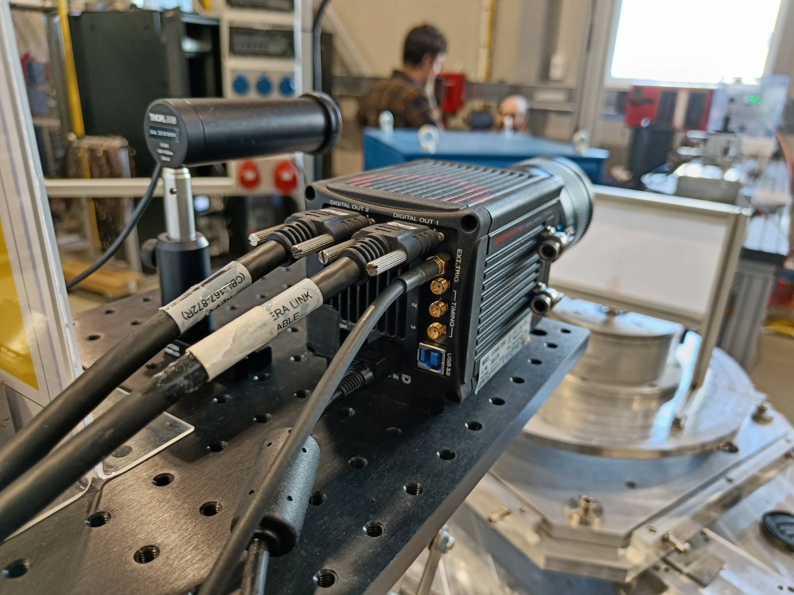
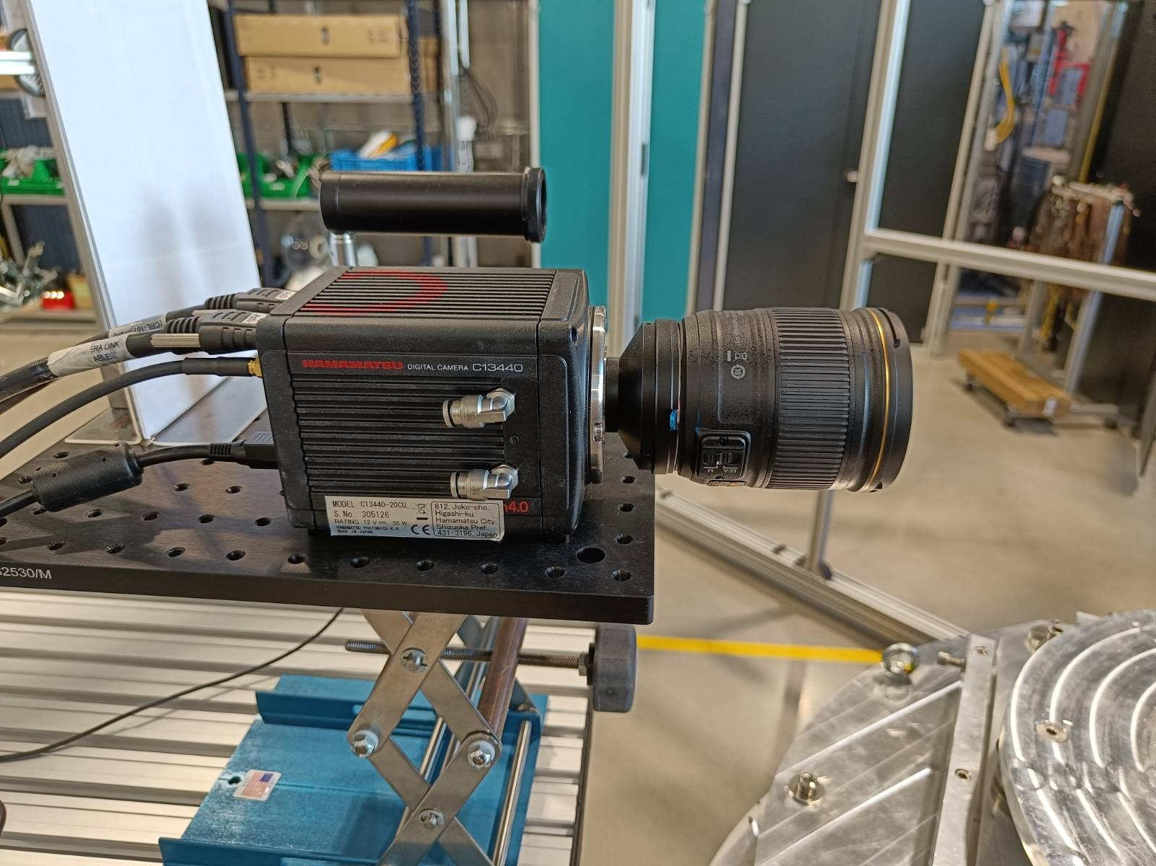
ODIN – Hamamatsu Orca
Camera – non-event mode for imaging
Hardware at ESS
Camera is working within EPICS area detetctor framework.
Allows basic data acquisition and control of parameters (some items still TBD).
Timing integration happens via connection to MRF event receiver. Verfication is ongoing to confirm
Synchonisation to “ESS time”
No drift or undue jitter
Not dropping frames

Slide 19
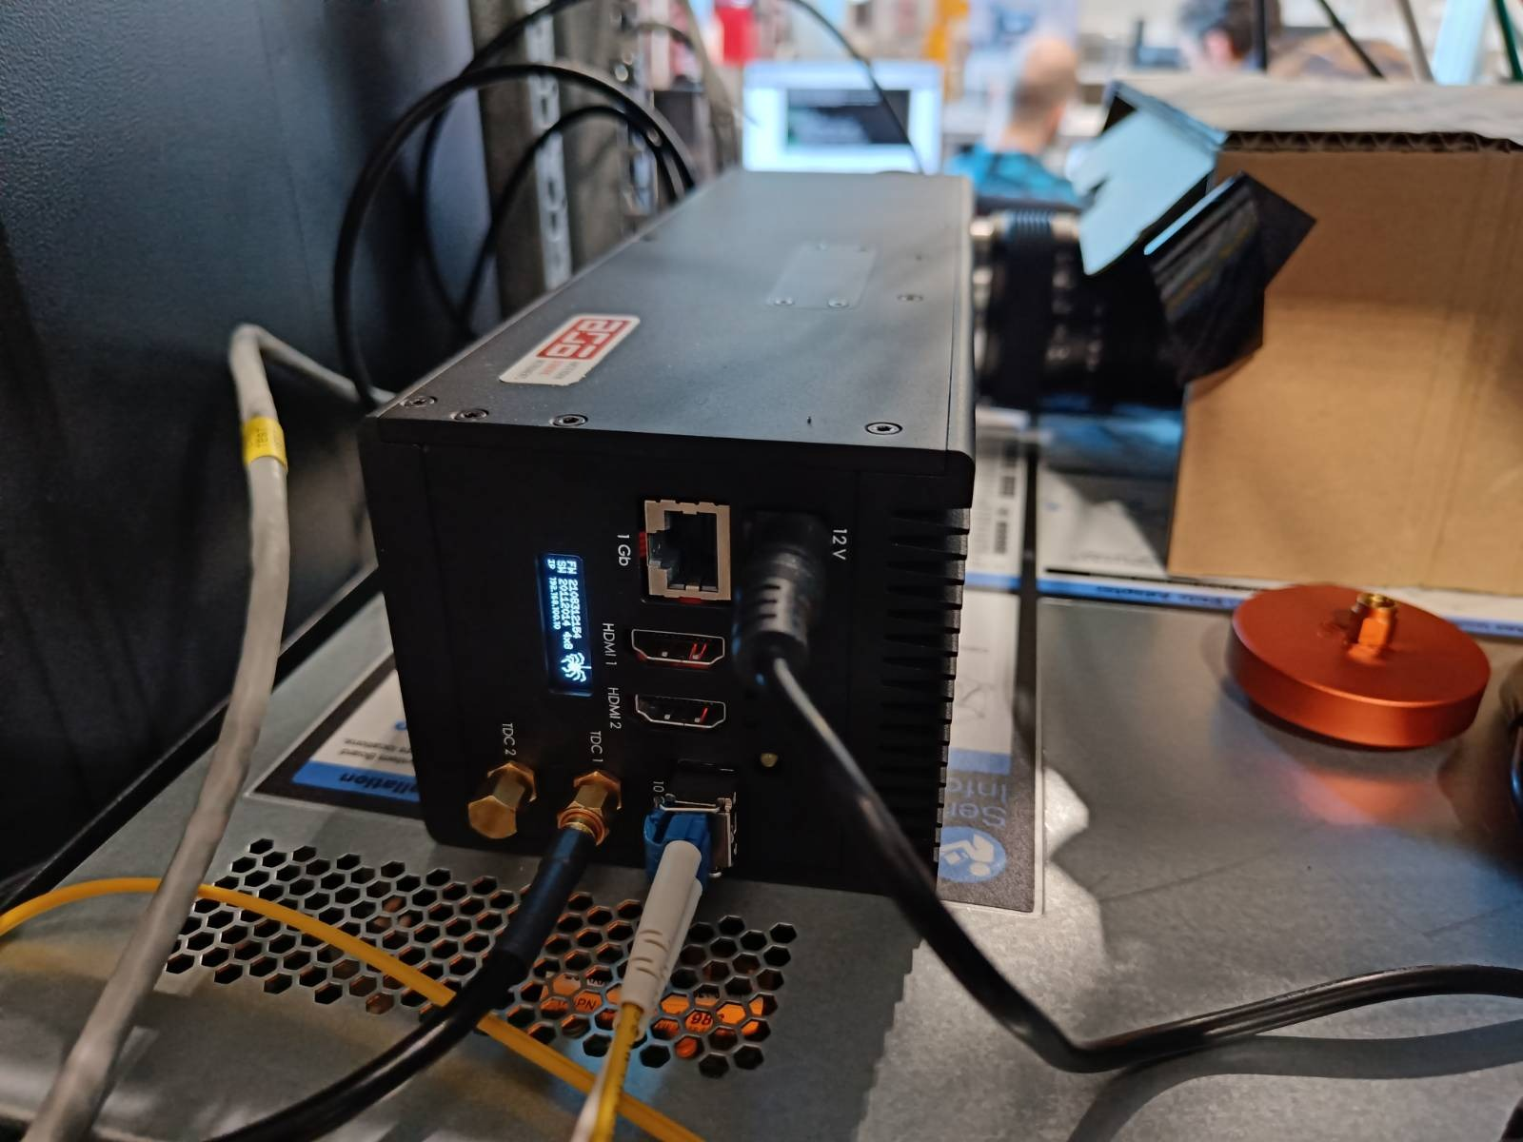
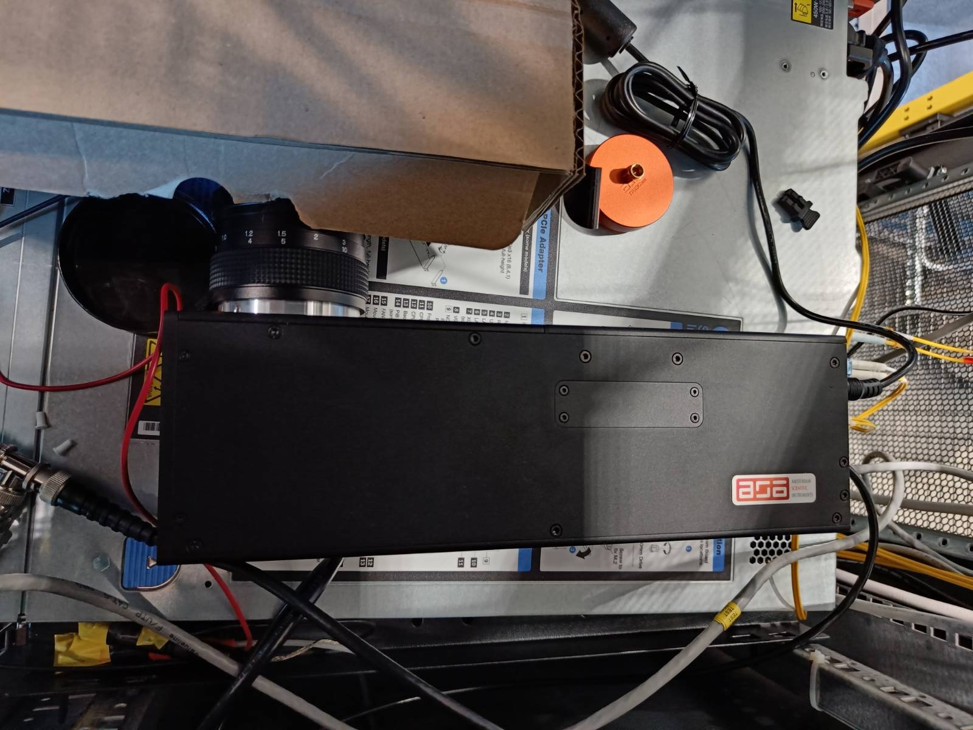
ODIN – Timepix3
Commercial event-mode detector
Hardware at ESS & Basic functionality reproduced
There are multiple operations modes and integration options that can meet the instrument team’s requirements
Vendor software vs ESS control
Standalone operations with MRF EVR vs ESS detector readout master integration
Under evaluation
LoskoVision-style acquisition/reduction similar to “standard” ESS live detector event formation mode

Slide 20
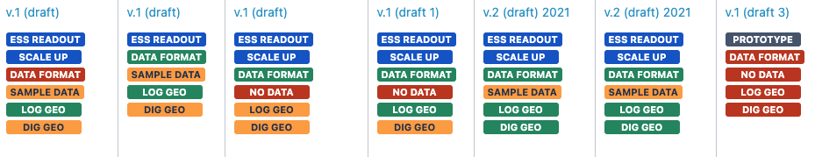
Interface Specifications + Timelines
For the early instruments getting everything ready relatively soon should be a priority.
We need to establish a joint timeline for
finalising designs
setting up tests
preparing slow control
implementation & verification
production
delivery with FAT/SAT
cold and hot commissioning
calibration
Discovering tasks or issues late is not fun!
Interface definition status for a random selection of Instruments. See:
https://confluence.esss.lu.se/display/ECDC/Instrument+Status+Overview
Other information of interest:
detector geometry
Rates (global, local, peak, average)
operation modes
commissioning plans
calibration procedures
etc

Slide 21
Detector Integration Overview
Focus on First Instruments (all with commercial detectors)
BIFROST
Good progress. Status as expected with respect to instrument schedule.
C-SPEC & MIRACLES
Expecting a solution similar to BIFROST, joining CAEN common effort
T-REX
Probably VMM based, no details known
VESPA
Nothing known yet
Beam Monitors
CDT electronics somewhat known
Event formation (coincidence building, location refinement, etc) in software requires intricate knowledge of frontends and data.
Main detector functionality and event formation are on a good way, where there is test data and agreements:
https://confluence.esss.lu.se/display/ECDC/Instrument+Status+Overview
Slow control (frontends and services) and calibration could do with a little bit more attention.

Slide 22
Questions?

