Slide 1
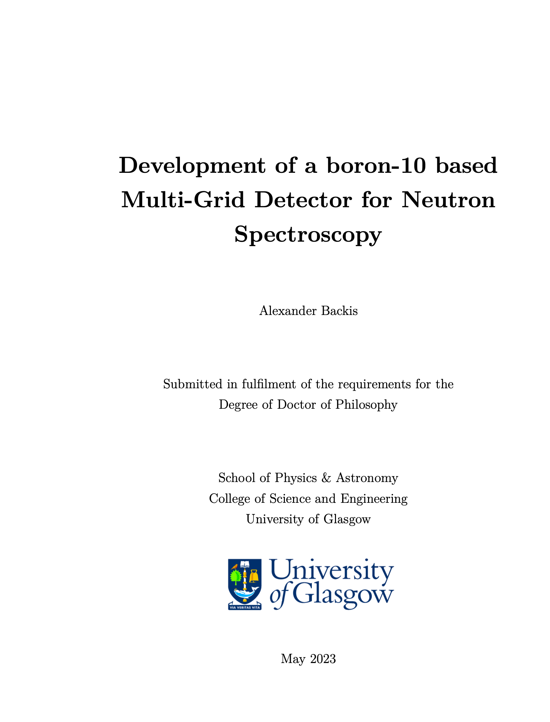
Development of a boron-10 based Multi-Grid Detector for Neutron Spectroscopy
SUBMITTED
PRESENTED BY alexander backis

Slide 2
Agenda
1 Introduction
2 The Multi-Grid Detector
3 Shielding investigation
4 V20 measurements
5 LET measurements
Summary
Thesis

Slide 3
1.
Introduction

Slide 4
1. Introduction
Overview
Work concerns the continued development of the boron-10 based Multi-Grid technology, a large area cold to epithermal neutron detector intended for neutron spectroscopy
The development was prompted by the price uncertainty of helium-3 and expected high flux at ESS, and began around 2010
The purpose was to design a simple and scalable neutron detector at low cost to replace helium-3 based detectors, with a high performance and high count rate
My work concerns detector characterization and selection of design parameters, primarily focused towards CSPEC
The main points includes signal-to-background, energy lineshape and energy resolution, and how to optimize these parameters

Slide 5

1. Introduction
Can probe short length scales non-destructively
Sensitive to light elements
Neutron properties
Science with neutrons is generally done by aiming a beam of neutrons on a material of interest (sample) and observing neutron state changes after the interaction
These states most commonly include direction and energy
From the observed state changes, information about the material structure and dynamics can be inferred
This includes information on how atoms and molecules are arranged, and how they vibrate, rotate and translate
Structure and dynamics can be probed simultaneously
Has de Broglie wavelengths at ～Å for ～meV energies
No regular dependence on atomic number
Can separate elements and isotopes with similar mass
Large interaction difference between
¹H and ²H
Mass is
1.67$⋅{10}^{−27}$ kg
Interacts via the strong nuclear force
Isotope sensitive
Neutrons
Electrically
neutral
Magnetic moment
Can be polarized
Straight-
forward analysis of scattering profiles
Low interaction probability
Can probe magnetic structures
Nuclear and magnetic interactions
can be separated
Deeply penetrating
Can probe volumetric averages

Slide 6
1. Introduction
Neutron properties
Science with neutrons is generally done by aiming a beam of neutrons on a material of interest (sample) and observing neutron state changes after the interaction
These states most commonly include direction and energy
From the observed state changes, information about the material structure and dynamics can be inferred
This includes information on how atoms and molecules are arranged, and how they vibrate, rotate and translate
Can probe short length scales non-destructively
Structure and dynamics can be probed simultaneously
Can probe magnetic structures
Nuclear and magnetic interactions
can be separated
Straight-
forward analysis of scattering profiles
Can probe volumetric averages
Deeply penetrating
Sensitive to light elements
Can separate elements and isotopes with similar mass
Large interaction difference between
¹H and ²H

Slide 7



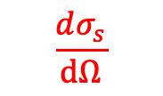
1. Introduction
Neutron methods
$$\frac{d^{2}σ_{s}}{dΩ{dE}_{f}}$$
Single crystal diffraction
Powder diffraction
SANS
Reflectometry
:
Neutron Spectroscopy
Neutrons
Sample
E_{i}
$$\frac{dσ_{s}}{dΩ}$$
:
Neutron Diffraction
Scattering
Absorption
Transmission
$$σ_{t}$$
:
Neutron Imaging
$σ_{s}:$ Scattering
$σ_{a}:$ Absorption
$σ_{t}:$ Transmission

Slide 8
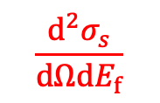

1. Introduction
Neutron Spectroscopy
$$\frac{d^{2}σ_{s}}{dΩ{dE}_{f}}$$
In neutron spectroscopy two parameters are measured: scattering angle and energy change
This is typically presented in a two-dimensional plot showing energy- and momentum transfer
12
10
8
6
4
2
0
Momentum transfer Q (Å⁻¹)
-50 -25 0 25 50
Energy transfer $ℏω$ (meV)

Slide 9
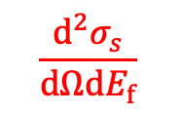

1. Introduction
$$\frac{d^{2}σ_{s}}{dΩ{dE}_{f}}$$
12
10
8
6
4
2
0
Neutron Spectroscopy
Momentum transfer Q (Å⁻¹)
This spectra is material dependent, where the probable region is limited by incident neutron energy and the detectable scattering angles
-50 -25 0 25 50
Energy transfer $ℏω$ (meV)

Slide 10

1. Introduction
12
10
8
6
4
2
0
Momentum transfer Q (Å⁻¹)
-50 -25 0 25 50
Energy transfer $ℏω$ (meV)
Neutron Spectroscopy
If we integrate over momentum, we see the dynamics: translations, rotations and vibrations
Inelastic scattering
Elastic scattering
Quasi-elastic scattering
Intensity (log scale)
Energy transfer $ℏω$ (meV)

Slide 11
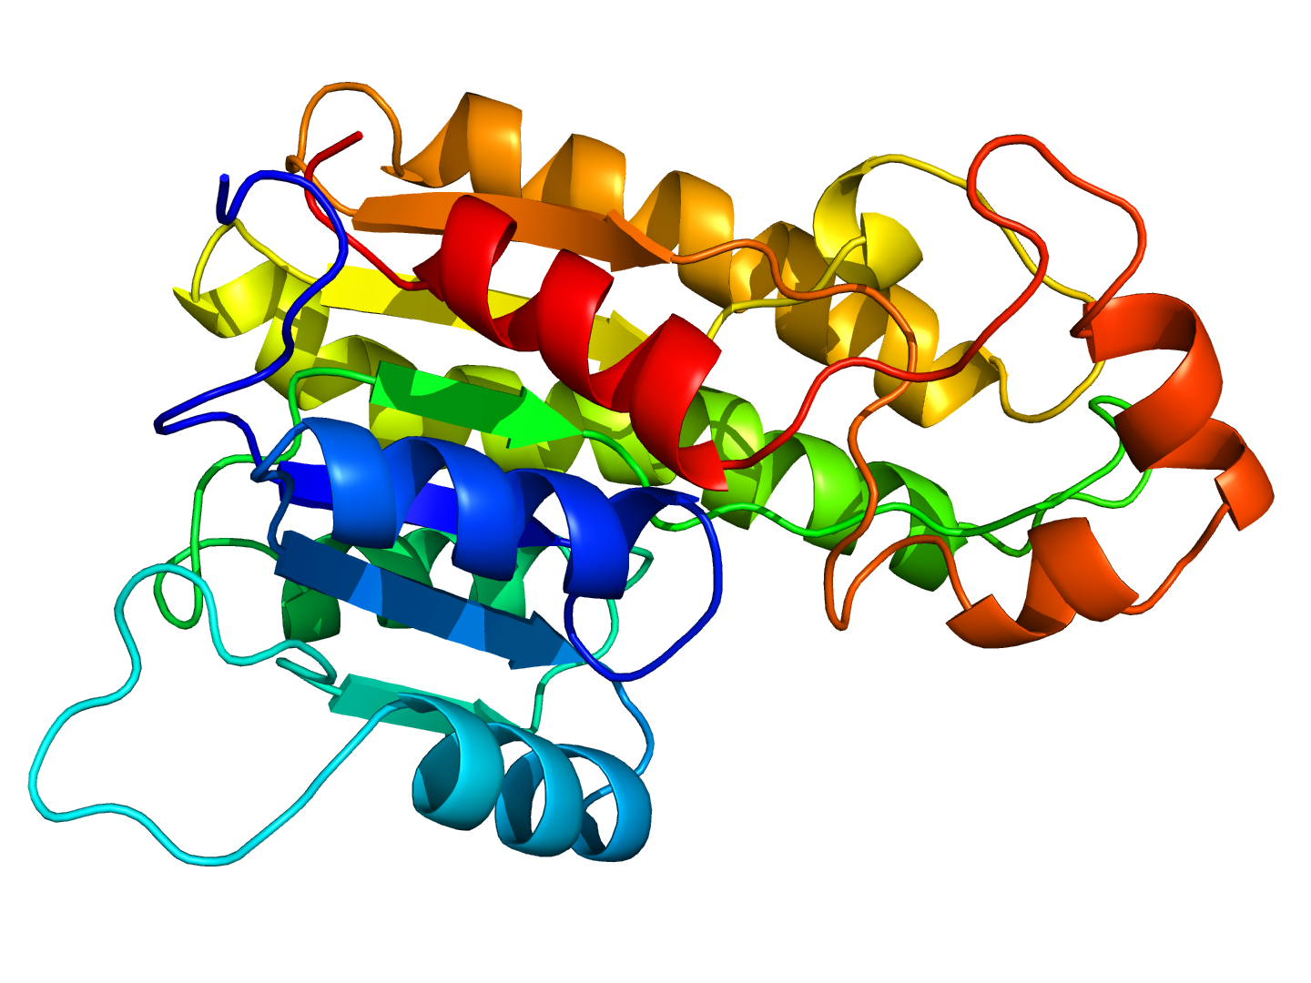

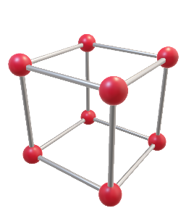
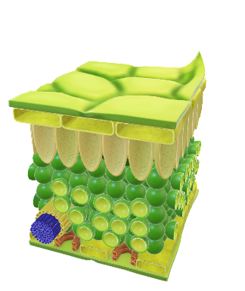
1. Introduction
12
10
8
6
4
2
0
-50 -25 0 25 50
Energy transfer $ℏω$ (meV)
Neutron Spectroscopy
Inelastic scattering gives information about vibrations and rotations
Quasi-elastic scattering gives information about translations
Inelastic scattering
Elastic scattering
Quasi-elastic scattering
Intensity (log scale)
Energy transfer $ℏω$ (meV)
Inelastic scattering
Quasi-elastic scattering
Distance
Source
Time

Slide 12
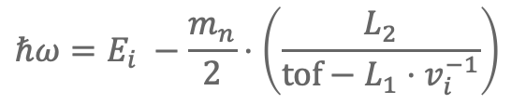

1. Introduction
Intensity (log scale)
Energy transfer $ℏω$ (meV)
Neutron Spectroscopy
To measure the neutron energy transfer, the neutron energy must be known before the interaction
To do this, the wide energy band received from the source has to be narrowed
This can be done with a chopper
The neutrons then hit the sample and exchange energy
From the known distances and time-of-flight, the energy exchange can be determined
Distance
tof
T₂
Detector
T₁
L₂
Sample
Chopper
L₁
Source
Time
$$ℏω=E_{i} −\frac{m_{n}}{2}⋅\left(\frac{L_{2}}{tof−L_{1}⋅v_{i}^{−1}}\right)$$

Slide 13
2.
The Multi-Grid Detector

Slide 14
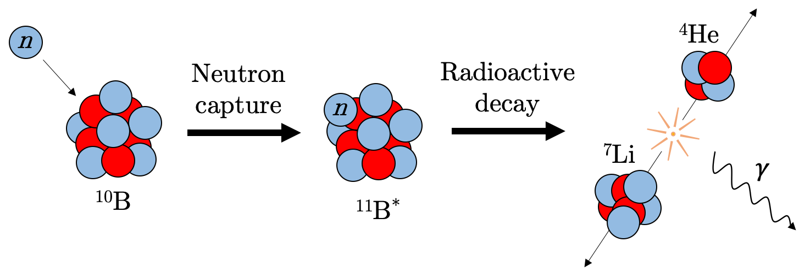
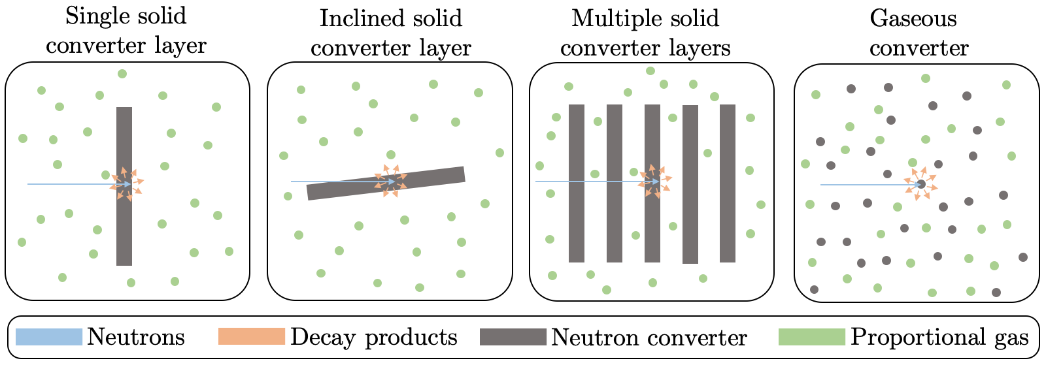
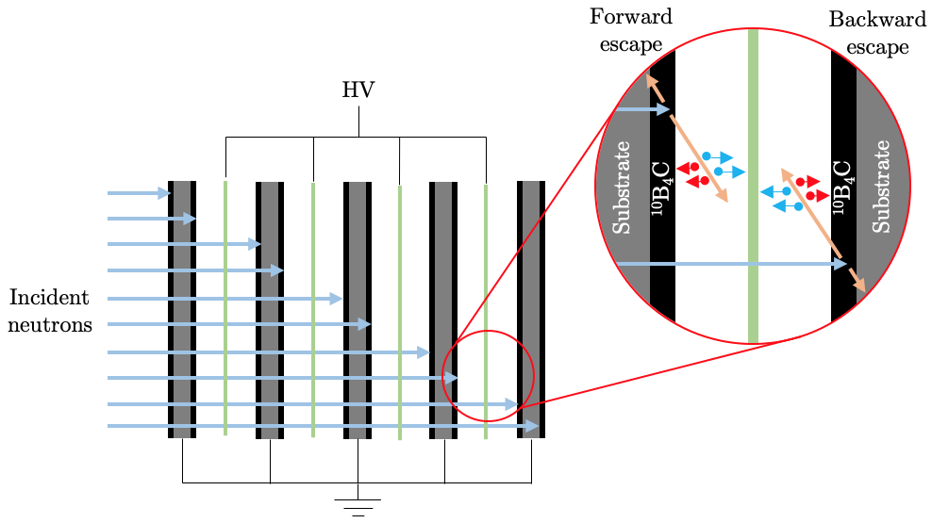
2. The Multi-Grid Detector
Principle
To register the passing of the neutron we want an electric pulse
As neutrons do not interact electrically – and slow neutron has insufficient energy to cause ionization (has meV but need eV) – an indirect detection method is used
This is done via neutron capture, which can result in subsequent decay products with MeV energies
To practically implement this, there are four general techniques (which can be combined)
The Multi-Grid detector uses the multiple solid converter layers strategy

Slide 15
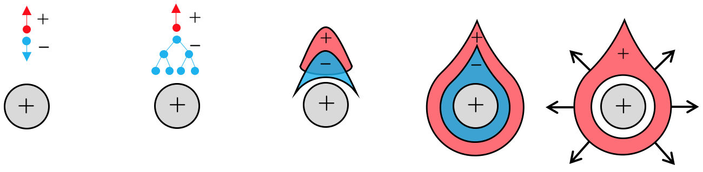
2. The Multi-Grid Detector
Principle
Converter layers has to be in the order of micrometers, and are therefore coated on substrates, called blades
To measure and amplify the released charge, an electric field is put between the blades

Slide 16
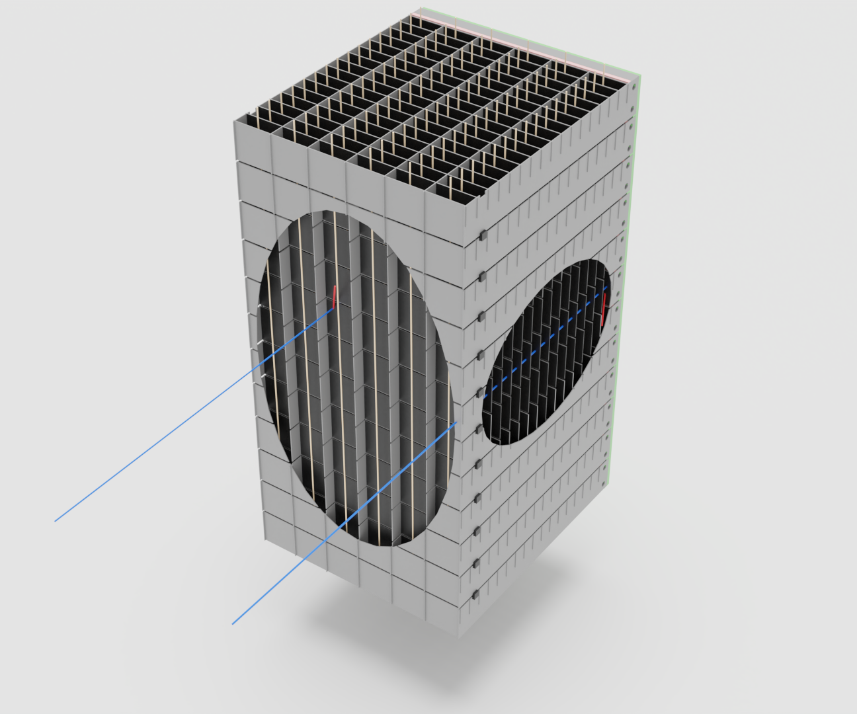
2. The Multi-Grid Detector
Principle
This causes charge avalanches and subsequent drift, which induces a measurable current in the blades and wires

Slide 17
2. The Multi-Grid Detector
Principle
By organizing the blades into grids, which are then stacked into columns, a three-dimensional readout is acquired
End shielding
Normal blade
Radial blade
Voxel
Conversion product
Incident neutron
Wire
Insulator
Grid
Spacer

Slide 18
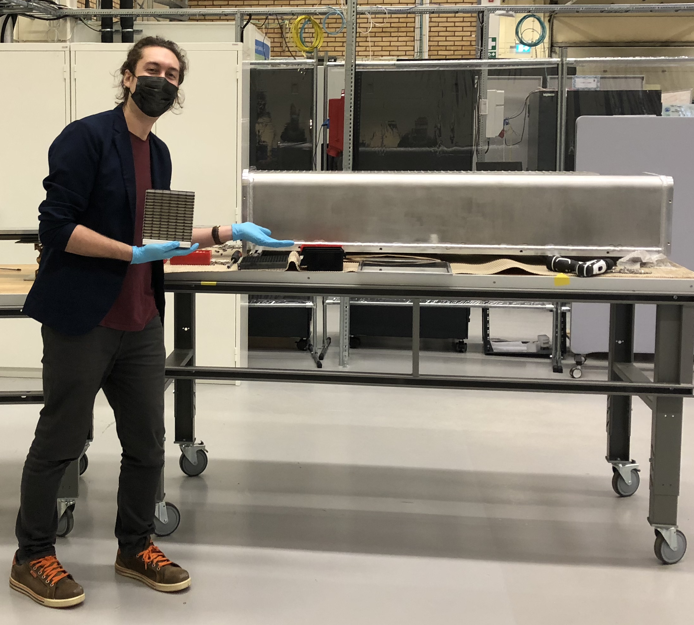
2. The Multi-Grid Detector
Principle
The columns are then placed inside vacuum-proof vessels, which are installed inside the detector tank of the neutron spectroscopy instrument
Grid
Vessel

Slide 19
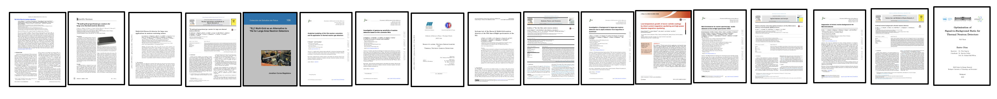
2. The Multi-Grid detector
Detection efficiency
Development
Uniformity
There had been a total of 17 publications related to the Multi-Grid before the start of my PhD
These publications cover areas such as proof of principle, detector characterization and detector simulations
My work concerns the next steps of this work, which most importantly concerns understanding the energy lineshape and how this can be improved
Gamma sensitivity
Coatings
Energy lineshape
Count rate
Energy lineshape
Intrinsic background
Energy resolution
Activation
Fast neutron sensitivity
Full-scale detector simulations
Notes:
There were, to the best of my understanding, 17 Multi-Grid detector publications when I started my PhD.

Slide 20
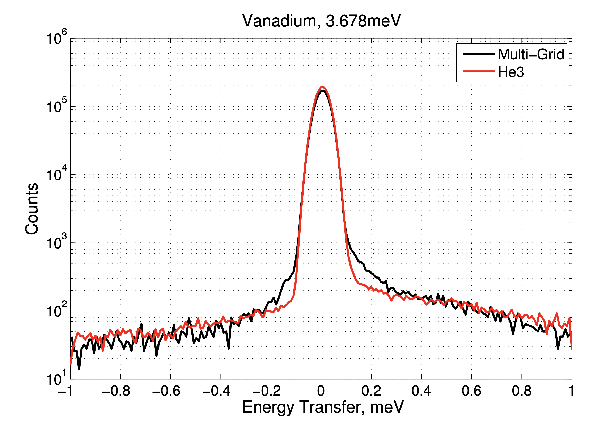
2. The Multi-Grid detector
Development
There had been a total of 17 publications related to the Multi-Grid before the start of my PhD
These publications cover areas such as proof of principle, detector characterization and detector simulations
My work concerns the next steps of this work, which most importantly concerns understanding the energy lineshape and how this can be improved
Khaplanov, A., et al.: Multi-grid detector for neutron spectroscopy: results obtained on time-of-flight spectrometer CNCS. Journal of Instrumentation 12(04), 04030– 04030 (2017). doi:10.1088/1748-0221/12/04/p04030
Notes:
There were, to the best of my understanding, 17 Multi-Grid detector publications when I started my PhD.

Slide 21
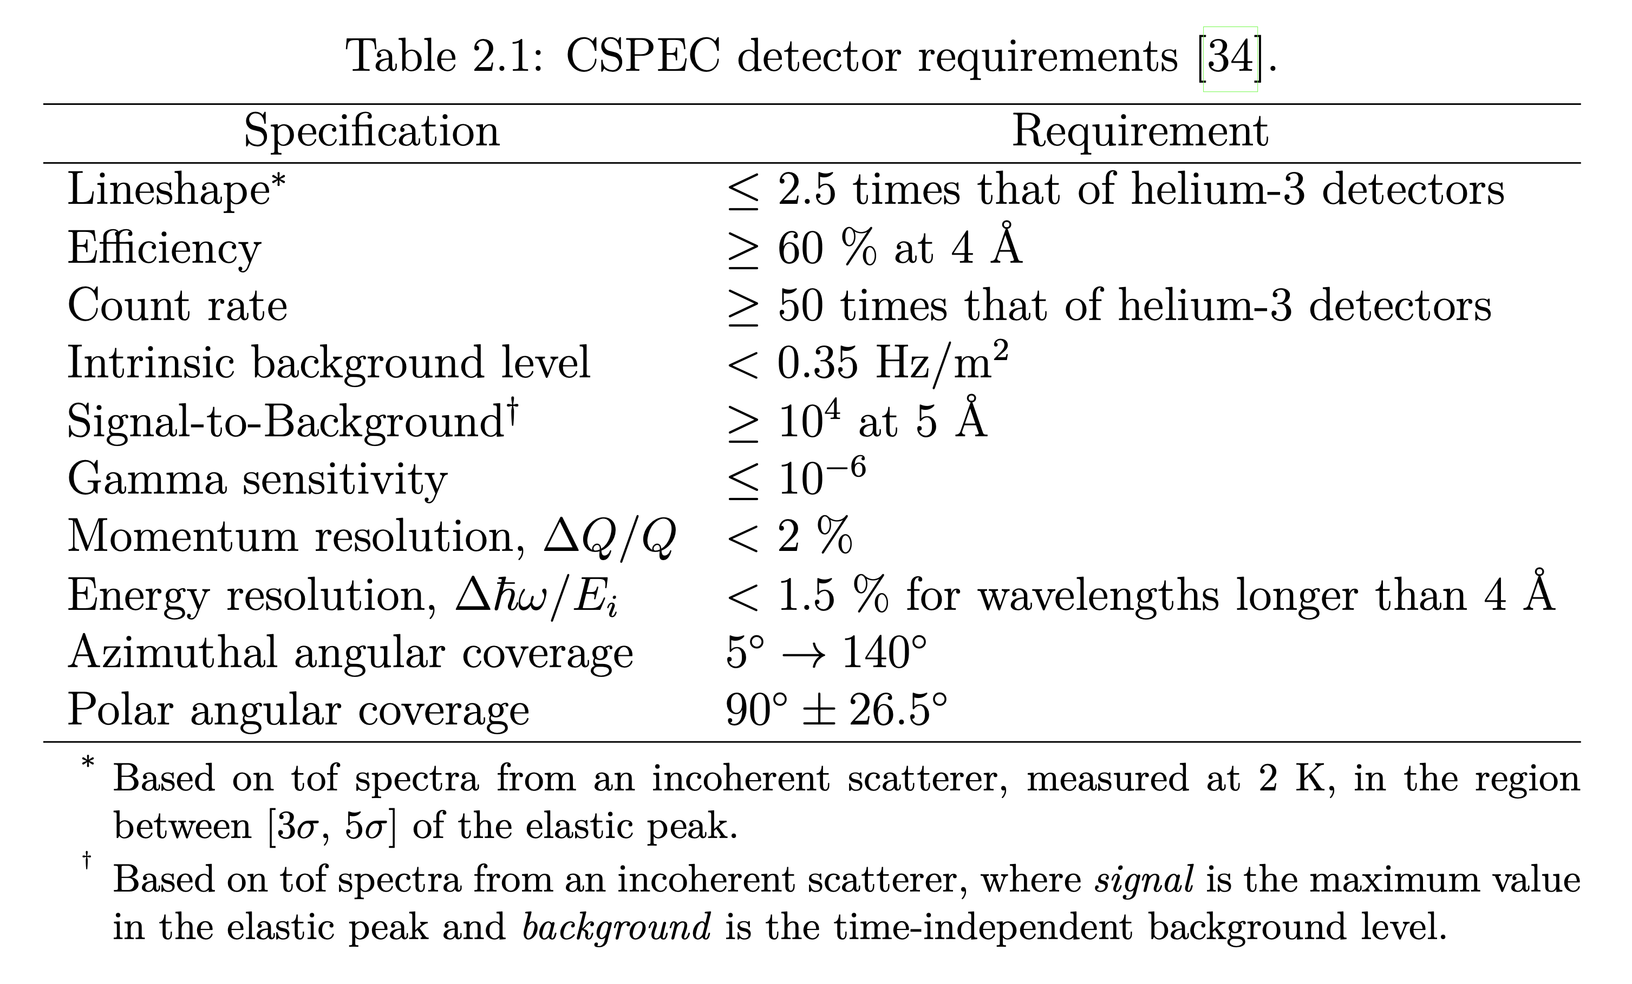
2. The Multi-Grid detector
What was the purpose of my PhD?
Most of my work has focused on meeting the CSPEC detector requirements in terms of lineshape and signal-to-background ratio
To do this, three separate studies have been done:
  A shielding investigation
  A beamtime at V20
  A beamtime at LET
The rest of the presentation will focus on these studies
Notes:
There were, to the best of my understanding, 17 Multi-Grid detector publications when I started my PhD.

Slide 22
3.
Shielding investigation

Slide 23
3. Shielding investigation
Purpose
Signal
SBR
Background
How can we decrease background?
Notes:
There were, to the best of my understanding, 17 Multi-Grid detector publications when I started my PhD.

Slide 24

3. Shielding investigation
What is background?
Counts
Background
Signal
Time-independent
Time-dependent
Background
Internal
External
Internal
External
Photons
Fast neutrons
Thermal neutrons
Charged particles
tof
Notes:
In addition to this, I will narrow the topic down to a specific type of background reduction. So, just to give a brief overview, the general case is that you have an overlaying background together with your signal. This background might have some time-independent and some time-dependent components. These are in turn due to a combination of internal and external background sources. Furthermore, depending on what your specific detector is sensitive to, it might be due a range of different particles.
Now, there has been a huge amount of effort to quantify and reduce the effect of these different components at ESS, and here I have just listed a portion of that research.
In this talk, in the interest of time, the focus will primarily be on how to reduce time-dependent external and internal sources of thermal neutrons. This has also been highlighted in other talks, such as Francescos yesterday, that thermal neutron scattering is a very important factor to consider.

Slide 25
3. Shielding investigation
Why is this important for the Multi-Grid?
Incident neutrons
Multi-layered structure
Advantage
Challenge
Rate spread between layers
⇒ High count rate
Relatively long travel path through aluminum
⇒ neutron scattering
Notes:
There were, to the best of my understanding, 17 Multi-Grid detector publications when I started my PhD.

Slide 26
3. Shielding investigation
How can we make this as general as possible?
Signal
Background
Shielding
Vessel
Active volume
Notes:
There were, to the best of my understanding, 17 Multi-Grid detector publications when I started my PhD.

Slide 27
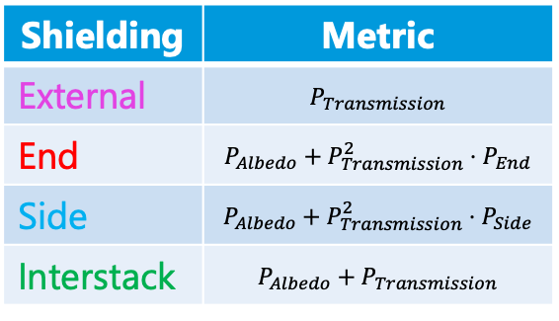
3. Shielding investigation
How can we make this as general as possible?
Required properties of shielding material varies depending on where it is situated
Will split the shielding into four categories, each with its own performance metric
Need to know how much neutron Transmission and Albedo (i.e. how much is backscattered) probabilities our shielding materials have
Shielding | Metric
External | $$P_{Transmission}$$
End | $$P_{Albedo}+P_{Transmission}^{2}⋅P_{End}$$
Side | $$P_{Albedo}+P_{Transmission}^{2}⋅P_{Side}$$
Interstack | $$P_{Albedo}+P_{Transmission}$$
Notes:
There were, to the best of my understanding, 17 Multi-Grid detector publications when I started my PhD.

Slide 28
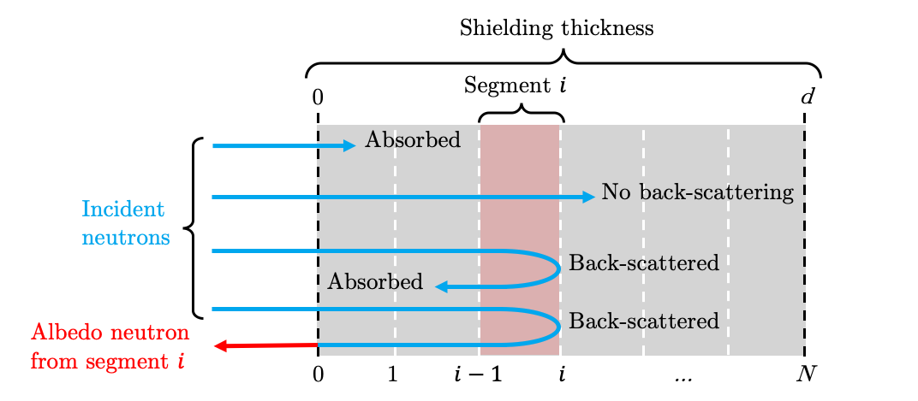
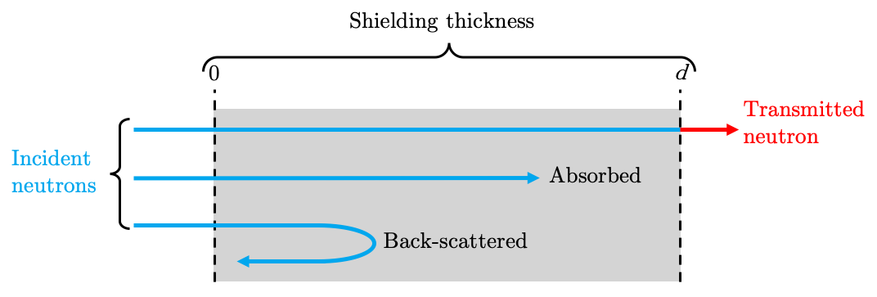
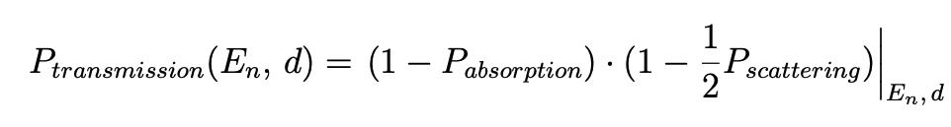
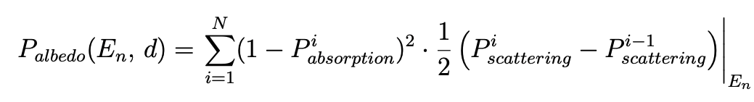
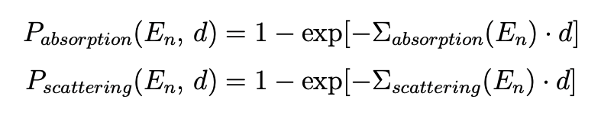
3. Shielding investigation
How do we simplify the considerations?
Transmission
Albedo
Notes:
There were, to the best of my understanding, 17 Multi-Grid detector publications when I started my PhD.

Slide 29
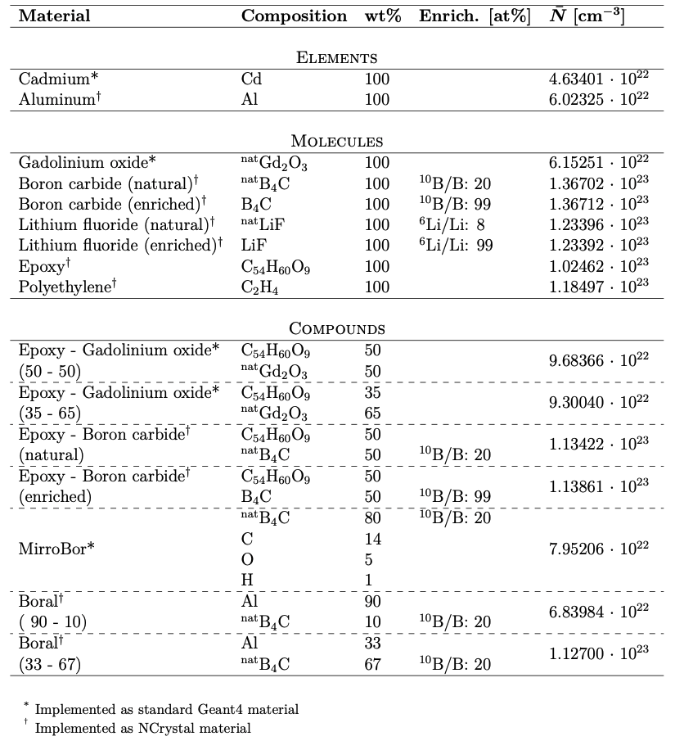
3. Shielding investigation
What materials to consider?
Notes:
There were, to the best of my understanding, 17 Multi-Grid detector publications when I started my PhD.

Slide 30
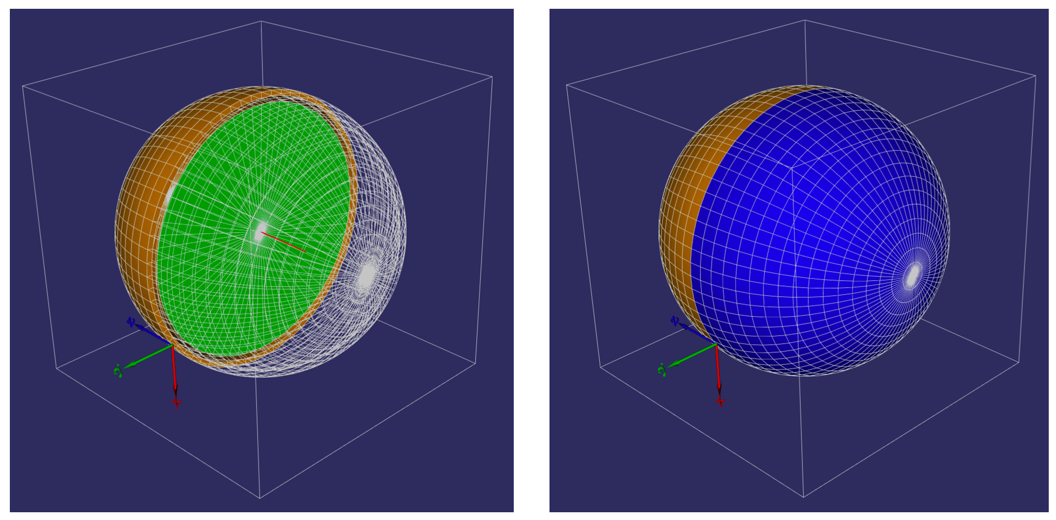
3. Shielding investigation
How accurate are the approximations?
Simulation setup
Notes:
There were, to the best of my understanding, 17 Multi-Grid detector publications when I started my PhD.

Slide 31
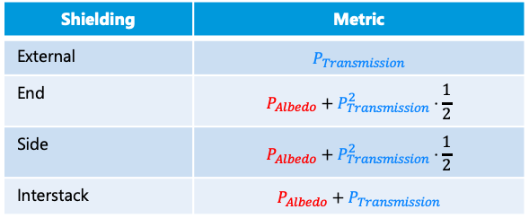
3. Shielding investigation
How to pinpoint the correct material and thickness?
Want to find an easy way to find the right material and shielding thickness for a specific requirement
Performance depends on transmission and albedo, which have opposite trends
Shielding | Metric
External | $$P_{Transmission}$$
End | $$P_{Albedo}+P_{Transmission}^{2}⋅\frac{1}{2}$$
Side | $$P_{Albedo}+P_{Transmission}^{2}⋅\frac{1}{2}$$
Interstack | $$P_{Albedo}+P_{Transmission}$$
Optimized thickness
P_{Albedo}
Probability
P_{Transmission}
Shielding thickness
Notes:
There were, to the best of my understanding, 17 Multi-Grid detector publications when I started my PhD.

Slide 32
3. Shielding investigation
How to pinpoint the correct material and thickness?
However, the optimal performance is always given by the saturated albedo probability
Shielding | Metric
External | $$P_{Transmission}$$
End | $$P_{Albedo}+P_{Transmission}^{2}⋅\frac{1}{2}$$
Side | $$P_{Albedo}+P_{Transmission}^{2}⋅\frac{1}{2}$$
Interstack | $$P_{Albedo}+P_{Transmission}$$
Optimized thickness
P_{Albedo}
Probability
P_{Transmission}
Shielding thickness
Notes:
There were, to the best of my understanding, 17 Multi-Grid detector publications when I started my PhD.

Slide 33
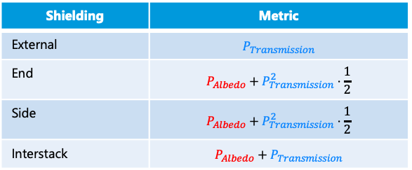
3. Shielding investigation
Shielding | Metric
External | $$P_{Transmission}$$
End | $$P_{Albedo}+P_{Transmission}^{2}⋅\frac{1}{2}$$
Side | $$P_{Albedo}+P_{Transmission}^{2}⋅\frac{1}{2}$$
Interstack | $$P_{Albedo}+P_{Transmission}$$
Optimized thickness
P_{Albedo}
Probability
P_{Transmission}
Shielding thickness
How to pinpoint the correct material and thickness?
Therefore, if this information is combined with transmission, we have everything we need
Notes:
There were, to the best of my understanding, 17 Multi-Grid detector publications when I started my PhD.

Slide 34
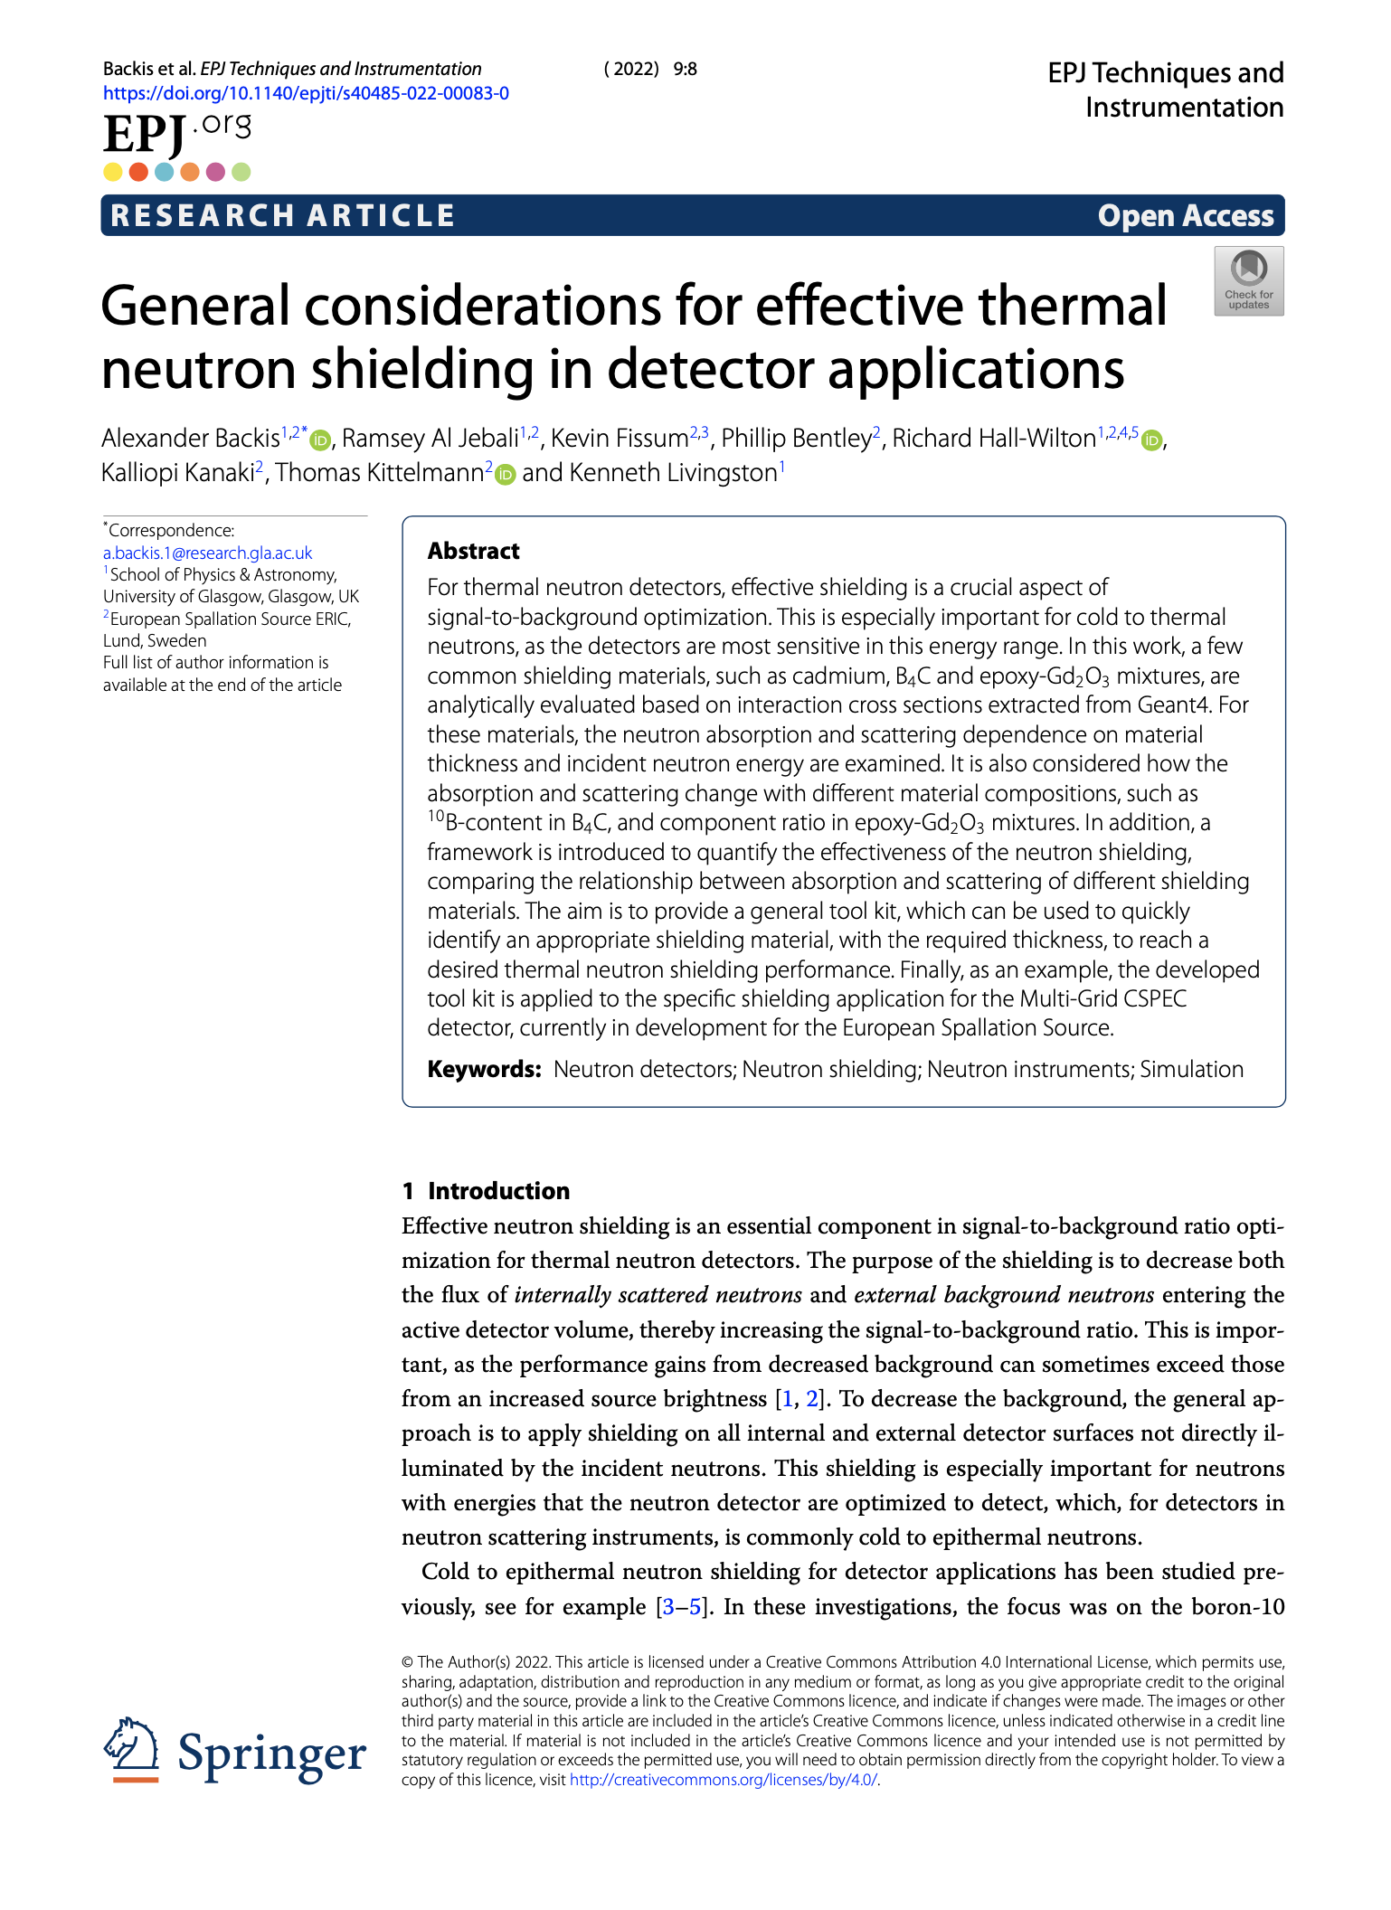
3. Shielding investigation
Conclusions
General shielding model and metric for performance introduced
Simplified calculations shown to compare well to simulations
Many shielding materials evaluated and method developed for finding appropriate shielding
Notes:
There were, to the best of my understanding, 17 Multi-Grid detector publications when I started my PhD.

Slide 35
4.
V20 measurements

Slide 36
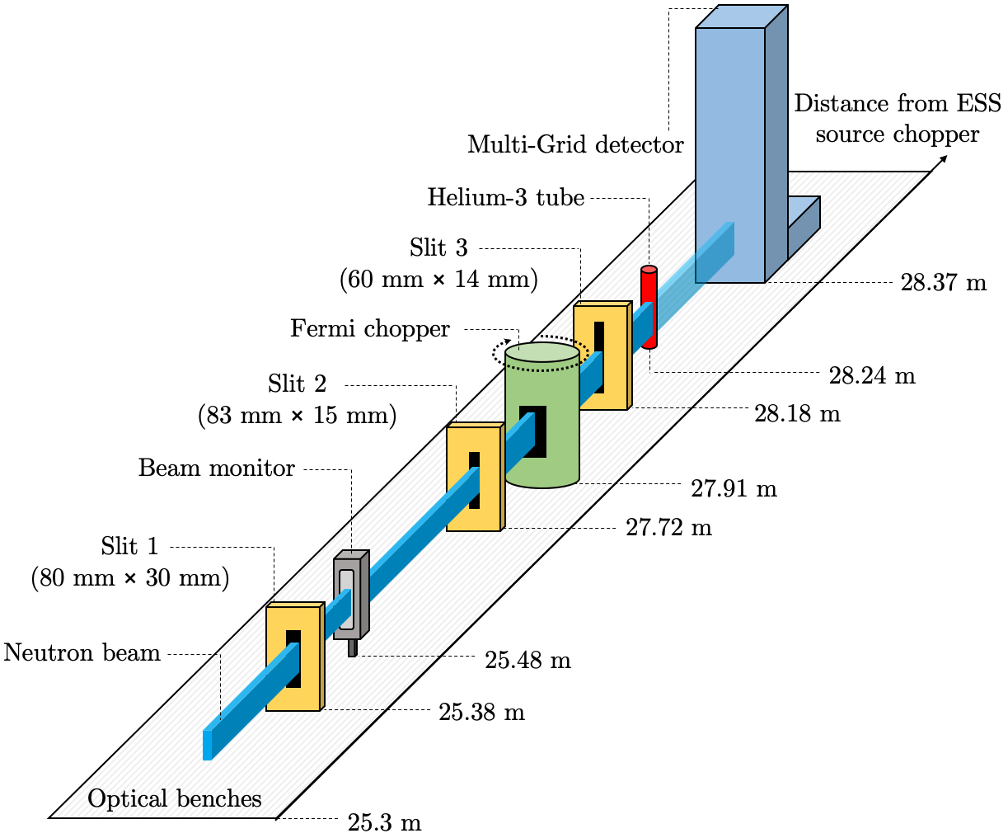
4. V20 measurements
Non-coated
Coated
Overview
The purpose of the measurements was to study efficiency, energy lineshape and energy resolution
This was done at the ESS test-beamline V20 at HZB in Germany
At the end of the beamline, there was a section where it was possible to setup your local equipment
We used a series of slits to contain a 6 cm x 1 cm beam
This thin beam was then chopped into ~10 µm short pulses hitting either the Multi-Grid detector or the Helium-3 tube
Notes:
There were, to the best of my understanding, 17 Multi-Grid detector publications when I started my PhD.

Slide 37
4. V20 measurements
Efficiency
Recorded neutrons
Efficiency
Incident neutrons
Notes:
There were, to the best of my understanding, 17 Multi-Grid detector publications when I started my PhD.

Slide 38
4. V20 measurements
Efficiency
Multi-Grid data
Efficiency
Helium-3 data
Helium-3 efficiency
Beam monitor data
Notes:
There were, to the best of my understanding, 17 Multi-Grid detector publications when I started my PhD.

Slide 39
4. V20 measurements
Efficiency
Saturation in helium-3 tube
Multi-Grid data
Helium-3 data
Helium-3 efficiency
Beam monitor data
Notes:
There were, to the best of my understanding, 17 Multi-Grid detector publications when I started my PhD.

Slide 40
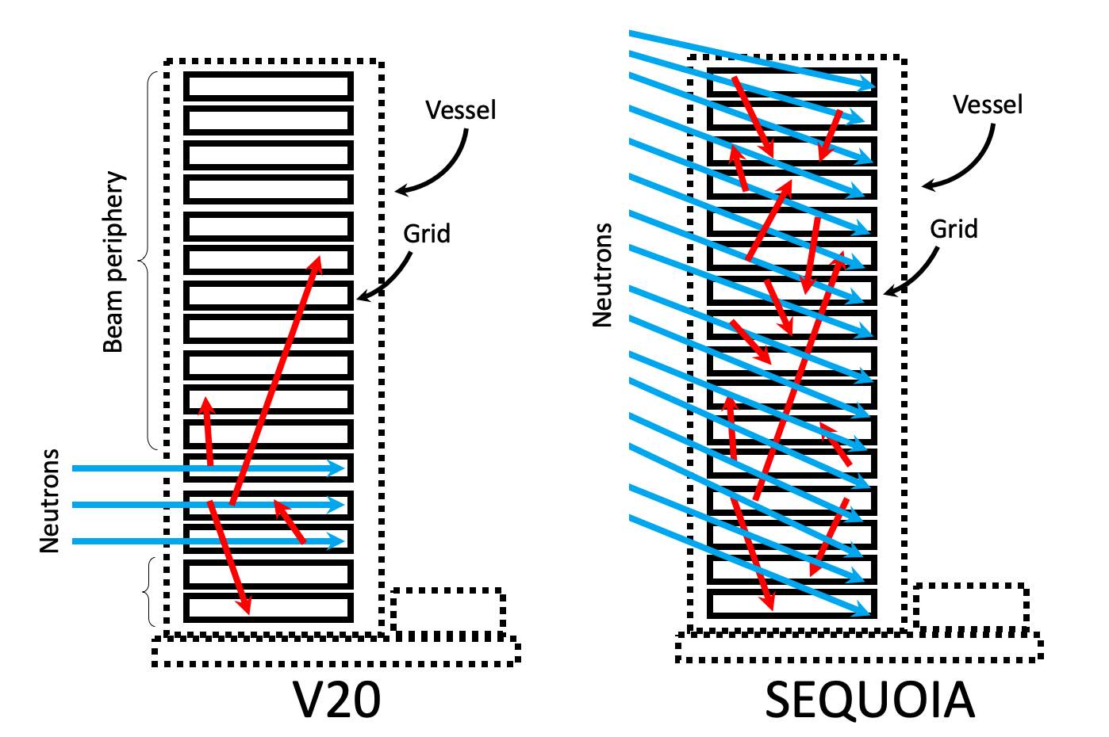
4. V20 measurements
Internal scattering
During normal operation, the directly absorbed neutrons and internally scattered neutrons are mixed
Notes:
There were, to the best of my understanding, 17 Multi-Grid detector publications when I started my PhD.

Slide 41
4. V20 measurements
Internal scattering
However, in our setup at V20 they were mostly separated
Notes:
There were, to the best of my understanding, 17 Multi-Grid detector publications when I started my PhD.

Slide 42
4. V20 measurements
Internal scattering
However, in our setup at V20 they were mostly separated
Scattered neutrons
Direct beam
Close up on a peak at 1.5 Å
Full data
Scattered
Direct beam
Helium-3
Notes:
There were, to the best of my understanding, 17 Multi-Grid detector publications when I started my PhD.

Slide 43
4. V20 measurements
Scattered neutrons
Direct beam
Internal scattering
This allowed a detailed study on how internal scattering affects the energy lineshape
Close up on a peak at 1.5 Å
Full data
Scattered
Direct beam
Helium-3
Notes:
There were, to the best of my understanding, 17 Multi-Grid detector publications when I started my PhD.

Slide 44
4. V20 measurements
Scattered neutrons
Direct beam
Internal scattering
Introduce Shoulder-to-Peak (SPR) metric
Notes:
There were, to the best of my understanding, 17 Multi-Grid detector publications when I started my PhD.

Slide 45
4. V20 measurements
Scattered neutrons
Direct beam
MG.SEQ.I
(non-coated radial blades)
MG.SEQ.II
(coated radial blades)
Internal scattering
Compare detector with coated and non-coated radial blades
Notes:
There were, to the best of my understanding, 17 Multi-Grid detector publications when I started my PhD.

Slide 46
4. V20 measurements
MG.SEQ.I
(non-coated radial blades)
MG.SEQ.II
(coated radial blades)
Internal scattering
An improvement in the order of a few 10 % was seen
Note that this is not normal operation
Notes:
There were, to the best of my understanding, 17 Multi-Grid detector publications when I started my PhD.

Slide 47
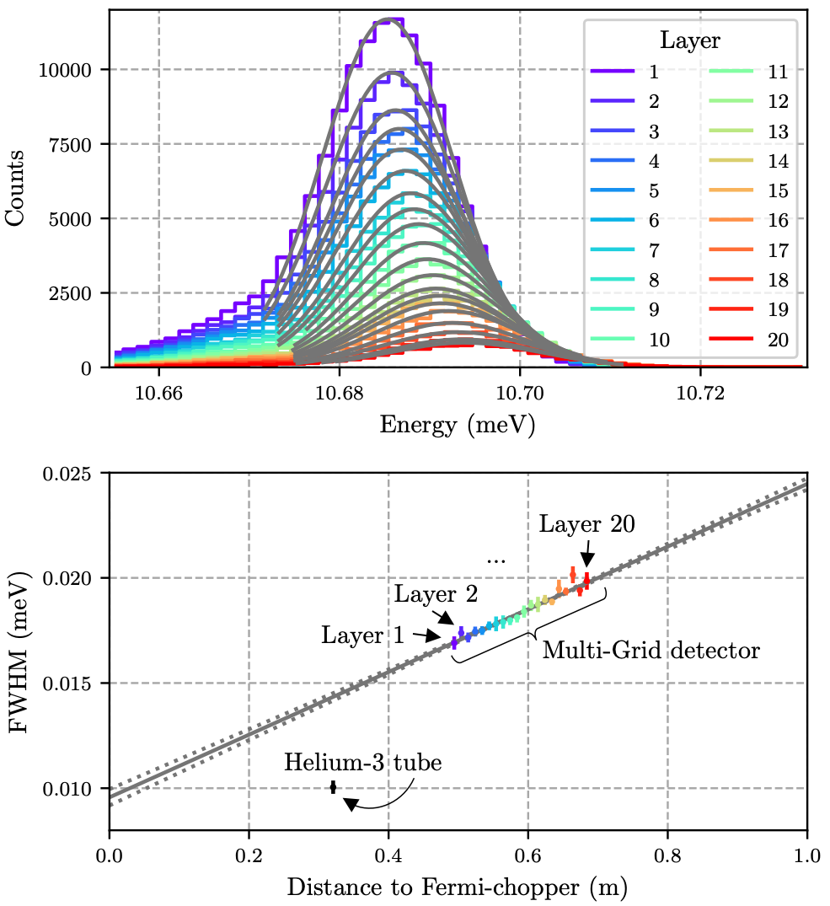
4. V20 measurements
Scattered neutrons
Direct beam
Energy resolution
Want to look at width of energy peak
Because the Multi-Grid was located further downstream than the Helium-3 tube, there is additional broadening in the Multi-Grid
Notes:
There were, to the best of my understanding, 17 Multi-Grid detector publications when I started my PhD.

Slide 48
4. V20 measurements
Scattered neutrons
Direct beam
Energy resolution
However, due to the layered structure of the detector, we can experimentally probe how this width changes with distance
Notes:
There were, to the best of my understanding, 17 Multi-Grid detector publications when I started my PhD.

Slide 49
4. V20 measurements
Scattered neutrons
Direct beam
Energy resolution
Resolution evaluated down to a few µeV
Notes:
There were, to the best of my understanding, 17 Multi-Grid detector publications when I started my PhD.

Slide 50
4. V20 measurements
Scattered neutrons
Direct beam
Energy resolution
Trends influenced by neutron absorption distribution
Notes:
There were, to the best of my understanding, 17 Multi-Grid detector publications when I started my PhD.

Slide 51
4. V20 measurements
Scattered neutrons
Direct beam
Energy resolution
For Multi-Grid, this happens at a fixed 0.95 cm distance, while for the Helium-3 tube this can vary over 2.5 cm
Notes:
There were, to the best of my understanding, 17 Multi-Grid detector publications when I started my PhD.

Slide 52
5. V20 measurements
Conclusions
Efficiency reconfirmed
Lineshape studied in detail and effect of radial coating quantified
Fundamental energy resolution of detector probed
Notes:
There were, to the best of my understanding, 17 Multi-Grid detector publications when I started my PhD.

Slide 53
5.
LET measurements

Slide 54
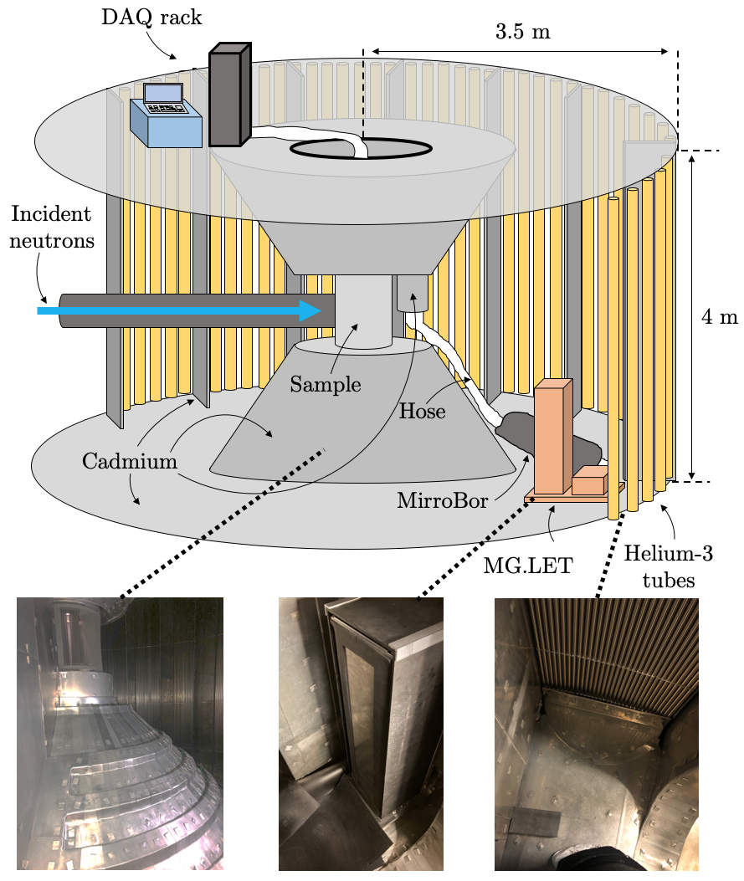
5. LET measurements
Overview
Purpose was to study signal-to-background ratio and energy lineshape
To do this, the Multi-Grid detector was installed inside the LET detector tank and operated in parallel with the helium-3 array
The incident energies varied from around 2 meV to 40 meV
The main measurements were done on C-60 (“bucky balls”) for alignment and vanadium for detector characterisation
Notes:
There were, to the best of my understanding, 17 Multi-Grid detector publications when I started my PhD.

Slide 55
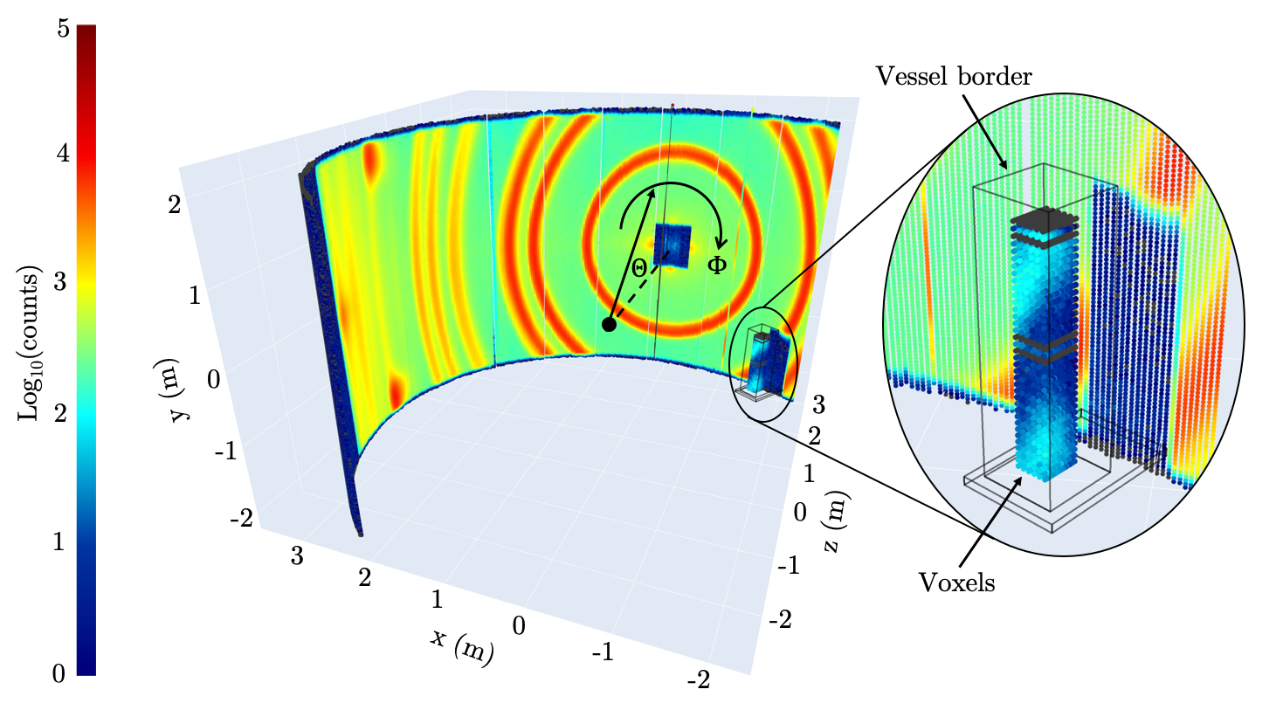
5. LET measurements
Alignment
First, the C-60 sample was measured with
A good agreement in both absolute and angular reconstruction was seen
However, an unexpectedly low efficiency was observed
Notes:
There were, to the best of my understanding, 17 Multi-Grid detector publications when I started my PhD.

Slide 56
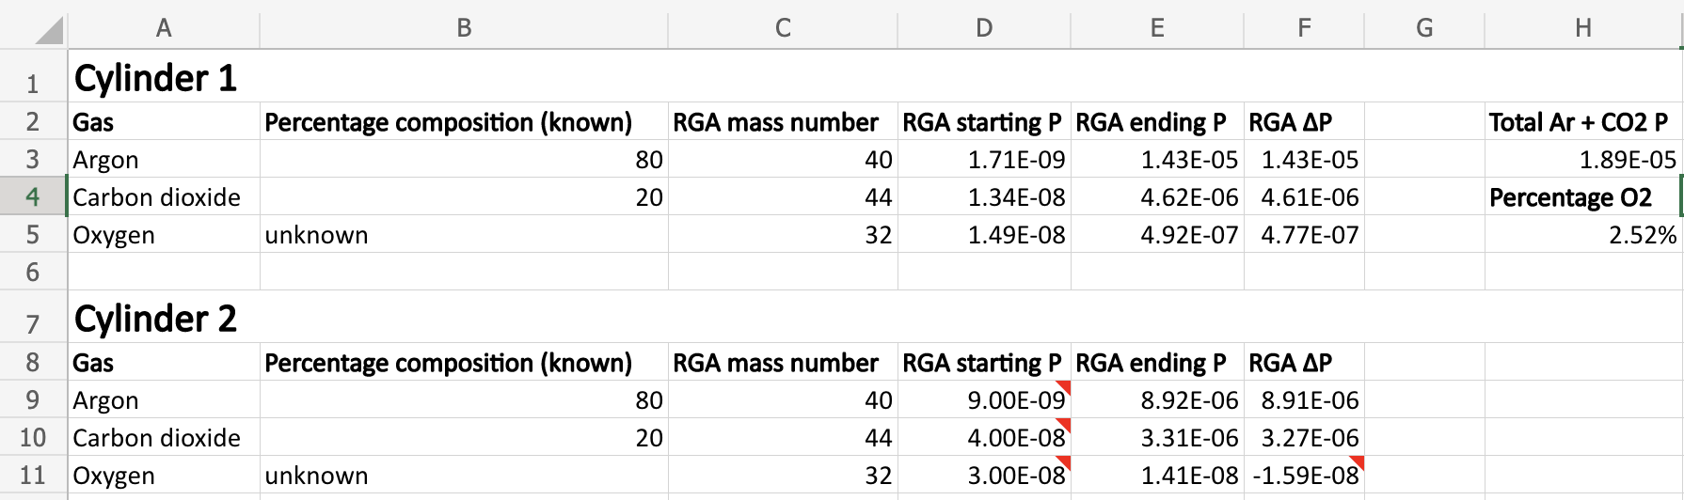
5. LET measurements
Efficiency
One proposed explanation for the encountered low efficiency was that it had something to do with the gas
To test this, measurements were done after the beamtime to check this.
This was done by measuring with two different gas supplies while keeping the rest of the setup constant
A strong reduction in rate was seen with the gas used during the measurements compared to a new supply
The gas used during the measurements was later shown to contain 2.5 % oxygen
Notes:
There were, to the best of my understanding, 17 Multi-Grid detector publications when I started my PhD.

Slide 57
5. LET measurements
Efficiency
One proposed explanation for the encountered low efficiency was that it had something to do with the gas
To test this, measurements were done after the beamtime to check this.
This was done by measuring with two different gas supplies while keeping the rest of the setup constant
A strong reduction in rate was seen with the gas used during the measurements compared to a new supply
The gas used during the measurements was later shown to contain 2.5 % oxygen
Later at Utgård, another gas supply with oxygen was tried and a similar drop in efficiency was seen
 | Ar | CO₂ | O₂
Ar-CO₂ (custom made) | 74.1 % | 23.9 % | 2.0 %
Ar-CO₂ (scientific grade) | 82.1 % | 17.9 %
Notes:
There were, to the best of my understanding, 17 Multi-Grid detector publications when I started my PhD.

Slide 58
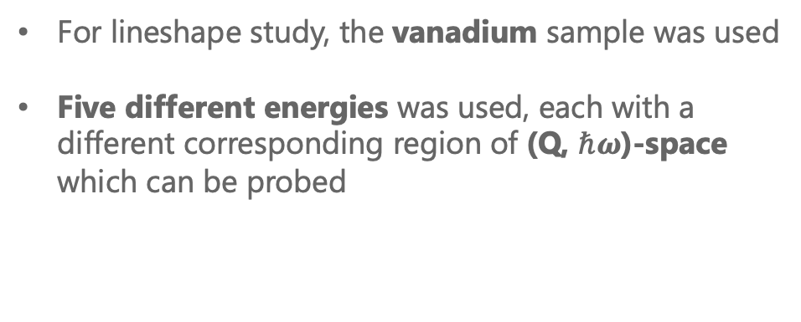
5. LET measurements
Lineshape
For lineshape study, the vanadium sample was used
Five different energies was used, each with a different corresponding region of (Q, $ℏω$)-space which can be probed
Notes:
There were, to the best of my understanding, 17 Multi-Grid detector publications when I started my PhD.

Slide 59

5. LET measurements
Lineshape
Here, the focus is only on energy transfer $ℏω$
Notes:
There were, to the best of my understanding, 17 Multi-Grid detector publications when I started my PhD.

Slide 60
5. LET measurements
Lineshape
Although the statistics are low, an overall good agreement is seen between the Multi-Grid detector and the Helium-3 tubes
Notes:
There were, to the best of my understanding, 17 Multi-Grid detector publications when I started my PhD.

Slide 61
5. LET measurements
Lineshape
This is further highlighted by the energy resolution
We can also compare the lineshape to an earlier measurement at the CNCS, which shows an improvement at the edges of the peak
Notes:
There were, to the best of my understanding, 17 Multi-Grid detector publications when I started my PhD.

Slide 62
5. LET measurements
Signal-to-Background
Each of the incident energies has its own corresponding signal-to-background ratio
We are going to focus at a peak around 5 Å
The value is obtained by comparing the maximum intensity of the peak with the average background from the flat region of the time-of-flight spectra
If the comparison is done in wavelength, a ratio of approximately 10⁴ is obtained
Note that when the Multi-Grid data is scaled with factor rate loss seen when shifting between gases, a more comparable efficiency is seen between the Multi-Grid and Helium-3 tubes
Notes:
There were, to the best of my understanding, 17 Multi-Grid detector publications when I started my PhD.

Slide 63
Summary

Slide 64
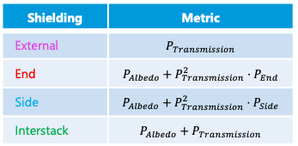
Shielding
V20
LET
General shielding model and metric for performance introduced
Efficiency re-confirmed
Shielding | Metric
External | $$P_{Transmission}$$
End | $$P_{Albedo}+P_{Transmission}^{2}⋅P_{End}$$
Side | $$P_{Albedo}+P_{Transmission}^{2}⋅P_{Side}$$
Interstack | $$P_{Albedo}+P_{Transmission}$$
SBR found to be close to 10⁴ in wavelength spectra
Simplified calculations shown to compare well to simulations
Lineshape studied in detail and effect of radial blades experimentally evaluated
Improvement in lineshape observed when compared to CNCS measurements
Many shielding materials evaluated and method developed for finding appropriate shielding
Energy resolution evaluated down to a few µeV and fundamental resolution probed
Notes:
There were, to the best of my understanding, 17 Multi-Grid detector publications when I started my PhD.

Slide 65
Thank you for your attention!

