Slide 2
Updates from missing IDSes
BEER, ODIN, DREAM, MAGIC, ESTIA (FREIA)
Thomas Holm Rod

Slide 3
Apologies
Søren is in Japan for NEUWAVE-11 (NEUtron WAVElength Dependent Imaging)
Céline is at Project Management course
Andrew M resigned!

Slide 4
IDS for Diffraction
DREAM and MAGIC
October 2023 updates
THOMAS HOLM ROD presenting on behalf of Céline Durniak

Slide 5
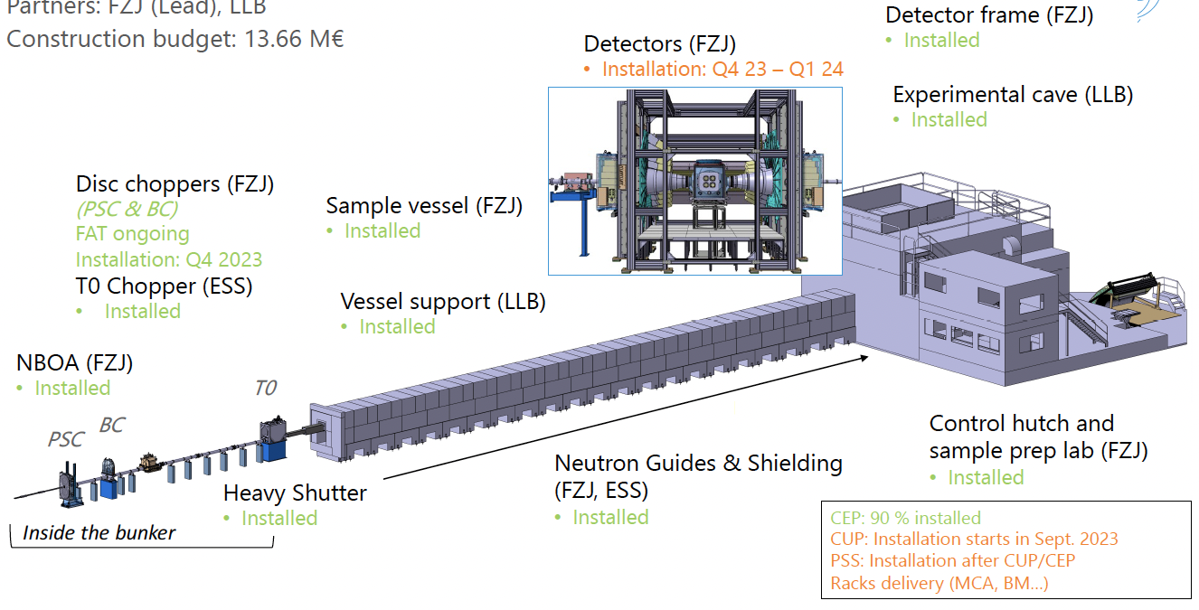
Updates since April 2023
From Lund
DREAM
Only detectors left to be installed
Florence Porcher moved from France (LLB) to Lund, from October 1st
Annika Stellhorn (polarised SANS) from Sept 1st
➜ help with SANS and polarisation for DREAM
MAGIC
Job advert for lead instrument scientist to be published soon
DREAM instrument layout

Slide 6
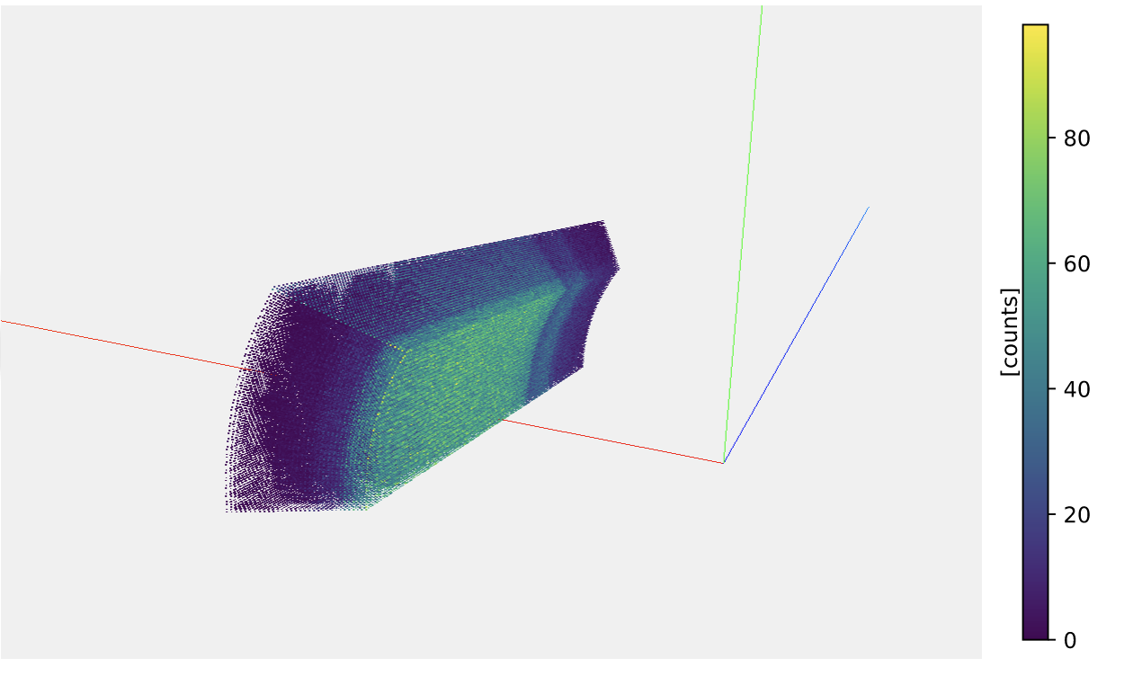
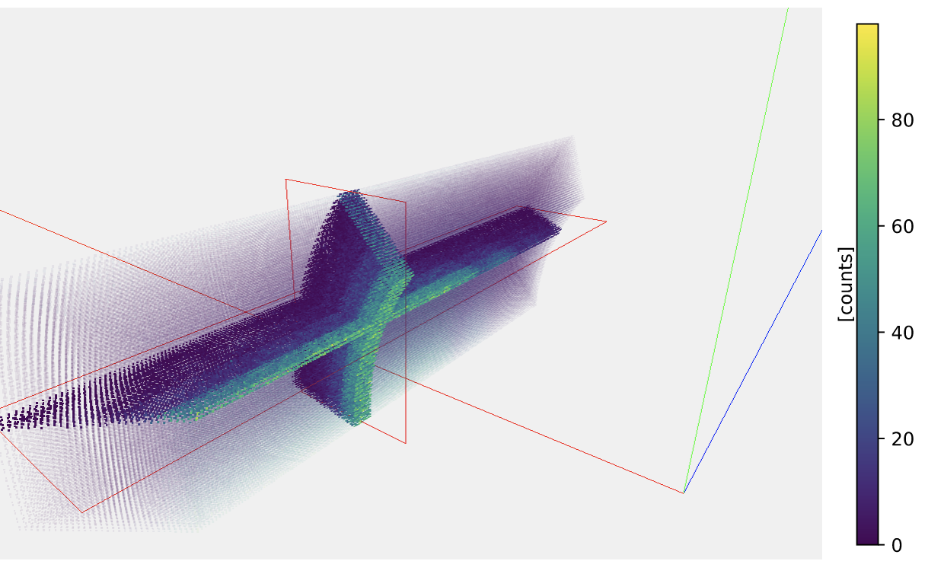
Updates since April 2023
Data processing pipeline
Mantle NeXus in Scipp
DREAM
adding data to Nexus file (done for Mantle)
link between Scipp and Easydiffraction (save_xye algorithm in Scipp)
Diffraction test data (from SNS) added to Scicat
2nd test of bi-spectral switch at ISIS
participated to experiment, data processing in Scipp, McStas simulation
Mantle NeXus in Scipp
Data reduction
Data archiving
Instrument
simulation
Data reduction
Data analysis
Diffraction test data
from SNS
ESS NeXus
with data
save_xye

Slide 7
Updates since April 2023
Data processing pipeline
MAGIC
Jira dashboard for DSMC development for cold and hot commissioning and first science
Tasks related to
User Office VISA Scicat | Scichat Instrument Control NeXus | Instrument Simulation Reduction Analysis

Slide 8
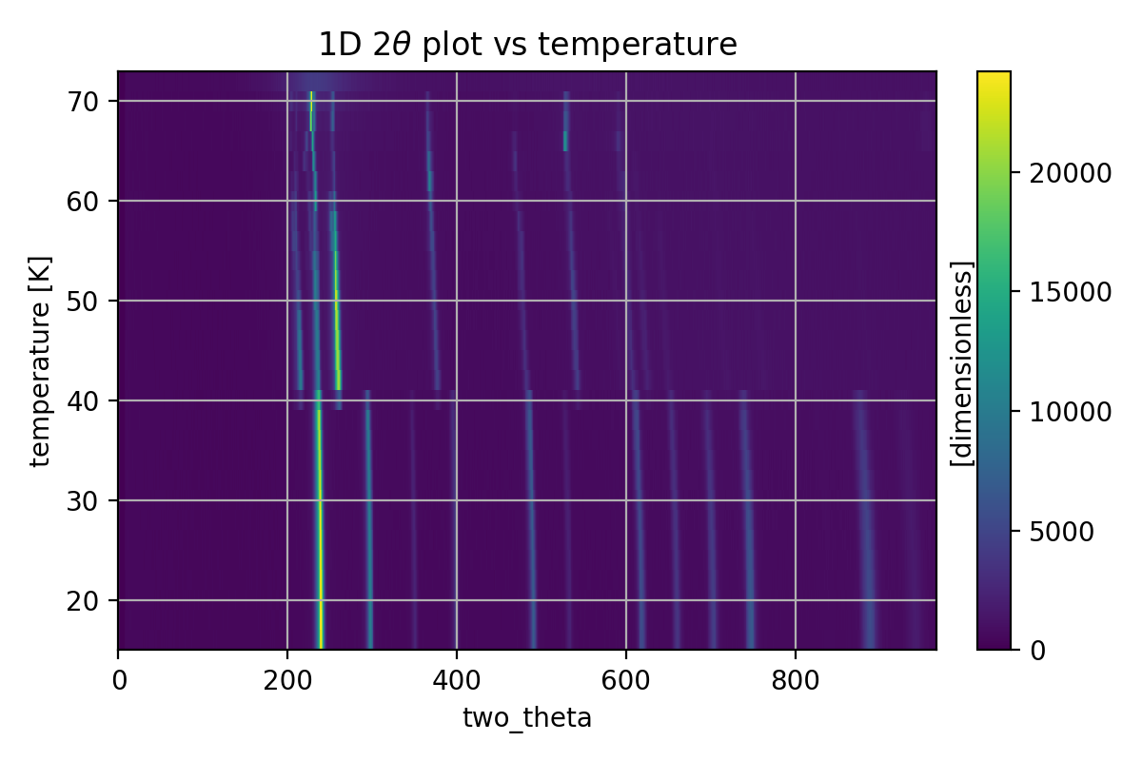
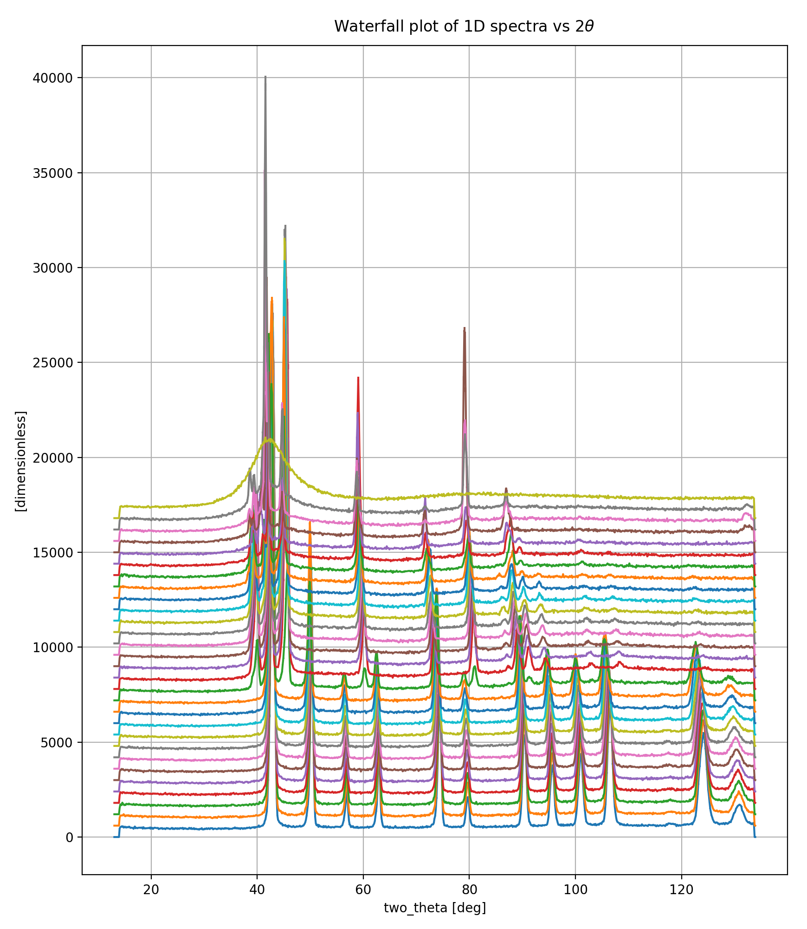
Updates since April 2023
Data processing pipeline
Publicising DMSC software
WOMBAT data + Scipp Jupyter notebook
PDF tutorial (Jupyter notebooks) using NOMAD data in Easydiffraction
Scipp Jupyter notebook to reduce NGEM data shared with ISIS instrument scientist
WOMBAT data in Scipp

Slide 9
Updates since April 2023
Scientific work and training
Beamtime at CoSAXS MaxIV (April-May)
magnetic nanoparticles with Mikhail Feygenson
IUCr 2023 talk on magnetic thin films (Aug)
Talk at ANSTO on Diffraction data processing pipeline at ESS (Sept)
thanks Anna
Scientific collaboration (magnetic thin films) at DST Adelaide Australia (Aug-Sept)
paper (writing in progress) + experiment
Training on Project management (Oct)
Other neutron scattering project
QENS library paper published

Slide 10
Updates on milestones
Status in October 2023
Milestone 1:
DREAM Instrument scientist and first friendly users should be able to reduce and analyse (1D) powder diffraction data from DREAM simulated by McStas/GEANT4, stored in a NeXus file on Scicat. The user should also be able to store reduced data (with relevant metadata) and reduction script on Scicat.
Milestone 2:
DREAM Instrument scientist and first friendly users should be able to reduce and analyse pair distribution function (PDF) data from DREAM simulated by McStas/GEANT4, stored in a NeXus file on Scicat. The user should also be able to store reduced data (with relevant metadata) and reduction script on Scicat
Done | To do
Adding data to NeXus file Link Scipp ↔︎ EasyDiffraction (data) Storing data on Scicat (raw data from SNS) | WFM stitching algorithm in Scipp Link Scipp ↔︎ Easydiffraction (metadata) Storing and retrieving data from Scicat (DREAM raw, reduced data & reduction script) Reduction workflow for DREAM powder reduction as Jupyter notebook in Scipp online documentation
Done | To do
Sample for McStas simulation Support for PDF analysis in EasyDiffraction (Jupyter notebook) | Scipp PDF reduction Link Scipp ↔︎ EasyDiffraction Reduction workflow for DREAM PDF as Jupyter notebook in Scipp online documentation

Slide 11
Plans for the next 6 months
DREAM & MAGIC
finalising powder diffraction reduction workflow
collaboration with ILL
visit to work on Python bindings of CrysFML (EasyDiffraction)
involved in BEER bi-spectral test at ISIS
similar approach to DREAM
MAGIC McStas simulations
finalising first paper on magnetic thin films

Slide 12
Update ODIN & BEER
BY Soeren Schmidt, presented by Thomas H. ROD

Slide 13
Milestones - ODIN
M1: Acquisition of YMIR tomography data through NICOS. Reduction, reconstruction and visualization on the VISA platform. Approval by ODIN instrument team & ECDC - March 1st 2024.
M2: Using data from McStas ODIN model for polarized neutrons, conduct data reduction for radiography measurements. Approval by ODIN instrument team – April 1st 2024.
M3: Using data from McStas ODIN model, conduct data reduction in WFM mode, non-textured Bragg edge fitting with TofLib. Approval by ODIN instrument team – May 15th 2024.
M4: Hot Commissioning package for data processing not included in M1-M3. Approval by ODIN instrument team – July 1st 2024.

Slide 14
Milestones for ODIN
M1: Acquisition of YMIR tomography data through NICOS. Reduction, reconstruction and visualization on the VISA platform. Approval by ODIN instrument team & ECDC - March 1st 2024.
Status:
Ability to handle YMIR attenuation tomography data with pymuhrec – standalone – proven
Python bindings of pymuhrec on Ubuntu (PSI) – available
Data acquisition at YMIR with NICOS, Kafka and file-writer (ECDC) – available
Live-view of white-beam data acquisition, including normalization (ECDC) - available
Archiving in SciCat and subscription to new data (ECDC) - available

Slide 15
Milestones for ODIN
M1: Acquisition of YMIR tomography data through NICOS. Reduction, reconstruction and visualization on the VISA platform. Approval by ODIN instrument team & ECDC - March 1st 2024.
Next steps:
Apptainer to host pymuhrec on the VISA platform is currently being pursued (DST)
Integrate pymuhrec tomography pipeline in the workflow
Make sure that automation is maximized, all needed meta-data is present and robustness against small changes in the hdf5 (e.g. the order of individual elements in the data acquisition scheme)

Slide 16
Milestones for ODIN
M2: Using data from McStas ODIN model for polarized neutrons, conduct data reduction for radiography measurements. Approval by ODIN instrument team – April 1st 2024.
Status:
McStas ODIN version for polarized neutrons is being configured
Next step:
Implement and test data reduction schemes for radiographic polarization measurements

Slide 17
Milestones for ODIN
M3: Using data from McStas ODIN model, conduct data reduction in WFM mode and non-textured Bragg edge fitting. Approval by ODIN instrument team – May 15th 2024.
Status:
Data reduction with scipp of ToF Timepix3 data; from events to image stacks achieved
Python bindings of Toflib available
McStas ODIN model for diffraction in transmission mode available
WFM correction of OB simulated ODIN data successful: Master thesis project by PSI master student (M. Morgano, Scipp, IDS)

Slide 18
Milestones for ODIN
M3: Using data from McStas ODIN model, conduct data reduction in WFM mode and non-textured Bragg edge fitting. Approval by ODIN instrument team – May 15th 2024.
Next steps:
Produce hdf5 file with event data and meta-data in the ODIN ToF hdf5 format
Data reduction of neutron events into image stacks (scipp): WFM correction, normalization and binning (space and time)
Bragg edge fitting with TofLib
Visualization
Store image stacks, meta-data and fit results in new hdf5 file

Slide 19
Milestones for ODIN
M4: Hot Commissioning package for data processing not included in M1-M3. Approval by ODIN instrument team – July 1st 2024.
Status:
HC plan available (ODIN instrument team + IDS)
Determine spatial resolution WB and ToF detectors ongoing

Slide 20
Milestones for ODIN
M4: Hot Commissioning package for data processing not included in M1-M3. Approval by ODIN instrument team – July 1st 2024.
Next steps:
Beam-profile fitting (space & time) for WFM and for ToF mode without pulse shaping (only bandwidth choppers)
Bragg edge fitting of Fe in same scenarios as above
Live-view (through subscription to SciCat) of ToF data
Establish data inspection with ImageJ
Potentially: Fit chopper settings from real data ToF profile using the Tof-package (scipp) as forward model in conjunction with an optimizer.

Slide 21
Outlook ODIN
Extended Bragg edge analysis
Job-ad out for a core-programmer for diffraction based transmission imaging – novel platform for isotropic and textured materials
IK contract with PSI on Muhrec/pymuhrec ended and Muhrec/pymuhrec still constitute a single point of failure
Requirements to DMSC regarding ODIN/TG5 (Q3+Q4 2024) process is unknown – will be discussed at the upcoming IKON workshop in November

Slide 22
BEER
Hot commissioning plan available, made by BEER team about 5 years ago
McStas model with initial BEER detector configuration is available (two detectors at +/- 90 degrees)
Discussions on data reduction for Modulation mode (multiplexing)
Data reduction is needed for both Pulse-shaping mode and Modulation mode
For pulse-shaping mode synergies for data reduction can be made with the DREAM instrument and has been discussed (IDS)
TG5 for BEER is Q3+Q4, 2025

Slide 23
IDS Reflectometry

Slide 24
Instrument Data Scientist resigned
but has handed over and has not abandoned us
Selene guide
Completed
(for his part)
Data reduction
Data analysis
Jos
(new Instrument Scientist)
Jan-Lukas & Neil
(scipp developers)
Piotr & Andrew S
EasyScience developers
Scipp team has had challenges recruiting but we are getting there.
EasyScience team is at half capacity with 2 developers. Currently two open positions.

Slide 25
ESTIA Milestones
Still on track despite no man-power
ESTIA IDS Integration of metrology cart software (p6).
ESTIA IDS Experimental planning tools available (p6)
Description | Date | Status
ESTIA IDS Completion of service blueprints for ESS user types | 2023-Apr-26 | Done
ESTIA IDS Coverage for reduction from all operating modes | 2024-Aug-02 | 2 out 8 modes completed
Delivery of complete data pipeline at the Amor instrument | 2024-05-01
Experimental planning tools available | 2026-09-22
Integration of metrology cart software | 2023-11-06 | Done

