Slide 2
DMSC admin
STAP April 2023
PRESENTED BY Petra Aulin

Slide 3
Agenda
1 Housing
2 Project

Slide 4
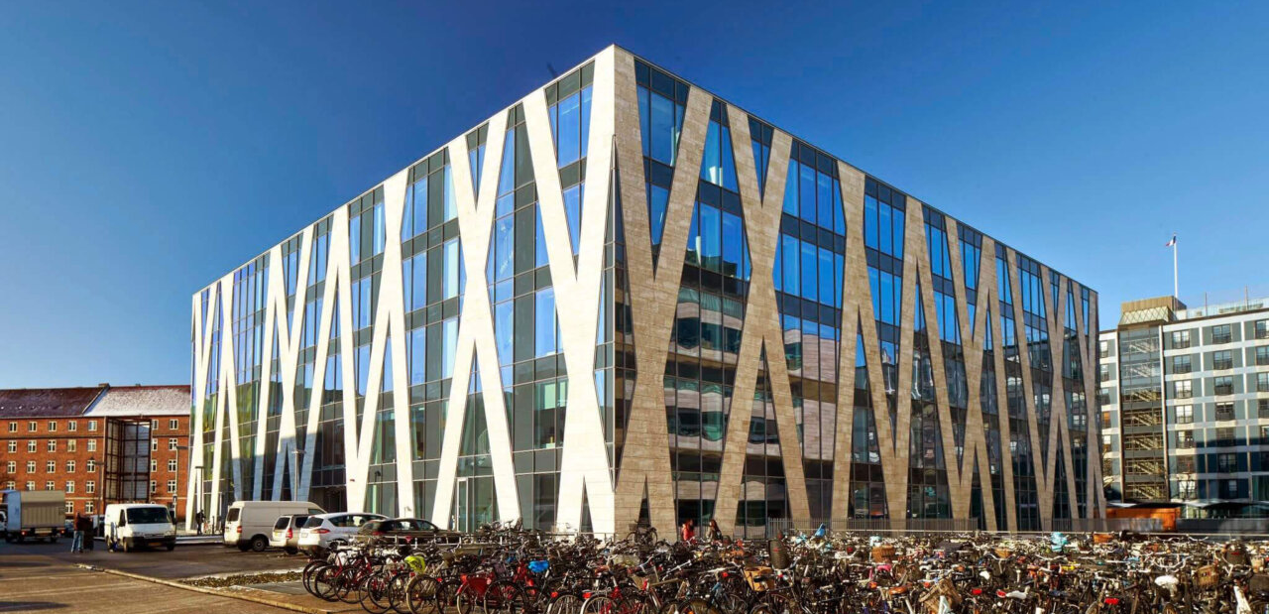
1
DMSC housing

Slide 5
Relocation of DMSC
DMSC is currently located on the UCPH Northern Campus
ESS cannot extend the lease agreement so ESS-DK will have to relocate at the latest March 2024

Slide 6
Server Room Relocation
Status today
  decision on server room location separated from the office move
  Server room in COBIS/BII contract is prolonged from March 2024 to September 2025
  No formal decision to move it to ESS in Lund but investigation is ongoing
  Timing for server room move completed needs to be before September 2025 as BOT is set to May 2025 (P0)

Slide 7
Office Relocation
Status today
Decision is made – DMSC is moving to DTU
Contract and appendixes are in final drafts and ready to be signed
MoU on Scientific Collaboration - not part of the lease agreement after all
Access dates are set in three stages
  2nd floor access: February 15 2024 (6 weeks before we need to leave COBIS/BII)
    Staff move April 1
  1st floor access: EOY 2024
    Staff reshuffle February 15 2025
  Opening between the floors (TBD 2025)
    Aim to make refurbishment in the summer period

Slide 8

Relocation
Concerns
Major concern is that staff will (have already) resign due to location of new premises and the instability in the organisation
A new office might not provide what we wanted (more synergies with the local academic environment, nice offices fulfilling our requirements for our staff)
During first year, people will be disturbed by refurbishment downstairs
During first year, some people will need to hot-desk

Slide 9
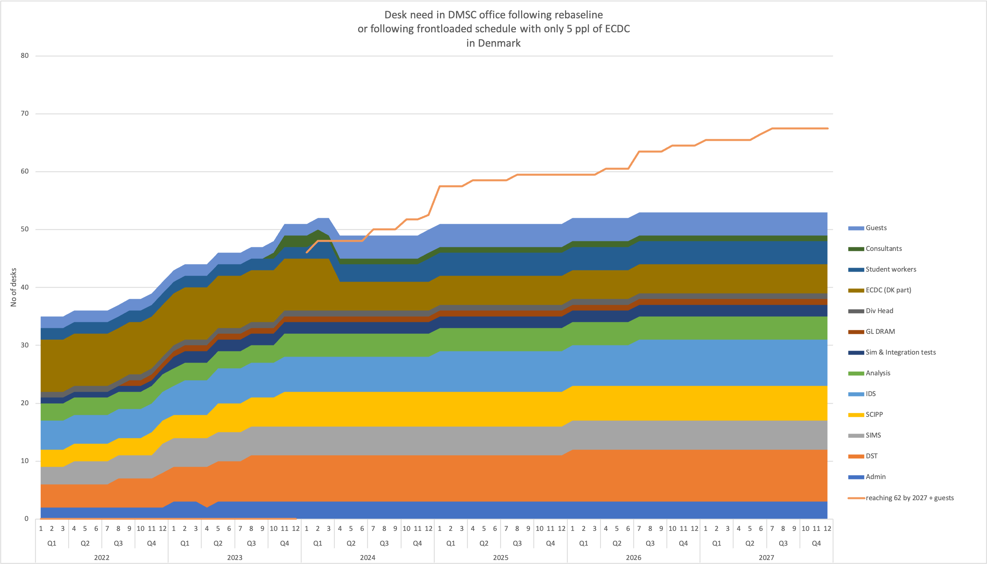
Desks – 38 desks for the first year
In the first year we will need 40-60 desks

Slide 10
Desks during first year (depending on distrubance)
Weekly rotation
50 ppl | Mon | Tue | Wed | Thur | Fri
10 | DTU | DTU | DTU | ESS | Home
10 | Home | DTU | DTU | DTU | ESS
10 | ESS | Home | DTU | DTU | DTU
10 | DTU | ESS | Home | DTU | DTU
10 | DTU | DTU | ESS | Home | DTU
50 ppl | DTU | ESS | Home
Daily | 30 | 10 | 10
- some ppl need their own desk (OWN)
- some ppl are fine with other using their desk but still not shifting desks themselves (DEDICATED)
- some ppl are fine with sitting where ever there is space (HOTDESKING)

Slide 11
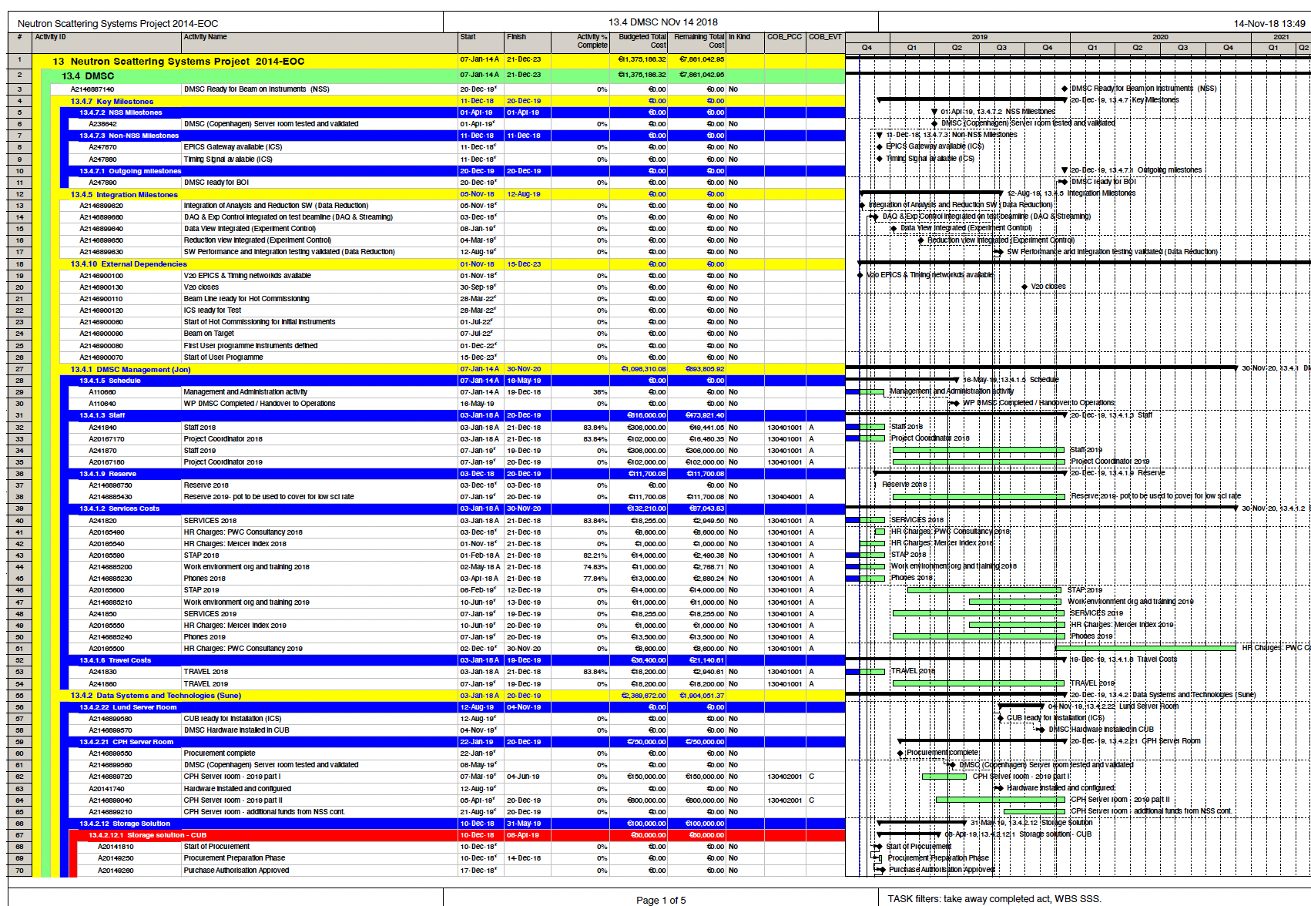
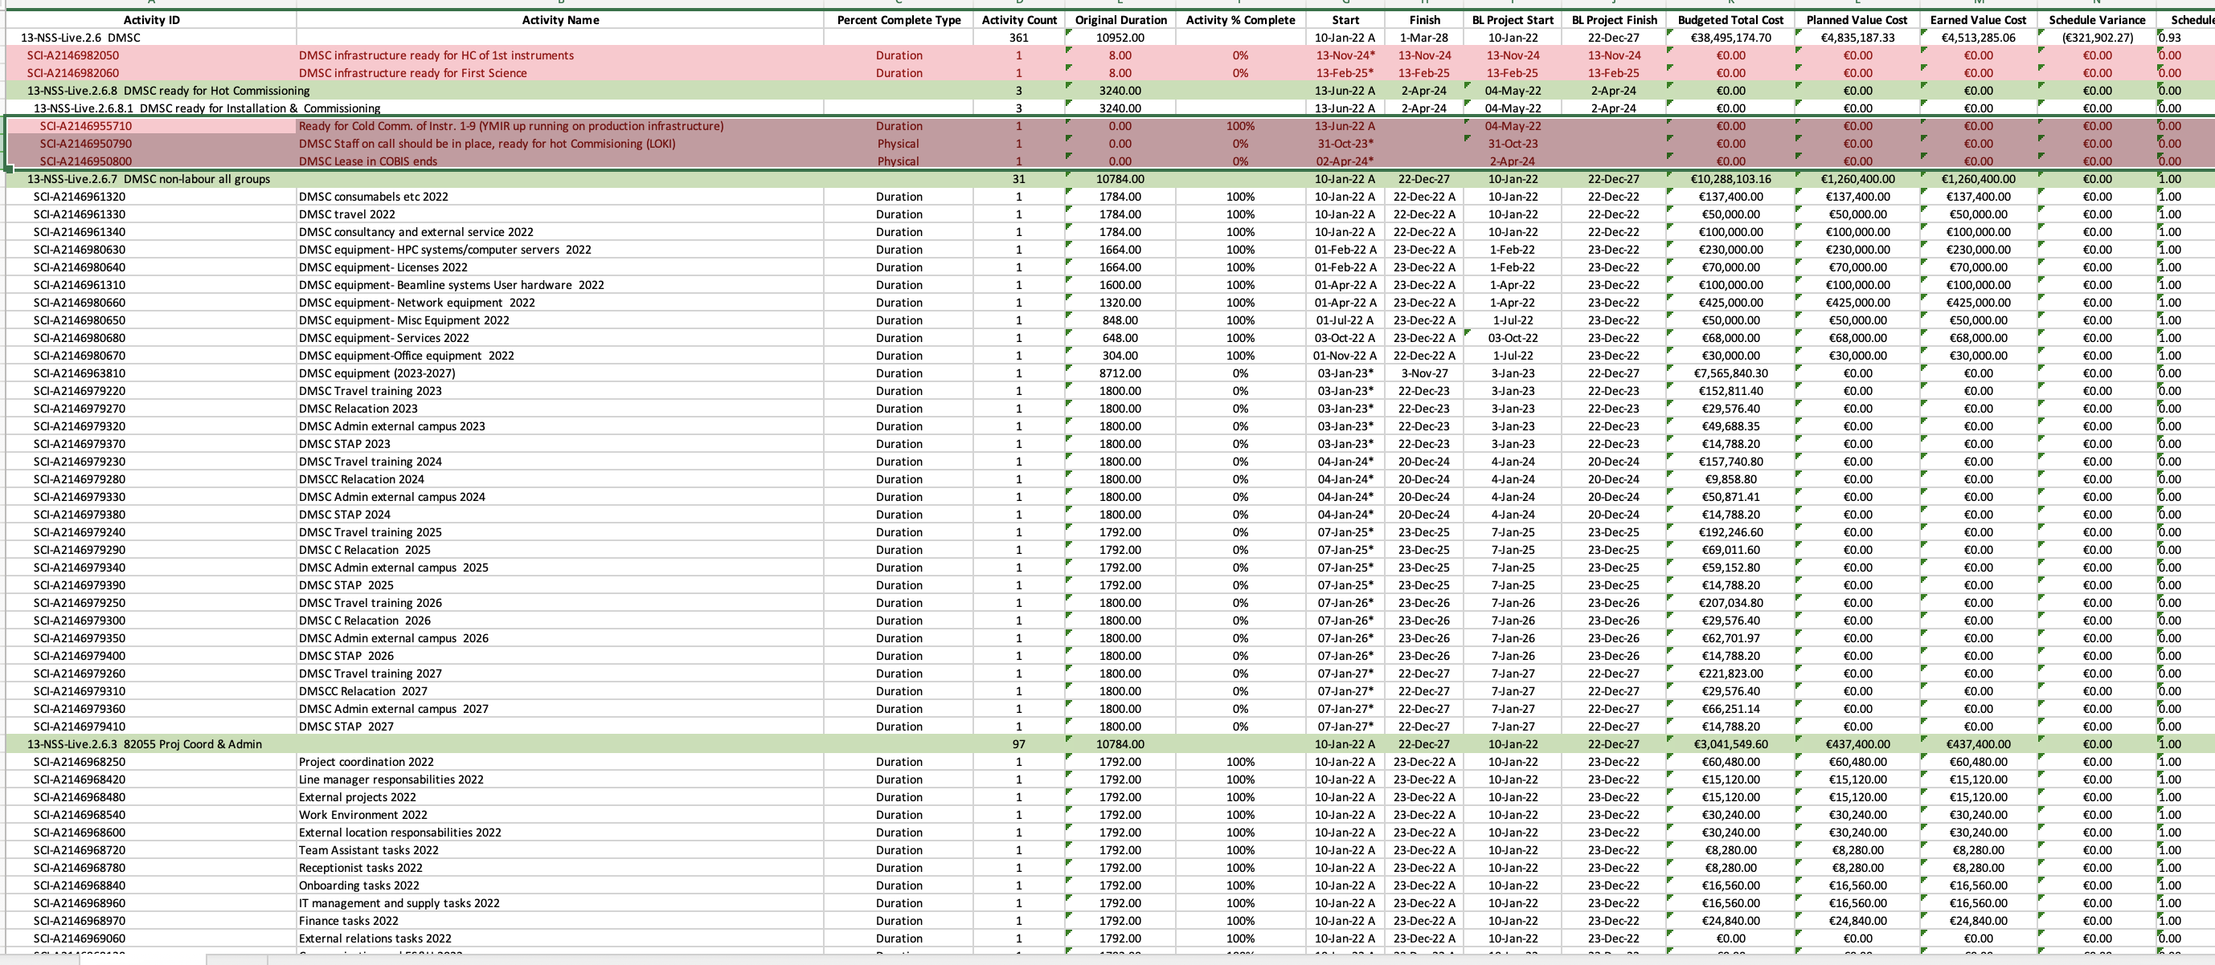
2
DMSC Project
Notes:
Each month the palnner reaches out and asks if an activity has started etc. The rebaselined plan is in there. With hours per activity from 2022-2027. Changes can be done as long as they are within budget and activities havent started

Slide 12
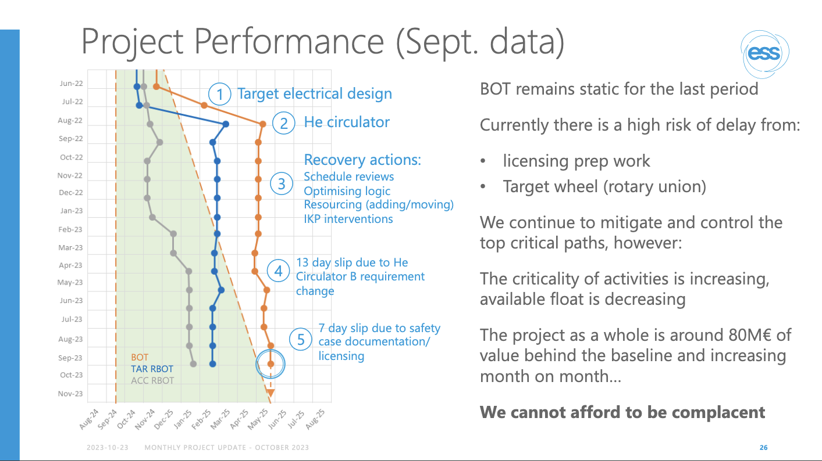
Notes:
First of all - Consistent way pf reporting on project each month from the project director.

Slide 13
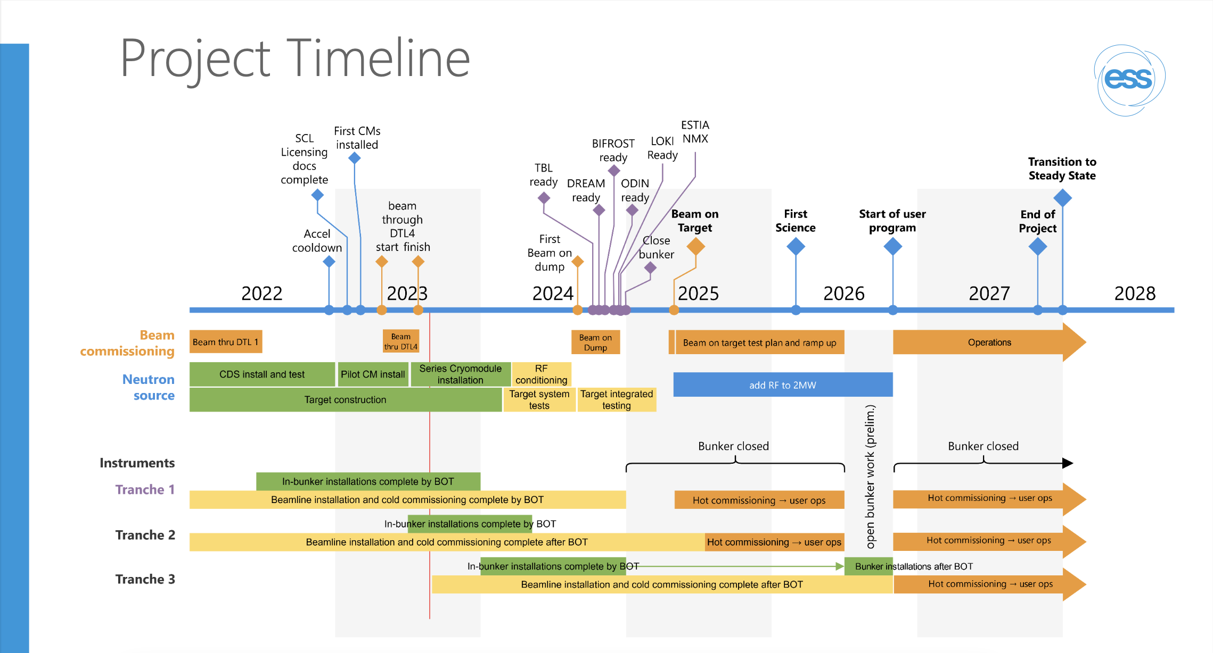

Slide 14
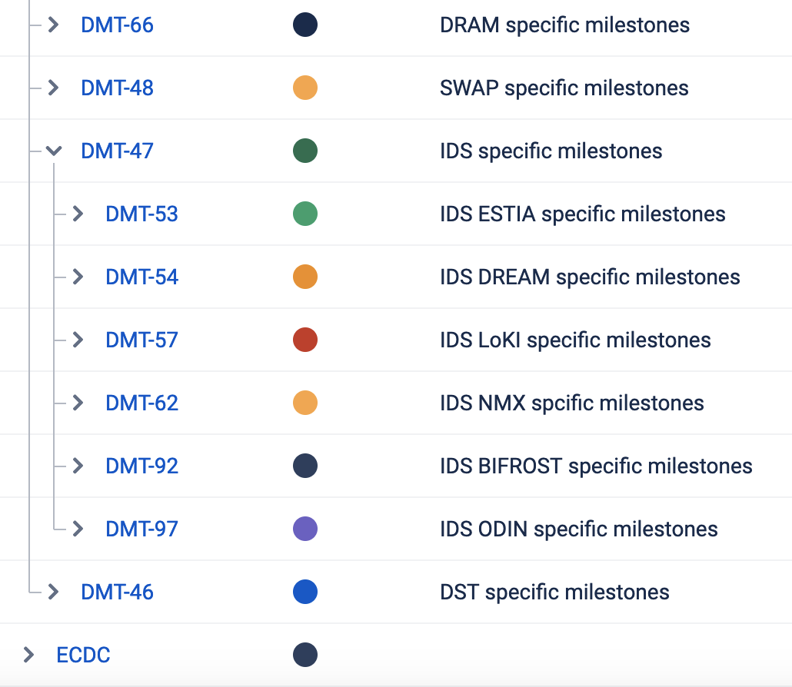
DMSC internal milestones
Tracked only in Big Picture
Milestones for each group
Focusing on the upcoming 18 months
Definition
  Due date, either absolute date or relative to another milestone (e.g. 6 months before Hot Comissioning)
  Description of milestone, e.g.:
    What does this actually mean?
    How would you demonstrate that the milestone is achieved?
    What can a user expect to be able to do when a milestone has been achieved?

Slide 15
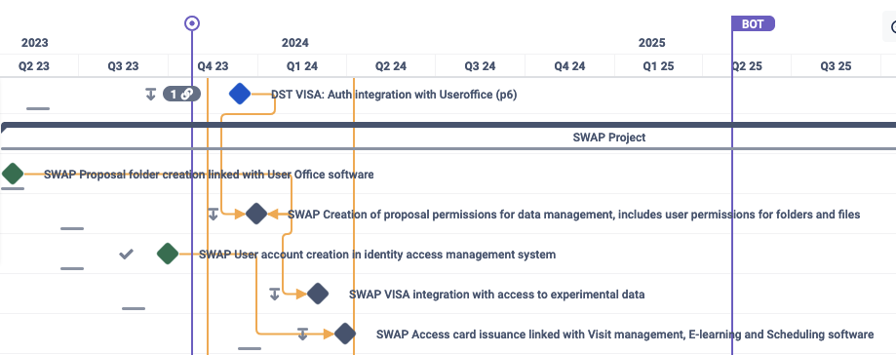
Status
Dependencies are in place. We track progress and delays

Slide 16
Concluding remarks on Project
For DMSC
Larger milestones in p6
Focusing on 18 months in Big Picture for Internal DMSC milestones
  We clearly see dependencies and timelines
  DMT focus on project once per month to get everyone involved in development and issues
Groups can do agile Project management in JIRA and link JIRA tasks to BigPicture
We have arranegd for a framwork agreement to mitigate the slip in schedule due to problems hiring

Slide 17
Finish presentation
Questions?

