Slide 1
Sample Environment Systems for SANS instruments Materials Science and Physics Support group MSPS
PRESENTED BY caroline curfs & Alexander T. Holmes

Slide 2
MSPS Scope
Provide and maintain sample environment systems in the fields of:
Low and ultra low temperatures
High temperature
Electric and magnetic fields
High pressure
Mechanical processing
Provide users services for materials engineering, quantum materials and physics
Provide mechanical integration for all SES
Provide control integration for complex SES and electronics
Coordinate the He management
Provide hardware and scientific support for polarisation

Slide 3
MSPS Team
Project leads for sample environment systems
Magnetic fields: Alexander Holmes
Low & Ultra low temp: Oleksiy Zadorozhko
High Pressure: Damian Paliwoda
High Temp & Mech. Processing: Caroline Curfs
Scientific support and interaction with Instruments and users
Define, design and procure SES
Manage projects within time and budgets
Test SES and lead the integration
Group leader : Caroline Curfs
Control electronics and integration
Niklas Ekström & Andreas Hagelberg
Design and fabrication of control electronics
Control integration of systems, which cannot use EPICS directly
Mechanical integration and technical support
Richard Ammer & Lauritz Saxtrup
Mechanical alignment and integration of SES
Mechanical workshop and technical work
Polarisation
Wai Tung Lee, Joel Hagman & Johan Ranstad
Design, develop and provide hardware for polarisation
Scientific support

Slide 4
SES for SANS instruments
Wishlist from LSS workshop (Nov 2018) - ESS-2712844 released July 2020
SES | LOKI | SKADI | Planned < 2027 | > 2027
2.5 T WBM | X | X | MSPS
Wet cryostat/ Cryofurnace | X | X | MSPS
Dry cryostat | X | X | MSPS
Dilution fridge < 1K | X | X | MSPS
High Field magnet |  | X | 17T from LU ?
1T electromagnet |  | X |  | To be confirmed
Stress/stretching rig | X | X | Interest need to be confirmed
Furnace |  | X | More infos needed – ILL type?

Slide 5
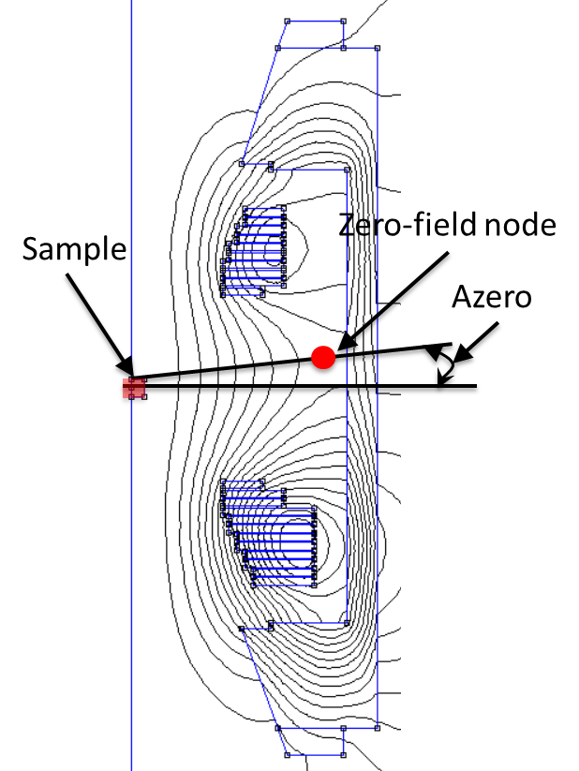
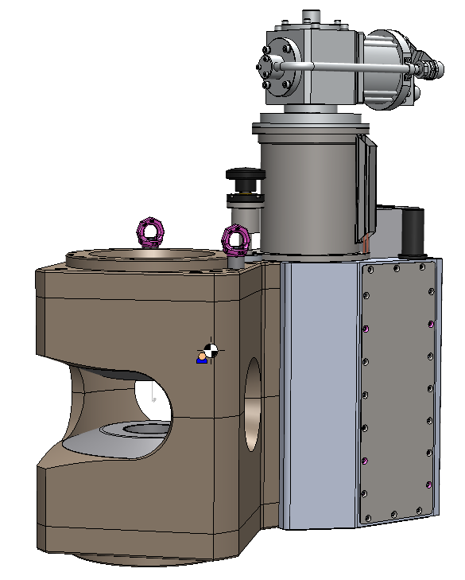
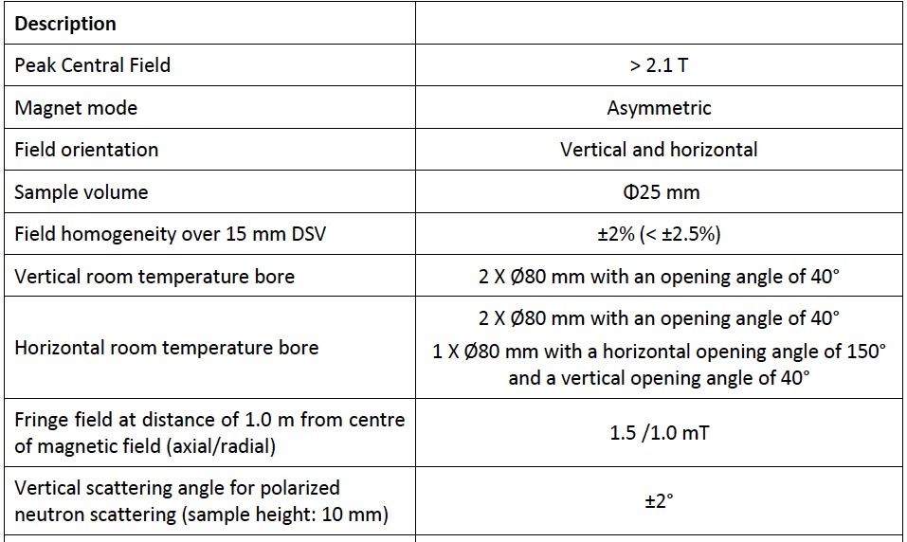
Warm bore magnet
A 2.1 T passively shielded asymmetric HTSC magnet from HTS110.
Design based on TOFTOF magnet at MLZ.
Assymmetric coils for polarised neturons, design study completed Feb ’23
Full procurement completed, kick-off July ‘23. PDR passed, currently in detailed design stage. CDR October 18th.
Delivery planned July ‘24.

Slide 6
Other systems
Possible SES for SANS:
Precipitates formation in metals and alloys during heat treatment under load
Dilatometer
100 kN stress rig with heating / tortion-rotation rig
Phase stability, precipitates, interfaces, grain size :
Hot air blower/cryostream sample changer (from 100K to 800 C)
UHT furnace / Induction furnace
High-Pressure: NMI3: A new pressure cell for SANS experiments up to 500MPa
Additional pieces of equipment for the labs
TBD

