Slide 1
ESS High Intensity Proton Source (PS-ESS) and the LEBT
S. Gammino (WP3 Leader)
Istituto Nazionale di Fisica Nucleare
ITALY

Slide 2
WP03 Master Schedule

Slide 3
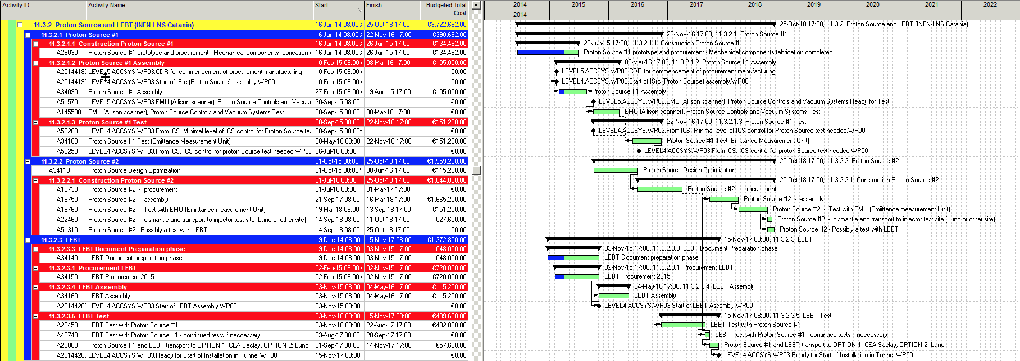
Ion source & LEBT: Schedule

Slide 4
Ion Source & LEBT Technical performances
Beam performances are specified by L3 requirements:
Parameters | Value
Nominal proton peak current | 74 mA
Proton fraction | > 80 %
Stable operation current range | 60-74 mA
Current stability(over 50us period) | ± 2 %
Pulse to pulse variation | ± 3.5 %
Beam Energy | 75 keV (±0.01)
Distance between pulses | 1 Hz< f <14 Hz
Restart after vacuum break Restart after cold start | <32 h <16 h
Parameters | Value
Beam current change (2 mA step, ±1 mA res.) | 2-74 mA
Nominal pulse length | 2.86 ms
Pulse length range (±0.001 ms) | 0.005-2.88 ms
99 % rms norm. emit. at RFQ input | < 2.25 pi.mm.mrad
Twiss parameter: α | α= 1.02 ±20%
Twiss parameter: β | β= 0.11 ±10%
Rise and fall time | <20 us
Maximum LEBT pressure | 6e-5 mbar

Slide 5
Ion Source & LEBT Technical performances
ISS (Ion Source Specialties) Level 4 requirements describe the functions to create and maintain the plasma and extract the beam from it. This includes, among others, the high voltage platform and the protection cage, the RF power into the plasma (magnetron), the hydrogen gas flow, the magnetic confinement, the 400 V isolation transformer and the high voltage extraction power supply. ISS requirements map the WP 3 WU Ion Source deliverables and scope from INFN-Catania.
In the LEBT, performances for chopper and its dump, magnets (solenoid with embedded steerers) and the iris (to modulate the current) are described by BMD (Beam Magnets and Deflectors) Level 4. Interfaces occur mainly with Beam Instrumentation (Diagnostic boxes: in between the solenoids and for commissioning) and with vacuum.

Slide 6
Ion source & LEBT: Selected technologies
The PS-ESS (Proton Source for ESS) is a MDIS (microwave discharge ion source) with improved features w.r.t. the previous ones (SILHI, TRIPS, VIS), either in terms of magnetic plasma generation and in terms of RF coupling to the plasma.
The High voltage system and extractor (φ=6,8,9 mm) are completely renewed, in order to cope with the request to minimize the emittance and to keep high the reliability.
The six-blades iris is a new element designed to reduce the transmitted current and preserve the round shape of the beam.
The chopper was optimized for a fast pulse transition and for reducing the heat issue at the end of the LEBT.
Different “expedients” were taken into account for a space charge compensated transport of the beam.

Slide 7
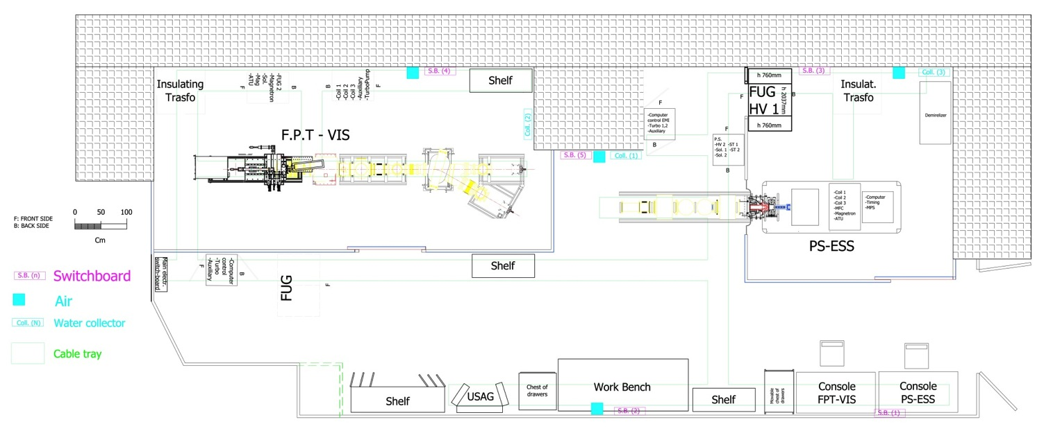
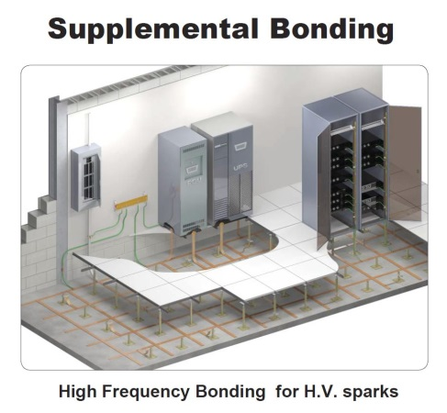
Ion Source & LEBT:
ESS test area at LNS
A careful preparation of the site has just been completed, with particular attention to grounding to minimize the effects of sparks

Slide 8
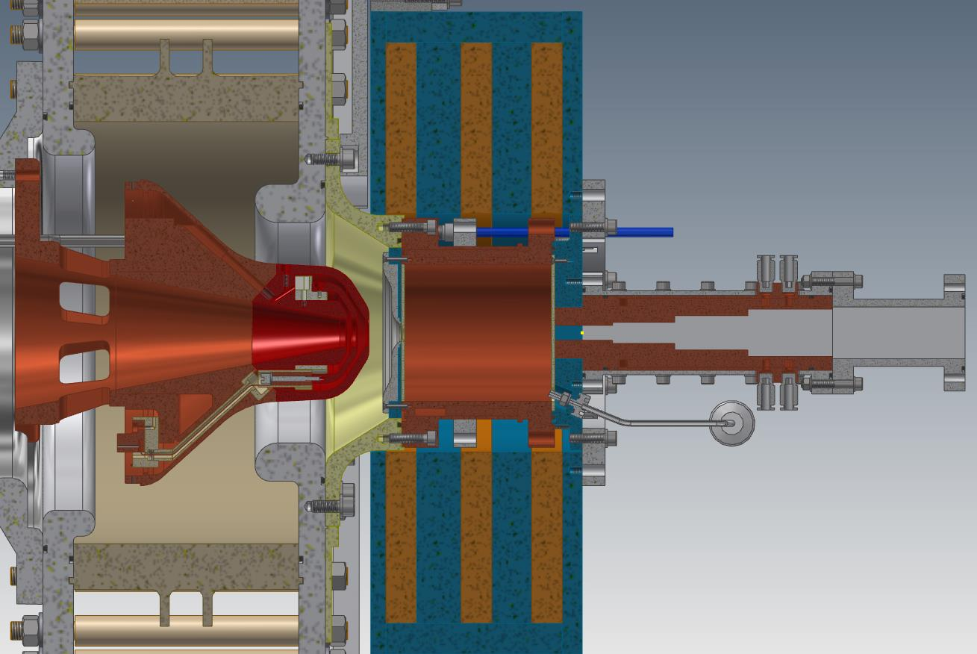
The Proton Source for ESS (PS-ESS)
Flexible magnetic system + improved RF injection-Plasma coupling + increased reliability + easy assembly procedure
CDR on Feb.10th
Positive evaluation
Under procurement

Slide 9
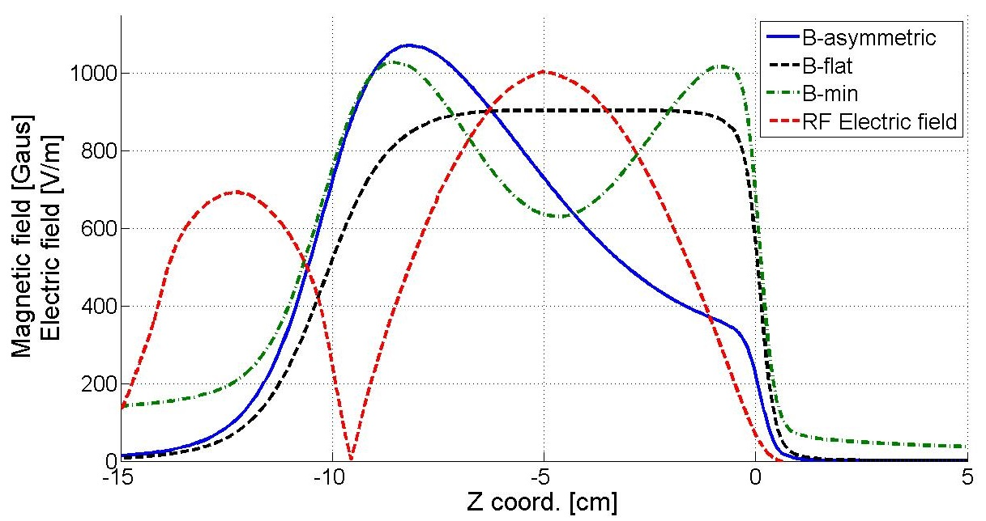
Flexible magnetic system
Low magnetic field in the RF inj. region
to prevent plasma formation inside wave guide
Low magnetic field in the extraction region
to prevent emittance growth
Classical MDIS flat profile (B-flat)
Simple-mirror (B-min) for the prolongation of H₂⁺ molecule lifetime, thus increasing ionization efficiency and proton fraction
Magnetic beach (B-asymmetric) making possible Bernstein Waves (BWs) formation through inner-plasma conversion of the input electromagnetic waves.

Slide 10
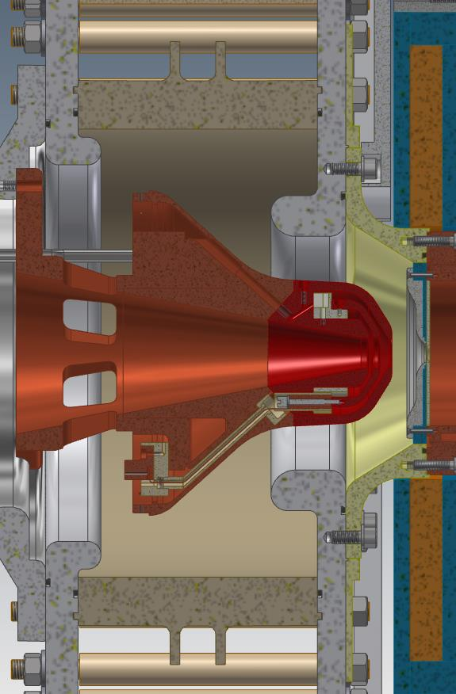

Final version of the extraction system
- Single alumina
- New alumina metallization
- New triple point design
- Completely new opening strategy
- Interchangeable electrodes head
- Cooling of all electrodes
- New X-ray shielding
- Improved emptying cavity gap
- New voltage shielding of the beam
- Detailed study to be ready for different plasma heating strategies

Slide 11
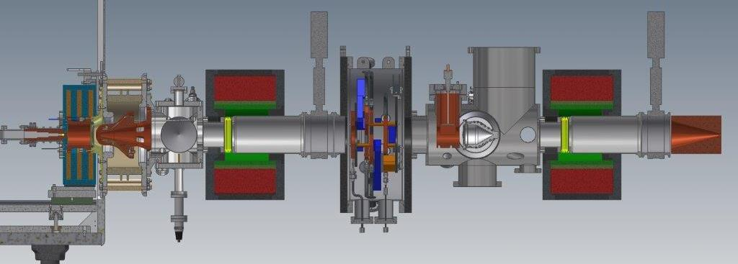
LEBT Layout
2654 mm from plasma electrode to LEBT collimator
540 mm Iris utilities + Diagnostics + Vacuum + Chopper
239 mm Vacuum + Utilities
128 mm Gate valve
128 mm Gate valve
234 mm Extraction
425 mm Solenoid
425 mm Solenoid
210 mm Collimator
325 mm Iris

Slide 12
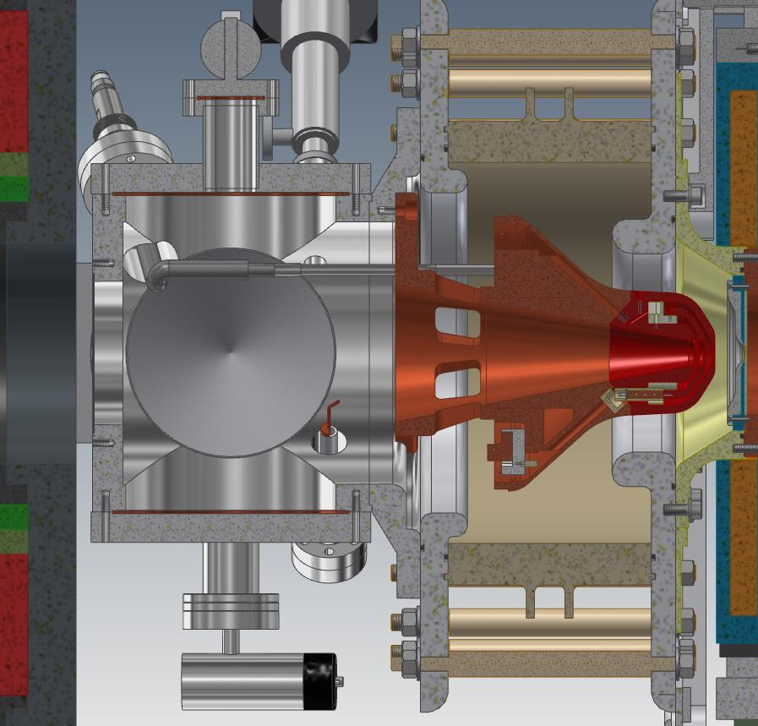
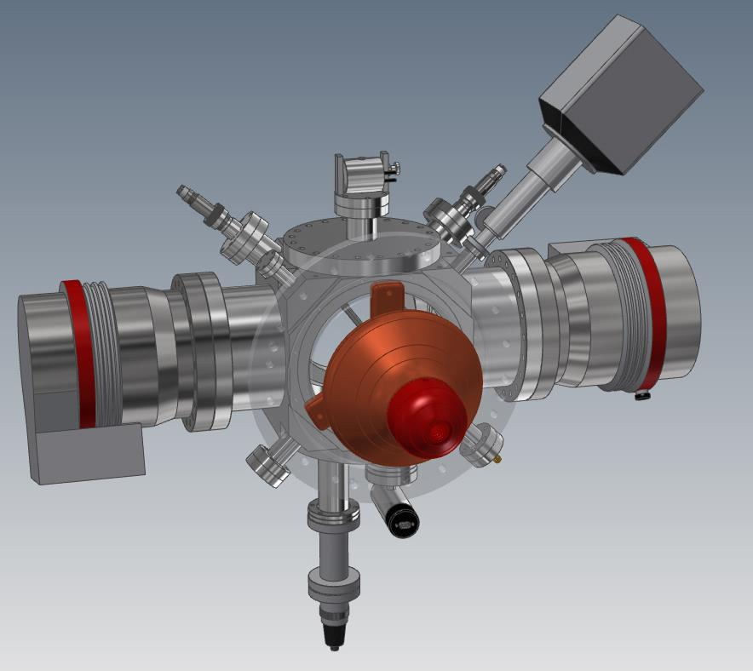
First LEBT element with two TMP
2 x TMP
Cooling water
HV repelling cable
Pirani/penning
Spinning rotor gauge
Gas inlet
RGA
483 mm

Slide 13
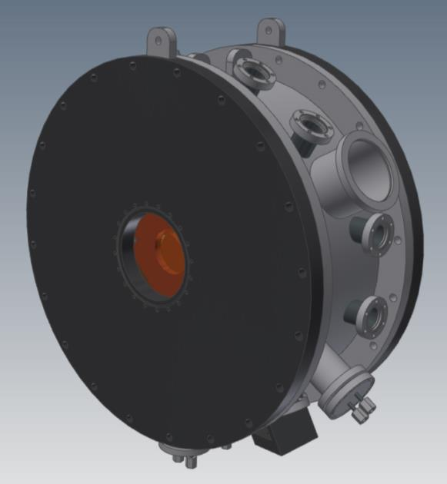
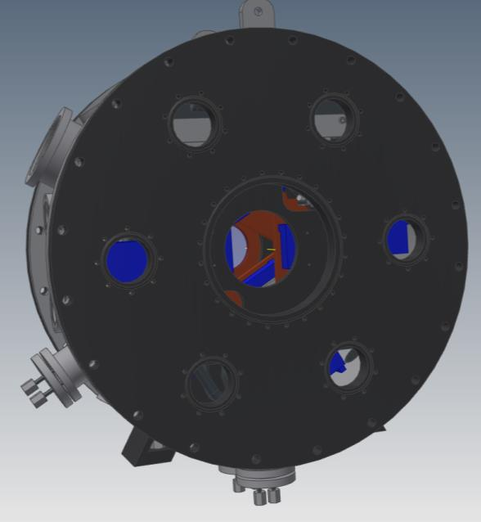
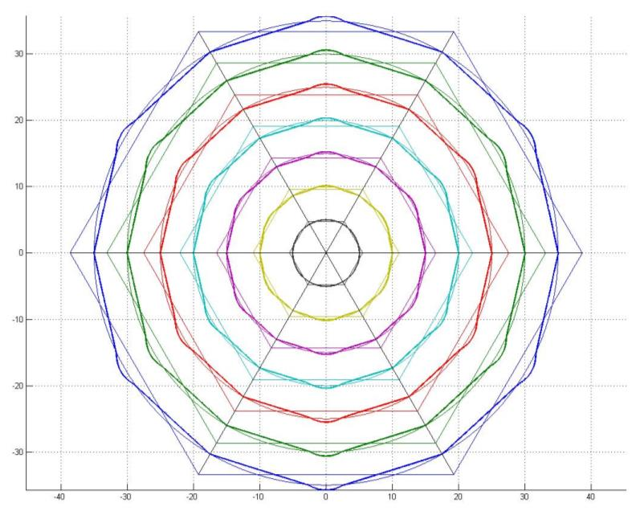
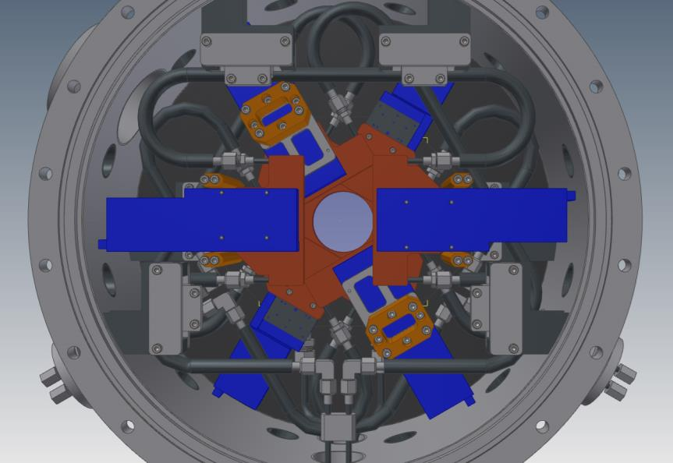
Iris: two possible configurations
Length 300 mm
Beam aperture from 5 mm to 70 mm with dodecagonal shape or from 1 mm to 80 mm with hexagonal shape

Slide 14
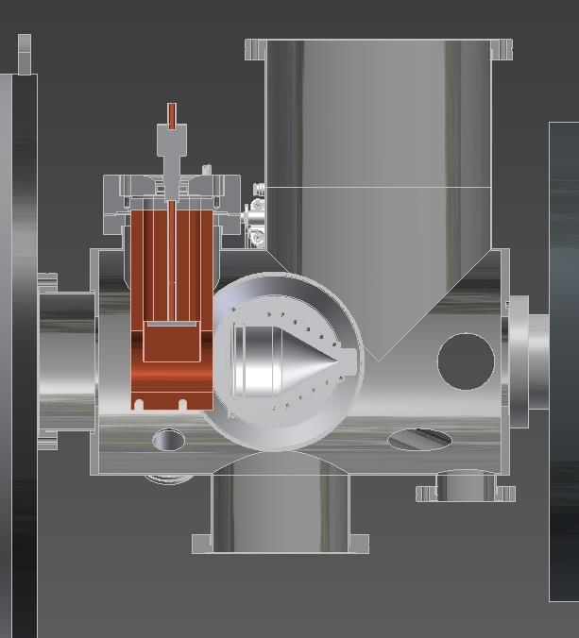
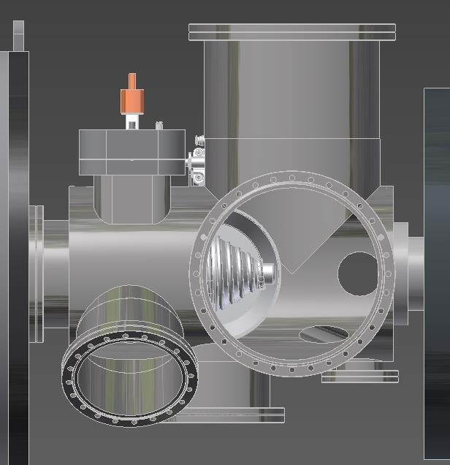
Diagnostic box with chopper
Length 540 mm
Chopper
EMUx
EMUy
View_{y}
FC
Beam
DS
TMP₁
TMP₂
View_{x}
Note: 1) Close collaboration with ESS diagnostic group; 2) Two diagnostic boxes will be used for the commissioning

Slide 15
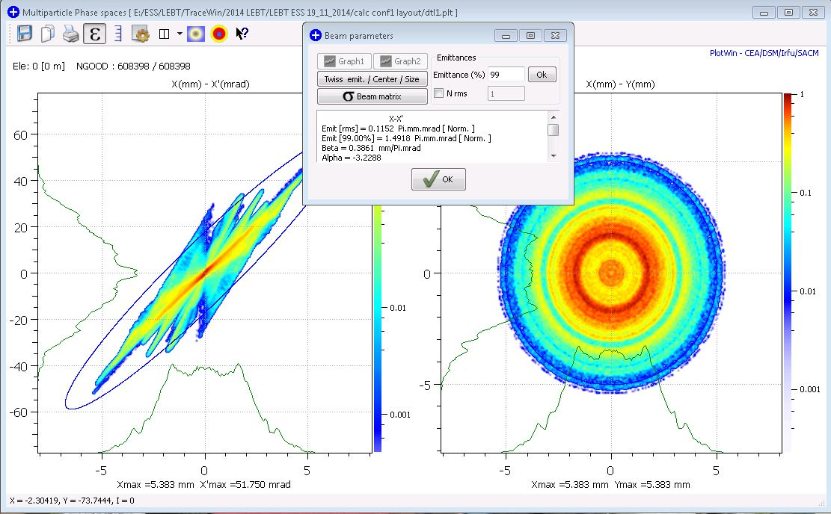
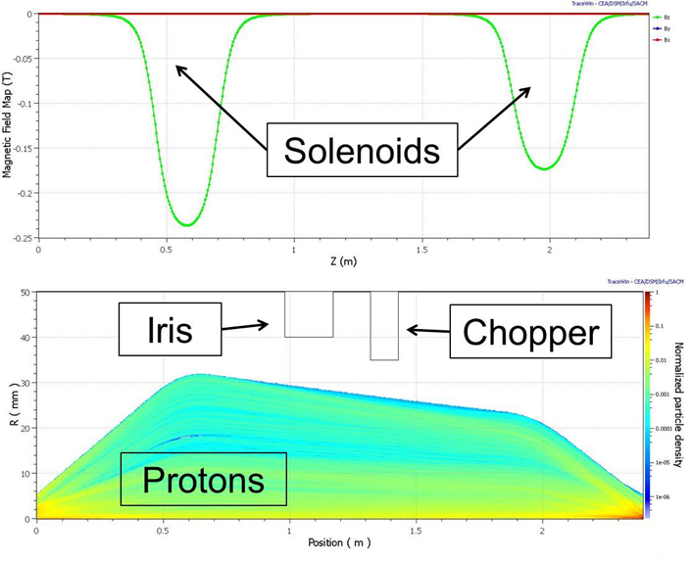
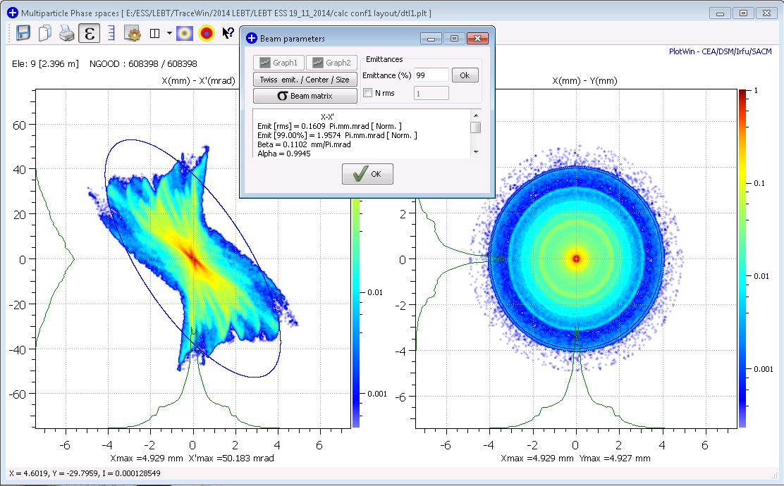
Ion source & LEBT: performances for different current rates
Beam from the source
Beam transport
Emit [99%]=1.492 ( < 1.8 ) Pi.mm.mrad [Norm]
Max Divergence= 55 ( < 80 ) mrad
Beam focused on the RFQ entrance
Emit [99%]= 1.957 ( < 2.25 ) Pi.mm.mrad [Norm]
α = 0.995 ( -2.5 % < ±20 % )
β = 0.1102 ( +0.2 % < ±10 % ) mm/Pi.mrad

Slide 16
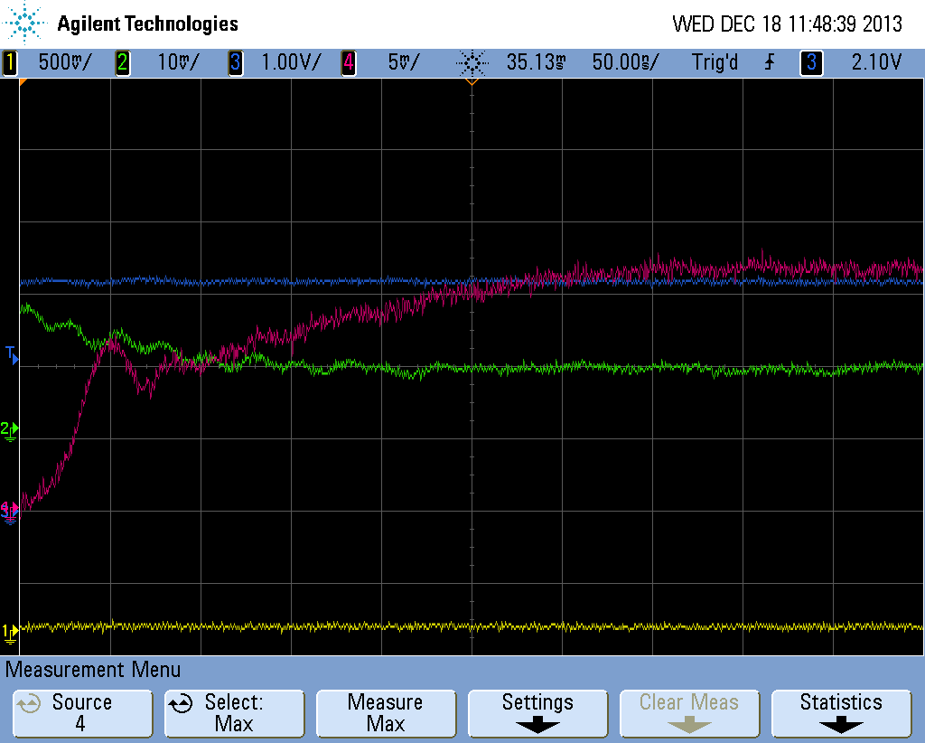
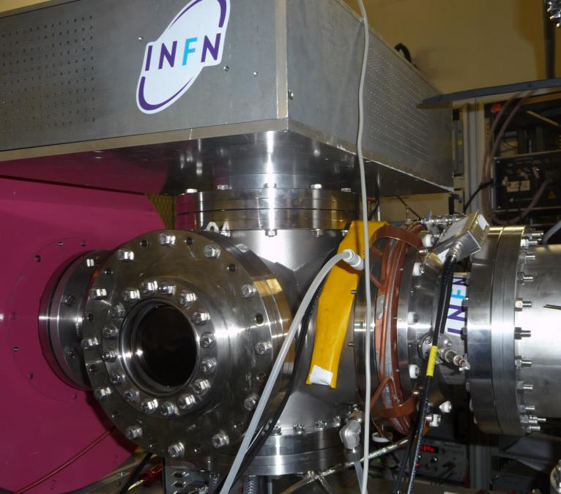
Chopping strategy
Beam Pulse rise time
Chopper
Slow transition ≈ 250 ns
Chopper HV
Fast transition ≈ 50 ns
Chopping strategy tested at CEA: result not conclusive because of the lower current and voltage, but many criticalities have been solved
Ch4: Beam Stop (Rτ = 5,5 ohm; C = 183 pf ; Rτ * C = 1 ns)
Ch2: Collimatore (Rτ = 5,5 ohm; C = 534 pf ; Rτ * C = 2,9 ns)

Slide 17
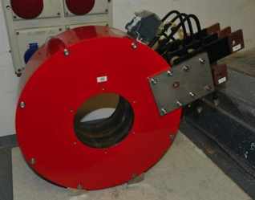
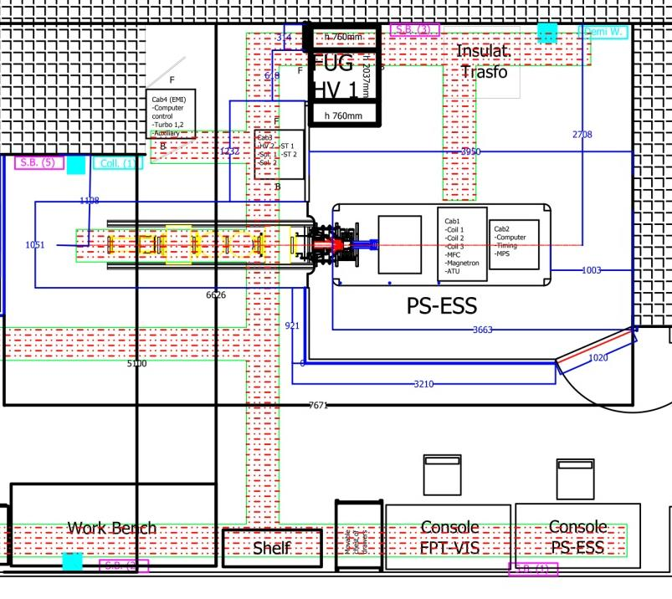
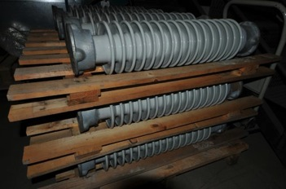
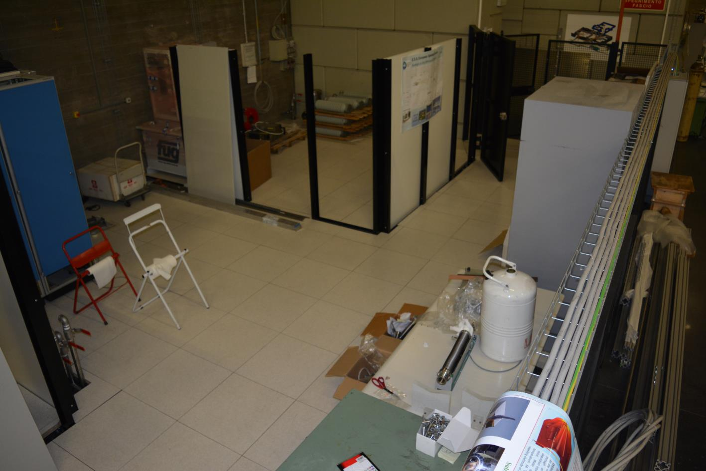
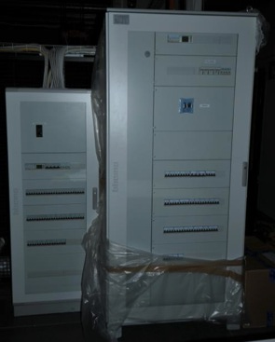
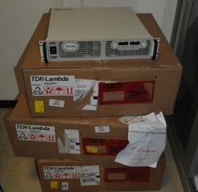
ESS site @ INFN-LNS
Notes:
È possibile attuare 100ns con il chopper all’rfq, far vedere la simulazione dello spazio svuotato alla scc corrispondente a 10ns

Slide 18
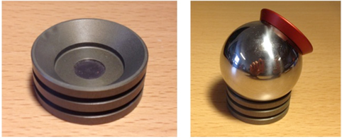
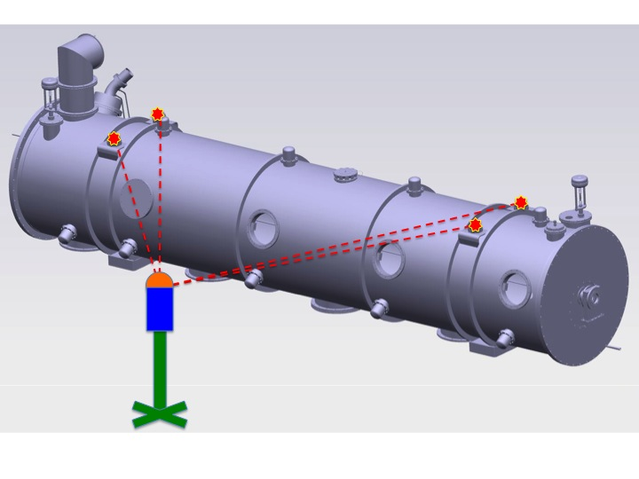
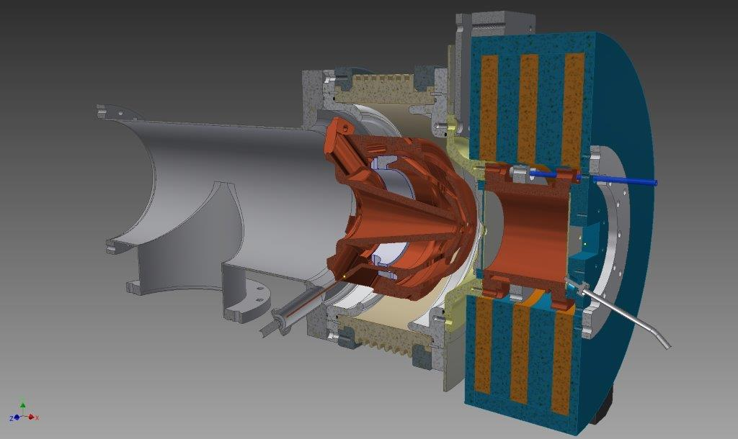
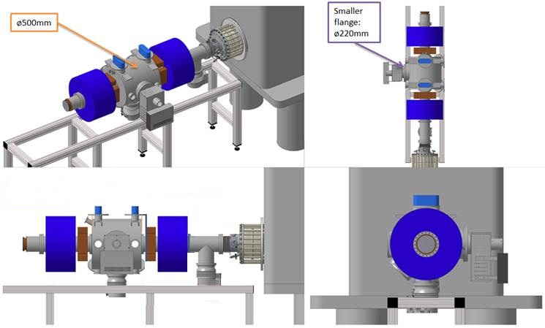
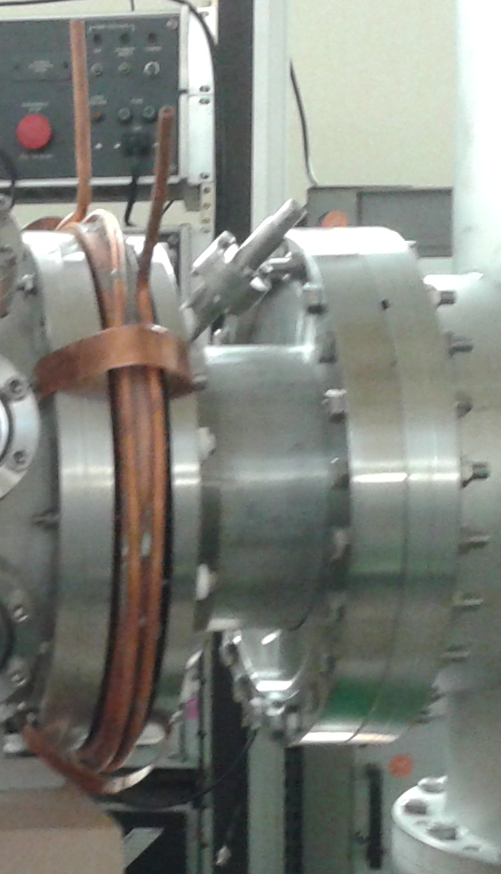
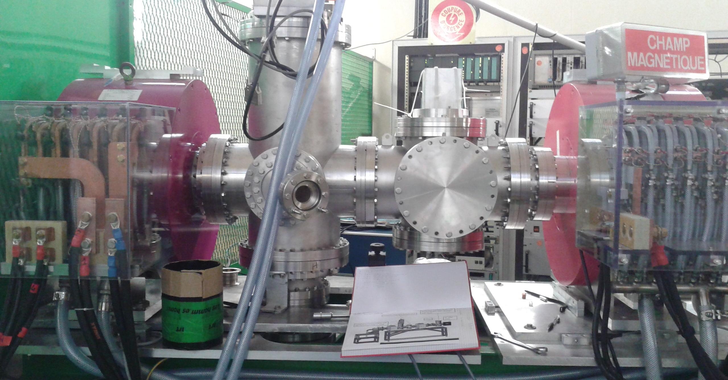
Alignment
Alignment strategy inside the ESS accelerator tunnel
Main important element for the alignment:
Plasma electrodes
Extraction electrodes
Two solenoids
RFQ entrance collimator
2
1
3
4

Slide 19
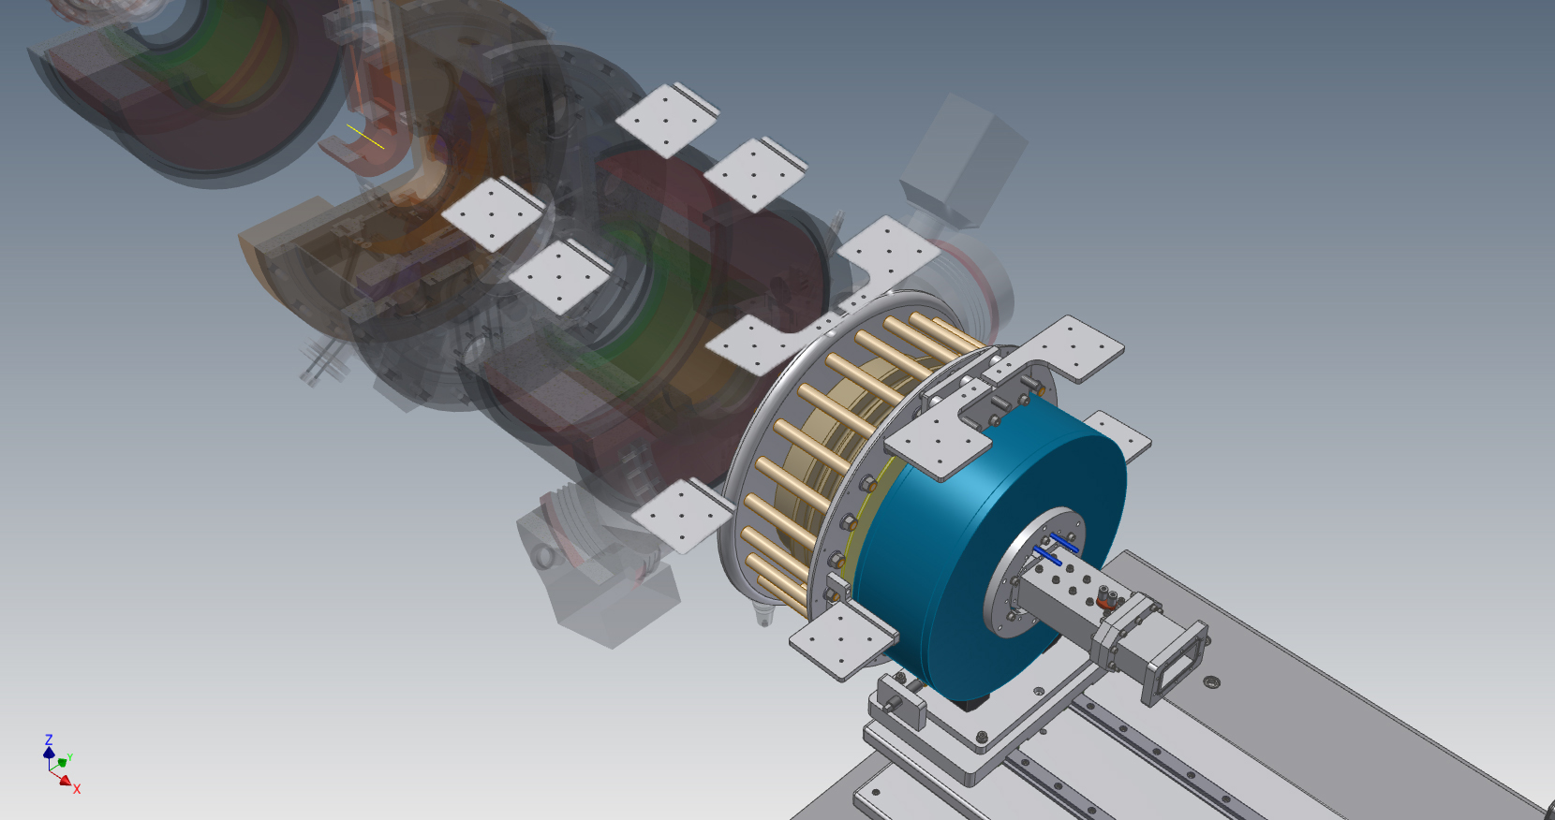
Alignment strategy in progress
Notes:
È possibile attuare 100ns con il chopper all’rfq, far vedere la simulazione dello spazio svuotato alla scc corrispondente a 10ns

Slide 20
Status and open items
Sites
LNS site | Complete except for interlocks
ESS-Lund site | Information and support to Lead Engineer
Proton source (PS-ESS) and accelerator column
HV platform | Few details to be revised
Power supplies (High current, High voltage) | Delivered
Microwaves equipment | Ordered
Magnetic system | Delivered
Plasma chamber | Ordered
Mechanical integration | defined, part of mechanical components ordered
Extraction system | Ordered
Interfaces
MPS | definition in progress
Control interface | definition in progress

Slide 21

Status and open items
Low Energy Beam Transport line (LEBT)
Solenoids & Steerers | Delays in administrative procedures, but not critical because of short delivery time (3 months)
Chopper mechanics | Revised after tests in 2014, material partially available, order of remaining parts in process
LEBT collimator | Delivery time not critical
Diagnostics box | definition with Beam Diagnostics WP done, delivery time not critical
Mechanical integration | Work in progress
IRIS | Motors ordered, mechanics to be ordered in June

Slide 22
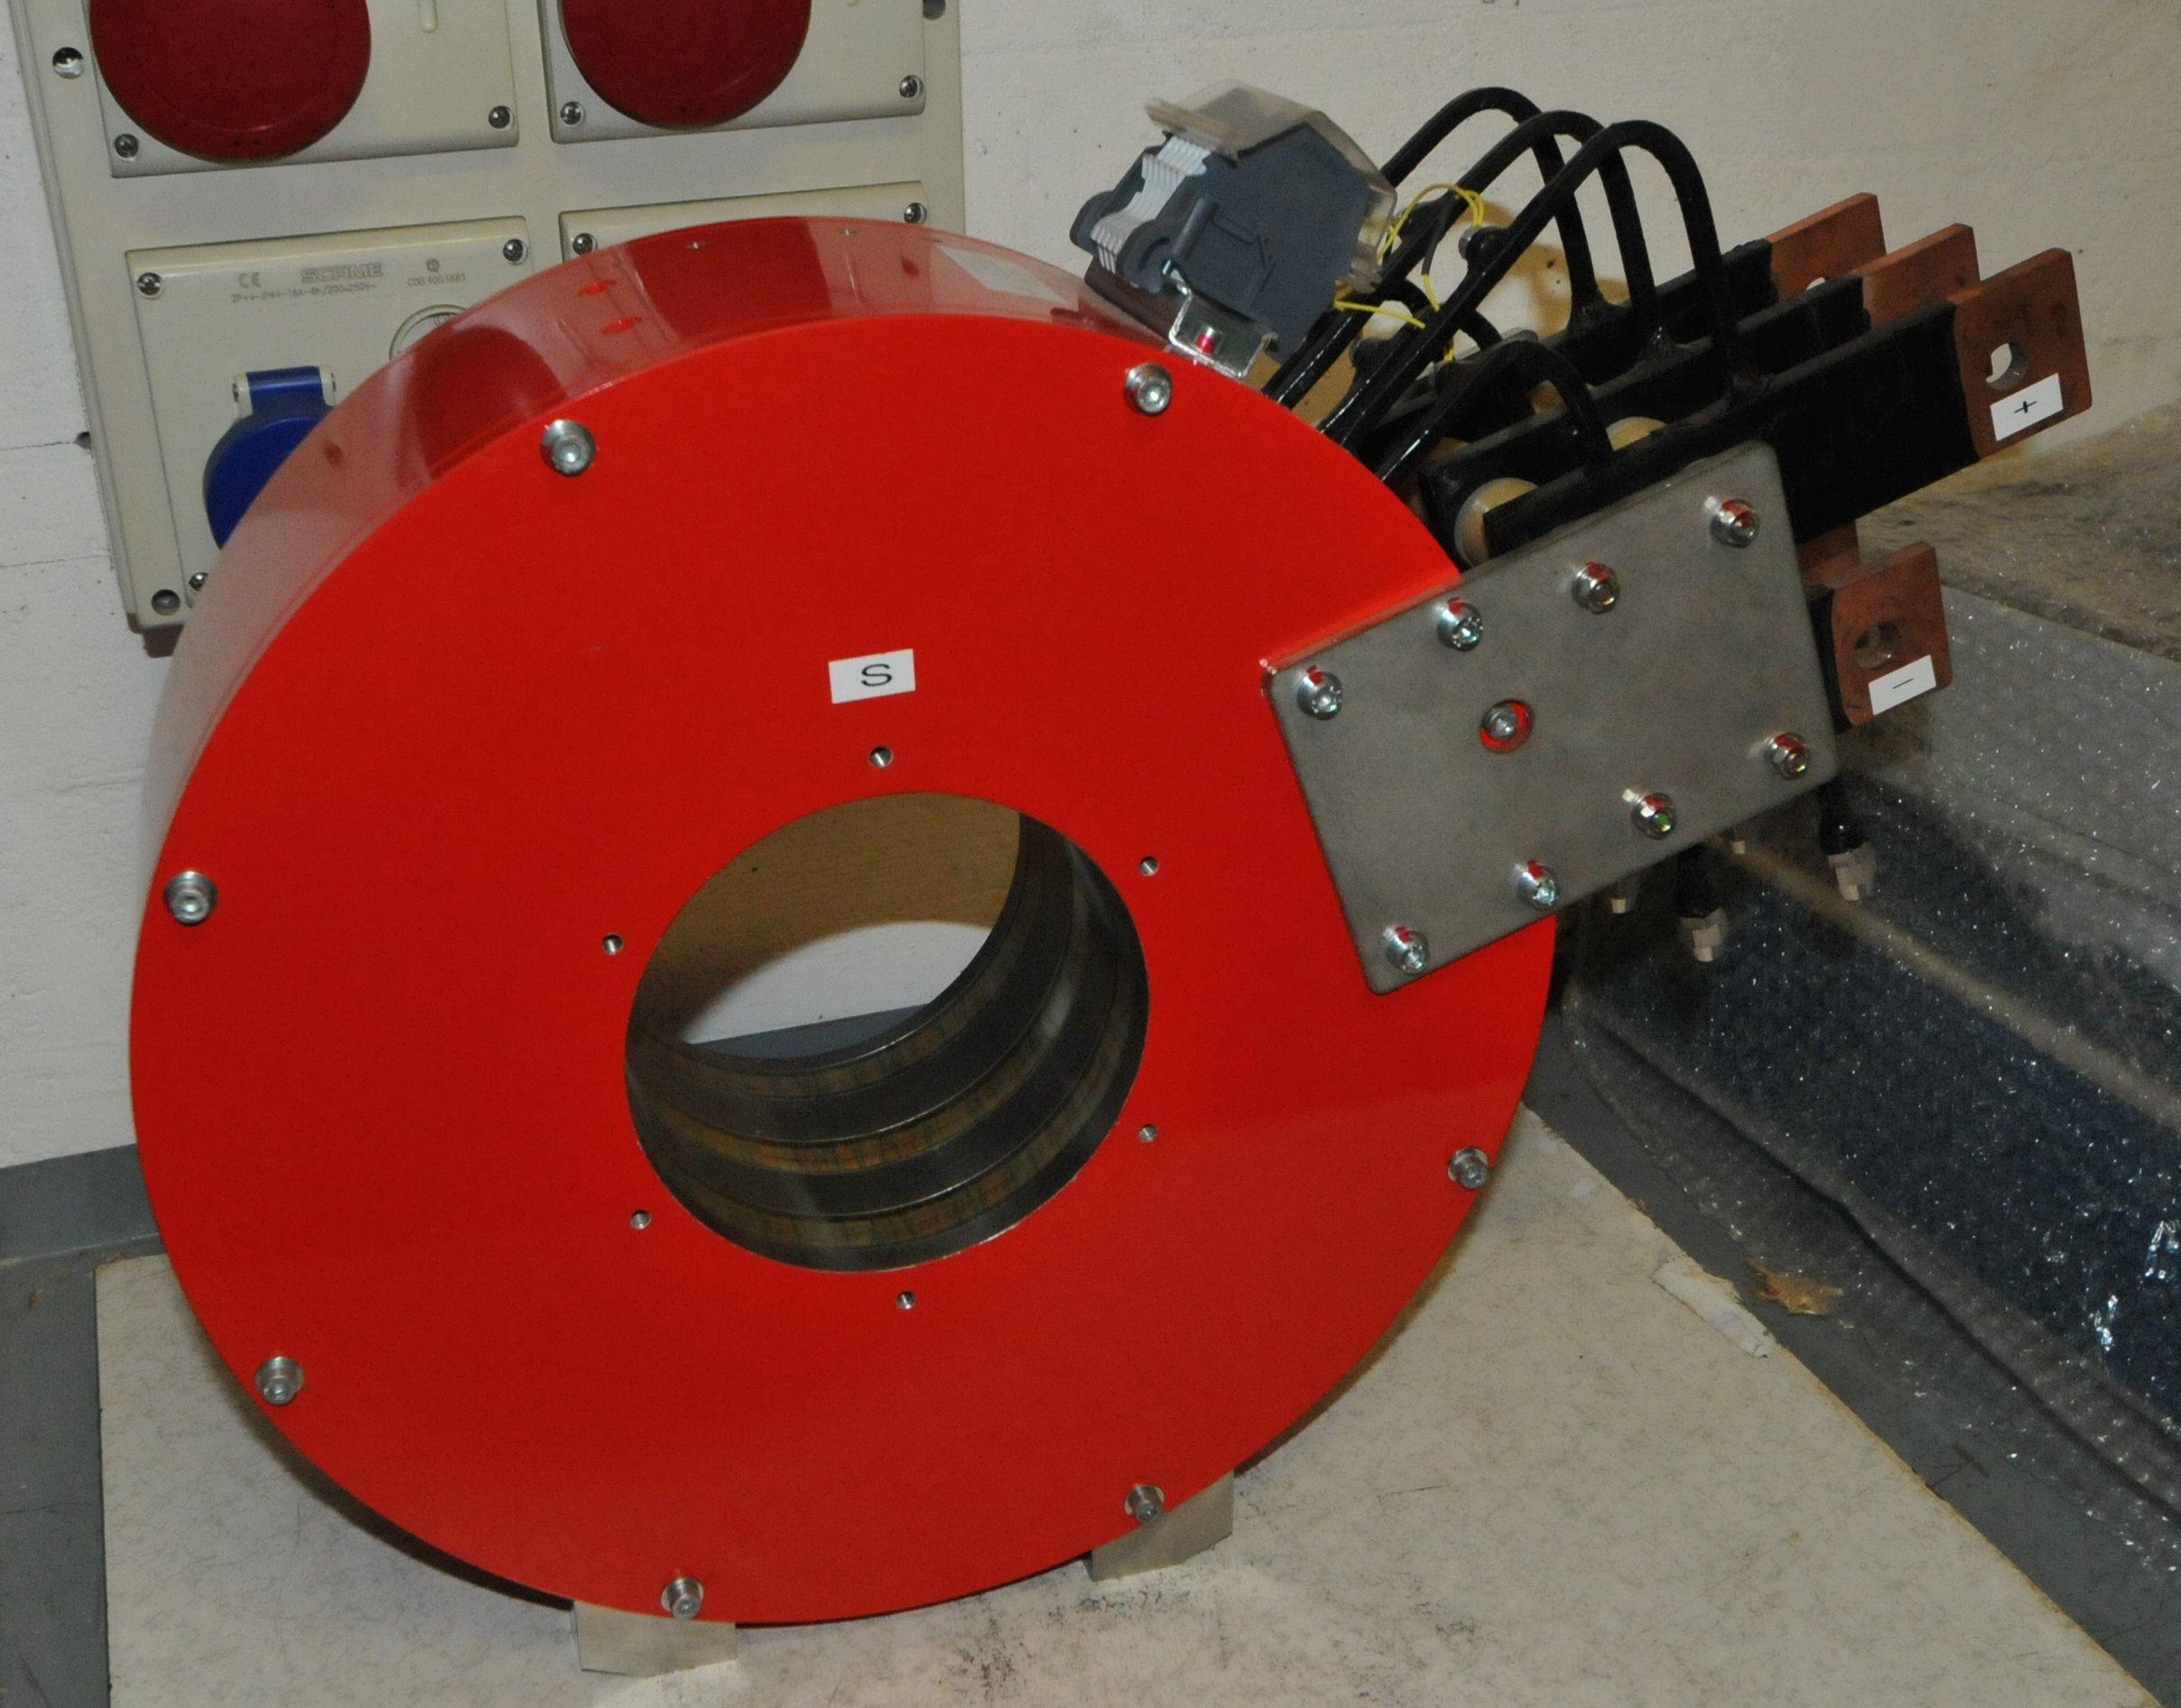

The PS-ESS very flexible magnetic system
Magnet manufactured by Sigma-phi
Magnetic system already delivered at LNS
Ready for installation!

Slide 23
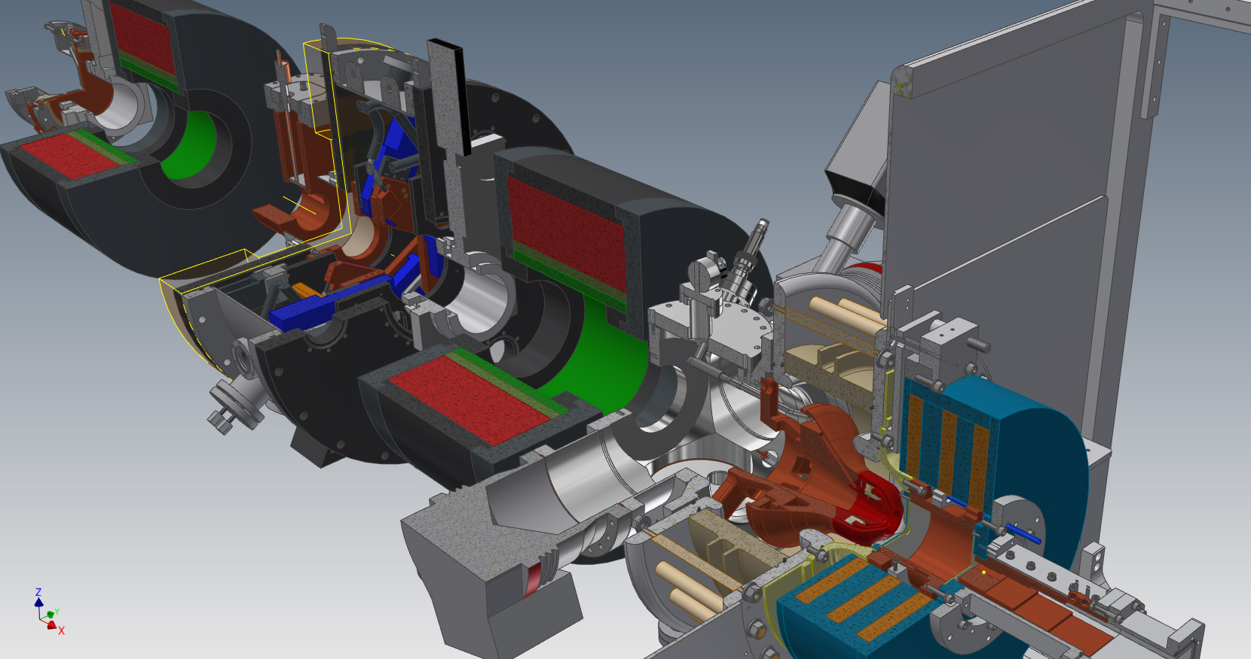
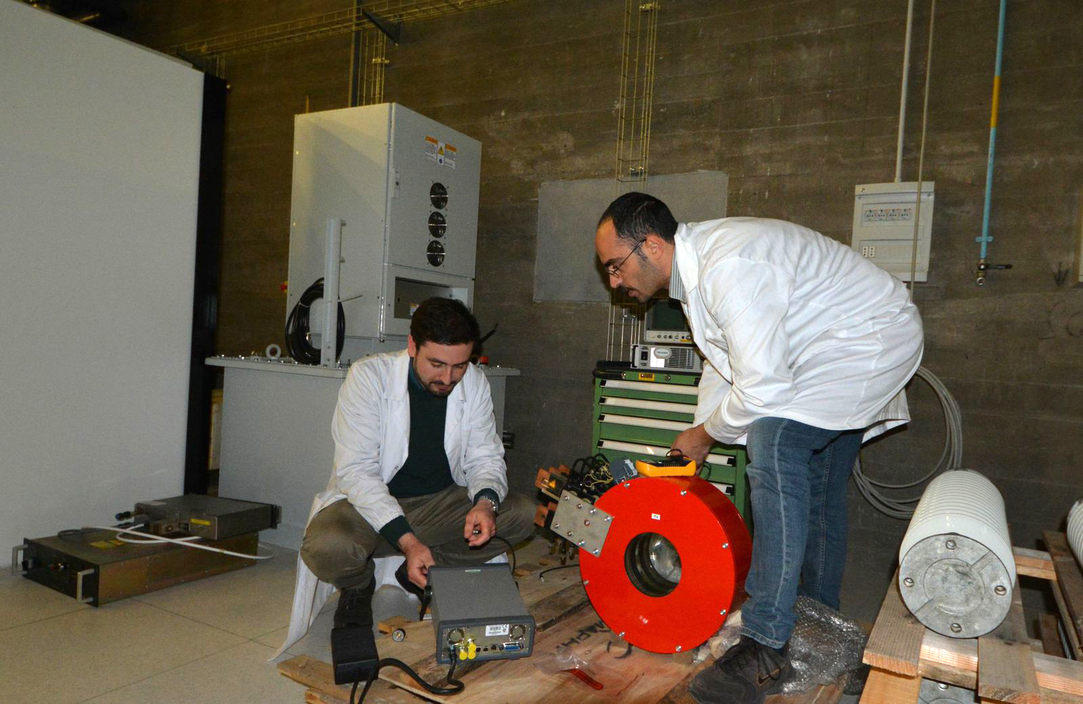
Ion source & LEBT: Selected technologies

Slide 24
Ion source & LEBT: Commissioning at Catania
Plasma Studies
Extracted Beam
Beam transport and pulse formation
ISrc
Interferometer 3D characterization
Langmuir probe analysis
High Voltage
Current Measurement with Faraday Cup (FC)
Emittance Measurement Unit (EMU)
Doppler Shift Measurement (DSM)
ISrc
High Voltage
Iris
Chopper
FC
EMU
DSM
Collimator
FC
EMU
DSM
Optical analysis
ISrc
Sol1
Sol1

Slide 25
Ion source & LEBT: Test series
Plasma characterization
High voltage tests
Beam extraction
Nominal beam optimization
Production and transport of 10-20-...-90-100% of nominal current
Tests of beam diagnostics
Emittance measurements 10 to 100%
Emittance minimization
Study of different magnetic field profiles/RF inputs to minimize the emittance further and maximize the current
Assembly of full LEBT and verification of above results
ICS tests and unmanned operations
Long run tests (1 month full current, 1 week 20%, 50%, 80%)

Slide 26
Ion source & LEBT: Organization at INFN-LNS and manpower criticalities (fixed/still worrying)
L. Celona WU Leader
L. Neri Deputy
D. Mascali Beam Physics
G. Torrisi Microwave Engineer
L. Andò – A. Galatà Beam Extraction optics
F. Chines – A. Amato EMI and High voltage issues
A. Caruso Chopper construction and test
G. Gallo-A. Allegra Mechanical design
E. Zappalà-E.Messina-G. Manno Mechanical integration
S. Marletta Vacuum design
S. Pulvirenti Control system
G. Schillaci-D. Bandiaramonte Technical services

Slide 27
Ion source & LEBT: Interfaces workshop
Attendees:
ESS: Matthew Conlon, Walter Wittmer, Georg Hulla, Edgar Sargsyan & representatives from WPs
Wus: Santo Gammino, Luigi Celona, Alain France, Andrea Pisent, Ibon Bustinduy
Goals:
which interfaces have already been identified/worked on - are there any that have been missed
what is their current status,
who are the interface partners on ESS/IKC side – have topical responsibles been assigned
how are (will) the interfaces (be) documented,
are there open questions that need to be addressed to the WU leaders,
is there something that you don't like,
is there something you want to be done better.

Slide 28
Ion source & LEBT: Interfaces workshop
WP99 Buildings and Site Infrastructure: Nick Gazis
Procedures and requirements for installation and transport need to be prepared by AIG
Procedure/platform for exchange of 3D models is in place, see:
CHESS shall be the single point of truth for 3D model exchange.
Installation process should be done together with IKC or an ESS team shall be trained on IKC site before installation.
Survey and alignment: Fabien Rey
Requirement for fiducials where shown in the presentation and can be found also here:
Only requirements for horizontal, vertical and longitudinal alignment ranges are in DOORS (see Accelerator System Requirements).
IKC partner shall identify to Fabien who is the partner’s stands designer.
IKC partner shall send proposed 3D models for stand solutions to Fabien for review and comments
  Fabien’s proposal prevents cut or drill through rebar of floor (clamping solution)
  Beam high is 1500 mm from ground level
  Floor horizontality along 600m should be within ±15mm
  Grouting plates are excluded
  Supports shall be directly fixed into the floor
  Reinforcement bars very close to ground surface (3 to 5 cm)

Slide 29
Ion source & LEBT: Interfaces workshop
WP15 Conventional Power, Cables and Racks: Evangelia Vaena, Frithiof Jensen
Cabling and enclosures for ISRC as well as requirements for power and UPS to be provided by LNS. Integration of cables (naming, routing, etc.) will be done by ESS
Inputs on racks & structure (interface diagrams) to be provided by all partners. Integration and cooling will be done by ESS
Load lists (CNPW to racks; CNPW to CF) to be filled in by all partners. A questionnaire to be filled will be provided by WP15
What needs to be isolated with respect to EMI (producer of, sensitive to)
Standard milestones in P6 are required: When does system “X” need power / “services”
Functional specifications for cables defined by IKC, cable routing shall be done by ESS
Vacuum, PBI and ICS cables provided by ESS, rest by WP3 (included in the budget?)
Standard racks (2200H-800D-600W) in the gallery will be provided and installed by ESS
Installation: Cables pulled by ESS contractor. Who will do the final connections and the testing of termination?
Who will perform any grounding connections?
Installation of equipment in racks: Who will do it (ESS or collaborators)?
Overlaps: Some cables in the scope of WP17 and WP8 can be found also in the scope of WP3 (N.B.: this may be the case with other WPs as well, need to be checked)
Guidelines for recommended cable insulation materials will be provided by WP15

Slide 30
Ion source & LEBT: Interfaces workshop
WP2 Beam Physics: Ryoichi Miyamoto
Numbers and positions of the BPMs and steerers in DTL have been revisited.
3D layout from IKC partners to be checked against optics lattice file
In one year from now real data from ISRC tests (emittance measurements as input for RFQ) will be available. A complete review of end-to-end beam simulations based on this input data shall be foreseen in February/March 2016.
WP7 Beam instrumentation: Benjamin Cheymol
LEBT diagnostic box between solenoids: work in progress (ESS PBI and Catania).
  Emittance Measurement Unit design nearly completed.
  Currently no spare Faraday cup is foreseen, question of the need came up.
  Discussion about commissioning procedure for this tank has started.
The requirements for the BCT in LEBT might change. Benjamin is driving this process.
  The mechanical interface between LEBT and RFQ is unclear at this moment.
LNS might work on it by the end of the year, however CEA needs a defined interface before the next CDR (most probably in September). Mechanical design input from both sides is needed to solve the issue.

Slide 31
Ion source & LEBT: Interfaces workshop
WP8 RF & LLRF: Anders Sunesson, Anders J. Johansson
RF interfaces were shown in the presentation
Timing will be provided by ICS
LLRF presentation gives good overview of interfaces (LLRF RF inputs for single coupler), signal levels and connector types
LLRF L4 interface requirements for RFQ, DTL, MEBT and ISRC are required by WUs
WP12 Vacuum: Marcelo Juni Ferreira
IRSC and LEBT are well developed
  Vacuum diagram complete
Wire diagram is seen as the vacuum control interface to partners
ICS interface: Timo Korhonen
Tools for configuration management needs to be completed
Data archiving will be provided from start of local commissioning
In principle ICS will provide user interfaces
Status of information exchange:
  ISRC well advanced

Slide 32
Ion source & LEBT: Interfaces workshop
WP13 Safety: Lali Tchelidze
No requirements in DOORS
LABS design in Kind hardware safety system to own best practice. Question about national regulations in respect to Swedish regulations came up.
Local protection systems in the scope of system owner
Safety manual in preparation, not ready yet. Currently WP safety gives advice on a case- by-case scenario.
IKC partners require input on Swedish safety regulations. A safety manual containing this information is in preparation by the Safety and Health division at ESS.
Any formal review will have a committee member representing safety
Question about who is designing the removable beam dump
Activation studies and neutron flux calculations are available here: https://chess.esss.lu.se/enovia/tvc- action/showObject/Workspace%20Vault/Radiation%20Protection/0000003893
IKC would like to test equipment with respect to radiation hardness, e.g. exposing equipment to a neutron spectrum as it is expected to happen at ESS (e.g. at the Svedberg Laboratory in Uppsala
Shielding requirements & tests need to be conducted by the individual WUs. WP Safety will assist in the tests by simulating specific scenarios. Local shielding boxes for sensitive electronics are envisaged, especially in the NCFE linac region (backscattered neutrons mainly from DTL tanks).
MPS, PSS, TSS: Annika Nordt
Very detailed presentations on interfaces + related questions
TSS interface with ISRC. In case of problems with the target the beam has to be shut off.
Stuart Birch will contact partners regarding hazards generated by their systems
Interface discussion with LNS in good shape
Detailed requirements about signals needed for MPS were provided to all systems
Series of workshops is planned to reevaluate its implementation
Post mortem discussions need to start

Slide 33
Ion source & LEBT: Interfaces workshop
WP17 PS: Carlos Martins
For standard power supplies IKC should not specify any connectors and ESS should update the cable/connector database according to data sheets from the suppliers
In many cases hard to give any information on power supplies, as the related devices are not yet defined (e.g. pulsed/conventional magnets).
LNS needs to see drawings of cable routing from Nick
A list of requirements will be sent to LNS for comments
WP17 has budget for DC magnet cables
Control interfaces for PS need to be defined
WP16 Water: Anton Lundmark
ISRC is designed for 20ºC water temperature. Functionality to be checked for a water supply temperature of 28ºC or higher.
Interface definition is needed between ISCR and WP16
LNS needs to work more on requirements (ISRC + LEBT)
Water requirements for LEBT are identified but not yet in DOORS
NOT ADDRESSED (Santo Gammino)
Energy management: L1 requirement
Level of dust during installation and commissioning

Slide 34
Ion source & LEBT: Budget and cost-book
3,897 M€ is the value of the Ion Source, of the LEBT, of the high voltage power supplies and of the plasma generator, along with the source and LEBT ancillaries
This value include an exact copy of the source (Isrc#2) with the high voltage power supplies, the plasma generator and the source ancillaries
A clear statement of the requested support during the commissioning phase is still due, which will become urgent to be clarified before 2016, in the case that INFN-LNS would engage in major cyclotron update
Cost of interfacing works for INFN was better defined after the interface workshop and contacts with ICS&Vacuum

Slide 35
FY | ISrc&LEBT
2015 | 15%
2016 | 45%
2017 | 40%
2018 | 10%
2019 | 0
2020 | 0
2021 | 0
2022 | 0
Total | 3,897 k€
INFN (scheduled) | 33,300 k€
The remaining procurement of the Isrc and LEBT will be carried out before Q2-2017 (I hope earlier): this is the investment profile requested to Italian government but INFN account will work as buffer to anticipate the order, in the case that Celona and coworkers would be faster than money arrival → no criticalities once that IKC be signed (HoA makes that easier, anyway)
The amount for 2018 will be mostly spare parts procurement and manpower (documentation, support to installation and commissioning)
No information about the IKC signature date, actions from INFN-CNR-ELETTRA presidents welcome

Slide 36
Ion source & LEBT: Major Procurements
Name | Model | State | By
Insulating Transformer | GUTH - ITD 303-80 | quotation | LNS
HV power supply | FUG : HCH 15000 - 100000 MOD | arrived | LNS
Magnetic system | Sigmaphi | arrived | LNS
Power supplies source coils | TDK-LAMBDA : GEN 10-500-LAN-3P400 | arrived | LNS
Body source | COMEB | lug-15 | LNS
Extraction coulmn | INTELLION | lug-15 | LNS
Solenoids and steerers | SEF | set-15 | LNS
Power supply solenoids | SORENSEN | arrived | LNS
Power supply steereres |  |  | LNS
Magnetron | Sairem : GMP20K IP 56T400FXX3IR | quotation | LNS
Solid State Power Amplifier | Innovaction : BX 2G5-2000GA | ordered | LNS
Signal Generator | HITTITE : HMC-T2220 | arrived | LNS
ATU | Sairem : AI4SAWR340D16X20MRR1PENUM24V | quotation | LNS
Vacuum system |  |  | ESS
Diagnostic box fully equipped |  |  | ESS
Commissioning tank fully equipped |  |  | ESS
Computer control and acillaries |  |  | ESS
RFQ input collimator |  |  | LNS
IRIS |  | ott-15 | LNS

Slide 37
Ion source & LEBT: Top risks
The ion source & LEBT are based on proven technologies developed on already working devices. Therefore, we do not expect major changes in the described layout, but during the commissioning at INFN-LNS minor improvements of some parts is expected.
  Extraction system optimization
  Microwave injection and magnetic field optimization
  Beam transport optimization
The time needed to properly solve the above mentioned problems may extend after the “minimum” commissioning time at INFN-LNS. This extra-time was partially considered in the schedule and Roland noticed immediately (that’s experience!) stating that “delivery of the first source could be anticipated if no troubles occur”
I agree “if no troubles occur and CF/interfaces are ready”

Slide 38
Ion source & LEBT: Next Six Months
Finalize remaining drawings, after the best definition of interfaces.
Issue the orders of remaining parts (short delivery terms).
Install the High voltage platform
Install all the electronics needed on board the HV platform for the source remote control
Installation of the magnetic system and measurements for the 3 profiles.
Body source installation and characterization of the plasma produced (new diagnostics available at the end of the year)

Slide 39
Ion source & LEBT: Summary
  The design phase of the injector for ESS is on track.
  Few of the most important parts are ready for the installation and the delivery of the remaining part is expected in the next months.
  The site preparation is completed.
  Integration activities are ongoing: the control system is under realization at CEA-Irfu, the integration with the diagnostic elements is close to the final solution as well as with the ESS vacuum standards.
  The mechanical interface with the next part of the accelerator is under definition.
  No major delays are expected, but the different integration activities on the source will require adequate interactions with all the stakeholders to avoid sequence of minor delays in the schedule.

Slide 40
Ion source & LEBT: To be addressed
A number of themes are still undefined or not satisfactory or not mature:
Technical spaces availability for maintenance (for all WUs of WP)
Storage area, , labs, workshop (no clean room requested but dusty construction areas are not acceptable for Ion Source installation)
Transportation (proposal from INFN-LNS and comments/changes from ESS)
Installation phase at ESS-Lund for Isrc#1 and LEBT: procedures, HR requested to INFN, responsibilities of INFN personnel and ESS interfacing engineers
Procedures for installation (24/24h, weekends? Presence of ESS staff necessary at any time?)
Training of ESS staff: when and how?
Transfer of people from INFN-LNS: if required, it should be known by INFN before end 2015

