Slide 1
Integrated Vertical Design Reviews
Stephen Molloy
www.europeanspallationsource.se
21 May 2015

Slide 2
Vertical Reviews
An examination of the design of a complete linac section
  i.e., reviews of the L3 sections
Purely technical
  Schedule/cost not covered
A concentration on the design concepts and the requirements
All information can be found here:
  https://ess-ics.atlassian.net/wiki/display/IVDR/Integrated+Vertical+Design+Reviews+Home

Slide 3
Charge
Are all L3 and L4 requirements, including interface requirements, baselined in DOORS?
Are the L3 requirements and specifications complete and traceable?
Are the L4 requirements and specifications complete and traceable?
Are the interfaces between Level 4 disciplines documented?
Are the interfaces between the Level 4 disciplines and the physical space understood?
Does the current state of the detailed design meet the L4 requirements and specifications?

Slide 4
Format
The review team will hold one hour informal interviews with each work package leader that has an engineering discipline with the Level 3 System.
The work package leader can bring as many staff as he/she would like to the interview.
  Teleconferences with external members of the work package are welcomed.
  To keep the interview informal, attendance at the interview will be limited to only members of the work package that is being interviewed.
  The interview will be in a a round table format. PowerPoint presentations are discouraged.
For the specific engineering discipline pertaining to the L3 system, it would be extremely helpful if the work package leader can bring to the interview the following
  A few short sentences describing the technical scope.
  A few short sentences describing the design concept.
  The list of the L4 requirements in DOORS
  The list of interfaces to other engineering disciplines
  The list of interface requirements that are in DOORS
  A list of the top three technical risks.

Slide 5
Attendance
Committee
  Lead Engineer for the section
  David McGinnis (CE)
  Stephen Molloy (LE Section Leader)
  Eugene Tanke (SE)
  Nick Gazis (Lead Integration Engineer)
Work Packages
  Work Package Leader, including perhaps one or two additional people
Invitations are sent to internal representatives
  Should be distributed to appropriate external experts
Telephone-based conferencing is welcomed

Slide 6
Interviews
No presentations!
Please bring an “information pack” including answers to the questions
  A few short sentences describing the technical scope.
  A few short sentences describing the design concept.
  The list of the L4 requirements in DOORS
  The list of interfaces to other engineering disciplines
  The list of interface requirements that are in DOORS
  A list of the top three technical risks.

Slide 7
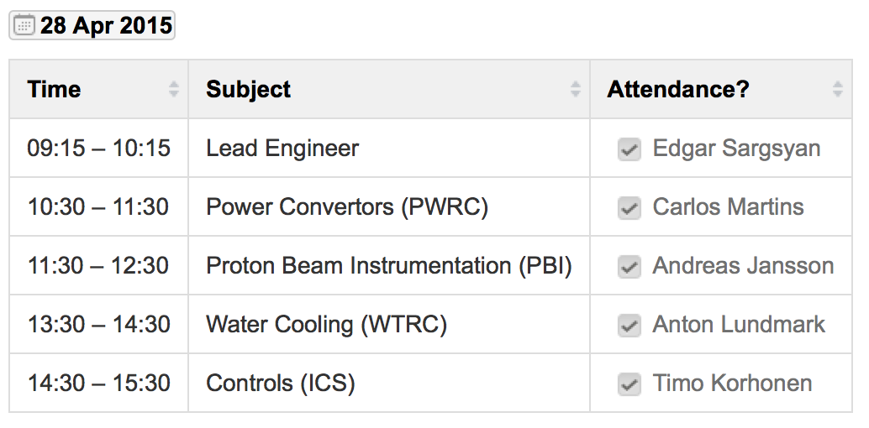
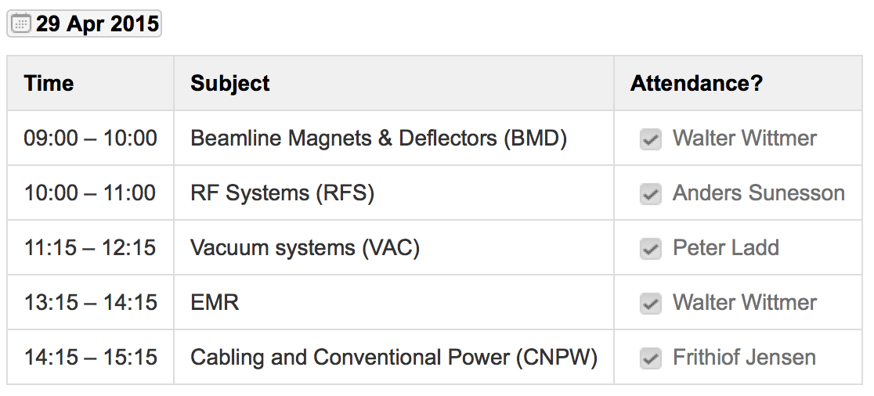
Example timetable

Slide 8
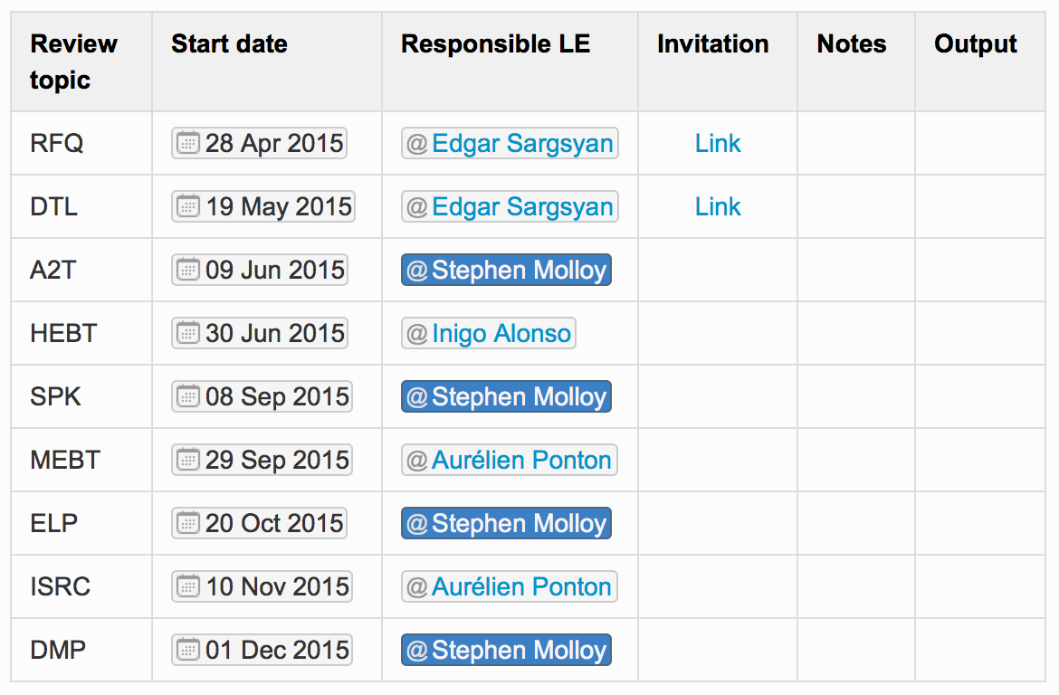
Schedule
Start dates are always on a Tuesday.
All reviews will be 2 days
Primarily a review of the LWU’s
Schedule is designed to lead CDR’s by ~3 weeks.
Recommendations from these can be dealt with by the time of the CDR.

Slide 9
Output
Approximate outline:
  Scope, design concepts, and interfaces, as reported to us
  Top-down requirements as found in DOORS
  Interface requirements as found in DOORS
  Recommendations for changes to the above
Delivered to the Division Head
Somewhat overwhelmed with information in the first review (which is a good thing!), and so have taken some time to develop this strategy

Slide 10
Personal opinion
Very pleased with the level of cooperation from the Work Packages – Thanks!
  Vital that this continues into the future
The vertical nature of the reviews unearths high-quality findings
Major issues:
  Very little documentation on interfaces
    Within ACCSYS teams and between divisions (i.e., with ICS)
  Projects involving ICS are not consistent with one another
  Lack of up-to-date 3D models is preventing proper integration and development of interfaces

