Slide 1

WP Status & General Issues
J. G. Weisend II
Deputy Head of Accelerator Projects
May 21, 2015

Slide 2
Outline
Work Package Highlights
  A very detailed status of the work packages was presented in the recent break out session of the annual review. Please see
  https://indico.esss.lu.se/indico/event/316/ and monthly reports for full details
  Selected highlights are shown today – Many slides contributed by WP Leaders
  Backup slides collect the planned activities of many work packages for the next 6 months
Work Package Audits and Design Reviews
  Audits on WP15 (Electrical Support), WP16 (cooling Support) and WP10 (Test Stands)
  Design review approach & upcoming design reviews
  PDR on Elliptical CMs Cryogenic Distribution System
Risk Update
Issues

Slide 3
Work Package Highlights
WP1 Management
Held Annual Audits on WP10 (Cryogenics) WP15 (Electrical Support) & WP16 (Cooling Support)
Annual Review preparation & participation
WP2 Beam Physics
LEBT model and RFQ transmission study
Study of Eddy currents due to pulsed magnets on the magnetic shield
Study of the trajectory correction in MEBT and DTL
Studying the post coupler frequency perturbation
Study of the emittance growths as functions of the input Twiss parameters for the DTL
Study of the emittance growth as a function of the klystron phase and amplitude error for the first DTL Tank with fieldmaps and comparison with thin elements
Error study on the DTL cell field by using the fieldmaps and comparison with thin elements

Slide 4
Work Package Highlights
WP3 NCFE
Different details of the diagnostic box (between the two solenoids of the LEBT) were defined and the integration of the chopper was completed with final design close to completion.
ESS Bilbao organized and hosted an ESS Industry day in Bilbao on 17 April. This was well attended by potential partners from local industry.
Accomplished the brazing and e-beam welding test of the DTL drift tubes.
Latest version of the Early In-Kind Technical annex for RFQ copper procurement and prototyping was sent to ESS on the 10th of April.
New Deputy Work Package Leader ( Walter Wittmer ) started at ESS.
Frank Hellström and Peo Gustavsson joined the WP 3 team in Lund as Work Unit Liaison Officers.
Preparations underway for the DTL IVDR (May) and CDR (June 22, 23)

Slide 5
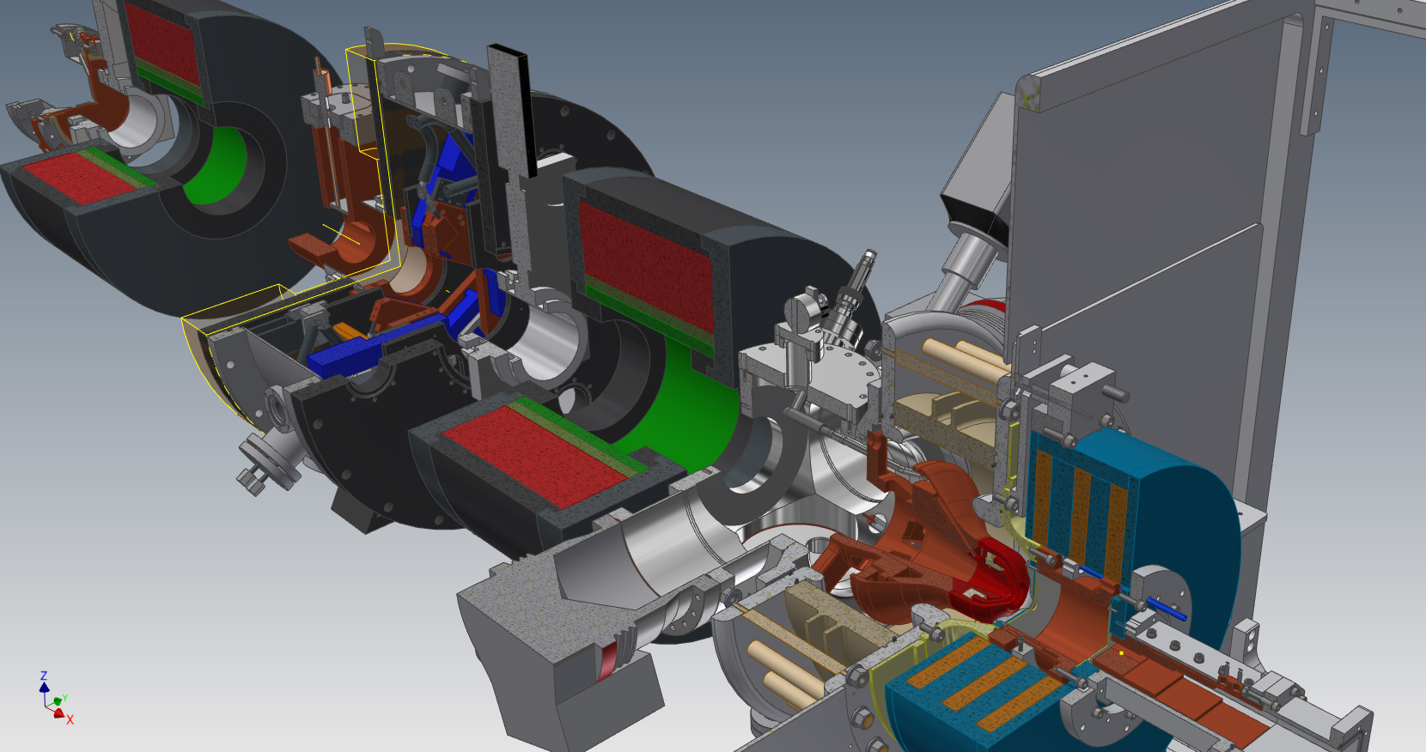
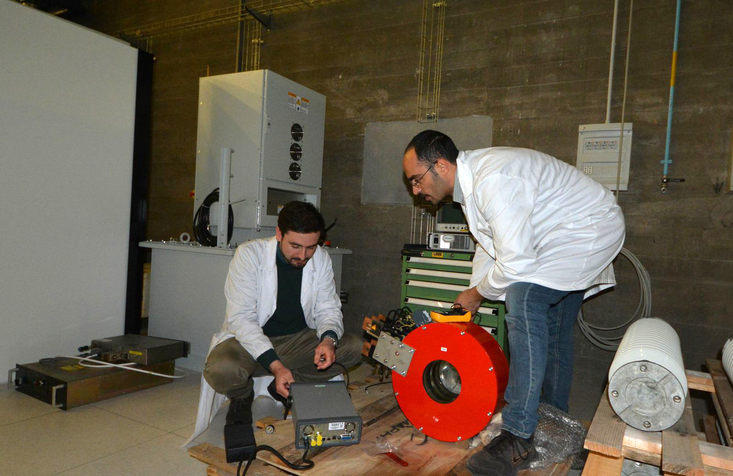
Ion source & LEBT: Selected technologies

Slide 6
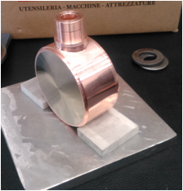
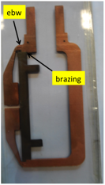
WP3 : DTL Technological prototype of the brazed drift tube before e-beam welding

Slide 7
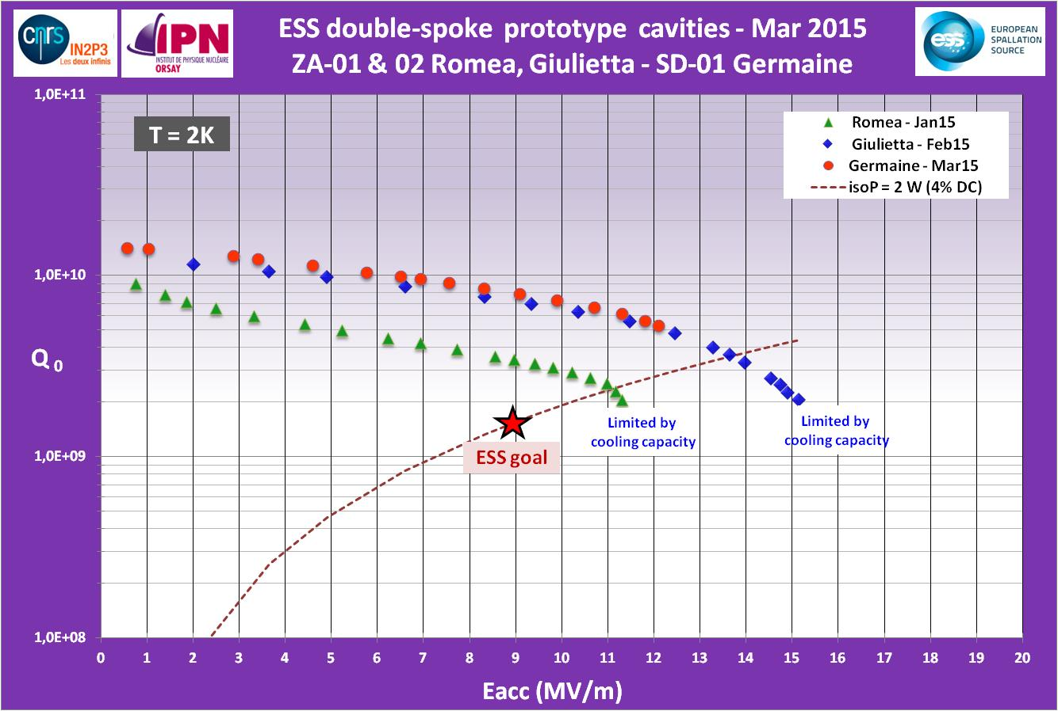
WP4 Spoke Cavities & Cryomodules
Spoke cavity prototype test results (Jan. – March 2015):
Excellent performances, well within specifications (both on Eacc & Qo)
Eacc max=15.1 MV/m achieved with Giulietta
Several MP barriers, but quite easily processed
Best Qo is > 10¹⁰ at low field
Strong FE at max gradient
Limitations on all 3 cavities is cooling capacity (unstable conditions, cavity in vertical position)

Slide 8
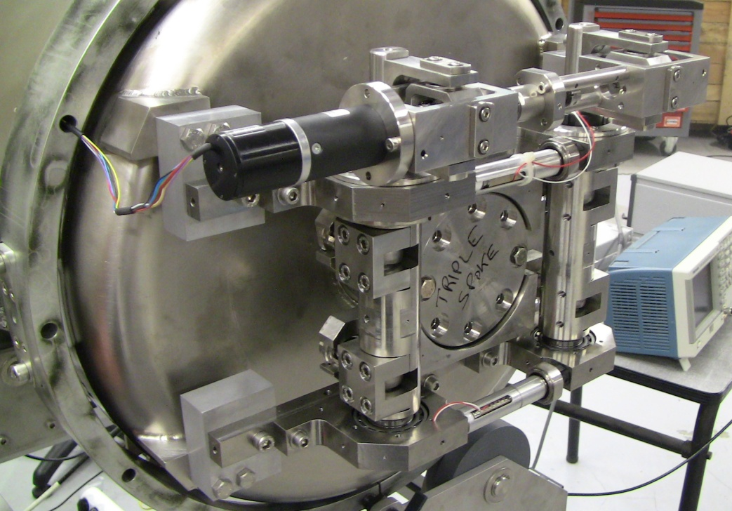
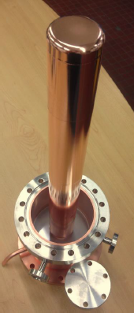
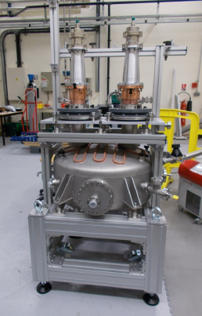
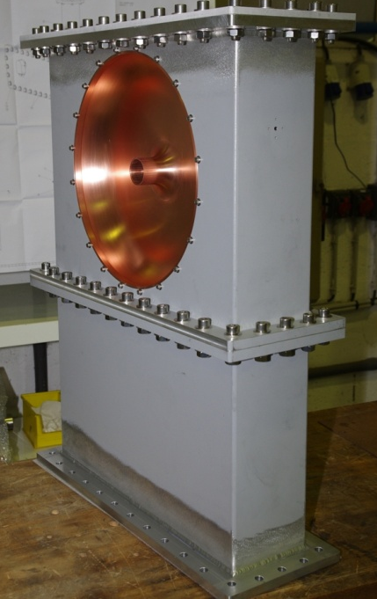
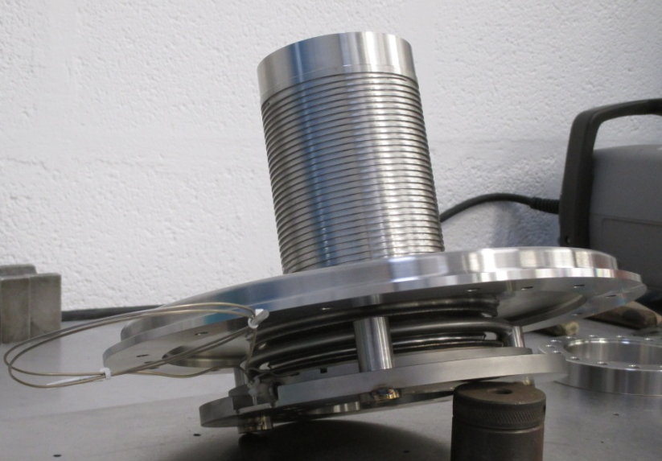
WP4: Spoke cryomodules: design & prototype fabrication
Prototype fabrication: power couplers, CTS
Power Coupler: 2 units achieved and received, 2 others in final production step
Cold Tuning System: 2 units fabricated
and tested, 2 more under production
Power coupler conditioning bench: all parts realized, dry assembly done.
Now in clean room for preparation
Power coupler parts: double wall external conductor and doorknob: fabricated

Slide 9
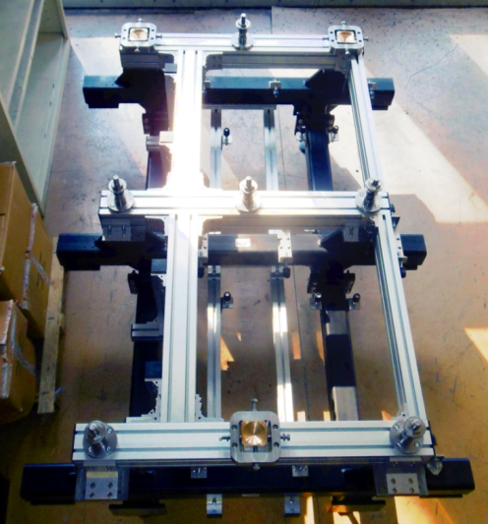
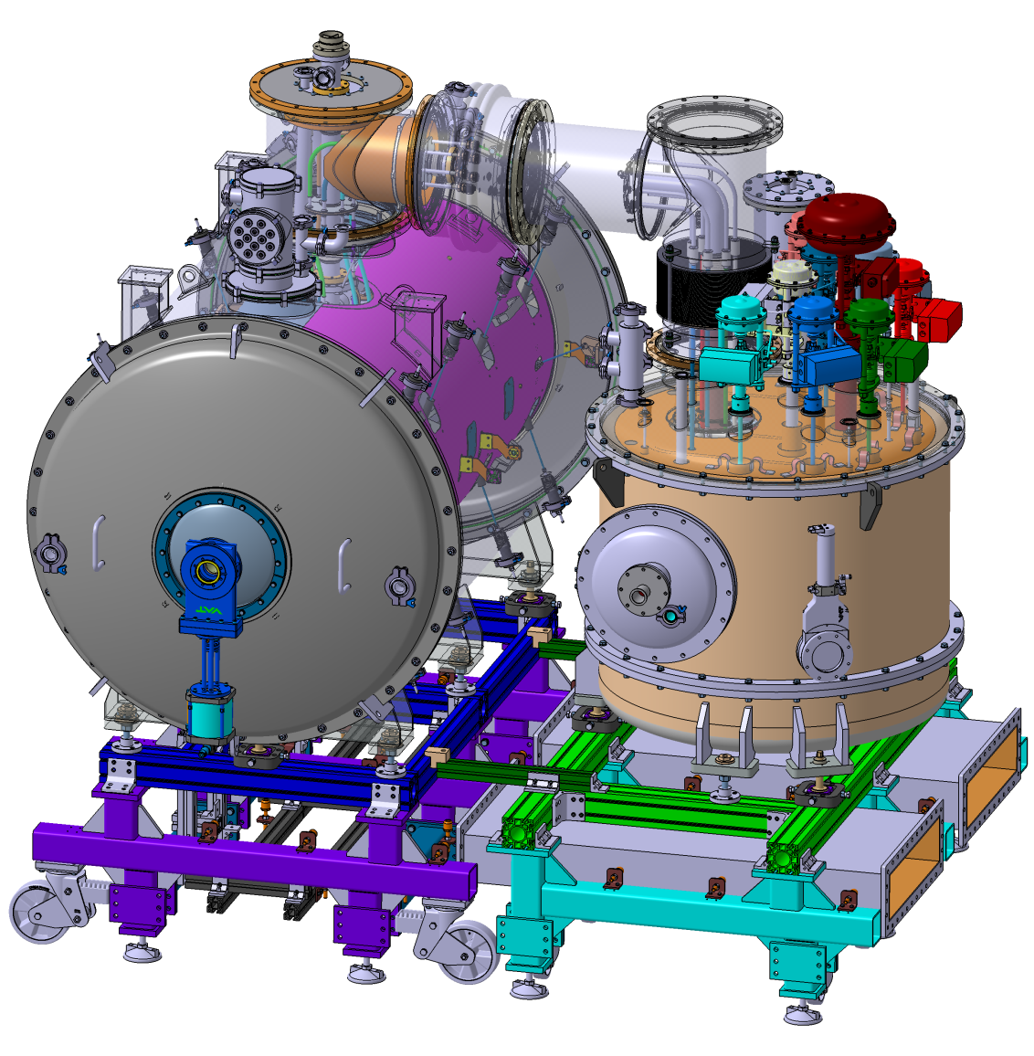
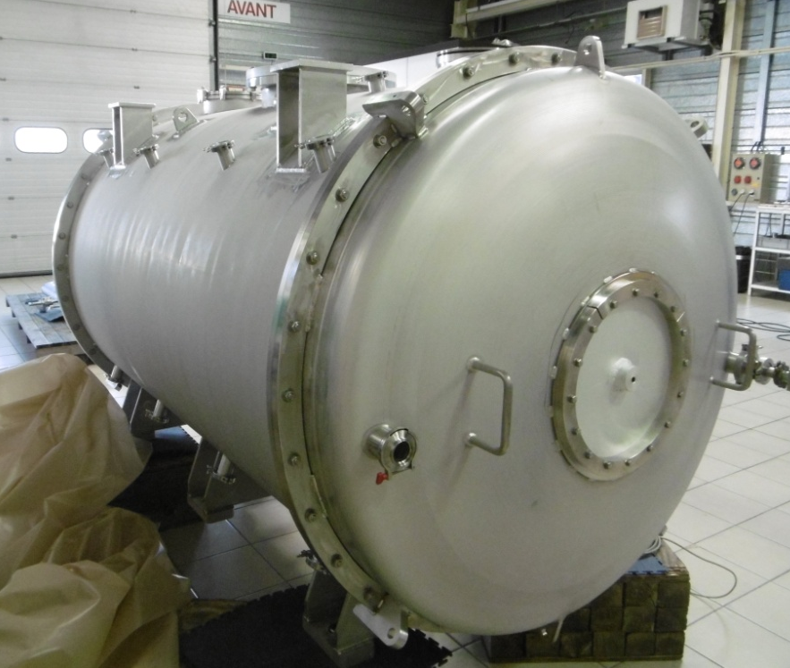
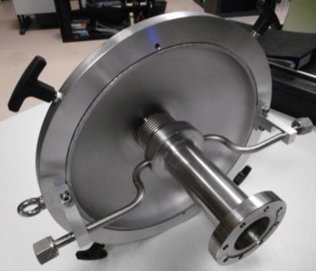
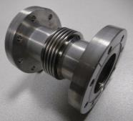
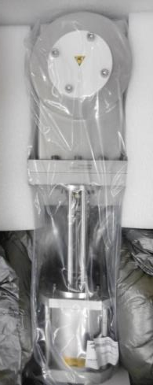
WP4: Spoke cryomodules: design & prototype fabrication
Prototype cryomodule fabrication: all “big” parts fabricated
Spoke cryomodule vacuum vessel:
Fabrication achieved (FAT done)
Cryomodule support
Spoke valve box: detailed design in progress, procurement for heat exchanger and cryo valves is ongoing
Inter-cavity
belows
Cold/warm transition
Gate valves

Slide 10



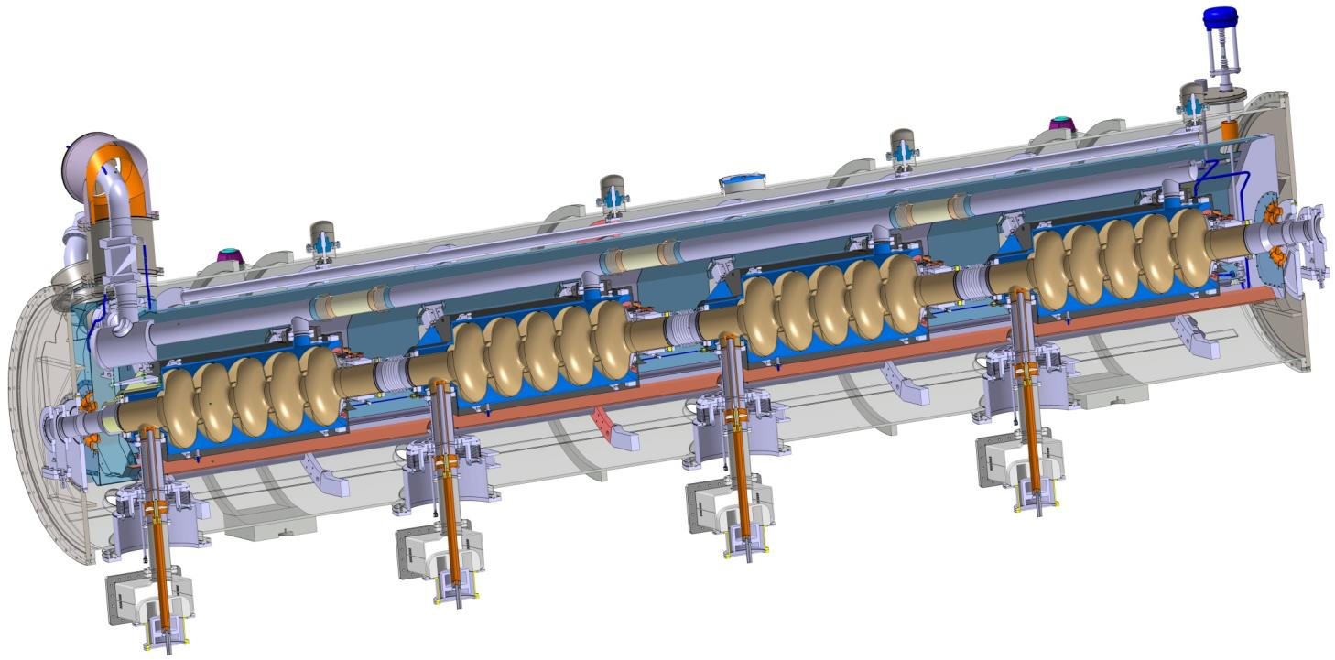
WP5: Selected technologies
Similar to CEBAF/SNS cryomodule concept with 4 cavities per cryomodule
Common design for medium (6 cells) and high beta (5 cells) cavities
Regulation He valve
Thermal shielding
Alignement fiducial
Vacuum valve
Jumper connection
Magnetic shielding
Spaceframe support
Heat exchanger
Diphasic He pipe
Proton Beam
Cavity with Helium tank
Intercavities belows
Power coupler
Cold to warm transition

Slide 11
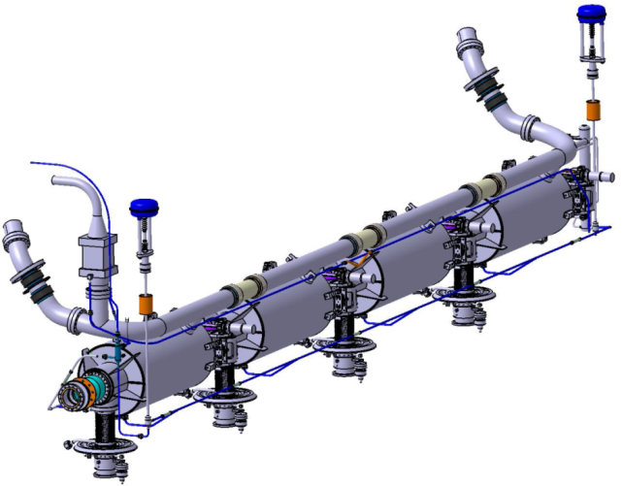
    WP5: Elliptical Cryomodules:
    Compliance with European
    PED 97/23/EC
Cryo pipes designed to reduce the overpressure in case of beam vacuum failure
    TUV Nord analysis report:
    The elliptical cryomodules are classified according to PED article 3.3
2 Φ=100 bursting disks at each extremity
continuous diphasic pipe Φ=100 with large curvatures
    Volumes of the helium circuits and vessels < 50 l
    1,431 bars< Working pressure
    Ps = 1,9 bars

Slide 12
WP5: Medium Beta Elliptical Cavities
Cavities will be supplied by INFN – LASA
Cavity design has started – will be plug compatible with CEA design
Baseline is standard Nb
Large grain Nb is a separate R&D effort – this may become baseline if successful and within schedule.

Slide 13
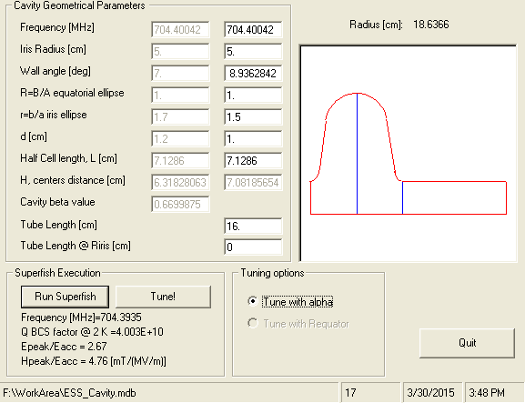
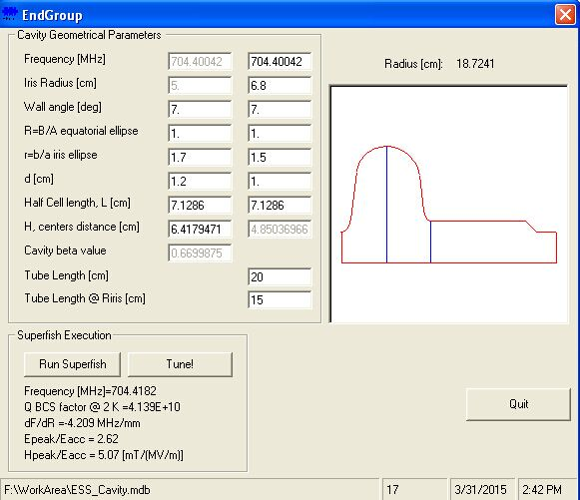
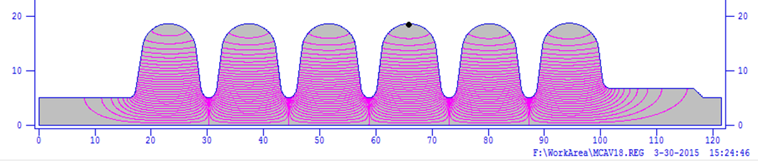
Medium beta cavities
INFN Plug - compatible design just started (but well in progress)

Slide 14
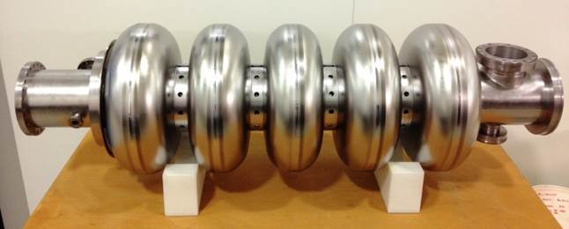
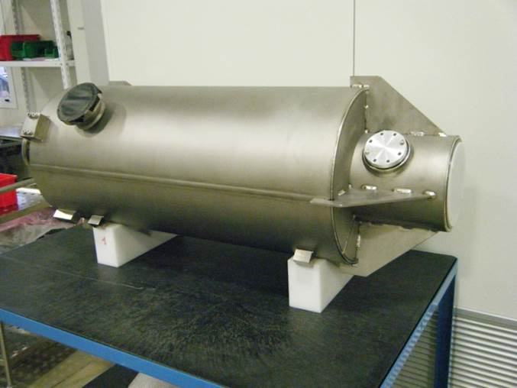
WP5: High Beta Cavities provided by STFC
84 (+ 4 spare) high-β dressed elliptical cavities capable of achieving 22.9 MV/m at 704 MHz, with a Q_{o} better than 5 x 10⁹
Niobium procurement: STFC to procure the high RRR Niobium for the high-β elliptical dressed cavities in agreement with the SRF collaboration for the ESS linac.
Cavity fabrication of the 84 (+4 spare) high-β elliptical dressed cavity in industry including:
  Cavity fabrication.
  Chemical processing.
  Heat treatment.
  Vacuum processing.
  High pressure rinsing.
  Field flatness and frequency tuning.
  Assembly of RF antenna and isolation valve in cleanroom.
  Shipment of dressed cavities to STFC.
Procedure Qualification and Training:
  Documentation for all the processes and procedures to be defined and
  agreed
  Training on the processes to be performed and monitored
  Process trials to be performed
  Cavity preparation and final test QC documentation prepared.

Slide 15
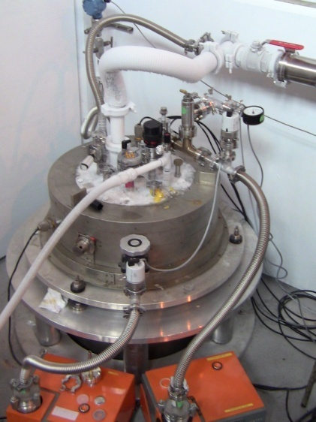
WP5: High Beta Cavities provided by STFC
Cavity Qualification:
  Installation of cavities onto vertical insert
  Installation into VTF cryostat
  Qualification in a vertical test facility of cavities at 2K to the required gradients
  of 22.9MV/m for the high-β cavities.
  Assessment and provision of test data
    Test data to be reviewed and approved
  Removal of cavities from VTF Cryostat and vertical insert.
  Complete final sealing, leak checks and QC processes.
  Sealing and packing of cavities
  Arrangement for delivery of cavities to cryomodule integration team (CEA-
  Saclay).
  Maintenance of the equipment
Cavity Rework:
  HPR of cavities
  Repeat qualification
Preparation and shipping of cavities to cryomodule integration site:
  STFC to design and procure shipping fixtures for SRF dressed cavities for transport from industry.
  STFC to transport SRF cavities from STFC to the cryomodule integration site.
  STFC to support transport cost in accordance with ESS transportation policy.

Slide 16
Work Package Highlights
WP6 Beam Delivery Systems
A substantial effort has been put into defining the raster scanning system to a more technical level. This has included initiating discussions pertaining to the interface requirements both at a mechanical level (vacuum systems, support, etc.) but also in terms of controls and signals (ICS, timing system, fast beam interlock system, etc.).
A functional hazard and risk analysis of the ESS raster magnet system has been continued in collaboration with the ESS MPS group and experts from Zurich University of Applied Sciences (ZHAW).

Slide 17
WP6:Hardware: Raster Scanning Magnet (RSM)
Coils (Cu, air), Bdot
Window frame magnet (ferrite)
Alignment targets

Slide 18
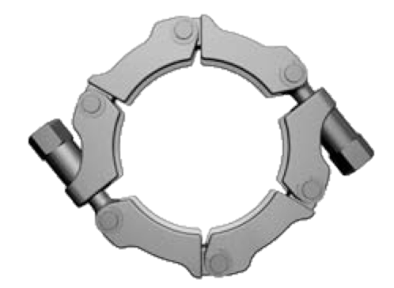
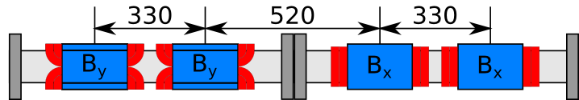
WP6: Hardware: Magnets + Support
Profile monitor (wires + non-invasive)

Slide 19
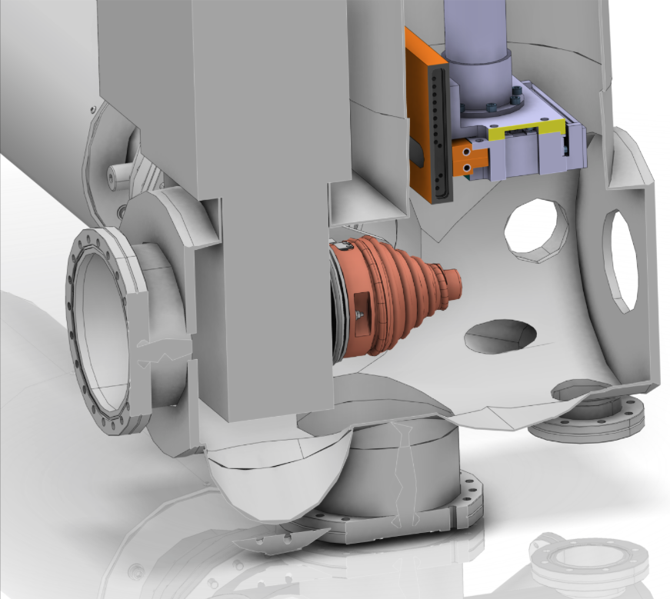
WP7 Beam Instrumentation
LEBT Diagnostics
CATIA Model of
LEBT Diagnostic and Chopper Tank
Emittance Measurement Unit
LEBT Faraday procured and delivered
LEBT Allison scanner design at Saclay well underway, and recently passed review
Work on Doppler underway at Saclay
ESS Lund is designing the diagnostics tank, which also houses the chopper.
Faraday Cup from Pantechnik
Ports for NPM and Doppler

Slide 20

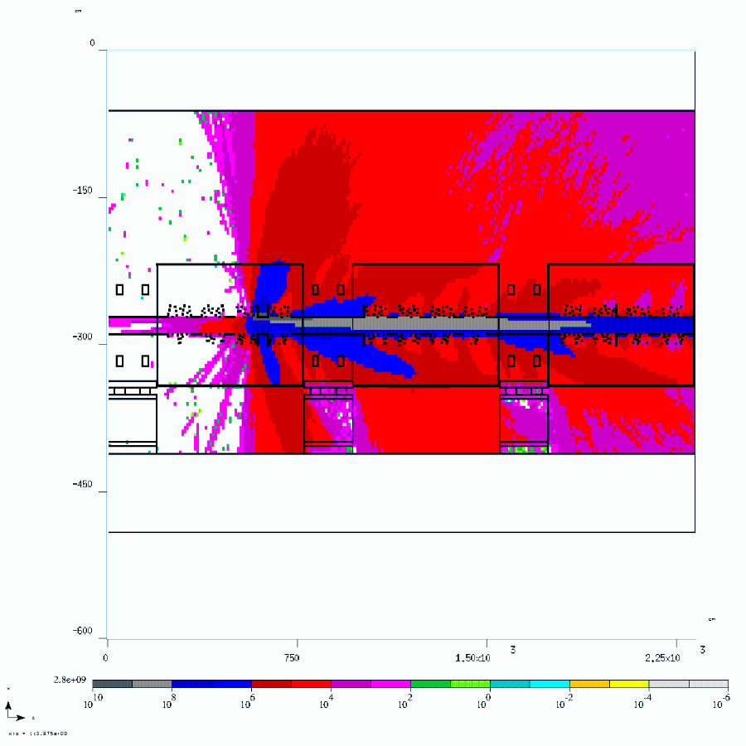
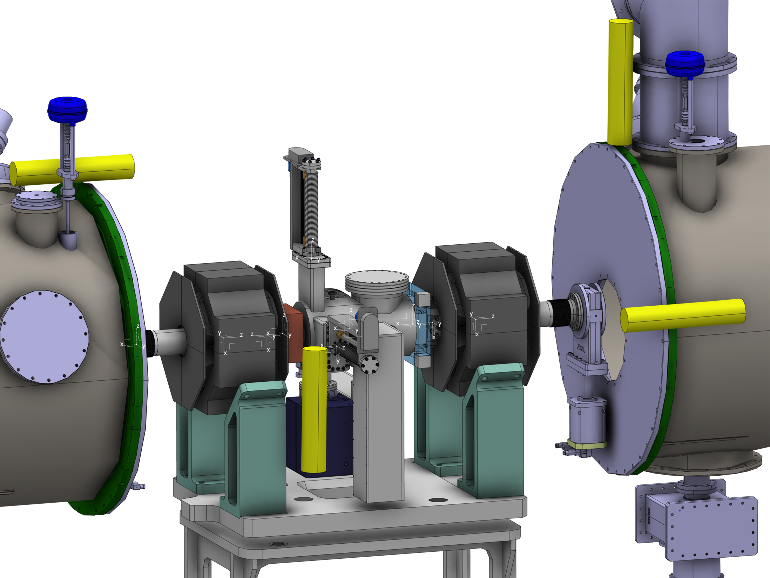
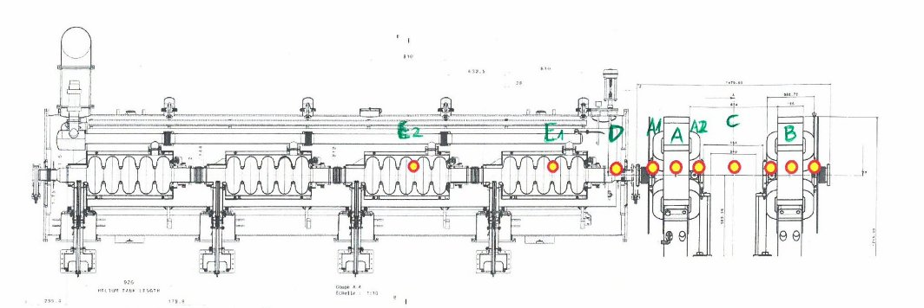
WP7: BLM
Simulations underway for all possible loss points along the linac.
Need full and redundant coverage for machine protection
At the same time, maximize diagnostic function (distinguish loss points).
4 BLMs per LWU/cryomodule foreseen, exact locations still being optimized.
Also investigating complementary detectors

Slide 21
WP8: RF In Kind discussions
NC RF systems and Spoke LLRF provided by ESS-Bilbao
Spoke RF transmitters provided by Elettra
Spoke, medium/high beta interlock systems provided by Hungary
704 MHz LLRF provided by Poland
Phase reference line provided by Warsaw Technical University
Distribution systems spoke, medium and high beta provided by Huddersfield University
Installation services provided by IFJ PAN Krakow
Ongoing discussions on design of dry HV HF transformers with Technical University Tallinn, Estonia
Covers all of WP 8 except Master oscillator, medium/high beta amplifiers
Covers WP 17 except medium/high beta High voltage supplies

Slide 22
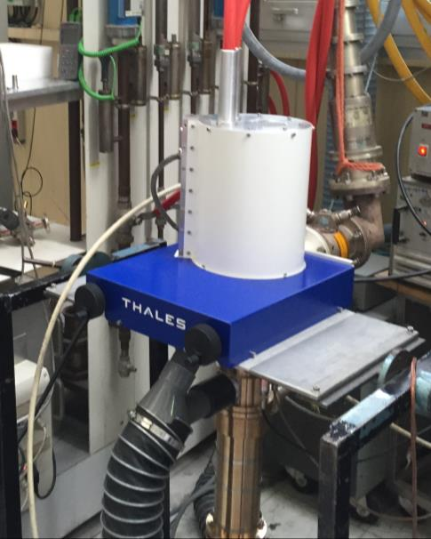
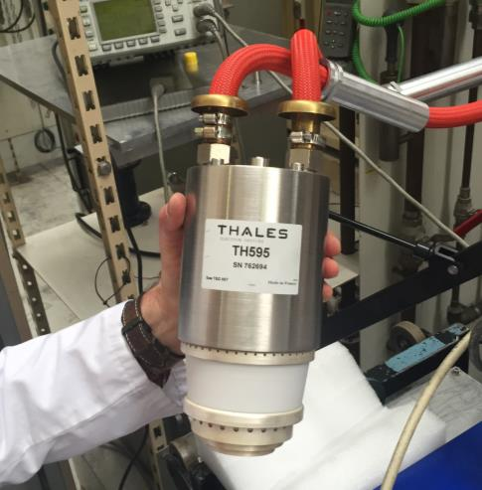
WP8: Spoke power sources
400 kW tetrode-based solution
Two complete stations to Uppsala University FREIA facility (Proof of concept)
FAT of tube recently (Thonon)
Results
Peak power | 200 kW
Efficiency | 66%
Gain | 15 dB
Duty | 4.6%

Slide 23
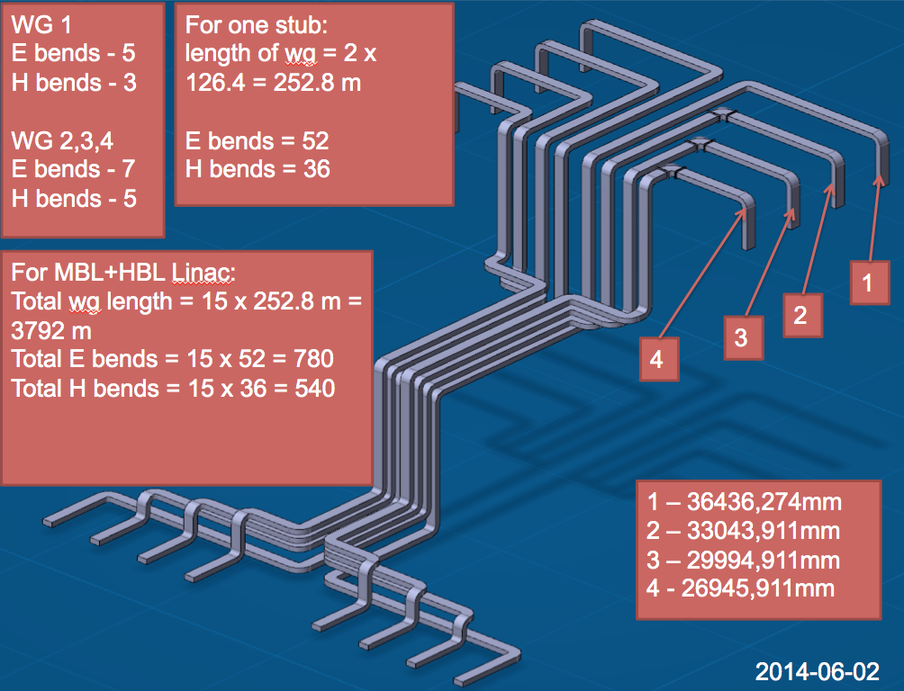
WP8: Distribution system layout example MB
ESS needs waveguides in
Huge quantity

Slide 24
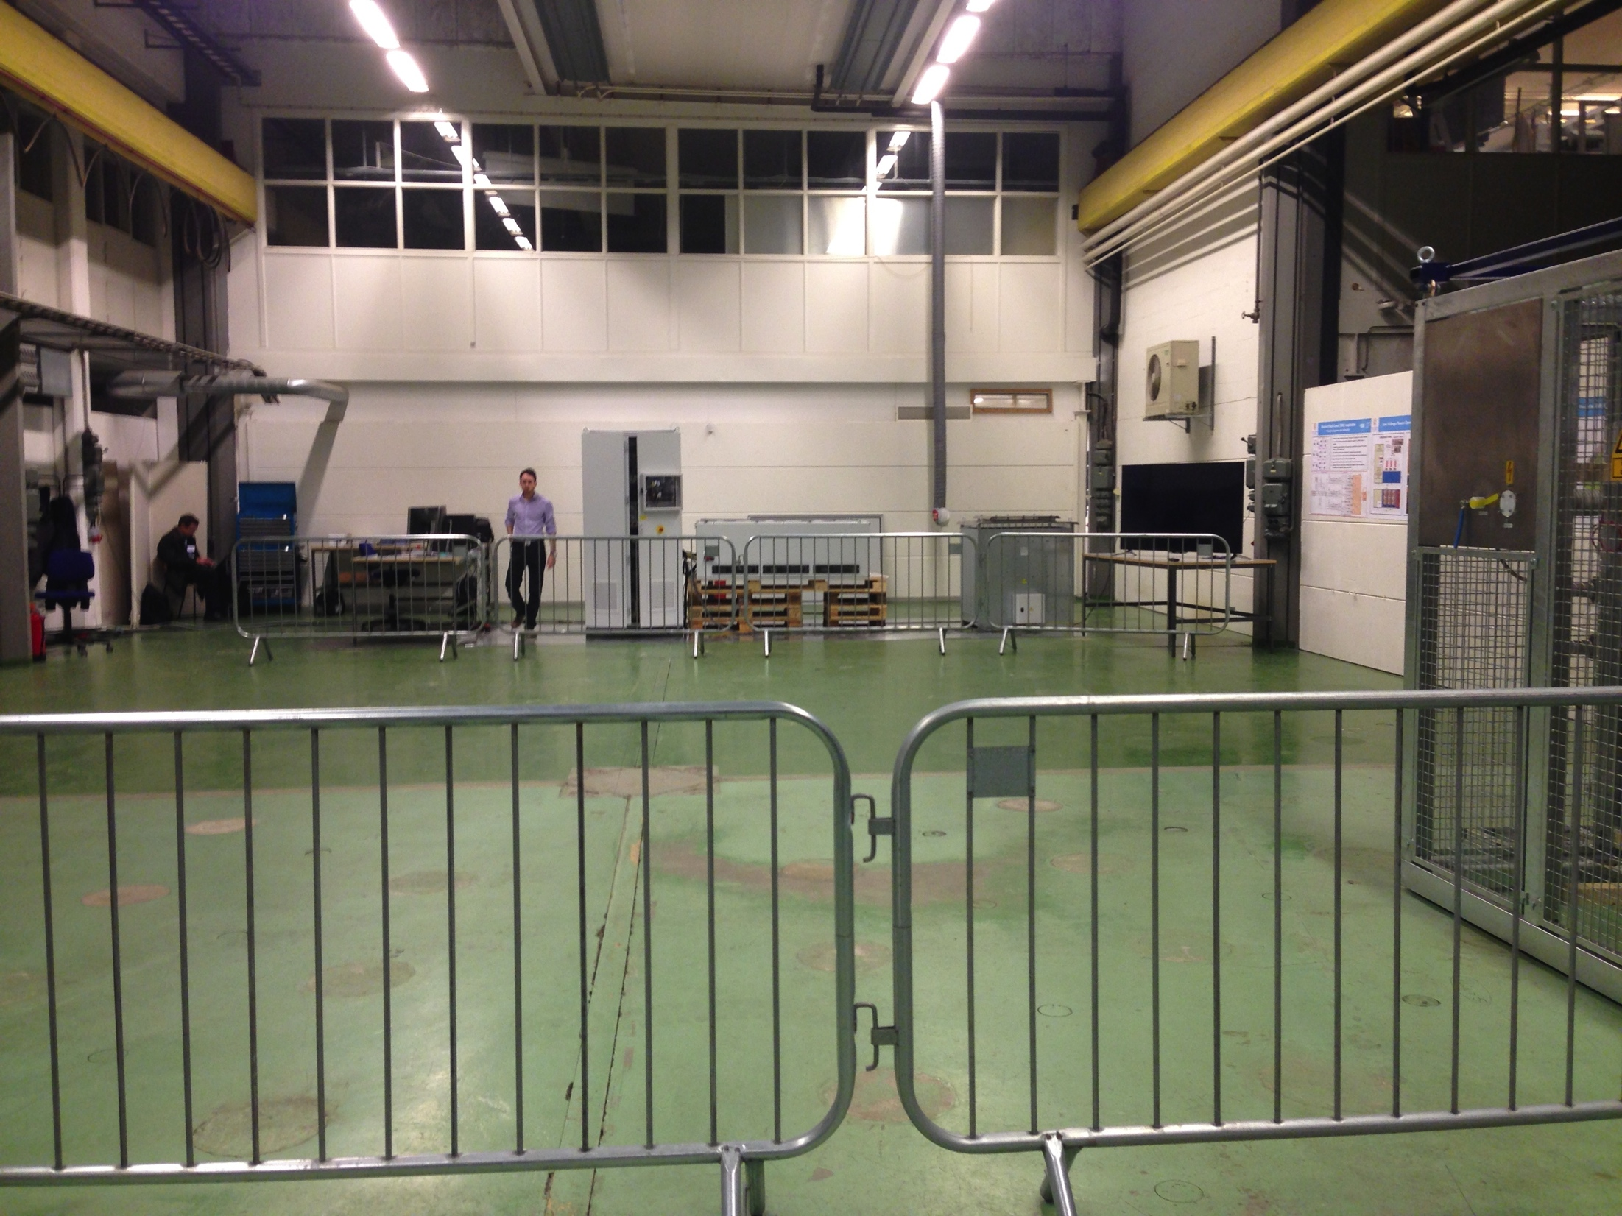
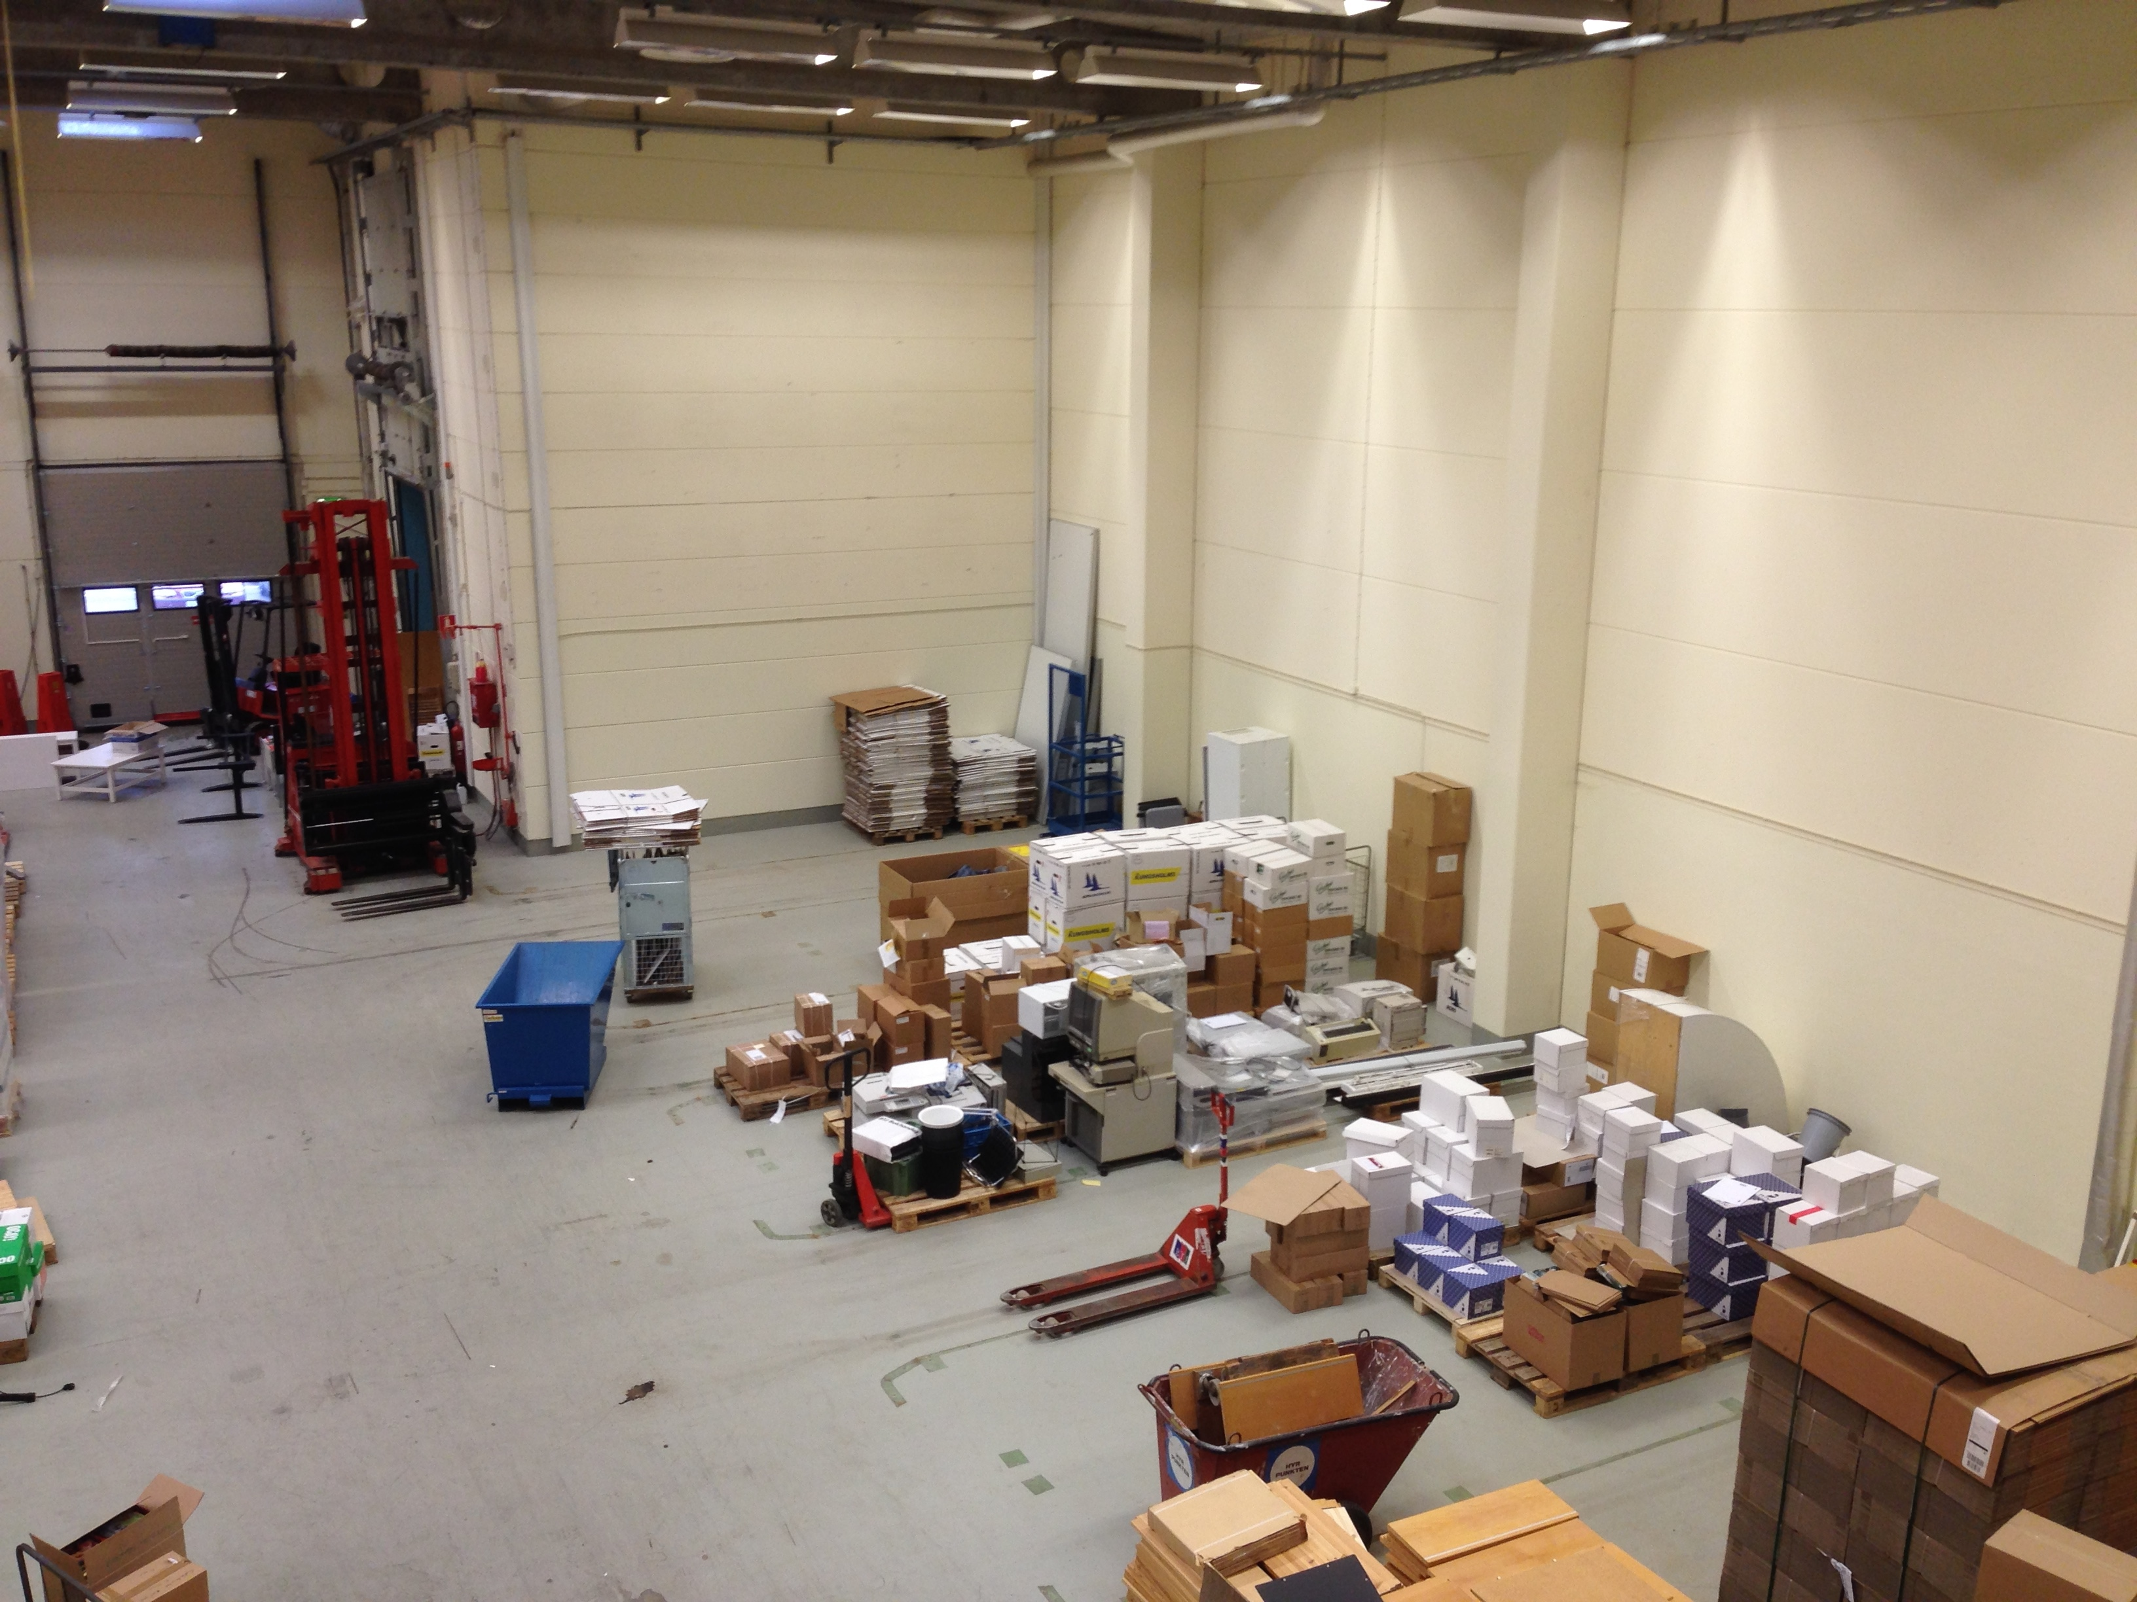
WP10 Test Stands
Lund RF labs
temporary RF Lab in LU’s M-house:
  starting spring 2015, duration 9 months: installation and test run of new topology modulator prototype (WP17) with dummy load
  contract for premises has been signed
  minor building modifications necessary – executed by landlord
  Testing of the reduced scale modulator prototype (WP17) has started in this lab
RF Lab in Utgård facility (Lund):
  starting summer / autumn 2015, duration 2-3 years: long term testing of modulator and klystron prototypes as well as RF distribution equipment (WP8 & WP17)
  contract for premises has been signed
  minor building modifications necessary – executed by landlord
  LCW system being procured by WP10
  facility is being shared with Detectors and Sample Environment
Lund

Slide 25
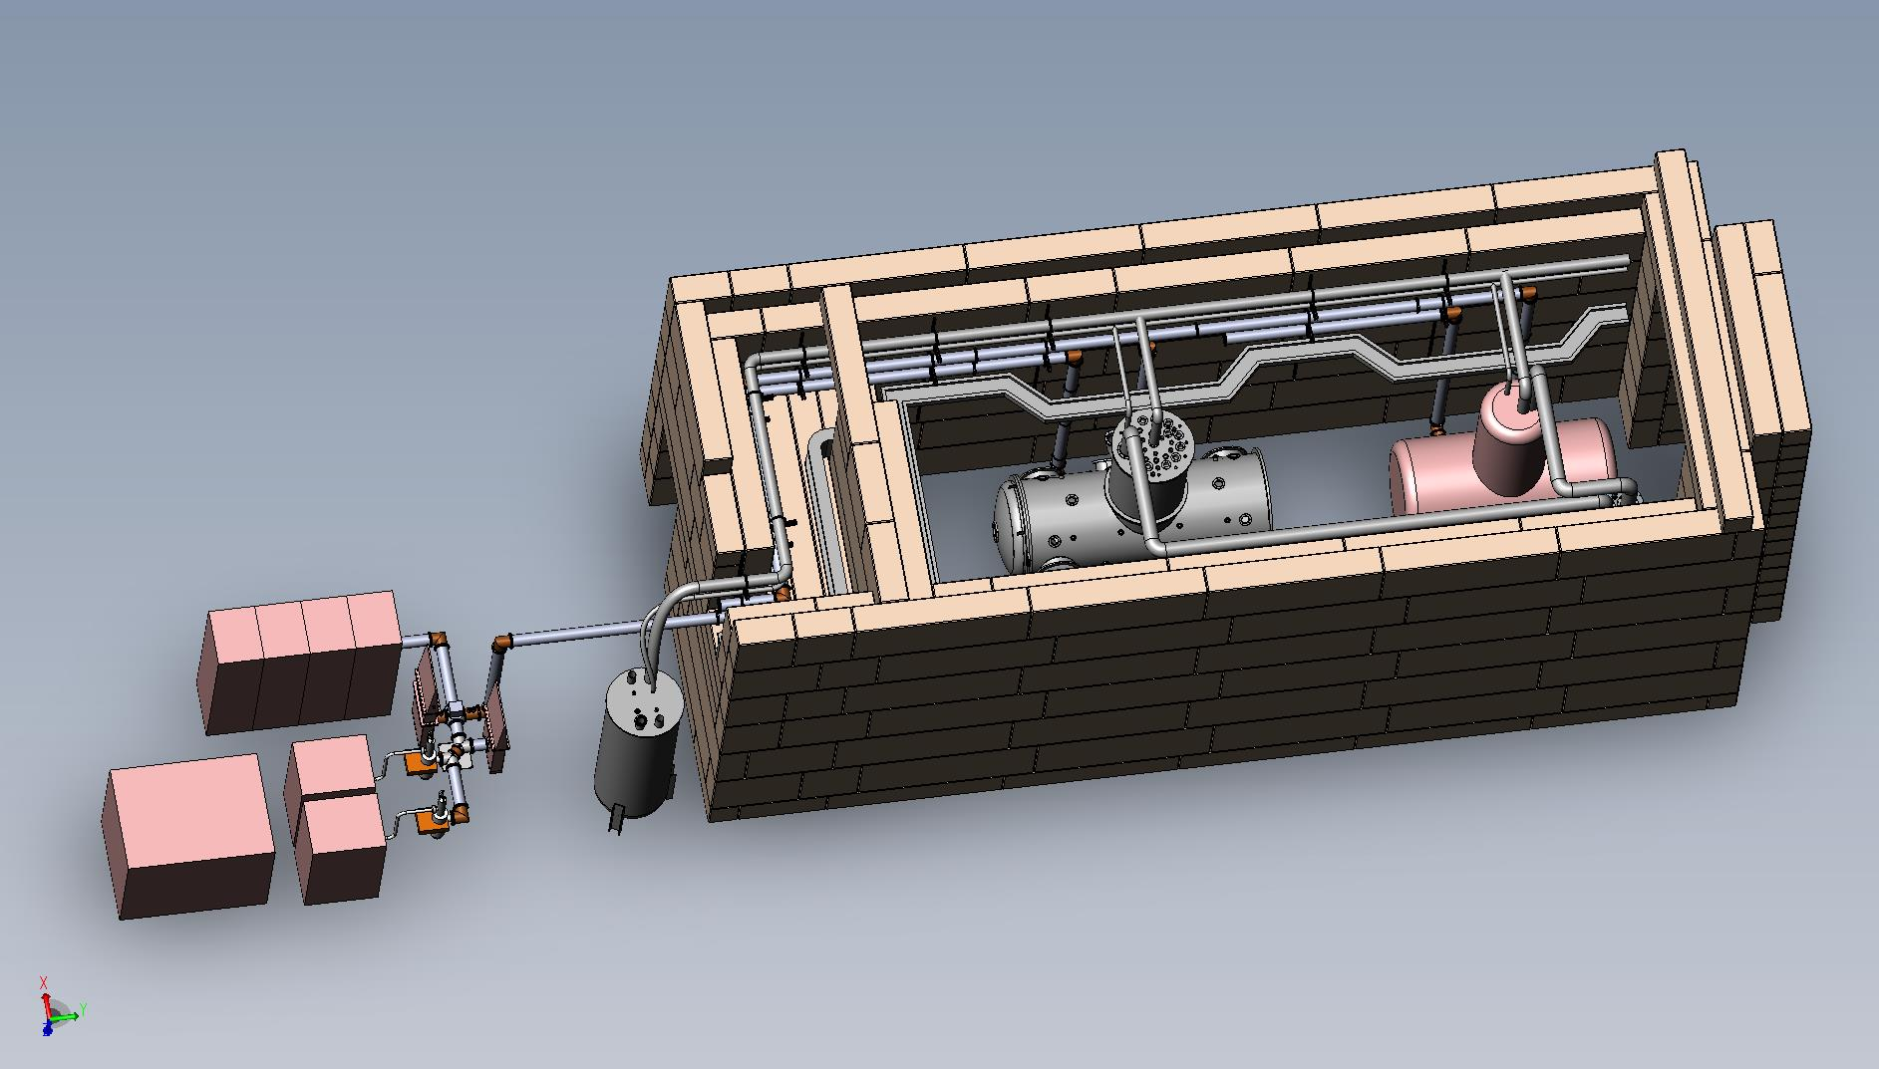
Uppsala Test Stand Implementation (Phase 1)
Both HNOSS & Cryoplant commissioned to 2 K operation
HNOSS
Horizontal Cryostat
(Spoke Cryomodule)
Bunker
SSA
Power Station
Helium
Cold Gas Heater
Helium Liquefier
Tetrode
Power Station

Slide 26
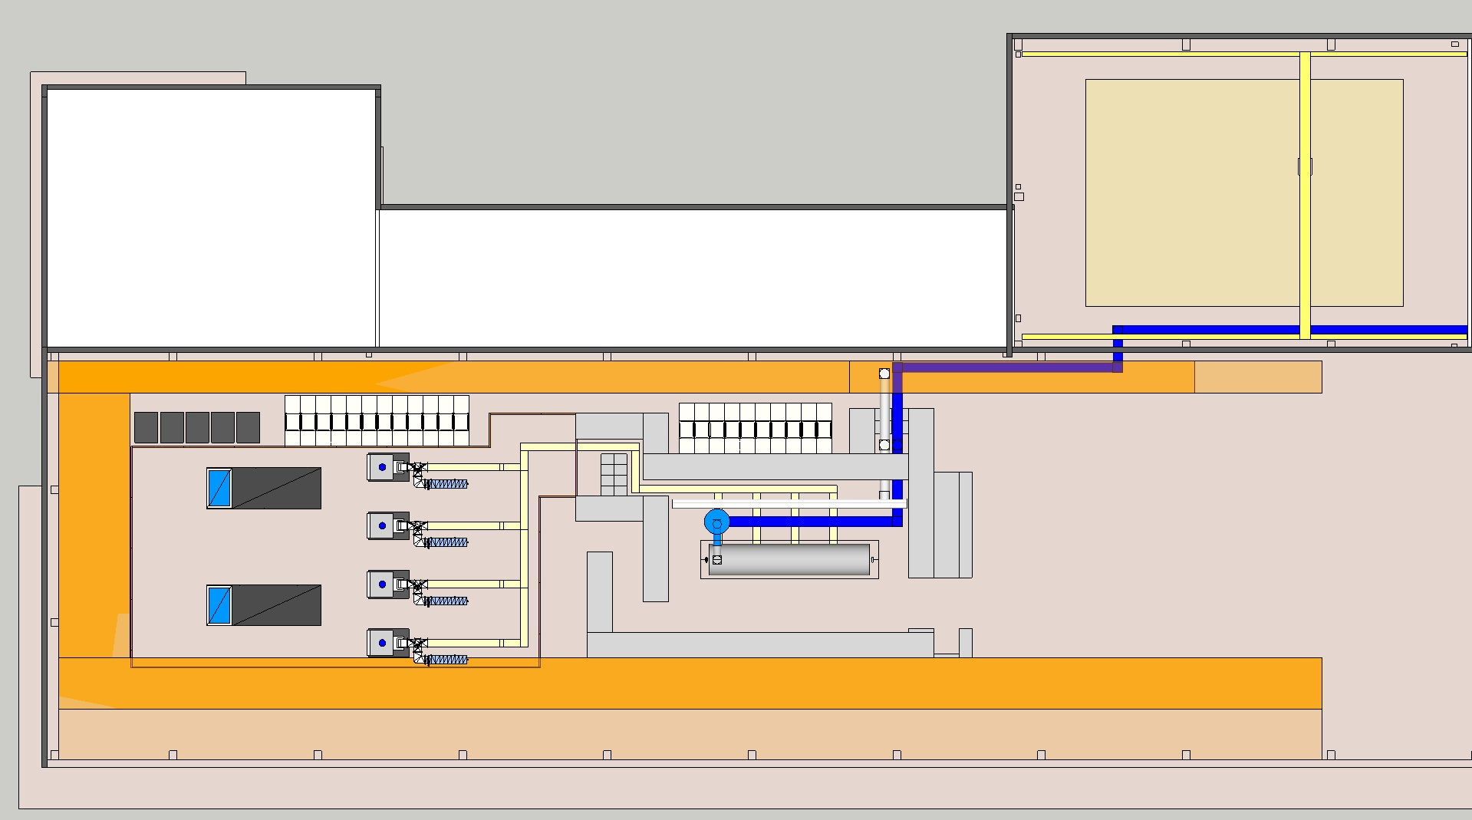
Test Stand 2 – Lund ( Elliptical CMs)
unloading area
control room

Slide 27
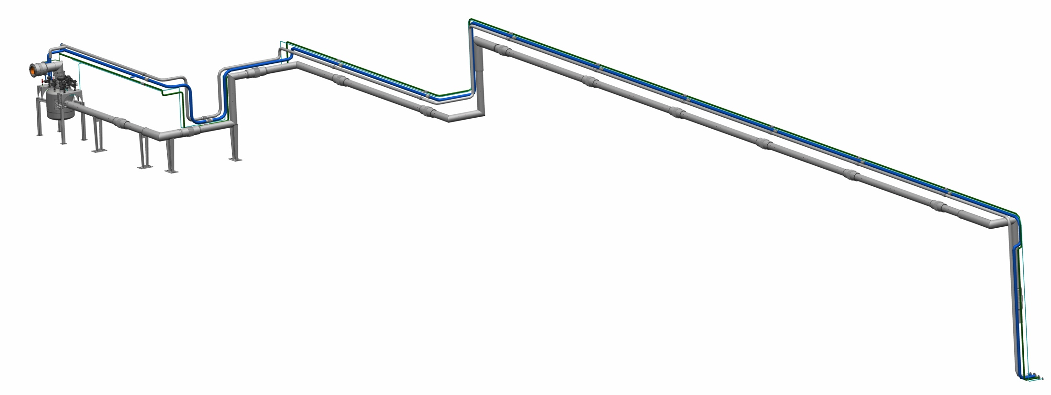
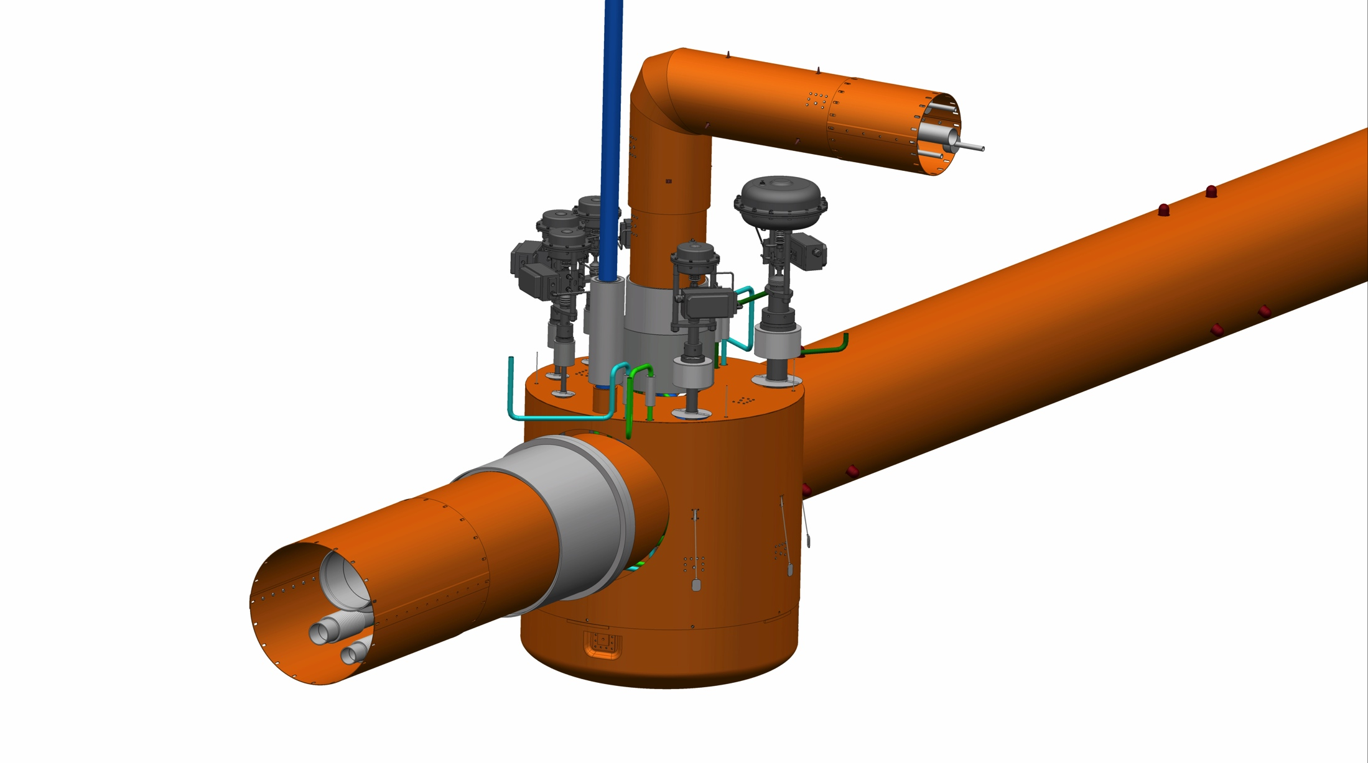
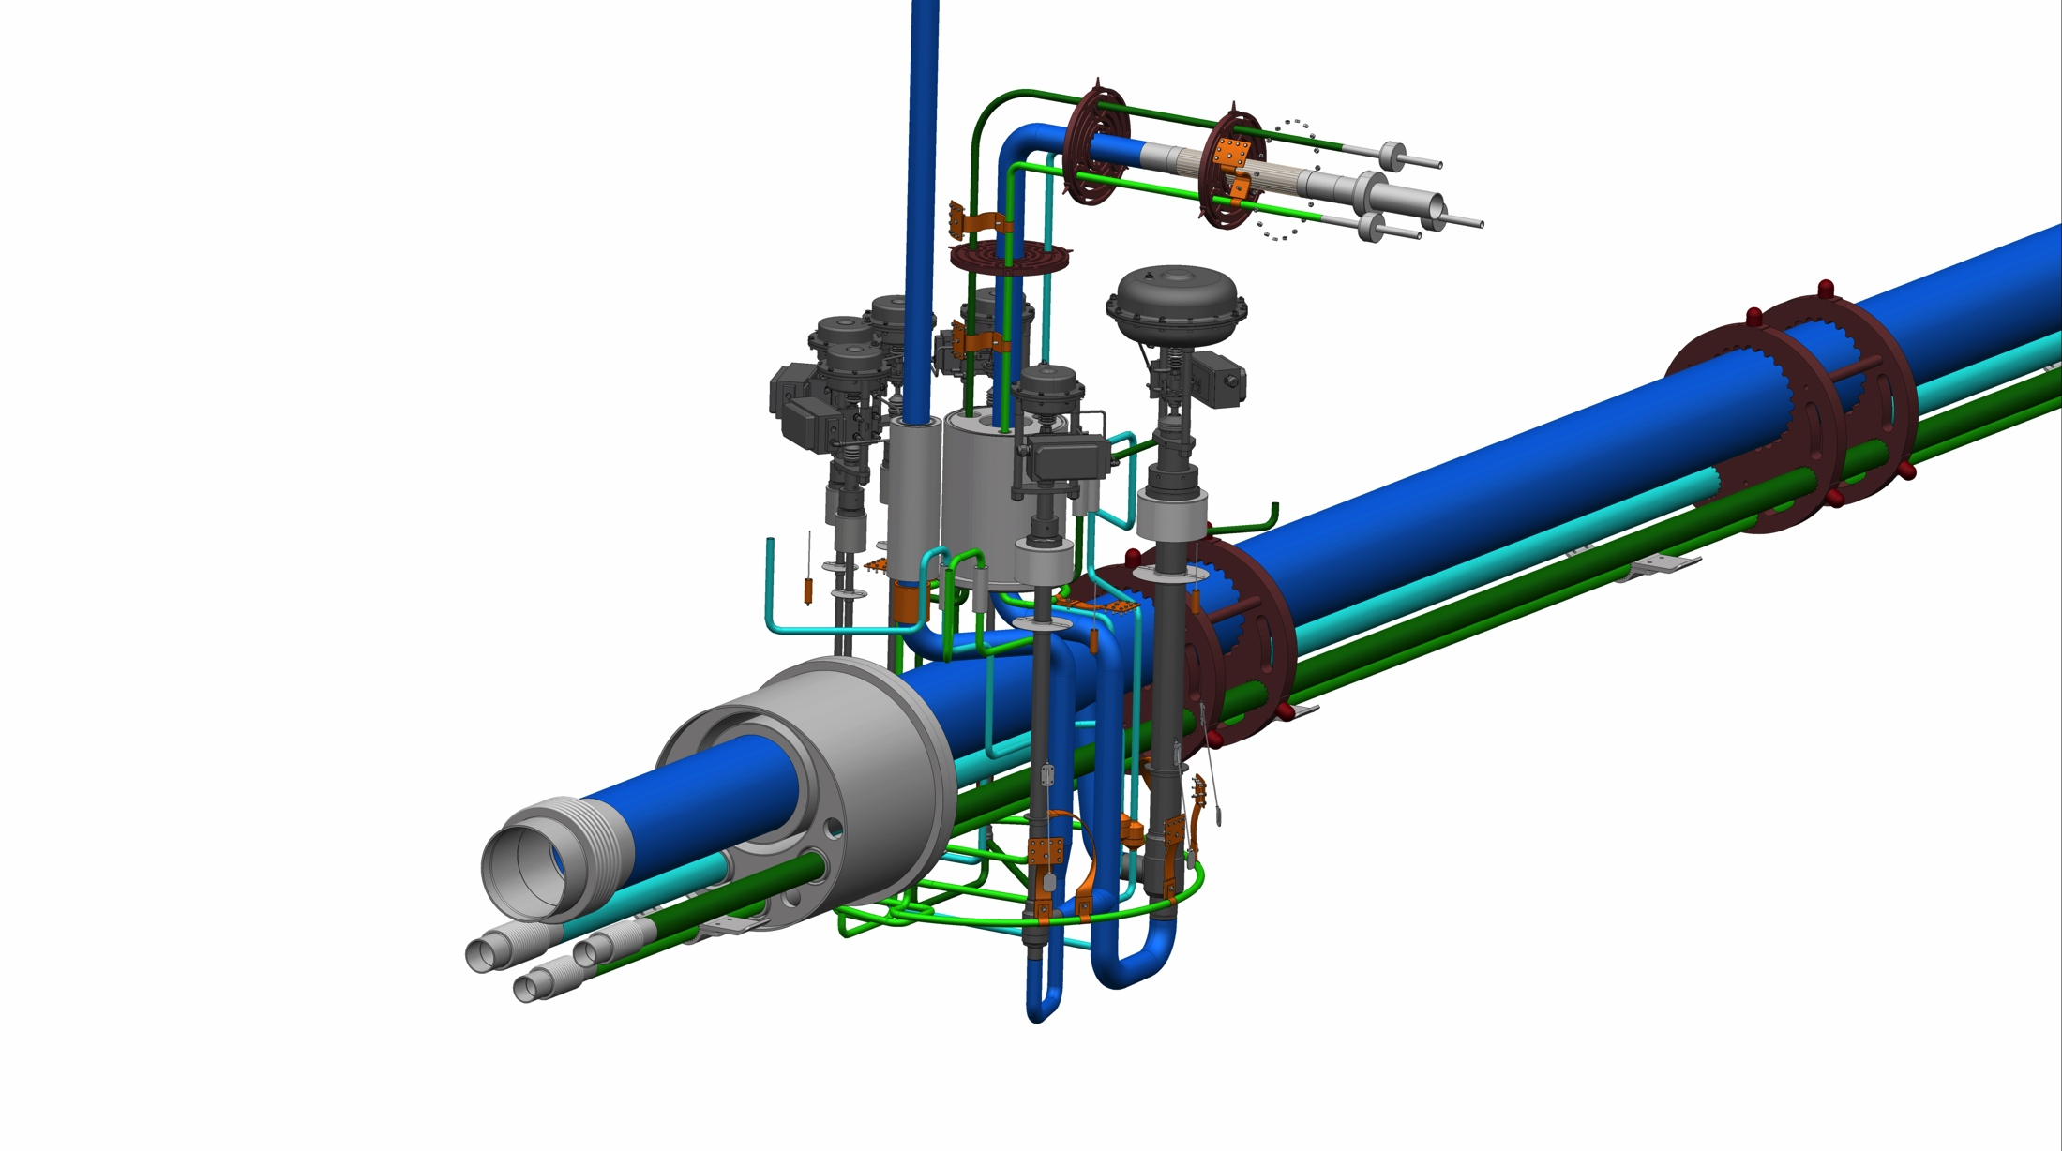
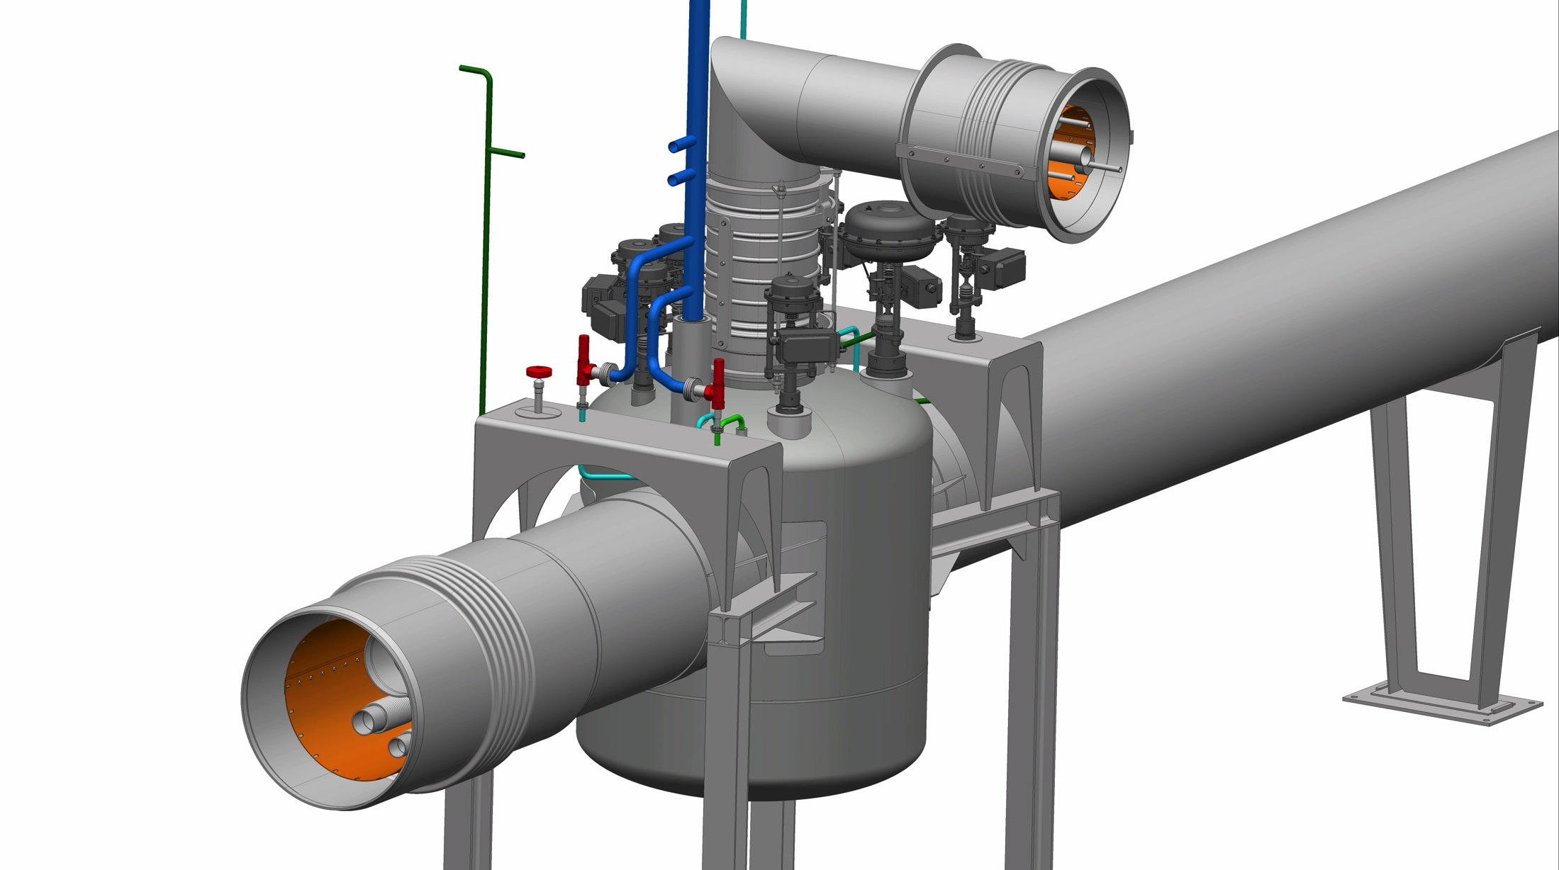
Cryogenics
CDS – In kind Agreements with IPNO and WrUT
PDR for the CTL and the Elliptical CDS (WrUT) held on May 20
Notes:
Cryodistribution System is the farthest along. I
IPNO: CDS for spoke section
WrUT: CDS for elliptical section + CDS for Lund CM test stand

Slide 28
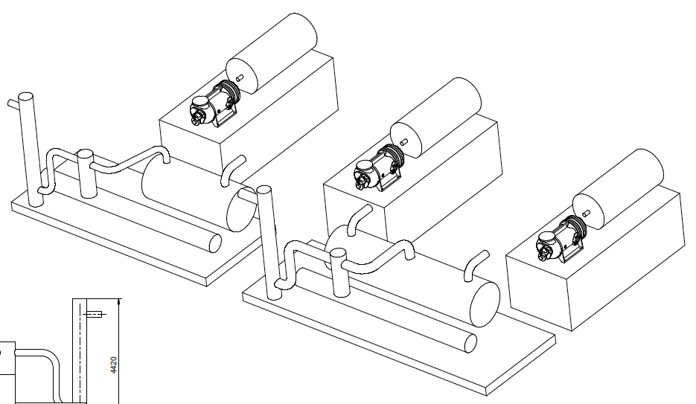
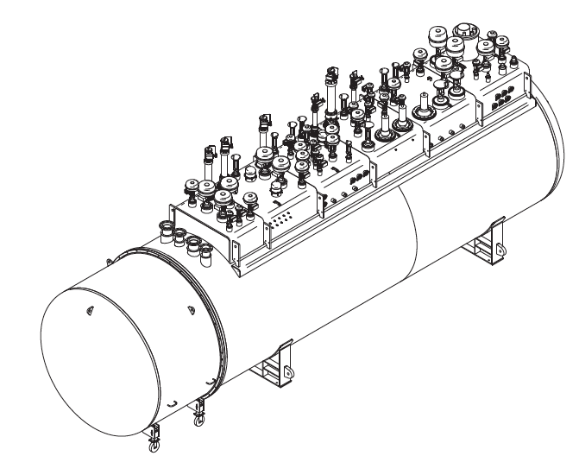
Cryogenics
ACCP – Contract Award to Linde Kryotechnik AG in December 2014
Kick Off Meeting with Linde held on May 8
Compressor System:
Three identical machines for SP→MP, LP→MP and MP→HP compression, hot spare compressor is under discussion
One Coldbox comprising 6 expansion turbines, 3 cold compressors, in-built acceptance test equipment
Notes:
Contract signature pending (expected March 2015), contract value < 20 million EUR (excluding installation, LHe Dewar, warm gas storage etc.)

Slide 29
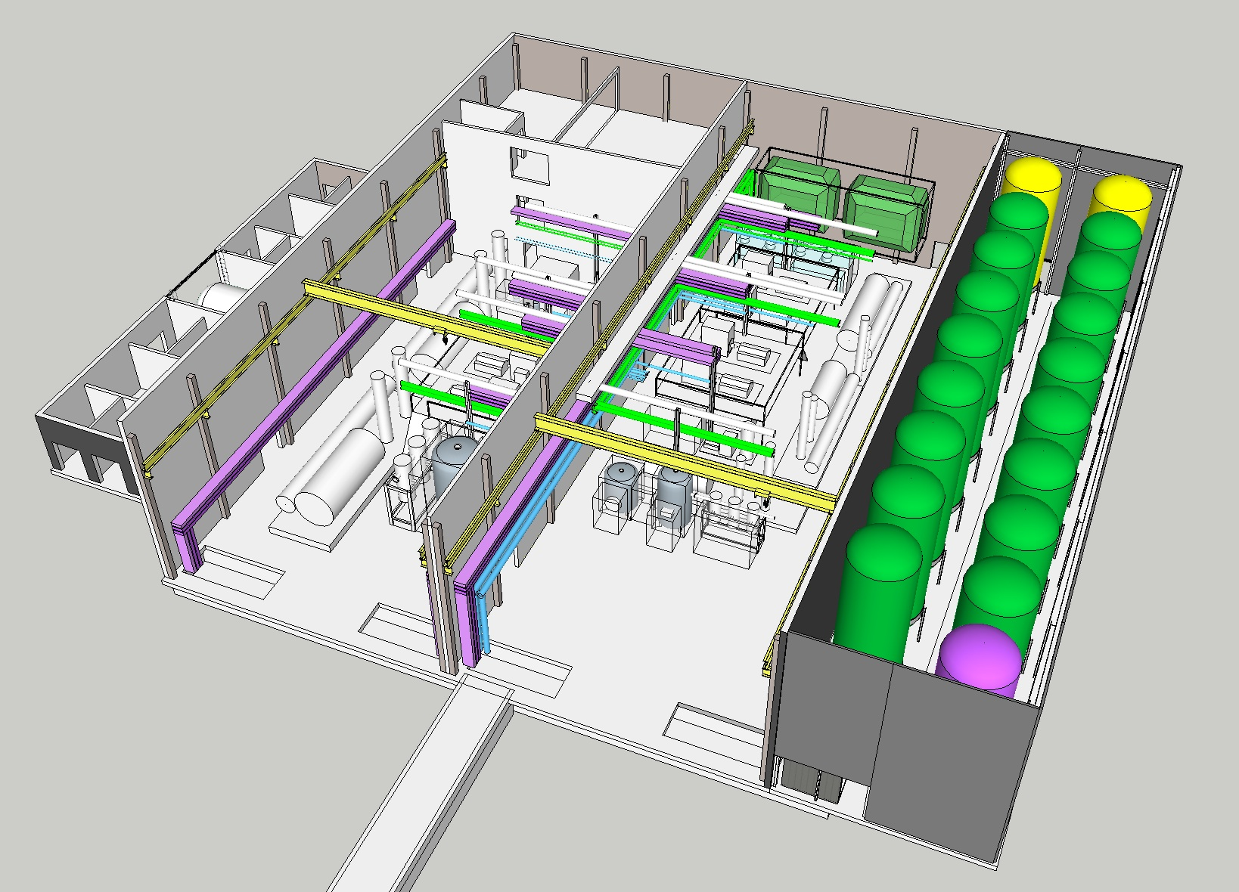
WP11 Plant Arrangement in Compressor Hall
Compressor Hall for TICP and TMCP
Compressor Hall for ACCP

Slide 30
Work Package Highlights
WP12 Vacuum Systems
The vacuum test facilities; vacuum integration, material test and calibration test stand to be supplied by STFC Daresbury under the IKC are proceeding on schedule with delivery planned for Q2/ Q3 2015.
The clean rooms of the particle test facility, also being provided under this IKC agreement, have now been designed and are in fabrication. Installation at the particle test laboratory located at Medicon Village is planned to start on June 8th, lasting about 4 days.
Work continues on the LWU and beam line package that also includes the portable cleanrooms required for installation of the cryomodules also being provided by STFC.
The vacuum design of the RFQ has now been finalized with CAE and a preliminary P&ID and wiring diagram prepared together with a preliminary list of major vacuum components. The IVDR for the vacuum system of the RFQ was attended and the results of the findings/ actions from this review are awaited.

Slide 31
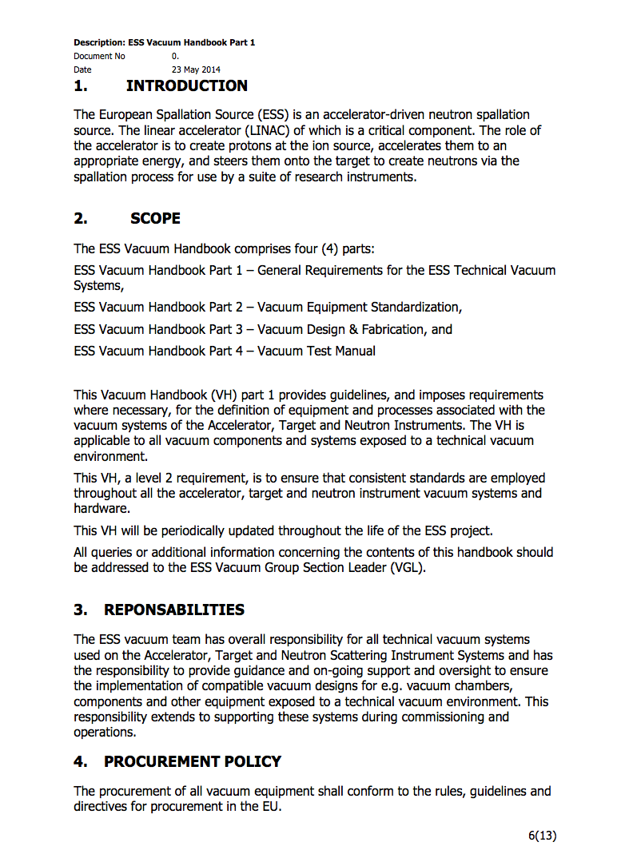
Vacuum Systems
Vacuum Standardization
Vacuum Standardization meeting Feb/2014,
ESS Vacuum Handbook as main document, cover all requirements for accelerator, target and instruments,
Vacuum Policy applied for all “in kind” contributions.
http://europeanspallationsource.se/accelerator-documents

Slide 32
WP17: Power Convertors
330kVA modulator prototype – Ampegon contract
A Design Review Meeting was held on 29th April after which the new version of the Technical Design Report (TDR) was approved.
Some important modifications were implemented with respect to the initial design which in some cases avoid showstoppers in terms either of functionality and/or performance.
Issues with capacitor choices & lifetime will be addressed prior to series production
Reduced scale modulator prototype
The HV rectifier bridge (2nd component of the HV module) has been successfully tested at full voltage (25 kV) and half of nominal current. The raise of the current to its nominal value is a straightforward step and should not create any difficulty, since it represents only a thermal issue, for which large design margins are available (at no extra cost).
The components to build the 3rd and last part of the HV module (HV inductor) have been purchased. Some difficulties were found to procure the inductor core and the fiberglass insulators which caused some unexpected delays of a few weeks but have been solved.
The design of the High Voltage oil tank assembly has progressed. The preparation of the production documentation has advanced, allowing hopefully to launch the call for tender for the entire High Voltage oil tank assembly by end May.

Slide 33
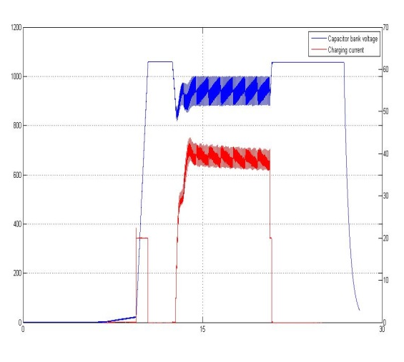
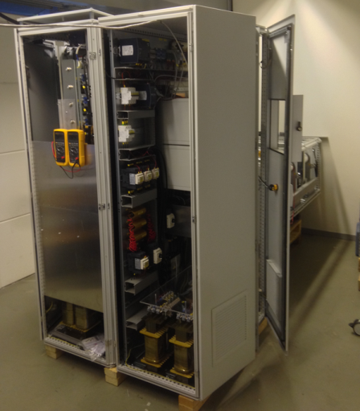
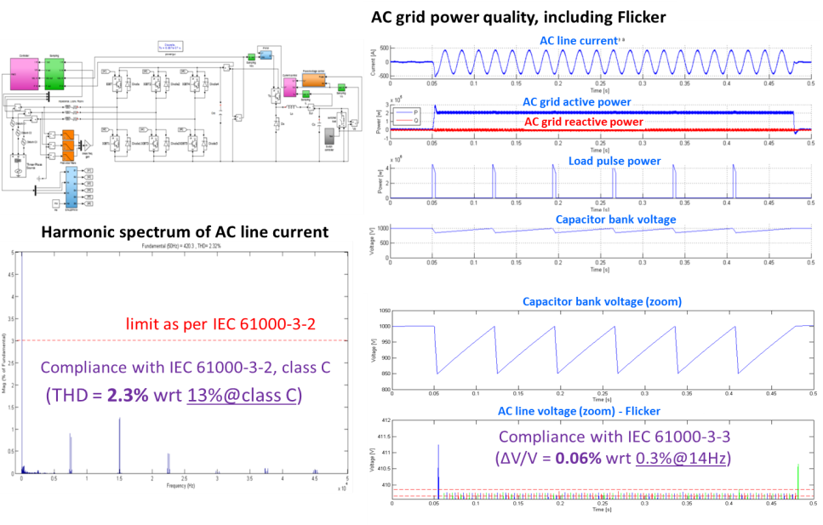
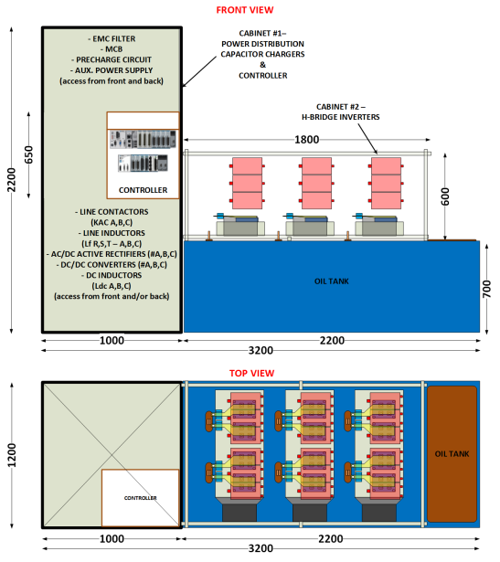
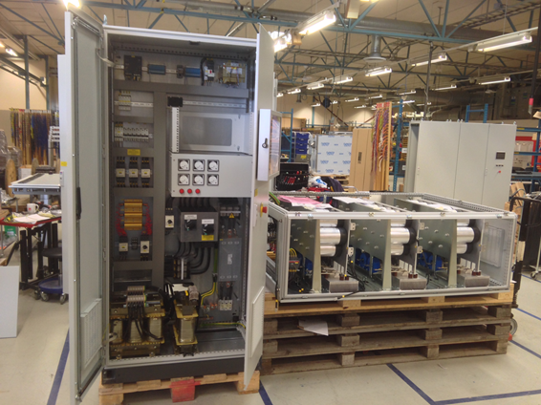

From a conceptual design to reality…
WP17: The Stacked Multi-Level (SML) modulator:
– Development roadmap
Construction and testing of High Voltage Oil tank assembly
Feb’15 to Sept’15
Jun ’13
Experimental results, low voltage stage
Sept ’13 – May ’14
Jan ’15
Apr ’14
May ’14
Aug ’14
33

Slide 34





WP17: High Voltage oil tank assembly:
Design in view of construction . Collaboration with LU
HV module
HV oil tank assembly
(Collaboration between ESS and LTH)
Design of the whole system undergoing;
control signal
HV module (HV transformer + HV rectifier)
Construction and validation of one HV module prototype is undergoing:
  - HV transformer assembled (first test results obtained two weeks ago);
  - HV rectifier is under construction (PCB’s delivered last Tuesday)
primary voltage
secondary voltage
secondary current

Slide 35
Work Package Audits
Since the last TB Annual Audits were held on WP15 (Electrical Support), WP10 (Test Stands) and WP16 (Cooling Support)
No technical showstoppers were found in any of the work package and all are on track to meet milestones.
WPs have completed most of the previous year’s recommendations
Lists of recommendations have been developed. A tracking system for recommendations using JIRA is under development.
Audit reports have been released.

Slide 36
Examples of Recommendations
WP15: Review at a ESS Management level the risk/benefit analysis of the use of harmonic filters on the power lines.
WP15: Confirm the voltage requirements needed in the Lund Cryomodule Test Stand RF System.
WP10: Look into the possible needed space for additional RF testing in Utgård
WP10: Develop a plan for analyzing and designing the radiation shield in TS2 in order to meet the schedule and permitting needs.
WP16: Present final RF system cooling water requirements to CCB as a formal change request.
WP16: Finalize with CF the tunnel penetrations for the water piping and cable trays in the front end.

Slide 37
Work Package Audits in 2015
Work Package | Date
WP15 Electrical Support | March 11
WP16 Cooling Support | April 29
WP10 Test Stands | April 28
WP2 Beam Physics | June 25
WP12 Vacuum | August
WP6 Beam Delivery | August
WP8 RF | September
WP17 Power Convertors | September
WP7 Beam Instrumentation | October
WP4/5 Cavities & CMs | October
WP3 NCFE | November
WP11 Cryogenics | December

Slide 38
Design Reviews
Preliminary Design Reviews and Critical Design Reviews will be held at the component level as appropriate.
These are scheduled in concert with IKCs or vendors & are tracked in P6
Detailed charges are written but, in the end, the question being asked is simple: Will the item being reviewed function properly to meet well understood requirements?
Generally, PDRs will be held at ESS while CDRs are held at partner institutions
PDRs can be held whenever deemed appropriate, CDRS can only be held after the corresponding IVDR is held.
Prototype work does not necessarily require a PDR or CDR but reviews may be included in some R&D contracts

Slide 39
Design Review Strategies
Reviews are organized and chaired by the Deputy Project Leader. The formal Review Committee consists of ACCSYS Management, QA, Safety and ICS (where appropriate). Other reviewers include: appropriate subsystem experts and work package managers.
Some reviews (e.g. beam instrumentation, RF sources) may have smaller committees
Multiple PDRs & CDRs may be held on a single component if deemed necessary
All reviews are advisory to ACCSYS Project Leader
Reviews should add value, not waste time

Slide 40
Expected Design Reviews in 2015
(some dates may change)
Component | Date
Ion Source & LEBT (CDR) | February 10
CDS (PDR) | April 20
DTL (CDR) | June 22, 23
L3 IOT (CDR) | September 18
ACCP (PDR1) | September 30
RFQ (CDR2) | September
CDS: Elliptical (CDR) | October
ACCP (PDR2) | December 1
Beam Delivery (PDR) | Q3/Q4 2015
LWU (CDR) | Q4 2015

Slide 41
CDS PDR General Comments
An Impressive amount of design work and modeling has been done by WrUT on this project. The committee is very impressed by these efforts and thank WrUT for both this effort and for the effort of preparing for the review
The chair would also like to thank all the ESS colleagues who participated in this review and contributed to it.
No issues that would prevent proper functioning of the CDS were identified
Work on the control systems in concert with ICS and IPN Orsay has started but needs to be expanded over the course of the year.
The committee believes that WrUt are on track to meeting milestones and being ready for the planned CDR in September

Slide 42
CDR PDR Recommendations
Provide an updated report within two weeks on the thermal and structural analysis and an updated 3 D Model
Provide the deliverables for the CDR to ESS 5 weeks prior to the review
Include the more accurate, less conservative structure design from the cryomodules in the stress modeling of the CDS/CM interconnect
Provide an analysis of possible thermoacoustic oscillations in the system
Provide an updated instrumentation and valve list so that controls work can start.
Provide required space in the instrumentation racks.
ESS and its partners should develop a unique standard for cost effective temperature sensor conditioning electronics.
Review design of CTL elbow module to allow for better maintainability

Slide 43
Risk and treatment status
No changes to risk status from last month
The cost impacts of the risks will be improved over the next year (Annual Review Recommendation)

Slide 44
Issues
Costs for installation activities are covered in the work packages. There are however, a few identified gaps:
  Staffing to physically move beam line components into the tunnel, mount and align in place
  Final connection piping connections between CDS and Cryomodules – (Will likely be taken on by WP11)
  Beam tube connections between NCFE beam line components (Will likely be taken on by WP12)
Costs for at least rudimentary stands exist in all work packages. Gaps identified are:
  Goal of developing standardized stand designs
  Break down of beam based alignment requirements into physical tolerances for installation and alignment
Impact of radiation on sensors (particularly pressure sensors) in tunnel - local shielding may be needed

Slide 45
Backup slides – 6 Month Look Ahead for Many Work Packages

Slide 46
Ion source & LEBT: Next Six Months
Finalize remaining drawings of LEBT.
Issue order of remaining parts.
Install the High voltage platform
Install all the electronics needed on board the HV platform for the source remote control
Installation of the magnetic system
Body source installation, RF test, plasma chamber under vacuum and characterization of the plasma produced

Slide 47
RFQ: Next Six Months
Call for tender for RFQ manufacturing
Copper delivery
Copper treatment by HIP technic
Coupler test bench manufacturing
CDR2 to clarify interfaces to finalize the RFQ support design (handling and installation)

Slide 48

MEBT: Next 6 Months

Slide 49

DTL: Next Six Months
CDR
Completion of mechanical specs and production drawings
Completion of critical prototypes
Forged tank procurement for the 1st module
Launch the RF window procurement
Istituto Nazionale di Fisica Nucleare (Italy)

Slide 50
WP4: Next six months
Conditioning of the 2 sets of power coupler pairs
Develop and validate several cavity procedures:
  Baking at 120 °C (expected benefit on Qo and field emission / multipacting)
  Cavity H degassing at 550 °C to cure from Q-disease
  Cavity venting procedure without inducing particle contamination
Achieve the valve box design and start fabrication of the prototype, compatible with operation in FREIA
Achieve preparation and assembly of the spoke cryomodule for Dec. 2015

Slide 51
WP5 : Next Six Months
Follow up of M-ECCTD prototype cryomodule component production
Test the first medium beta prototype cavity
Test the first power coupler prototype
Complete and test the Saclay cryogenic line of RF power test stand
Development of Control/command system of RF power test stand
Prepare the assembling area of the M-ECCTD outside the clean room
Organize and prepare all In-Kind activities for the production of series cryomodules
Technical Annexes for In-Kind Contributions
Collaborations and Interfaces with LASA-STFC-IPNO-ESS
Team work organization in Saclay (incl. QA/QC)
Preparation of series procurements

Slide 52
Medium Beta (INFN LASA)
Next Six Months
Design of medium beta cavities plug compatible with CEA boundary conditions
LG Nb ingot arrival at LASA
LG Nb ingot slicing (wire cutting)
Medium beta prototype ordering
Deep drawing of cells
Activities for the technological transfer of the cavity processing (BCP) to the industry
Vertical test adaptation for 700 MHz cavities

Slide 53
High Beta Cavities STFC: Next Six Months
STFC ESS Project Board to approve defined programme – April 2015
  UK contingency level to be defined and how it is to be centrally managed.
Need to resolve 15/16 funding issue caused by expected UK funding timescales.
UK-IKC Technical Annex to be defined and agreed
Formal UK – IKC agreement to be agreed and approved:
  Date: TBD
NDA agreement to be set-up with CEA Saclay
  Date: TBD
  Commence discussions on refining requirements for the high-β cavity
Integration of Vertical Test Facility
  Design of systems
  Commence procurement
Continue on-going discussions with potential suppliers
  Defining requirements

Slide 54
WP6:Next Six Months
Prepare for IVDR (June 9):
  Settle interfaces
  Finish simulations of tolerances (input for procurement)
Prepare for Critical DR (June 9 + 3 months?)
Prepare and start procurement

Slide 55
WP8: Next Six Months
HoAs and in kind contracts signatures, and finalisation of the SoWs (mid summer)
Continued follow-up of IOT, klystron, and modulator contracts
Finalization of the SML modulator prototype
First HV tests of SML prototype
Hiring of four positions to the RF group
Finalization of interlock system design
Phase reference line prototype

