Slide 1
Status of the 3D model and updates from the IKC models
nick.gazis@esss.se
www.europeanspallationsource.se
May 2015

Slide 2
Status
ESS uses Catia V6 as its CAD platform
(decision fixed in Oct. 2014)
  ESS does require in-house designs to use Catia V6
  ESS does not require in-kind partners to use Catia V6
ESS introduced Integration Drawing Exchange Solution (IDES) based on CHESS
(Mar. 2015)
  The IKC CAD models are uploaded to CHESS and converted to Catia V6 by ESS for integration in the ESS master model
  Layouts, interfaces, cable & pipe routing are worked out with info & model exchange between ESS & IKC
  Rapid feedback is then provided to the IKC based on the civil construction (which is well underway), model coherence to requirements etc.
Reporting updates, changes, progress under the WIKI pages of Confluence
https://ess-ics.atlassian.net/login
  *Users of IKCs have been receiving CHESS login’s and Confluence login’s:
  for more please send e-mail and affiliation to nick.gazis@esss.se

Slide 3
LinacLego Organization
FOR REFERENCE
LinacLego is used to describe the ESS lattice
  It is the single-point-of-truth for tunnel components
  Available on the Web
    https://aig.esss.lu.se:8443/LinacLegoWebApp/
The lattice is described in the following hierarchy:
  Section (ISRC, LEBT, RFQ, DTL, SPK, etc…)
    Cell (SPK-01, SPK-02,… SPK-13)
      Slot (SPK-02-LWU, SPK-02-CRM)
        Beamline Element (SPK-02-LWU-QH01, SPK-02-LWU-QH02)
The ESS 3-D integration model is based on slots
  Slots are considered installation sub-assemblies
  Definition of a Slot is flexible
  There is one CHESS document to contain the 3-D model of each Slot design

Slide 4


Lattice hierarchy in LinacLego
FOR REFERENCE
SECTION
ISRC
LEBT
RFQ
DTL
SPK
MBL
etc…
CELL
SPK-01
SPK-02
SPK-03
…
SPK-13
SLOT
SPK-02-LWU
BEAMLINE ELEMENTS
SPK-02-LWU-QH01,
SPK-02-LWU-QH02, …
Level of exchange for the CAD files between IKC-ESS
SPK-02-CM

Slide 5
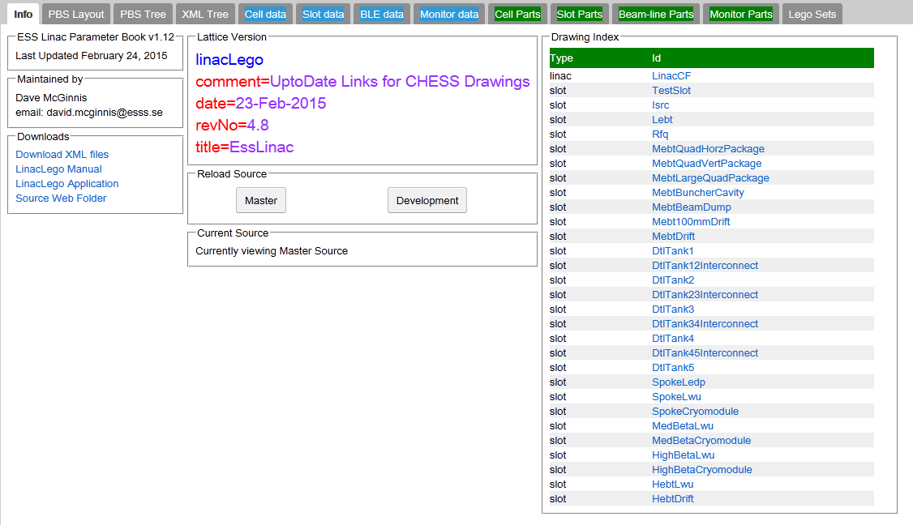
Go to LinacLego:
FOR REFERENCE
Once in LinacLego, you can click on the link that lead to the CHESS document describing a SLOT design

Slide 6
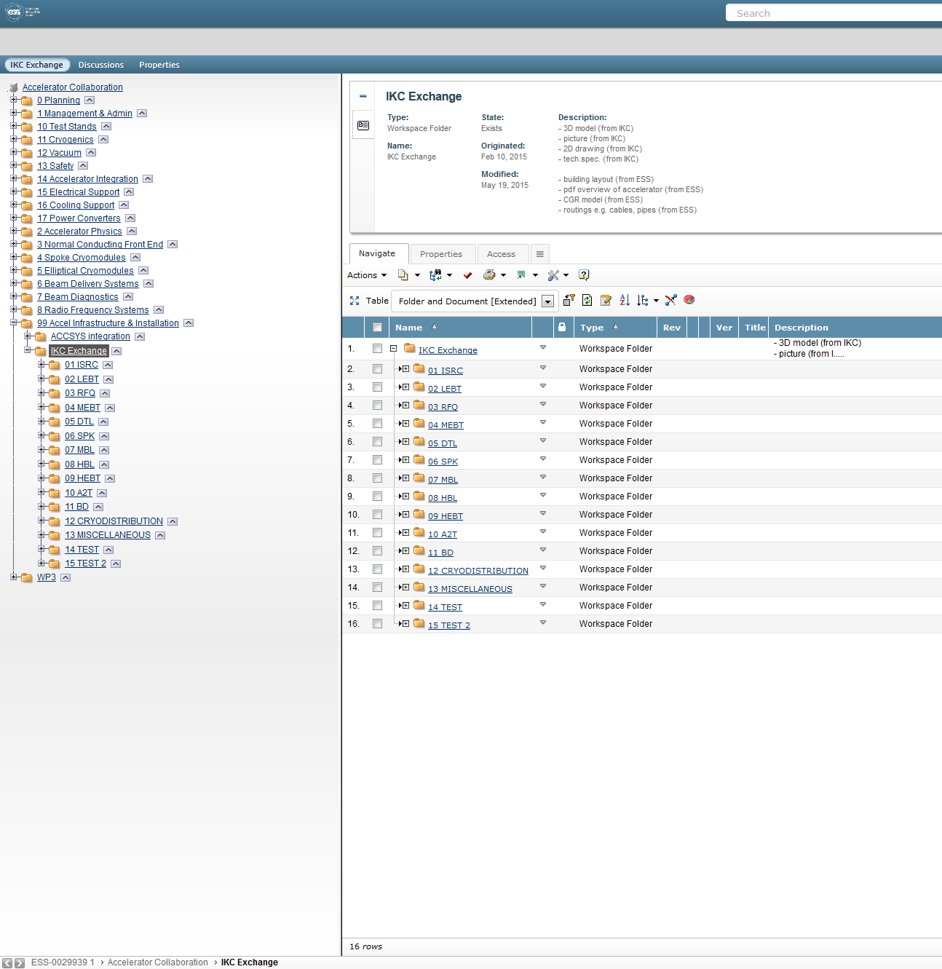
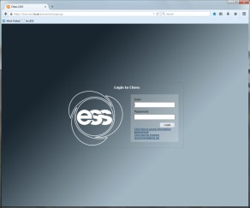
Integration Drawing Exchange Solution
Login CHESS
Collaboration area in CHESS
Exchange folders
Parent folder
History bar

Slide 7

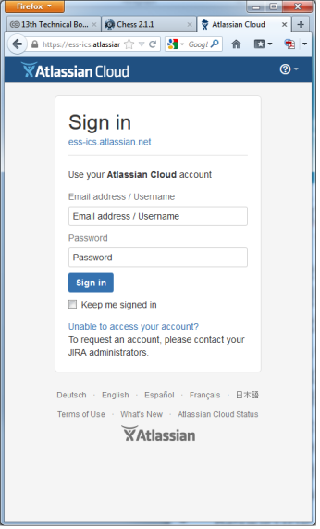
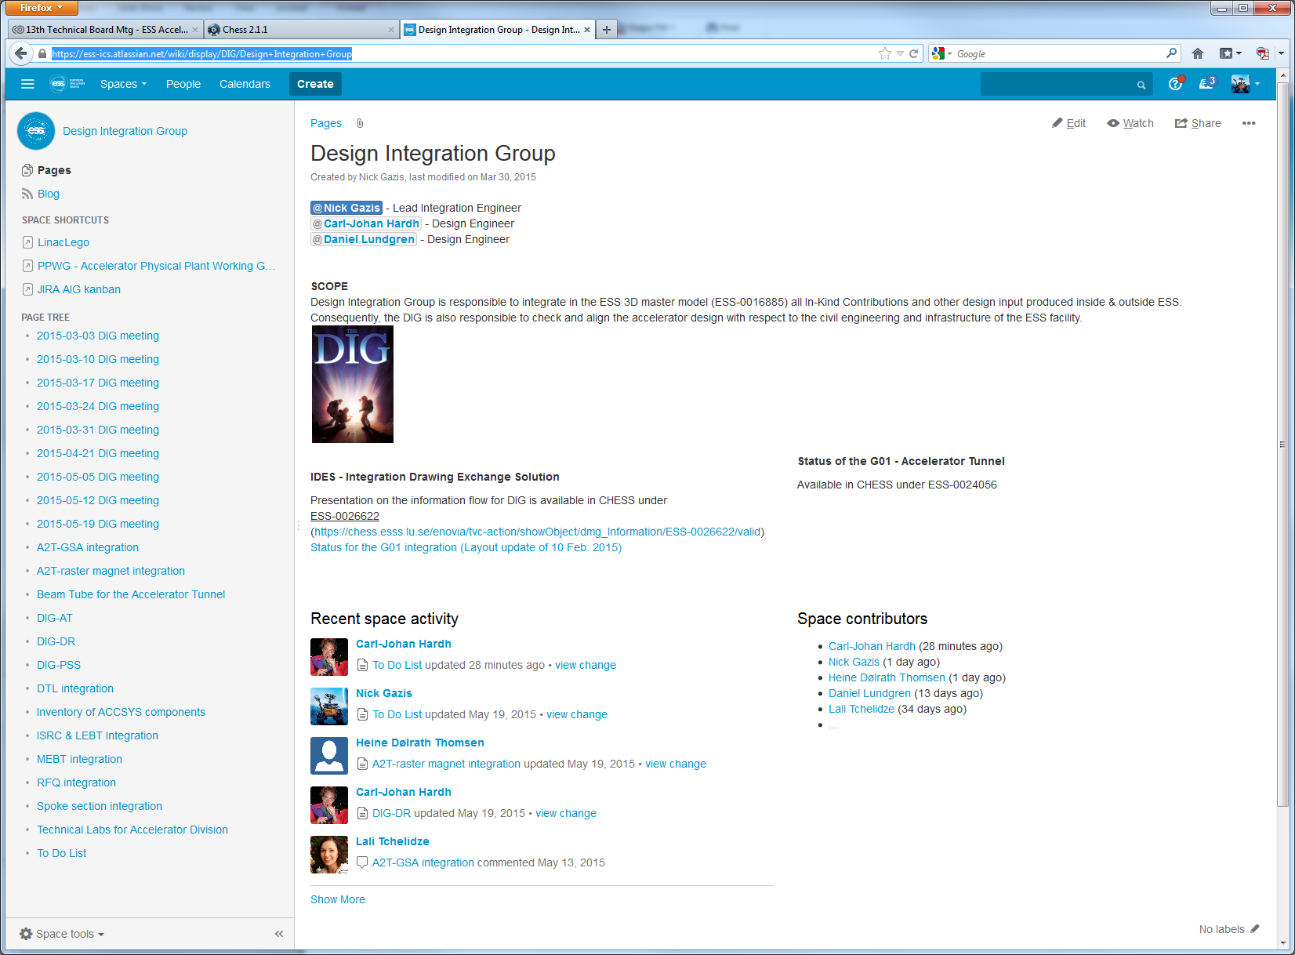
Report in Confluence
Login Confluence
Weblinks to dedicated pages for model integration

Slide 8
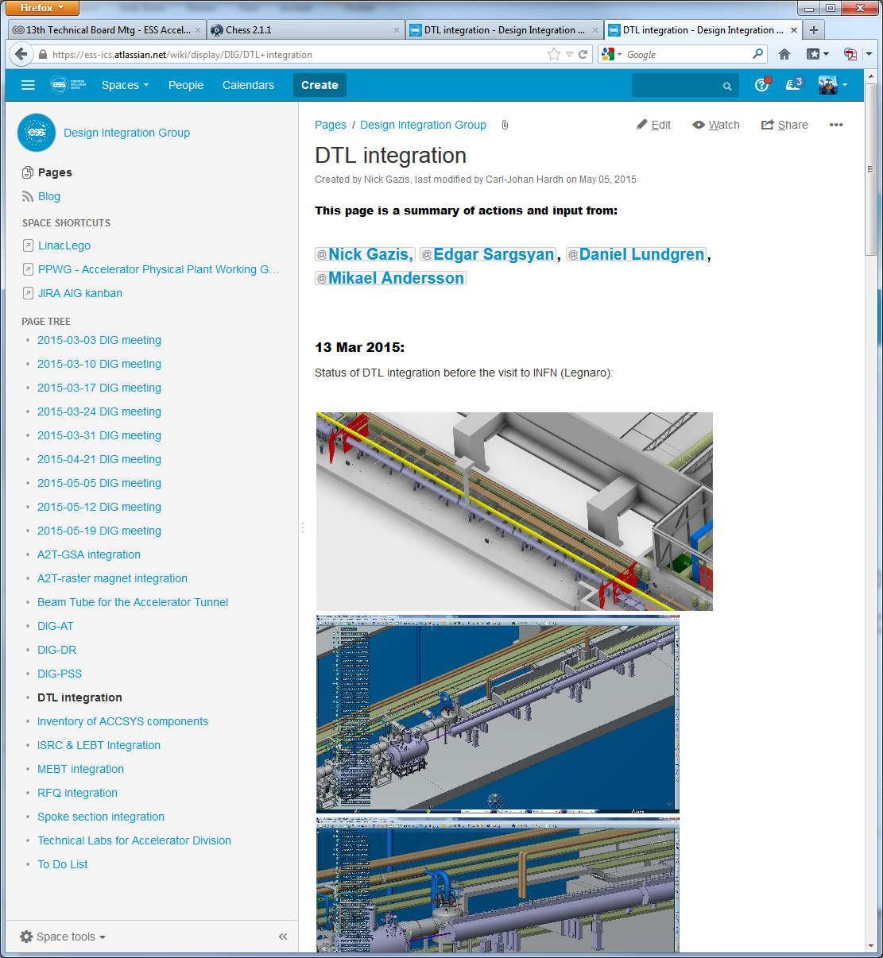
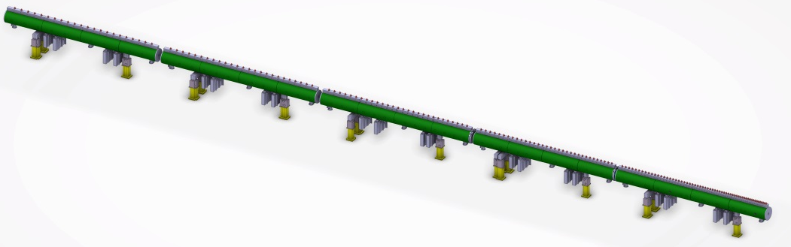
Report in Confluence (DTL example)
After the updated IKC model was uploaded in CHESS, a progress discussion started in
Result:
Clash control, interface check etc. of the latest model is being discussed

Slide 9
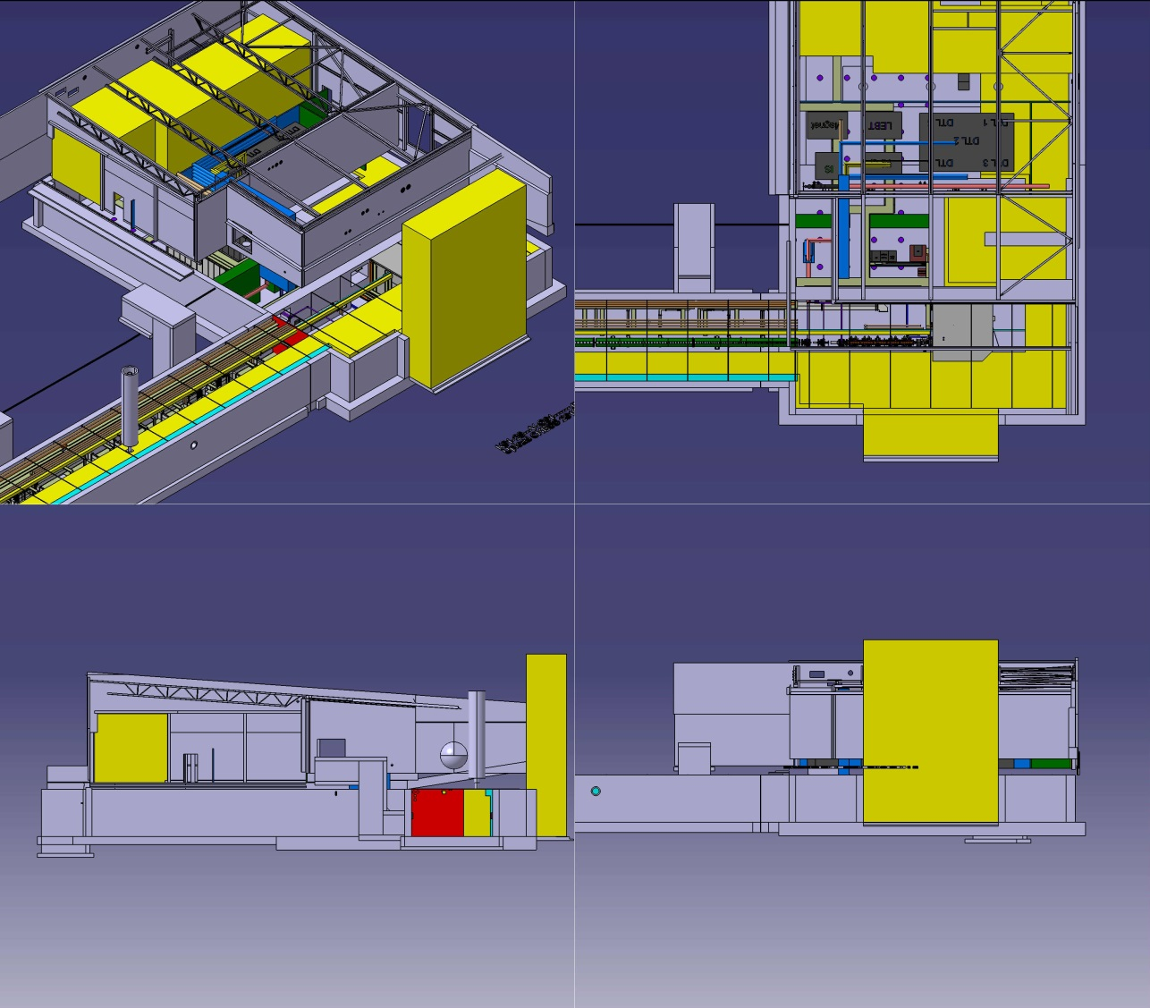
Feedback to IKCs (warm linac example)
After the need to communicate the latest ESS master model of the warm linac:
ESS-0021792 (https://chess.esss.lu.se/enovia/tvc-action/showObject/dmg_Information/ESS-0021792/valid)
*Yellow volumes indicate all transportation zones

Slide 10
End
Thank you for your updated contributions,
looking forward for more!
  *Users of IKCs have been receiving CHESS login’s and Confluence login’s:
  for more please send e-mail and affiliation to nick.gazis@esss.se

Slide 11
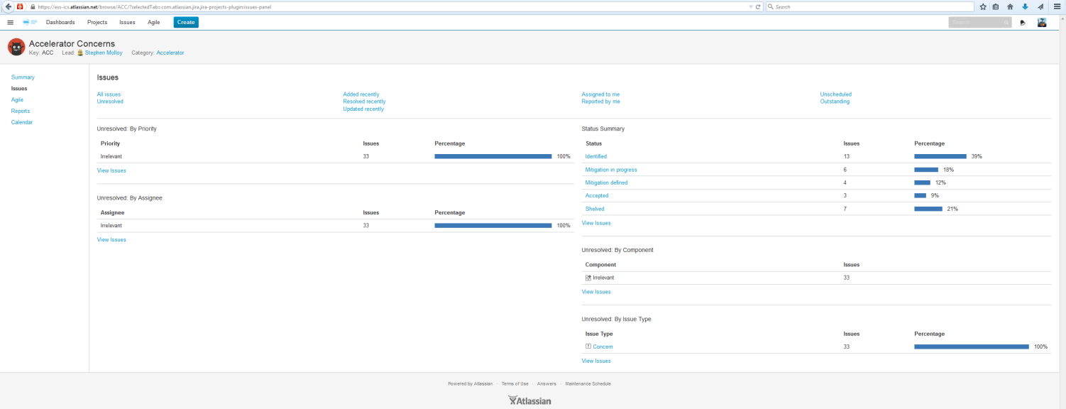
SPARE SLIDE – Comments on CHESS
FOR REFERENCE
If you have comments and requests for CHESS documents, please refer to the concerns JIRA database and write them down:
https://ess-ics.atlassian.net/browse/ACC-34?jql=project%20%3D%20ACC

