Slide 1
RATS facilities for ACCSYS
definition of “RATS”:
Receiving, Acceptance, Testing, Storage areas
extended definition applied for ACCSYS:
Receiving, Acceptance, Testing, Storage +
labs, workshops, assembly areas, laydown areas
in crucial cases: transport between areas
from now to the end of construction *
* and beyond, in selected cases

Slide 2
data collection
done so far:
held 1-hour interviews with all concerned WPs
discussed requirements & filled in a questionnaire
consolidated data and transferred it to a database
still to be done:
feedback sessions with WPs, clarification of open issues
transfer data (but not responsibility) to ESS logistics

Slide 3
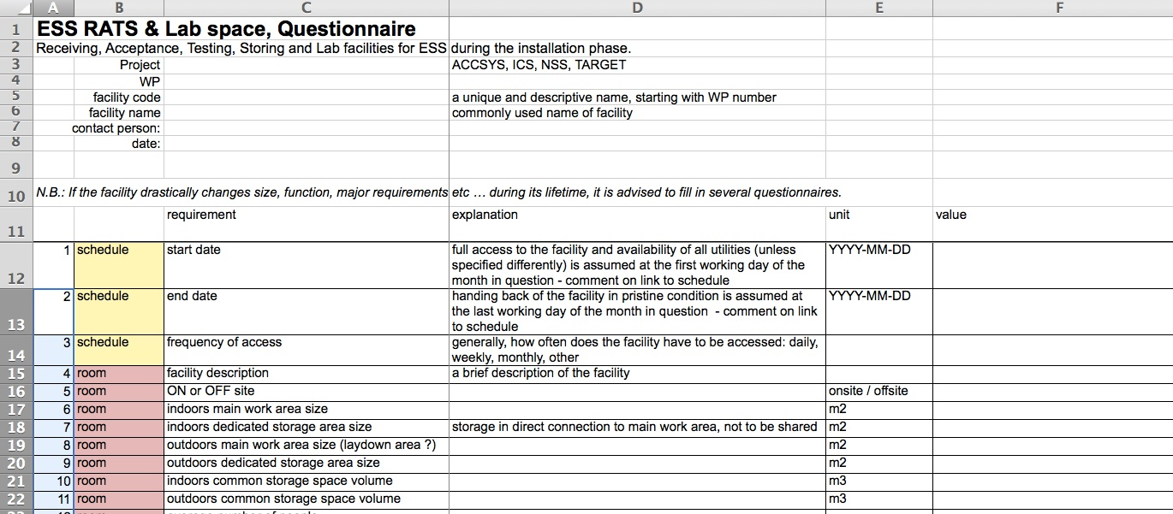
questionnaire
there can be more than one facility per WP
one questionnaire per facility

Slide 4
ACCSYS RATS needs
list of facilities (2015-05-20):
WP3 DTLassy | WP10 TS2
WP3 IS LEBT | WP11 summary
WP3 MEBT | WP12 LWUs and beam pipes
WP3 RFQ | WP12 vacuum lab
WP4 SPK | WP15 cable drums storage
WP5 HBL | WP15 cable drums storage WP99
WP5 MBL | WP15 receiving area
WP7 beam diagnostics | WP16 WTRC
WP8 klystron assembly | WP17 magnet PS
WP8 RF equipment | WP17 power converters

Slide 5
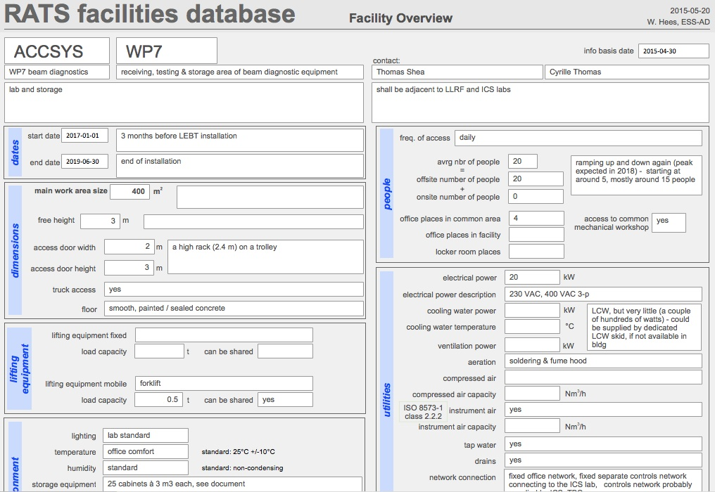
ACCSYS RATS needs
dates
sizes
utilities
equipment
environment
safety

Slide 6
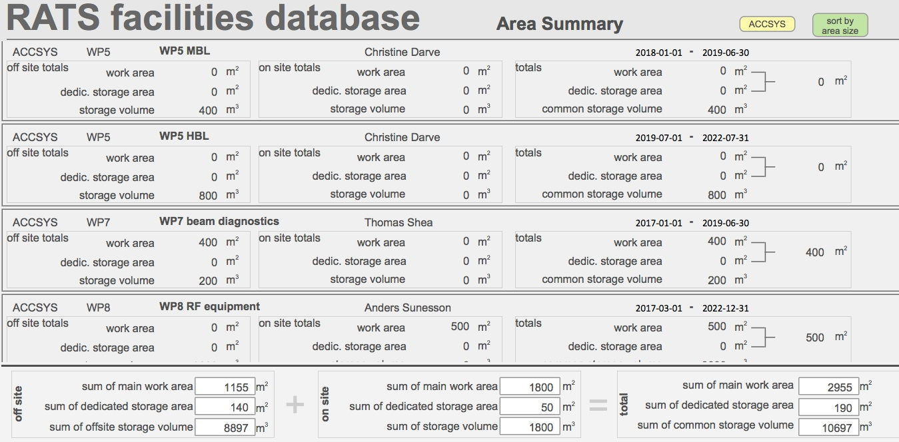
ACCSYS RATS needs
preliminary data
> 3000 m² work area, > 10’000 m³ storage volume

Slide 7
ACCSYS RATS needs
preliminary data

Slide 8
ACCSYS RATS needs
preliminary data

Slide 9
ACCSYS RATS needs
preliminary data

Slide 10
next steps
consolidating ACCSYS RATS data
transfer data to ESS logistics
work with Target, ICS, NSS to start up their RATS efforts
work actively with ESS procurement / logistics to ensure fulfillment of ACCSYS RATS requirements

