Slide 1
Status of In-Kind Contributions to Accelerator
Håkan Danared
www.europeanspallationsource.se
ACCSYS Technical Board, 21 May 2015

Slide 2

In-Kind to Accelerator
The accelerator collaboration for the pre-construction phase was established in 2009. Additional partners are joining for the construction phase.
Since the launch of Expressions of Interest in spring 2013, discussions on in-kind are going on with 26 organizations.
Possible partners to Accelerator have been identified in Denmark, Estonia, France, Germany, Hungary, Italy, Norway, Poland, Spain, Sweden, Switzerland, and UK.
Value of items discussed with in-kind partners represents 50% of the accelerator budget.
Host countries cannot formally give in-kind contributions, contracts represent 3% of budget.
Another 18% possible as in-kind, but mostly constitute large commercial items less attractive as in-kind.
Not IKC, 29%
Planned IKC, 50%
Potential IKC, 18%
SE,DK, 3%

Slide 3
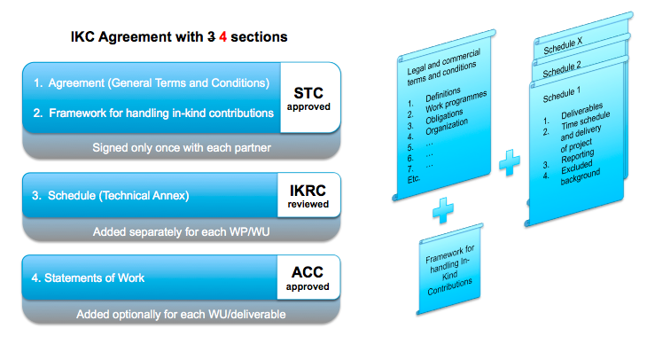
In-Kind Agreements
The general ESS aim is to have IK Agreements signed soon after the ERIC transition.
Discussions with in-kind partners in progress to agree on technical details and to write requirements and specifications. This is the task of work-package and work-unit leaders.
With some partners a preliminary agreement, Heads of Agreement, is needed and has been signed or is being signed.
At the same time, issues need to be solved at the ESS level concerning cash flow, VAT, etc.
At the technical level our target is to have Technical Appendices ready in June 2015.
In parallel, work is being done!

Slide 4
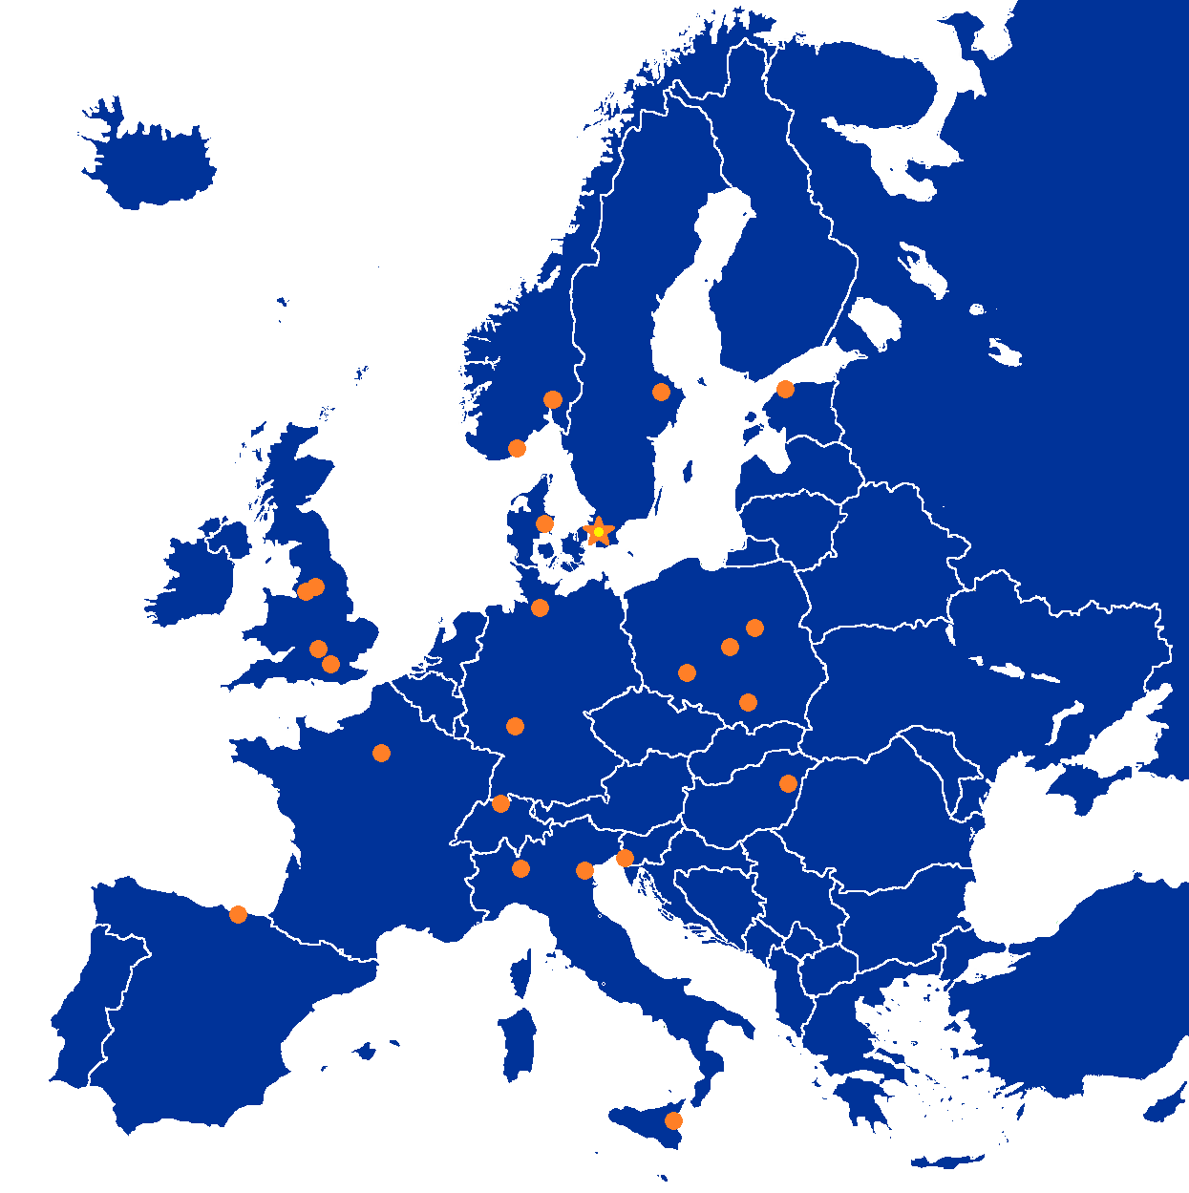
Partner Institutions
In-kind (main contributions)
Univ Agder (Ion source expert)
ATOMKI (RF-LPS)
CEA (RFQ, SRF, Diagn)
CNRS (SRF, Cryo)
Cockcroft Inst (Diagn)
Daresbury Lab (SRF, Vacuum)
Elettra (RF, Magn, PS, Diagn)
ESS-Bilbao (MEBT, RF)
GSI (Diagn, Vacuum, Cryo (?))
Huddersfield Univ (RF distrib)
IFJ PAN (Installations)
INFN Catania (Source, LEBT)
INFN Legnaro (DTL)
INFN Milan (SRF)
NCBJ (LLRF)
RAL (Diagn)
RHUL (Diagn)
Tallinn UT (RF)
TU Lodz (LLRF)
Univ Oslo (Diagn)
Warsaw UT (LLRF)
Wroclaw UT (Cryo)
Paid contracts
Aarhus Univ (Beam del)
DESY (Diagn)
Lund Univ (LLRF, RF)
PSI (Diagn)
Uppsala Univ (Tests)

Slide 5
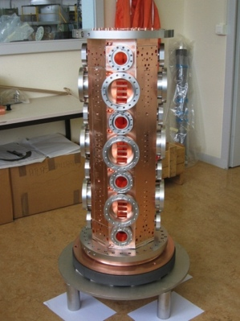
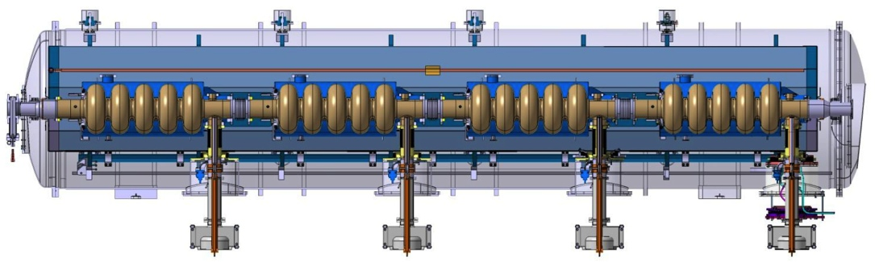
CEA Saclay, France
Title: RFQ, Elliptical cryomodules, Beam diagnostics
Value: 70,855 k€
Status: Collaboration since 2009, work progressing in many areas, prototypes built, technical annexes to HoA almost ready
Agreement type: HoA + IK Agreement
Agreement time schedule: June 2015 (HoA), June 2015 (IK technical annexes)
Not ESS RFQ!
ESS cryomodule, preliminary design

Slide 6
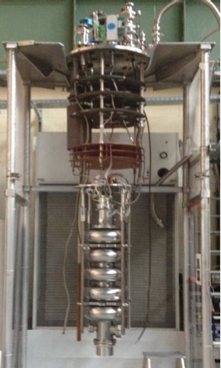
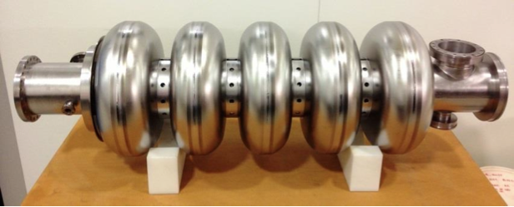
Daresbury Lab, UK
Title: High-beta cavities, Beam diagnostics, Vacuum
Value: 32,285 k€
Status: Planning for procurement and testing of cavities in progress, scope of beam diagnostics remains to be defined, vacuum partially agreed and partially being specified
Agreement type: IK Agreement
Agreement time schedule: June 2015

Slide 7
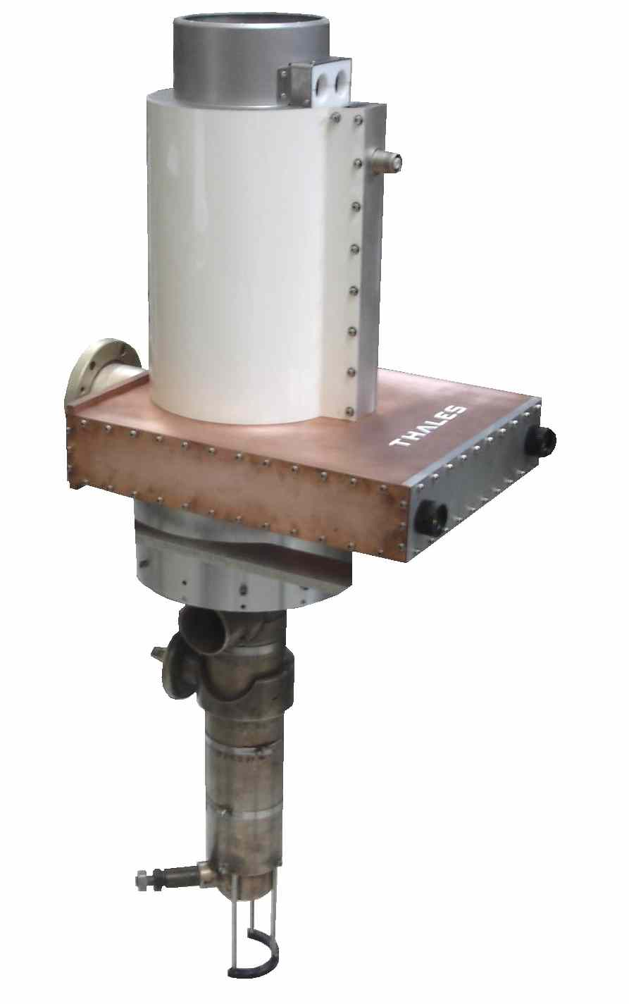
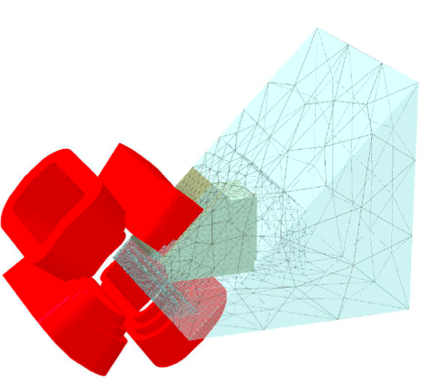
Elettra, Italy
Title: RF sources for spokes, Beam diagnostics, Warm magnets, Magnet power supplies, Installation work
Value: 30,531 k€
Status: Detailed technical discussions and calculations in progress for RF sources, diagnostics, magnets and power supplies. Installation work remains to be defined.
Agreement type: HoA + IK Agreement
Agreement time schedule: May 2015 (HoA), June 2015 (IK technical annexes)

Slide 8
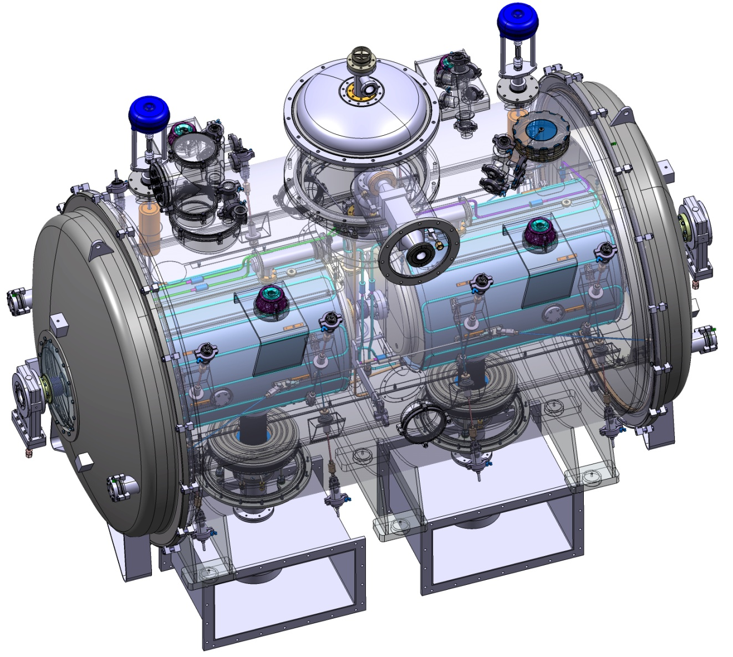
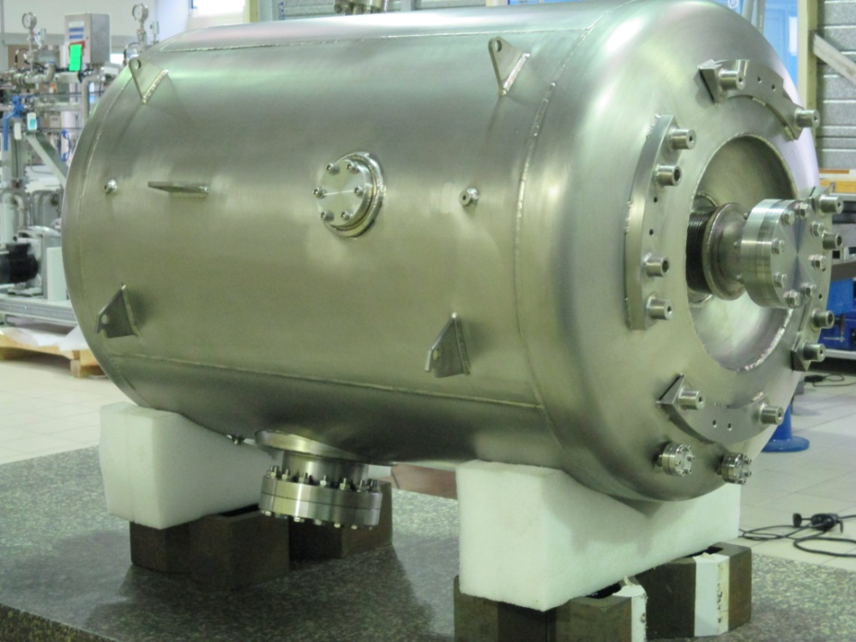
IPN Orsay, France
Title: Spoke cavities and cryomodules, Cryo distribution
Value: 19,899 (+3,000) M€
Status: Collaboration since 2009, work progressing in many areas, prototypes built, technical annexes to HoA being written at Orsay. Additional contribution on cryomodule controls being discussed.
Agreement type: HoA + IK Agreement
Agreement time schedule: June 2015 (HoA), June 2015 (IK technical annexes)

Slide 9

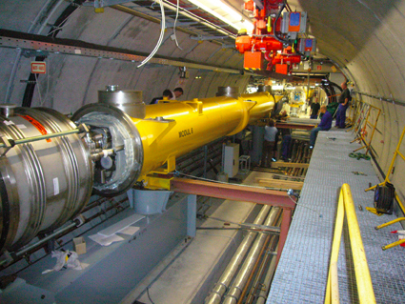
IFJ PAN, Poland
Title: Installation work
Value: 18,100 k€
Status: Planning of work partially started
Agreement type: IK Agreement
Agreement time schedule: June 2015?

Slide 10
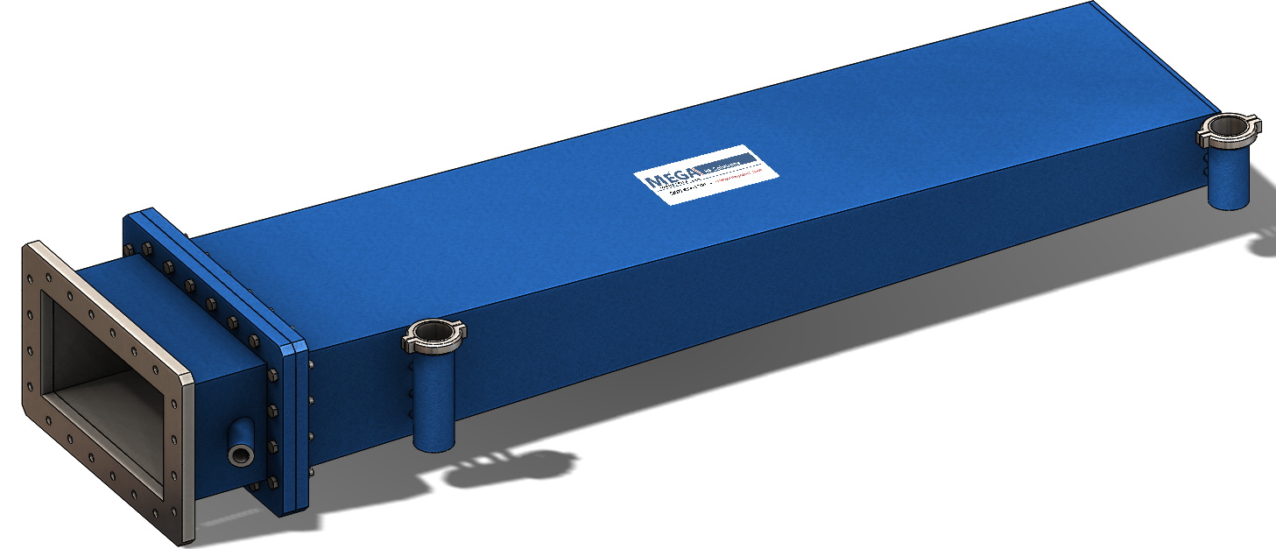
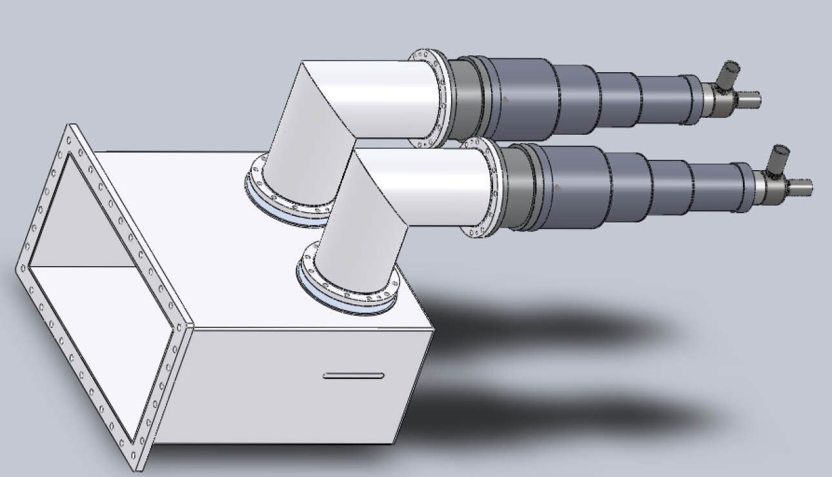
Huddersfield University, UK
Title: RF Distribution
Value: 17,500 k€
Status: Detailed technical discussions
Agreement type: IK Agreement
Agreement time schedule: June 2015

Slide 11
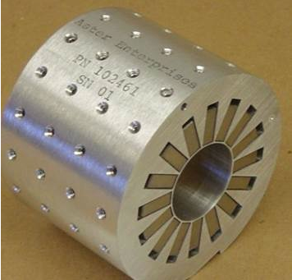
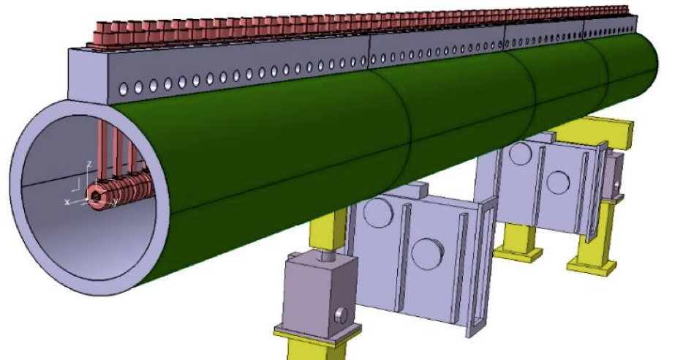
INFN Legnaro, Italy
Title: Drift-tube linac, Beam diagnostics
Value: 16,761 k€
Status: Design in advanced stage, some prototypes built, HoA in preparation
Agreement type: HoA + IK Agreement
Agreement time schedule: May 2015 (HoA), June 2015 (IK technical annexes)

Slide 12
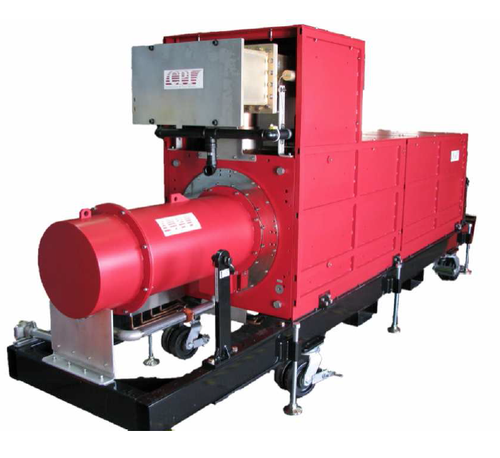
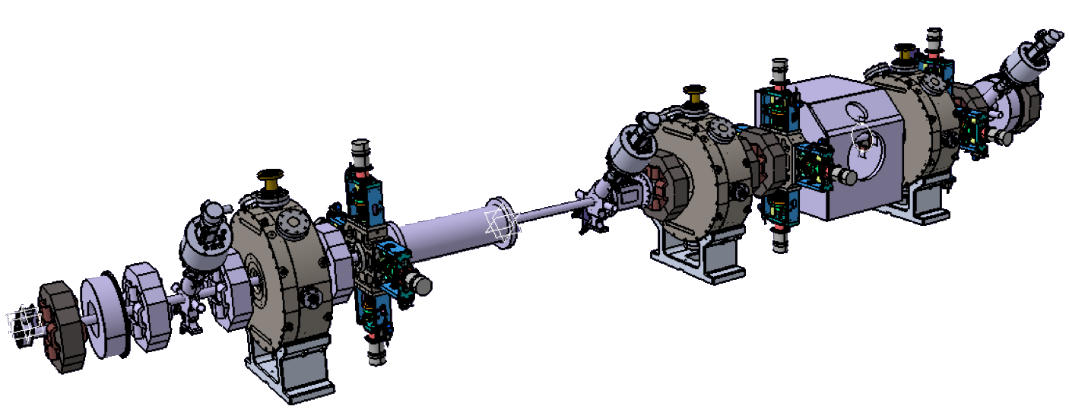
ESS-Bilbao, Spain
Title: MEBT, RF for warm linac, Beam diagnostics, Insertable beam dump
Value: 15,740 k€
Status: MEBT HoA signed, RF HoA ready for signature, Beam diagnostics and beam dump in technical discussions
Agreement type: HoA + IK Agreement
Agreement time schedule: May 2015 (remaining HoA), June 2015 (IK technical annexes)

Slide 13
INFN Milan, Italy
Title: Medium-beta elliptical cavities
Value: 10,079 k€
Status: Planning for procurement and testing of cavities in progress, alternative cavity design on-going, HoA in preparation
Agreement type: HoA + IK Agreement
Agreement time schedule: May 2015 (HoA), June 2015 (IK technical annexes)

Slide 14
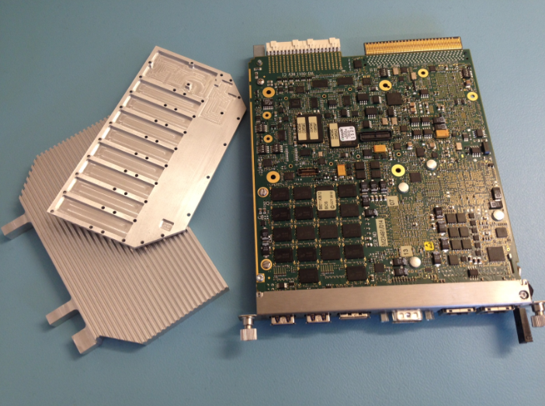
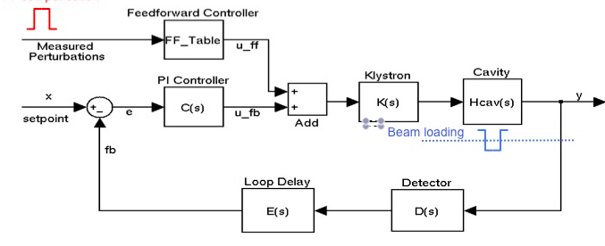
NCBJ, Poland
Title: Low-level RF electronics 704 MHz, Gamma blocker, Collimator design
Value: 989 k€ + 9,975 k€ for LLRF consortium
Status: EoI received for IK consortium with NCBJ and WUT (PEG), detailed proposal expected before end of April. Collimator design nearing completion and has been sub-contracted by WP6
Agreement type: IK Agreement
Agreement time schedule: June 2015

Slide 15
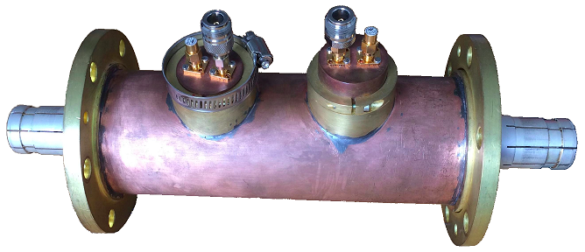
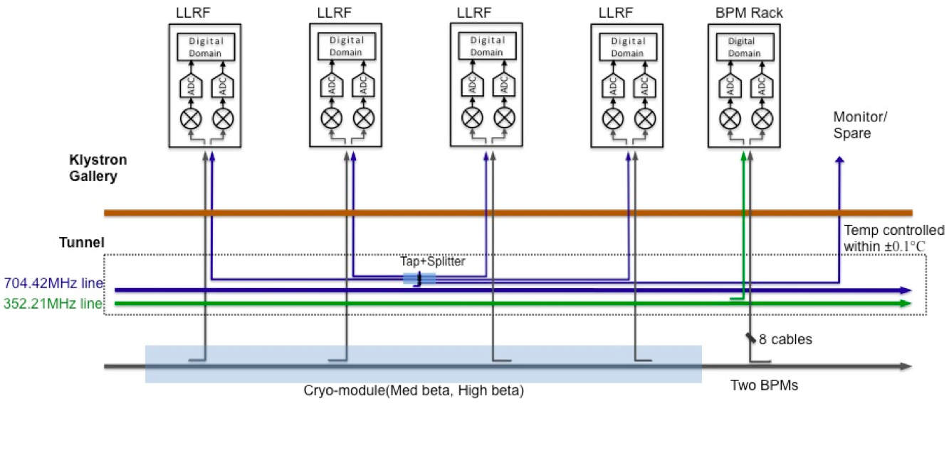
Warsaw UT, Poland
Title: Phase-reference line, Low-level RF electronics 704 MHz
Value: 731 k€ + 9,975 k€ for LLRF consortium
Status: Planning for phase-reference line in progress. EoI received for IK consortium with NCBJ and WUT (PEG), detailed proposal expected before end of April.
Agreement type: IK Agreement
Agreement time schedule: June 2015

Slide 16
Lodz UT, Poland
Title: Low-level RF electronics 704 MHz
Value: 9,975 k€ for LLRF consortium
Status: EoI received for IK consortium with NCBJ and WUT (PEG), detailed proposal expected before end of April.
Agreement type: IK Agreement
Agreement time schedule: June 2015

Slide 17
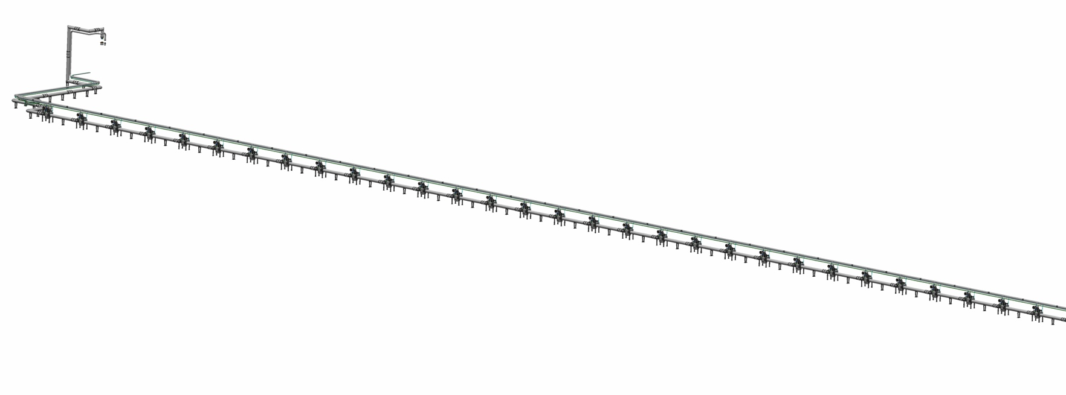
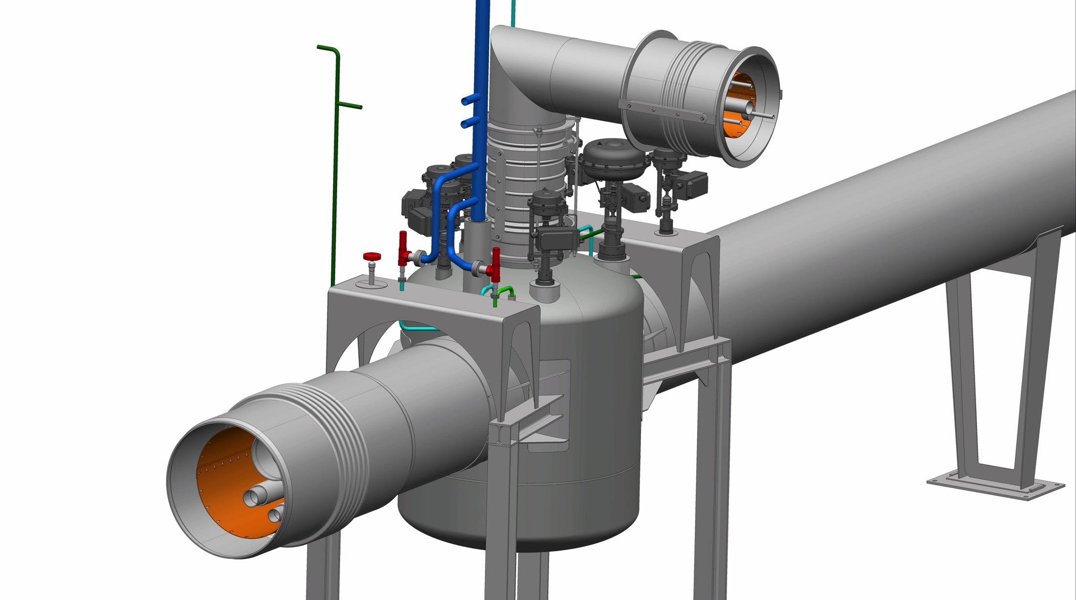
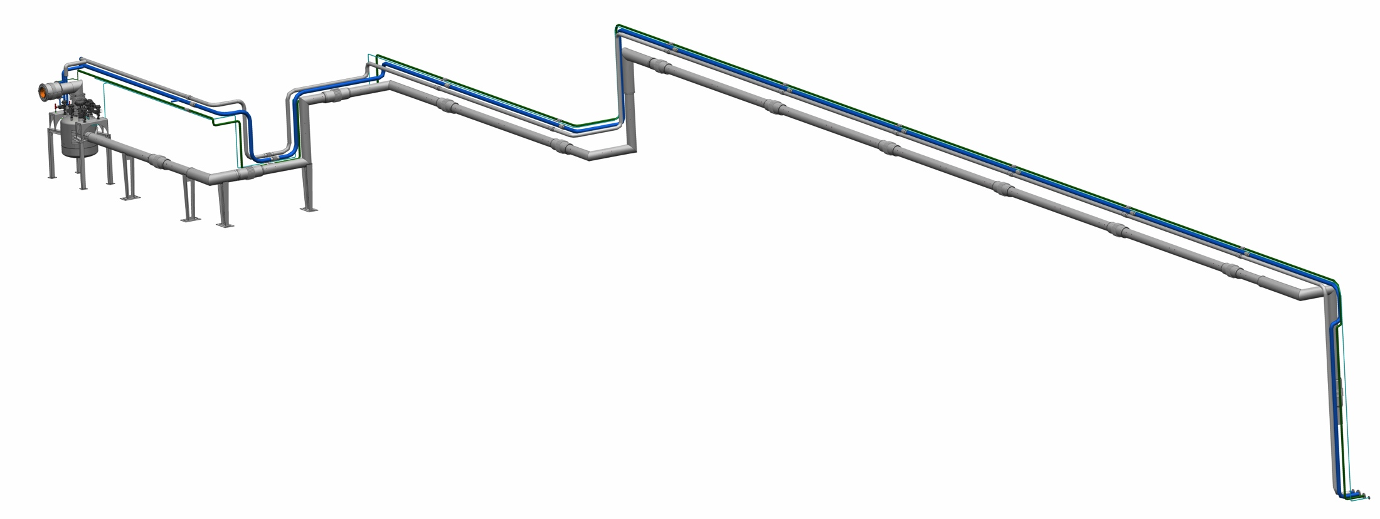
Wroclaw UT, Poland
Title: Cryo distribution
Value: 7190 k€
Status: Design work has started, draft IK agreement sent to WrUT
Agreement type: IK Agreement
Agreement time schedule: June 2015

Slide 18
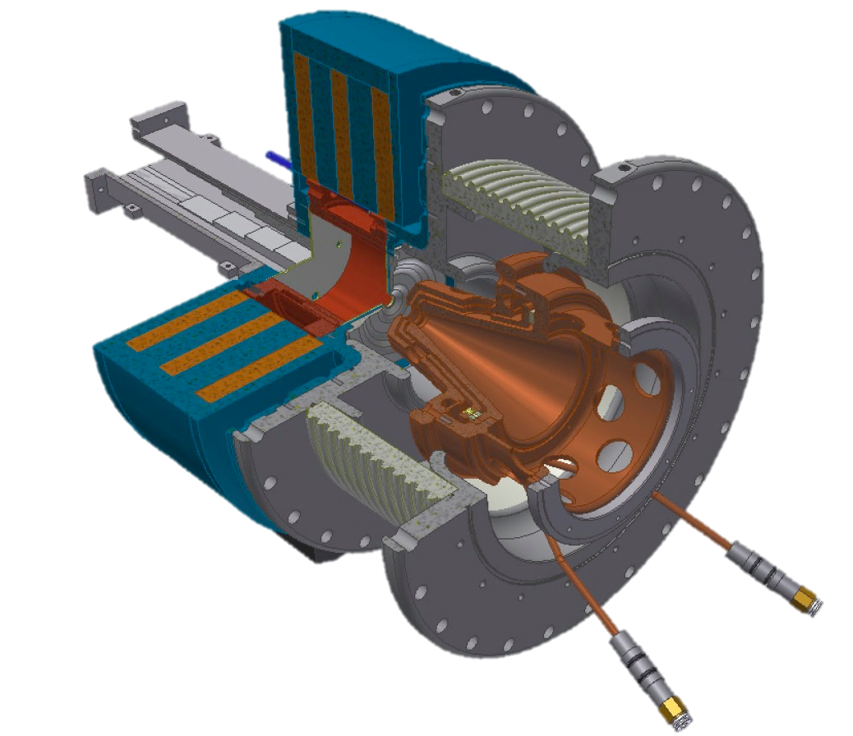
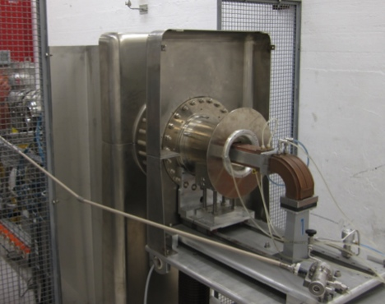
INFN Catania, Italy
Title: Proton source and LEBT
Value: 3,897 k€
Status: Source and LEBT prototypes exist, HoA in preparation
Agreement type: HoA + IK Agreement
Agreement time schedule: May 2015 (HoA), June 2015 (IK technical annexes)

Slide 19
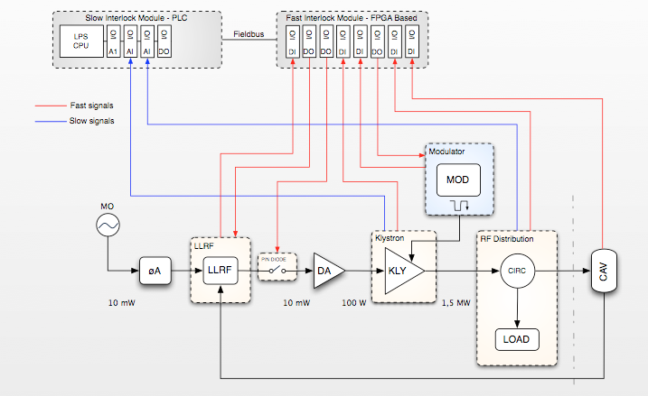
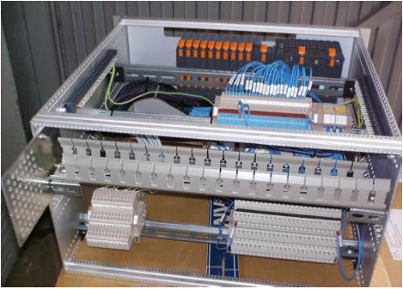
ATOMKI, Hungary
Title: RF Local Protection System (RF-LPS)
Value: 2,200 k€
Status: Technical discussions started in Feb 2015, visit to Debrecen 18-19 May for detailed discussions. Drafting of agreements has not started yet. Pilot project in Hungary for IKCs to ESS
Agreement type: IK Agreement
Agreement time schedule: June 2015

Slide 20
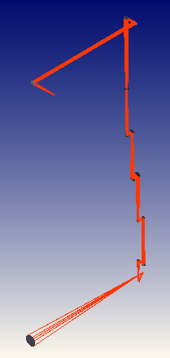
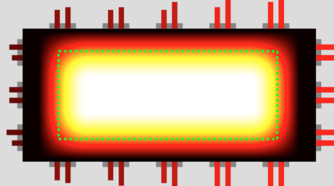
University of Oslo, Norway
Title: Target proton beam diagnostics
Value: 1,500–2,000 k€
Status: Discussions starting since beginning of March
Agreement type: IK Agreement
Agreement time schedule: June 2015

Slide 21

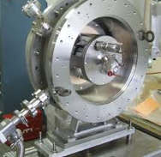
Agder University, Norway
Title: Ion-source expert
Value: 216 k€
Status: Agreed, practical issues concerning employment etc being discussed
Agreement type: IK Agreement
Agreement time schedule: June 2015

Slide 22
Tallinn UT, Estonia
Title: IOT modulator development
Value: 50 k€
Status: Development work starting
Agreement type: IK Agreement
Agreement time schedule: June 2015

Slide 23
Cockcroft Institute, UK
Title: Target imaging
Value: Not defined
Status: Design work starting, but scope of final commitment uncertain
Agreement type: IK Agreement
Agreement time schedule: June 2015

Slide 24
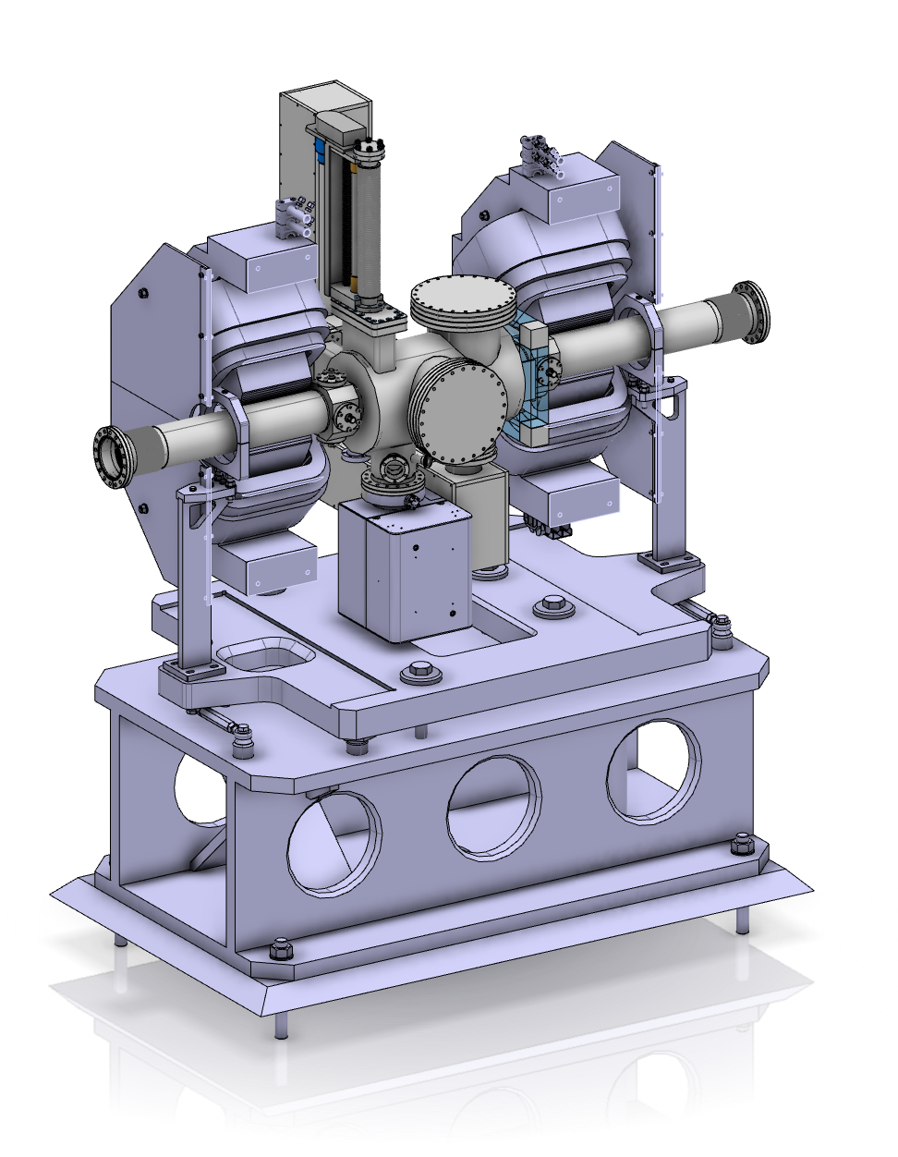
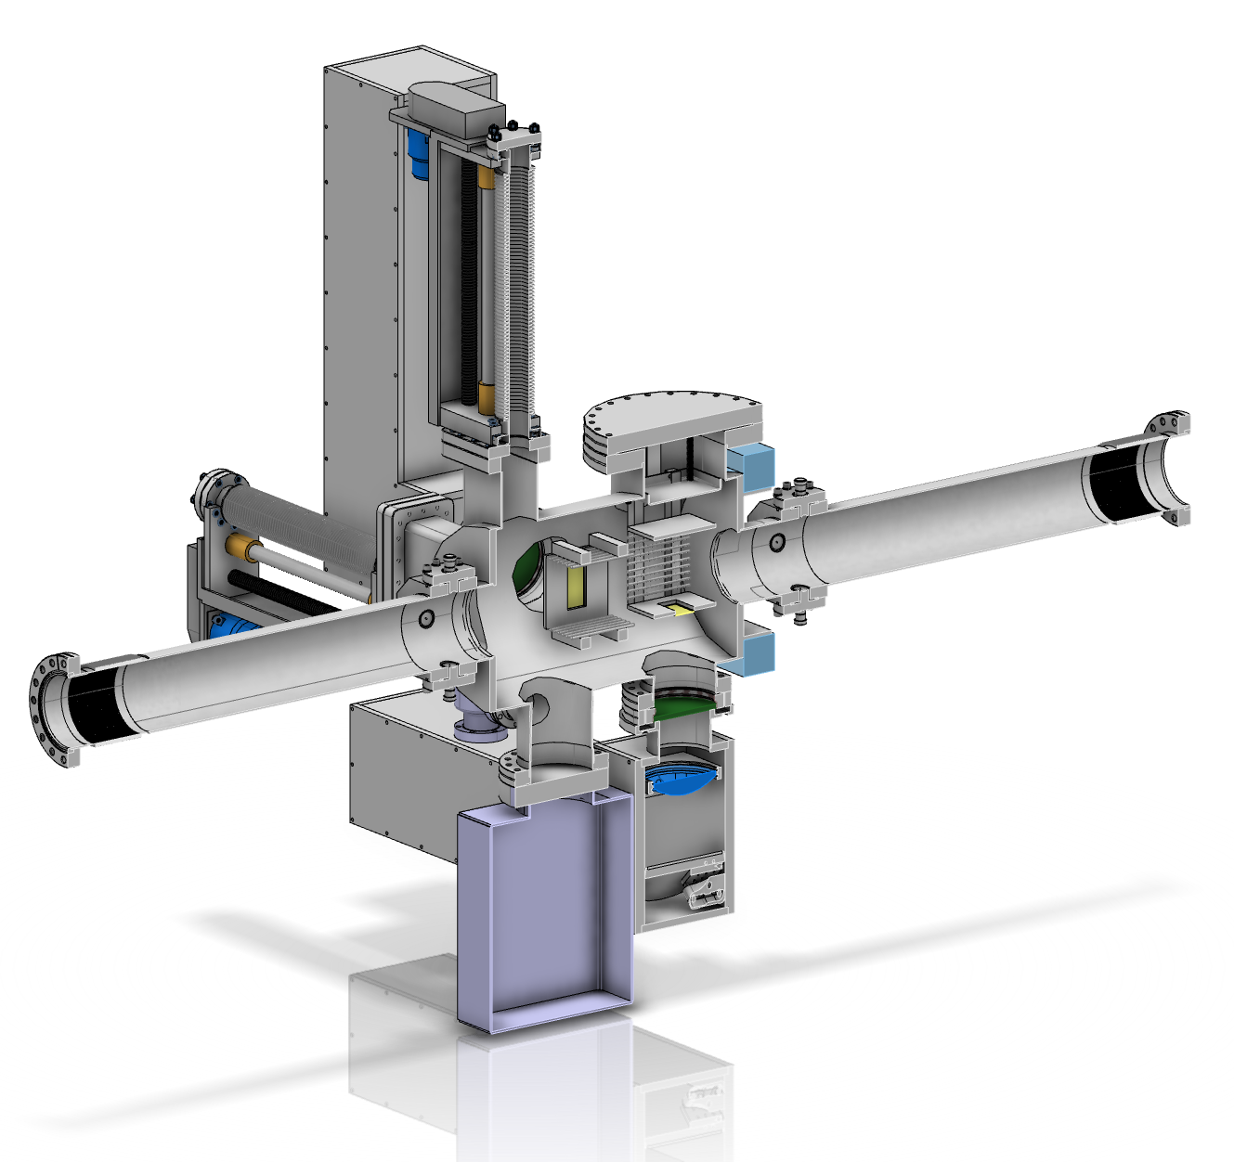
GSI, Germany
Title: Beam diagnostics, Cryogenics
Value: Not defined
Status: Exploratory phase
Agreement type: IK Agreement?
Agreement time schedule: Not defined

Slide 25
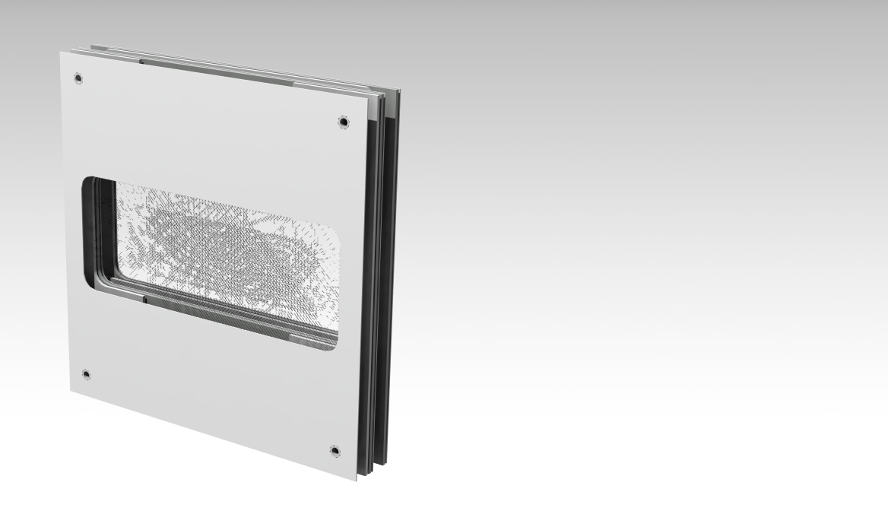
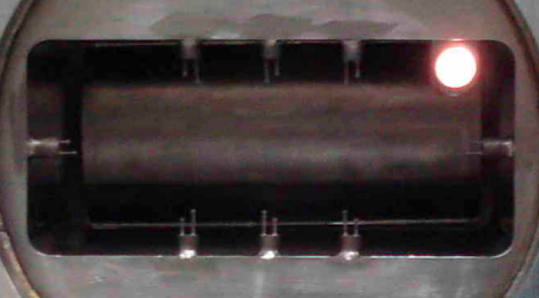
PSI, Switzerland
Title: Target proton beam diagnostics
Value: Not defined
Status: Exploratory phase
Agreement type: IK Agreement
Agreement time schedule: June 2015

Slide 26
RAL/ISIS, UK
Title: Target proton beam diagnostics, Beam physics
Value: Not defined
Status: Scope and commitment to be defined
Agreement type: IK Agreement
Agreement time schedule: June 2015

Slide 27
RHUL, UK
Title: Target proton beam diagnostics
Value: Not defined
Status: Scope and commitment to be defined
Agreement type: IK Agreement
Agreement time schedule: June 2015

Slide 28
Collaborations with Paid Contracts
Aarhus University, Denmark
Title: Beam delivery system
Value: 2,635 k€
Status: Contract signed, work in progress
Lund University, Sweden
Title: Low-level RF, Modulator development, RF test stand
Value: 2,900 k€ signed
Status: On-going collaboration since 2010
Uppsala University, Sweden
Title: Spoke cavity and cryomodule tests, 704 MHz RF test stand
Value: 6,500 k€ signed, 3,150 k€ ready for signature
Status: On-going collaboration since 2010
DESY, Germany
Title: Beam diagnostics, Lund test stand
Value: 200 k€
Status: Main part of diagnostics work done, test stand under discussion

