Slide 2
Soft Matter and Chemistry Sample environment (SCSE)
Alice Corani, Harald Schneider
PRESENTED BY Alice Corani

Slide 3
Soft matter and Chemistry Sample Environment
Provide sample environment systems and devices for:
Shear rheology
Liquids
Syringe/HPLC pumps
Stopped flow cell
Langmuir trough
Trough
Rheometer
Stopped flow cell
Thermalized liquid/ gas
Liquid flow
IR / UV-vis probe
Gas adsorp. (0-12 bar)
Reaction cells
TGA
Gas flow/ sorption
Humidity
In situ experiments
Electro-chemistry
Humidity cell
Flow cells
HP gas adsorp.
Pump-Probe setup
Indiv. T cells
Soft condensed
Matter (bio/lifescience)
chemistry
?
Notes:
Work on the slide presentation and what to put in

Slide 4
Overview Sample Environment SCSE
For soft matter, Life science and chemistry
Easiest for planning and learning, however, takes up more resources
In House
Designed/ procured/ built at ESS
Rheometer – Anton Paar
In-Kind
Designed/ Procured / built at our partners
Instrument
Via grant by instrument teams
Gas handling manifold
Ultrasonic levitator
Grant
Via grant by partners/collaborators and ESS
Flexiprobe
Static troughs Automation
Solid Liquid Cell – FREIA /ESTIA
IR ellipsommetry set up
Huginn Individual thermalized cuvette
Great in most cases as knowledge transfer is possible
Collaboration with share f experience and expertize
Great, but need to participate in beamtime…
Notes:
Small description about Inkind

Slide 5
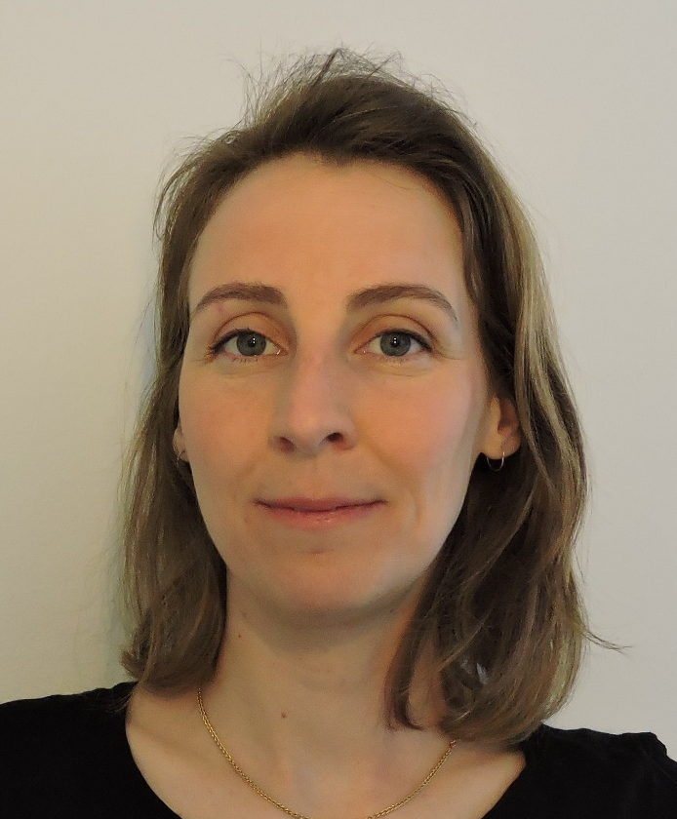
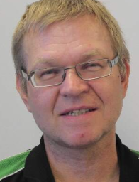
Personnel
A.Corani:
  Sample environment related to chemistry, Electrochemistry and chemistry cells.
H.Schneider:
  Sample environment for life science and soft matter R&D on ultrasonic levitator.
Technician
  Support the daily task in the workshop, and technical task for the projects
Part of the International Society for Sample Environment community, ISSE

Slide 6
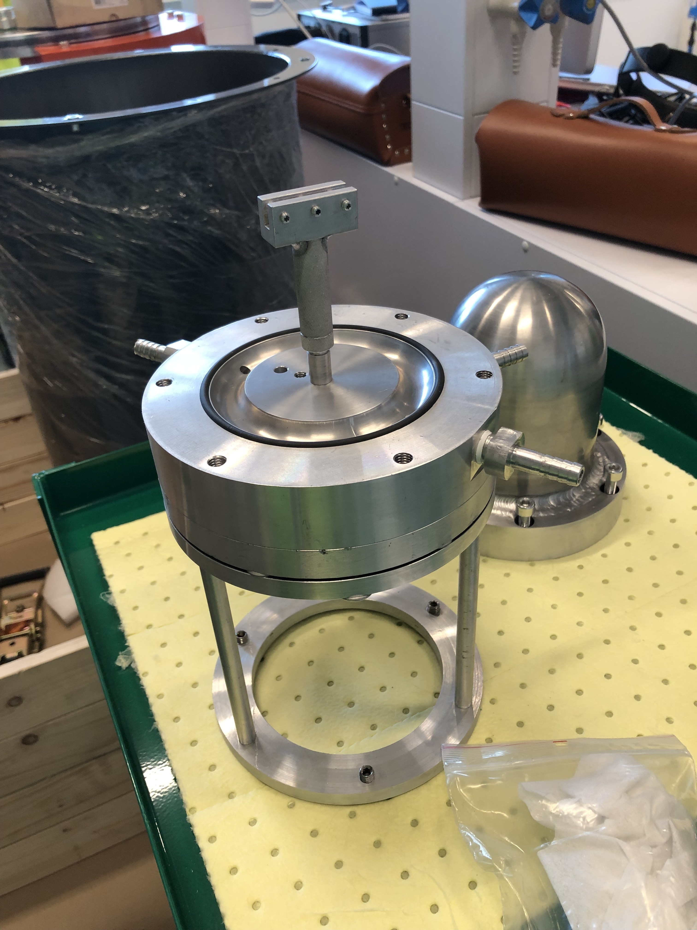
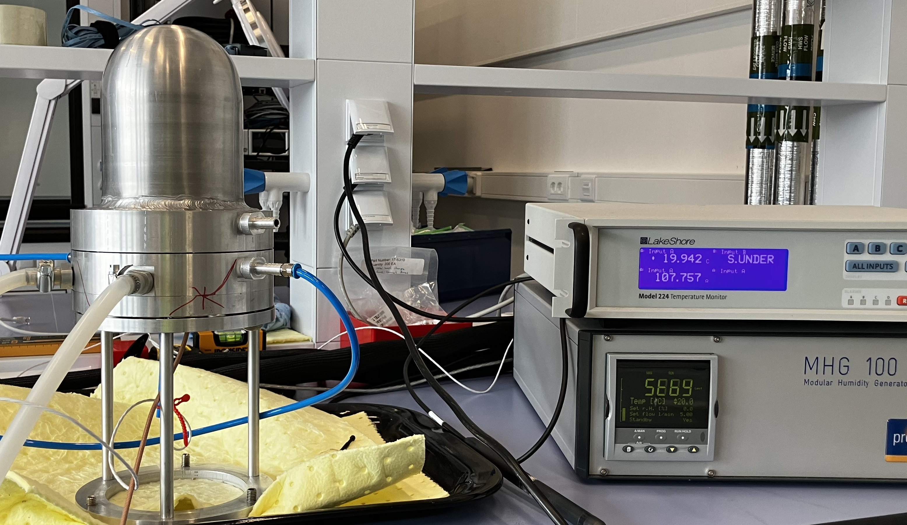
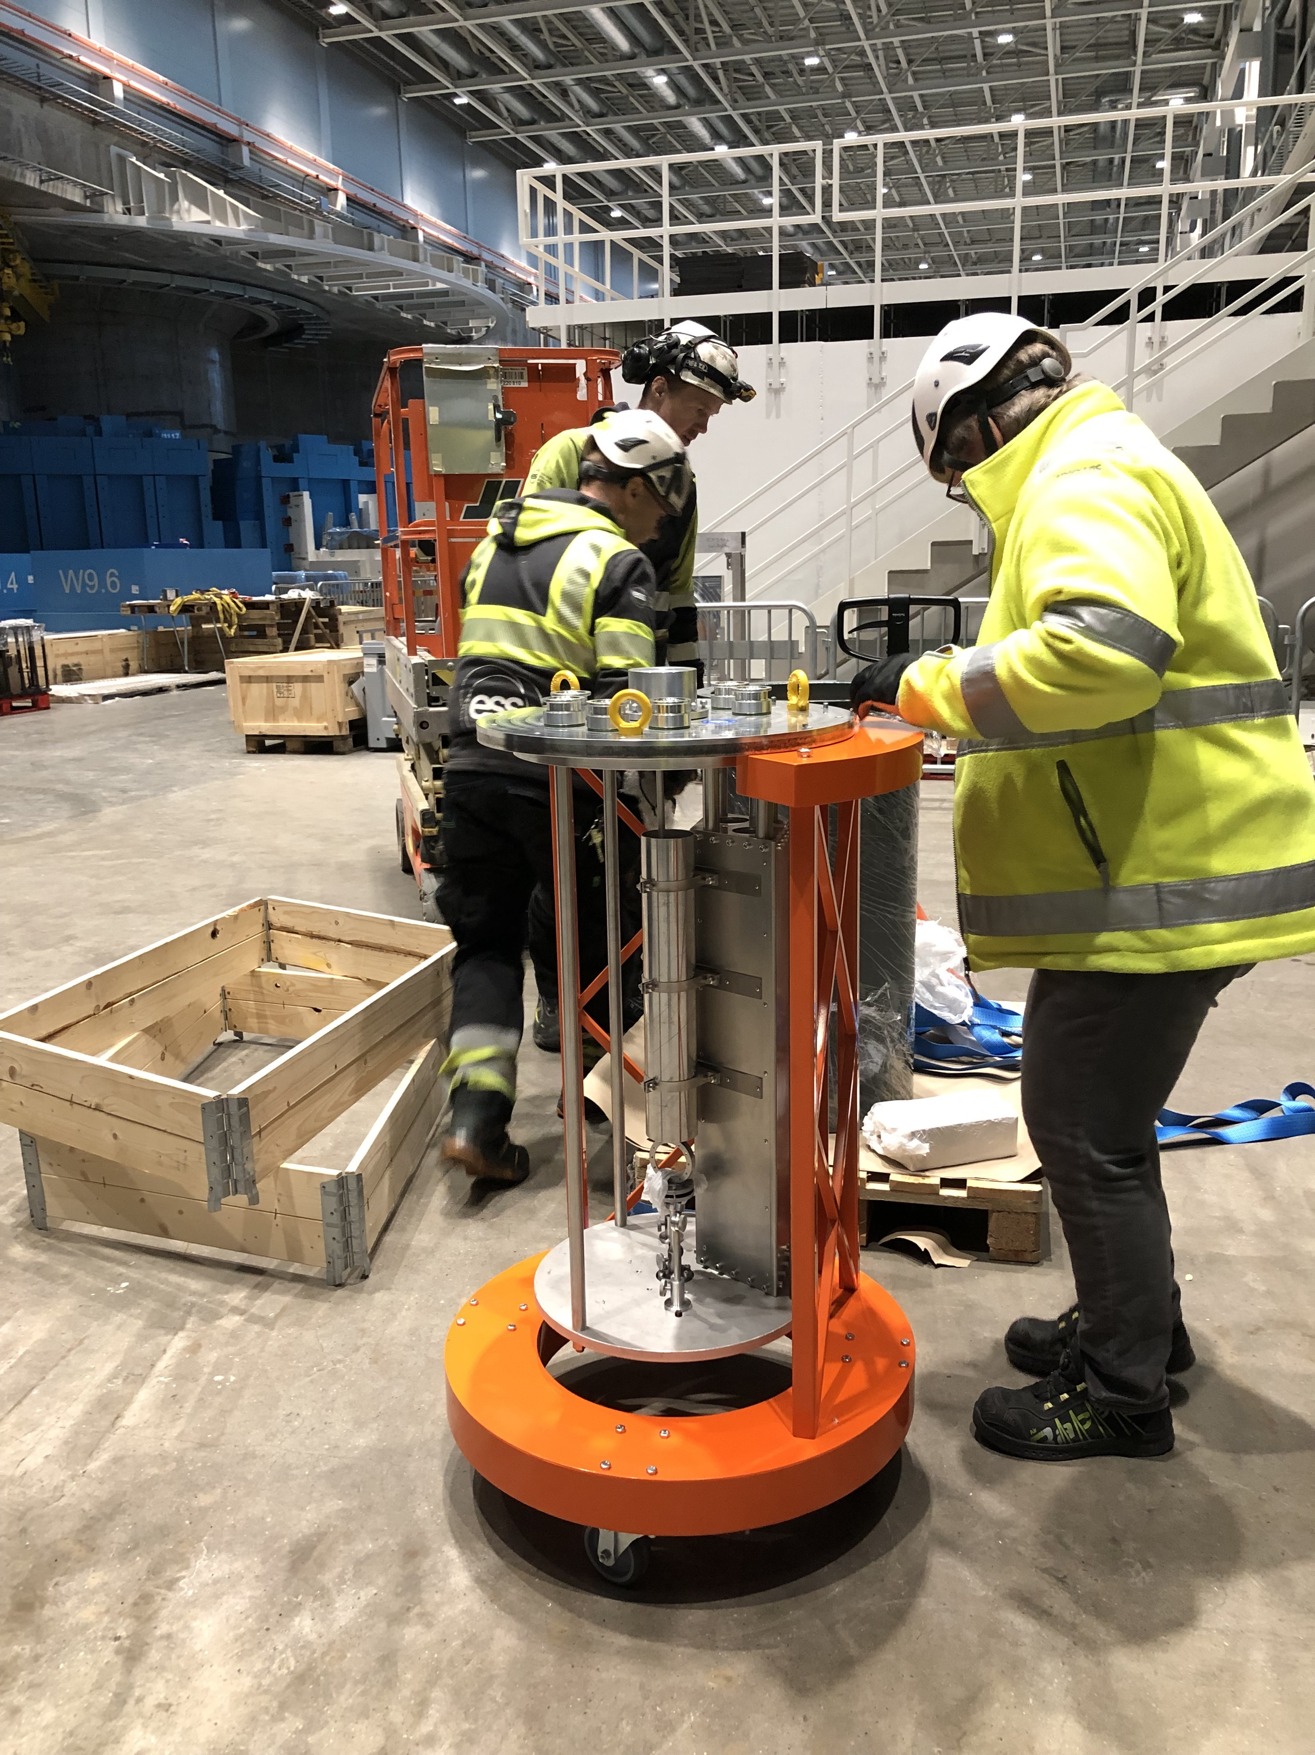
Main updates
Estonian InKind at ESS
Humidity cell
Laser Pump Probe (LPP)
  Properties:
  Laser excitation of sample
  QENS, Spectroscopy instrument
  Development:
  Waiting for the optics and laser to be tested completely
  Fit the spectroscopy lab to be able to make safe tests
  Development:
  Sensors
  Test the limits
  Mechanical integration to instrument
  Humidity generator and thermometry control integration
Properties:
  Can be used with humidity generator and salt solution
  SANS
  Possibility to have a sample changer

Slide 7
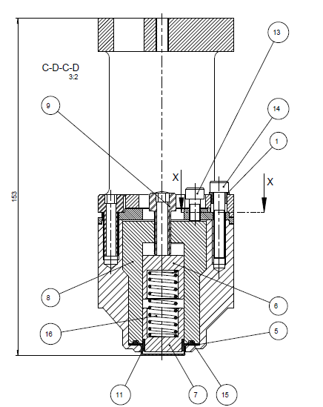
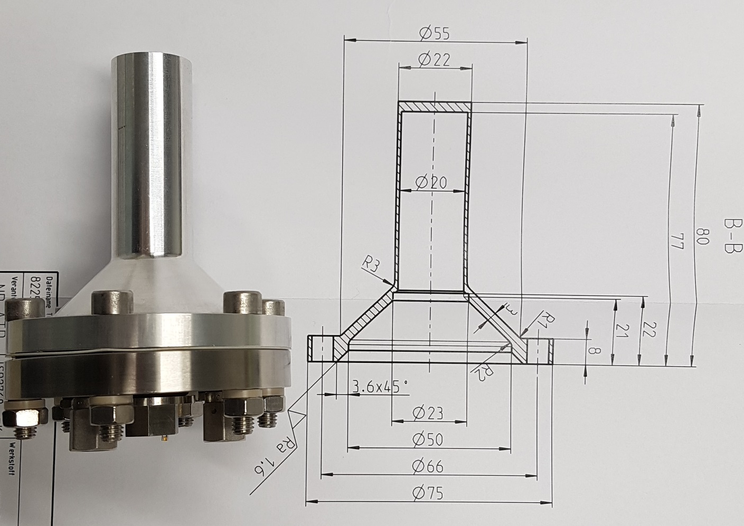
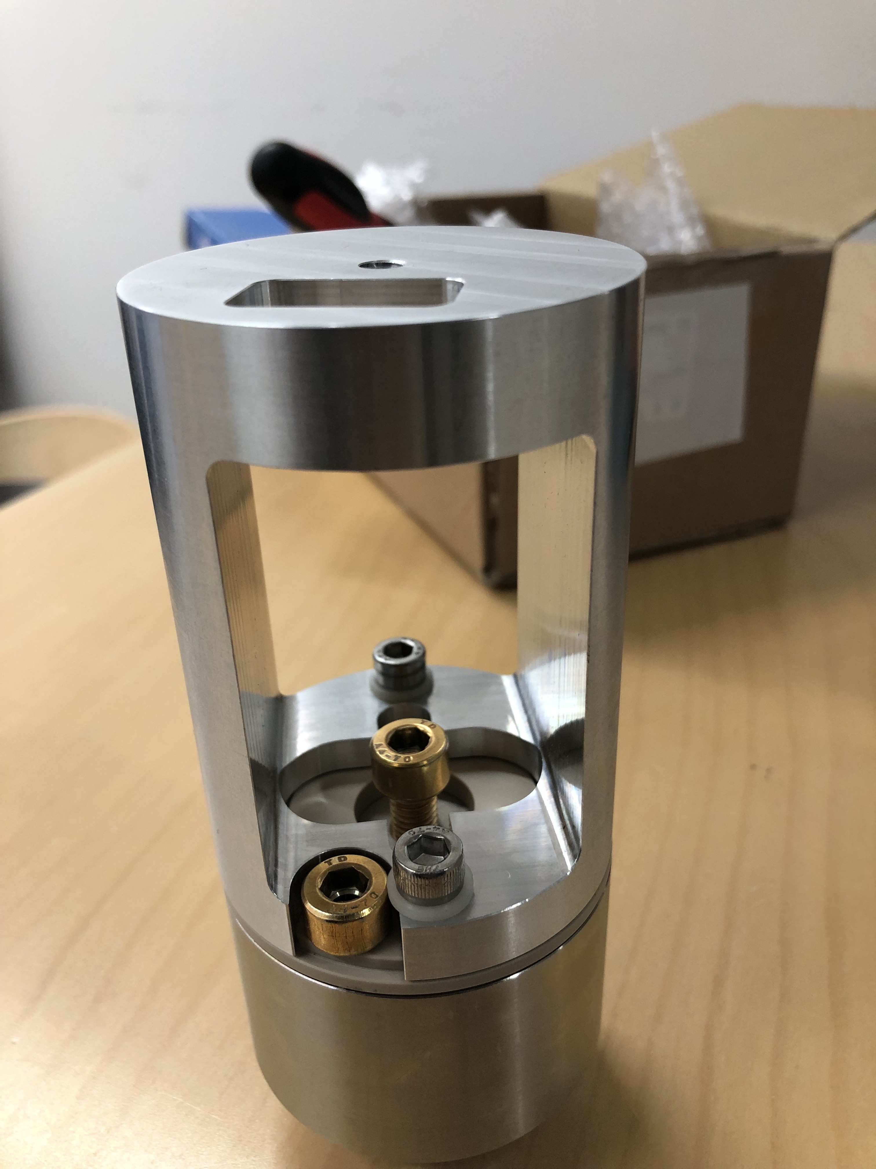
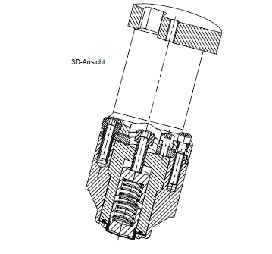
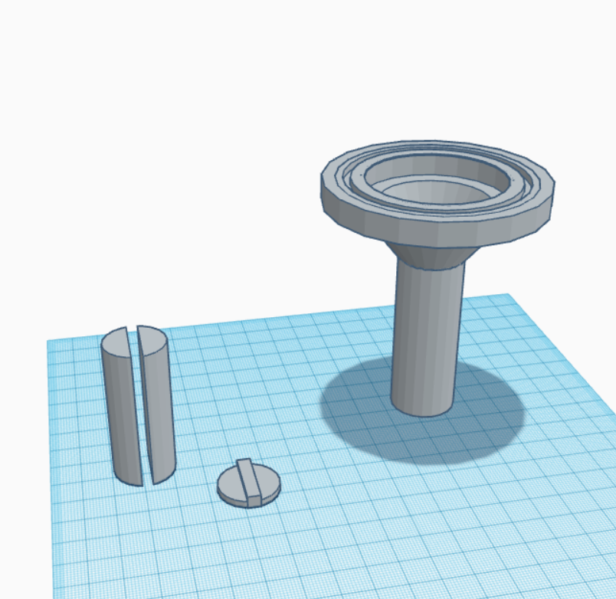
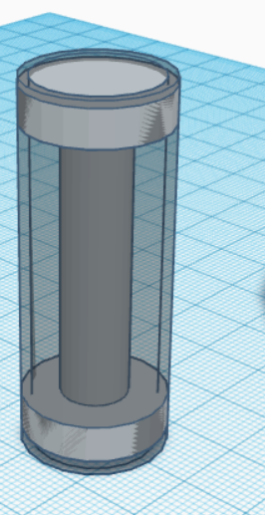
Main updates
Estonian Inkind
Battery study, neutron diffraction powder:
Electrolyte and electrochemical material development :
Properties
2 electrodes
Sample container size can be easily modified
Easy assembly
Small amount of sample
In Situ measurement
Development:
Lighter version
Sample stick
Insert for thermometry
Properties
Versatile cell, powder, battery
In situ / operand
2 to 3 electrodes
Temperature sensor
Gas inlet and outlet
Development:
Shorter cell
Sample can with different insert
Sample stick
Electrodes connection

Slide 8
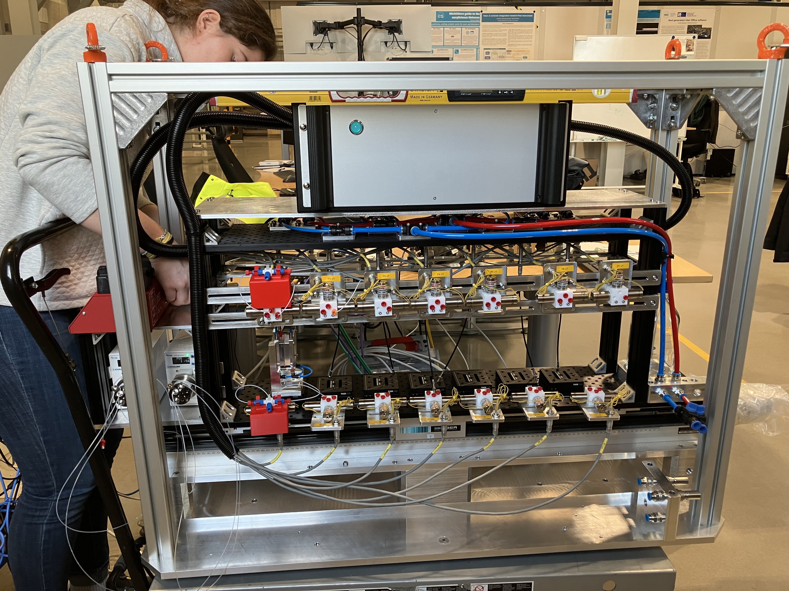
Main updates
Estia Sample changer
Hardware is done
Cells have been ordered
To be done:
Control integration including the 3 ways valves and the logic to run an experiment.
Test to run the whole system for the tubing and the connection
Development:
Lifting cage to be update
Cell needs to be adapt for layer deposition
Dripping plate under water connector
Transport, storing cart

Slide 9
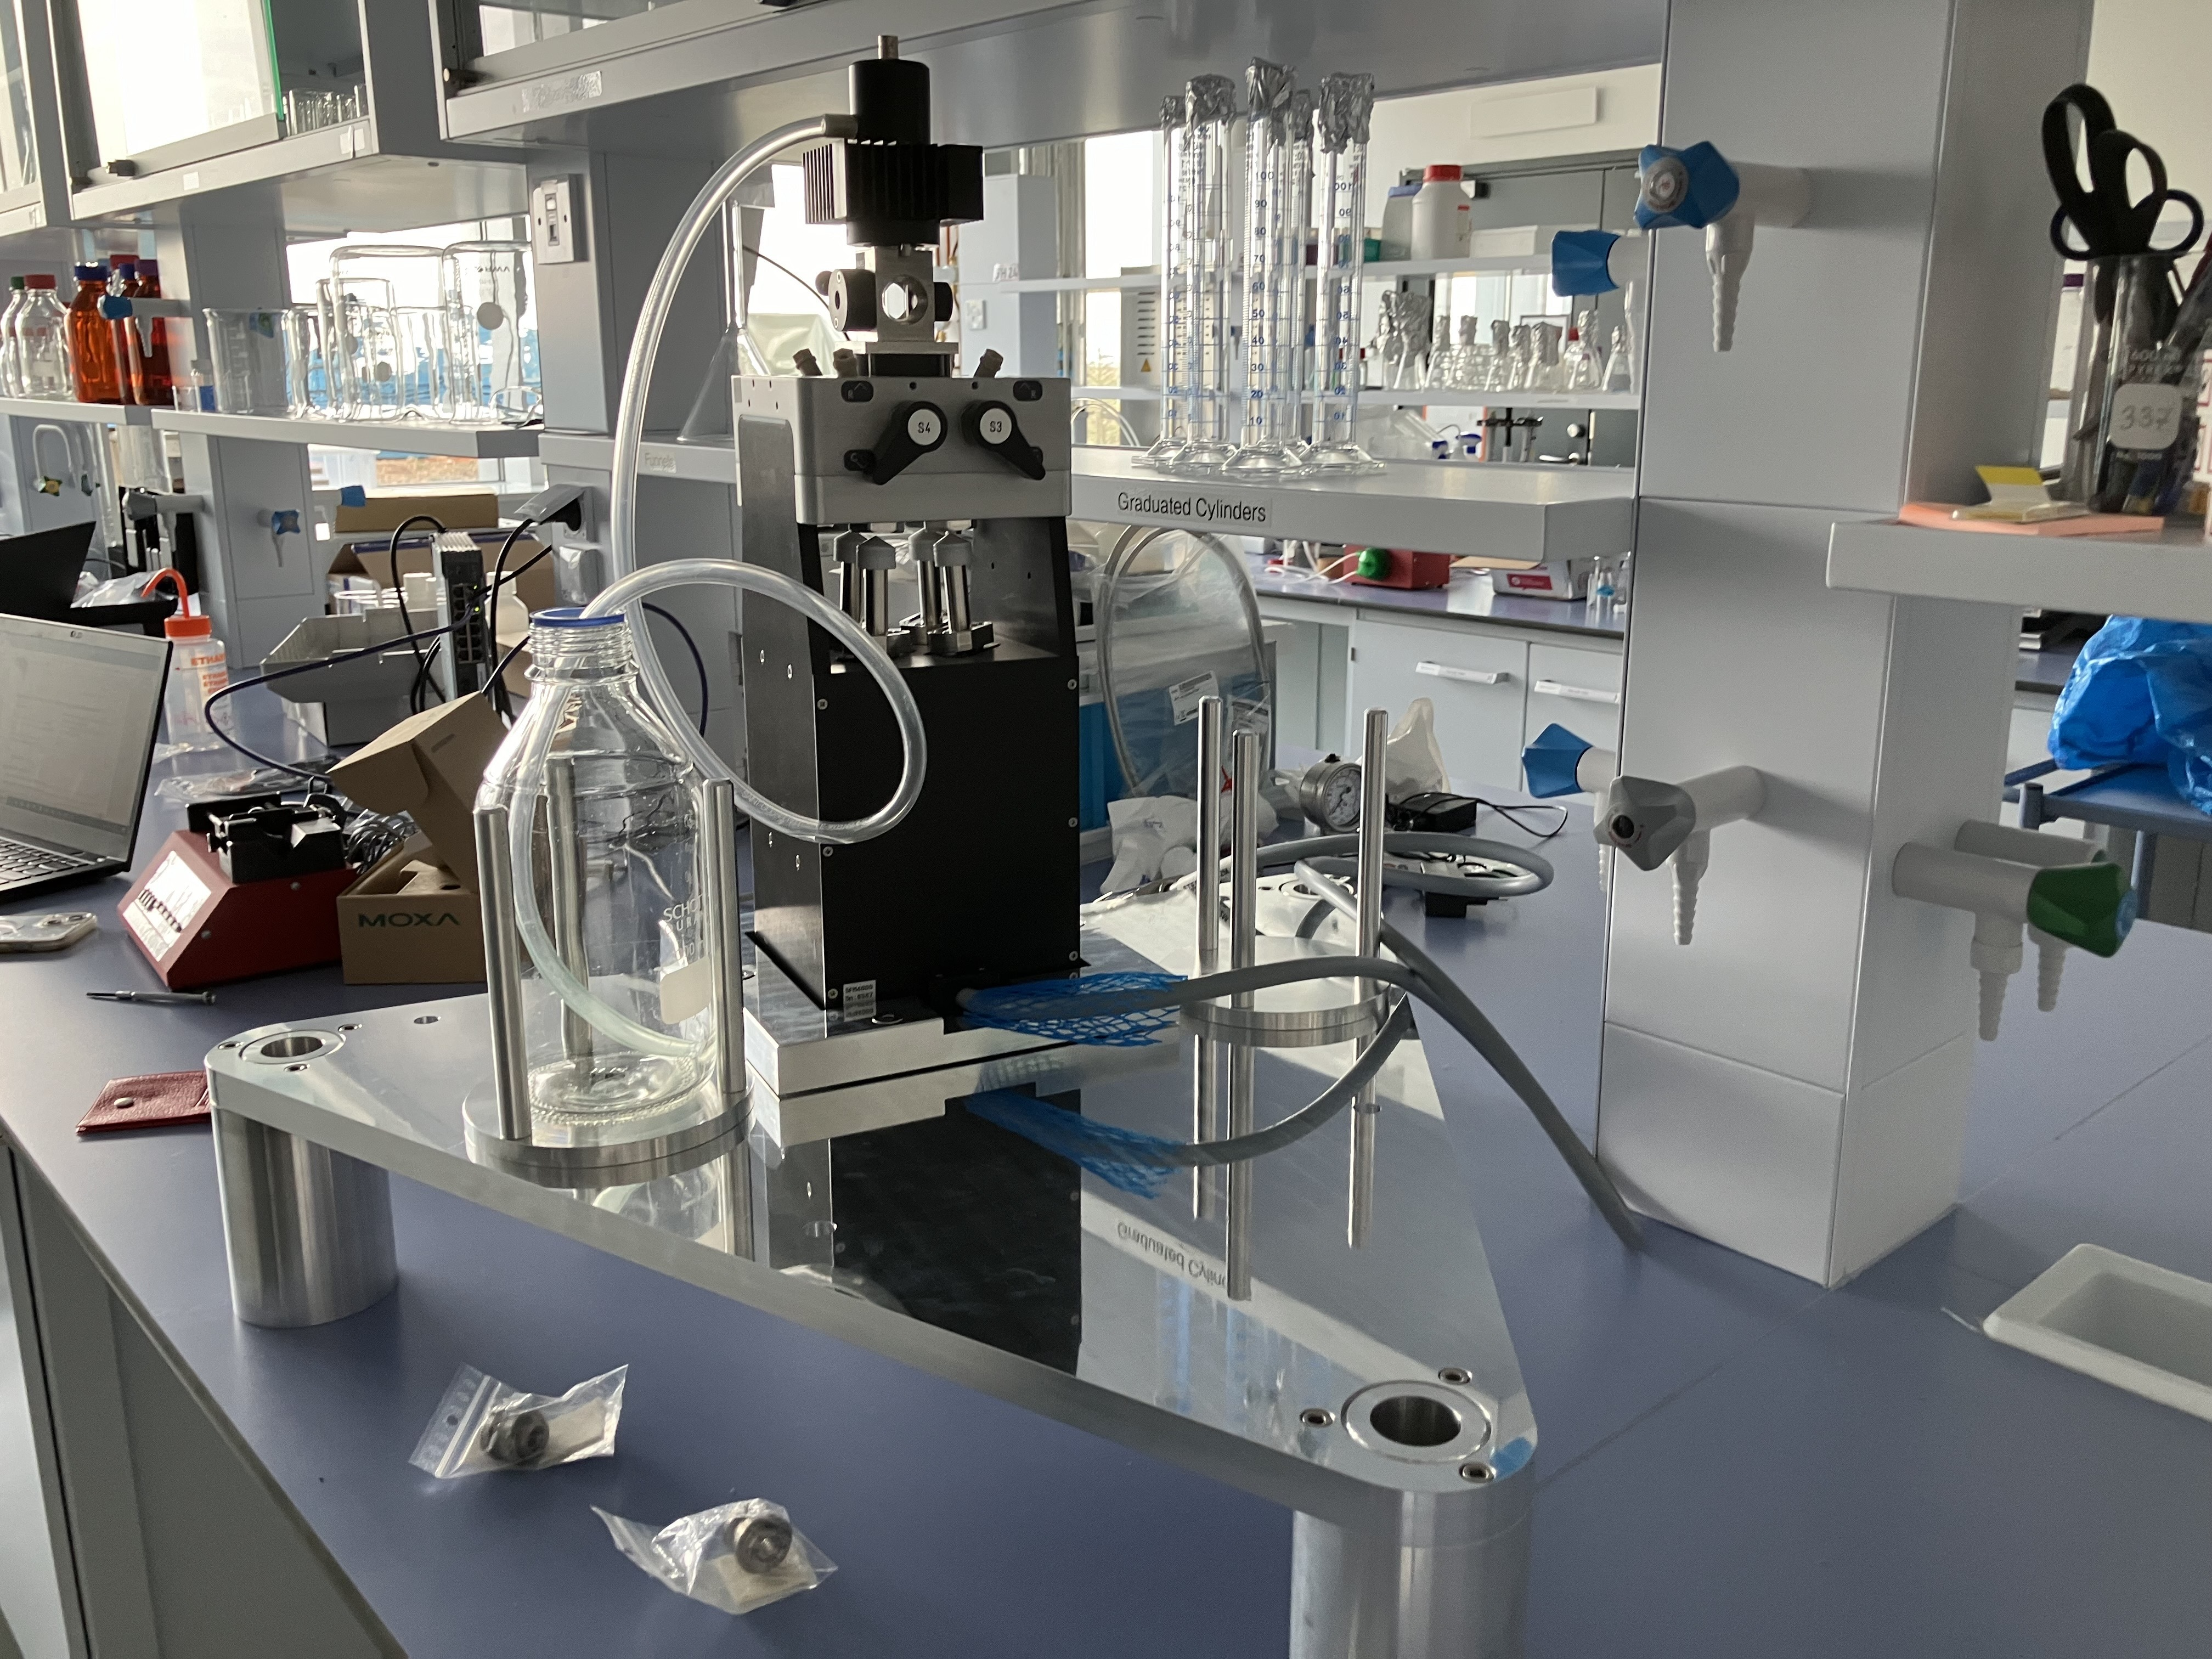
Main update
Stopped flow cell
Rheometer | Adaptator plate | Q4 2024
Julabo | trolley | Q4 2024
Ellipsommetry/ IR project | IK grant for FREIA | Summer/fall 2024
Skadi magazine | Check the design | Tranche 2 instrument
Humidity chamber | adapter plate | 2025 , Q2/3
”Universal” Support for different cell |  | Q3 2025
Instrument integration with them Mechanical engineer Luca S.:
  Adaptor plate to instrument S1
  Lifting frame and cart design is done
  Part are ordered
  Design for the stopped flow cell is finished

Slide 10
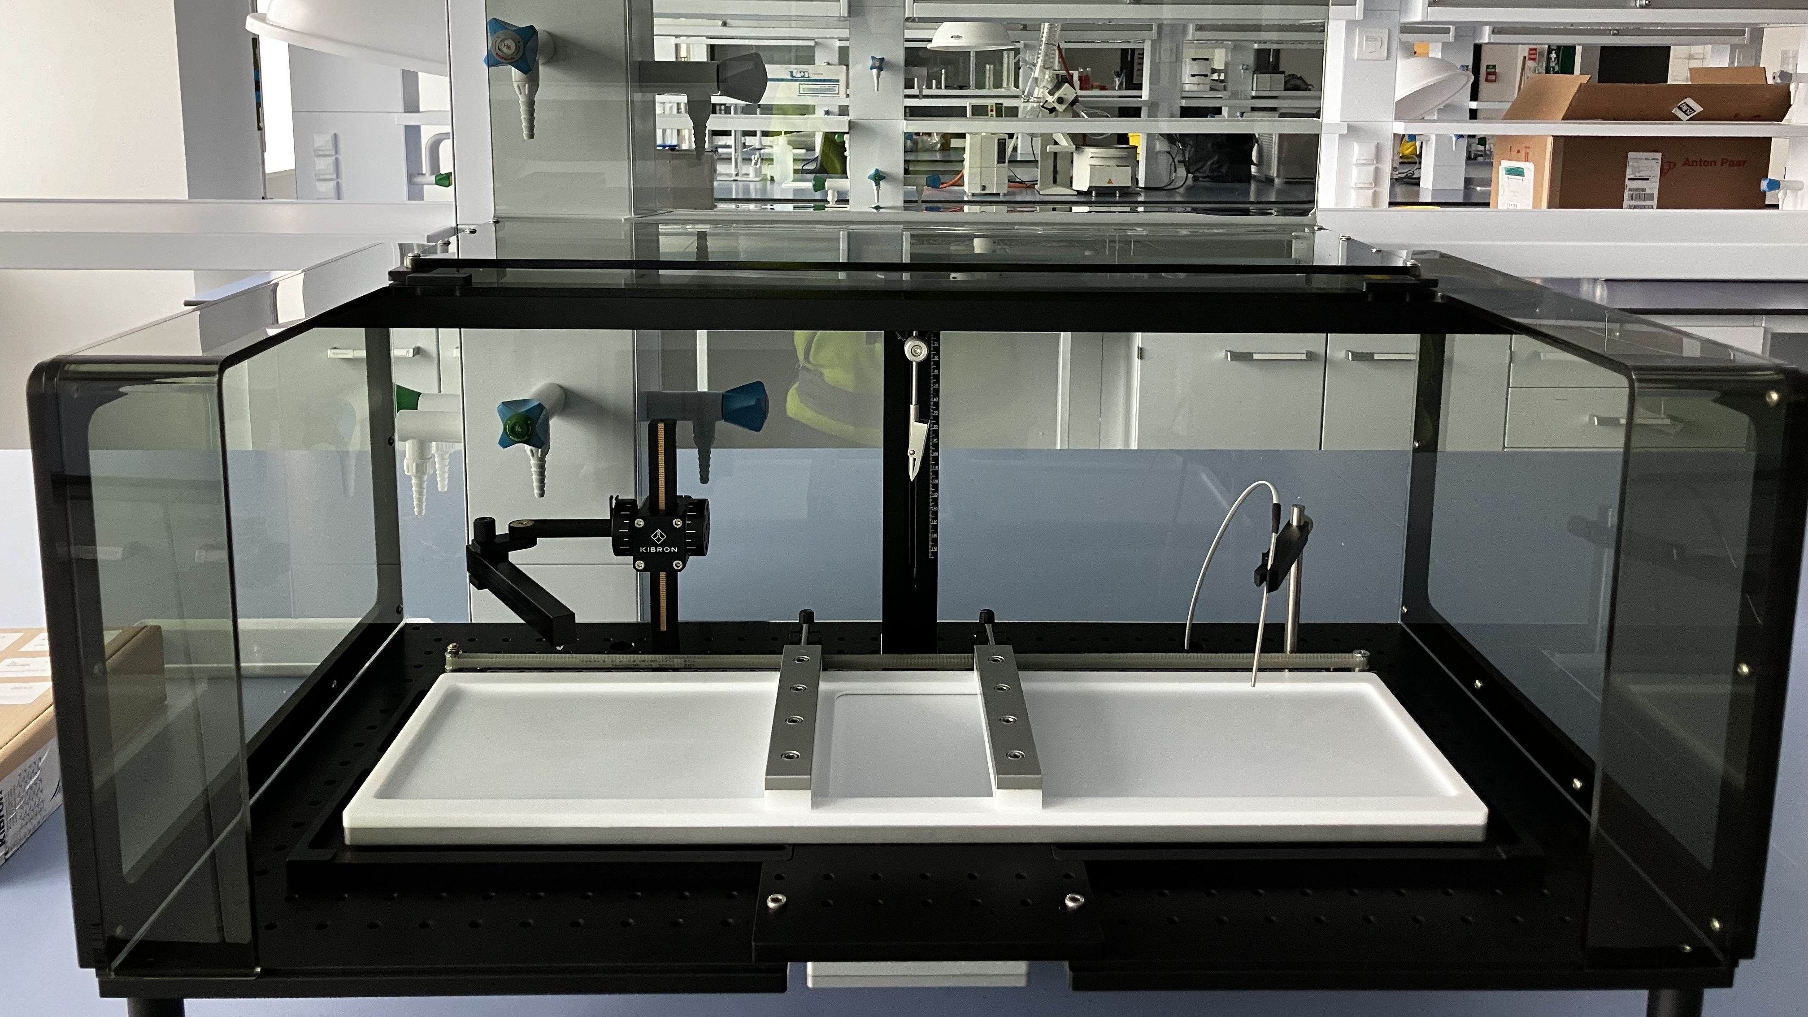
Main update
Troughs
Langmuire BG troughs
Equipment for sample preparation has been received
Start to test and define the parameters for the control integration
Static troughs
  RAC grant with LU automation
  Concept for automation
  Post Doc LU
  ESS
    FREIA Instrument
    SCSE + Mechanical Engineer
    Motion control (robotic arm)

Slide 11
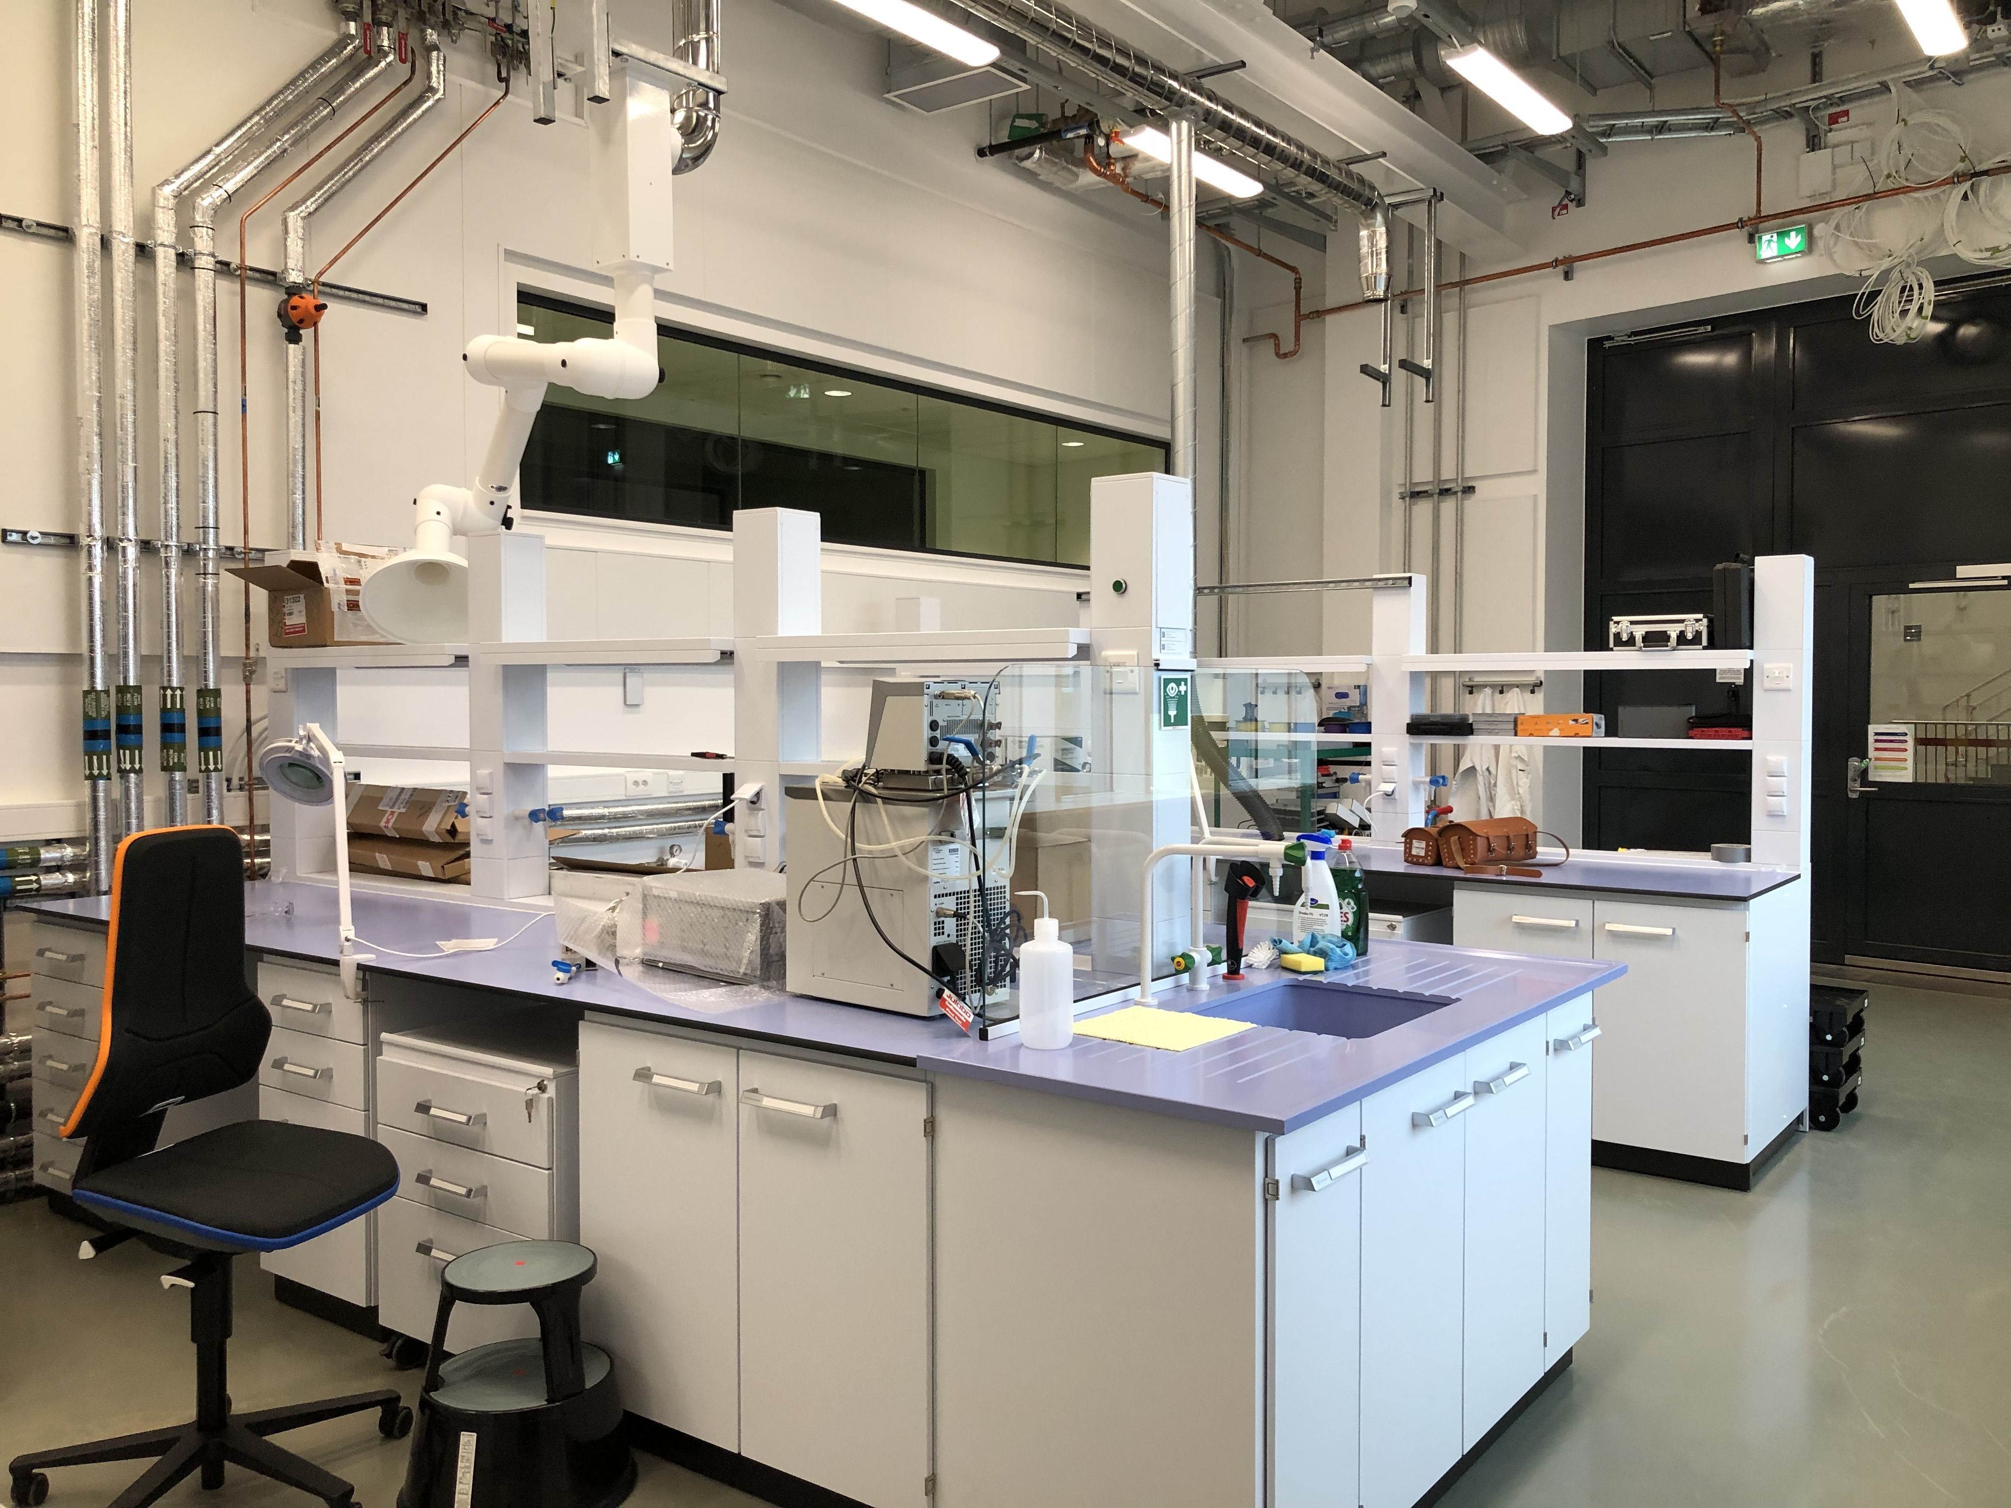
SCSE workshop
D04 – Close to LOKI and FREIA
Workshop:
Participating in the planning for D04 for the spectroscopy Lab too be able to test and align the laser pump probe set up
Data, electricity, water, gases available in the workshop.
Other space:
E04 for gas, electrochemistry experiment and rheometer
D04 Langmuir troughs
Discussion about the network for the timing system. What do we need to test our equipment ?

Slide 12
Priority
 |  | Date CC | CC | Date HC | HC
Tranche 1 | DREAM | Q1-2025 | Cryofurnace/Quentin setup | Q1-2026 | Vacuum furnace/ Quentin’ changer
 | LOKI | Q1-2025 | Sample changer | Q1-2026 | Rheometer
 | ODIN | Q1-2025 | Syringe pump | Q1-2026 | Robin stress rig
 | TBL | Q1-2025 | n/a |  | n/a
 | BIFROST | Q2-2025 | Wet cryostat / 15T magnet | Q1-2026 | Wet cryostat / 15T magnet
 | NMX | Q2-2025 |  | Q2-2026
Tranche 2 | ESTIA | Q4-2025 | Flow cryostat / Solid liquid sample changer |  | Flow cryostat / Solid liquid sample changer
 | BEER | Q4-2026 | Deformation rig | Q2-2027 | Dilatometre
 | MAGIC | Q3-2026 | Cryostat/8T magnet |  | 8T magnet
 | SKADI | Q1-2026 | Sample changer (temperature controlled) | Q2-2026 | Electromagnet / Rheometer / Syringe pumps/mixing setup / Stopped flow if available
 | CSPEC | Q1-2027 | Cryofurnace + rotation stage | Q3-2027 | High field magnet (6T)
Tranche 3 | MIRACLES | Q4-2026 | Dry cryostat | Q3-2027 | 8-Sample changer with CCR/ Wet cryostat Humidity chamber/ Laser pump-probe
 | HEIMDAL | Q4-2026 | Blue furnace / Cryostat |  | Blue furnace / Cryostat
 | TREX | Q4-2026 | Cryofurnace | Q3-2027 | He3 insert
 | FREIA | Q4-2026 | Solid-liquid cell sample changer/Langmuir trough/Julabos & temperature controllers/Static trough | Q3-2027 | HPLC & syringe pumps
 | VESPA | Q3-2027 | Cryostat |  | runnning Cryostat

Slide 13
LOKI
Sample changer CC | Follow the project and support the mechanical and control integration
Rheometer HC | Support the control and the mechanical integration
Odin CC
Syringe pump | Done, Tubing, connectors
Estia
Sample changer CC | get a functionning setup for CC
SKADI
Sample changer CC | Follow the project and support the mechanical and control integration
FREIA CC/HC
Solid liquid cell sample changer | adapt the ESTIA sample changer to FREIA
Troughs | Static troughs
 | langmuir trough
Ellispommetry/IR | Grant project follow and support the project
Stopped flow LOKI FS
Humidity chamber FS
Electrochemsitry FS
Gases manifold FS
 | Up to 200 bar isorb
 | 0 to 30 bar
LPP | test and development
Sample stick | For gases and EC
Julabo | Maintenance schema, trolley

Slide 14


Future plan
Getting the lab ready for operation, with tools spare part
Preparing doc. for SSO:
  Risk assessment
  Guide for user
  Guide for SCSE maintenance, installation etc.
Follow up with the instrument
Preparing for CC and testing the mounting of the SES
Technician to be hire as a replacement for H.B.
Notes:
More pictures, new lab, pptmaster ppt for catalog

Slide 15
STAP Charges
  How do we keep progressing with the equipment not planned for first tranche/CC but e.g. first tranche/HC or second tranche CC in order to be ready in time?
• Our equipment is integrated by our colleagues from ECDC/ICS. Where do we put the limit in the automation of our equipment to reach reasonable balance between an operating and a fully controllable device?
• With ESS characteristics in mind, are there scientific topics not covered that the SCSE team needs to dig into?
• How do we make sure our colleagues are aware of the importance of other sample environment equipment for the success of ESS.

Slide 16
Finish presentation

