Slide 1
A Quick Update on the STS and CUPI²D:
Rebuilding the Science Case
Adrian Brügger*, Ph.D., Columbia University, New York, NY
Hassina Bilheux, Ph.D., Oak Ridge National Laboratory, Oak Ridge, TN
NEUWAVE-12| Lund, Sweden| 3 September 2024
*presenting

Slide 2
ORNL User Facility Three-Source Strategy
The Spallation Neutron Source (SNS) at ORNL provides the most intense, pulsed accelerator-based neutron beams in the world, while the High Flux Isotope Reactor (HFIR) is the most powerful reactor-based source of neutrons for research in the United States.
HFIR – highest flux
SNS – sharpest pulses
STS – brightest pulses

Slide 3
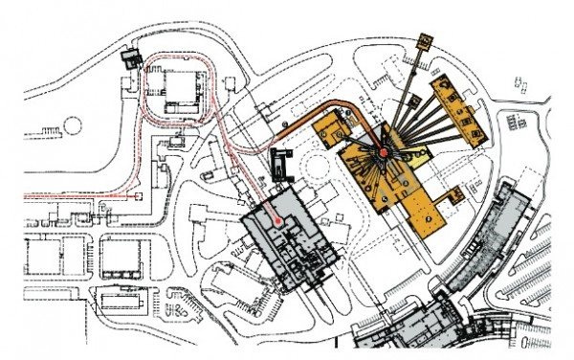
Accelerator Proton Power Upgrade - PPU
Second Target Station (STS) will feed off existing Spallation Neutron Source (SNS) accelerator.
Divert every fourth 60 Hz proton pulse to produce a 15 Hz cold spectrum pulse.
Increase accelerator power from 1.7 MW to 2.7 MW
  1.3 GeV proton pulses
  700 kW proton beam power for STS
Rotating solid tungsten spallation target
  25x brighter pulse than First Target Station
  More robust than Hg target
Notes:
Proton pulse parasite

Slide 4
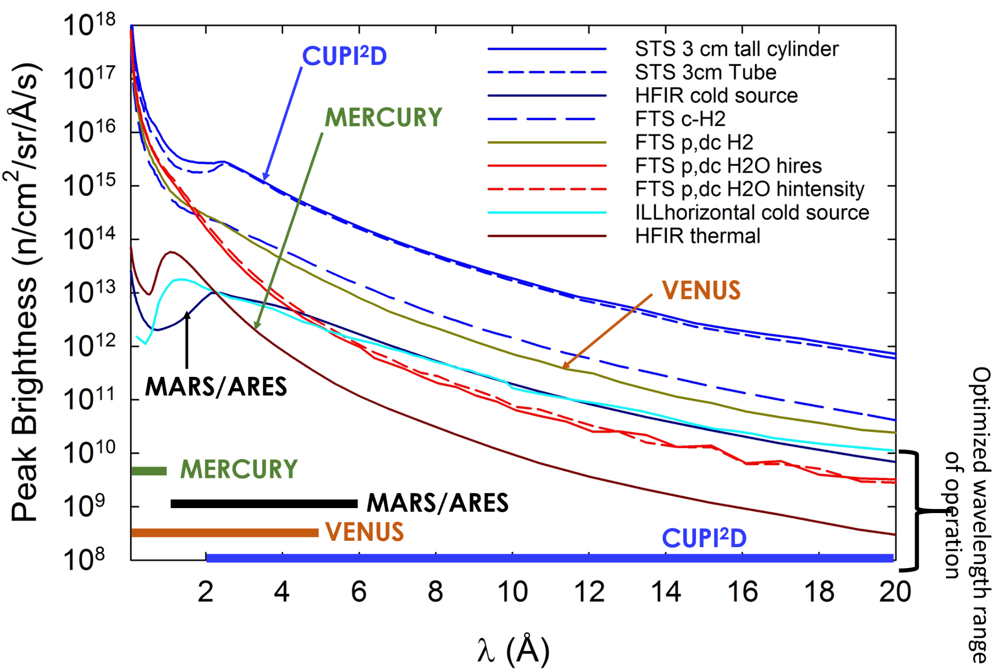
Source Brightness Comparison
Brügger, Bilheux, et al. Rev. Sci. Instrum. (2023)

Slide 5
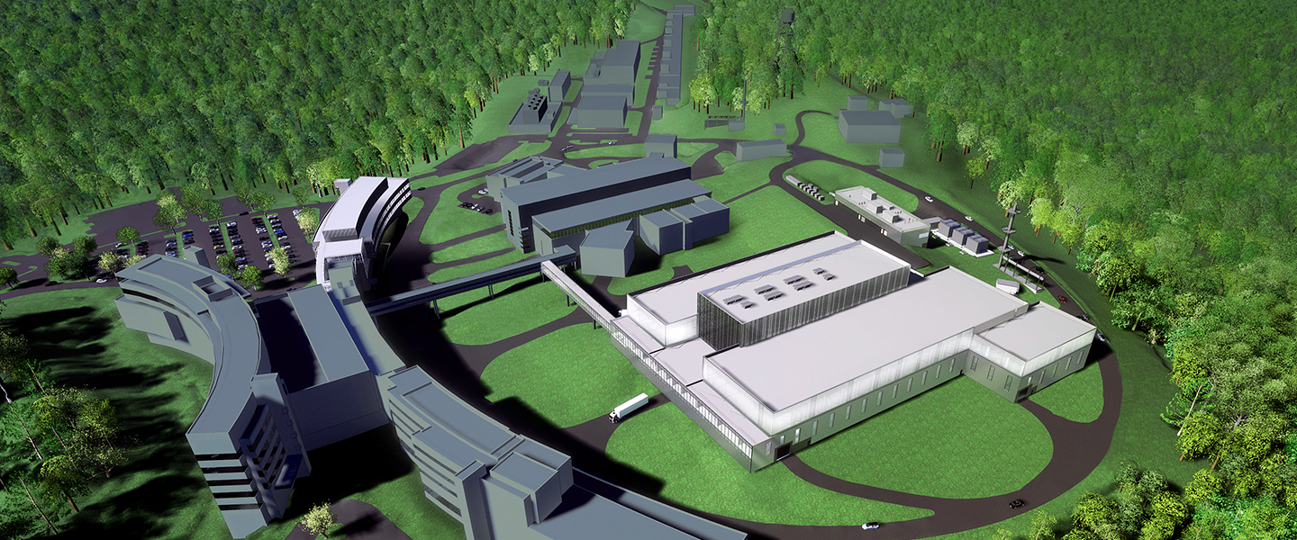
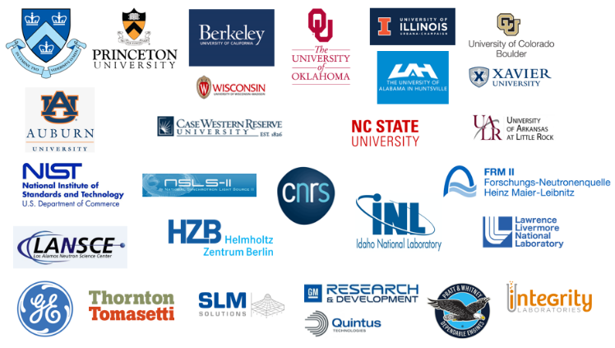

CUPI²D Project Timeline
2019.12
Science at the STS Workshop
2020.9.29
CUPI²D Proposal Initiated
(Town Hall)
2020.10.23
CUPI²D Proposal Submitted
2020.11
Critical Decision 1 (CD-1) approval of conceptual design, cost, schedule

Slide 6
CUPI²D proposal team
Spokesperson
Adrian Brügger | Columbia University | brugger@civil.columbia.edu
ORNL Point-of-Contact
Hassina Bilheux | ORNL SNS/HFIR | bilheuxhn@ornl.gov
Energy Conversion
George Nelson | University of Alabama - Huntsville | george.nelson@uah.edu
Andy Kiss | BNL NSLS-II | akiss@bnl.gov
Jonathan Morris | Xavier University | morrisd3@xavier.edu
Engineered Materials
Matt Connolly | NIST | matthew.connolly@nist.gov
Alex Long | LANL LANSCE | alexlong@lanl.gov
Anton Tremsin | UC Berkeley | astr@berkeley.edu
In situ & In-Operando Systems
Andrea Strzelec | University of Wisconsin - Madison | strzelec@wisc.edu
Mark Anderson | University of Wisconsin - Madison | manderson@engr.wisc.edu
Bob Agasie | University of Wisconsin - Madison | ragasie@wisc.edu
Charles Finney | ORNL Fuels & Engines | finneyc@ornl.gov
Martin Wissink | ORNL Fuels & Engines | wissinkml@ornl.gov
Cementitious Materials
Mija Hubler | University of Colorado - Boulder | hubler@colorado.edu
Roland Pellenq | CNRS - France | Roland.pellenq@cnrs.fr
Claire White | Princeton University | whitece@princeton.edu
Nuclear Materials
Brent Heuser | University of Illinois | bheuser@illinois.edu
Aaron Craft | INL | aaron.craft@inl.gov
Jason Harp | ORNL NFM | harpjm@ornl.gov
Chuting Tan | INL | chuting.tan@inl.gov
Life Sciences & Biology
Kathryn Morris | Xavier University | morrisk10@xavier.edu
Ann Junghans | LANL | annjunghans@lanl.gov
Sanna Sevanto | LANL CSES | sanna@lanl.gov
Jeff Warren | ORNL ESD | warrenjm@ornl.gov
Medical & Dental Biomaterials
Fernando Esteban Florez | University of Oklahoma | fernando-esteban-florez@ouhsc.edu
Alex Biris | University of Arkansas | asbiris@ualr.edu
Maria Cekanova | Integrity Laboratories | mcekanova@integritylaboratories.com
Neutron Technique Experts
Nikolay Kardjilov Burkhard Schillinger | HZB – Germany FRM-II – Germany | kardjilov@helmholtz-berlin.de Burkhard.Schillinger@frm2.tum.de
Jiao Lin Matt Frost | ORNL - STS Project ORNL - FTS | linjiao@ornl.gov frostmj@ornl.gov
Sven Vogel | LANL LANSCE | sven@lanl.gov
Notes:
First let me thanks the CUPID proposal team.
The team was led by Adrian as the spokesperson, and Hassina as the point of contact.
They organizee the scientific community and provide the technical leadership and the scientific vision. Thanks to their leadership we get this proposal aproved so that we now have this opportunity to build the CUPID instrument

Slide 7

Inferred structure (indirect)
Direct structure
VENUS (FTS epithermal)
Heavy element detection: nuclear materials, geosciences
VENUS (FTS thermal, cold)
Phase transformation in crystalline materials such as advanced alloys and natural materials under stress, nuclear materials, energy materials
2D: hrs
30 cm x 30 cm
2D: Tens of min to hrs
MERCURY (HFIR epithermal)
Difficult to penetrate materials: Life sciences and biology, large engineering materials (H-rich materials, thick and large objects), Nuclear materials, etc.
Future proposal
Maximum field-of-view
2D: min
Approved
CUPI²D (STS cold)
Dynamics: Materials science (energy materials, alloys, etc.), biology, etc., under extremes conditions.
MARS (HFIR cold)
Thin samples: Micro-defect detections and dynamic processes in engineered and natural materials, magnetic domain mapping, life sciences and biology
10 cm x 10 cm
Current MARS beamline moved to new position
2D: s to min
2D: ms to min
1Å
10 Å
0.5 μm
0.1 mm
0.5 mm
1.0 cm
Resolution sensitivity

Slide 8

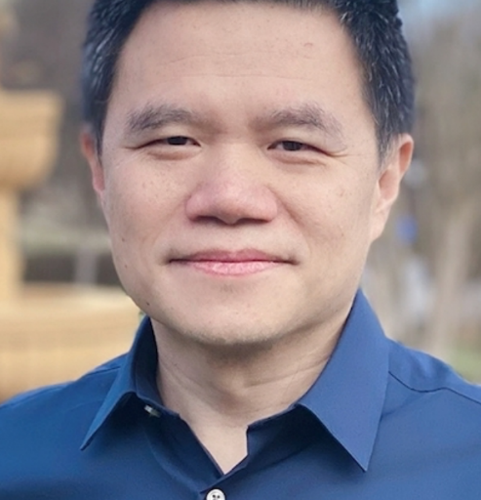

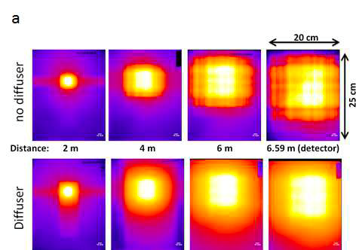
CUPI²D Project Timeline
2021.4
CUPI²D Proposal Approved as 1 of 8 instruments
2021.11
Jiao Lin hired as CUPI²D Instrument Scientist
2022.11
Jiao Lin leaves us for California
Design of Optical System

Slide 9
And now what?
Congressional Funding: Project Projection vs. Reality – stretched development time of 8 beamlines into two buildout stages:
BWAVES – wide-angle spectrometer
CENTAUR – small/wide angle scattering
CHESS – direct geometry spectrometer
CUPI²D – TOF dynamic imaging
EXPANSE – wide-angle spin echo
PIONEER – single-crystal, polarized neutron spectrometer
QUIKR – horizontal-sample-surface reflectometer
VERDI – magnetic structure diffractometer
∴ No new CUPI²D instrument scientist until at least next year

Slide 10
BES Capital Project Pipeline
The Field is crowded, with multiple projects kicking off now and some urgent projects potentially overtaking STS.
CD0: Mission Need | CD1: Alternative Selection and Cost Range | CD2: Performance Baseline and beyond
Brookhaven National Lab (BNL)
National Synchrotron Light Source-II Experimental Tools (NEXT)–III [Total Project Cost (TPC) range: $350-500M]
National Synchrotron Light Source (NSLS) – II Upgrade (NSLS-II-U) [BES Pre-conceptual cost estimate is $1,000M]
Oak Ridge National Lab (ORNL)
Second Target Station (STS) [Total Project Cost (TPC) range: $1,800–$3,000M]
High Flux Isotope Reactor (HFIR) Pressure Vessel Replacement (PVR) [Total Project Cost (TPC) range: $300-740M]
SLAC National Accelerator Laboratory
Linac Coherent Light Source (LCLS) – II – High Energy (HE) Upgrade [Total Project Cost (TPC) point estimate: $710M]
LCLS Low Emittance Injector (LEI) [pre-conceptual cost estimate is $210M]
Linac Coherent Light Source (LCLS) – X [BES pre-conceptual cost estimate is $1,500M]
Future Light Source [BES pre-conceptual cost estimate is $2,000M] - Location to be determined.

Slide 11
BESAC Response
BESAC provided feedback to ORNL on STS program a few time, most recently on 28 May 2024.

Slide 12
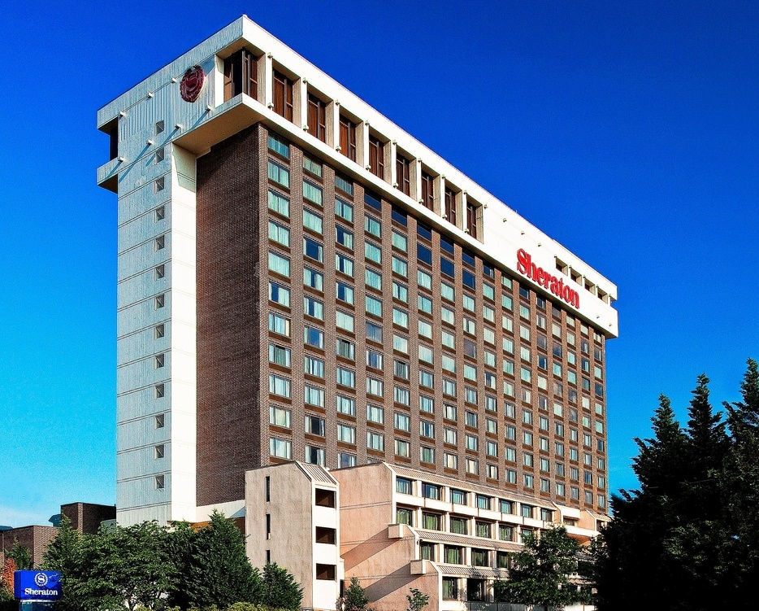
Rewriting the Science Case
Hastily organized STS Grand Challenges Workshop – 23 August 2024 (weekend)
Science → Capability → Instrument
Questions:
What transformational science can be performed exclusively with neutrons produced by the STS
For neutron imaging, answer is obvious:
  Imaging that requires TOF cold neutrons
  Live, in situ/operando multiscale characterization of large(ish) samples
  Large atomic structures >4Å

Slide 13
Grand Challenges
Grand challenge and STS project opening timelines must match (2035 opening)
Science must be grandiose and driven top-down, not bottom-up – start with science, not instrument
Do not promise what you’ve already promised before: batteries, grid redesign, sustainable energy, medical devices are politically stale
Technique must be impossible without STS (in the USA)
Science-based discovery and commercialization of high- performance materials using digital twins
Circular economy materials
Autonomous Terrestrial and Extraterrestrial Construction

Slide 14
Materials degradation in energy systems can occur due to single- and combined-effects
Listed degradation modes for structural materials
Atomic
Displacement
Irradiation creep/fatigue
High-temperature
helium embrittlement
Irradiation disordering
Thermal
creep/fatigue
Chemical & Field
Environment
Stress
Hydrogen
Embrittlement
Irradiation-assisted
stress-corrosion
cracking
Irradiation-
assisted corrosion
Transmutation-
assisted
corrosion
Transmutation
Low-temperature
embrittlement
Temperature
14
Helium-assisted
cavity swelling
Original graphic by KG Field
14

Slide 15
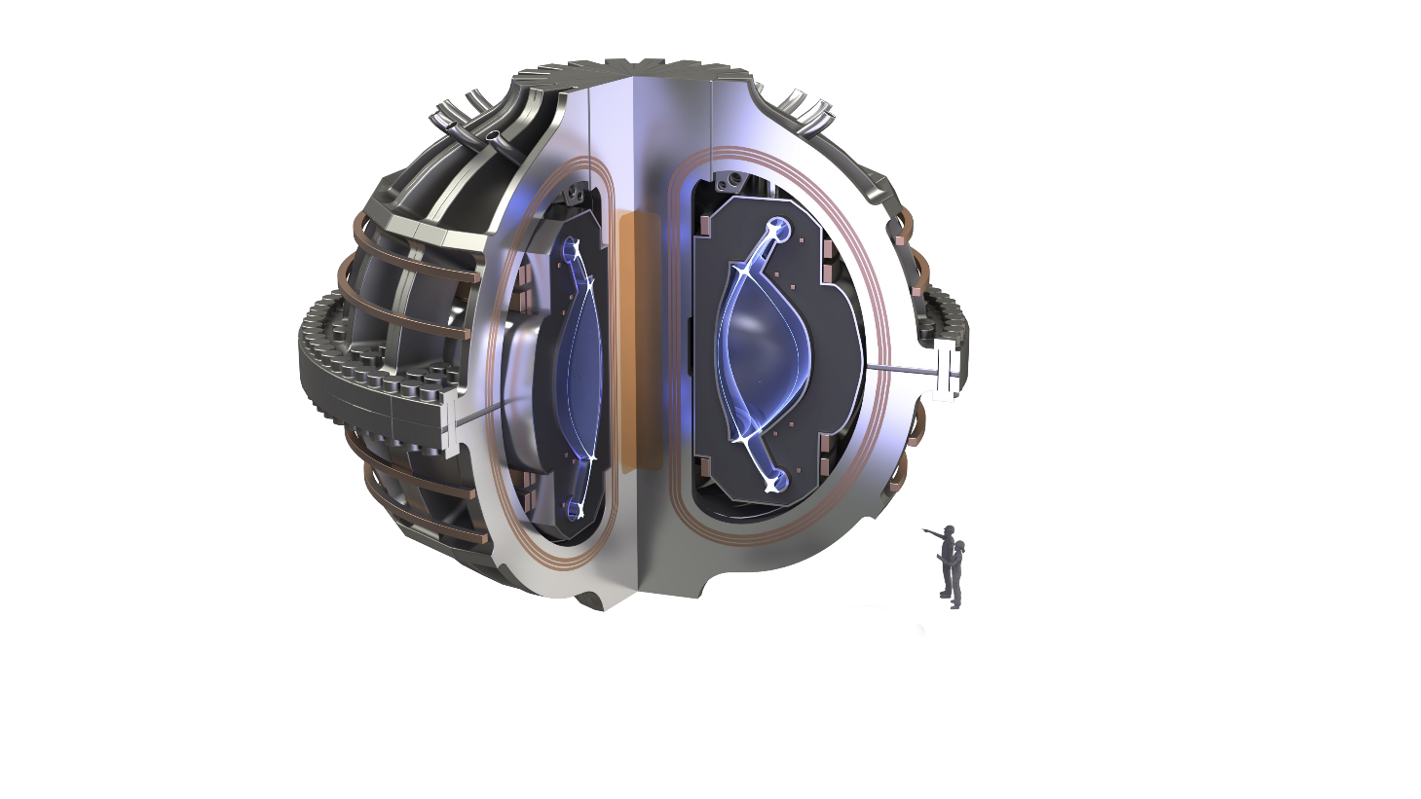
Science and technology for energy materials is fundamentally Temporally and Spatially Multi-scale
Texture
Swelling
Atomic structure
Surface
Roughness
Phase Stability
Cracks
Macro-scale
Hardening
Grain Stability
1D lattice defects
Meso-scale
Micro-scale
Nano-scale
Atomic-scale
Decades
Years
Months
Sub-seconds
Events occur across 10 orders of magnitude!
Figure inspired by M. Koyama et al., Recent progress in microstructural hydrogen mapping in steels: quantification, kinetic analysis, and multi-scale characterization, Mat. Sci. & Tech. (2017)
Notes:
Add temporal concepts

Slide 16

Acknowledgements
Many Thanks to
CUPI²D Proposal Team
Too many to name, many in this room!
ORNL IMAGING Team
Hassina Bilheux
Yuxuan Zhang
James Torres
Chen Zhang
Harley Skorpenske
Roger Hobbs
Jean Bilheux
Shimin Tang
Jiao Lin (former)
ORNL Engineering Team
Cristina Boone
Gabriele Sala
STS Project Office

