Slide 1
Investigation of Star-like Moderator-Reflector Structure for the High Brilliance Neutron Source (HBS)
17.04.2024 LENS-ELENA Meeting
Junyang Chen

Slide 2
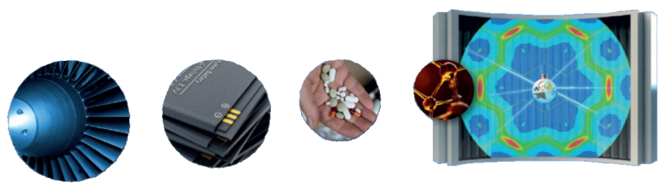
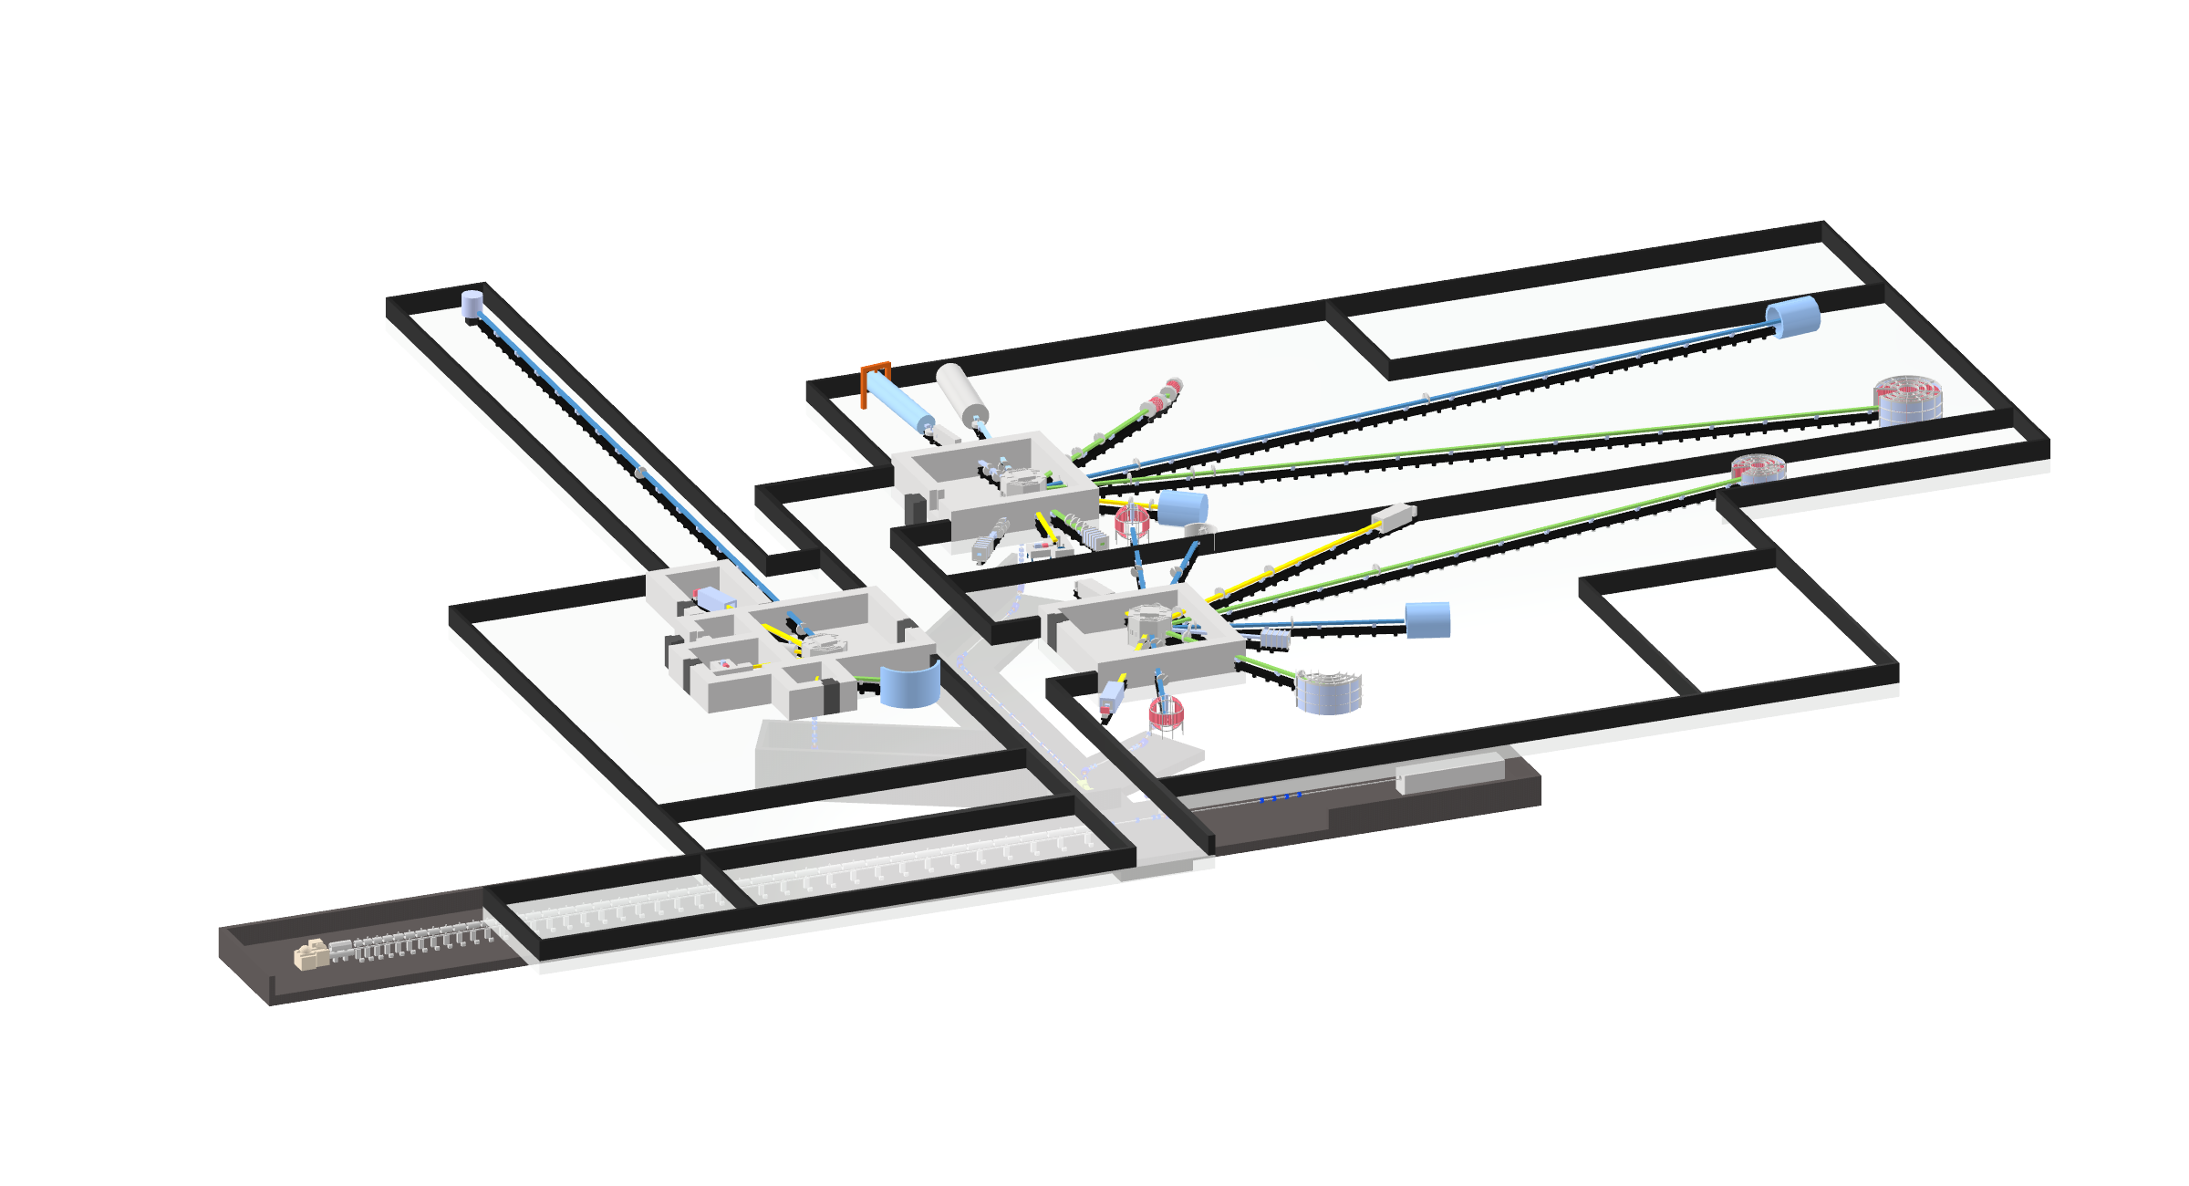
High Brilliance Neutron Source (HBS))
Background
Need for neutron-scattering facilities :
growing
Some existing reactor-based sources :
decommissioned
Wide application of neutron
Basic paradigm
Produce neutron more efficiently
Save cost
HBS layout

Slide 3
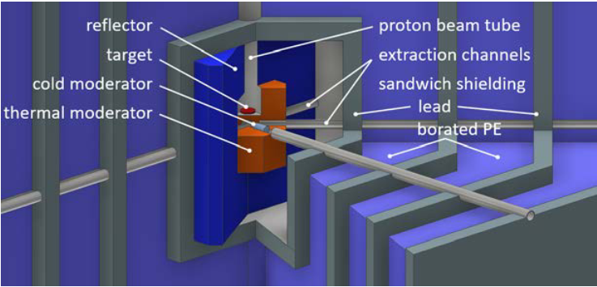
High Brilliance Neutron Source (HBS))
Main features
Key component to “more efficiently”
Moderator-Reflector
1)Moderator : decrease neutron energy
2)Reflector : reflecting escaping neutron
Neutron transfer system
Proton energy : 70 MeV
Proton beam power : 100 kW
Three target station : 24 Hz, 96 Hz, 96 Hz
10-12 instruments for each target stations
Optimal time structure and energy structure : fulfill the needs of each individual instrument

Slide 4
HBS Moderator-reflector : Confinement and Extraction
Proton beam (low energy)
Proton beam (high energy)
Target
Target
Extraction channel inside cloud with specific moderator
Small Neutron cloud with high density
Optimal energy with high brilliance
Low energy
Small target
Single tube is ideal case

Slide 5
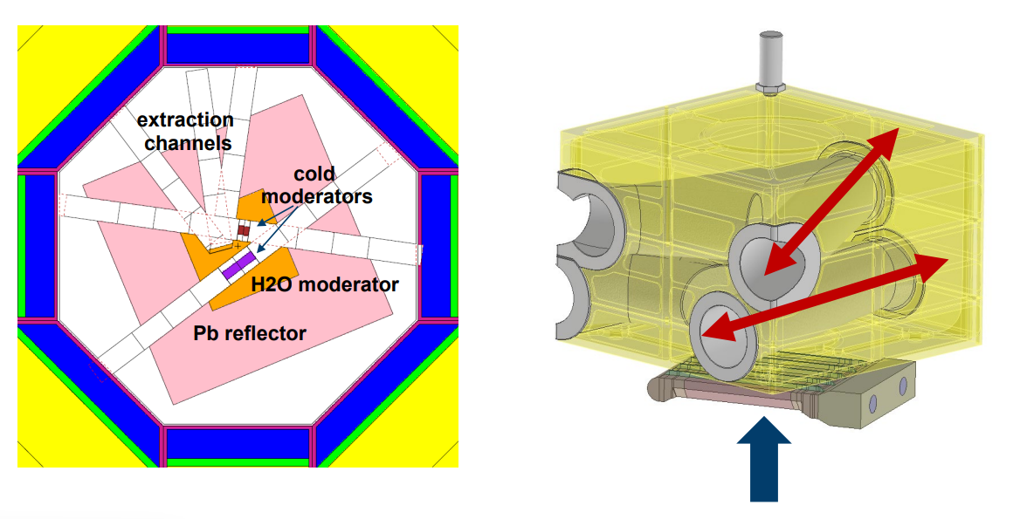
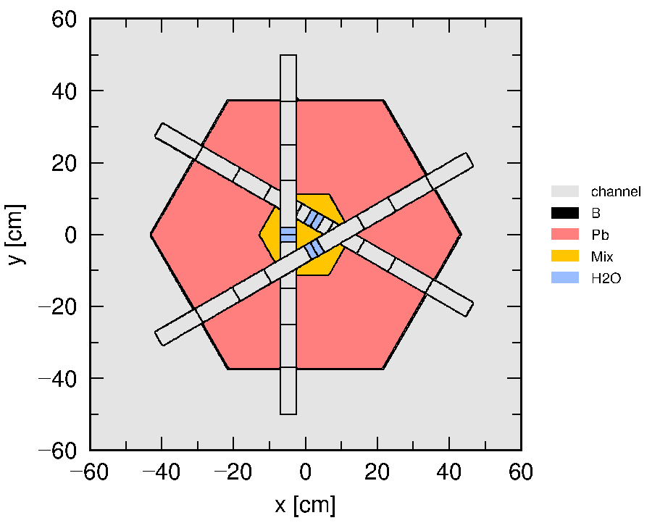
Multiple channel Extraction
Extraction:
Specific moderator in the channel
Diameter of channel should be larger (6 cm)
Mean free path of thermal neutron
in water : 0.5-1 cm
Multiple channels
Losing moderator material
Dilute neutron cloud

Slide 6
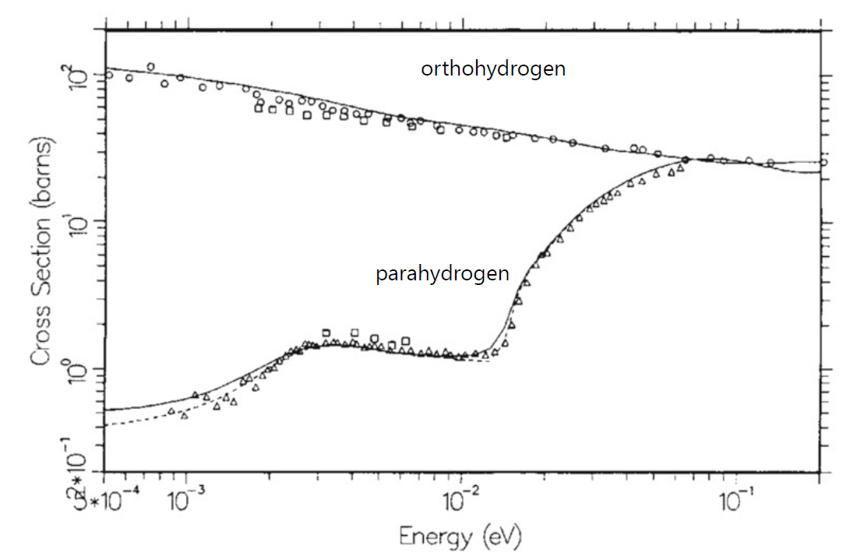
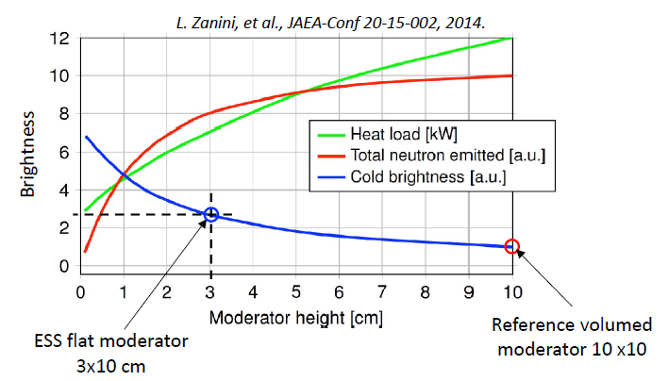
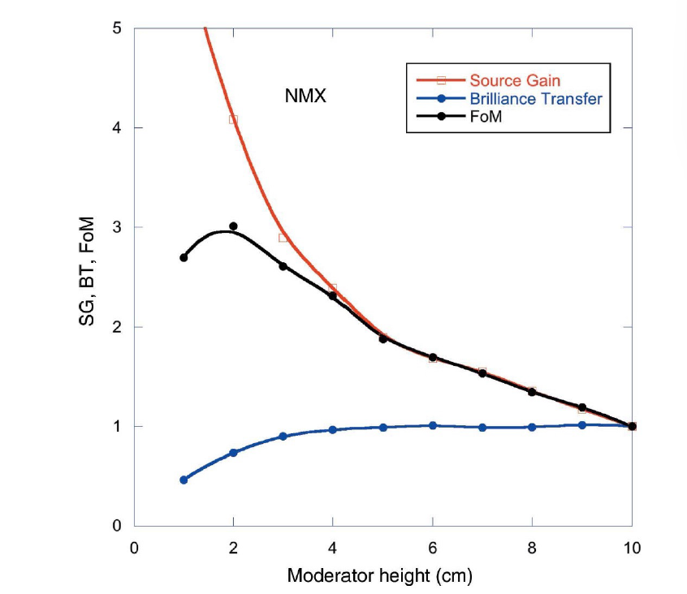
Low dimensional moderator
Cold moderator material : paraH₂ (20k)
Low dimensional moderator
Suitable dimension to avoid decreasing brilliance transfer
L. Zanini, et al., JAEA-Conf 20-15-002, 2014
L. Zanini, ESS Seminar, 2023

Slide 7
Pancake structure
neutron
One cold moderator
Multiple instrument
neutron
neutron
Premoderator
Cold moderator
Moderator /Reflector
Small thickness
High brilliance

Slide 8
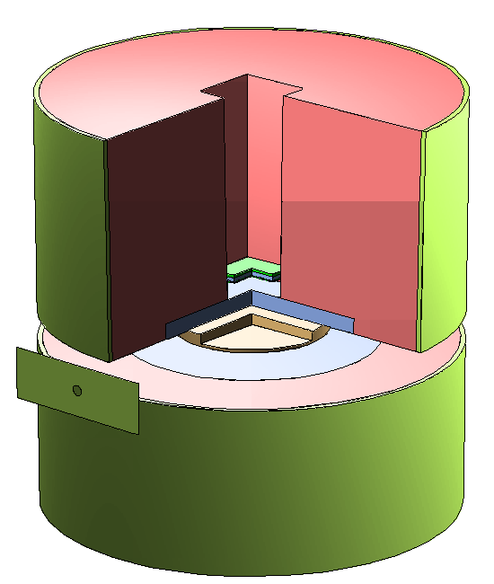
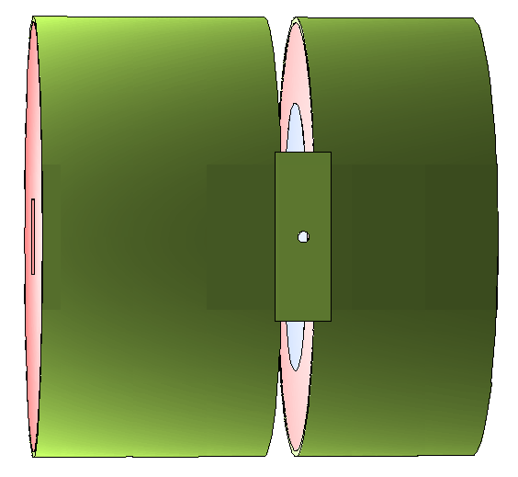
Tally for brightness
target
Pb
water
Point detector
1m
parahydrogen
Slit with boron

Slide 9

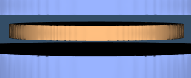

Surface-to-volume ratio of cold moderator
High energy neutron
Thermal neutron
Target
Thermal moderator
Cold moderator
Quantity of
feeding thermal neutron
Surface-to-volume of
cold moderator
Efficiency of cold moderator
Moderation efficiency of
thermal-to-cold process
Moderator material
Water
Parahydrogen (20K)
Single tube structure
Simple pancake structure
Single tube: higher surface-to-volume of cold moderator
High cold neutron brightness

Slide 10
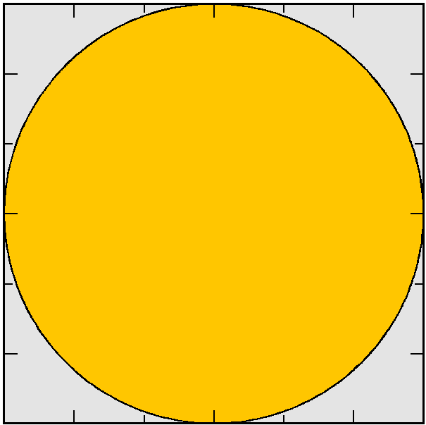
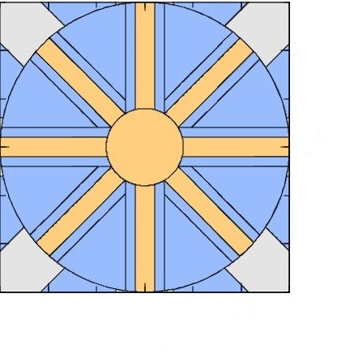
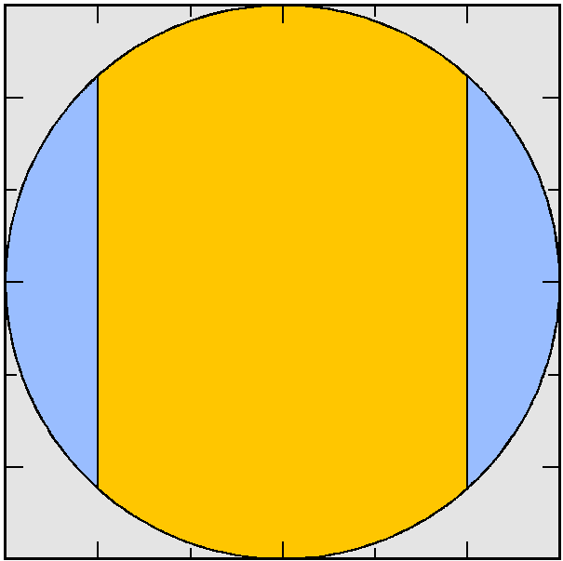
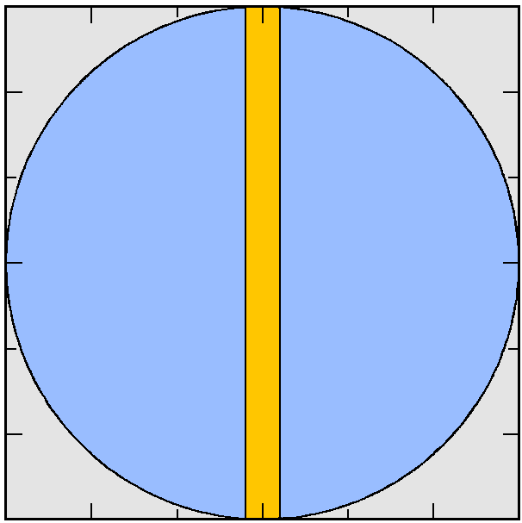
Modified pancake
neutron
Transverse
section
Water
Parahydrogen (20K)

Slide 11
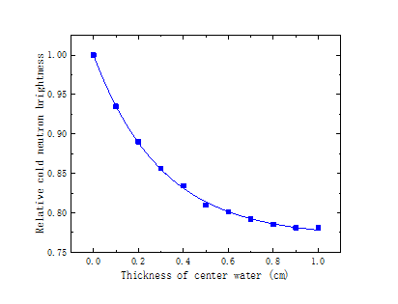
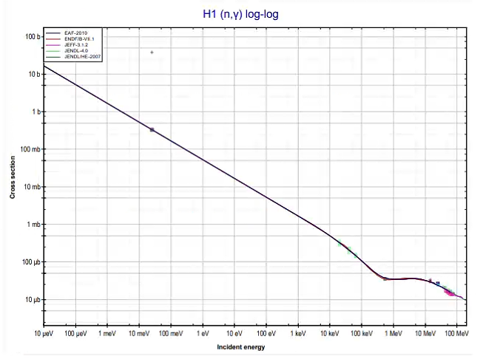
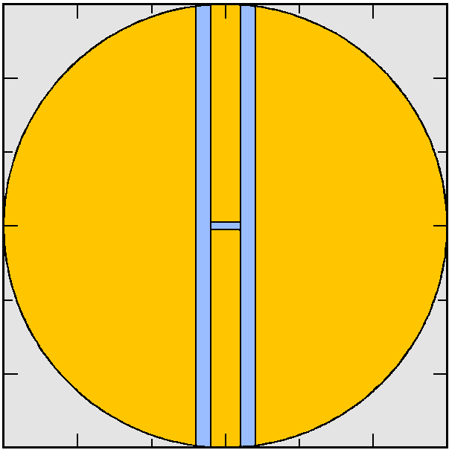
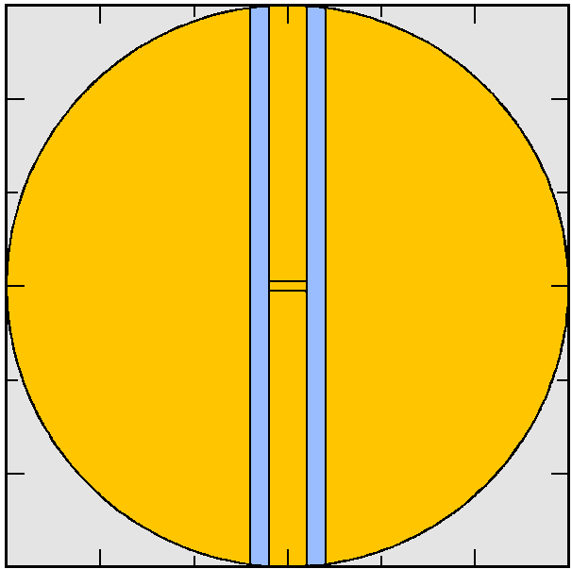

Absorption effect of water for cold neutron
Tally point
Absorption cross section of H
$$e^{−t/0.3}$$
Cold neutron absorbed by center water
Exponential decay for increasing thickness of center water

Slide 12
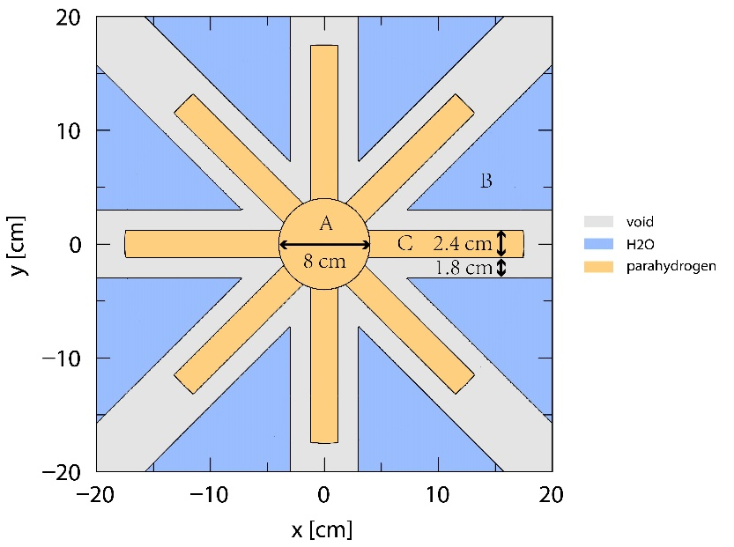
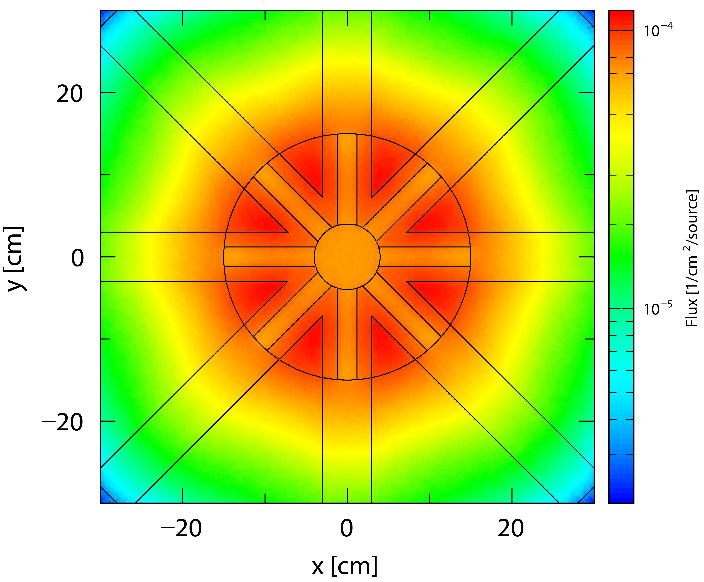
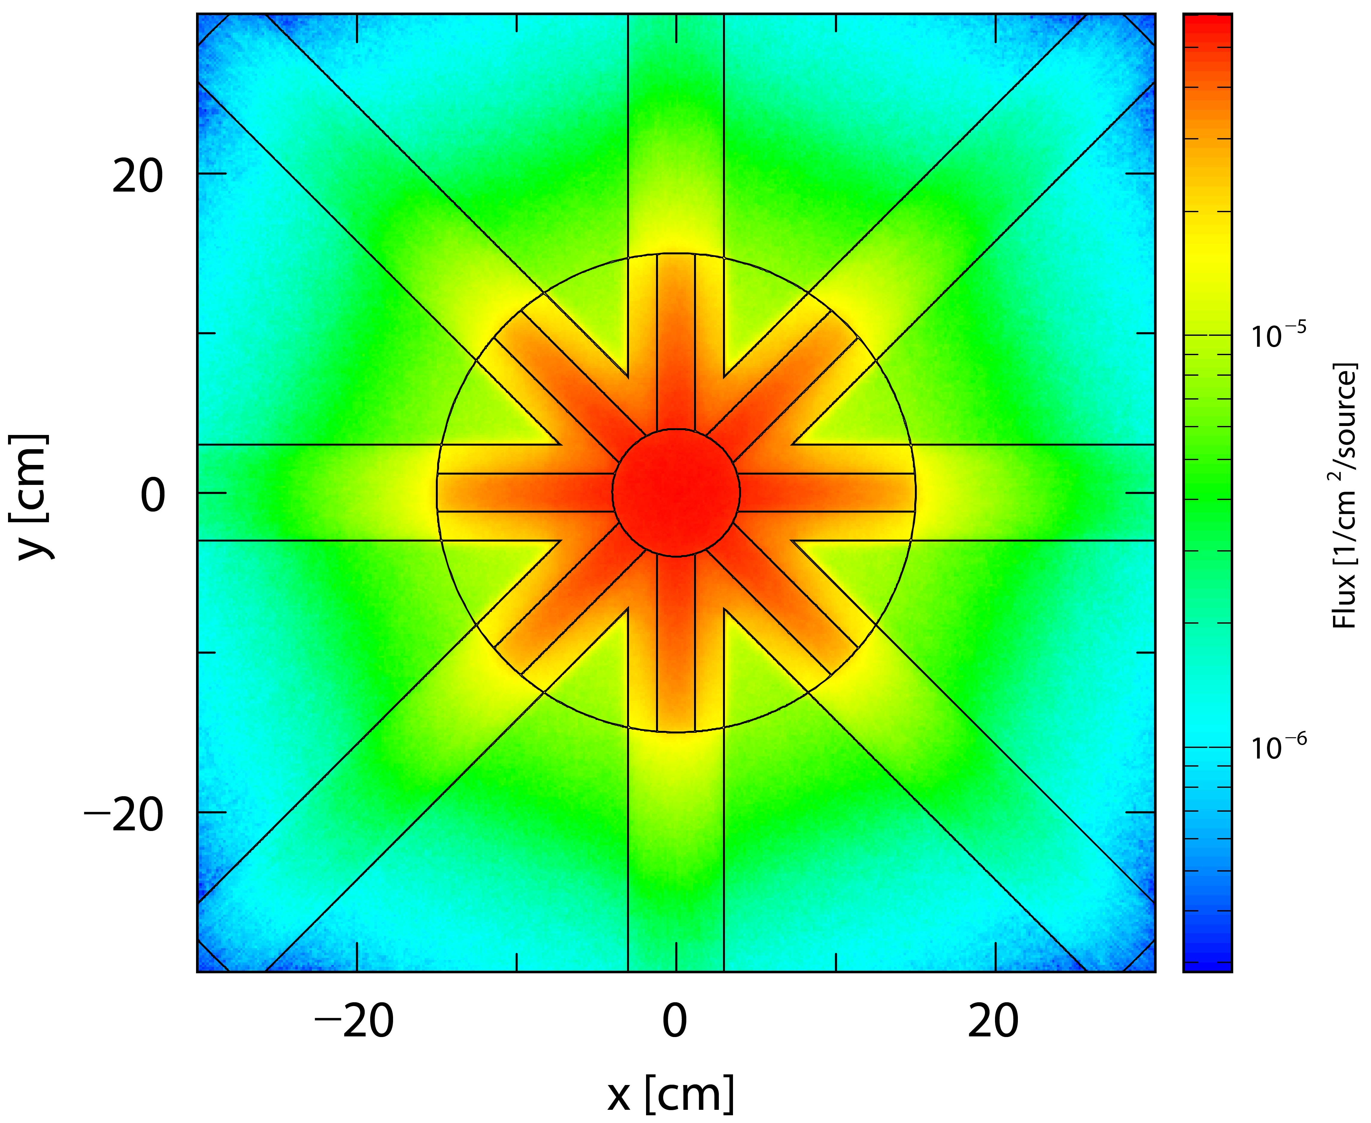
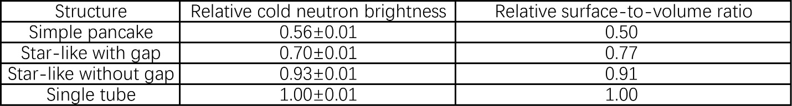
Star-like structure
Geometry
Thermal neutron distribution
Cold neutron distribution
Potential engineering container

Slide 13
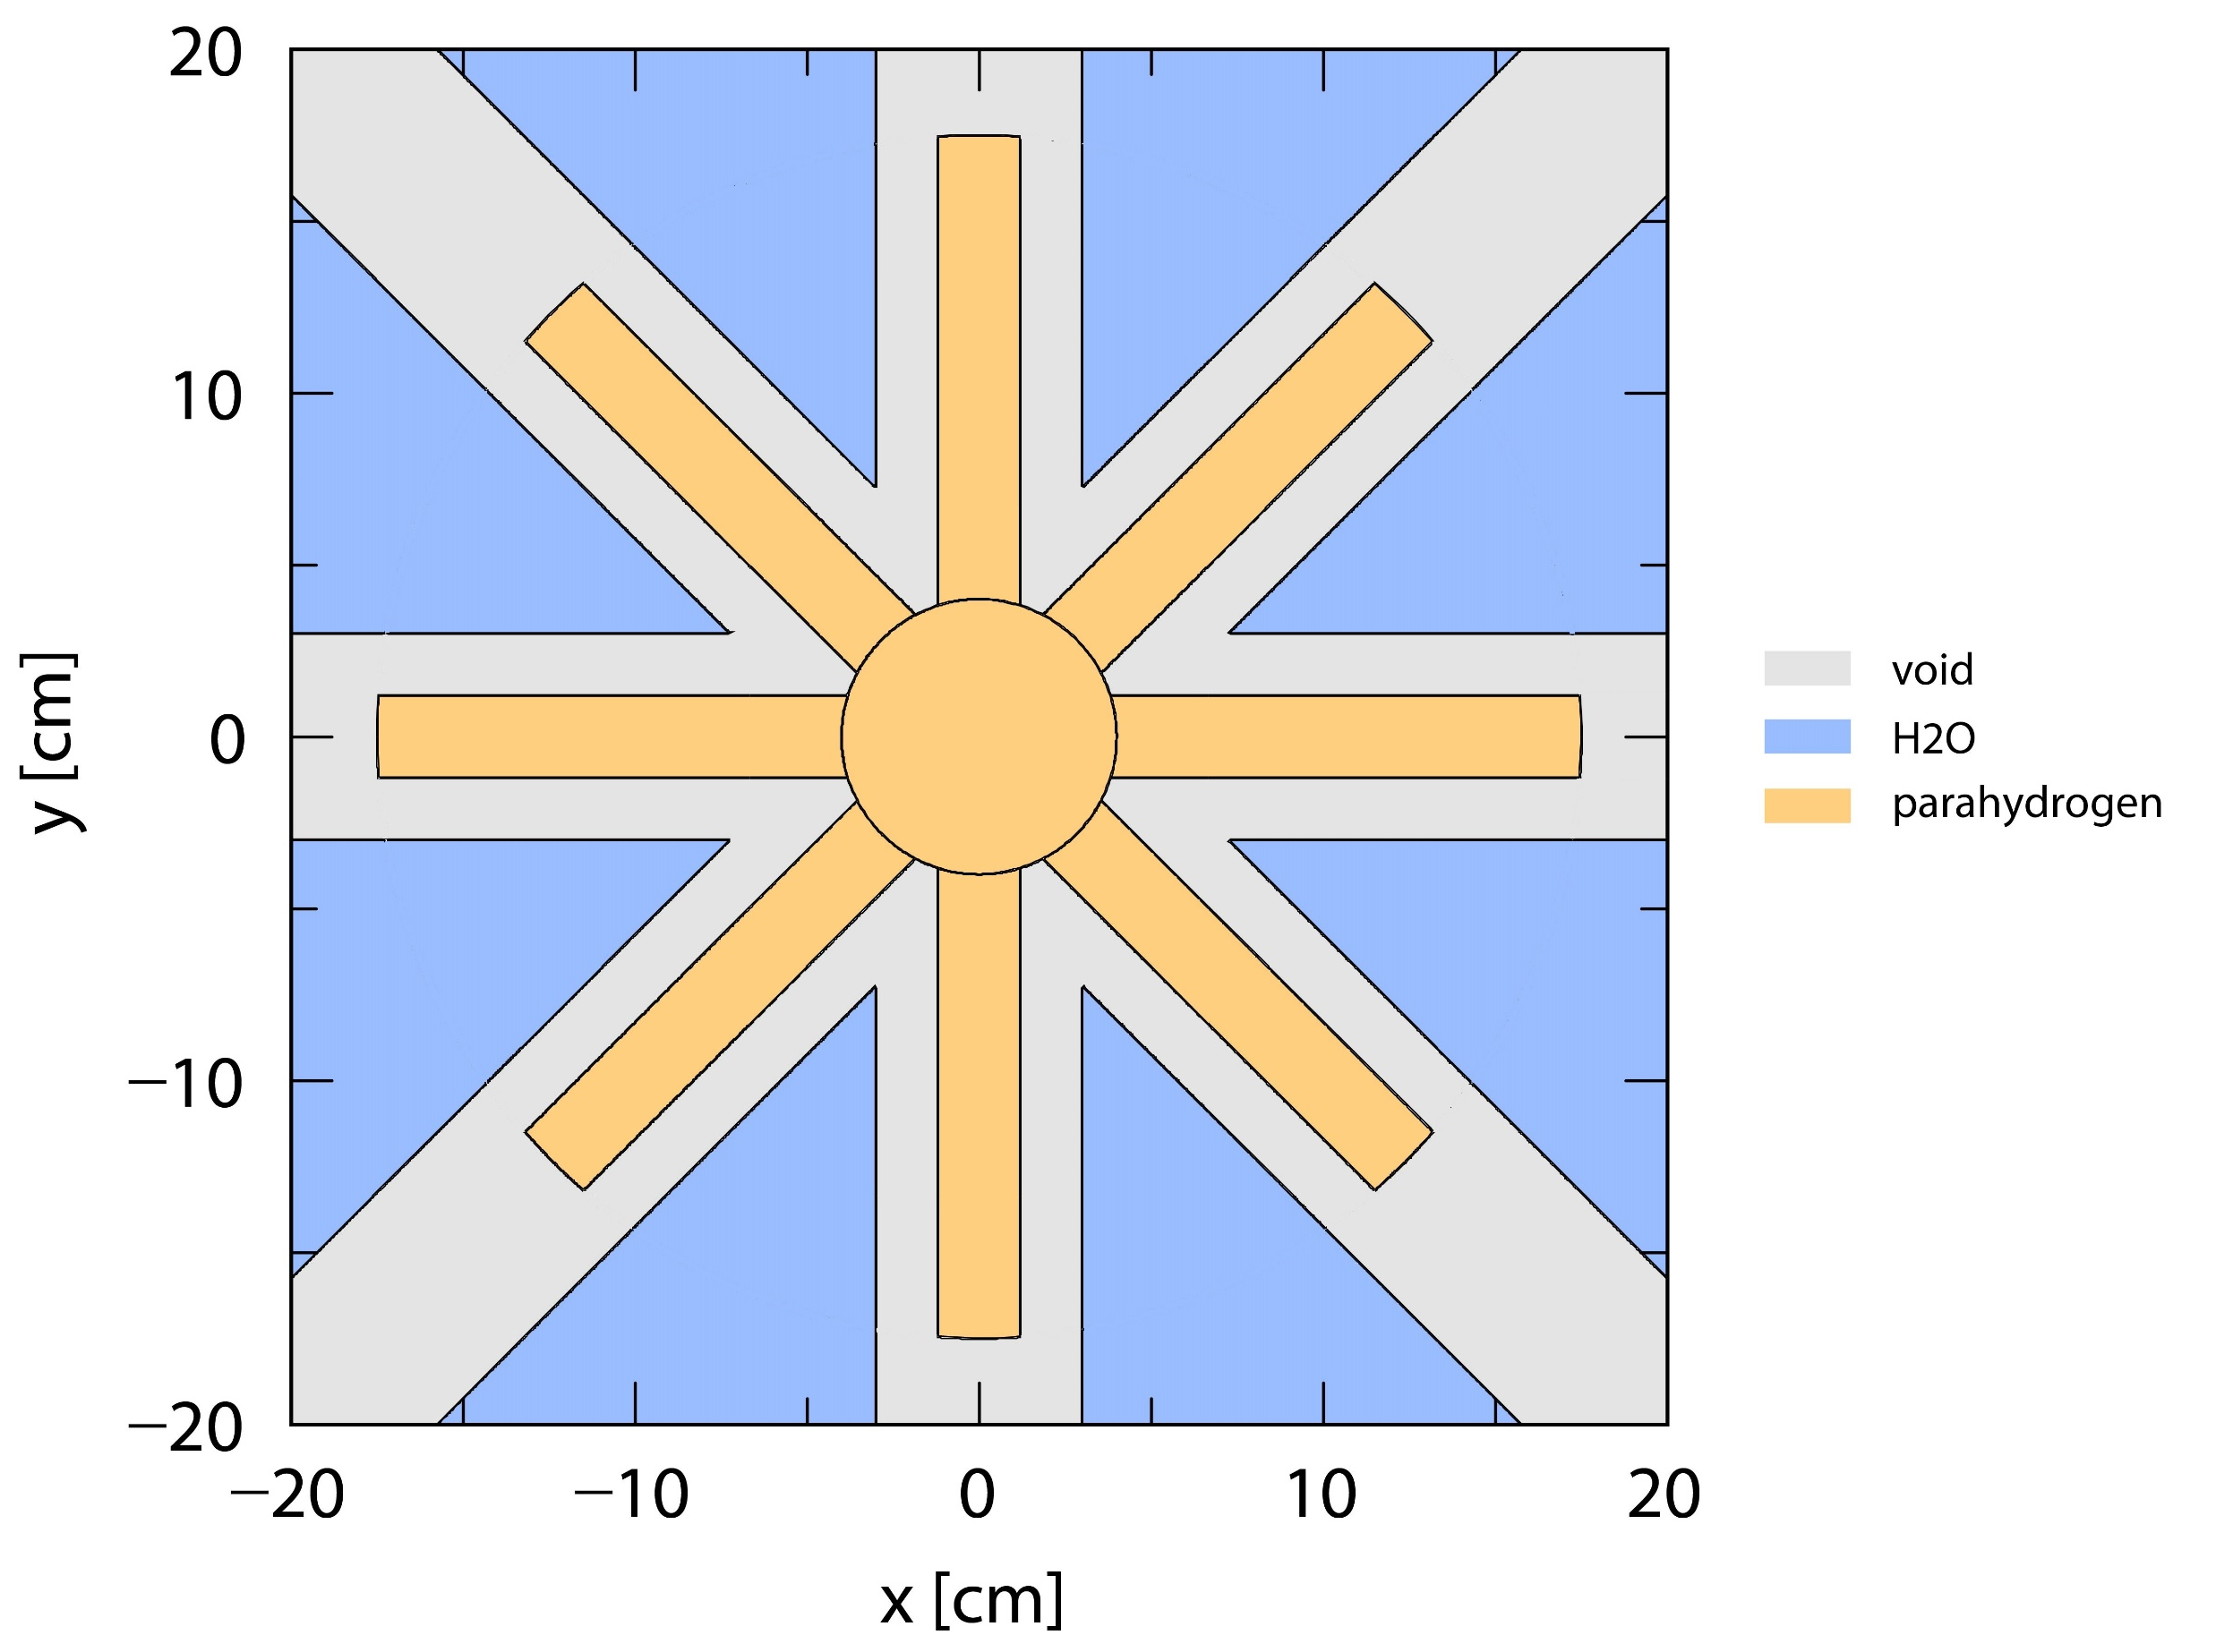
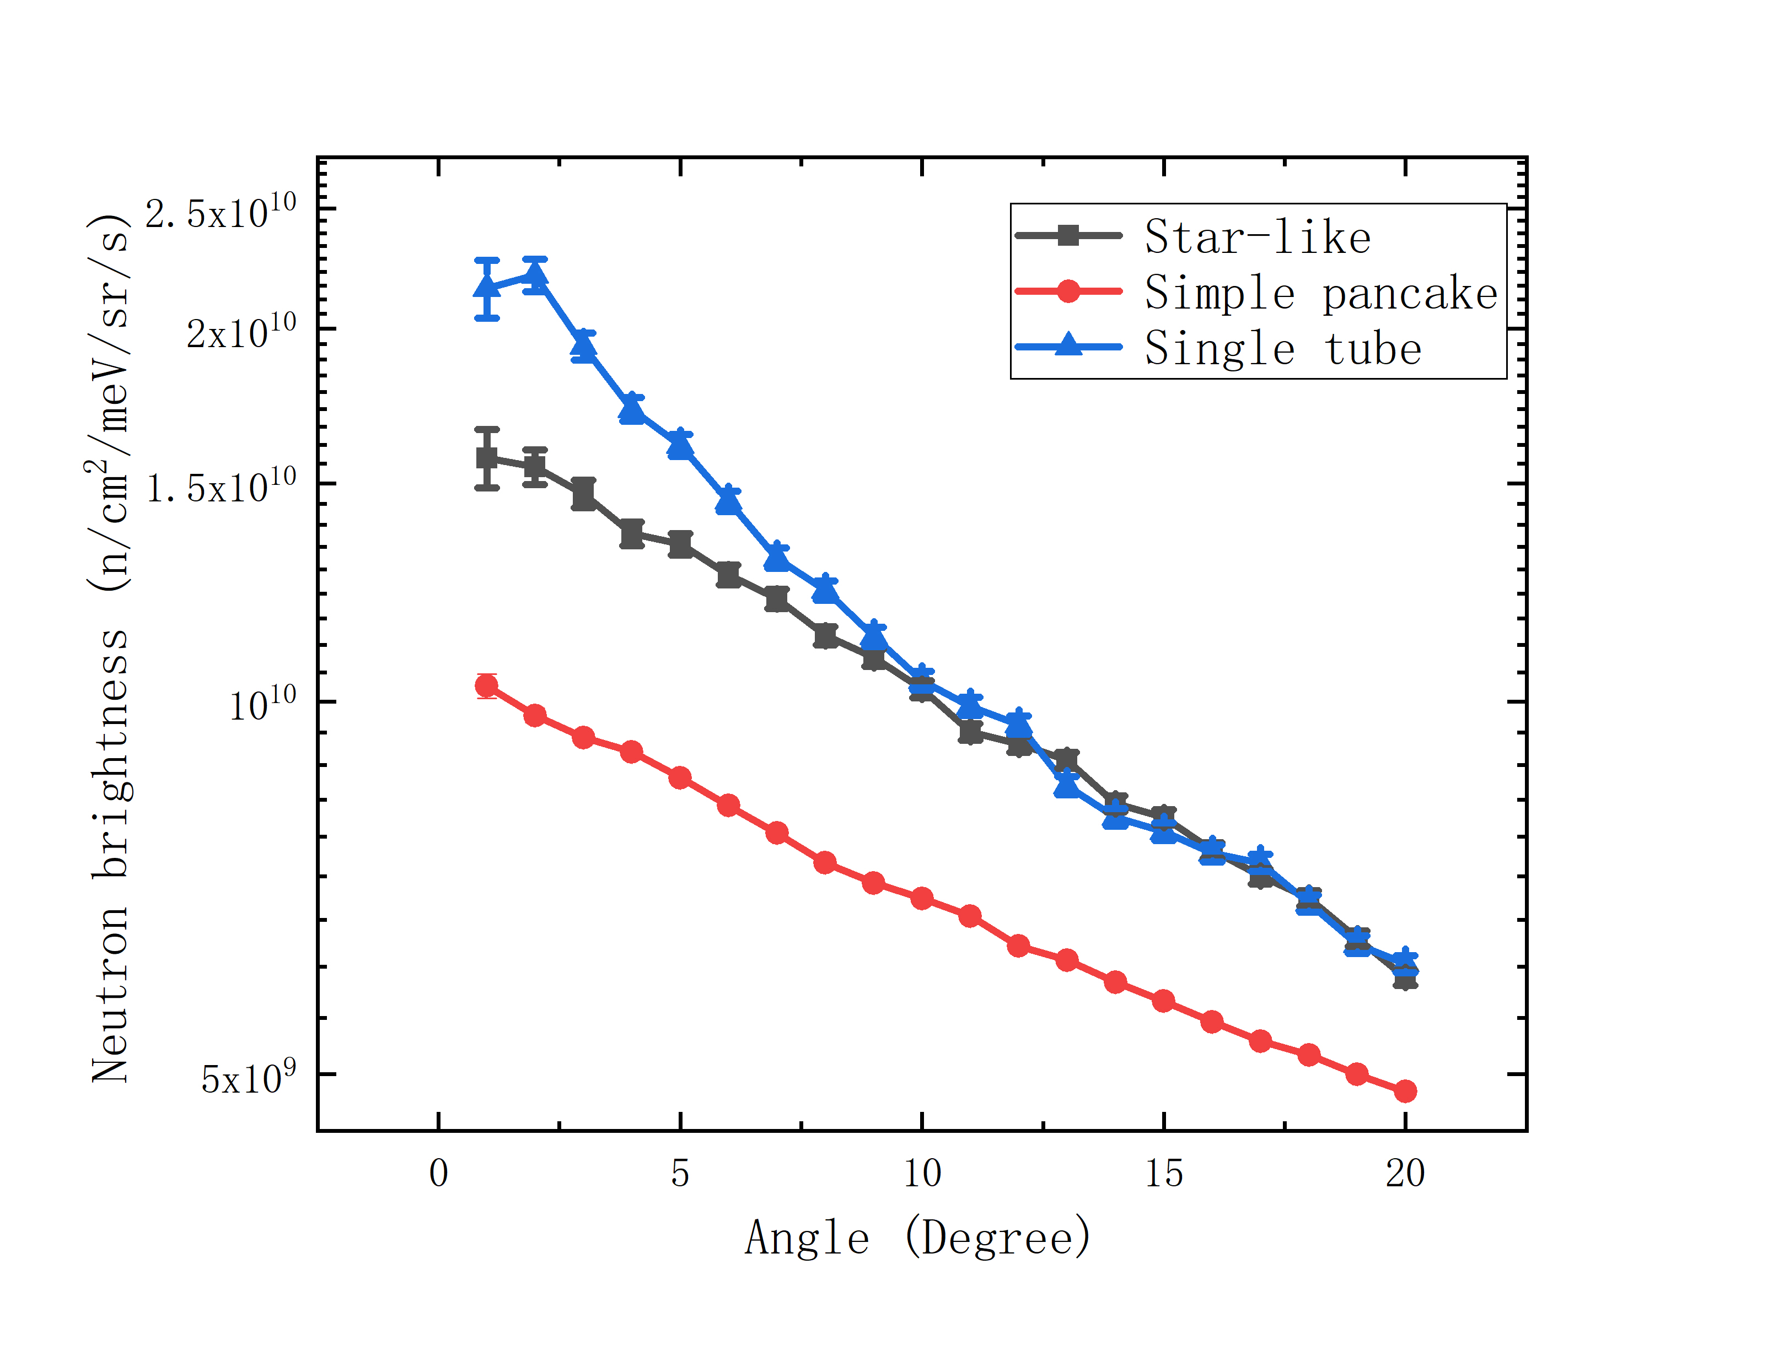
Neutronic characterization: angle
Cold neutron brightness versus emitting angle
Effective area:
Feeding thermal neutron:
Neutron emitting direction:
Difference of cold neutron brightness between single tube and star-like structure become smaller as emitting angle become larger
Large emitting angle: small effective area in the margin position
Small emitting angle: large effective area

Slide 14
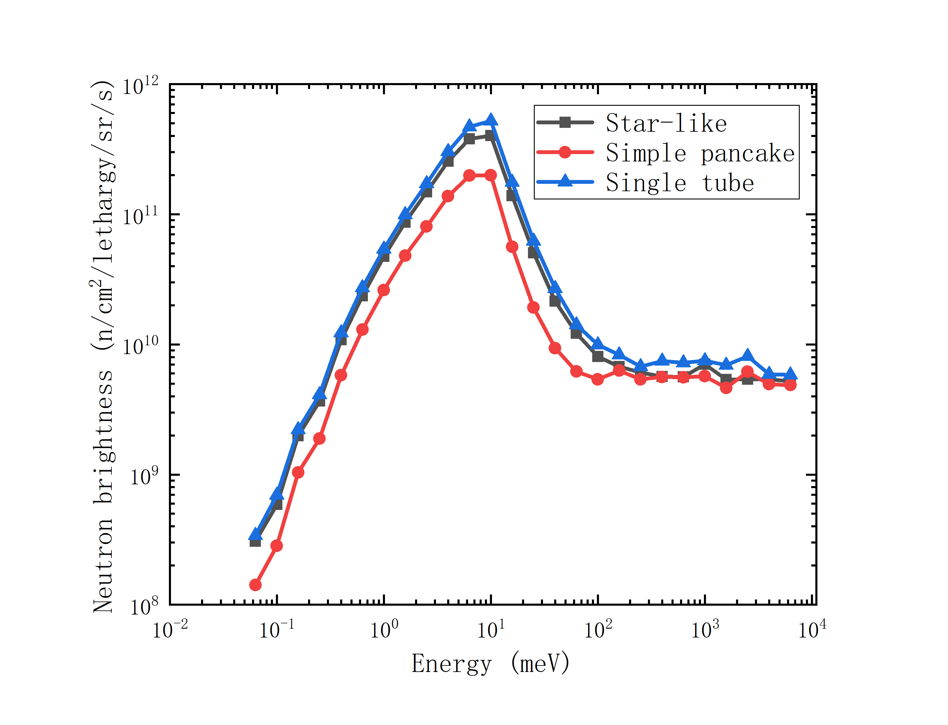
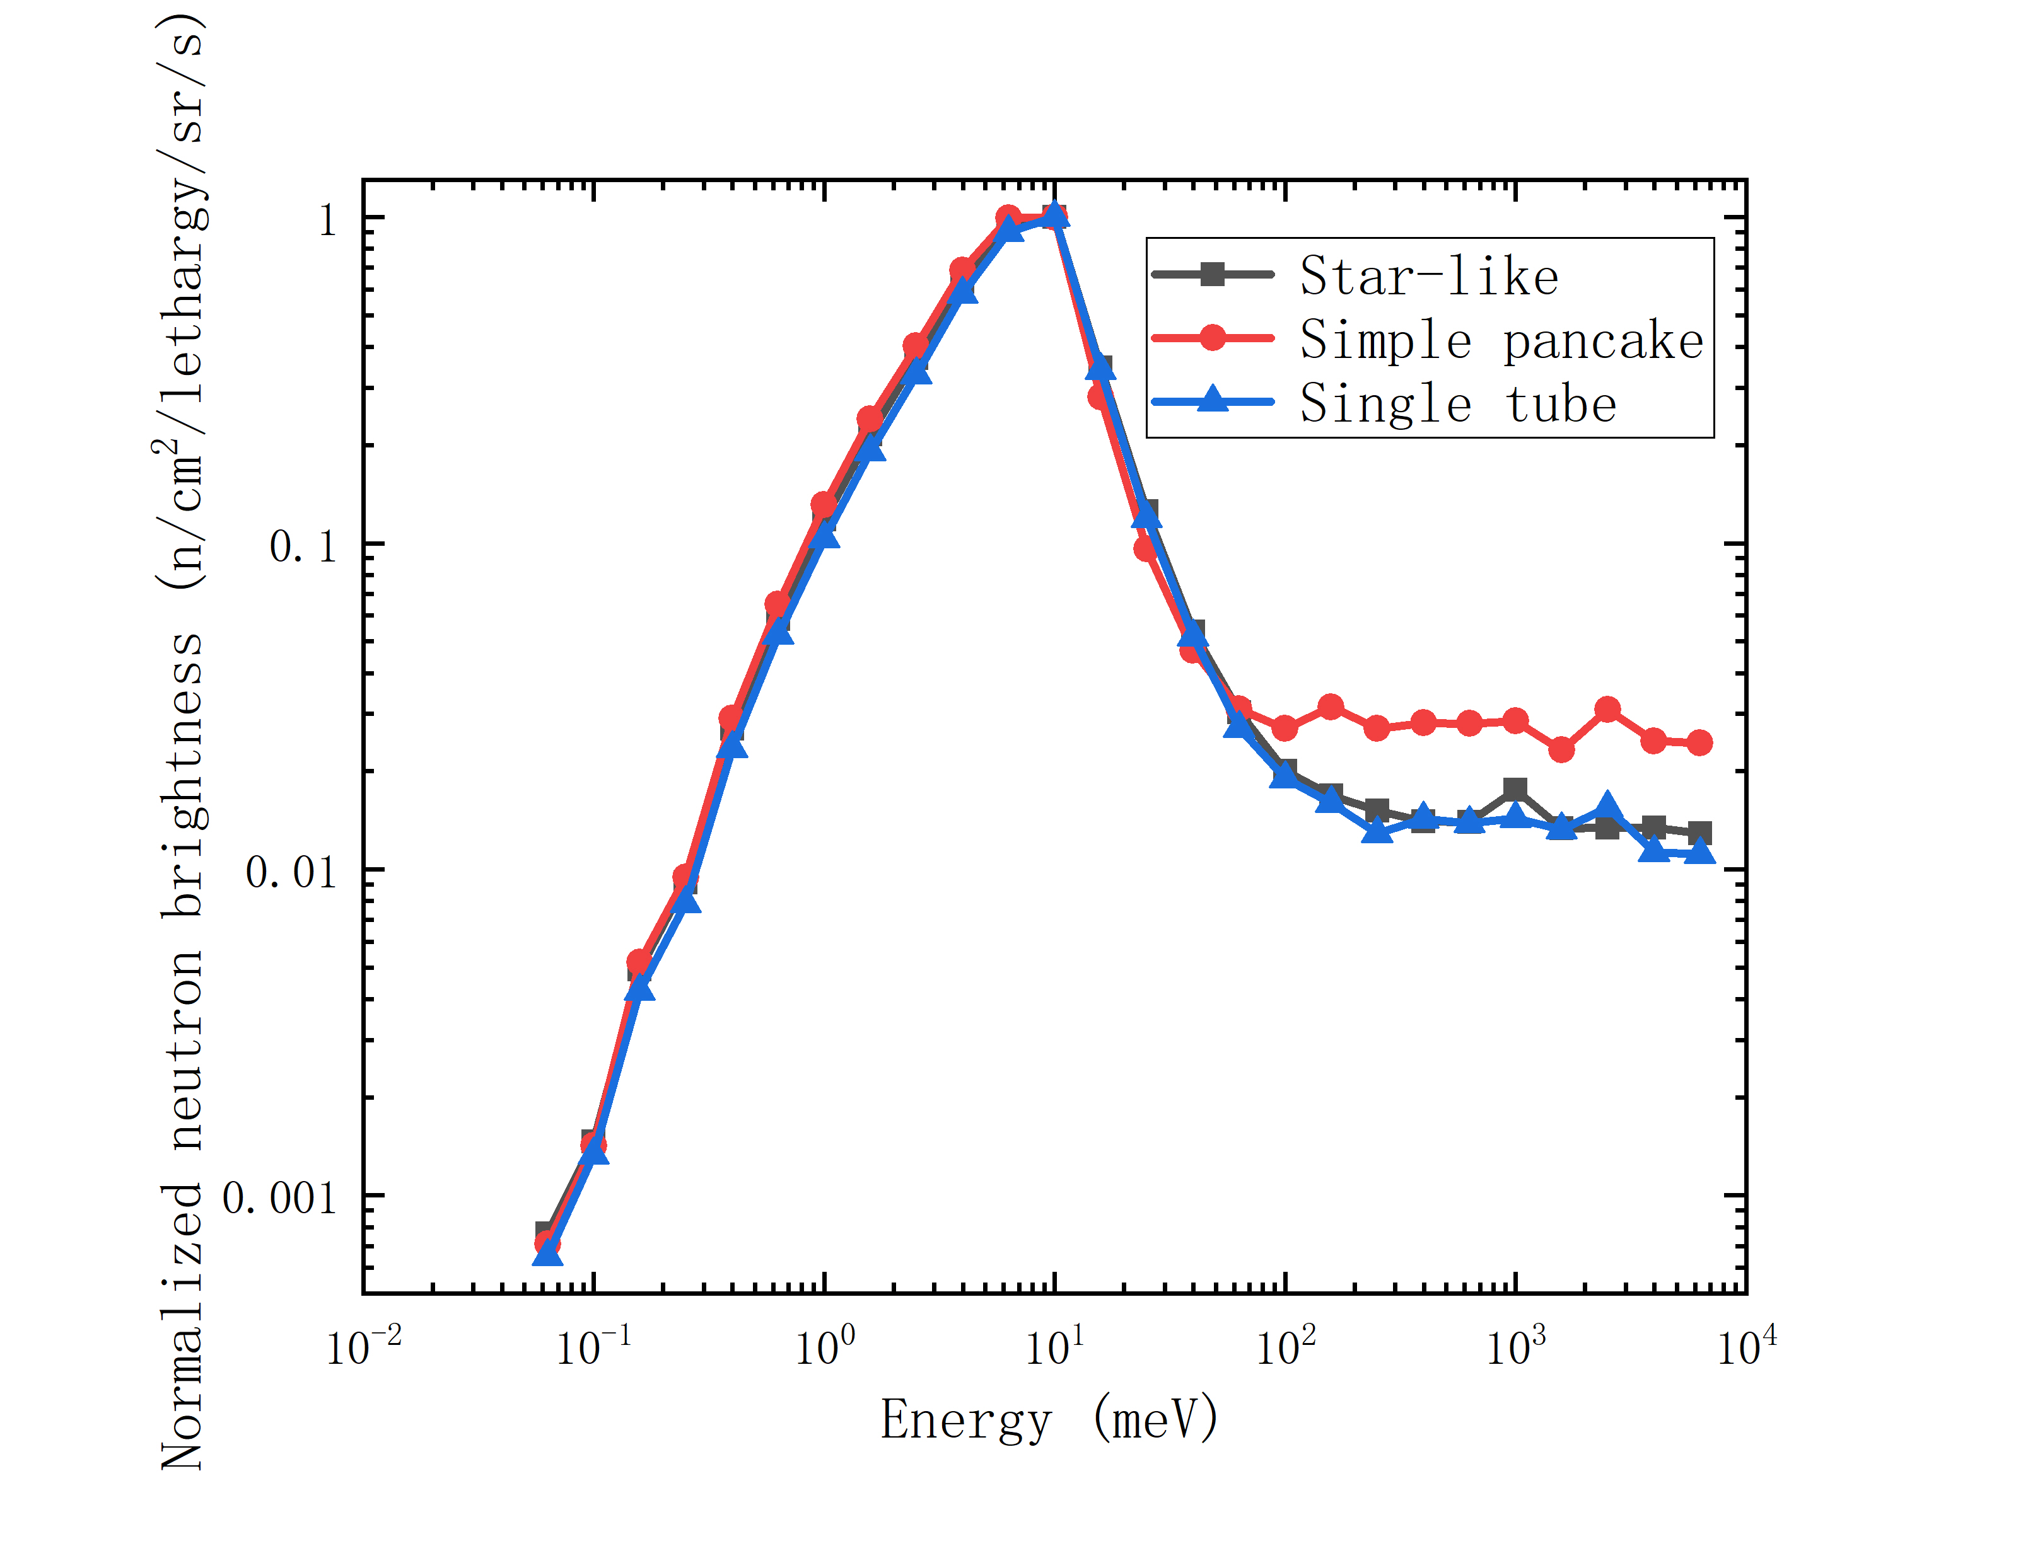
Neutronic characterization: energy
Cold neutron brightness versus energy
Normalized cold neutron brightness versus energy
Absence of water
High energy neutrons escape
Consistent energy distribution
Star-like structure enhances absolute brightness compared with simple pancake

Slide 15
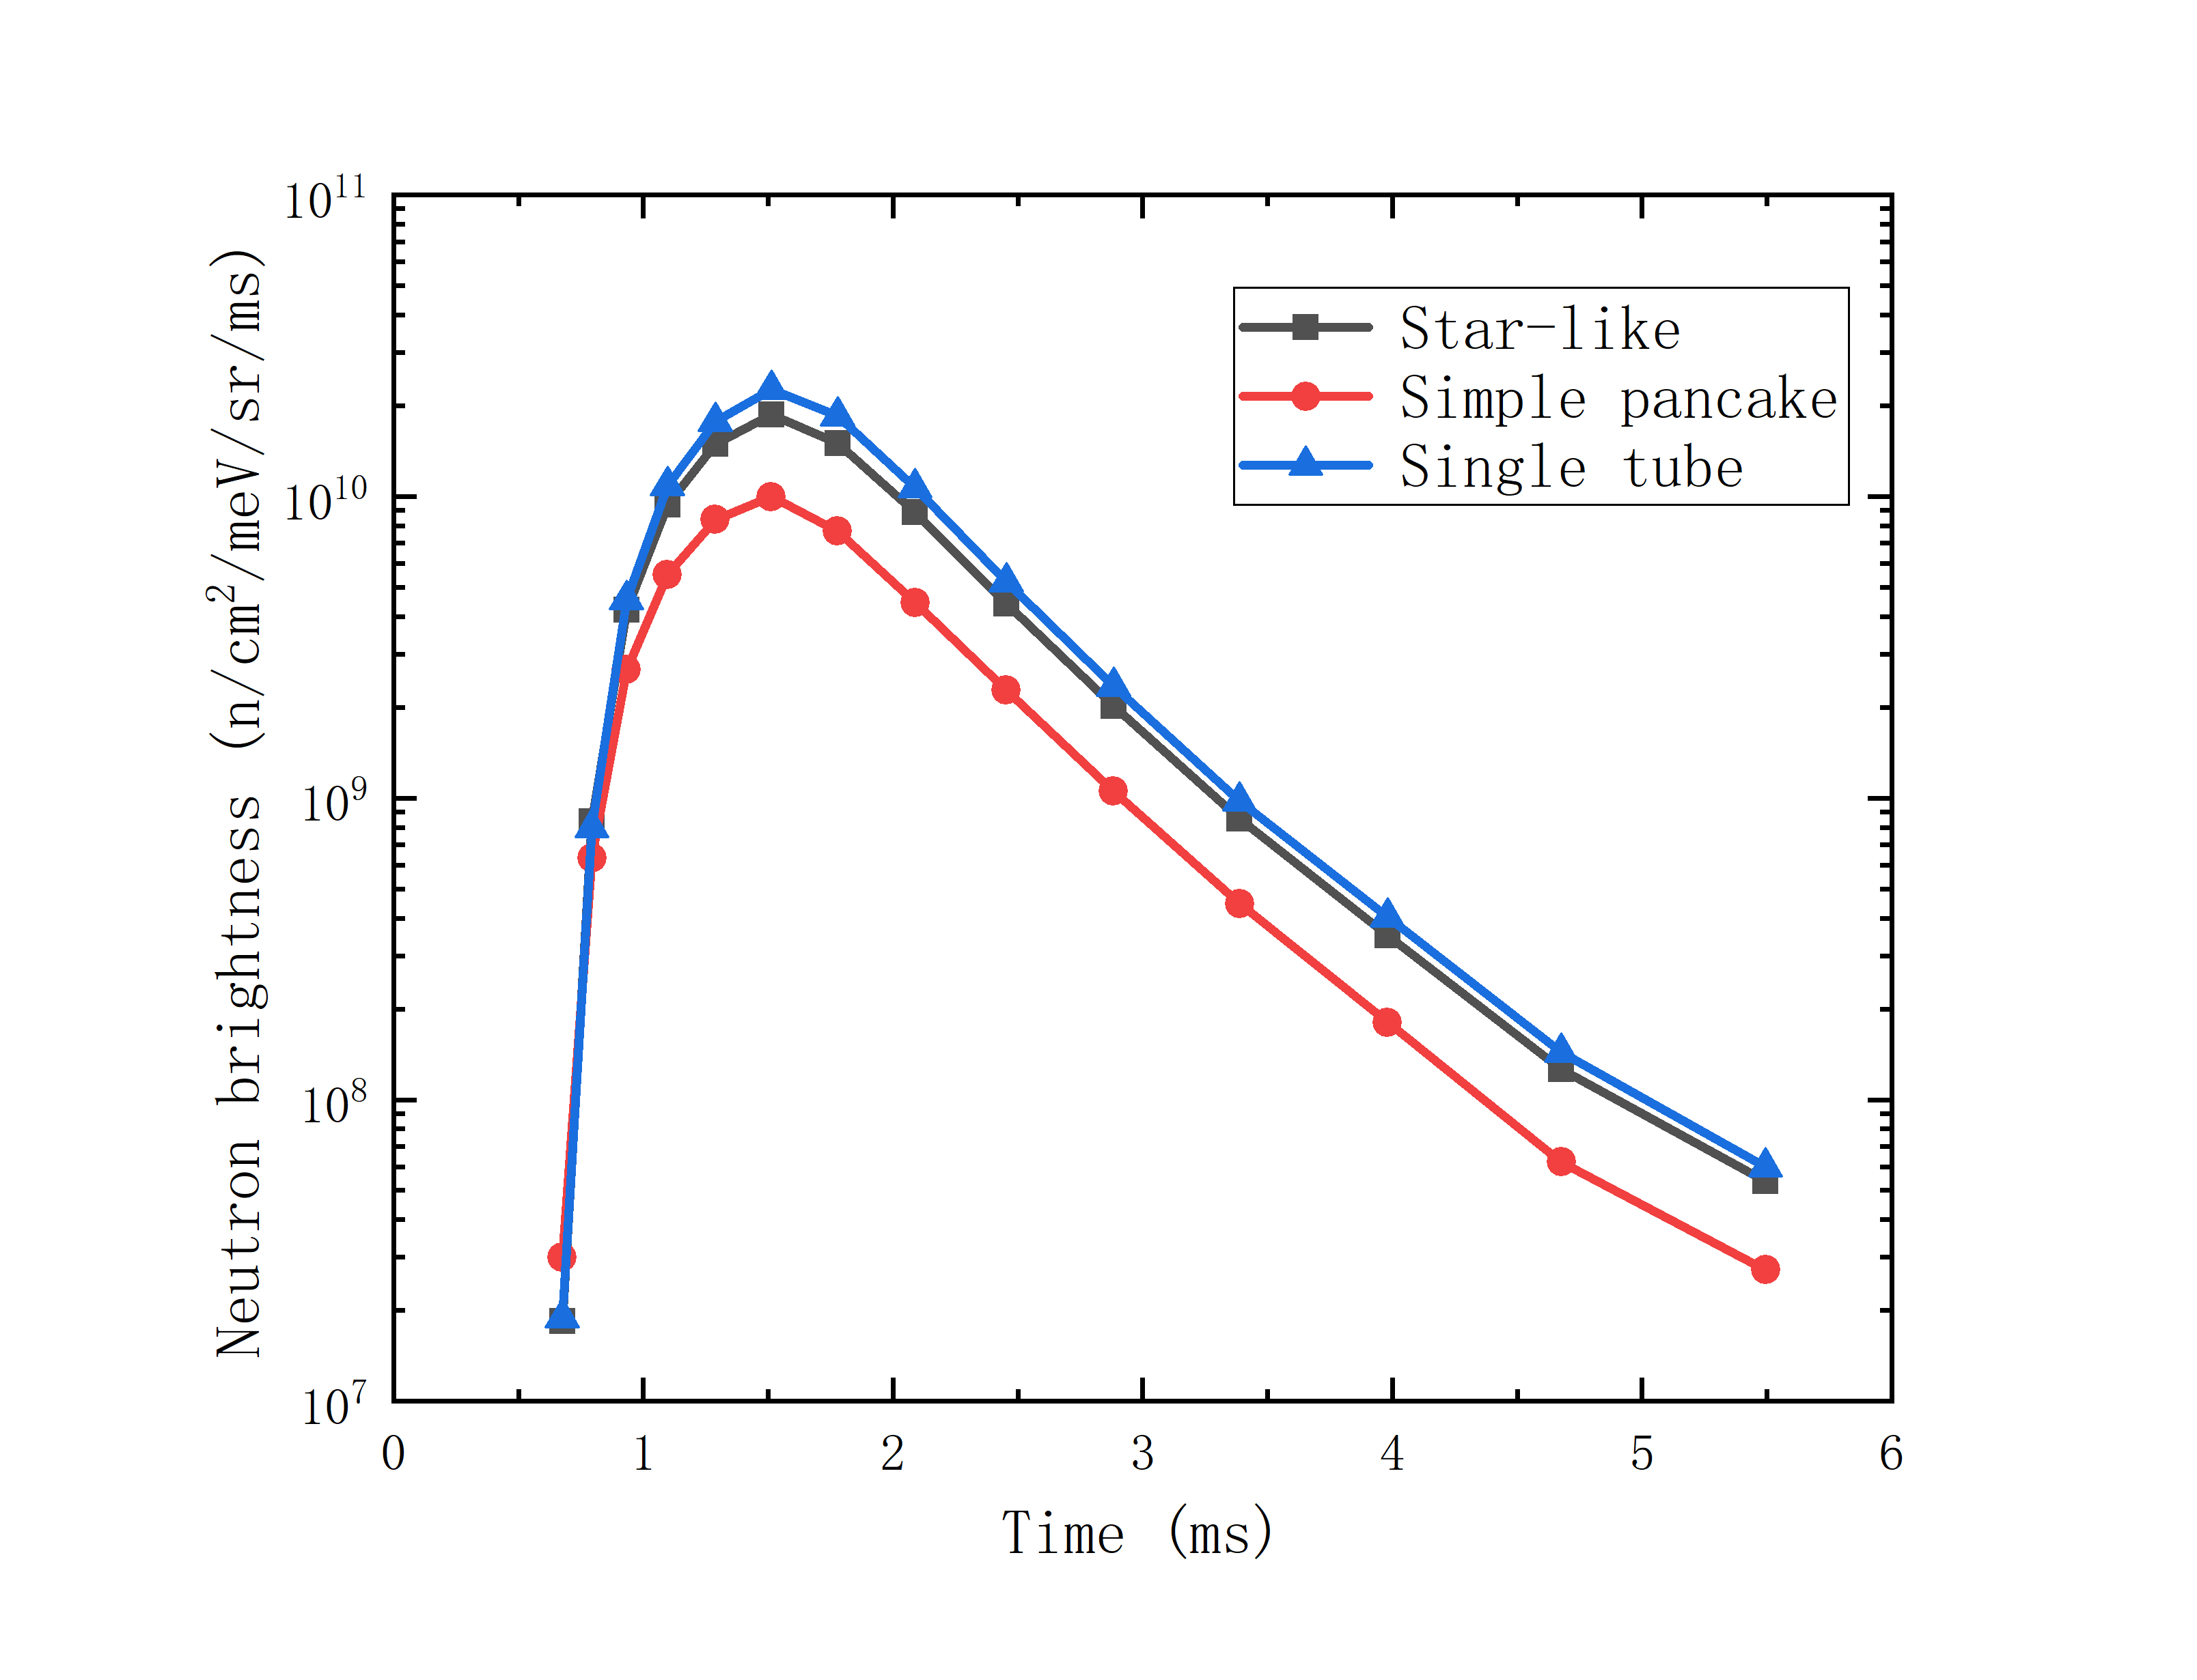
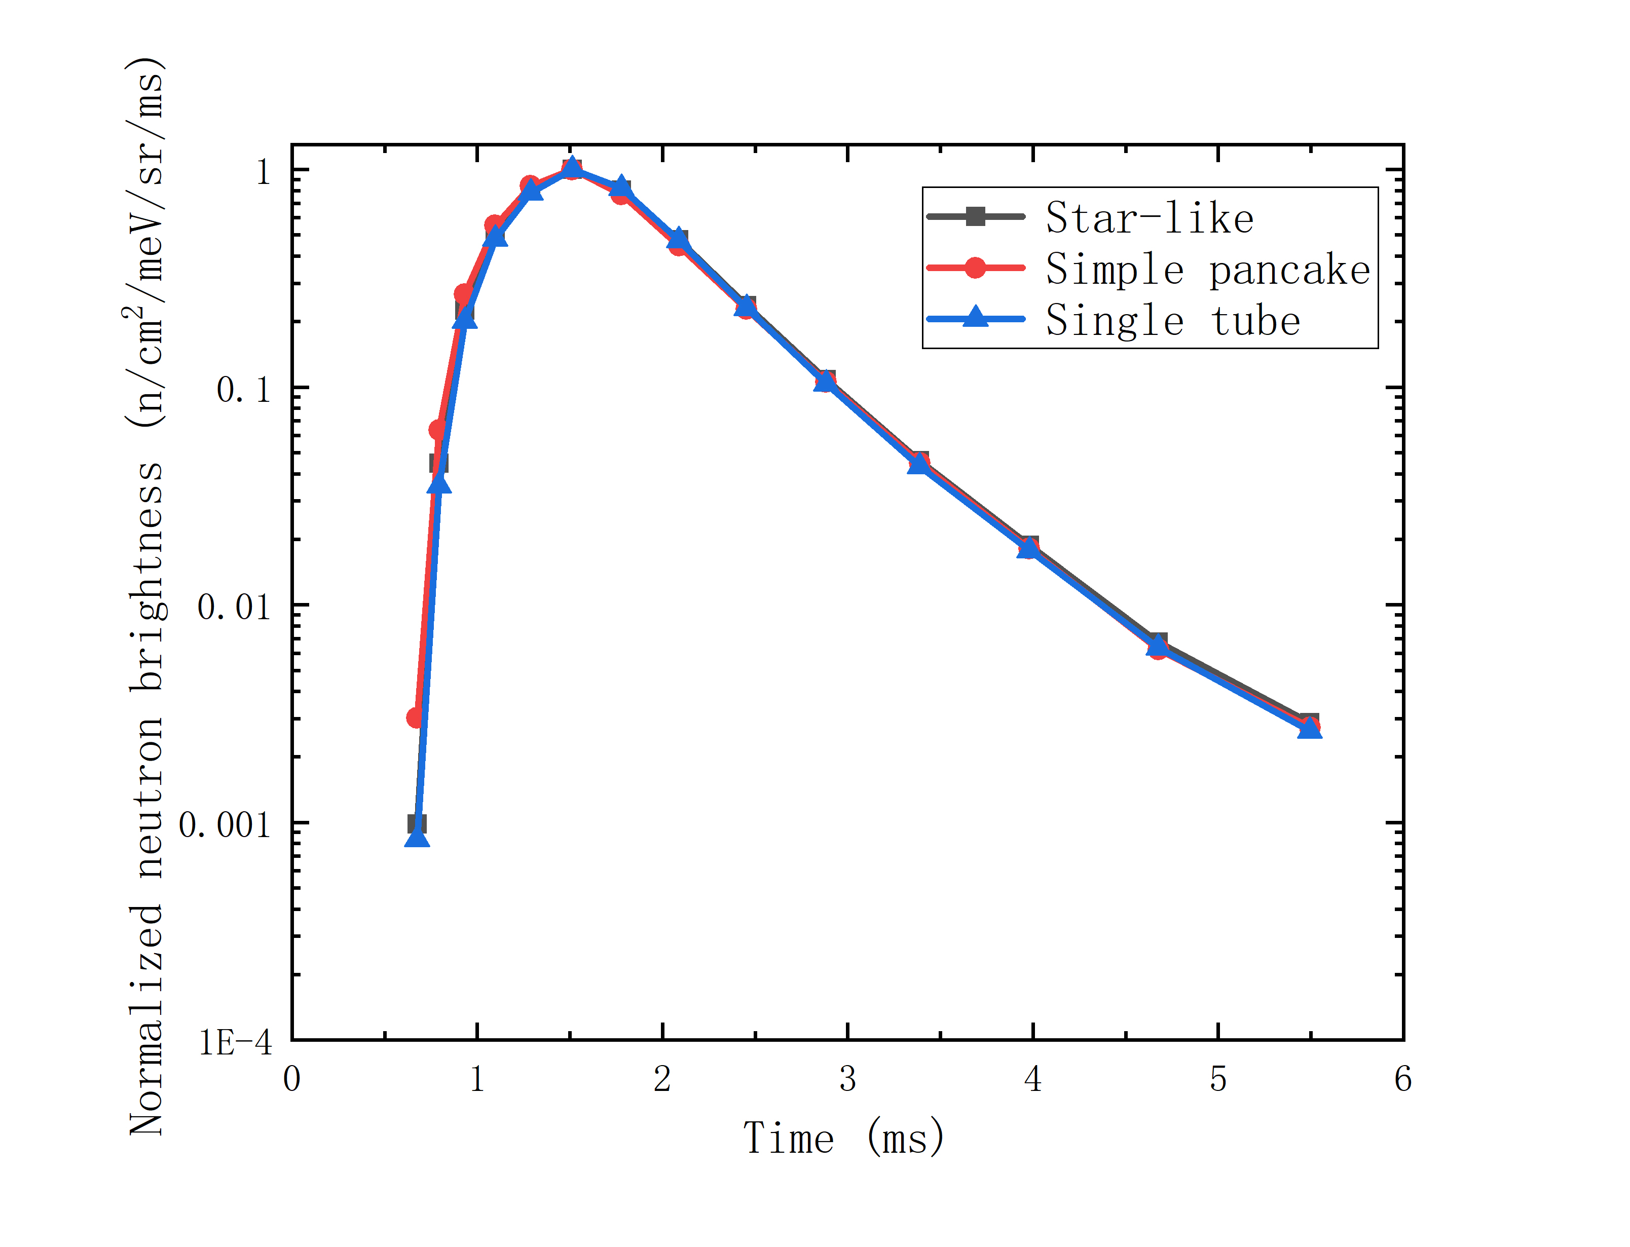
Neutronic characterization: time
Cold neutron brightness versus time
Normalized cold neutron brightness versus time
Consistent time distribution
Star-like structure enhances absolute brightness compared with simple pancake

Slide 16
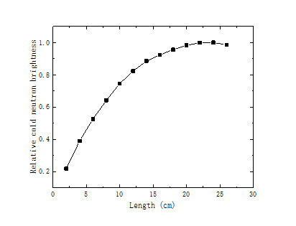
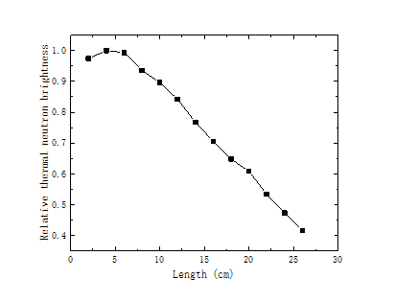
Different effect of thermal and cold moderator
Thermal neutron feeding
Thermal neutron feeding
Cold moderator
Thermal moderator
Thermal neutron feeding
Thermal neutron feeding
Water : 1) confine thermal feeding neutron cloud
2) provide thermal neutron to instruments
Large and fill in the space
Small and close to center

Slide 17
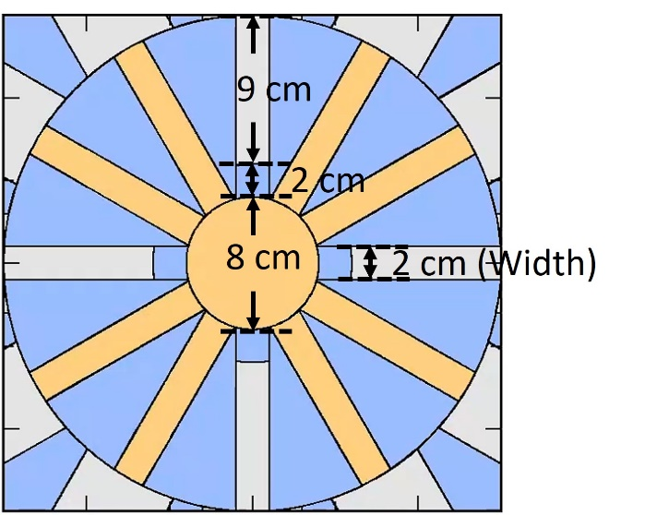
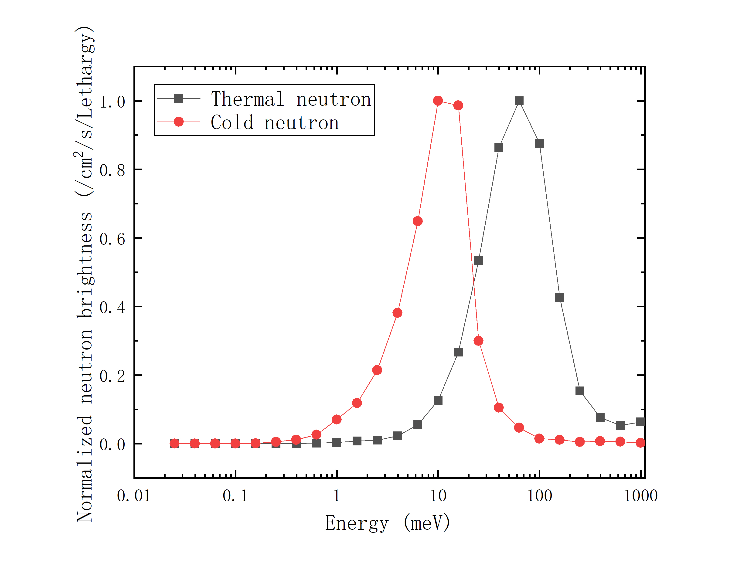

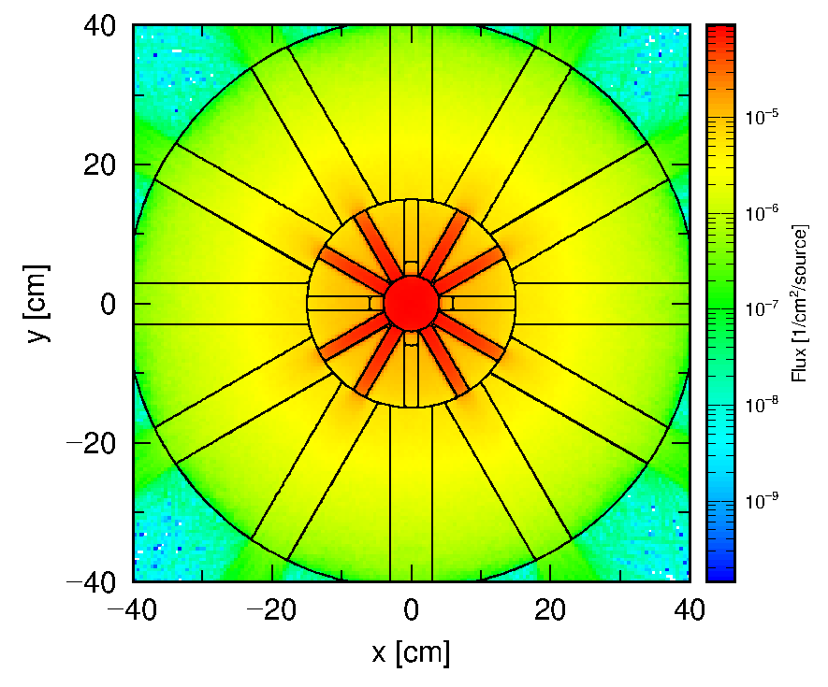
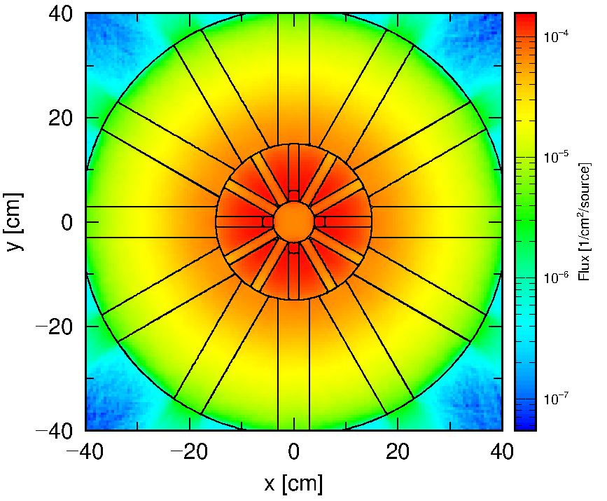
Thermal neutron extraction
Cold neutron flux distribution
Thermal neutron flux distribution
12 extraction channels
8 channels for cold neutron
4 channels for thermal neutron

Slide 18
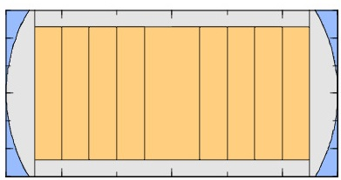
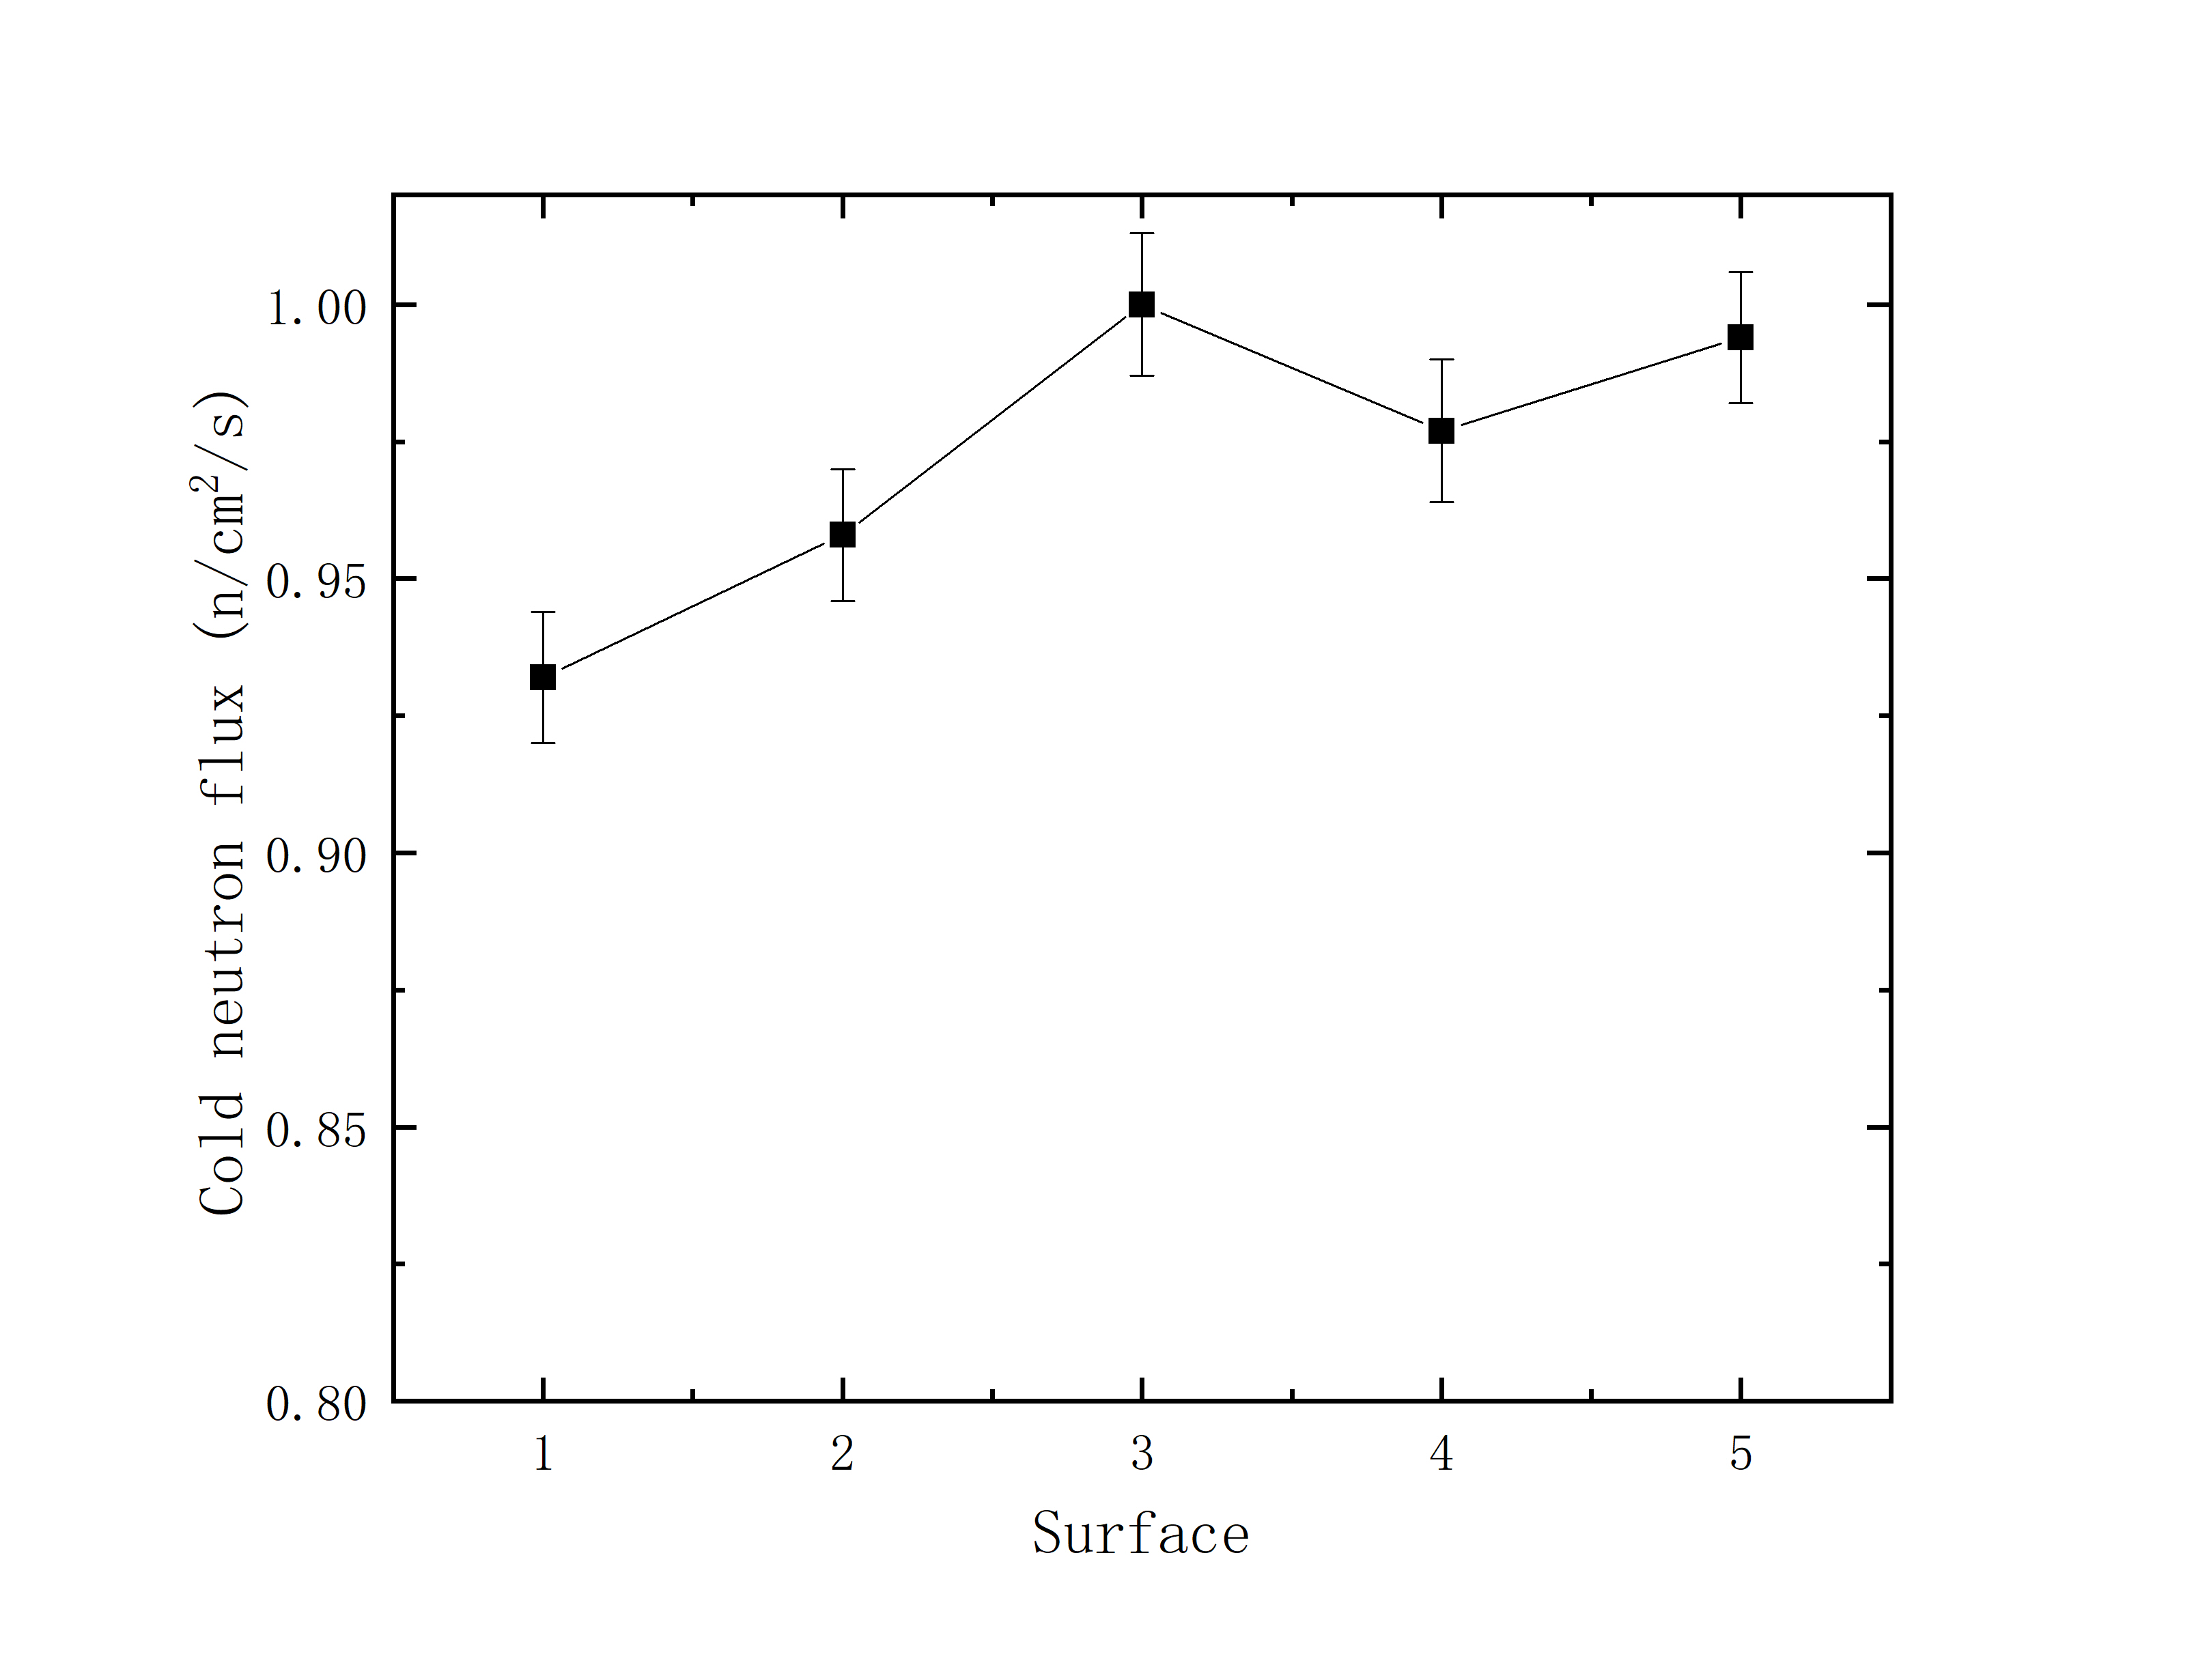
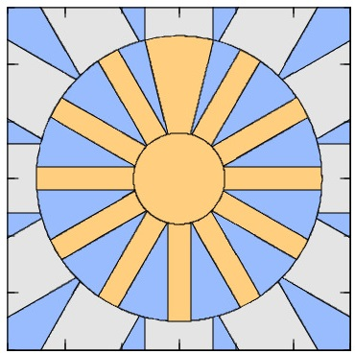
Large emitting surface
Enlarging the emitting surface
Rectangle shape → Sector shape
Maximum width: 6cm
Cold neutron brightness of sector shape (width 6 cm): 94% of rectangle shape (width 2 cm)
1
3
2
4
5
4
2
3
1
6 cm

Slide 19
Summary and outlook
Principle: increase surface-to-volume ratio of cold moderator
Modified low dimensional moderator: star-like structure
Influence of engineering problem for neutronics
Compatibility with neutron delivery system

Slide 20
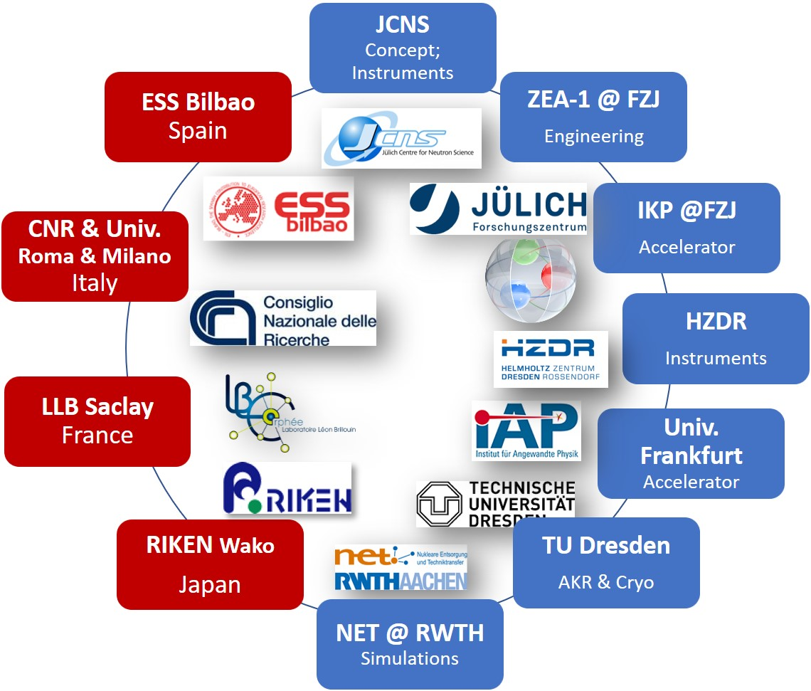



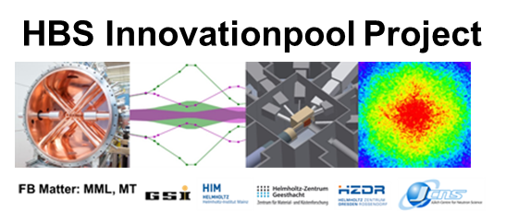



Thanks to HBS Team
J. Baggemann
Th. Brückel
T. Cronert (†)
Q. Ding
P.-E. Doege
T. Gutberlet
J. Chen
J. Li
K. Lieutenant
Z. Ma
E. Mauerhofer
N. Ophoven
U. Rücker
N. Schmidt
A. Schwab
J. Voigt
P. Zakalek
Monia EI Barbari
- Core group:
design, verification,
instrumentation
ZEA-1:
Y. Bessler
R. Hanslik
R. Achten
F. Löchte
M. Strothmann
- Engineering
IKP-4:
O. Felden
R. Gebel
A. Lehrach
M. Rimmler
R. Similon
- Nuclear physics
INM-5:
B. Neumaier
- Radio isotopes
S. Böhm
J.P. Dabruck
R. Nabbi
- Nuclear simul.
C. Lange
T. Langnickel
Ch.Haberstroh
M. Klaus
S. Eisenhut
- AKR-2, liquid H₂
H. Podlech
O. Meusel
- Accelerator
W. Barth
- Accelerator
/ HIM

