Slide 1
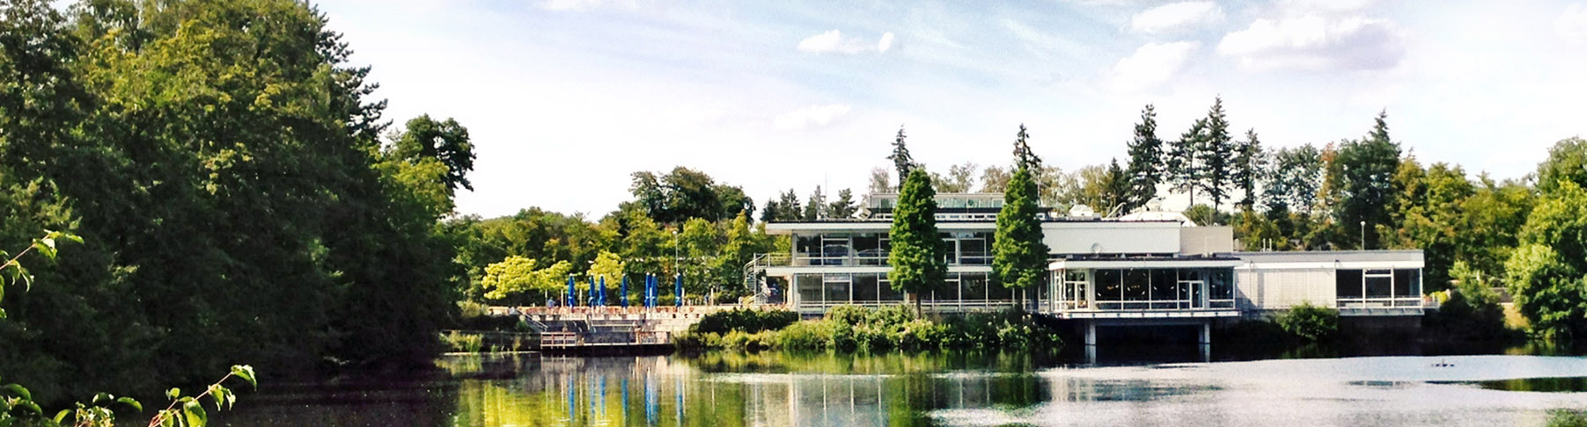
Towards the development of a very cold neutron source
For the high brilliance neutron source (HBS)
LENS-ELENA NEUTRON MODERATOR WORKSHOP | 17.04.2024 I Dalini D. maharaj

Slide 2
a very cold neutron source for the HBS
Outline
Overview of the High Brilliance Source
Motivation
Introduction to Moderator Materials
Concept Development
Initial Results
Future Work

Slide 3
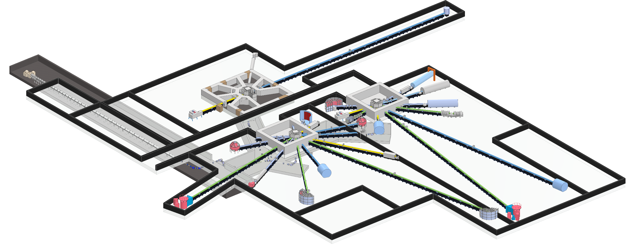
What is the HBS?
High Brilliance Neutron Source – A HiCANS facility
Linac Parameters
100mA, 70 MeV proton source
Multiplexer
Proton beam distributed among 3 target stations
Target Stations
Each target station operated at distinct frequency
Optimize thermal spectrum for each target-moderator combination
6-8 instruments per target station
Dedicated beam port for each instrument
  Can have its own cold source as needed

Slide 4
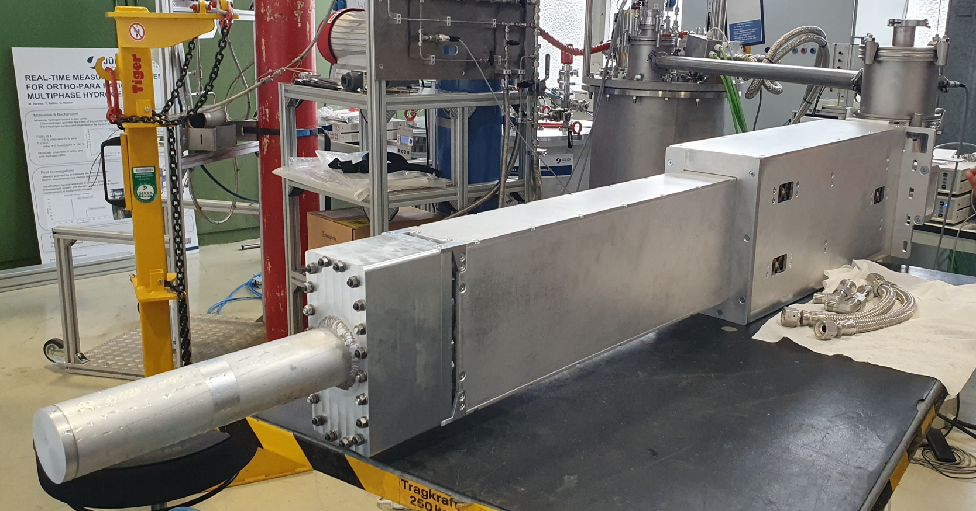
What is the HBS?
High Brilliance Neutron Source – A HiCANS facility
Linac Parameters
100mA, 70 MeV proton source
Multiplexer
Proton beam distributed among 3 target stations
Target Stations
Each target station operated at distinct frequency
Optimize thermal spectrum for each target-moderator combination
6-8 instruments per target station
Dedicated beam port for each instrument
  Can have its own cold source as needed
High degree of flexibility makes the HBS adaptable
J. Baggemann, “Development of Neutron Extraction Plugs for HBS”, DENIM XII Jülich, 21st September 2023

Slide 5
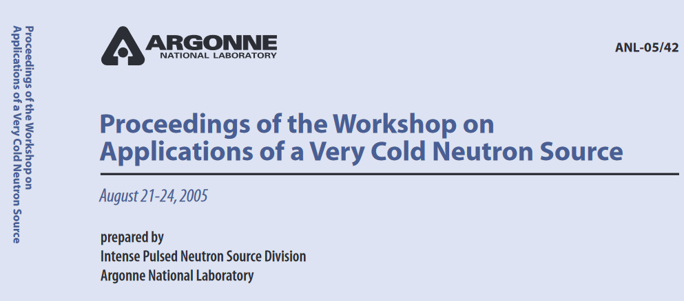
motivation
Very Cold Neutrons for Materials Investigations
Range of very cold neutrons
10 - 100 Å
0.81 meV
0.05 meV
0.008 meV
10 Å
40 Å
100 Å
¹J.M Carpenter and B.J. Micklich, ANL (05/42) (2005).
Access to longer length and time scales – large biological structures on the nanoscale
Significant improvement of gains in intensity and resolution for some neutron instruments
Can apply light optics methods to control neutron beams as refracting power ≈ λ²

Slide 6
motivation
Very Cold Neutrons for Materials Investigations
Range of very cold neutrons
10 - 100 Å
0.81 meV
0.05 meV
0.008 meV
10 Å
40 Å
100 Å
¹J.M Carpenter and B.J. Micklich, ANL (05/42) (2005).
Access to longer length and time scales – large biological structures on the nanoscale
Significant improvement of gains in intensity and resolution for some neutron instruments
Can apply light optics methods to control neutron beams as refracting power ≈ λ²
Previously difficult to extract VCN beams from conventional cold sources
Lower temperature cross sections not previously available

Slide 7
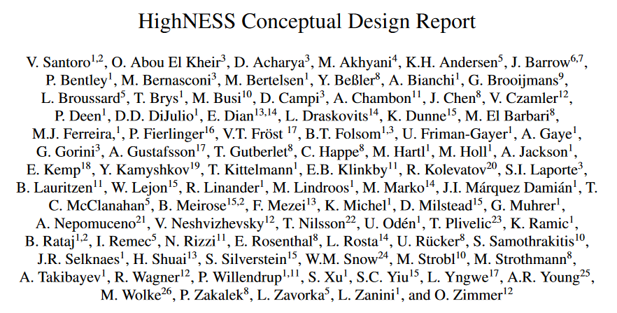
Why ONLY now?
Neutron scattering kernels developed through the HighNESS project for many candidate moderator and reflector materials
²V. Santoro et al, HighNESS Conceptual Design Report arXiv:2309.17333v3 [physics.ins-det]
Opportunity to explore VCN development for HBS – we are adaptable, after all

Slide 8
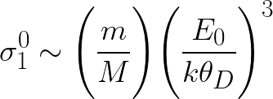
producing very cold neutrons
Neutrons can also excite vibrational modes in solid state materials
Cross section due to lattice drops precipitously at temperature scales well below Debye temperature
Accessible low energy modes, ideally not restricted by a dispersion relation
Solid D₂
Methane (in phase II)
Clathrates – THF-hydrates, methane hydrate

Slide 9
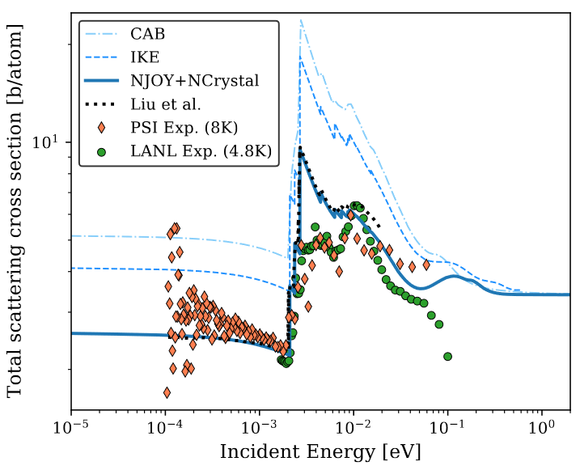
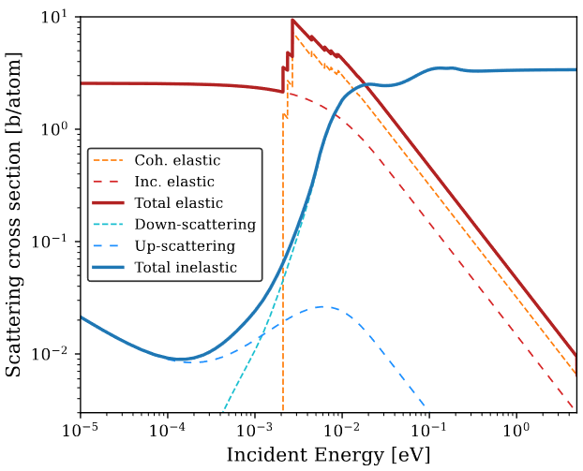
Candidate very cold moderators
Solid D₂
Methane (in phase II)
Clathrates – THF-hydrates, methane hydrate
Moderation by: rotational and translational modes (phonons)
Pros
Very low neutron absorption cross section and small nuclear mass
Operated at 5 K
Small upscattering cross section
Cons
Suffer broadening of pulse by a factor of five
Requires larger moderator volumes

Slide 10
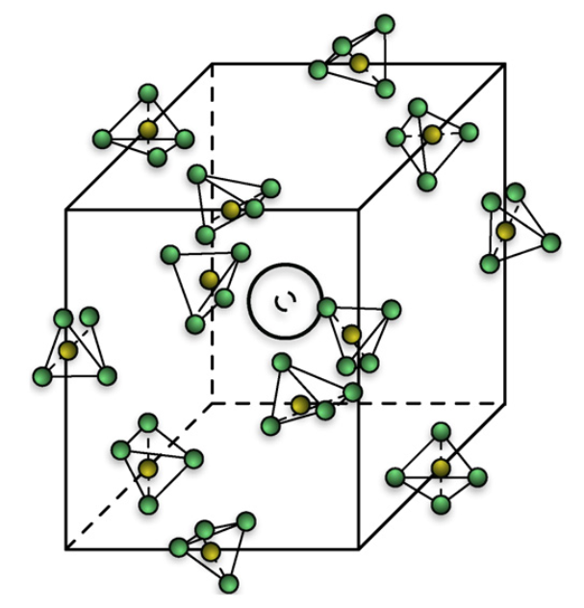
Candidate very cold moderators
Solid D₂
Methane (in phase II)
Clathrates – THF-hydrates, methane hydrate
Transition to phase II below 20.4 K
  Partially orientationally ordered state
Y. Shin et al, Nuc. Ins. Meth Phys Res A 620 pp. 382–390 (2010).

Slide 11
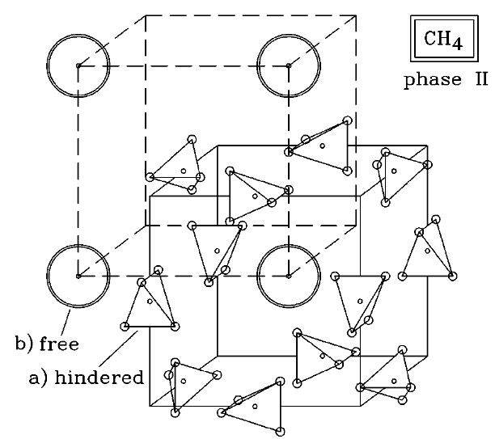
Candidate very cold moderators
Solid D₂
Methane (in phase II)
Clathrates – THF-hydrates, methane hydrate
Transition to phase II below 20.4 K
  Partially orientationally ordered state
Disordered sites - O_{h}
Weak CEF
No molecular field
Almost free quantum rotor!
Ordered sites - D_{2d}
-Librational modes
-Rotational tunneling
S. Grieger et al, J. Chem. Phys. 109 3161–3175 (1998).

Slide 12
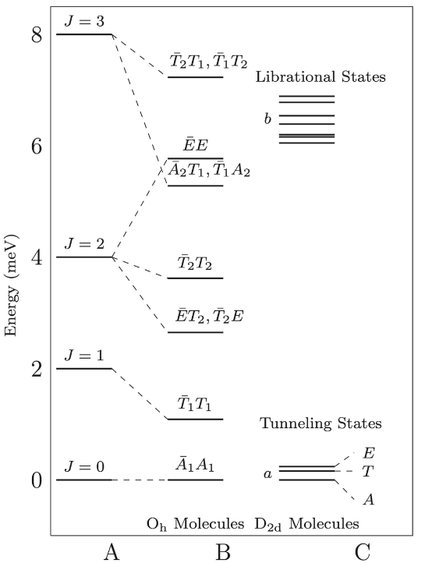
Candidate very cold moderators
Solid D₂
Methane (in phase II)
Clathrates – THF-hydrates, methane hydrate
Transition to phase II below 20.4 K
  Partially orientationally ordered state
¾ Disordered sites - O_{h}
Weak CEF
No molecular field
Almost free quantum rotor!
¼ Ordered sites - D_{2d}
-Librate in minima of orientational potential
-Rotational tunneling
Free rotor contributes the most significantly to the scattering cross section
Y. Shin et al, Nuc. Ins. Meth Phys Res A 620 pp. 382–390 (2010).

Slide 13
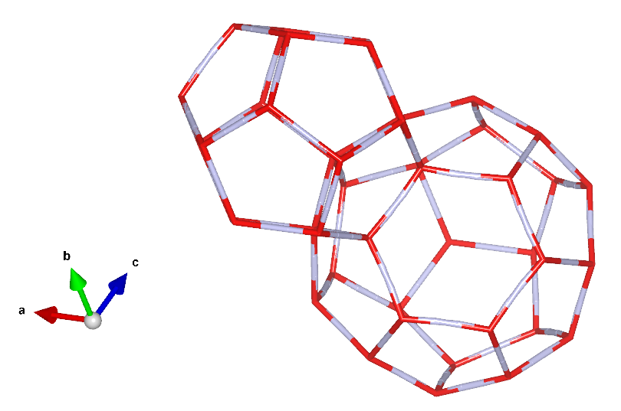
Candidate very cold moderators
Solid D₂
Methane
Clathrates – THF/TDF-hydrates, methane hydrate
Inclusion compounds containing nanovoids
Very large unit cell; a ~ 17 Å
Cages can host guest molecules
  THF (TDF) - C₄H₈O (C₄D₈O)
  Oxygen - O₂ (triplet GS with zero-field splitting of 0.4 meV)
  Methane - CH₄ (discussed previously)
A. Falenty et al, Nature 516 pp. 231-233 (2014).

Slide 14
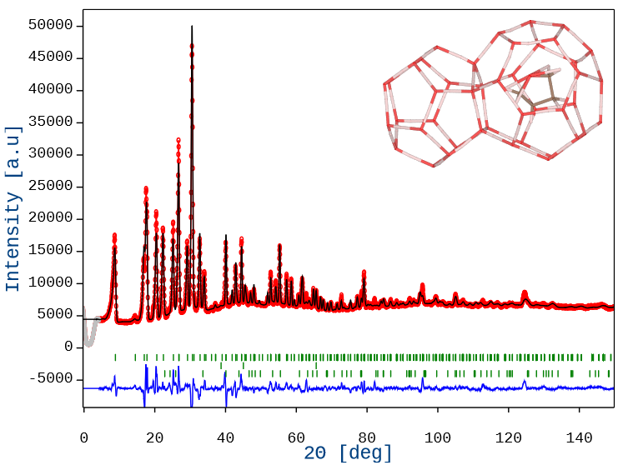
Candidate very cold moderators
Solid D₂
Methane
Clathrates – THF/TDF-hydrates, methane hydrate
A. Falenty et al, Nature 516 pp. 231-233 (2014).
Inclusion compounds containing nanovoids
Very large unit cell; a ~ 17 Å
Cages can host guest molecules
  THF (TDF) - C₄H₈O (C₄D₈O)
  Oxygen - O₂ (triplet GS – E* = 0.4 meV)
  Methane - CH₄ (discussed previously)
HighNESS - Cross sections developed for THF (TDF)-clathrates
V. Czamler et al, EPJ Web of Conferences 286 05004 (2023).

Slide 15
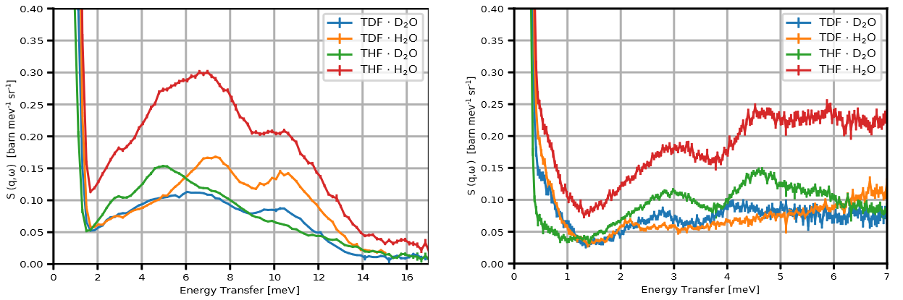
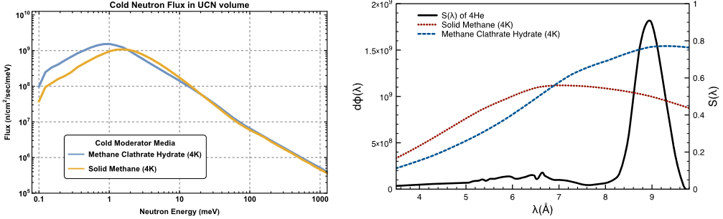
Candidate very cold moderators
Solid D₂
Methane
Clathrates – THF-hydrates, methane hydrate
Cages can host guest molecules
  THF (TDF) - C₄H₈O (C₄D₈O)
  Oxygen - O₂ (triplet GS – E* = 0.4 meV)
  Methane - CH₄ (discussed previously)
HighNESS - Cross sections developed for THF-clathrates
Methane clathrate advantage over solid methane?
V. Czamler et al, EPJ Web of Conferences 286 05004 (2023).
Y.C. Shin et al, Eur. Phys.J. Plus 136 882 (2021).
17 April 2024

Slide 16
CONCEPT DEVELOPMENT
Scope of Study
Goal - Optimize VCN moderator-reflector design for various instruments
  SANS
  TOF-INS
  NSE
Must demonstrate competitive advantage over cold parahydrogen source at low energies
Requirements and considerations
Compact design for Hi-CANS
Technically feasible
Optics – how can we use this to our advantage

Slide 17
Concept development
Major Challenges and Considerations
I. Computational demands of simulations
II. Heat removal from moderator – important to maintain moderator at sufficiently low temperatures
Moderators
Reflectors
Material | Temperature (K)
L-parahydrogen | 14 K
L-orthohydrogen | 14 K
Solid methane | 20 K
Solid D₂ | 5 K
Clathrate hydrates | 2.4 K!
Material | Temperature (K)
MgH₂ | 20 K
Nanodiamond | 296 K

Slide 18
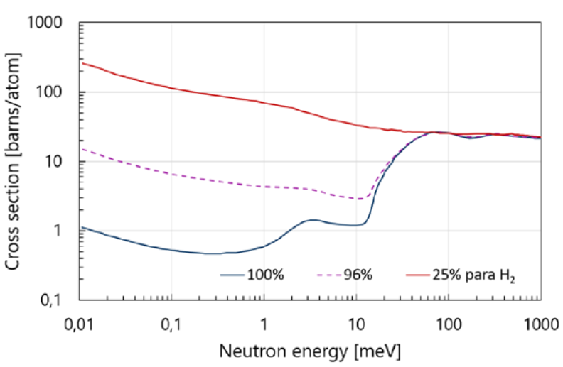
CONCEPT DEVELOPMENT
Geometrical Description
Starting point
  Low dimensional para-hydrogen source cold source developed for HBS
  Highly efficient cold neutron converter
  Already realized
Neutron
Extraction
Cold parahydrogen
Moderator
Target
Ta
H₂ Scattering Cross Section at 20K
Reflector
Thermal
Moderator

Slide 19
CONCEPT DEVELOPMENT
Geometrical Description
Starting point
  Low dimensional para-hydrogen source cold source developed for HBS
  Highly efficient cold neutron converter
  Already realized
Very Cold Neutrons
  Use efficiency of para source
  “Embed” appropriate moderator within
Neutron
Extraction
Cold parahydrogen
Moderator
Target
Ta
Reflector
Thermal
Moderator

Slide 20
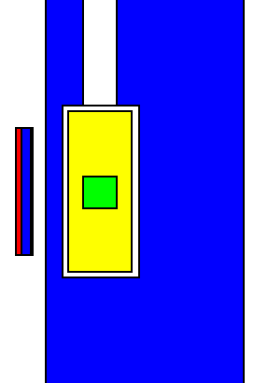
CONCEPT DEVELOPMENT
Geometrical Description
Neutron
Extraction
Neutron
Extraction
Cold parahydrogen
Moderator
Cold parahydrogen
Moderator
Target
Target
System
Ta
Very cold neutron
moderator
Thermal
Moderator
Reflector
Thermal
Moderator

Slide 21
CONCEPT DEVELOPMENT
Simulation Description
Zero importance mask
1. “Artificial” rectangular monoenergetic 25 meV neutron source
Avoid lengthy computation times
2. Add a zero importance mask around extraction channel at surface of moderator
  Only see neutrons exiting extraction channel
Neutron
extraction
Cold parahydrogen
moderator
Target
system
Very cold neutron
moderator
Artificial
source
Thermal
moderator
17 April 2024
Page 21

Slide 22
CONCEPT DEVELOPMENT
Simulation Description – Point Tally Definition
L = 50cm
Zero
Importance
R = 1cm
2r
(x,y,z)
Fix L, fix r
2r – diameter of neutron extraction channel
L – distance from extraction channel boundary to centre of point tally
θ – divergence
R – radius of fictitious sphere for point tally definition
(x,y,z) – centre of point tally
17 April 2024
Page 22

Slide 23
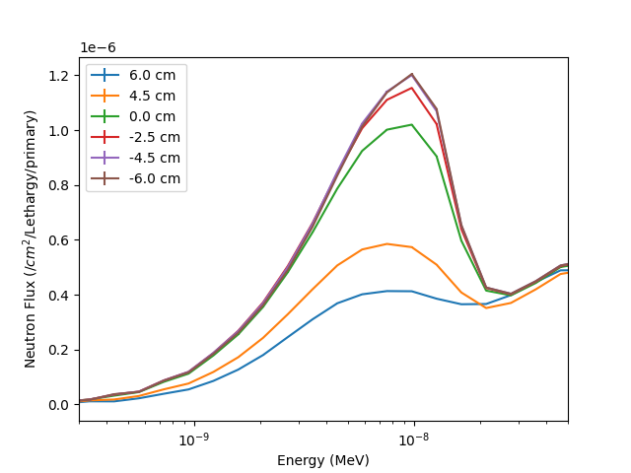
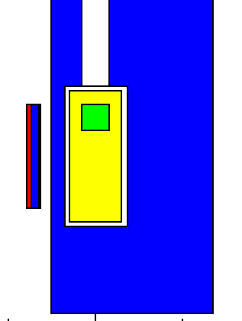
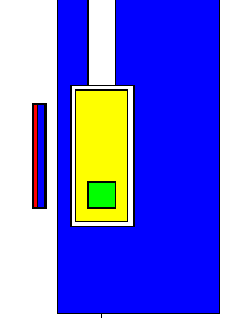
CONCEPT DEVELOPMENT
Preliminary Simulation Results
dy = +4.5
dy = 0.0
dy = -4.5
dY is displacement of VCN from centred position (dy = 0)
17 April 2024
Page 23

Slide 24
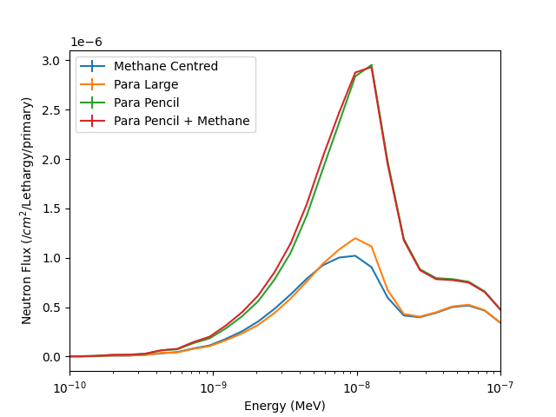
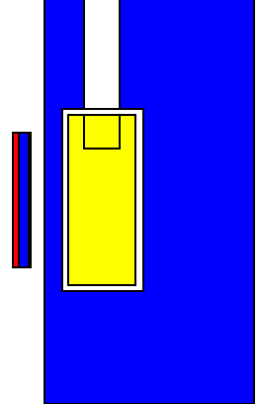
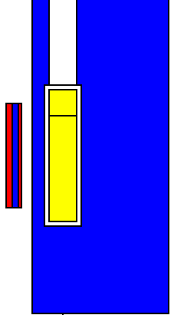
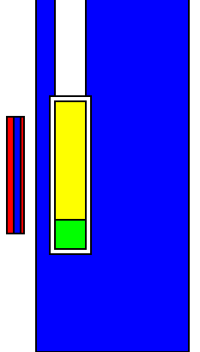
CONCEPT DEVELOPMENT
Preliminary Simulation Results
Methane centred
Para Large
Para pencil
Para pencil + methane
17 April 2024
Page 24

Slide 25
Further work
Holistic Optimization Study of Methane in Para
Optimize the geometry – keeping in mind
  Consider requirements of instruments – development of appropriate figures-of-merit
  Assess how optics might shape moderator design
Study methane at 5K – practical considerations
Assess feasibility of designs
Other VCN Materials
Asses performance of other candidate materials
  Is it practical to consider deuterated materials for compact source like HBS?
    If yes, must also consider engineering challenges with cooling large moderator volumes
  Compare performance against para + methane solution
17 April 2024

Slide 26
references
[1] J.M Carpenter and B.J. Micklich, ANL (05/42) (2005).
[2] V. Santoro et al, HighNESS Conceptual Design Report. arXiv:2309.17333v3 [physics.ins-det].
[3] Y. Shin et al, Nuc. Ins. Meth Phys Res A 620 pp. 382–390 (2010).
[4] S. Grieger et al, J. Chem. Phys. 109 3161–3175 (1998).
[5] A. Falenty et al, Nature 516 pp. 231-233 (2014).
[6] V. Czamler et al, EPJ Web of Conferences 286 05004 (2023).
[7] Y.C. Shin et al, Eur. Phys.J. Plus 136 882 (2021).
17 April 2024

Slide 27
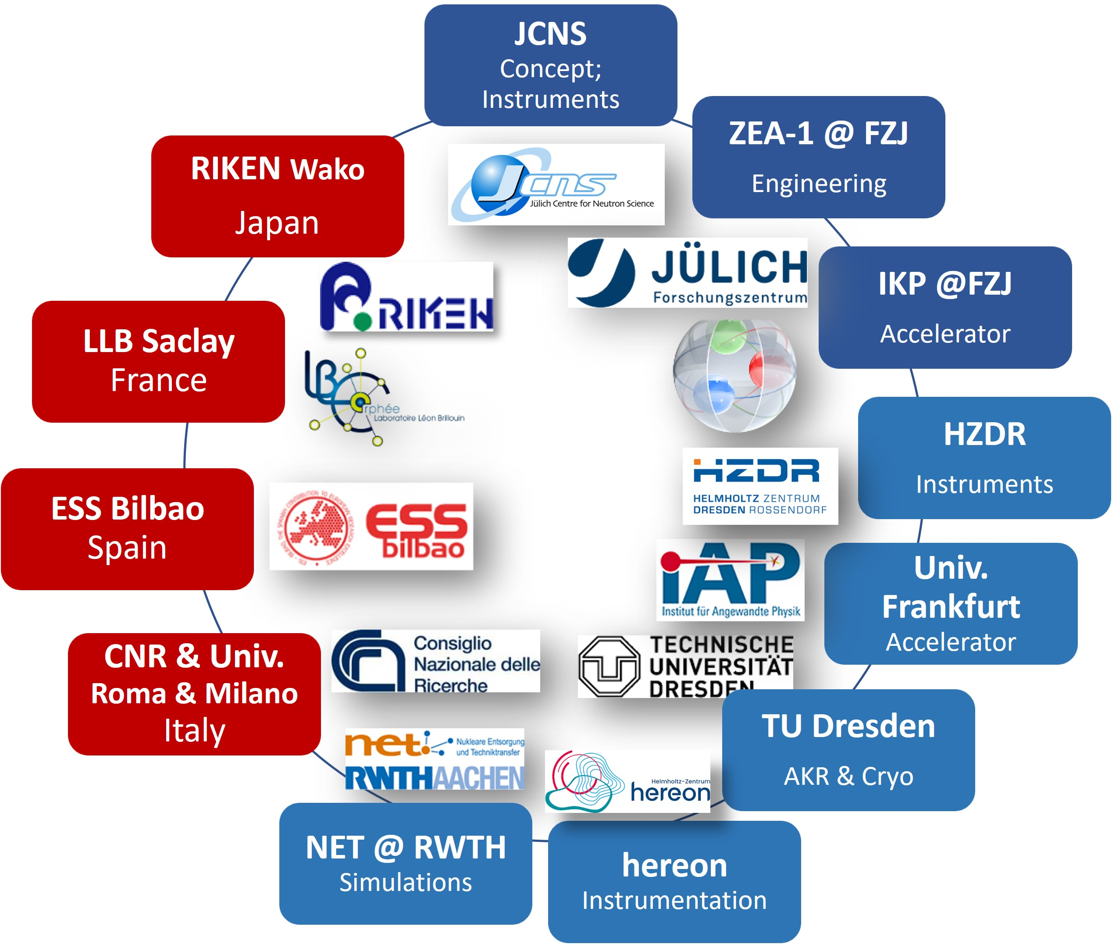




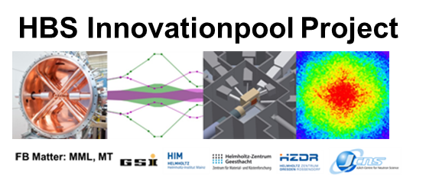





HBS Team
J. Baggemann
Th. Brückel
J. Chen
T. Claudio-Weber
T. Cronert (†)
Q. Ding
P.-E. Doege
M. El Barbari
T. Gutberlet
J. Li
K. Lieutenant
Z. Ma
E. Mauerhofer
N. Ophoven
U. Rücker
N. Schmidt
A. Schwab
E. Vezhlev
J. Voigt
P. Zakalek
- Design, verification,
instrumentation
ZEA-1:
Y. Bessler
R. Hanslik
R. Achten
F. Löchte
M. Strothmann
- Engineering
IKP-4:
O. Felden
R. Gebel
A. Lehrach
M. Rimmler
R. Similon
- Nuclear physics
INM-5:
B. Neumaier
- Radio isotopes
S. Böhm
R. Nabbi
- Nuclear simul.
Ch.Haberstroh
M. Klaus
S. Eisenhut
C. Lange
- Liquid H₂, AKR-2
H. Podlech
O. Meusel
- Accelerator
W. Barth
- Accelerator
/ HIM
@hbsneutron
https://hbs.fz-juelich.de/
J. Fenske
- Instrumentation

