Slide 1

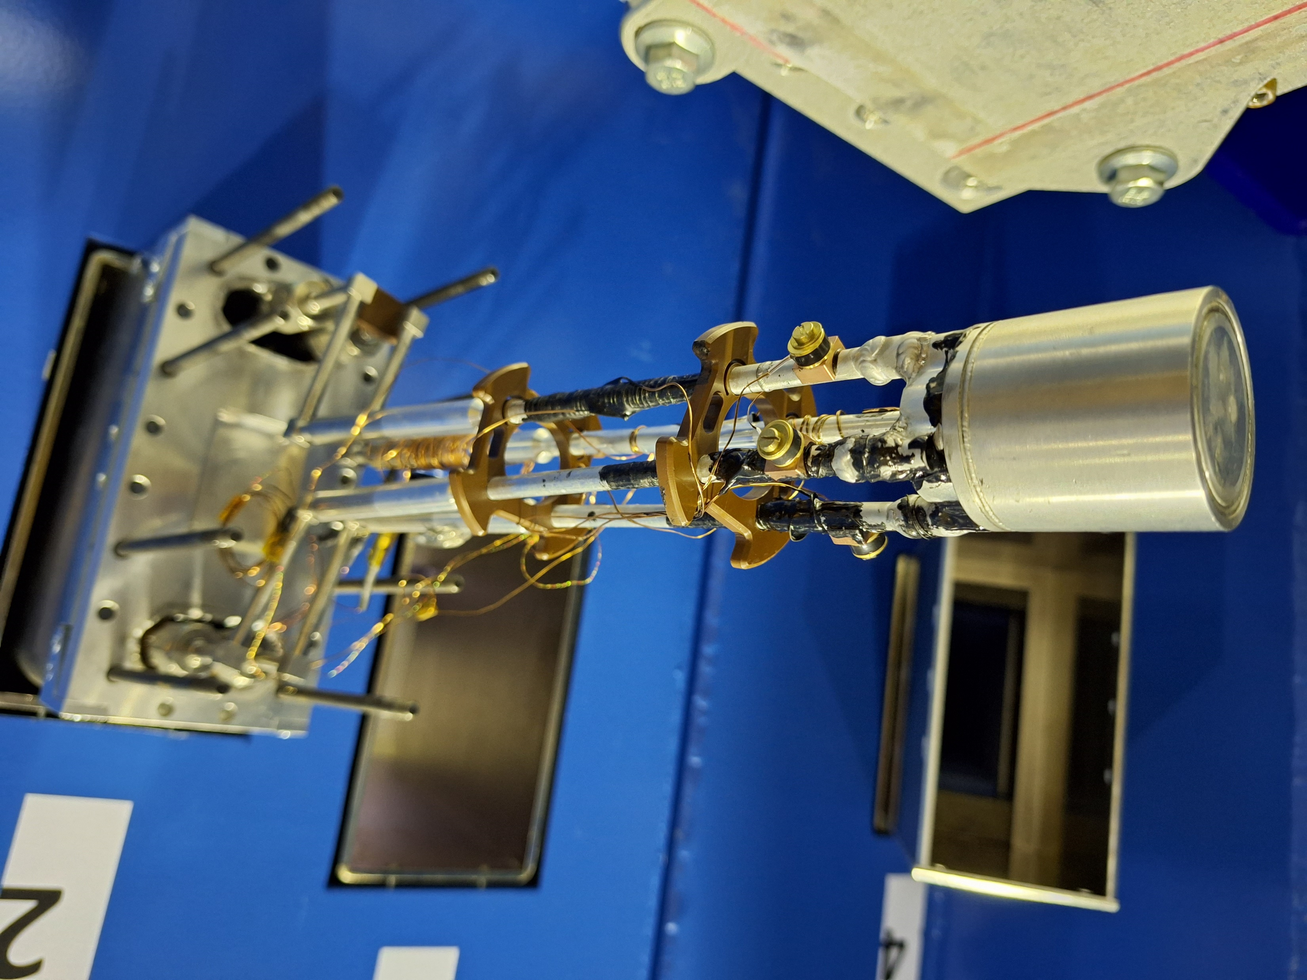
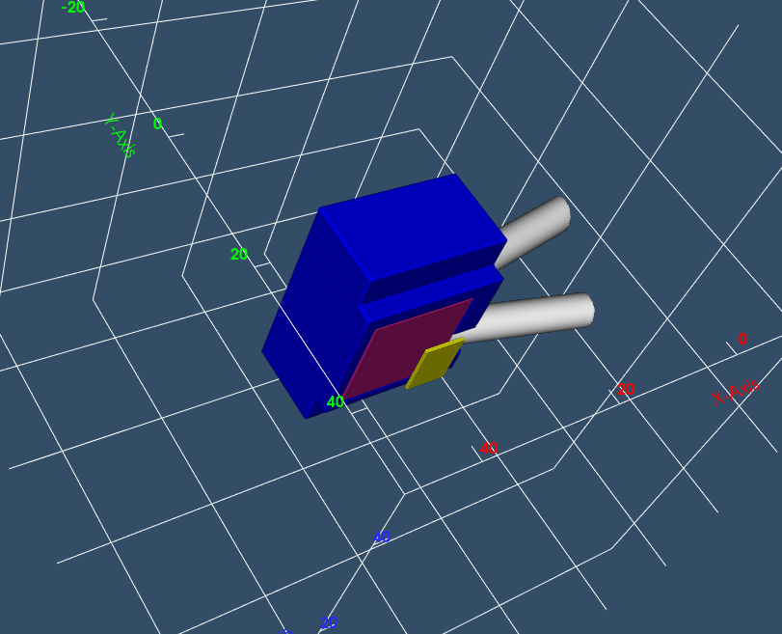
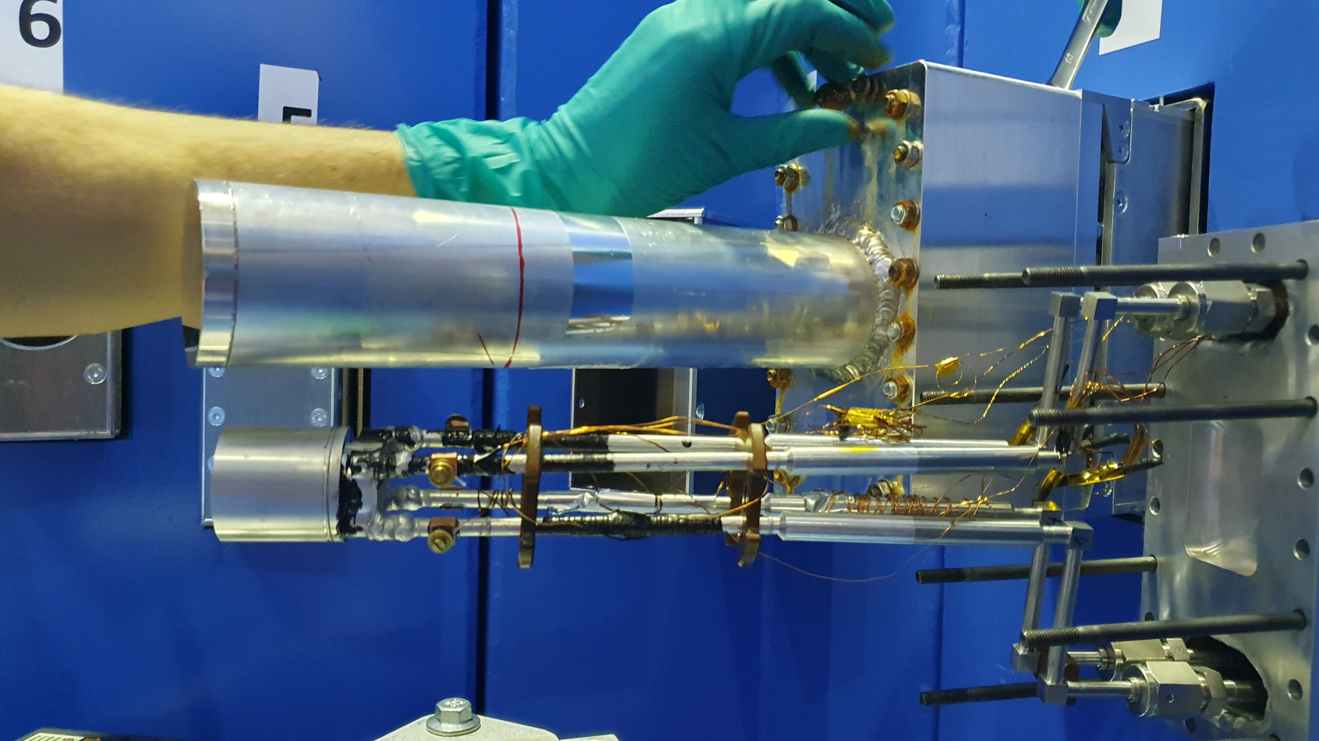
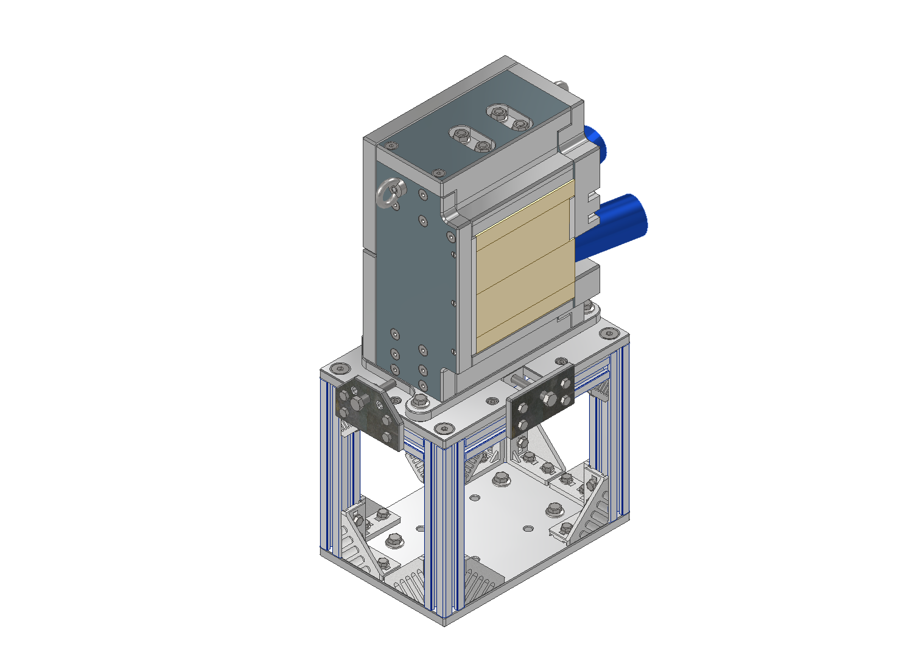

Ethane measurements at the JULIC Neutron Platform
M. EL BARBARI, JCNS-HBS 17 April 2024

Slide 2
Topics
Introduction
Experimental setup
Results
Correction processing
Neutron temperature extraction
Cross section generation
PHITS simulations and outlook

Slide 3
Topics
Introduction
Experimental setup
Results
Correction processing
Neutron temperature extraction
Cross section generation
PHITS simulations and outlook

Slide 4
Introduction
Materials | Hydrogen Atom Density (atoms/cm³)
Polyethylene (HDPE) | 8.07 × 10²²
Liquid Hydrogen | 4.18 × 10²²
Liquid Methane | 6.31 × 10²²
Solid Methane | 6.91 × 10²²
Liquid Ethane | 6.56 × 10²²
Solid Ethane | 7.45 × 10²²
Solid ammonia | 8.66 × 10²²

Slide 5
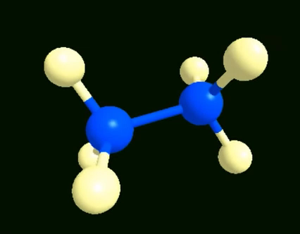
Introduction
Ethane
Crystalline form → 60-70 K
Metastable phase → 30-55 K
Amorphous phase → < 30 K
Materials | Hydrogen Atom Density (atoms/cm³)
Polyethylene (HDPE) | 8.07 × 10²²
Liquid Hydrogen | 4.18 × 10²²
Liquid Methane | 6.31 × 10²²
Solid Methane | 6.91 × 10²²
Liquid Ethane | 6.56 × 10²²
Solid Ethane | 7.45 × 10²²
Solid ammonia | 8.66 × 10²²
Boiling point: 184.52 K
Melting point: 89.88 K

Slide 6
Topics
Introduction
Experimental setup
Results
Correction processing
Neutron temperature extraction
Cross section generation
PHITS simulations and outlook

Slide 7
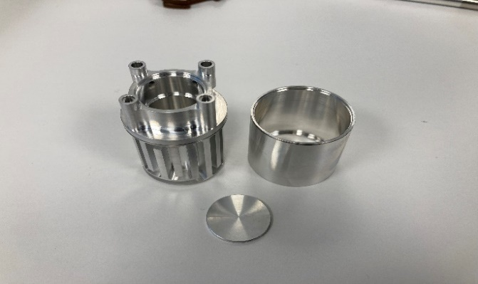

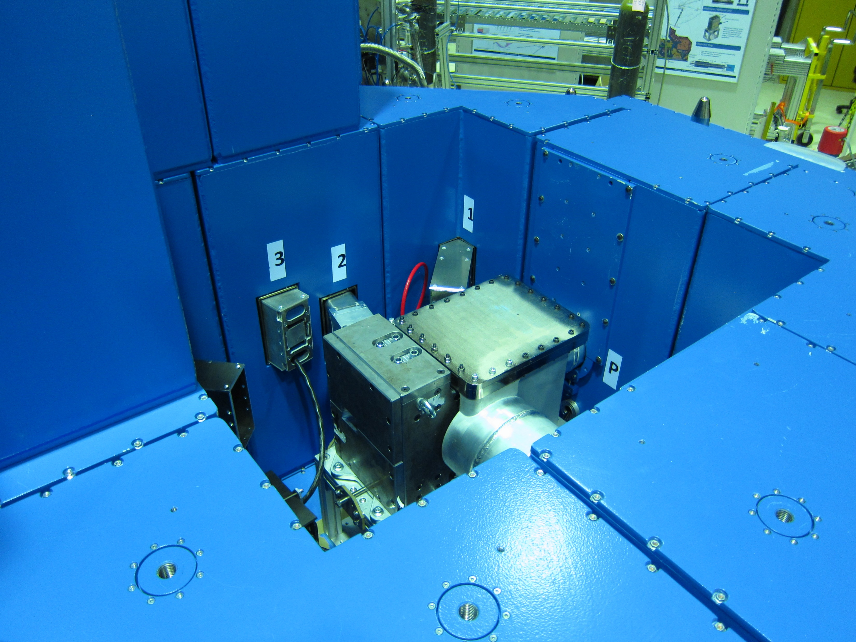
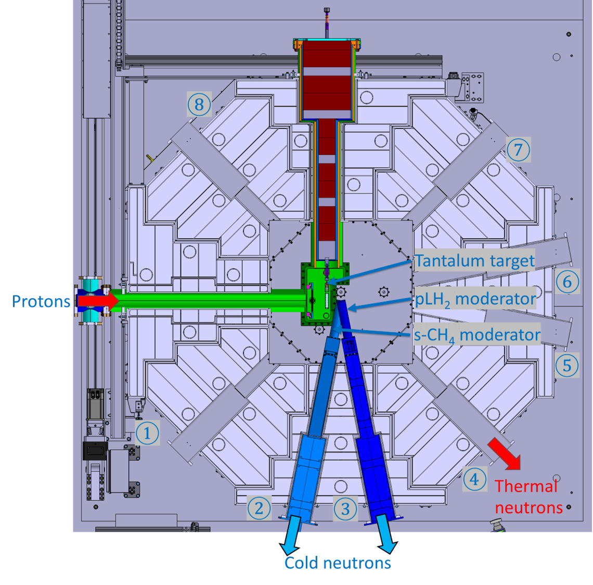
Experimental setup
Moderator assembly
The cryogenic moderator vessel is contained within a cylindrical vacuum vessel 4.5 cm in length and an outer diameter of 2.2 cm.
The moderator vessel connected to a completely evacuated guideline of 6.5 meters, coated with nickel (⁵⁸Ni). At the end of the guide, we find an assembly of detectors.
The ethane moderator is placed at the beamline number 2 at BigKarl in the JULIC neutron platform.

Slide 8
Topics
Introduction
Experimental setup
Results
Correction processing
Neutron temperature extraction
Cross section generation
PHITS simulations and outlook

Slide 9
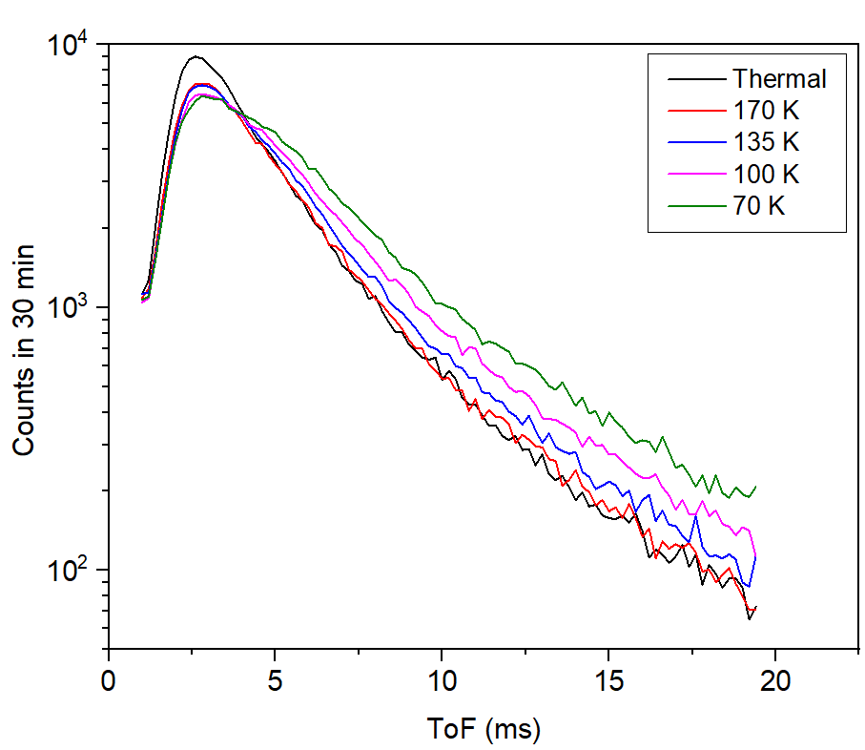
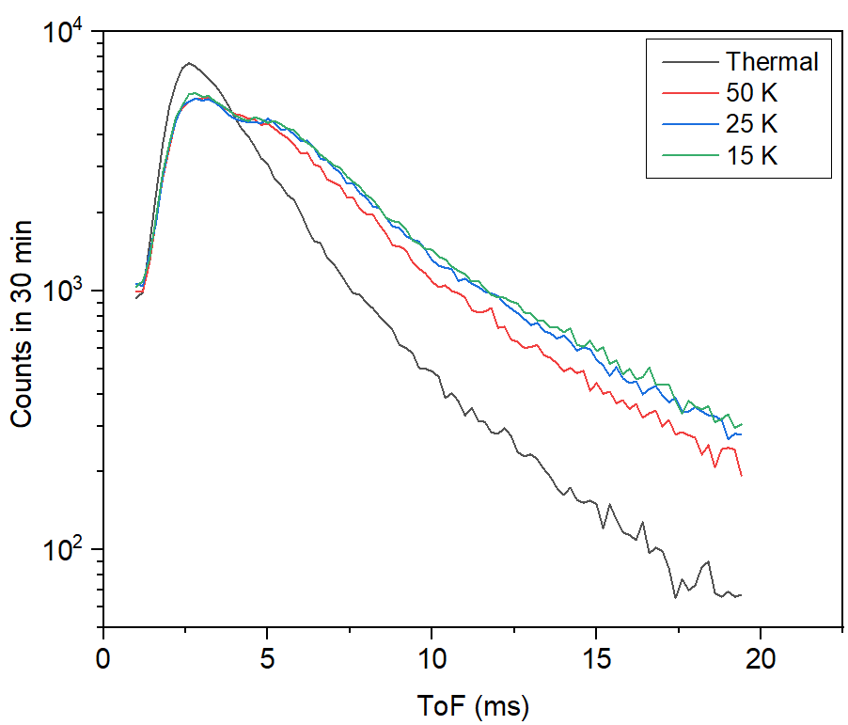
Results
Ethane’s measurements
Neutron spectrum emitted at 6.5m from the ethane cold neutron moderator in separate-on-time tests with different thermal contributions.
temperatures of 170K, 135K, and 100K representing the liquid state, 70K for the solid state and crystalline phase, 50K for the second phase characterized by a metastable state, and subsequently 25K, 15K, and 10K for the amorphous phase of solid ethane.

Slide 10
Topics
Introduction
Experimental setup
Results
Correction processing
Neutron temperature extraction
Cross section generation
PHITS simulations and outlook

Slide 11
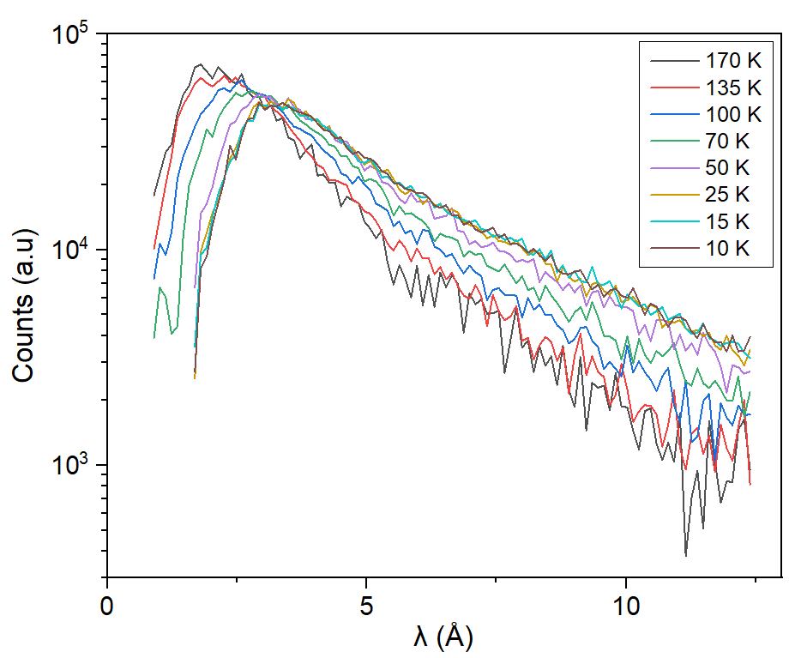
Correction processing
Thermal contribution / normalization to monitor
The thermal flux contribution to the overall cold neutron spectra is influenced by the ratio of the cylindrical moderator's surface area (Ø 2.2 cm) to that of the rectangular guide (3.0 cm, 5.0 cm).
Sg-Sc/Sg = 0.747

Slide 12
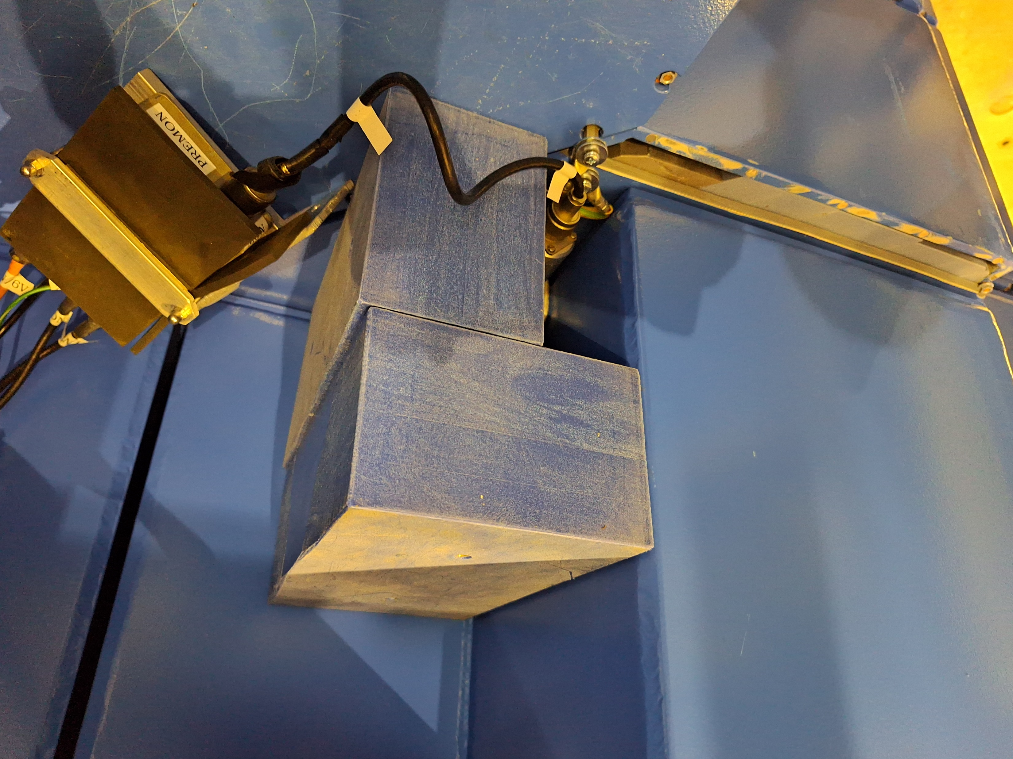
Correction processing
Thermal contribution / normalization to monitor
The thermal flux contribution to the overall cold neutron spectra is influenced by the ratio of the cylindrical moderator's surface area (Ø 2.2 cm) to that of the rectangular guide (3.0 cm, 5.0 cm).
Sg-Sc/Sg = 0.747
Normalization to the monitor

Slide 13
Topics
Introduction
Experimental setup
Results
Correction processing
Neutron temperature extraction
Cross section generation
PHITS simulations and outlook

Slide 14
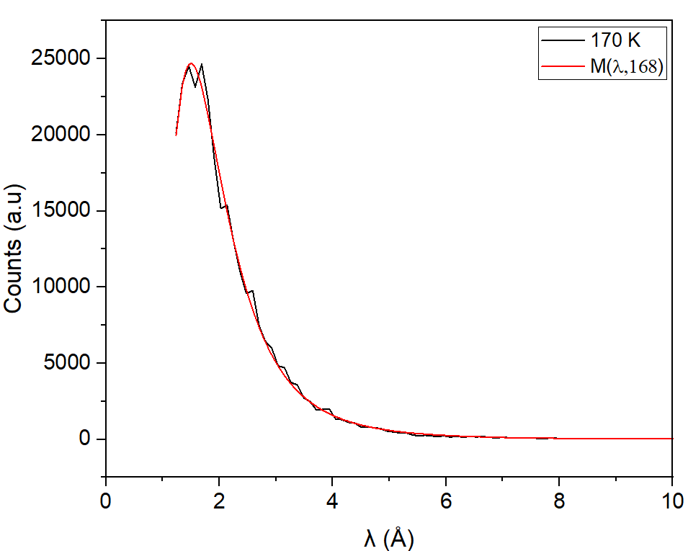
Neutron temperature extraction
Maxwellian distribution fitting
The normalized Maxwell wavelength distribution is characterized by the following function
M(λ,T) = 2 a² λ⁻⁵ exp(-a/ λ²)
‘a’ is a parameter calculated as 950.52/T, determined by the wavelength and temperature of a 25 meV neutron.

Slide 15
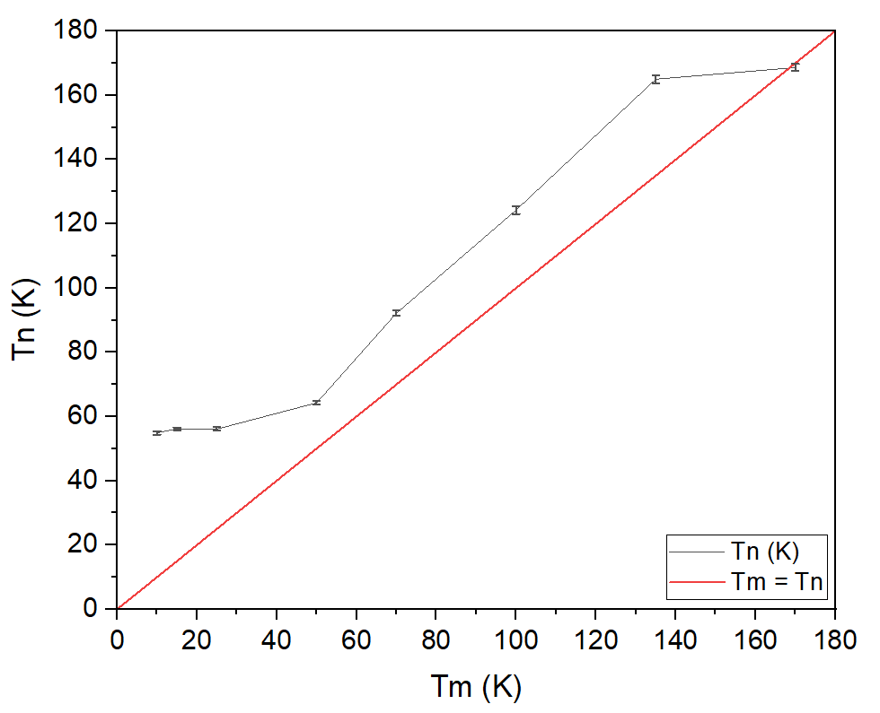
Neutron temperature extraction
Maxwellian distribution fitting
the trend of the neutron temperature shows a decreasing value of temperature proportional to the decreasing of the moderator temperature.

Slide 16
Topics
Introduction
Experimental setup
Results
Correction processing
Neutron temperature extraction
Cross section generation
PHITS simulations and outlook

Slide 17
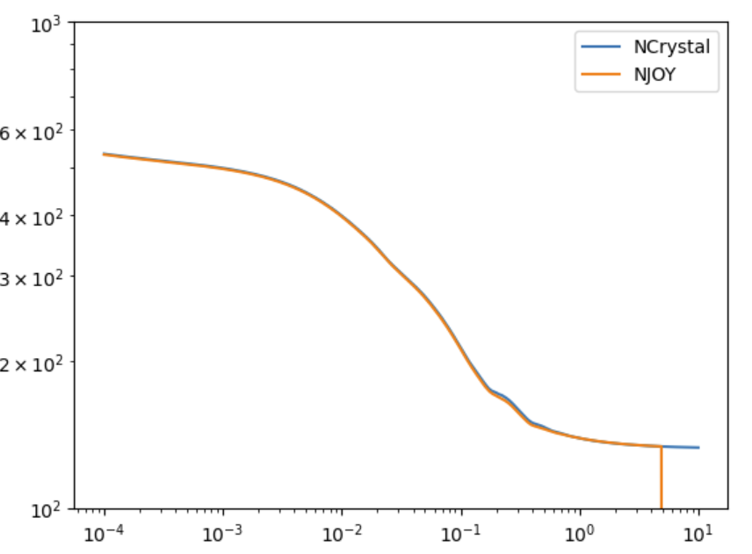
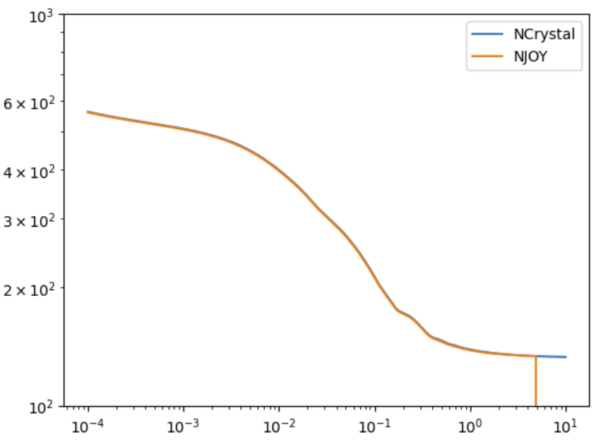
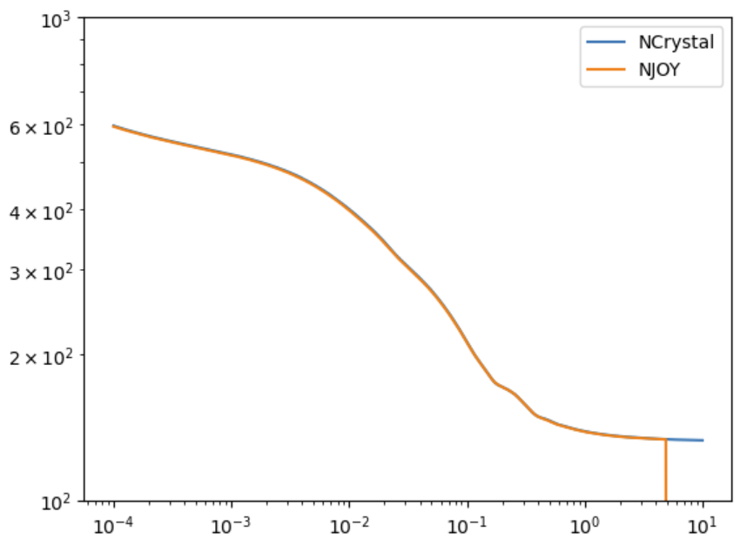
Cross section generation
Solid ethane 70 K – 50 K – 15 K
70 K
100 K
135 K
50 K
15 K
170 K
XS (barn)
100 K
E (eV)

Slide 18
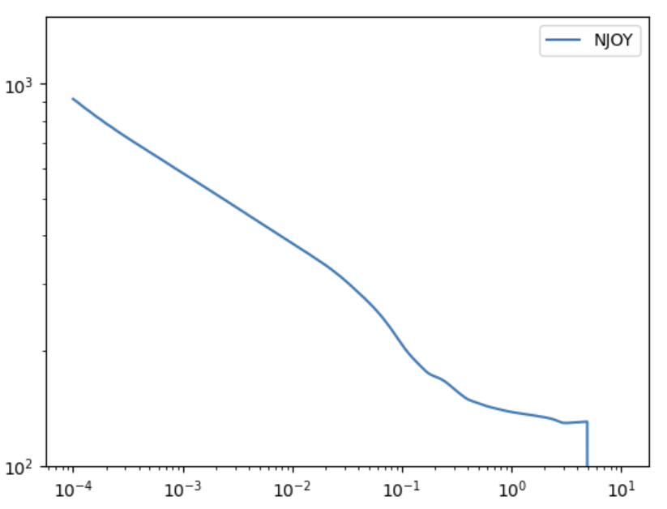
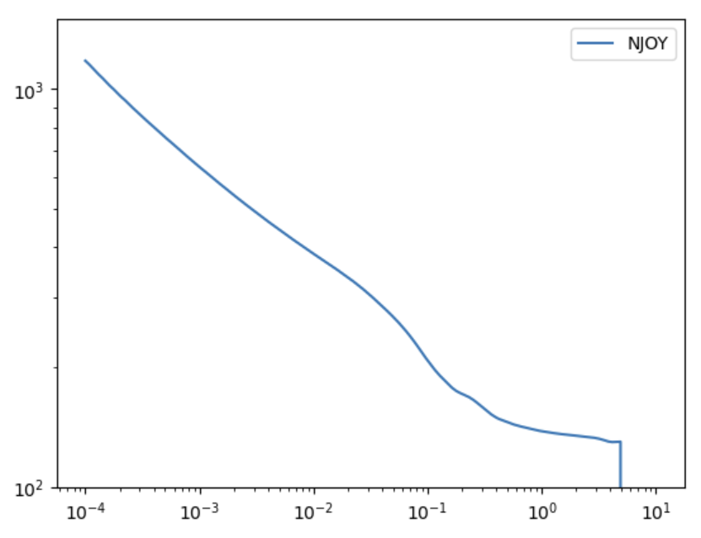
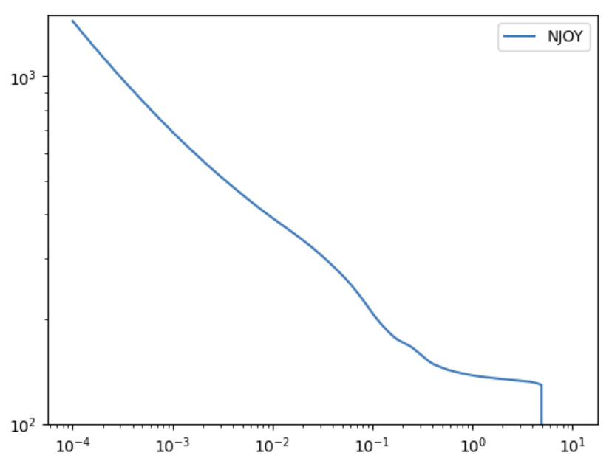
Cross section generation
Liquid ethane 100 K – 135 K – 170 K
100 K
135 K
170 K
XS (barn)
100 K
E (eV)

Slide 19
Topics
Introduction
Experimental setup
Results
Correction processing
Neutron temperature extraction
Cross section generation
PHITS simulations and outlook

Slide 20
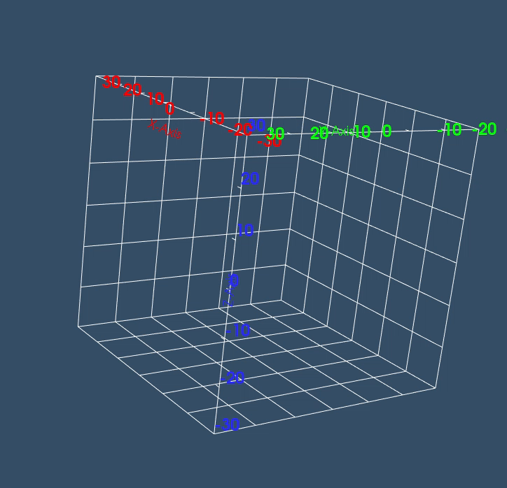
PHITS simulations and outlook
PHITS simulations to compare with the experimental results and also.
23 – 24 March 2023

Slide 21
Thank you!

Slide 22
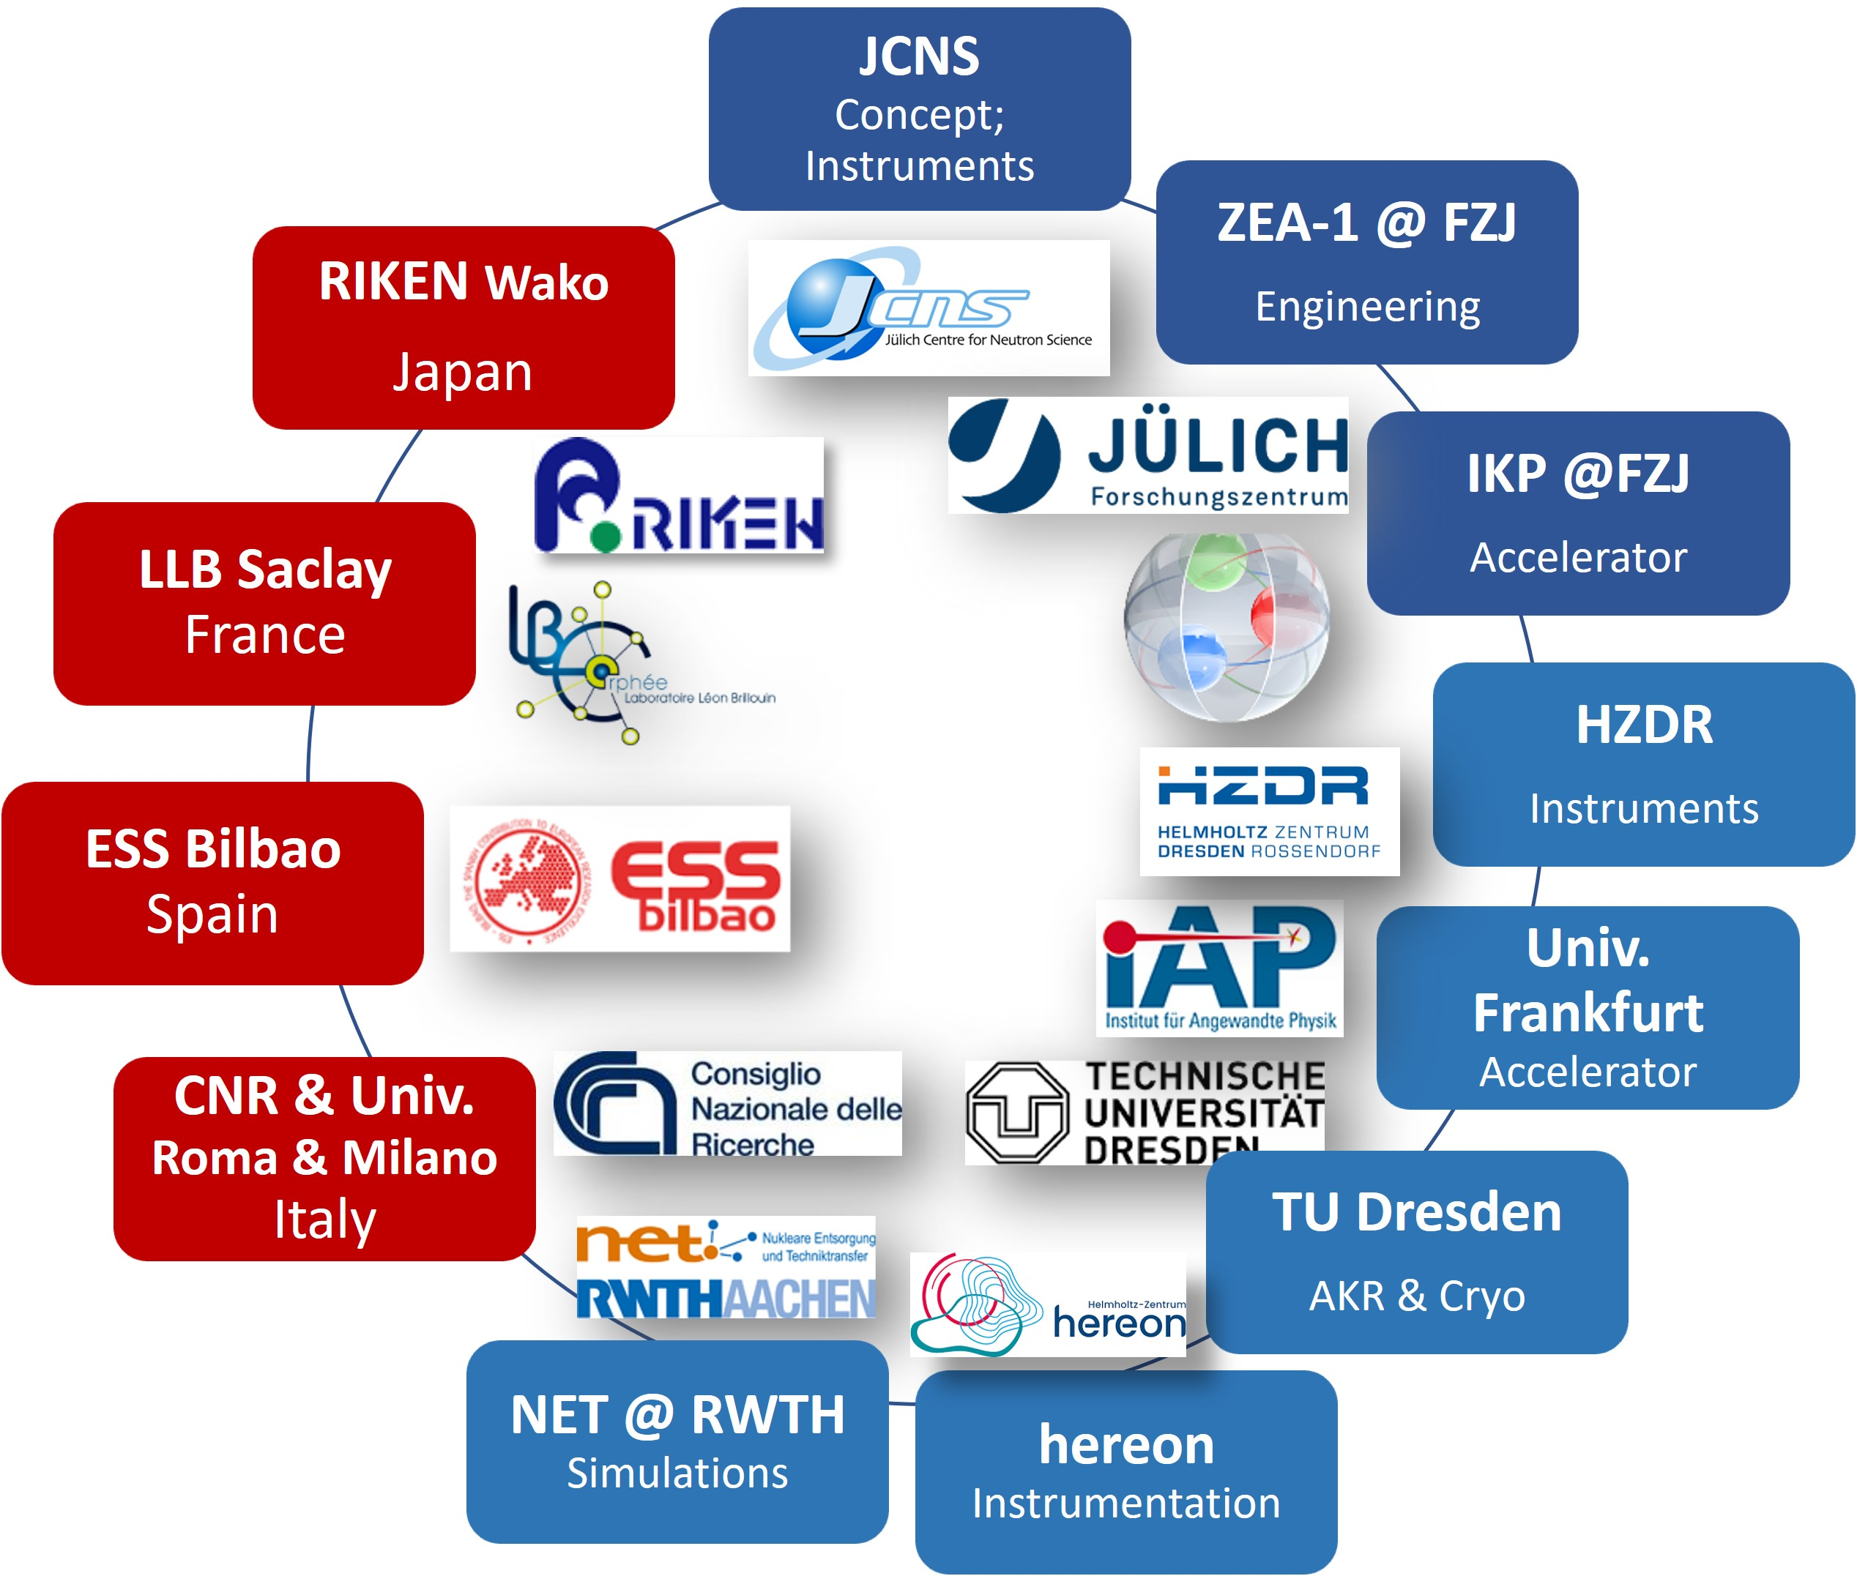










HBS Team
J. Baggemann
Th. Brückel
J. Chen
T. Claudio-Weber
T. Cronert (†)
Q. Ding
P.-E. Doege
M. El Barbari
T. Gutberlet
J. Li
K. Lieutenant
Z. Ma
D. Maharaj
E. Mauerhofer
N. Ophoven
U. Rücker
N. Schmidt
A. Schwab
E. Vezhlev
J. Voigt
P. Zakalek
- Design, verification,
instrumentation
ZEA-1:
Y. Bessler
R. Hanslik
R. Achten
F. Löchte
M. Strothmann
- Engineering
IKP-4:
O. Felden
R. Gebel
A. Lehrach
M. Rimmler
R. Similon
- Nuclear physics
INM-5:
B. Neumaier
- Radio isotopes
S. Böhm
R. Nabbi
- Nuclear simul.
Ch.Haberstroh
M. Klaus
S. Eisenhut
C. Lange
- Liquid H₂, AKR-2
H. Podlech
O. Meusel
- Accelerator
W. Barth
- Accelerator
/ HIM
@hbsneutron
https://hbs.fz-juelich.de/
J. Fenske
- Instrumentation

